Slide 1
Network Layer: ARP & ICMP
By dr. R. K. Ojha
Lecture-32-33
( Chapter 09 )

Slide 2
Topics to be discussed
Mapping Logical to Physical Address
Mapping Physical to Logical Address

Slide 3
ADDRESS MAPPING
The delivery of a packet to a host or a router requires two levels of addressing: logical and physical.
We need to be able to map a logical address to its corresponding physical address and vice versa.
This can be done by using either static or dynamic mapping.
A link-layer address is sometimes called a link address, sometimes a physical address, and sometimes a MAC address.

Slide 4
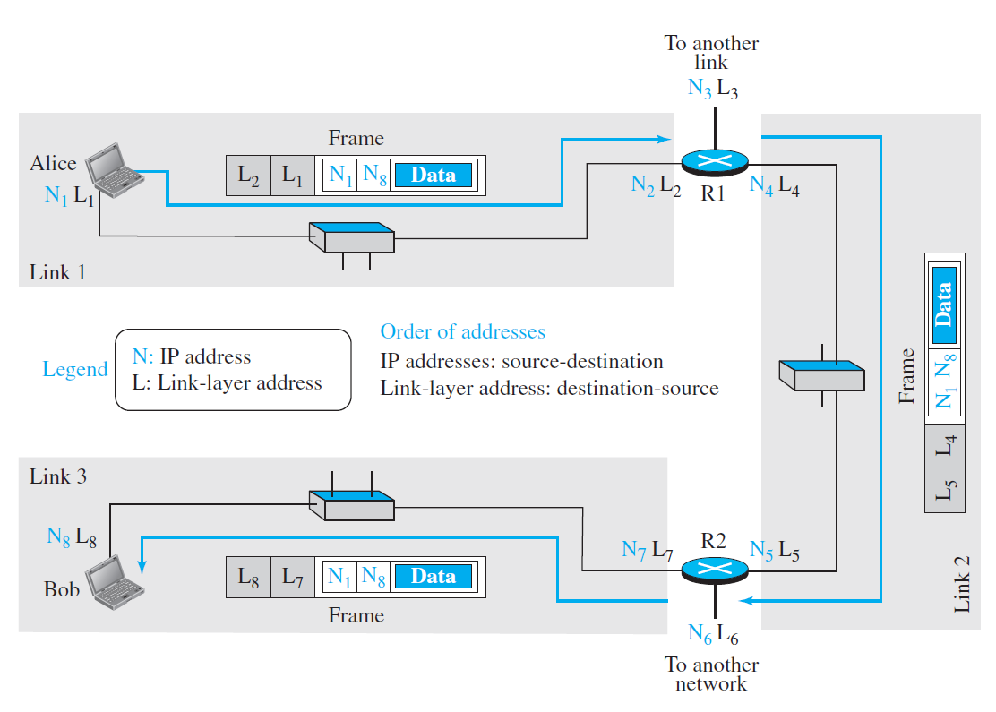

Slide 5
In the internet in Figure, we have three links and two routers.
We also have shown only two hosts: Alice (source) and Bob (destination).
For each host, we have shown two addresses, the IP addresses (N) and the link-layer addresses (L).
Note that a router has as many pairs of addresses as the number of links the router is connected to.
We have shown three frames, one in each link. Each frame carries the same datagram with the same source and destination addresses (N1 and N8), but the link-layer addresses of the frame change from link to link.
In link 1, the link-layer addresses are L1 and L2. In link 2, they are L4 and L5. In link 3, they are L7 and L8. Note that the IP addresses and the link-layer addresses are not in the same order.
For IP addresses, the source address comes before the destination address; for link-layer addresses, the destination address comes before the source.

Slide 6
Address Resolution Protocol

Slide 7
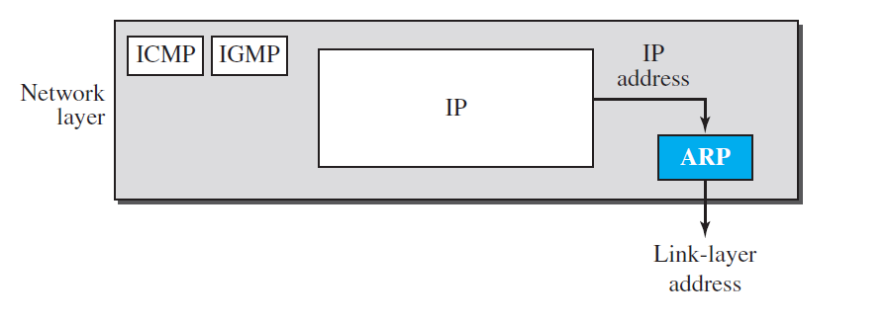
ARP operation

Slide 8
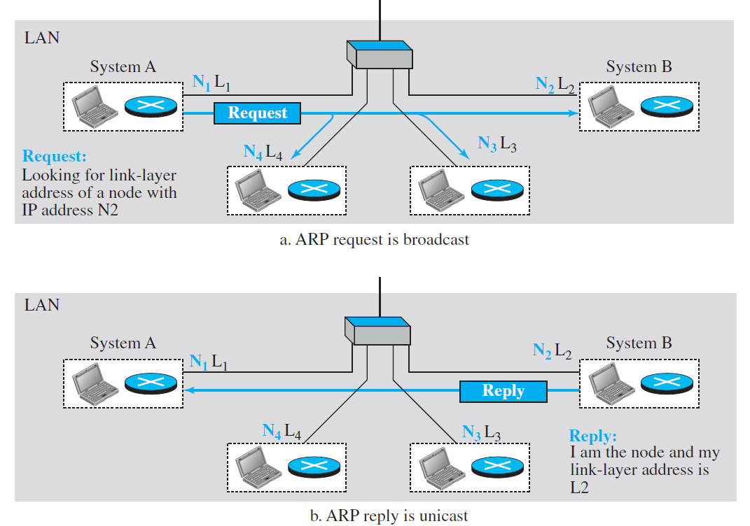
Figure 21.1 ARP operation

Slide 9
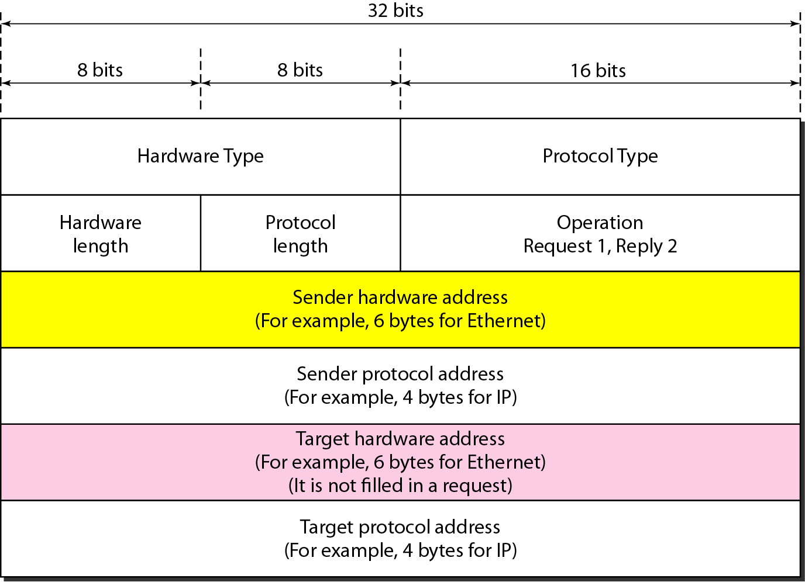
Figure 21.2 ARP packet

Slide 10
Hardware type: This field defines the type of the link-layer protocol; Ethernet is given the type 1.
Protocol type: This field defines the network-layer protocol: IPv4 protocol is (0800)16.
Source hardware and source protocol: The addresses are variable-length fields defining the link-layer and network-layer addresses of the sender.
Destination hardware address and destination protocol address: These fields define the receiver link-layer and network-layer addresses.
An ARP packet is encapsulated directly into a data-link frame. The frame needs to have a field to show that the payload belongs to the ARP and not to the network-layer datagram.

Slide 11
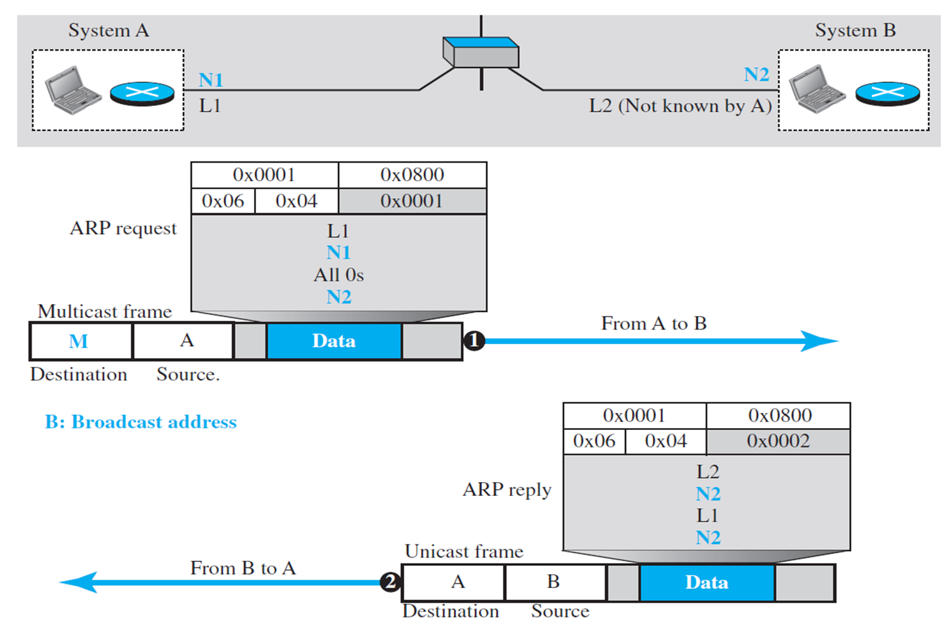
Figure 21.3 Encapsulation of ARP packet

Slide 12
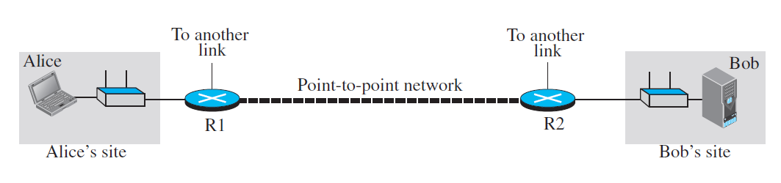

Slide 13
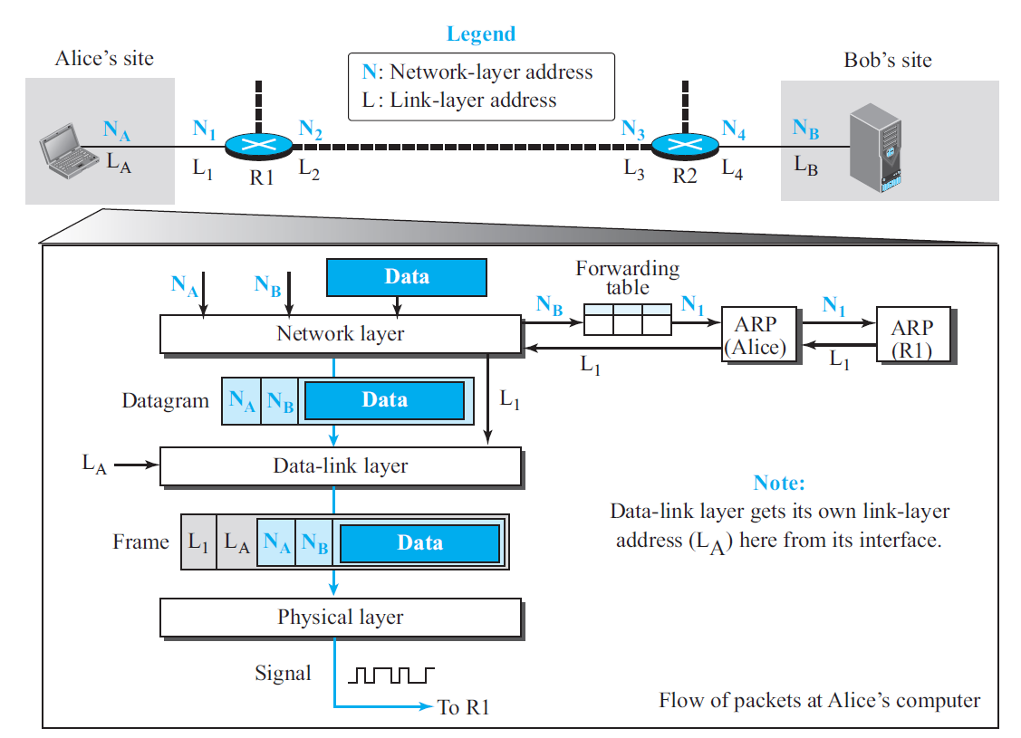

Slide 14
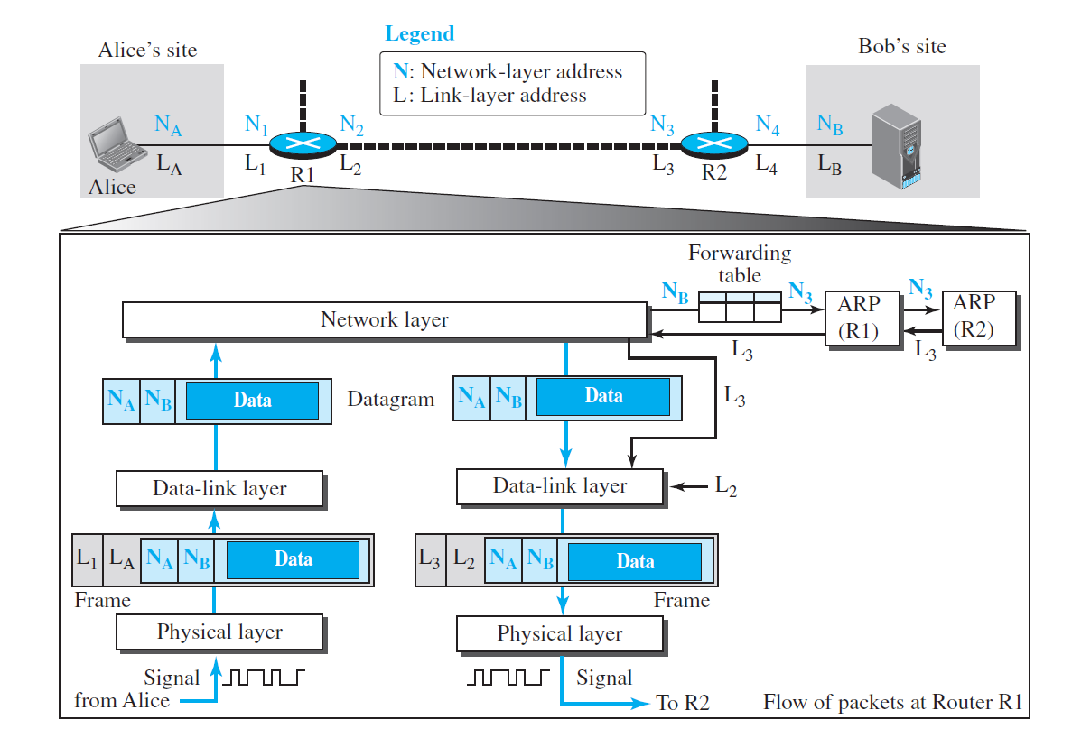

Slide 15
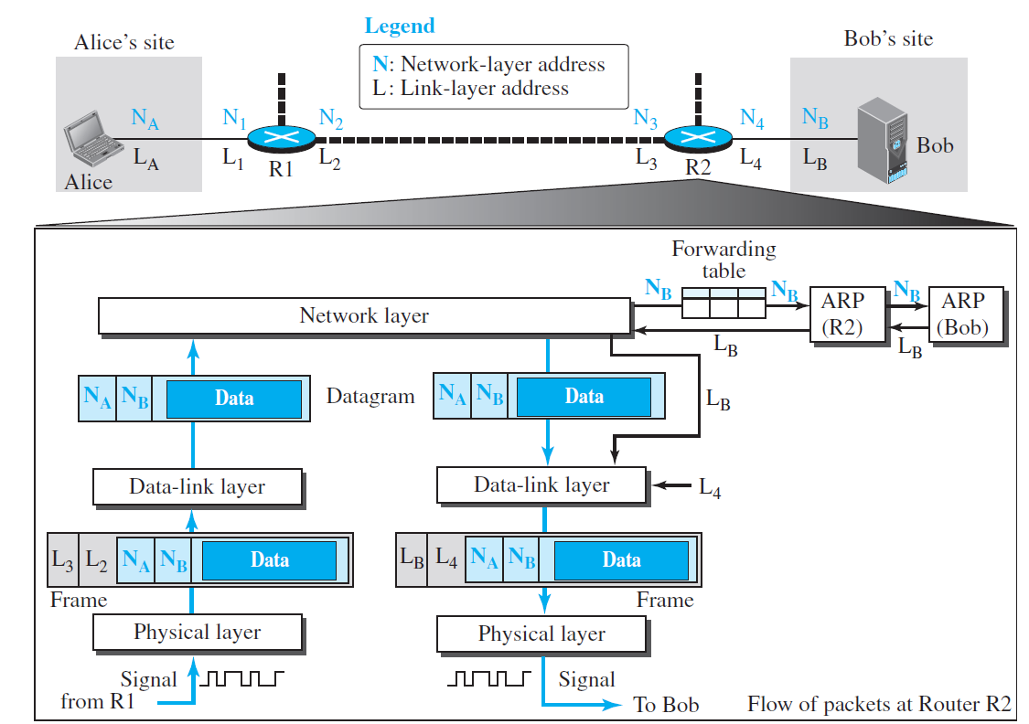

Slide 16
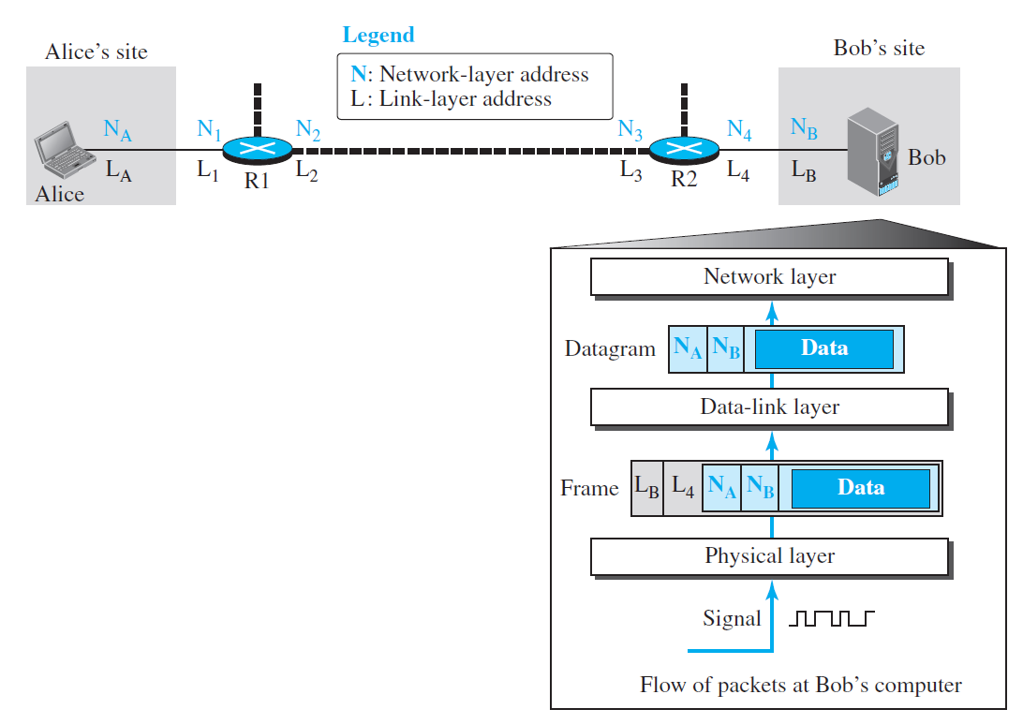

Slide 17

Note
An ARP request is broadcast; an ARP reply is unicast.

Slide 18
Example 21.1
A host with IP address 130.23.43.20 and physical address B2:34:55:10:22:10 has a packet to send to another host with IP address 130.23.43.25 and physical address A4:6E:F4:59:83:AB. The two hosts are on the same Ethernet network. Show the ARP request and reply packets encapsulated in Ethernet frames.
Solution
Figure 21.5 shows the ARP request and reply packets. Note that the ARP data field in this case is 28 bytes, and that the individual addresses do not fit in the 4-byte boundary. That is why we do not show the regular 4-byte boundaries for these addresses.

Slide 19
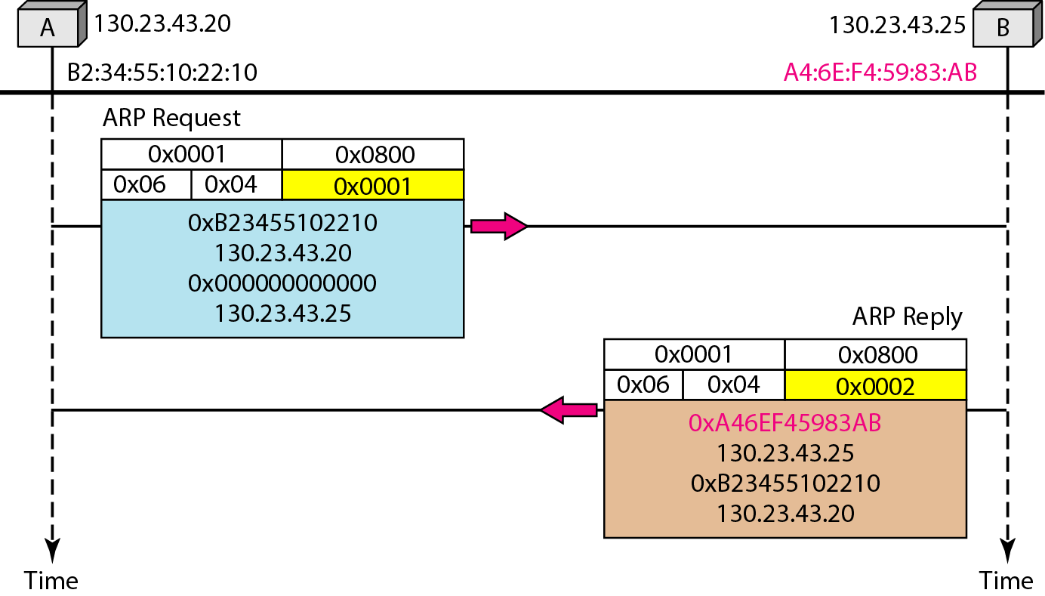
Figure 21.5 Example 21.1, an ARP request and reply

Slide 20
Note
DHCP provides static and dynamic address allocation that can be manual or automatic.

Slide 21
ICMP
The IP protocol has no error-reporting or error-correcting mechanism. The IP protocol also lacks a mechanism for host and management queries. The Internet Control Message Protocol (ICMP) has been designed to compensate for the above two deficiencies. It is a companion to the IP protocol.
Topics discussed in this section:
Types of Messages Message Format Error Reporting and Query
Debugging Tools

Slide 22
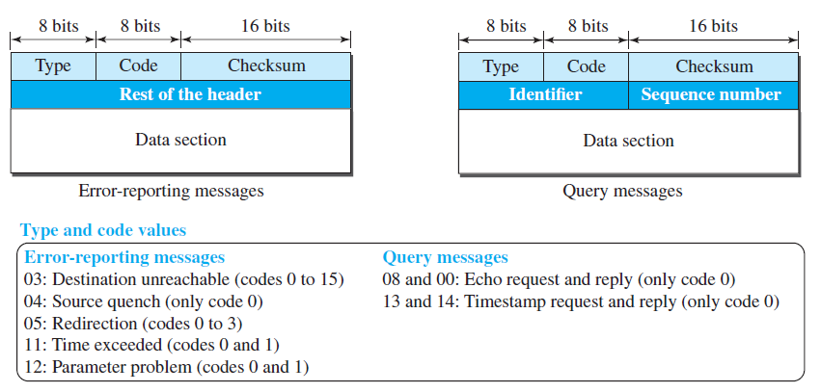
Figure 21.8 General format of ICMP messages

Slide 23
Note
Important points about ICMP error messages:
No ICMP error message will be generated in response to a datagram carrying an ICMP error message.
No ICMP error message will be generated for a fragmented datagram that is not the first fragment.
No ICMP error message will be generated for a datagram having a multicast address.
No ICMP error message will be generated for a atagram having a special address such as 127.0.0.0 or 0.0.0.0.

Slide 24
Note
ICMP always reports error messages to the original source.

Slide 25
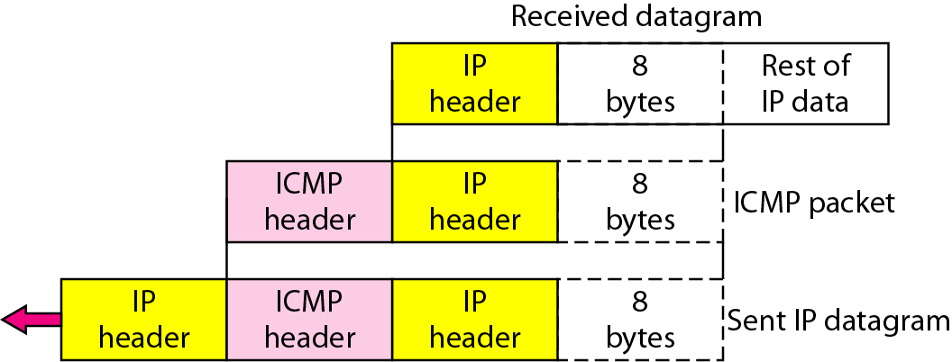
Figure 21.10 Contents of data field for the error messages

Slide 26
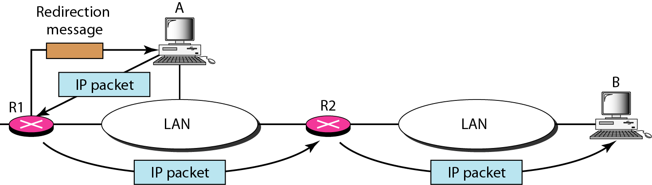
Figure 21.11 Redirection concept

Slide 27
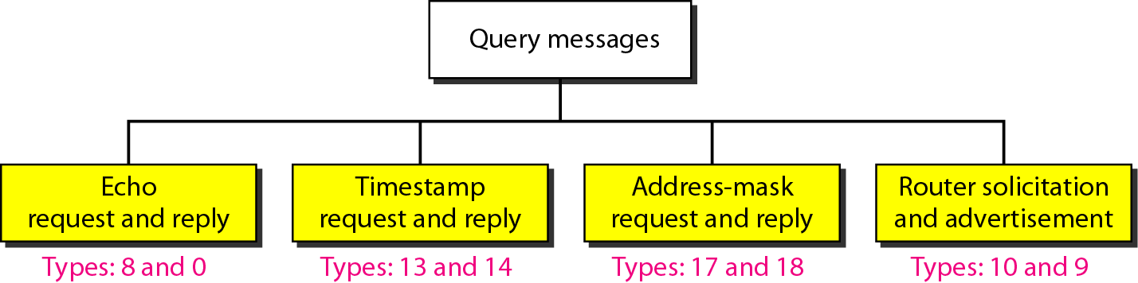
Figure 21.12 Query messages

Slide 28
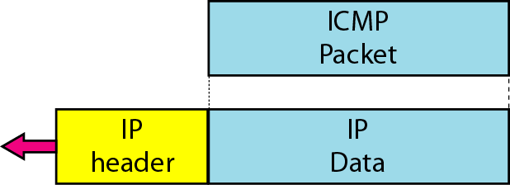
Figure 21.13 Encapsulation of ICMP query messages

Slide 29
Example 21.2
Figure 21.14 shows an example of checksum calculation for a simple echo-request message. We randomly chose the identifier to be 1 and the sequence number to be 9. The message is divided into 16-bit (2-byte) words. The words are added and the sum is complemented. Now the sender can put this value in the checksum field.

Slide 30
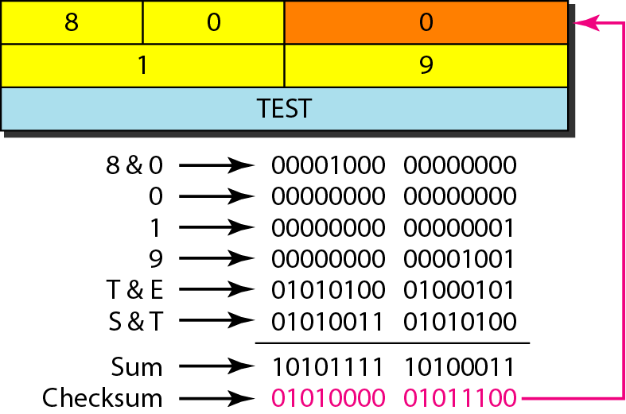
Figure 21.14 Example of checksum calculation

Slide 31
Example 21.3
We use the ping program to test the server fhda.edu. The result is shown on the next slide. The ping program sends messages with sequence numbers starting from 0. For each probe it gives us the RTT time. The TTL (time to live) field in the IP datagram that encapsulates an ICMP
message has been set to 62. At the beginning, ping defines the number of data bytes as 56 and the total number of bytes as 84. It is obvious that if we add 8 bytes of ICMP header and 20 bytes of IP header to 56, the result is 84. However, note that in each probe ping defines the number of bytes as 64. This is the total number of bytes in the ICMP packet (56 + 8).

Slide 32
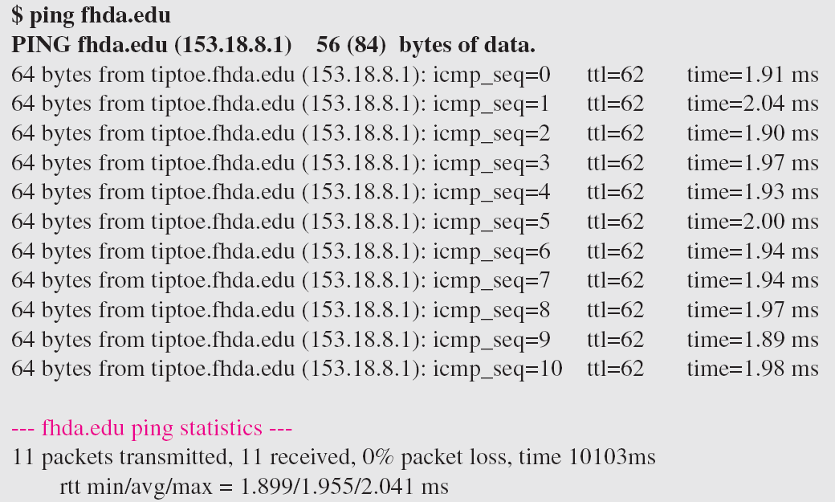
Example 21.3 (continued)

Slide 33
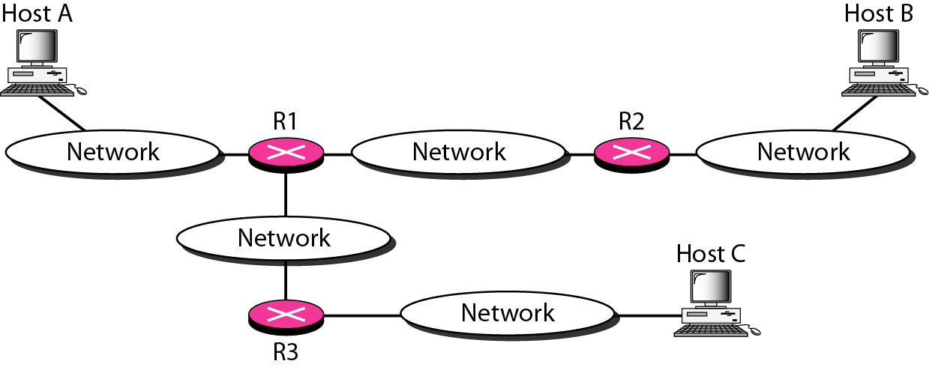
Figure 21.15 The traceroute program operation

Slide 34
Example 21.4
We use the traceroute program to find the route from the computer voyager.deanza.edu to the server fhda.edu. The following shows the result:
The unnumbered line after the command shows that the destination is 153.18.8.1. The packet contains 38 bytes: 20 bytes of IP header, 8 bytes of UDP header, and 10 bytes of application data. The application data are used by traceroute to keep track of the packets.

Slide 35
Example 21.4 (continued)
The first line shows the first router visited. The router is named Dcore.fhda.edu with IP address 153.18.31.254. The first round-trip time was 0.995 ms, the second was 0.899 ms, and the third was 0.878 ms. The second line shows the second router visited. The router is named Dbackup.fhda.edu with IP address 153.18.251.4. The three round-trip times are also shown. The third line shows the destination host. We know that this is the destination host because there are no more lines. The destination host is the server fhda.edu, but it is named tiptoe.fhda.edu with the IP address 153.18.8.1. The three round-trip times are also shown.

Slide 36
Example 21.5
In this example, we trace a longer route, the route to xerox.com (see next slide). Here there are 17 hops between source and destination. Note that some round-trip times look unusual. It could be that a router was too busy to process the packet immediately.

Slide 37
Example 21.5 (continued)

Slide 38
IGMP
The IP protocol can be involved in two types of communication: unicasting and multicasting. The Internet Group Management Protocol (IGMP) is one of the necessary, but not sufficient, protocols that is involved in multicasting. IGMP is a companion to the IP protocol.
Topics discussed in this section:
Group Management IGMP Messages and IGMP Operation
Encapsulation
Netstat Utility

Slide 39
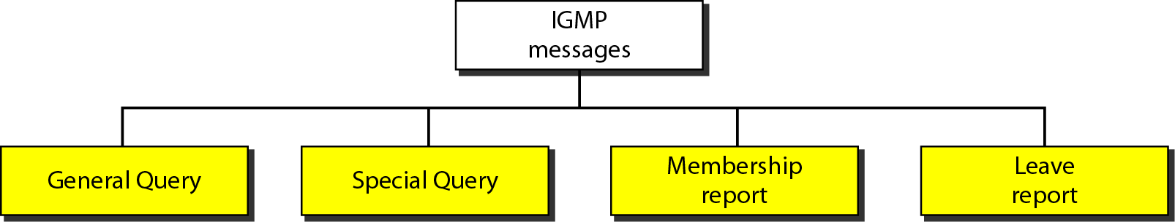
Figure 21.16 IGMP message types

Slide 40
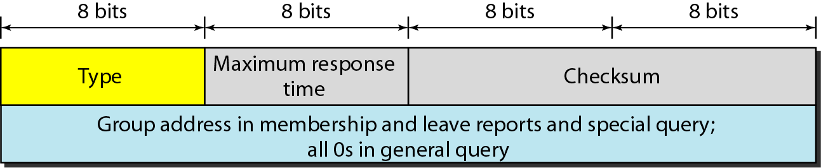
Figure 21.17 IGMP message format

Slide 41
What have we completed?
Thank You
Need for Network Layer
Internet as a Datagram Network
Internet as a Connectionless Network
IPv4 Datagram
IPv4 Fragmentation
IPv4 Checksum
IPV6 Advantages
IPV6 Packet Format
IPV6 Extension Headers
Transition from IPV4 to IPV6

