Slide 1
Network Layer: Delivery, Forwarding and Routing
By dr. R. K. Ojha
Lecture-34-35
( Chapter 22 )

Slide 2
Topics to be discussed
Direct Versus Indirect Delivery
Forwarding Techniques & Forwarding Process
Routing Table
Distance Vector Routing and RIP
Link State Routing and OSPF
Path Vector Routing and BGP
MOSPF
Reverse path forwarding

Slide 3
DELIVERY
The network layer supervises the handling of the packets by the undeR1ying physical networks. We define this handling as the delivery of a packet.
Topics discussed in this section:
Direct Versus Indirect Delivery

Slide 4
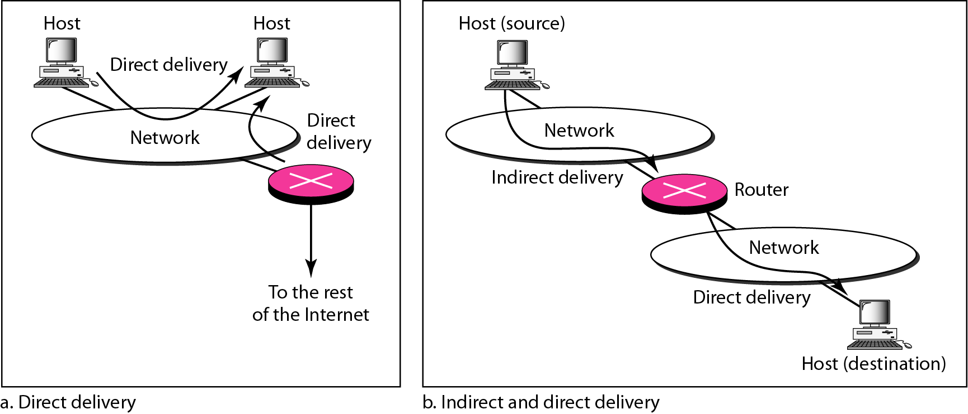
Figure 22.1 Direct and indirect delivery

Slide 5
FORWARDING
Forwarding means to place the packet in its route to its destination. Forwarding requires a host or a router to have a routing table. When a host has a packet to send or when a router has received a packet to be forwarded, it looks at this table to find the route to the final destination.
Topics discussed in this section:
Forwarding Techniques Forwarding Process
Routing Table

Slide 6
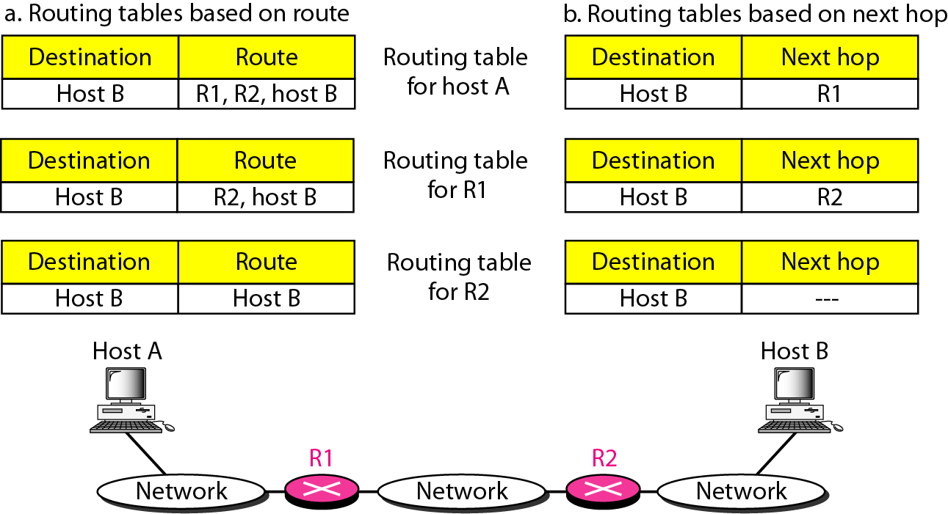
Figure 22.2 Route method versus next-hop method

Slide 7
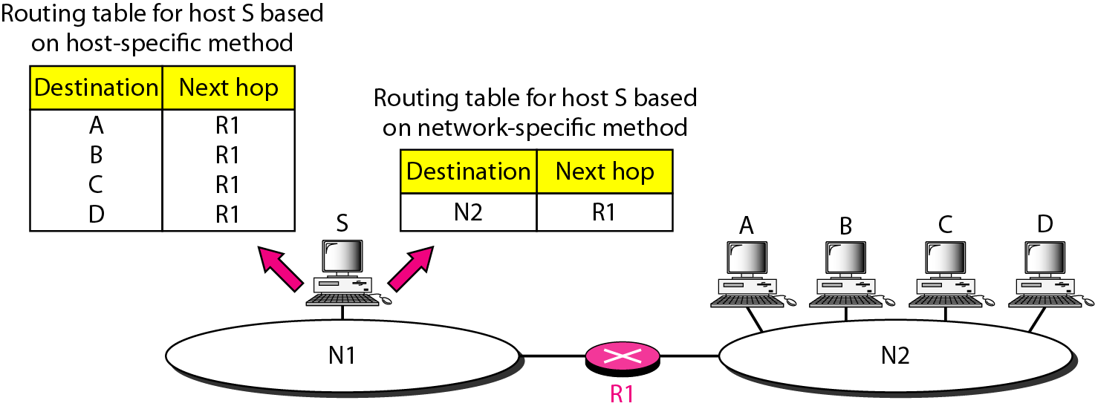
Figure 22.3 Host-specific versus network-specific method

Slide 8
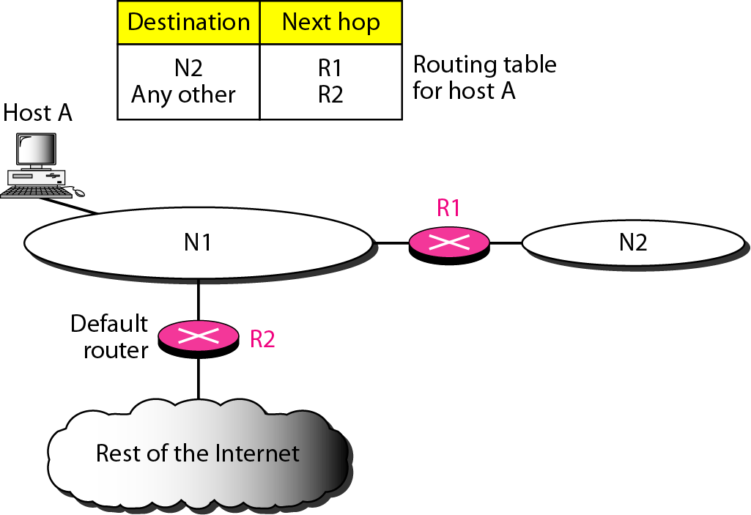
Figure 22.4 Default method

Slide 9
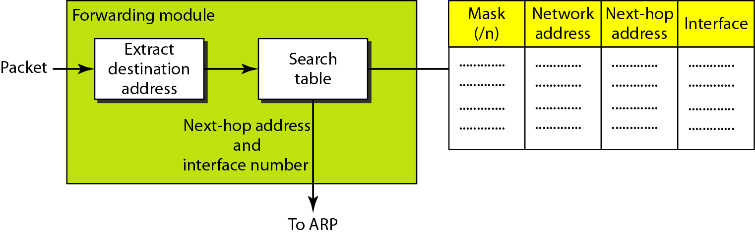
Figure 22.5 Simplified forwarding module in classless address

Slide 10

Note
In classless addressing, we need at least four columns in a routing table.

Slide 11
Example 22.1
Make a routing table for router R1, using the configuration in Figure 22.6.
Solution
Table 22.1 shows the corresponding table.

Slide 12
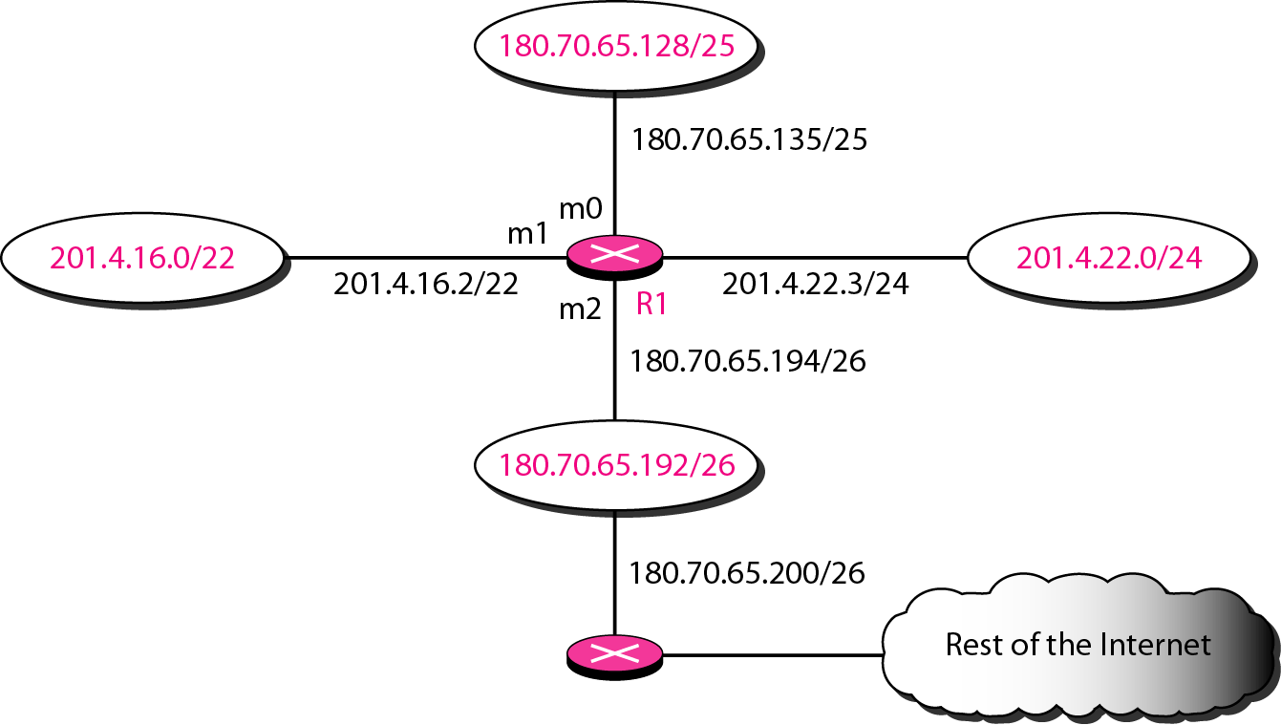
Figure 22.6 Configuration for Example 22.1

Slide 13
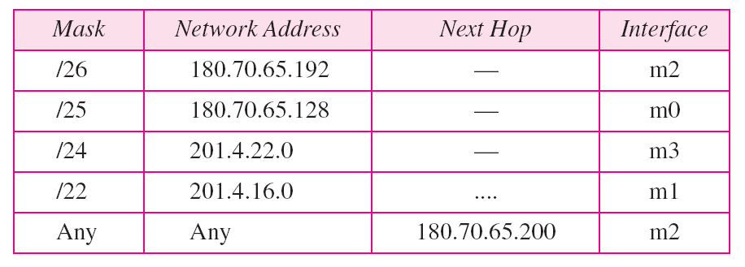
Table 22.1 Routing table for router R1 in Figure 22.6

Slide 14
Example 22.2
Show the forwarding process if a packet arrives at R1 in Figure 22.6 with the destination address 180.70.65.140.
Solution
The router performs the following steps:
1. The first mask (/26) is applied to the destination address. The result is 180.70.65.128, which does not match the corresponding network address.
2. The second mask (/25) is applied to the destination address. The result is 180.70.65.128, which matches the corresponding network address. The next-hop address and the interface number m0 are passed to ARP for further processing.

Slide 15
Example 22.3
Show the forwarding process if a packet arrives at R1 in Figure 22.6 with the destination address 201.4.22.35.
Solution
The router performs the following steps:
1. The first mask (/26) is applied to the destination address. The result is 201.4.22.0, which does not match the corresponding network address.
2. The second mask (/25) is applied to the destination address. The result is 201.4.22.0, which does not match the corresponding network address (row 2).

Slide 16
Example 22.3 (continued)
3. The third mask (/24) is applied to the destination address. The result is 201.4.22.0, which matches the corresponding network address. The destination address of the packet and the interface number m3 are passed to ARP.

Slide 17
Example 22.4
Show the forwarding process if a packet arrives at R1 in Figure 22.6 with the destination address 18.24.32.78.
Solution
This time all masks are applied, one by one, to the destination address, but no matching network address is found. When it reaches the end of the table, the module gives the next-hop address 180.70.65.200 and interface number m2 to ARP. This is probably an outgoing package that needs to be sent, via the default router, to someplace else in the Internet.

Slide 18
Address aggregation
This is called address aggregation because the blocks of addresses for four organizations are aggregated into one larger block.
Router R1 is connected to networks of four organizations that each use 64 addresses.
Router R2 is somewhere far from R1. Router R1 has a longer routing table because each packet must be correctly routed to the appropriate organization.
Router R2, on the other hand, can have a very small routing table.
For R2, any packet with destination 140.24.7.0 to 140.24.7.255 is sent out from interface m₀ regardless of the organization number.
Router R2 would have a longer routing table if each organization had addresses that could not be aggregated into one block.

Slide 19
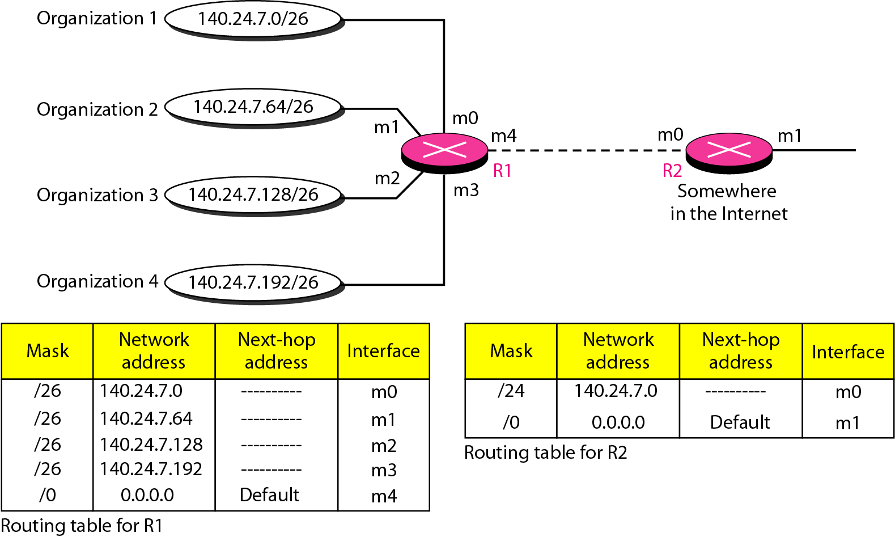
Figure 22.7 Address aggregation

Slide 20
Longest mask matching
This principle states that the routing table is sorted from the longest mask to the shortest mask. In other words, if there are three masks /27, /26, and /24, the mask /27 must be the first entry and 124 must be last.
Let us see if this principle solves the situation in which organization 4 is separated from the other three organizations.
Figure 22.8 shows the situation.
Suppose a packet arrives for organization 4 with destination address 140.24.7.200.
The first mask at router R2 is applied, which gives the network address 140.24.7.192.
The packet is routed correctly from interface ml and reaches organization 4. If, however, the routing table was not stored with the longest prefix first, applying the /24 mask would result in the incorrect routing of the packet to router R1.

Slide 21
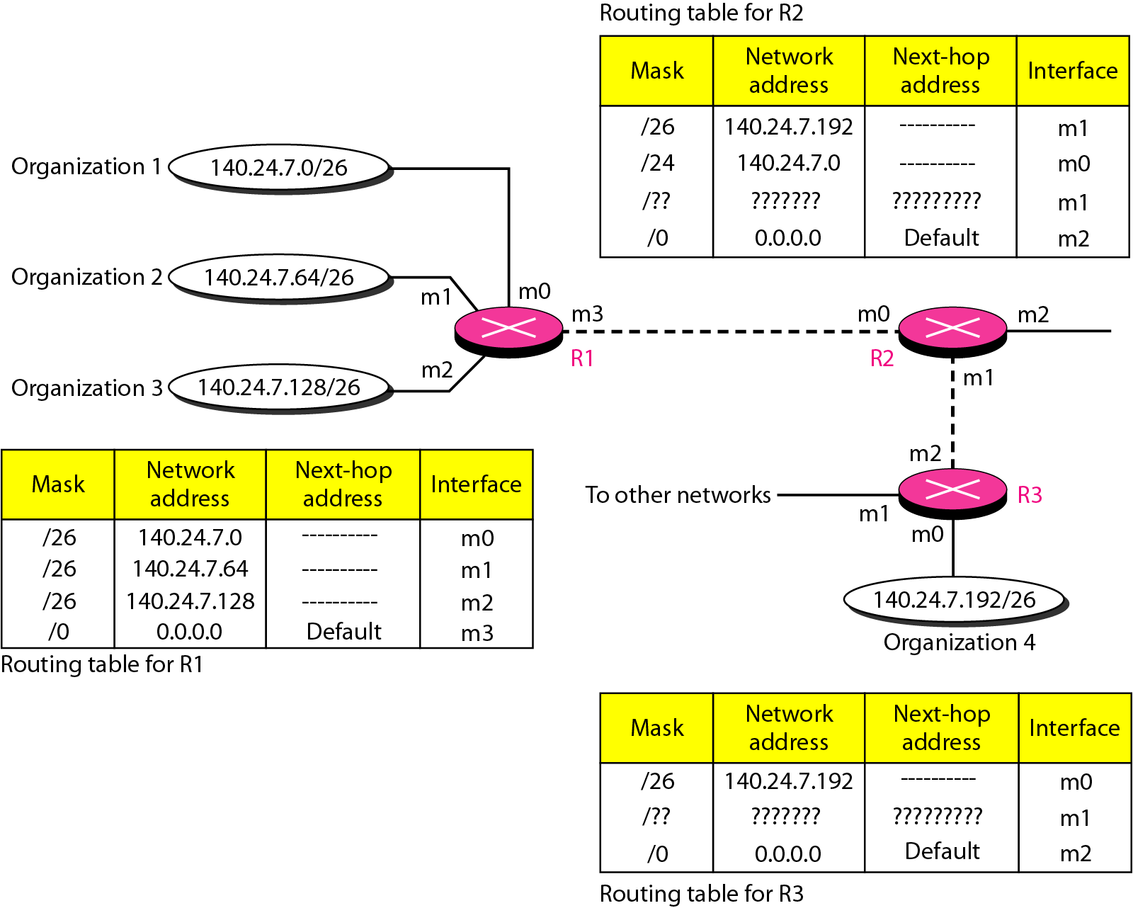
Figure 22.8 Longest mask matching

Slide 22
Example 22.5
As an example of hierarchical routing, let us consider Figure 22.9. A regional ISP is granted 16,384 addresses starting from 120.14.64.0. The regional ISP has decided to divide this block into four subblocks, each with 4096 addresses. Three of these subblocks are assigned to three
local ISPs; the second subblock is reserved for future use. Note that the mask for each block is /20 because the original block with mask /18 is divided into 4 blocks.
The first local ISP has divided its assigned subblock into 8 smaller blocks and assigned each to a small ISP. Each small ISP provides services to 128 households, each using four addresses.

Slide 23
Example 22.5 (continued)
The second local ISP has divided its block into 4 blocks and has assigned the addresses to four large organizations.
The third local ISP has divided its block into 16 blocks and assigned each block to a small organization. Each small organization has 256 addresses, and the mask is /24.
There is a sense of hierarchy in this configuration. All routers in the Internet send a packet with destination address 120.14.64.0 to 120.14.127.255 to the regional ISP.

Slide 24
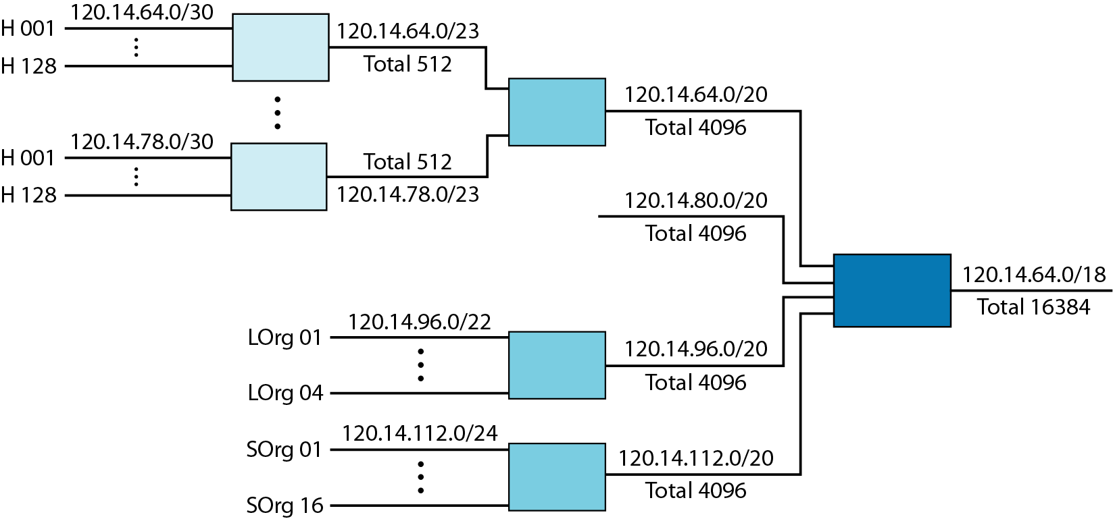
Figure 22.9 Hierarchical routing with ISPs

Slide 25
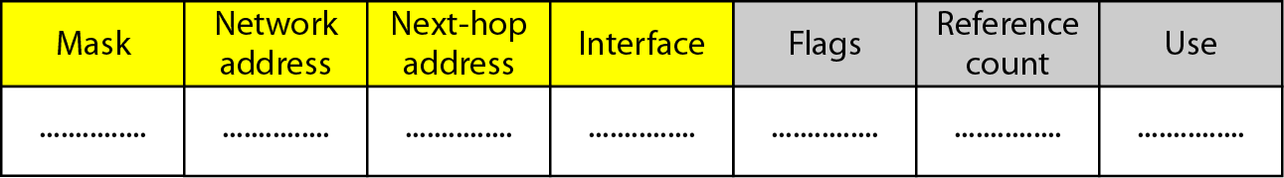
Figure 22.10 Common fields in a routing table
1. Mask. This field defines the mask applied for the entry.
2. Network address. This field defines the network address to which the packet is finally delivered. In the case of host-specific routing, this field defines the address of the destination host.
3. Next-hop address. This field defines the address of the next-hop router to which the packet is delivered.
4. Interface. This field shows the name of the interface.
5. Reference count. This field gives the number of users of this route at the moment. For example, if five people at the same time are connecting to the same host from this router, the value of this column is 5.
6. Use. This field shows the number of packets transmitted through this router for the corresponding destination.

Slide 26
7. Flags. This field defines up to five flags. Flags are on/off switches that signify either presence or absence. The five flags are U (up), G (gateway), H (host-specific), D (added by redirection), and M (modified by redirection).
a. U (up). The U flag indicates the router is up and running. If this flag is not present, it means that the router is down. The packet cannot be forwarded and is discarded.
b. G (gateway). The G flag means that the destination is in another network. The packet is delivered to the next-hop router for delivery (indirect delivery). When this flag is missing, it means the destination is in this network (direct delivery).
c. H (host-specific). The H flag indicates that the entry in the network address field is a host-specific address. When it is missing, it means that the address is only the network address of the destination.
d. D (added by redirection). The D flag indicates that routing information for this destination has been added to the host routing table by a redirection message from ICMP. We discussed redirection and the ICMP protocol in Chapter 21.
e. M (modified by redirection). The M flag indicates that the routing information for this destination has been modified by a redirection message from ICMP. We discussed redirection and the ICMP protocol in Chapter 21.

Slide 27
Example 22.6
One utility that can be used to find the contents of a routing table for a host or router is netstat in UNIX or LINUX. The next slide shows the list of the contents of a default server. We have used two options, r and n. The option r indicates that we are interested in the routing table, and the option n indicates that we are looking for numeric addresses. Note that this is a routing table for a host, not a router. Although we discussed the routing table for a router throughout the chapter, a host also needs a routing table.

Slide 28
Example 22.6 (continued)
The destination column here defines the network address. The term gateway used by UNIX is synonymous with router. This column actually defines the address of the next hop. The value 0.0.0.0 shows that the delivery is direct. The last entry has a flag of G, which means that the destination can be reached through a router (default router). The Iface defines the interface.

Slide 29
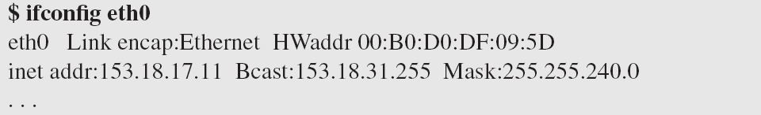
Example 22.6 (continued)
More information about the IP address and physical address of the server can be found by using the ifconfig command on the given interface (eth0).

Slide 30
UNICAST ROUTING PROTOCOLS
A routing table can be either static or dynamic. A static table is one with manual entries. A dynamic table is one that is updated automatically when there is a change somewhere in the Internet.
A routing protocol is a combination of rules and procedures that lets routers in the Internet inform each other of changes.
Topics discussed in this section:
Intra- and Interdomain Routing
Distance Vector Routing and RIP
Link State Routing and OSPF
Path Vector Routing and BGP

Slide 31
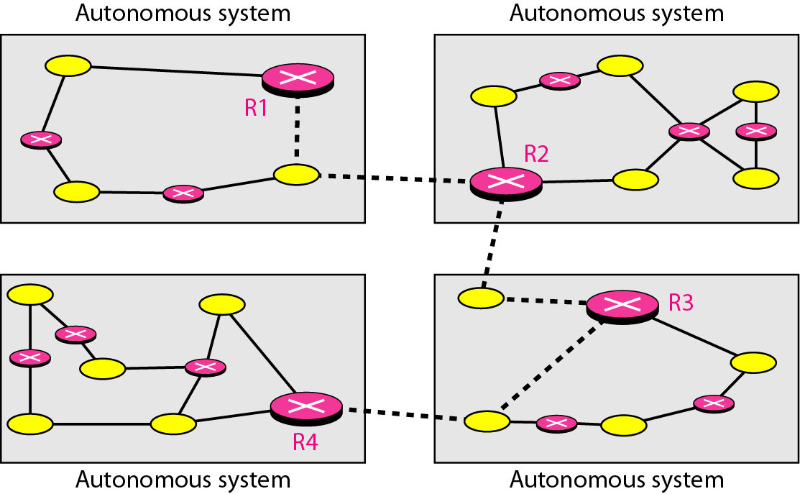
Figure 22.12 Autonomous systems

Slide 32
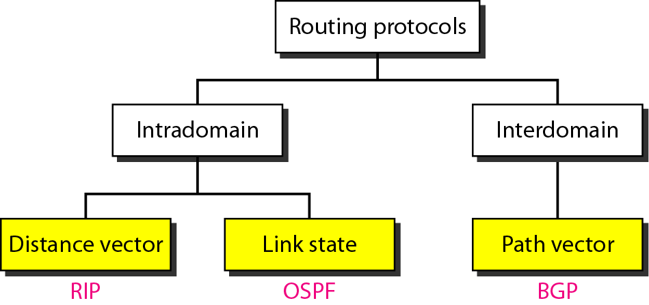
Figure 22.13 Popular routing protocols

Slide 33
Distance vector routing
In distance vector routing, the least-cost route between any two nodes is the route with minimum distance.
In this protocol, as the name implies, each node maintains a vector (table) of minimum distances to every node.
The table at each node also guides the packets to the desired node by showing the next stop in the route (next-hop routing).
The whole idea of distance vector routing is the sharing of information between neighbors.
Example: Although node A does not know about node E, node C does. So if node C shares its routing table with A, node A can also know how to reach node E.
A node is not aware of a neighbor's table so each node is to send its entire table to the neighbor and let the neighbor decide what part to use and what part to discard.
However, the third column of a table (next stop) is not useful for the neighbor. When the neighbor receives a table, this column needs to be replaced with the sender's name.

Slide 34
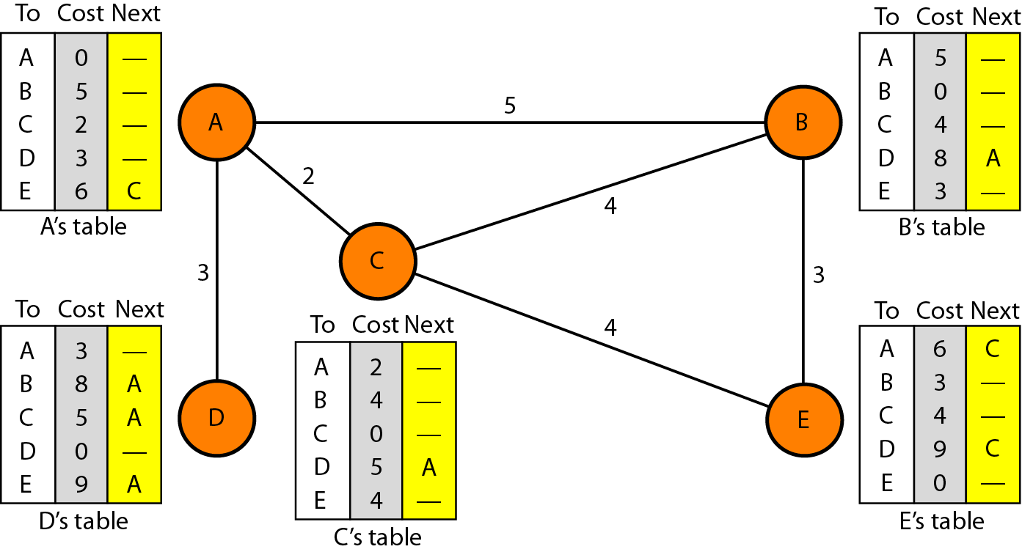
Figure 22.14 Distance vector routing tables

Slide 35
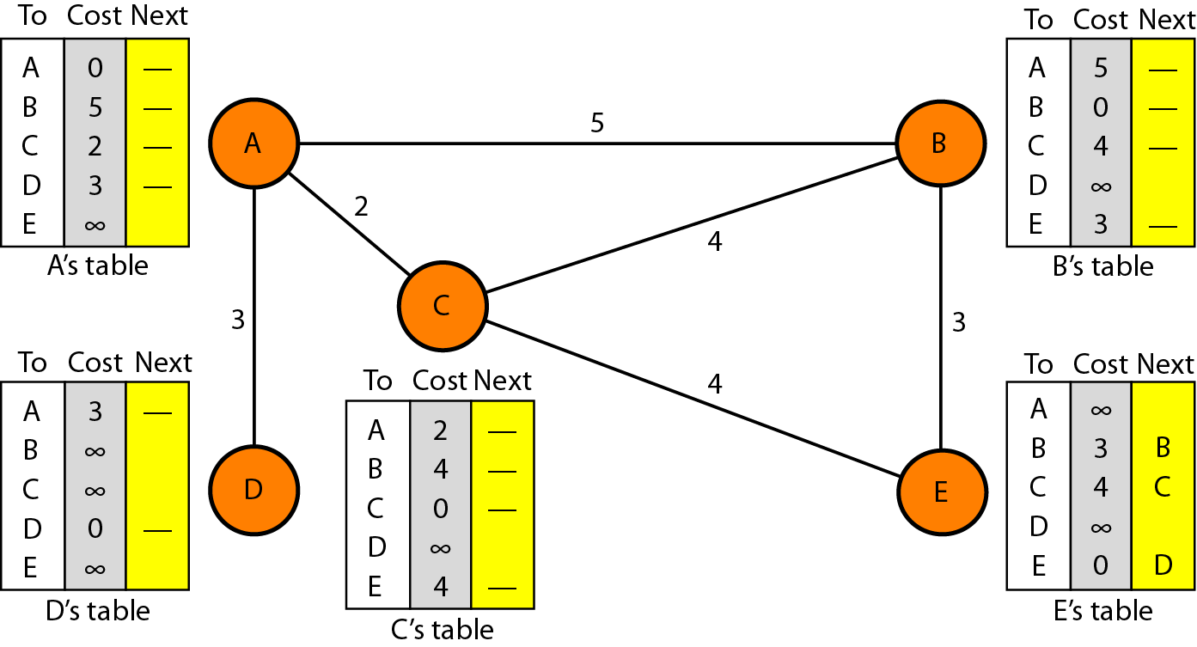
Figure 22.15 Initialization of tables in distance vector routing

Slide 36
Note
In distance vector routing, each node shares its routing table with its
immediate neighbors periodically and when there is a change.

Slide 37
Process to update the routing table
When a node receives a two-column table from a neighbor, it needs to update its routing table. Updating takes three steps:
1. The receiving node needs to add the cost between itself and the sending node to each value in the second column. The logic is clear. If node C claims that its distance to a destination is x mi, and the distance between A and C is y mi, then the distance between A and that destination, via C, is x + y mi.
2. The receiving node needs to add the name of the sending node to each row as the third column if the receiving node uses information from any row. The sending node is the next node in the route.
3. The receiving node needs to compare each row of its old table with the corresponding row of the modified version of the received table.
a. If the next-node entry is different, the receiving node chooses the row with the smaller cost. If there is a tie, the old one is kept.
b. If the next-node entry is the same, the receiving node chooses the new row. For example, suppose node C has previously advertised a route to node X with distance 3. Suppose that now there is no path between C and X; node C now advertises this route with a distance of infinity. Node A must not ignore this value even though its old entry is smaller. The old route does not exist any more. The new route has a distance of infinity.

Slide 38
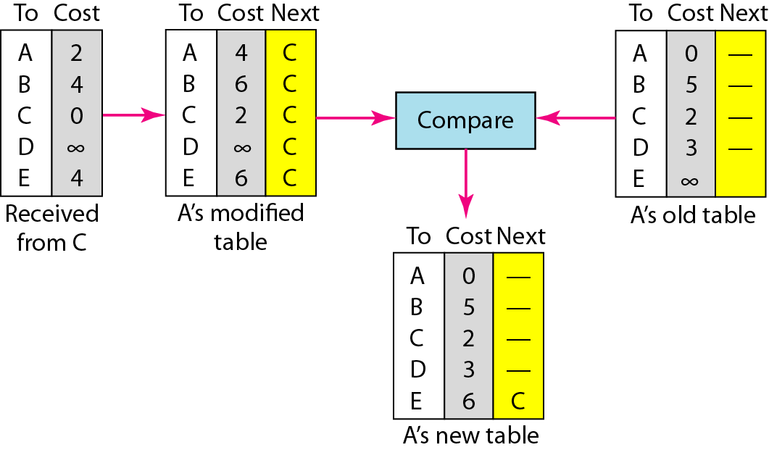
Figure 22.16 Updating in distance vector routing

Slide 39
When does a node send its partial routing table (only two columns) to all its immediate neighbors?
The table is sent both periodically and when there is a change in the table. There are two strategies to update the table and they are as follows:
Periodic Update: A node sends its routing table, normally every 30 s, in a periodic update. The period depends on the protocol that is using distance vector routing.
Triggered Update: A node sends its two-column routing table to its neighbors anytime there is a change in its routing table. This is called a triggered update. The change can result from the following.
1. A node receives a table from a neighbor, resulting in changes in its own table after updating.
2. A node detects some failure in the neighboring links which results in a distance change to infinity.

Slide 40
Two-Node Loop Instability problem
A problem with distance vector routing is instability, which means that a network using this protocol can become unstable.
let us look at the scenario depicted in Figure 22.17. At the beginning, both nodes A and B know how to reach node X. But suddenly, the link between A and X fails.
Node A changes its table. If A can send its table to B immediately, everything is fine. However, the system becomes unstable if B sends its routing table to A before receiving A's routing table.
Node A receives the update and, assuming that B has found a way to reach X, immediately updates its routing table. Based on the triggered update strategy, A sends its new update to B.
Now B thinks that something has been changed around A and updates its routing table. The cost of reaching X increases gradually until it reaches infinity.
At this moment, both A and B know that X cannot be reached. However, during this time the system is not stable. Node A thinks that the route to X is via B; node B thinks that the route to X is via A. If A receives a packet destined for X, it goes to B and then comes back to A. Similarly, if B receives a packet destined for X, it goes to A and comes back to B. Packets bounce between A and B, creating a two-node loop problem.

Slide 41
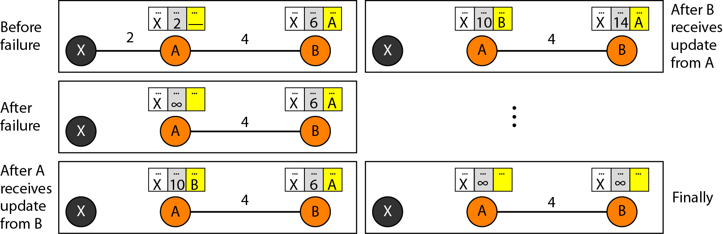
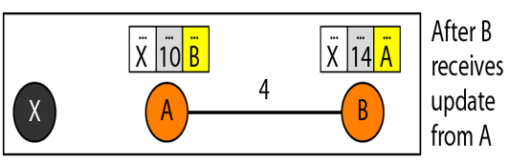
Figure 22.17 Two-node instability
1
Accidentally
2
4
3
5

Slide 42
Solution to the Two-Node Loop Instability problem
Defining Infinity: Redefine infinity to a smaller number. For our previous scenario, the system will be stable in less than 20 updates.
As a matter of fact, most implementations of the distance vector protocol define the distance between each node to be 1 and define 16 as infinity.
However, this means that the distance vector routing cannot be used in large systems. The size of the network, in each direction, can not exceed 15 hops.
2. Split Horizon: In this strategy, instead of flooding the table through each interface, each node sends only part of its table through each interface.
If, according to its table, node B thinks that the optimum route to reach X is via A, it does not need to advertise this piece of information to A; the information has come from A (A already knows).
Taking information from node A, modifying it, and sending it back to node A creates the confusion.
In this scenario, node B eliminates the last line of its routing table before it sends it to A.
In this case, node A keeps the value of infinity as the distance to X. Later when node A sends its routing table to B, node B also corrects its routing table.
The system becomes stable after the first update: both node A and B know that X is not reachable.

Slide 43
3. Split Horizon and Poison Reverse: Using the split horizon strategy has one drawback.
Normally, the distance vector protocol uses a timer, and if there is no news about a route, the node deletes the route from its table.
When node B in the previous scenario eliminates the route to X from its advertisement to A, node A cannot guess that this is due to the split horizon strategy (the source of information was A) or because B has not received any news about X recently.
The split horizon strategy can be combined with the poison reverse strategy.
Node B can still advertise the value for X, but if the source of information is A, it can replace the distance with infinity as a warning: "Do not use this value; what I know about this route comes from you."

Slide 44
Three-Node Loop Instability problem
Suppose, after finding that X is not reachable, node A sends a packet to Band C to inform them of the situation.
Node B immediately updates its table, but the packet to C is lost in the network and never reaches C. Node C remains in the dark and still thinks that there is a route to X via A with a distance of 5.
After a while, node C sends to Bits routing table, which includes the route to X.
Node B is totally fooled here. It receives information on the route to X from C, and according to the algorithm, it updates its table, showing the route to X via C with a cost of 8.
This information has come from C, not from A, so after awhile node B may advertise this route to A. Now A is fooled and updates its table to show that A can reach X via B with a cost of 12.
Of course, the loop continues; now A advertises the route to X to C, with increased cost, but not to B. Node C then advertises the route to B with an increased cost.
Node B does the same to A. And so on. The loop stops when the cost in each node reaches infinity.

Slide 45
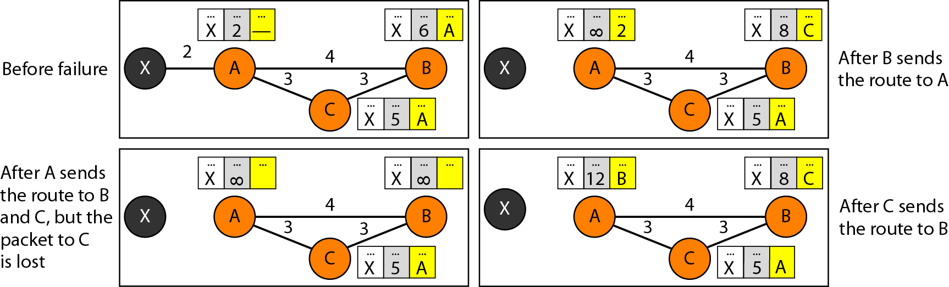
Figure 22.18 Three-node instability

Slide 46
The Routing Information Protocol (RIP)
RIP is an intra-domain routing protocol used inside an autonomous system. It is a very simple protocol based on distance vector routing. RIP implements distance vector routing directly with some considerations:
1. In an autonomous system, we are dealing with routers and networks (links). The routers have routing tables; networks do not.
2. The destination in a routing table is a network, which means the first column defines a network address.
3. The metric used by RIP is very simple; the distance is defined as the number of links (networks) to reach the destination. For this reason, the metric in RIP is called a hop count.
4. Infinity is defined as 16, which means that any route in an autonomous system using RIP cannot have more than 15 hops.
5. The next-node column defines the address of the router to which the packet is to be sent to reach its destination.

Slide 47
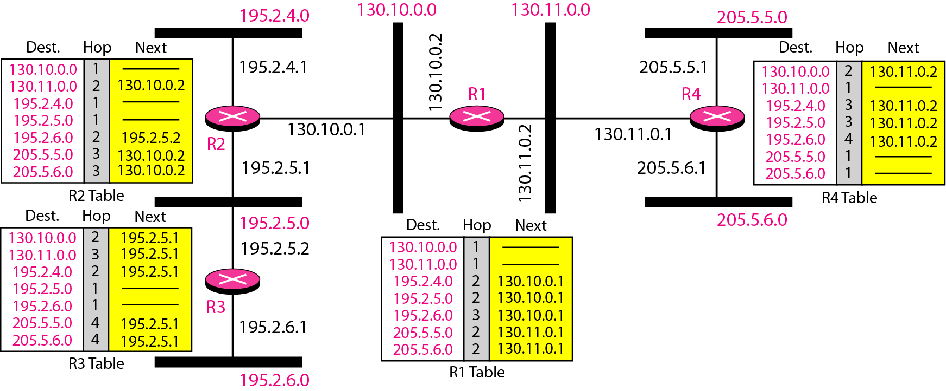
Figure 22.19 Example of a domain using RIP

Slide 48
Figure 22.19 shows an autonomous system with seven networks and four routers.
Let us look at the routing table for R1. The table has seven entries to show how to reach each network in the autonomous system.
Router R1 is directly connected to networks 130.10.0.0 and 130.11.0.0, which means that there are no next-hop entries for these two networks.
To send a packet to one of the three networks at the far left, router R1 needs to deliver the packet to R2.
The next-node entry for these three networks is the interface of router R2 with IP address 130.10.0.1.
To send a packet to the two networks at the far right, router R1 needs to send the packet to the interface of router R4 with IP address 130.11.0.1.
The other tables can be explained similarly.

Slide 49
Link State Routing
In link state routing, if each node in the domain has the entire topology of the domain-the list of nodes and links, how they are connected including the type, cost (metric), and condition of the links (up or down)-the node can use Dijkstra's algorithm to build a routing table.
Figure 22.20 shows the concept. The figure shows a simple domain with five nodes. Each node uses the same topology to create a routing table, but the routing table for each node is unique because the calculations are based on different interpretations of the topology.
The topology must be dynamic, representing the latest state of each node and each link. If there are changes in any point in the network (a link is down, for example), the topology must be updated for each node.
No node can know the topology at the beginning or after a change somewhere in the network. Link state routing is based on the assumption that, although the global knowledge about the topology is not clear, each node has partial knowledge: it knows the state (type, condition, and cost) of its links.
In other words, the whole topology can be compiled from the partial knowledge of each node. Figure 22.21 shows the same domain as in Figure 22.20, indicating the part of the knowledge belonging to each node.

Slide 50
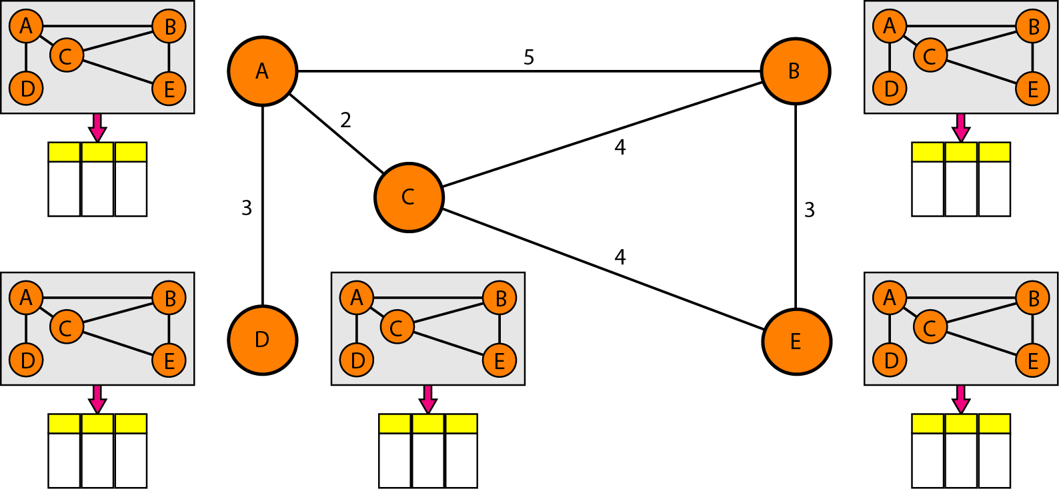
Figure 22.20 Concept of link state routing

Slide 51
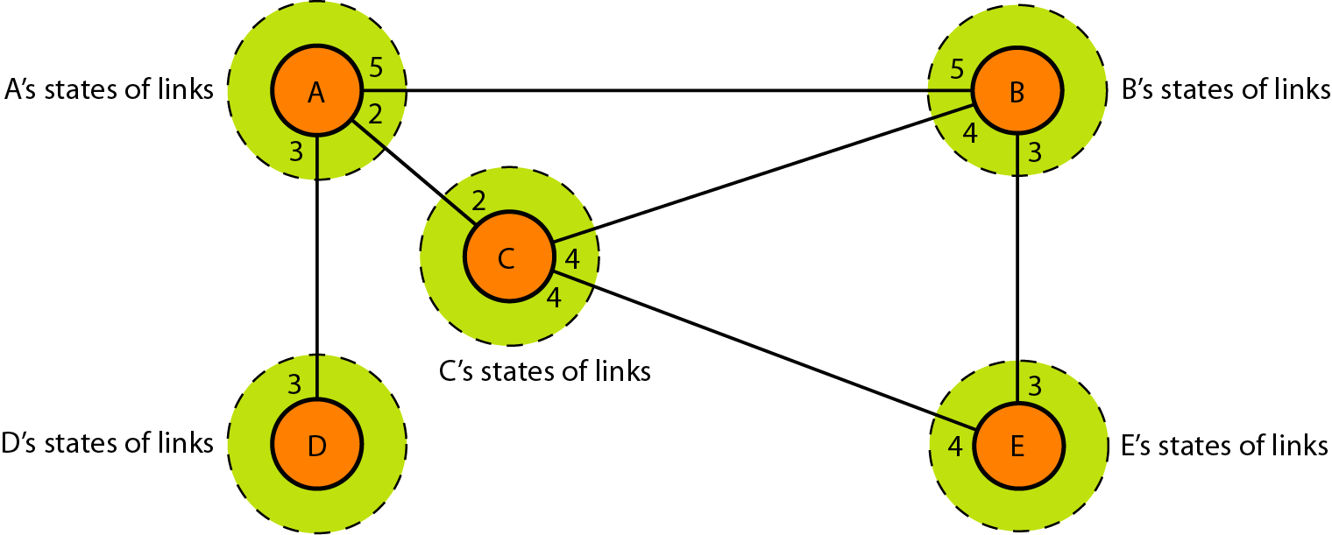
Figure 22.21 Link state knowledge
Node A knows that it is connected to node B with metric 5, to node C with metric 2, and to node D with metric 3. Node C knows that it is connected to node A with metric 2, to node B with metric 4, and to node E with metric 4. Node D knows that it is connected only to node A with metric 3. And so on. Although there is an overlap in the knowledge, the overlap guarantees the creation of a common topology-a picture of the whole domain for each node.

Slide 52
Building Routing Tables
In link state routing, four sets of actions are required to ensure that each node has the routing table showing the least-cost node to every other node.
1. Creation of the states of the links by each node, called the link state packet (LSP).
2. Dissemination of LSPs to every other router, called flooding, in an efficient and reliable way.
3. Formation of a shortest path tree for each node.
4. Calculation of a routing table based on the shortest path tree.

Slide 53
Creation of Link State Packet (LSP) :
A link state packet can carry a minimum amount of data: the node identity, the list of links, a sequence number, and age.
The first two, node identity and the list of links, are needed to make the topology.
The third, sequence number, facilitates flooding and distinguishes new LSPs from old ones.
The fourth, age, prevents old LSPs from remaining in the domain for a long time. LSPs are generated on two occasions:
1. When there is a change in the topology of the domain. Triggering of LSP dissemination is the main way of quickly informing any node in the domain to update its topology.
2. On a periodic basis. The period in this case is much longer compared to distance vector routing. As a matter of fact, there is no actual need for this type of LSP dissemination. It is done to ensure that old information is removed from the domain. The timer set for periodic dissemination is normally in the range of 60 min or 2 h based on the implementation. A longer period ensures that flooding does not create too much traffic on the network.

Slide 54
Flooding of LSPs: After a node has prepared an LSP, it must be disseminated to all other nodes, not only to its neighbors. The process is called flooding and based on the following:
1. The creating node sends a copy of the LSP out of each interface.
2. A node that receives an LSP compares it with the copy it may already have. If the newly arrived LSP is older than the one it has (found by checking the sequence number), it discards the LSP. If it is newer, the node does the following:
a. It discards the old LSP and keeps the new one.
b. It sends a copy of it out of each interface except the one from which the packet arrived. This guarantees that flooding stops somewhere in the domain (where a node has only one interface).

Slide 55
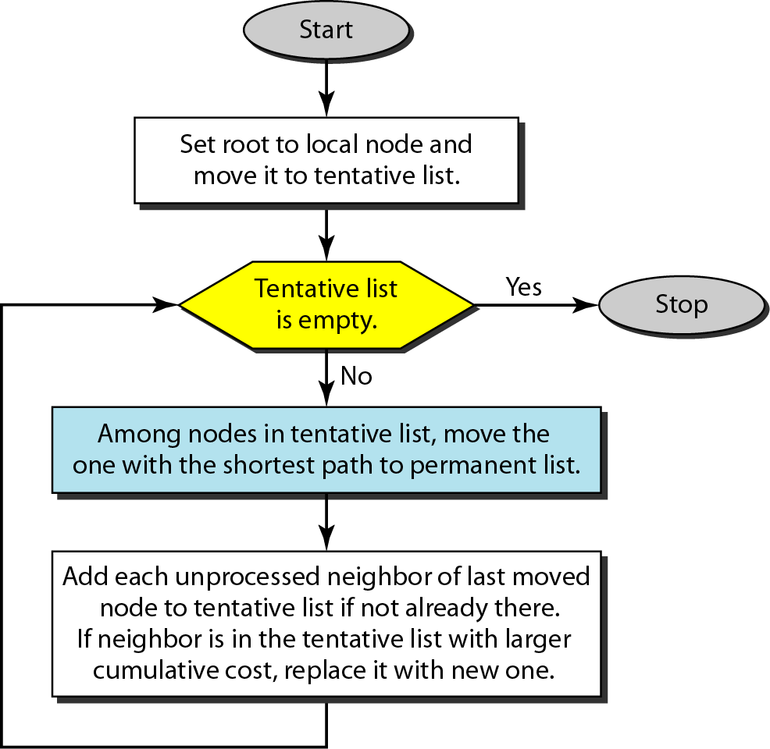
Figure 22.22 Dijkstra algorithm

Slide 56
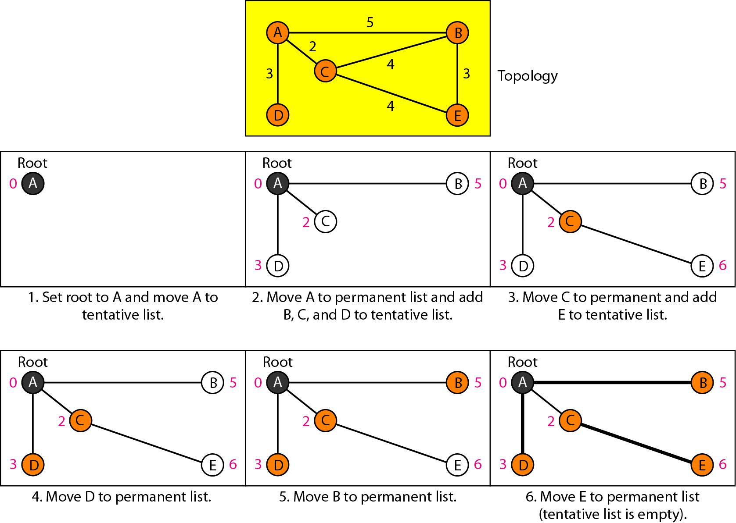
Figure 22.23 Example of formation of shortest path tree

Slide 57
1. We make node A the root of the tree and move it to the tentative list. Our two lists are
Permanent list: empty Tentative list: A(O)
2. Node A has the shortest cumulative cost from all nodes in the tentative list. We move A to the permanent list and add all neighbors of A to the tentative list. Our new lists are
Permanent list: A(O) Tentative list: B(5), C(2), D(3)
3. Node C has the shortest cumulative cost from all nodes in the tentative list. We move C to the permanent list. Node C has three neighbors, but node A is already processed, which makes the unprocessed neighbors just B and E. However, B is already in the tentative list with a cumulative cost of 5. Node A could also reach node B
through C with a cumulative cost of 6. Since 5 is less than 6, we keep node B with a cumulative cost of 5 in the tentative list and do not replace it. Our new lists are
Permanent list: A(O), e(2) Tentative list: B(5), 0(3), E(6)
4. Node D has the shortest cumulative cost of all the nodes in the tentative list. We move D to the permanent list. Node D has no unprocessed neighbor to be added to the tentative list. Our new lists are Permanent list: A(O), C(2), 0(3) Tentative list: B(5), E(6)

Slide 58
5. Node B has the shortest cumulative cost of all the nodes in the tentative list. We move B to the permanent list. We need to add all unprocessed neighbors of B to the tentative list (this is just node E). However, E(6) is already in the list with a smaller cumulative cost. The cumulative cost to node E, as the neighbor of B, is 8. We keep node E(6) in the tentative list. Our new lists are Permanent list:A(O), B(5), C(2), 0(3) Tentative list: E(6)
6. Node E has the shortest cumulative cost from all nodes in the tentative list. We move E to the permanent list. Node E has no neighbor. Now the tentative list is empty. We stop; our shortest path tree is ready. The final lists are
Permanent list: A(O), B(5), C(2), D(3), E(6) Tentative list: empty

Slide 59
Table 22.2 Routing table for node A

Slide 60
The Open Shortest Path First (OSPF)
OSPF protocol is an intradomain routing protocol based on link state routing. Its domain is also an autonomous system.
Areas: To handle routing efficiently and in a timely manner, OSPF divides an autonomous system into areas. An area is a collection of networks, hosts, and routers all contained within an autonomous system.
An autonomous system can be divided into many different areas. All networks inside an area must be connected.
Routers inside an area flood the area with routing information. At the border of an area, special routers called area border routers summarize the information about the area and send it to other areas.
Among the areas inside an autonomous system is a special area called the backbone; all the areas inside an autonomous system must be connected to the backbone. In other words, the backbone serves as a primary area and the other areas as secondary areas.
This does not mean that the routers within areas cannot be connected to each other, however. The routers inside the backbone are called the backbone routers. Note that a backbone router can also be an area border router.
If, because of some problem, the connectivity between a backbone and an area is broken, a virtual link between routers must be created by an administrator to allow continuity of the functions of the backbone as the primary area.

Slide 61
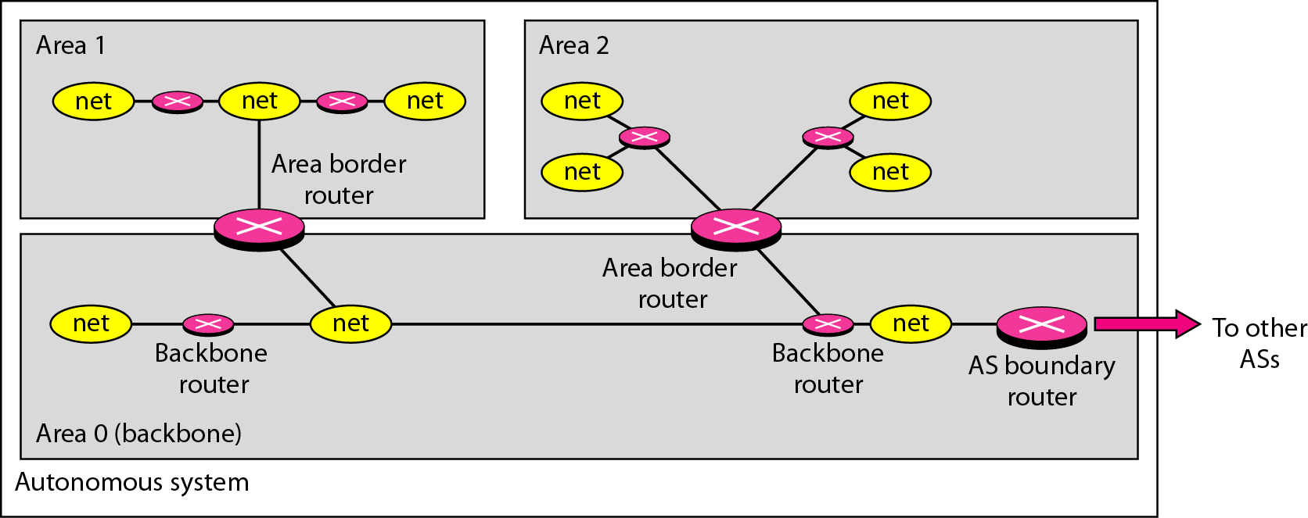
Figure 22.24 Areas in an autonomous system

Slide 62
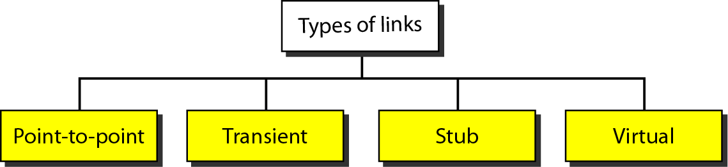
Figure 22.25 Types of links
When the link between two routers is broken, the administration may create a virtual link between them, using a longer path that probably goes through several routers.

Slide 63
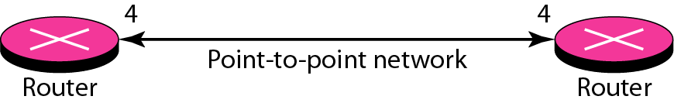
Figure 22.26 Point-to-point link
A point-to-point link connects two routers without any other host or router in between.
The purpose of the link (network) is just to connect the two routers. An example of this type of link is two routers connected by a telephone line or a T line.
There is no need to assign a network address to this type of link.
Graphically, the routers are represented by nodes, and the link is represented by a bidirectional edge connecting the nodes. The metrics, which are usually the same, are shown at the two ends, one for each direction.

Slide 64
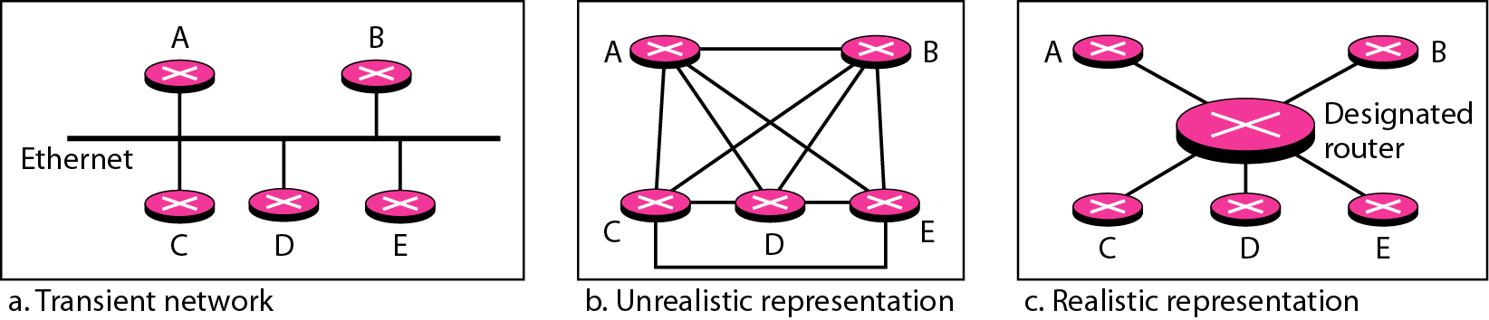
Figure 22.27 Transient link
A transient link is a network with several routers attached to it.
The data can enter through any of the routers and leave through any router.
All LANs and some WANs with two or more routers are of this type. In this case, each router has many neighbors.
For example, consider the Ethernet in Figure 22.27a. Router A has routers B, C, D, and E as neighbors. Router B has routers A, C, D, and E as neighbors.
If we want to show the neighborhood relationship in this situation, we have the graph shown in Figure 22.27b.
To show that each router is connected to every other router through one single network, the network itself is represented by a node. However, because a network is not a machine, it cannot function as a router. One of the routers in the network takes this responsibility. It is assigned a dual purpose; it is a true router and a designated router.
We can use the topology shown in Figure 22.27c to show the connections of a transient network.

Slide 65
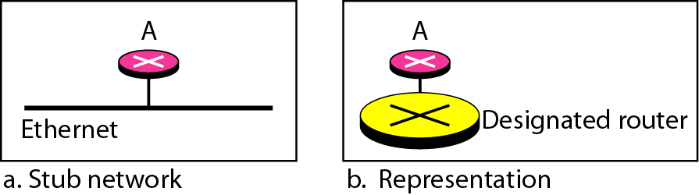
Figure 22.28 Stub link
A stub link is a network that is connected to only one router.
The data packets enter the network through this single router and leave the network through this same router.
This is a special case of the transient network.
We can show this situation using the router as a node and using the designated router for the network. However, the link is only one-directional, from the router to the network (see Figure 22.28).

Slide 66
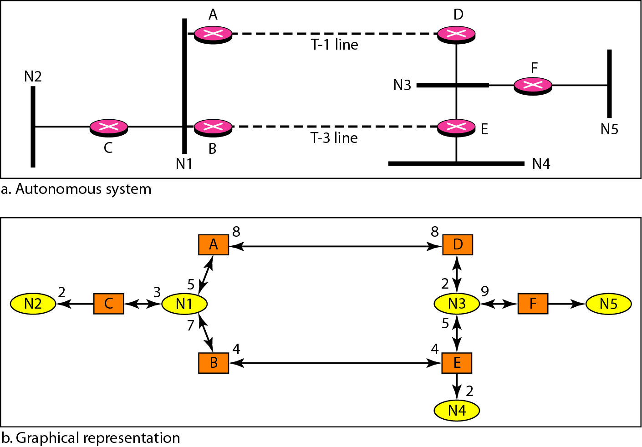
Figure 22.29 Example of an AS and its graphical representation in OSPF

Slide 67
Figure 22.29 shows a small AS with seven networks and six routers. Two of the networks are point-to-point networks.
We use symbols such as N1 and N2 for transient and stub networks.
There is no need to assign an identity to a point-to point network.
The figure also shows the graphical representation of the AS as seen by OSPF.
We have used square nodes for the routers and ovals for the networks (represented by designated routers).
However, OSPF sees both as nodes. Note that we have three stub networks.

Slide 68
Path Vector Routing
Distance vector routing is subject to instability if there are more than a few hops in the domain of operation.
Link state routing needs a huge amount of resources to calculate routing tables. It also creates heavy traffic because of flooding.
There is a need for a third routing protocol which we call path vector routing.
Path vector routing proved to be useful for interdomain routing.
The principle of path vector routing is similar to that of distance vector routing. In path vector routing, we assume that there is one node (there can be more, but one is enough for our conceptual discussion) in each autonomous system that acts on behalf of the entire autonomous system.
Let us call it the speaker node. The speaker node in an AS creates a routing table and advertises it to speaker nodes in the neighboring ASs.
The idea is the same as for distance vector routing except that only speaker nodes in each AS can communicate with each other.
However, what is advertised is different. A speaker node advertises the path, not the metric of the nodes, in its autonomous system or other autonomous systems.

Slide 69
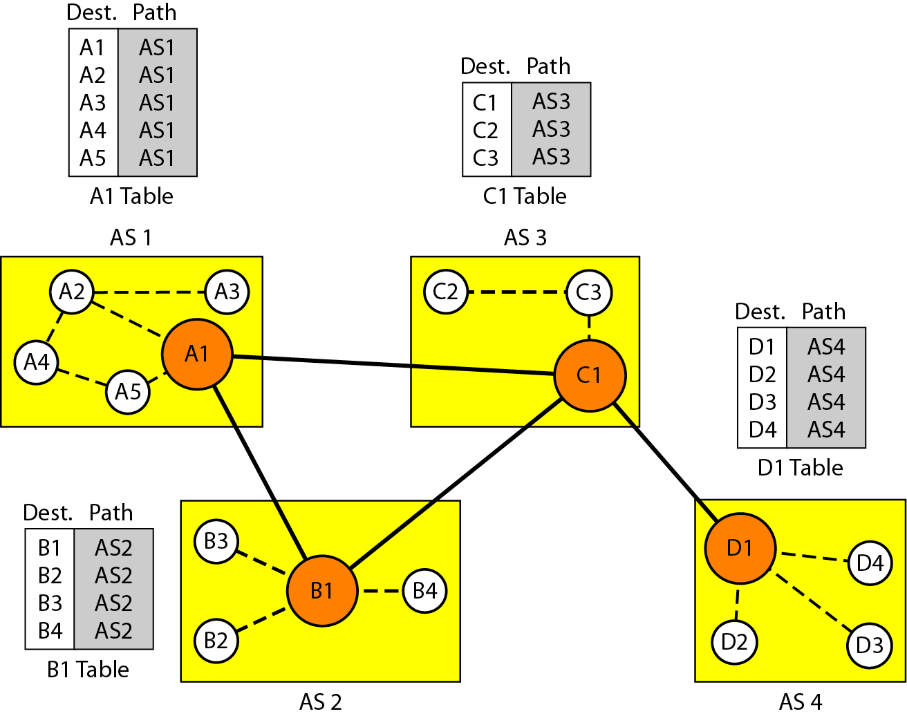
Figure 22.30 Initial routing tables in path vector routing

Slide 70
Initialization process
At the beginning, each speaker node can know only the reachability of nodes inside its autonomous system. Figure 22.30 shows the initial tables for each speaker node in a system made of four ASs.
Node A1 is the speaker node for ASl, Bl for AS2, Cl for AS3, and Dl for AS4. Node A1 creates an initial table that shows A1 to A5 are located in ASI and can be reached through it. Node Bl advertises that Bl to B4 are located in AS2 and can be reached through Bl. And so on.
Sharing Just as in distance vector routing, in path vector routing, a speaker in an autonomous system shares its table with immediate neighbors. In Figure 22.30, node Al shares its table with nodes B1 and C1. Node C1 shares its table with nodes D1, B1, and A1. Node Bl shares its table with Cl and A1. Node D1 shares its table with C1.
Updating When a speaker node receives a two-column table from a neighbor, it updates its own table by adding the nodes that are not in its routing table and adding its own autonomous system and the autonomous system that sent the table.
After a while each speaker has a table and knows how to reach each node in other ASs. Figure 22.31 shows the tables for each speaker node after the system is stabilized.
According to the figure, if router Al receives a packet for nodes A3, it knows that the path is in ASI (the packet is at home); but if it receives a packet for Dl, it knows that the packet should go from ASl, to AS2, and then to AS3.
The routing table shows the path completely. On the other hand, if node Dl in AS4 receives a packet for node A2, it knows it should go through AS4, AS3, and AS 1.

Slide 71
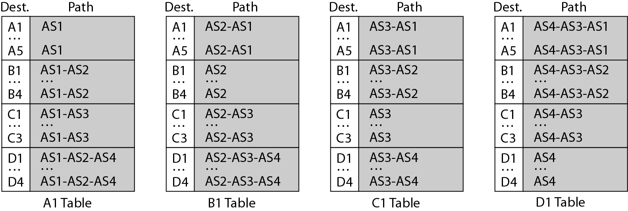
Figure 22.31 Stabilized tables for three autonomous systems

Slide 72
Advantages of Path Vector Routing
Loop prevention. The instability of distance vector routing and the creation of loops can be avoided in path vector routing. When a router receives a message, it checks to see if its autonomous system is in the path list to the destination. If it is, looping is involved and the message is ignored.
Policy routing. Policy routing can be easily implemented through path vector routing. When a router receives a message, it can check the path. If one of the autonomous systems listed in the path is against its policy, it can ignore that path and that destination. It does not update its routing table with this path, and it does not send this message to its neighbors.
Optimum path. One system may use, internally, RIP, which defines hop count as the metric; another may use OSPF with minimum delay defined as the metric. The optimum path is the path that fits the organization. In our previous figure, each autonomous system may have more than one path to a destination.
For example, a path from AS4 to ASI can be AS4-AS3-AS2-AS1, or it can be AS4-AS3-ASI. For the tables, we chose the one that had the smaller number of autonomous systems, but this is not always the case. Other criteria, such as security, safety, and reliability, can also be applied.

Slide 73
Border Gateway Protocol (BGP)
BGP is an interdomain routing protocol using path vector routing. It first appeared in 1989 and has gone through four versions.
We can divide autonomous systems into three categories: stub, multihomed, and transit.
(a) Stub AS. A stub AS has only one connection to another AS. The interdomain data traffic in a stub AS can be either created or terminated in the AS. The hosts in the AS can send data traffic to other ASs. The hosts in the AS can receive data coming from hosts in other ASs. Data traffic, however, cannot pass through a stub AS. A stub AS is either a source or a sink. A good example of a stub AS is a small corporation or a small local ISP.
(b) Multihomed AS. A multihomed AS has more than one connection to other ASs, but it is still only a source or sink for data traffic. It can receive data traffic from more than one AS. It can send data traffic to more than one AS, but there is no transient traffic. It does not allow data coming from one AS and going to another AS to pass through. A good example of a multihomed AS is a large corporation that is connected to more than one regional or national AS that does not allow transient traffic.
(c) Transit AS. A transit AS is a multihomed AS that also allows transient traffic. Good examples of transit ASs are national and international ISPs (Internet backbones).

Slide 74
BGP Sessions: The exchange of routing information between two routers using BGP takes place in a session. A session is a connection that is established between two BGP routers only for the sake of exchanging routing information. To create a reliable environment, BGP uses the services of TCP. In other words, a session at the BGP level, as an application program, is a connection at the TCP level. However, there is a subtle difference between a connection in TCP made for BGP and other application programs.
When a TCP connection is created for BGP, it can last for a long time, until something unusual happens. For this reason, BGP sessions are sometimes referred to as semipermanent connections.
External and Internal BGP: If we want to be precise, BGP can have two types of sessions: external BGP (E-BGP) and internal BGP (I-BGP) sessions. The E-BGP session is used to exchange information between two speaker nodes belonging to two different autonomous systems. The I-BGP session, on the other hand, is used to exchange routing information between two routers inside an autonomous system. Figure 22.32
shows the idea.

Slide 75
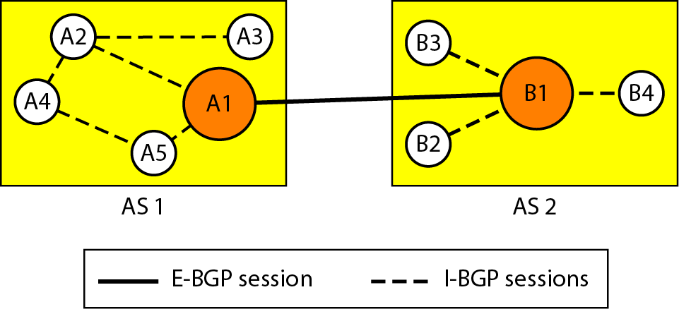
Figure 22.32 Internal and external BGP sessions

Slide 76
MULTICAST ROUTING PROTOCOLS
Topics discussed in this section:
Unicast, Multicast, and Broadcast Applications
Multicast Routing
Routing Protocols

Slide 77
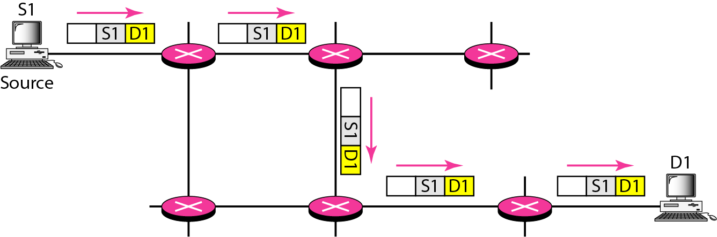
Figure 22.33 Unicasting
In unicast communication, there is one source and one destination. The relationship between the source and the destination is one-to-one. In this type of communication, both the source and destination addresses, in the IP datagram, are the unicast addresses assigned to the hosts (or host interfaces, to be more exact).

Slide 78
Note
In unicasting, the router forwards the received packet through
only one of its interfaces.

Slide 79
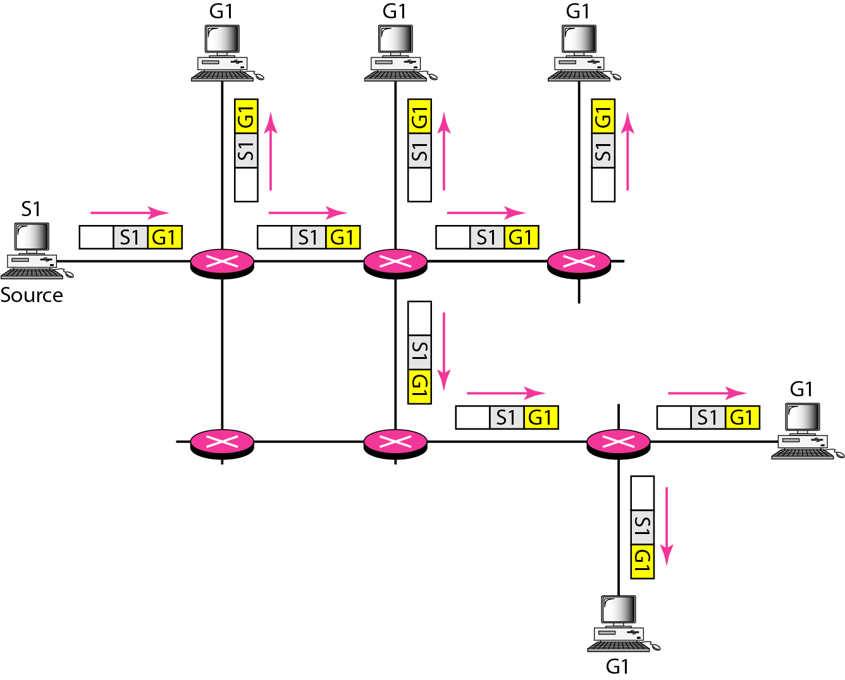
Figure 22.34 Multicasting
In multicast communication, there is one source and a group of destinations. The relationship is one-to-many. In this type of communication, the source address is a unicast address, but the destination address is a group address, which defines one or more destinations. The group address identifies the members of the group.

Slide 80
Note
In multicasting, the router may forward the received packet
through several of its interfaces.

Slide 81
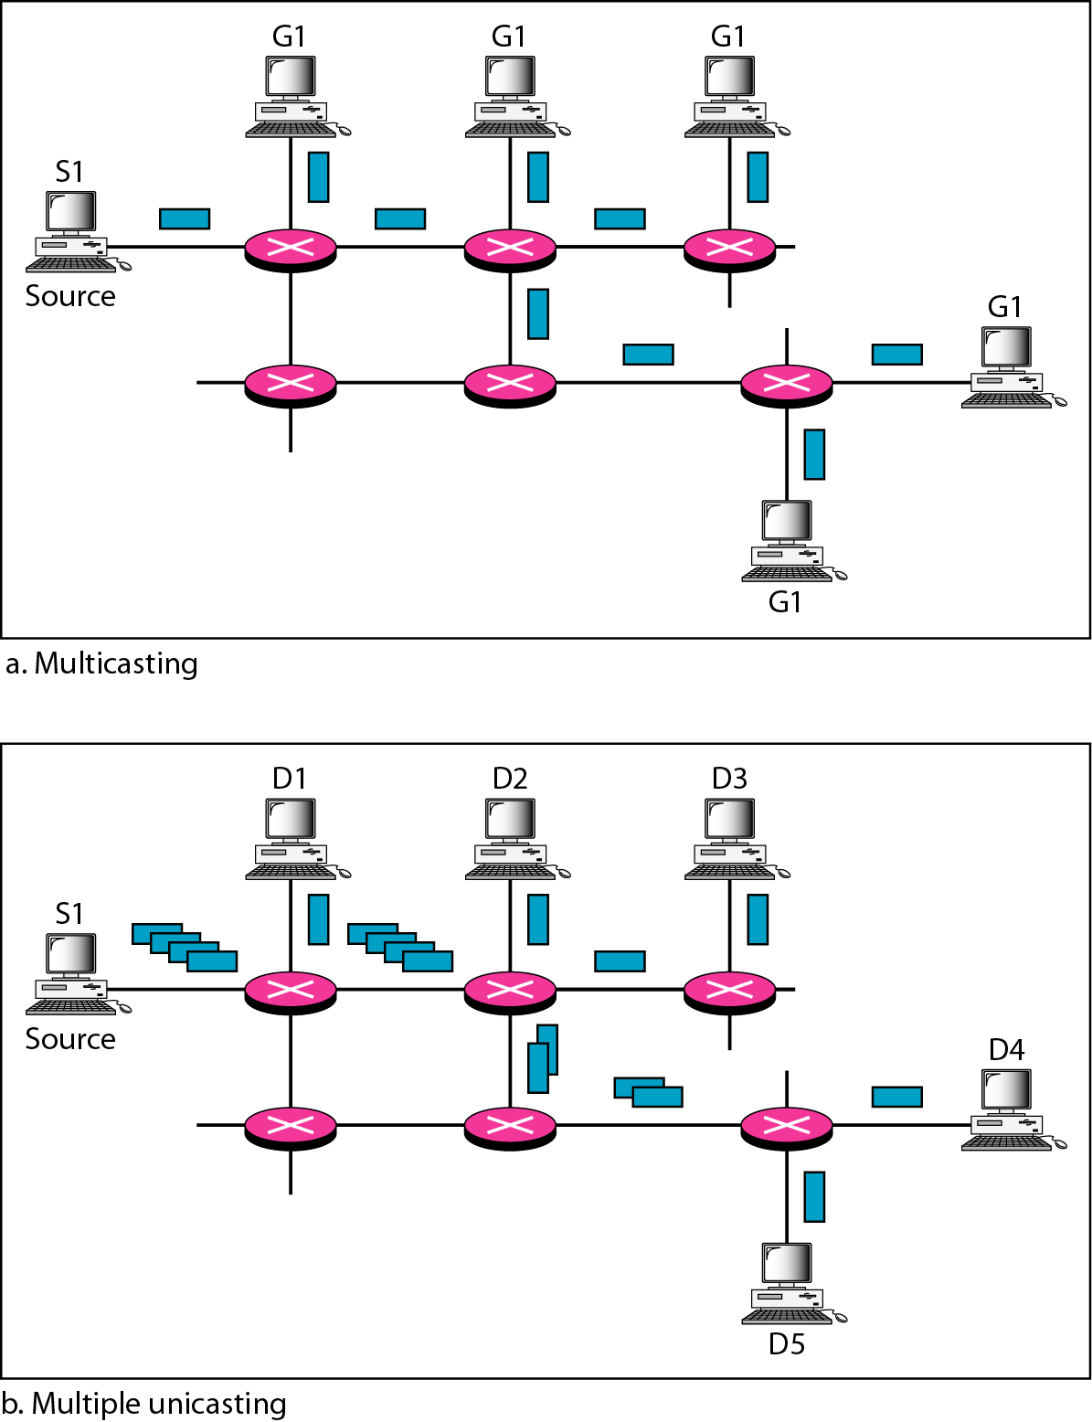
Figure 22.35 Multicasting versus multiple unicasting
Multicasting starts with one single packet from the source that is duplicated by the routers.
The destination address in each packet is the same for all duplicates. Note that
only one single copy of the packet travels between any two routers.
In multiple unicasting, several packets start from the source. If there are five destinations, for example, the source sends five packets, each with a different unicast destination address. Note that there may be multiple copies traveling between two routers.

Slide 82
Emulation of Multicasting with Unicasting
You might wonder why we have a separate mechanism for multicasting, when it can be emulated with unicasting. There are two obvious reasons for this.
1. Multicasting is more efficient than multiple unicasting. In Figure 22.35, we can see how multicasting requires less bandwidth than does multiple unicasting. In multiple unicasting, some of the links must handle several copies.
2. In multiple unicasting, the packets are created by the source with a relative delay between packets. If there are 1000 destinations, the delay between the first and the last packet may be unacceptable. In multicasting, there is no delay because only one packet is created by the source.

Slide 83
Note
In unicast routing, each router in the domain has a table that defines
a shortest path tree to possible destinations.

Slide 84
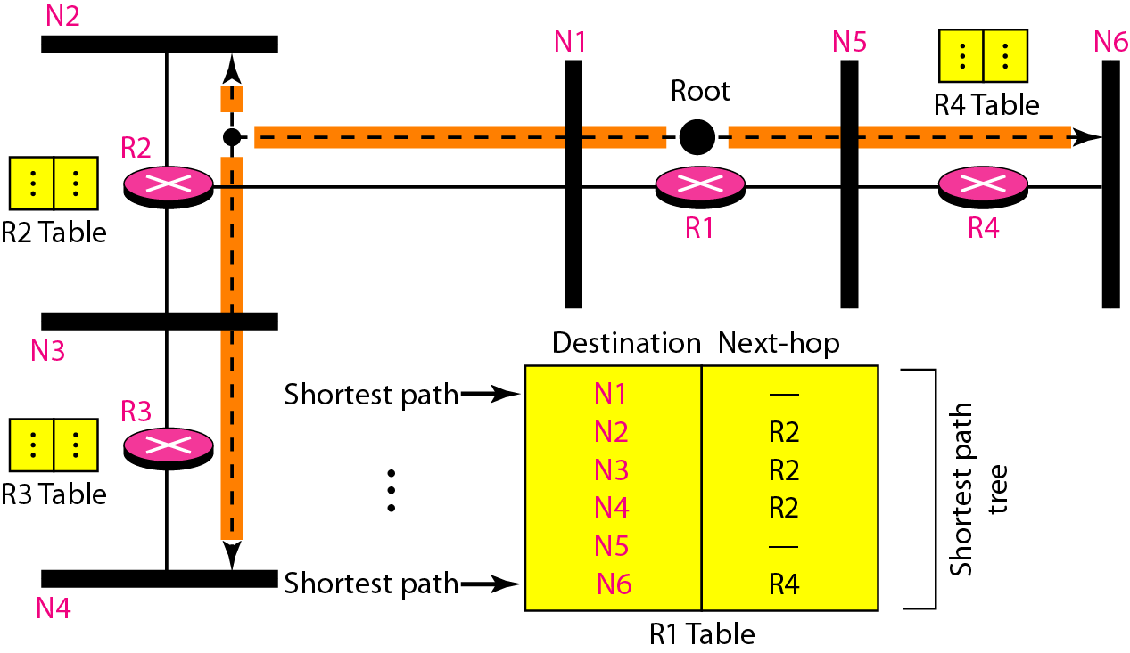
Figure 22.36 Shortest path tree in unicast routing

Slide 85
Multicast Routing
When a router receives a multicast packet, the situation is different from when it receives a unicast packet.
A multicast packet may have destinations in more than one network.
Forwarding of a single packet to members of a group requires a shortest path tree. If we have n groups, we may need n shortest path trees. We can imagine the complexity of multicast routing.
Two approaches have been used to solve the problem: source-based trees and group-shared trees.

Slide 86
Note
In multicast routing, each involved router needs to construct
a shortest path tree for each group.

Slide 87
Source-Based Tree
In the source-based tree approach, each router needs to have one shortest path tree for each group. The shortest path tree for a group defines the next hop for each network that has loyal member(s) for that group.
In Figure 22.37, we assume that we have only five groups in the domain: G1, G2, G3, G4, and G5.
At the moment GI has loyal members in four networks, G2 in three, G3 in two, G4 in two, and G5 in two. We have shown the names of the groups with loyal members on each network.
Figure 22.37 also shows the multicast routing table for router R1. There is one shortest path tree for each group; therefore there are five shortest path trees for five groups.
If router R1 receives a packet with destination address G1, it needs to send a copy of the packet to the attached network, a copy to router R2, and a copy to router R4 so that all members of G1 can receive a copy.
In this approach, if the number of groups is m, each router needs to have m shortest path trees, one for each group.
We can imagine the complexity of the routing table if we have hundreds or thousands of groups. However, we will show how different protocols manage to alleviate the situation.

Slide 88
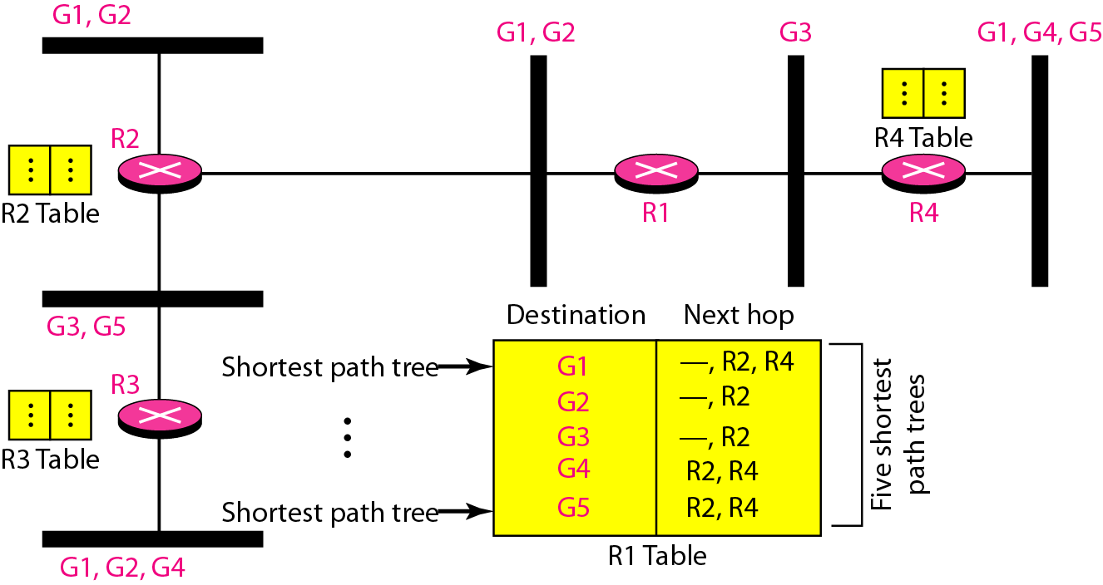
Figure 22.37 Source-based tree approach

Slide 89
Note
In the source-based tree approach, each router needs to have one shortest path tree for each group.

Slide 90
Group-Shared Tree
In the group-shared tree approach, instead of each router having m shortest path trees, only one designated router, called the center core, or rendezvous router, takes the responsibility of distributing multicast traffic.
The core has m shortest path trees in its routing table.
The rest of the routers in the domain have none.
If a router receives a multicast packet, it encapsulates the packet in a unicast packet and sends it to the core router.
The core router removes the multicast packet from its capsule, and consults its routing table to route the packet. Figure 22.38 shows the idea.

Slide 91
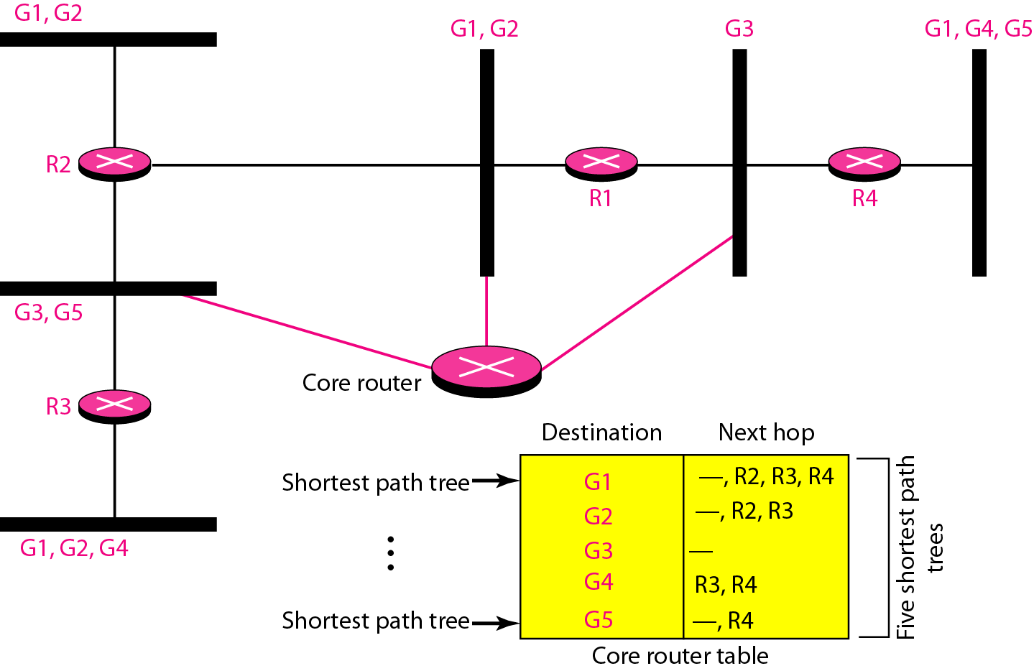
Figure 22.38 Group-shared tree approach

Slide 92
Note
In the group-shared tree approach, only the core router, which has a shortest path tree for each group, is involved in multicasting.

Slide 93
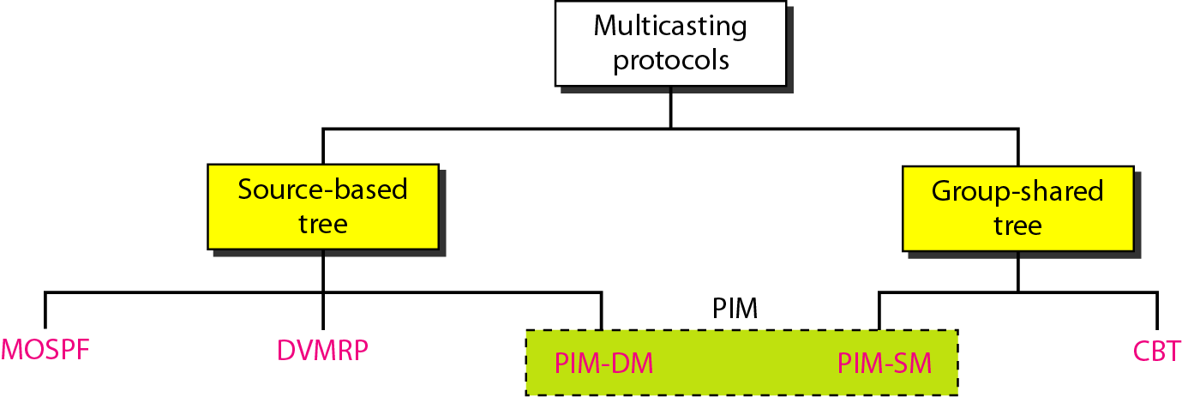
Figure 22.39 Taxonomy of common multicast protocols

Slide 94
Multicast Link State Routing: MOSPF
Multicast link state routing is a direct extension of unicast routing and uses a source-based tree approach.
Although unicast routing is quite involved, the extension to multicast routing is very simple and straightforward.
For multicast routing, a node needs to revise the interpretation of state. A node advertises every group which has any loyal member on the link. Here the meaning of state is "what groups are active on this link."
The information about the group comes from IGMP. Each router running IGMP solicits the hosts on the link to find out the membership status.
When a router receives all these LSPs, it creates n (n is the number of groups) topologies, from which n shortest path trees are made by using Dijkstra's algorithm. So each router has a routing table that represents as many shortest path trees as there are groups.
The only problem with this protocol is the time and space needed to create and save the many shortest path trees.
The solution is to create the trees only when needed. When a router receives a packet with a multicast destination address, it runs the Dijkstra algorithm to calculate the shortest path tree for that group. The result can be cached in case there are additional packets for that destination.

Slide 95
Note
Multicast link state routing uses the source-based tree approach.

Slide 96
Note
Flooding broadcasts packets, but creates loops in the systems.

Slide 97
Note
RPF eliminates the loop in the flooding process.

Slide 98
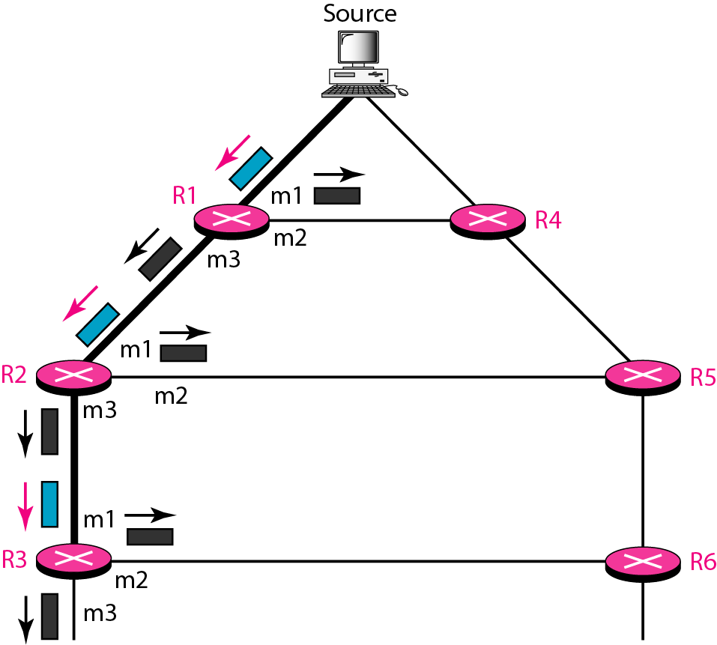
Figure 22.40 Reverse path forwarding (RPF)

Slide 99
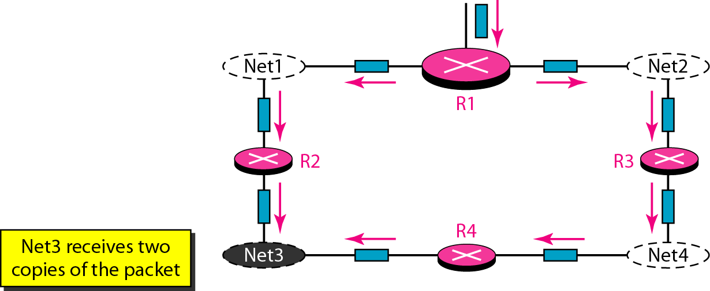
Figure 22.41 Problem with RPF

Slide 100
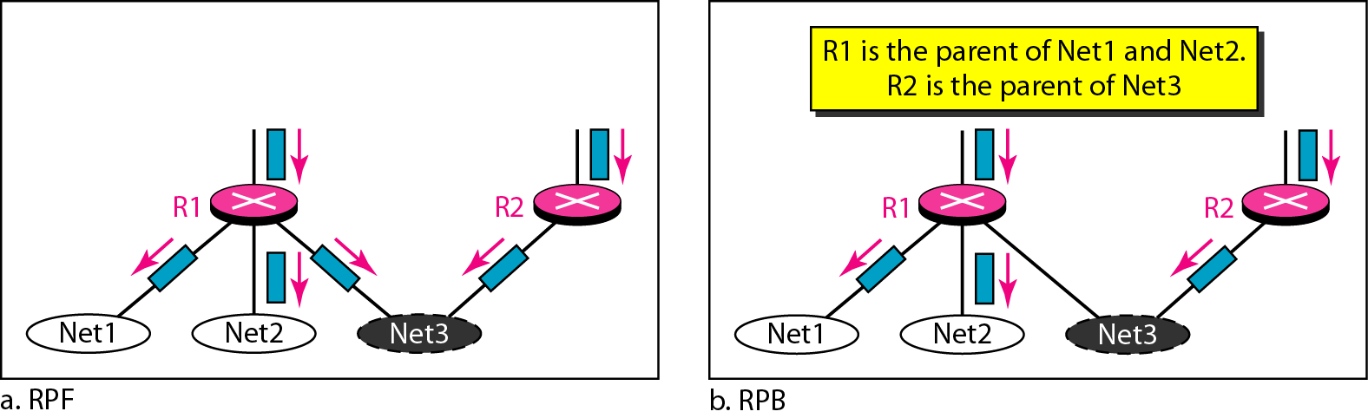
Figure 22.42 RPF Versus RPB

Slide 101
Note
RPB creates a shortest path broadcast tree from the source to each destination.
It guarantees that each destination receives one and only one copy of the packet.

Slide 102
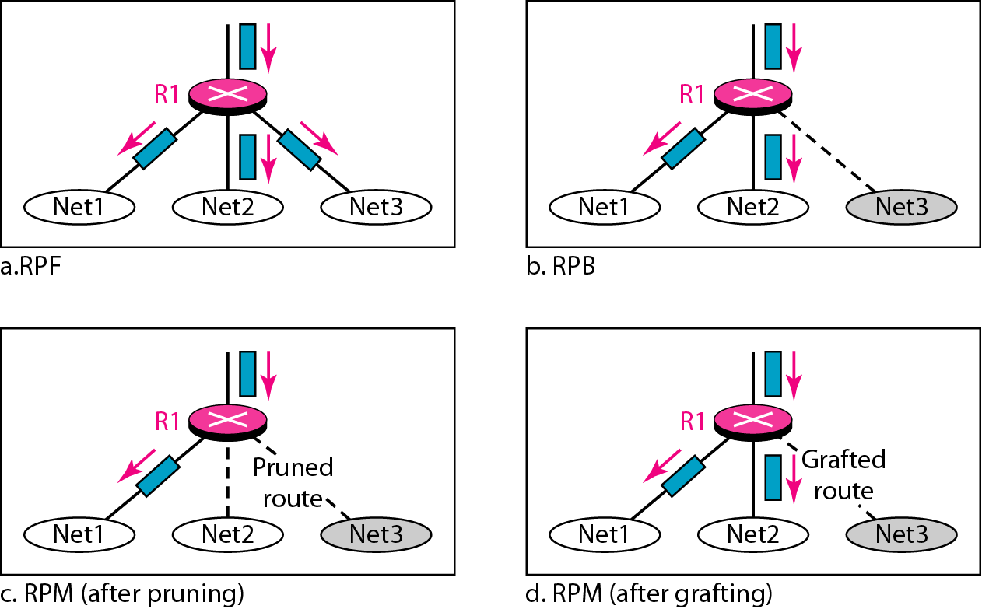
Figure 22.43 RPF, RPB, and RPM

Slide 103
Note
RPM adds pruning and grafting to RPB to create a multicast shortest
path tree that supports dynamic membership changes.

Slide 104
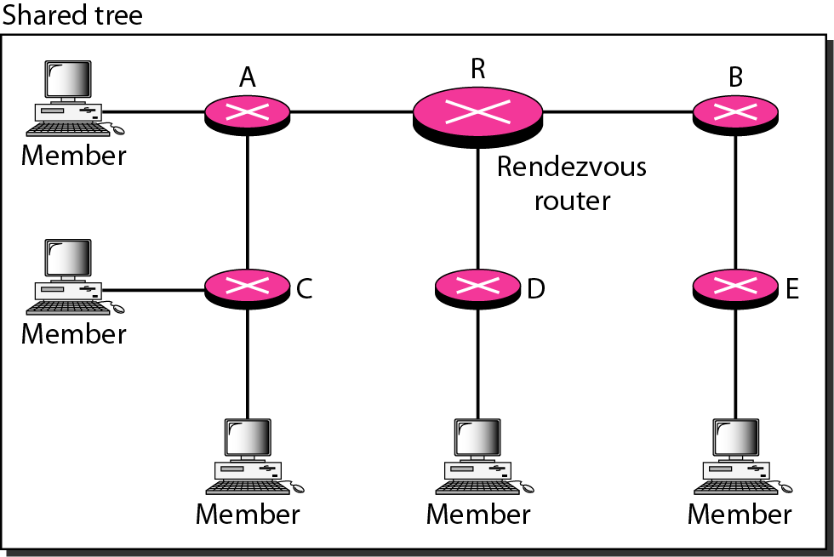
Figure 22.44 Group-shared tree with rendezvous router

Slide 105
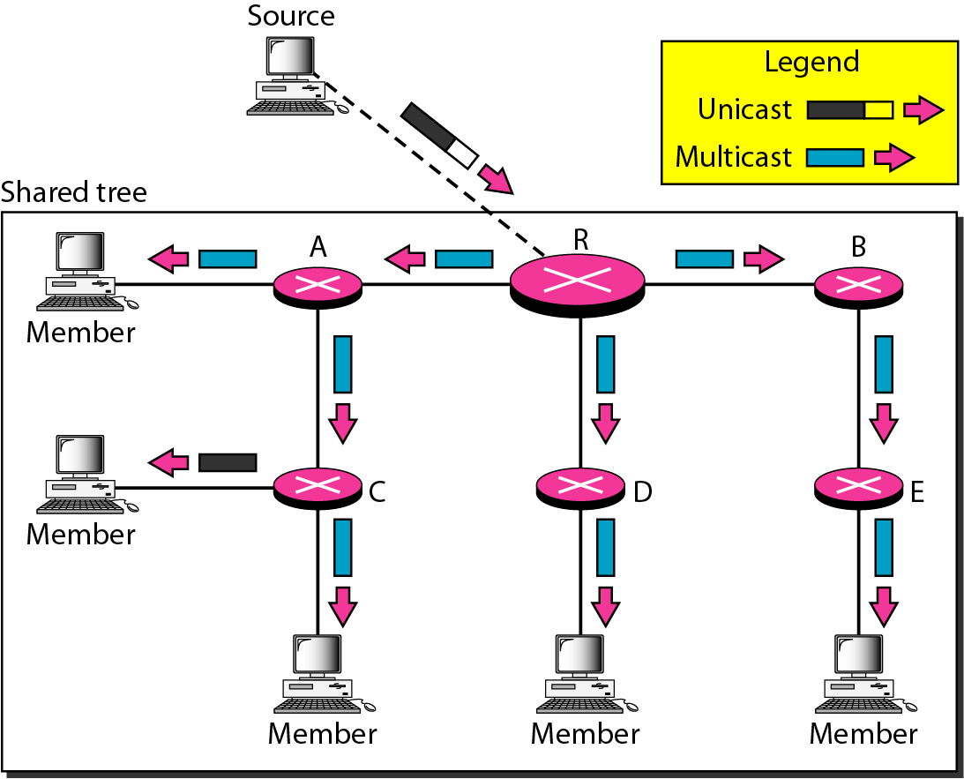
Figure 22.45 Sending a multicast packet to the rendezvous router

Slide 106
Note
In CBT, the source sends the multicast packet (encapsulated in a unicast packet) to the core router. The core router decapsulates the packet and forwards it to all interested interfaces.

Slide 107
Note
PIM-DM is used in a dense multicast environment, such as a LAN.

Slide 108
Note
PIM-DM uses RPF and pruning and grafting strategies to handle multicasting.
However, it is independent of the undeR1ying unicast protocol.

Slide 109
Note
PIM-SM is used in a sparse multicast environment such as a WAN.

Slide 110
Note
PIM-SM is similar to CBT but uses a simpler procedure.

Slide 111
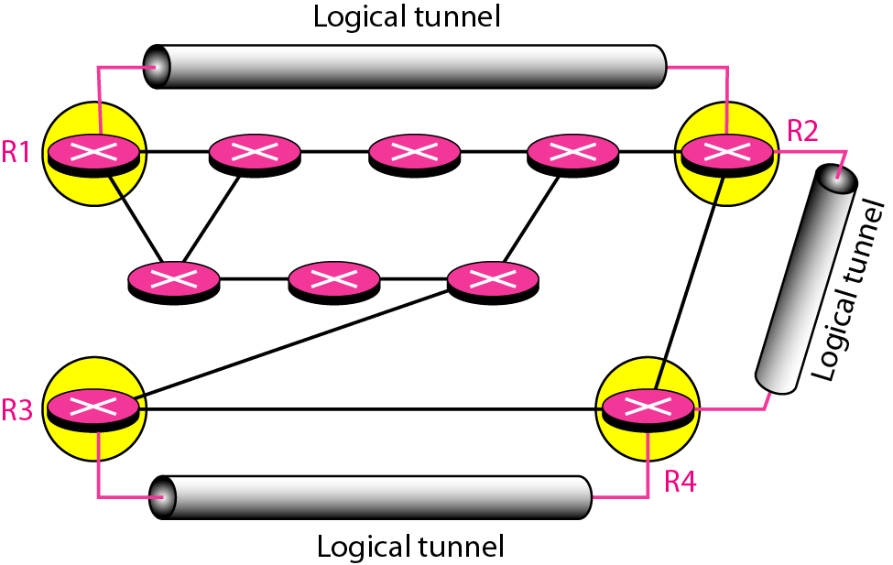
Figure 22.46 Logical tunneling

Slide 112
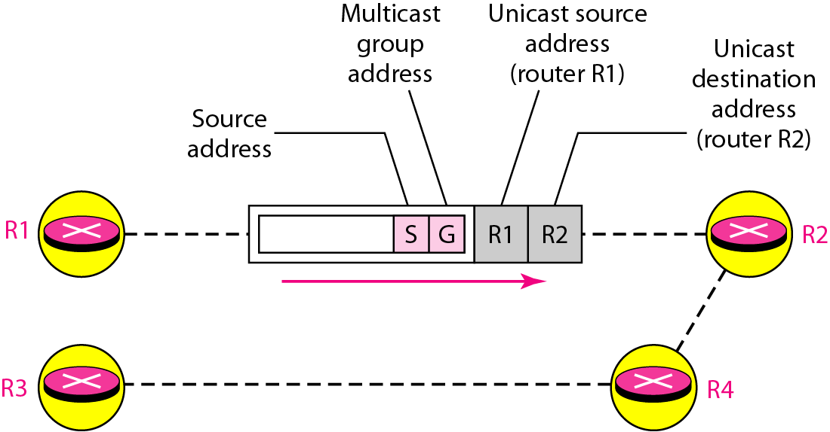
Figure 22.47 MBONE

Slide 113
What have we completed?
Thank You
Direct Versus Indirect Delivery
Forwarding Techniques & Forwarding Process
Routing Table
Distance Vector Routing and RIP
Link State Routing and OSPF
Path Vector Routing and BGP
MOSPF
Reverse path forwarding

