Slide 1
Transport Layer: Process to Process Delivery (UDP, TCP)
By dr. R. K. Ojha
Lecture-36-37
( Chapter 23 )

Slide 2
Topics to be discussed
Well-Known Ports for UDP
User Datagram
Checksum
UDP Operation
Use of UDPTCP Services
TCP Features
Segment
A TCP Connection
Flow Control
Error Control

Slide 3

Note
The transport layer is responsible for process-to-process delivery.

Slide 4
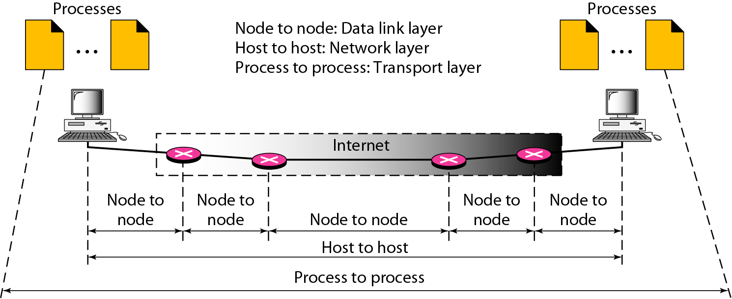
Figure 23.1 Types of data deliveries

Slide 5
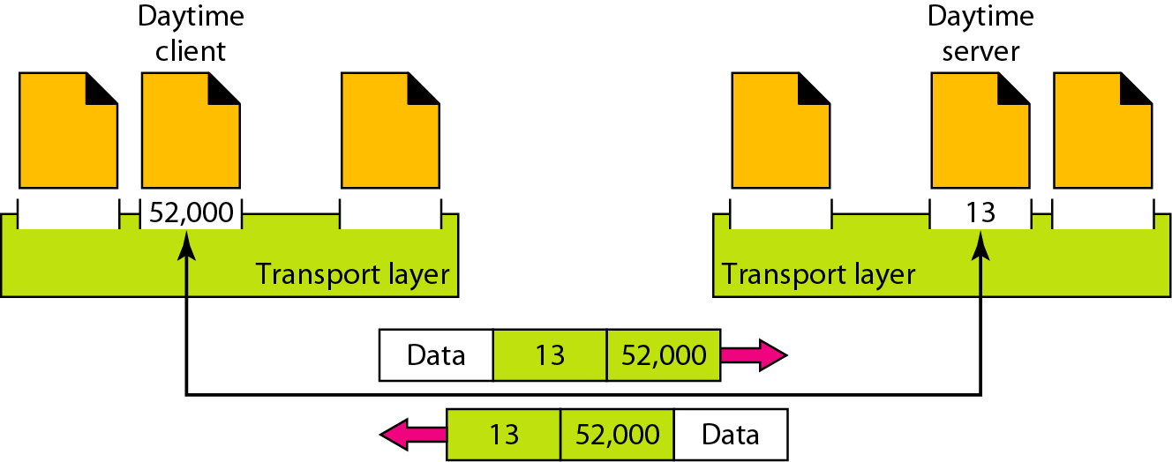
Figure 23.2 Port numbers

Slide 6
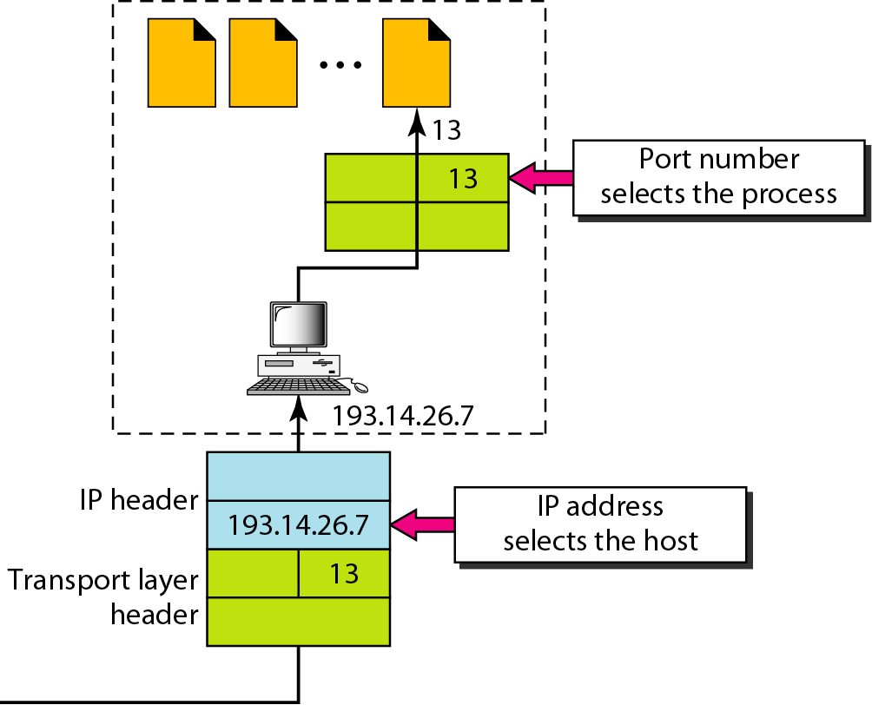
Figure 23.3 IP addresses versus port numbers

Slide 7
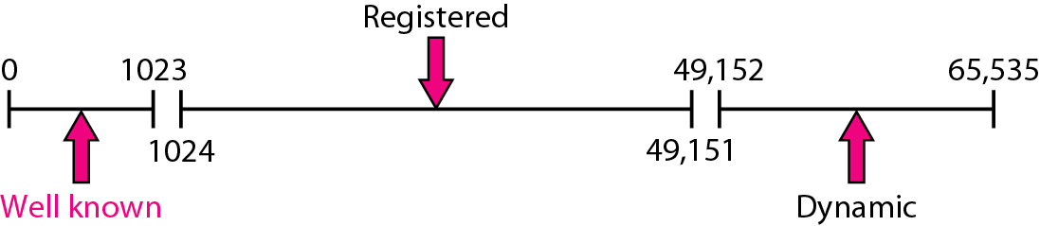
Figure 23.4 IANA ranges
The lANA (Internet Assigned Number Authority) has divided the port numbers into three ranges: well known, registered, and dynamic (or private), as shown in Figure 23.4.
Well-known ports. The ports ranging from 0 to 1023 are assigned and controlled by lANA. These are the well-known ports.
Registered ports. The ports ranging from 1024 to 49,151 are not assigned or controlled by lANA. They can only be registered with lANA to prevent duplication.
Dynamic ports. The ports ranging from 49,152 to 65,535 are neither controlled nor registered. They can be used by any process. These are the ephemeral ports.

Slide 8
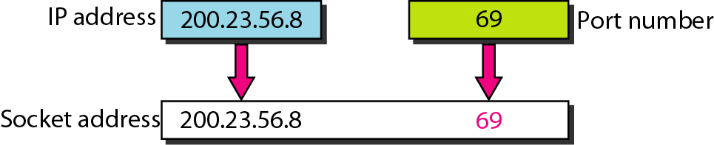
Figure 23.5 Socket address
* The combination of an IP address and a port number is called a socket address.

Slide 9
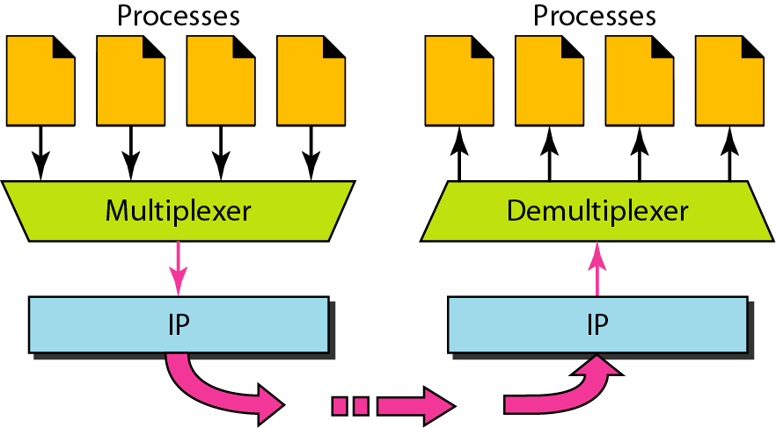
Figure 23.6 Multiplexing and demultiplexing

Slide 10
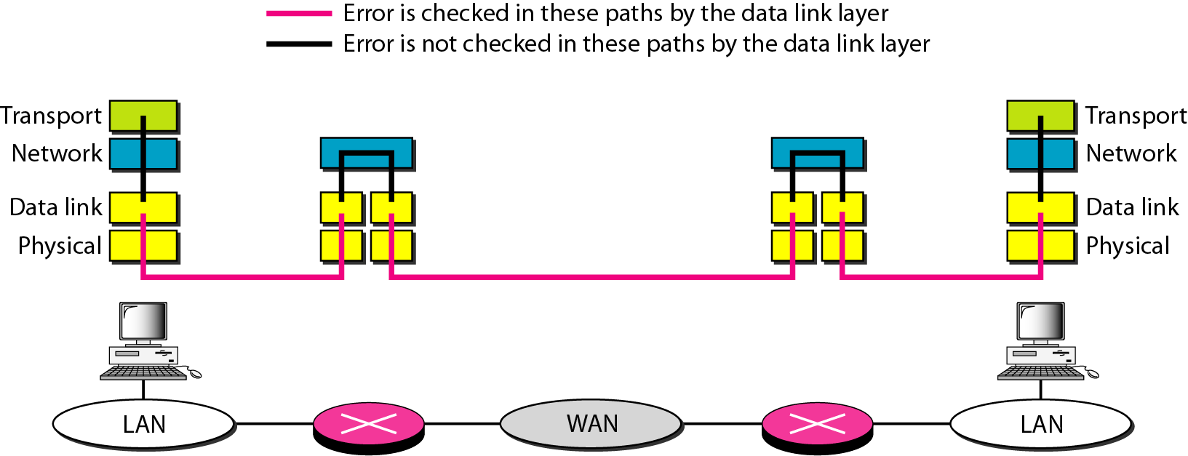
Figure 23.7 Error control

Slide 11
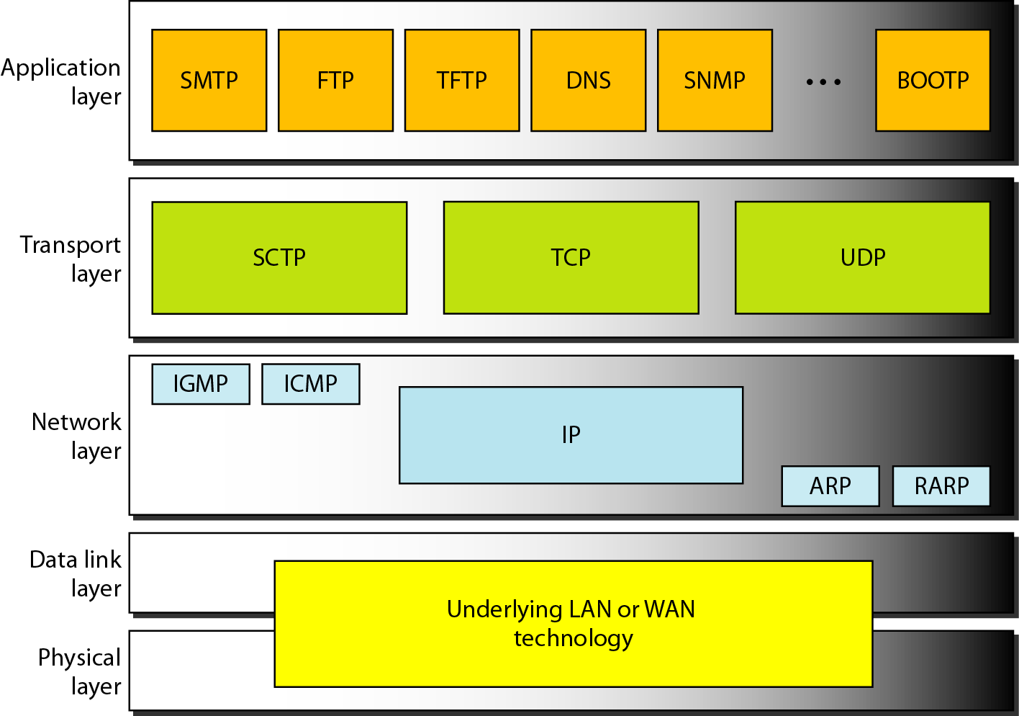
Figure 23.8 Position of UDP, TCP, and SCTP in TCP/IP suite

Slide 12
USER DATAGRAM PROTOCOL (UDP)
The User Datagram Protocol (UDP) is called a connectionless, unreliable transport protocol.
It does not add anything to the services of IP except to provide process-to-process communication instead of host-to-host communication.
Topics discussed in this section:
Well-Known Ports for UDP User Datagram
Checksum
UDP Operation
Use of UDP

Slide 13
Table 23.1 Well-known ports used with UDP

Slide 14
Example 23.1
In UNIX, the well-known ports are stored in a file called /etc/services. Each line in this file gives the name of the server and the well-known port number. We can use the
grep utility to extract the line corresponding to the desired application. The following shows the port for FTP. Note that FTP can use port 21 with either UDP or TCP.

Slide 15
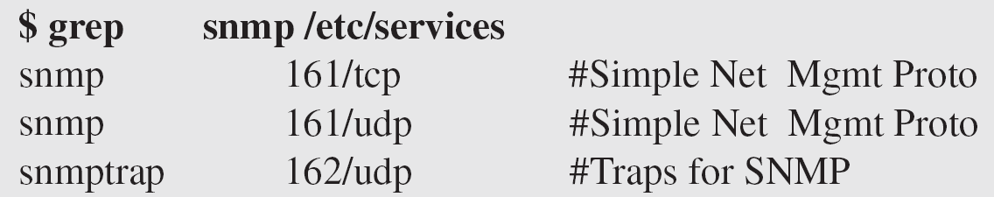
Example 23.1 (continued)
SNMP uses two port numbers (161 and 162), each for a different purpose, as we will see in Chapter 28.

Slide 16
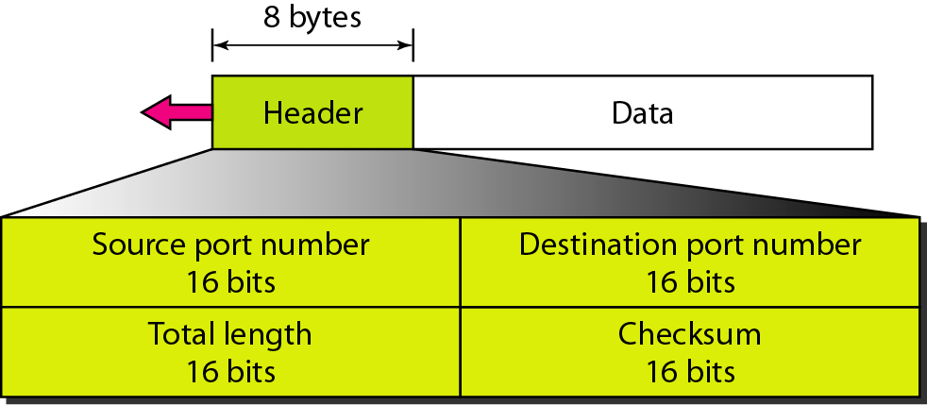
Figure 23.9 User datagram format

Slide 17
Fields in a user Datagram
Source port number. This is the port number is 16 bits long number used by the process running on the source host which ranges from 0 to 65,535. If the source host is the client (a client sending a request), the port number, in most cases, is an ephemeral port number requested by the process and chosen by the UDP software running on the source host. If the source host is the server (a server sending a response), the port number, in most cases, is a well-known port number.
Destination port number. This is the port number used by the process running on the destination host. It is also 16 bits long. If the destination host is the server (a client sending a request), the port number, in most cases, is a well-known port number. If the destination host is the client (a server sending a response), the port number, in most cases, is an ephemeral port number. In this case, the server copies the ephemeral port number it has received in the request packet.
Length. This is a 16-bit field that defines the total length of the user datagram, header plus data. The 16 bits can define a total length of 0 to 65,535 bytes. However, the total length needs to be much less because a UDP user datagram is stored in an IP datagram with a total length of 65,535 bytes.
Checksum. This field is used to detect errors over the entire user datagram (header plus data).

Slide 18
Note
UDP length = IP length – IP header’s length

Slide 19
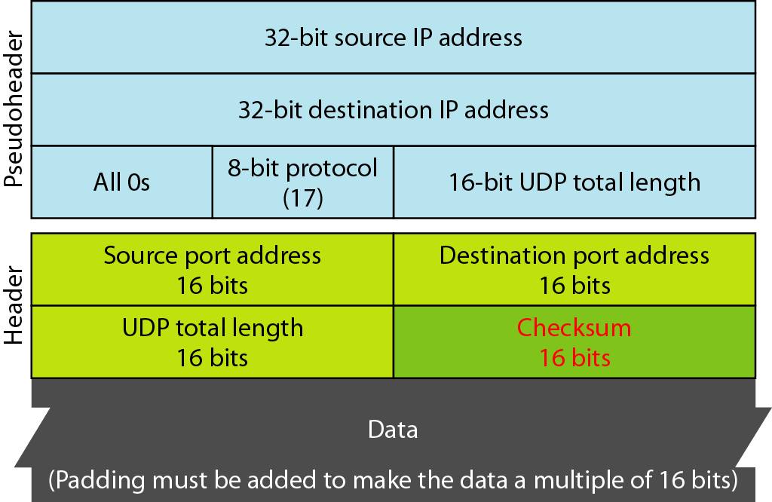
Figure 23.10 Pseudoheader for checksum calculation

Slide 20
Pseudoheader for checksum calculation
The UDP checksum calculation is different from the one for IP and ICMP. Here the checksum includes three sections: a pseudo-header, the UDP header, and the data coming from the application layer.
The pseudo-header is the part of the header of the IP packet in which the user datagram is to be encapsulated with some fields filled with 0s (see Figure 23.10).
If the checksum does not include the pseudo-header, a user datagram may arrive safe and sound. However, if the IP header is corrupted, it may be delivered to the wrong host.
The protocol field is added to ensure that the packet belongs to UDP, and not to other transport-layer protocols.
The value of the protocol field for UDP is 17. If this value is changed during transmission, the checksum calculation at the receiver will detect it and UDP drops the packet. It is not delivered to the wrong protocol.
The calculation of the checksum and its inclusion in a user datagram are optional. If the checksum is not calculated, the field is filled with 1s. Note that a calculated checksum can never be all 1s because this implies that the sum is all 0s, which is impossible because it requires that the value of fields to be 0s.

Slide 21
Example 23.2
Figure 23.11 shows the checksum calculation for a very small user datagram with only 7 bytes of data. Because the number of bytes of data is odd, padding is added for checksum calculation. The pseudo-header as well as the padding will be dropped when the user datagram is delivered to IP.

Slide 22
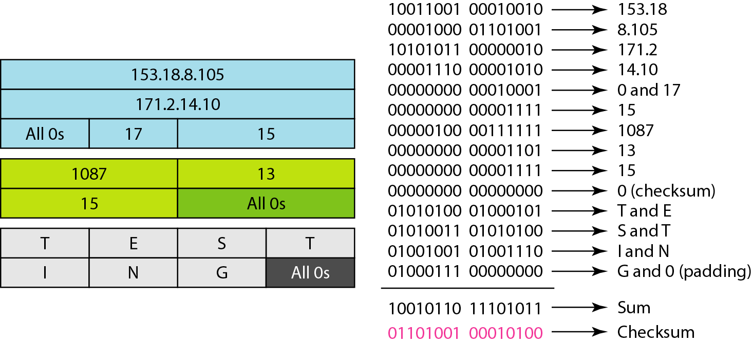
Figure 23.11 Checksum calculation of a simple UDP user datagram

Slide 23
Connectionless Services
UDP provides a connectionless service i.e. each user datagram sent by UDP is an independent datagram.
There is no relationship between the different user datagrams even if they are coming from the same source process and going to the same destination program.
The user datagrams are not numbered.
There is no connection establishment and no connection termination, as is the case for TCP. This means that each user datagram can travel on a different path.
One of the ramifications of being connectionless is that the process that uses UDP cannot send a stream of data to UDP and expect UDP to chop them into different related user datagrams.
Instead each request must be small enough to fit into one user datagram. Only those processes sending short messages should use UDP.
There is no flow control and hence no window mechanism. The receiver may overflow with incoming messages.
There is no error control mechanism in UDP except for the checksum. This means that the sender does not know if a message has been lost or duplicated.

Slide 24
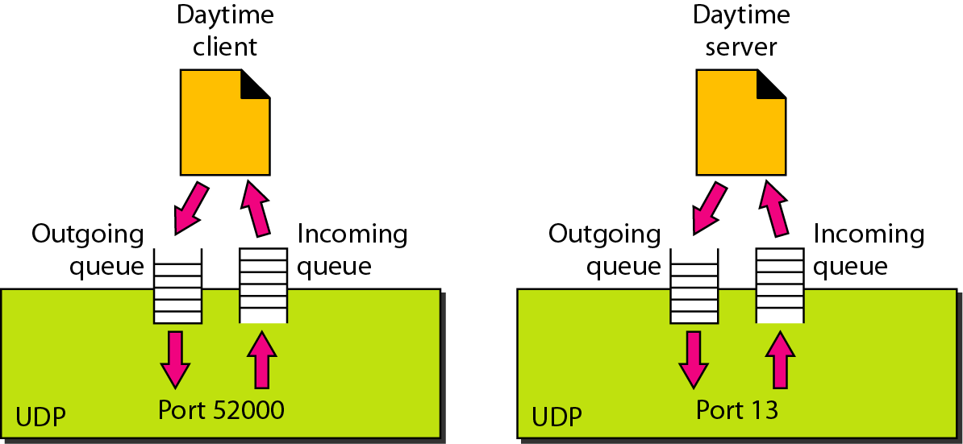
Figure 23.12 Queues in UDP

Slide 25
At the client site, when a process starts, it requests a port number from the operating system. Some implementations create both an incoming and an outgoing queue associated with each process and some implementations create only an incoming queue associated with each process.
Note that even if a process wants to communicate with multiple processes, it obtains only one port number and eventually one outgoing and one incoming queue.
The queues opened by the client are, in most cases, identified by ephemeral port numbers. The queues function as long as the process is running. When the process terminates, the queues are destroyed.
The client process can send messages to the outgoing queue by using the source port number specified in the request. UDP removes the messages one by one and, after adding the UDP header, delivers them to IP.
If an outgoing queue overflow the operating system can ask the client process to wait before sending any more messages.
When a message arrives for a client, UDP checks to see if an incoming queue has been created for the port number specified in the destination port number field of the user datagram.
If there is such a queue, UDP sends the received user datagram to the end of the queue.
If there is no such queue, UDP discards the user datagram and asks the ICMP protocol to send a port unreachable message to the server.
All the incoming messages for one particular client program, whether coming from the same or a different server, are sent to the same queue.
An incoming queue can overflow. If this happens, UDP drops the user datagram and asks for a port unreachable message to be sent to the server.

Slide 26
23-3 TCP
TCP is a connection-oriented protocol; it creates a virtual connection between two TCPs to send data. In addition, TCP uses flow and error control mechanisms at the transport level.
Topics discussed in this section:
TCP Services TCP Features
Segment
A TCP Connection
Flow Control
Error Control

Slide 27
Table 23.2 Well-known ports used by TCP

Slide 28
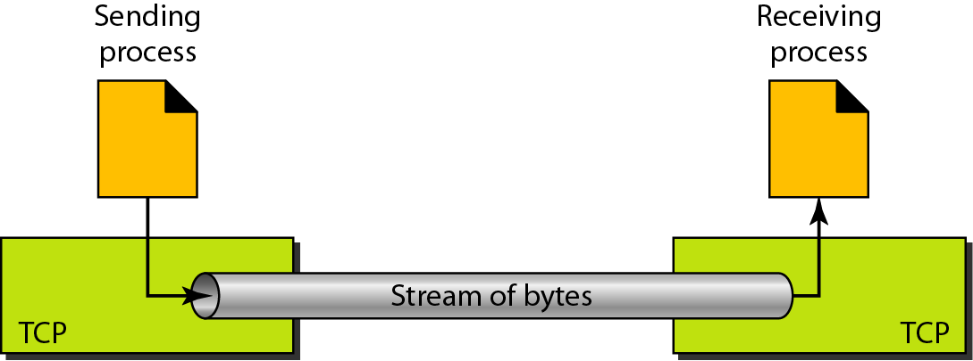
Figure 23.13 Stream delivery

Slide 29
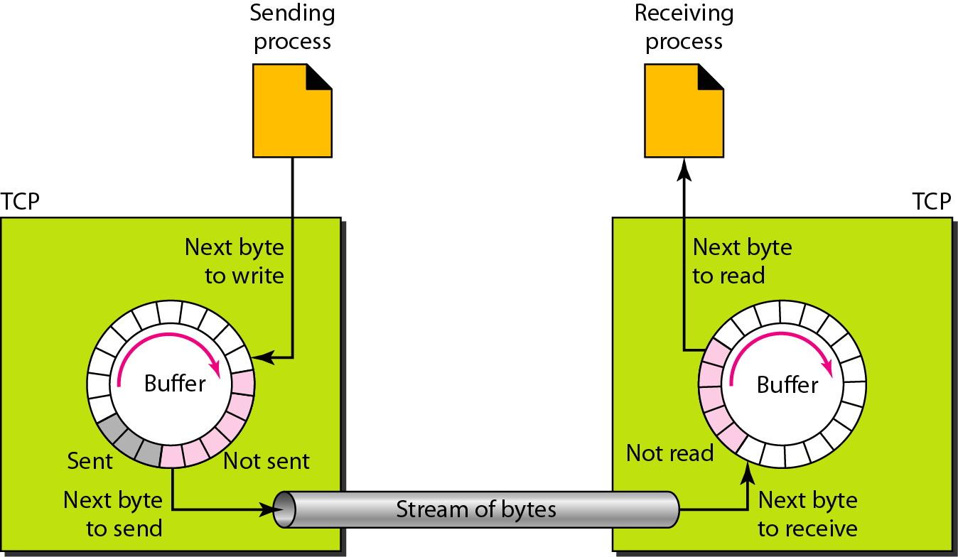
Figure 23.14 Sending and receiving buffers

Slide 30
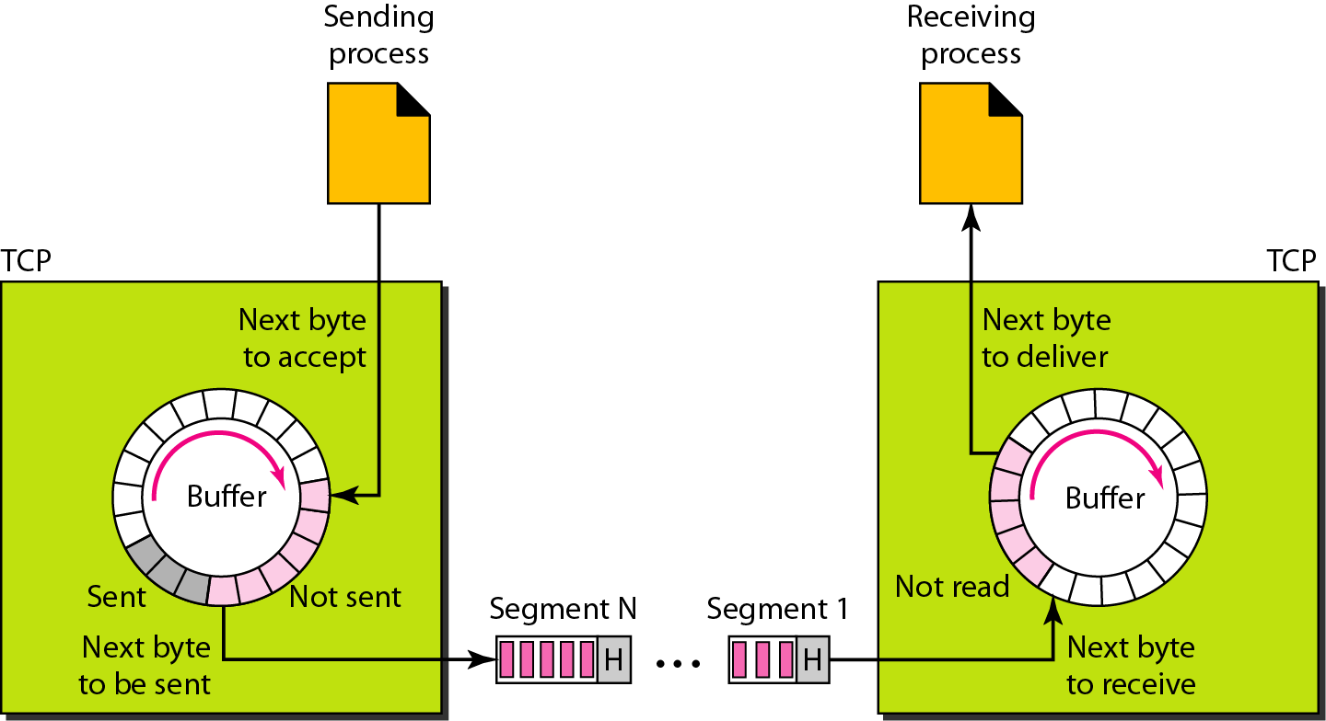
Figure 23.15 TCP segments

Slide 31
Note
The bytes of data being transferred in each connection are numbered by TCP.
The numbering starts with a randomly generated number.

Slide 32
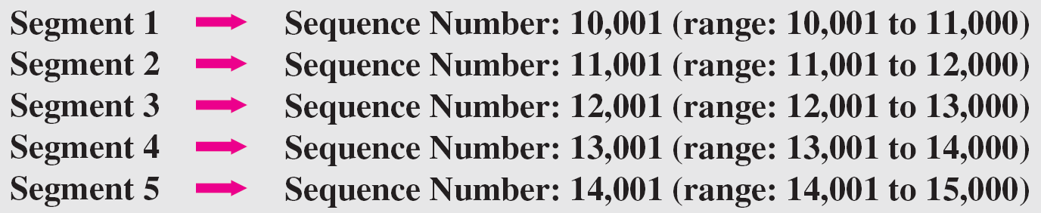
Example 23.3
The following shows the sequence number for each segment:

Slide 33
Note
The value in the sequence number field of a segment defines the
number of the first data byte contained in that segment.

Slide 34
Note
The value of the acknowledgment field in a segment defines
the number of the next byte a party expects to receive.
The acknowledgment number is cumulative.

Slide 35
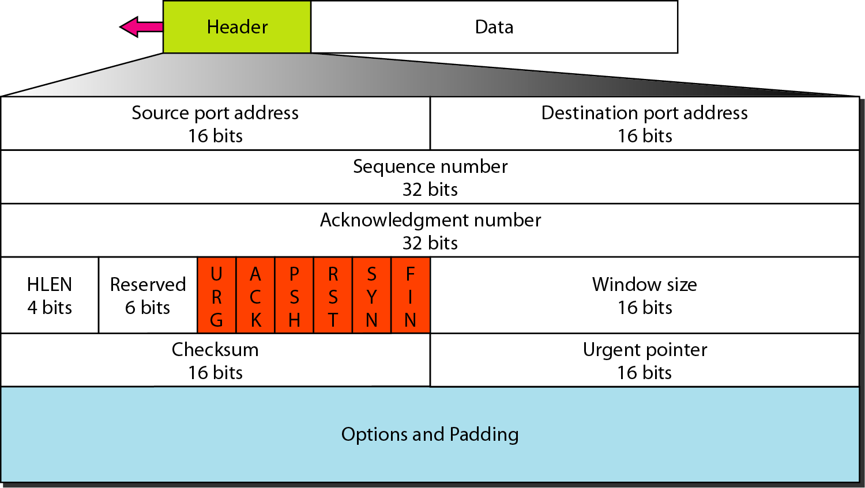
Figure 23.16 TCP segment format

Slide 36
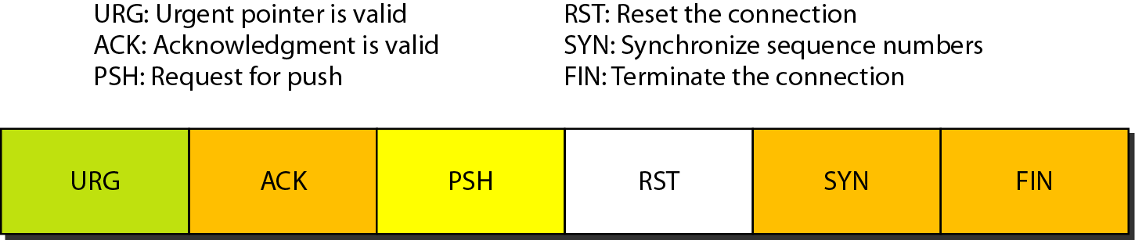
Figure 23.17 Control field

Slide 37
Table 23.3 Description of flags in the control field

Slide 38
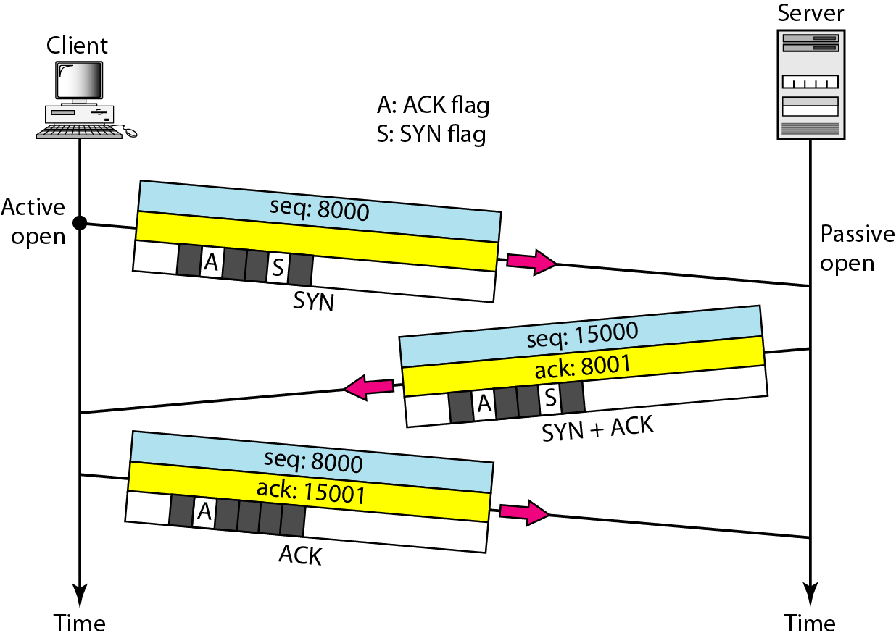
Figure 23.18 Connection establishment using three-way handshaking

Slide 39
Note
A SYN segment cannot carry data, but it consumes one sequence number.

Slide 40
Note
A SYN + ACK segment cannot carry data, but does consume one sequence number.

Slide 41
Note
An ACK segment, if carrying no data, consumes no sequence number.

Slide 42
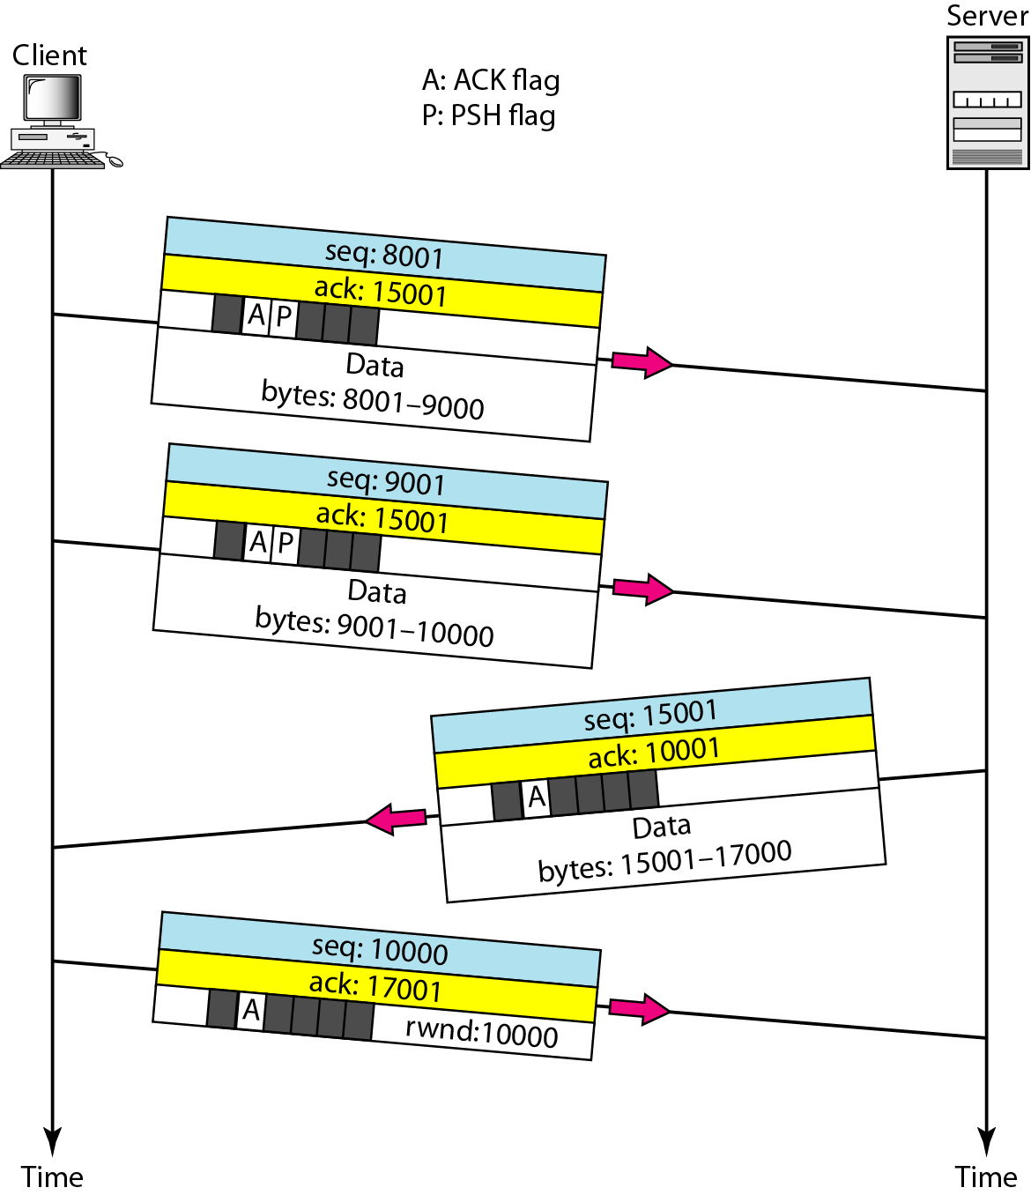
Figure 23.19 Data transfer

Slide 43
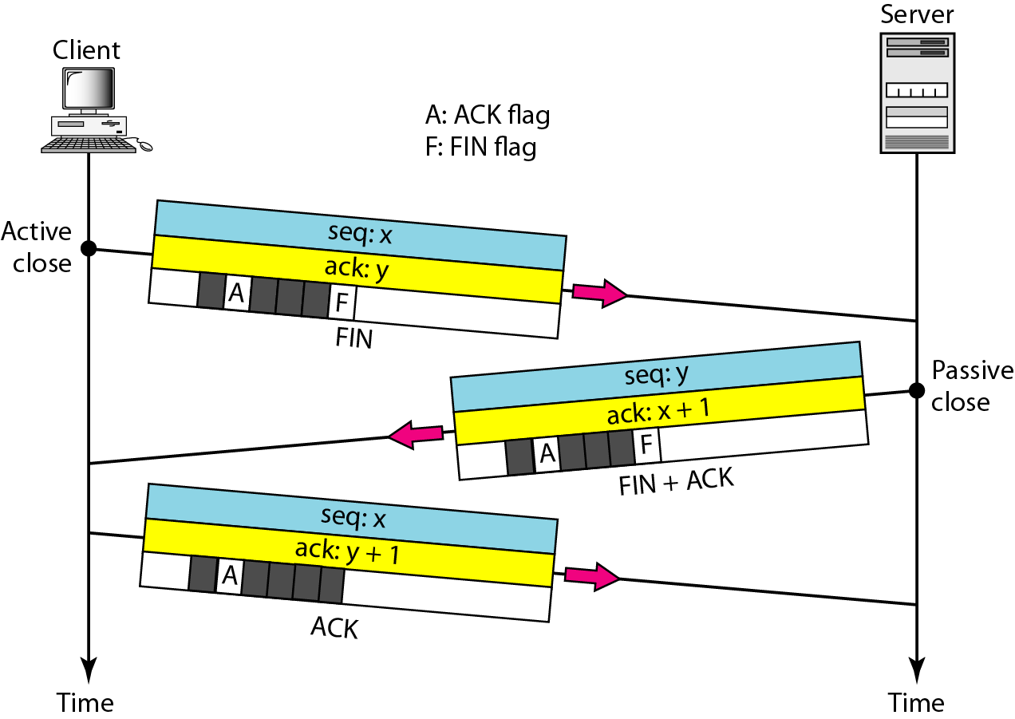
Figure 23.20 Connection termination using three-way handshaking

Slide 44
Note
The FIN segment consumes one sequence number if it does not carry data.

Slide 45
Note
The FIN + ACK segment consumes one sequence number if it does not carry data.

Slide 46
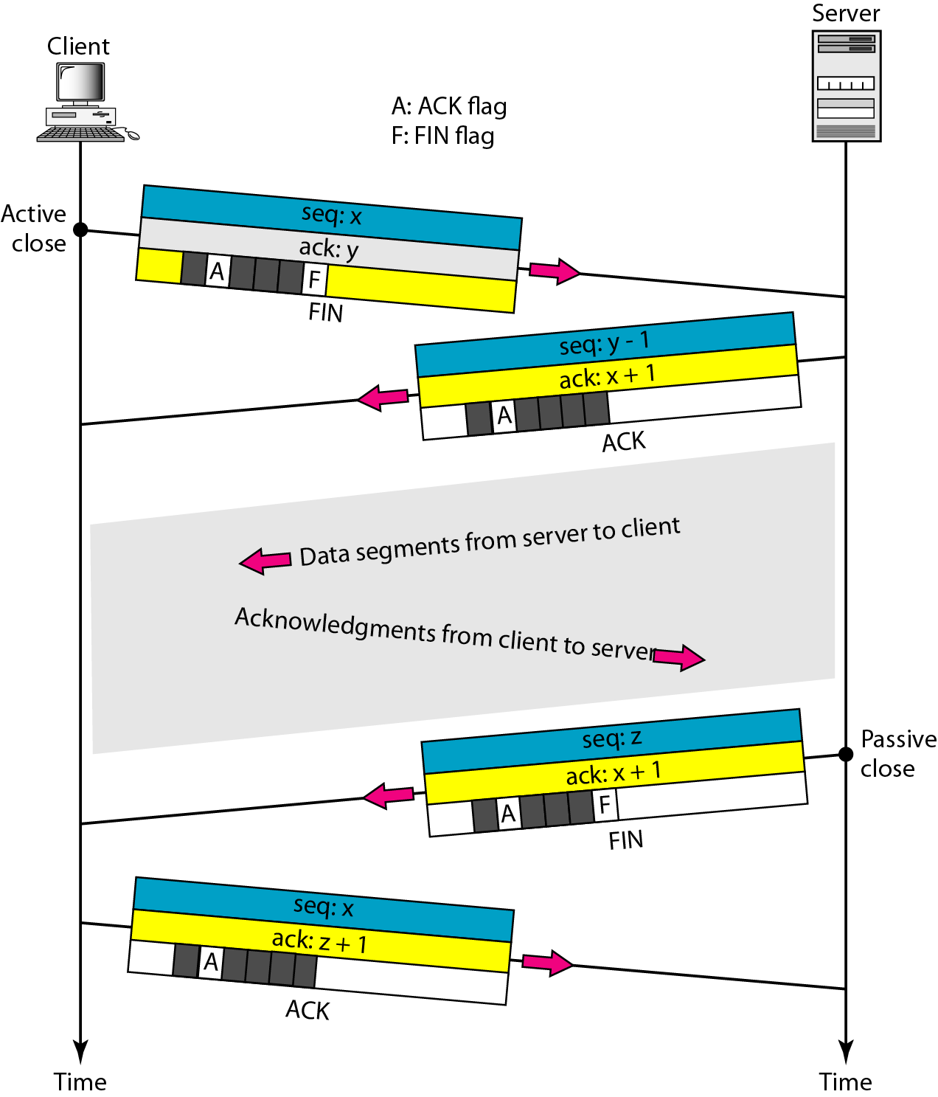
Figure 23.21 Half-close

Slide 47
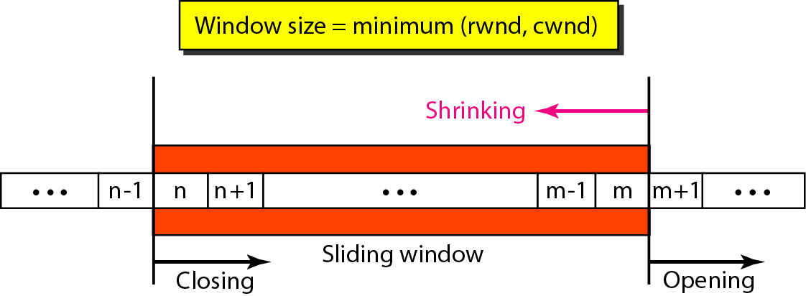
Figure 23.22 Sliding window

Slide 48
Note
A sliding window is used to make transmission more efficient as well as
to control the flow of data so that the destination does not become
overwhelmed with data. TCP sliding windows are byte-oriented.

Slide 49
Example 23.4
What is the value of the receiver window (rwnd) for host A if the receiver, host B, has a buffer size of 5000 bytes and 1000 bytes of received and unprocessed data?
Solution
The value of rwnd = 5000 − 1000 = 4000. Host B can receive only 4000 bytes of data before overflowing its buffer. Host B advertises this value in its next segment to A.

Slide 50
Example 23.5
What is the size of the window for host A if the value of rwnd is 3000 bytes and the value of cwnd is 3500 bytes?
Solution
The size of the window is the smaller of rwnd and cwnd, which is 3000 bytes.

Slide 51
Example 23.6
Figure 23.23 shows an unrealistic example of a sliding window. The sender has sent bytes up to 202. We assume that cwnd is 20 (in reality this value is thousands of bytes). The receiver has sent an acknowledgment number of 200 with an rwnd of 9 bytes (in reality this value is thousands of bytes). The size of the sender window is the minimum of rwnd and cwnd, or 9 bytes. Bytes 200 to 202 are sent, but not acknowledged. Bytes 203 to 208 can be sent without worrying about acknowledgment. Bytes 209 and above cannot be sent.

Slide 52
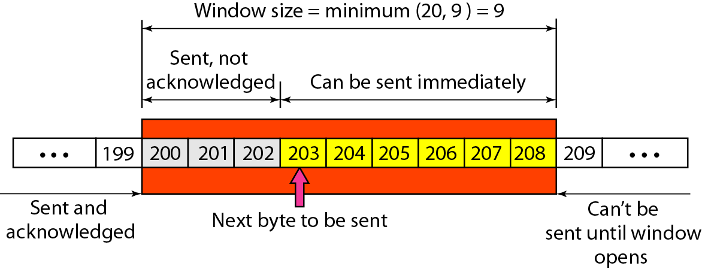
Figure 23.23 Example 23.6

Slide 53
Note
Some points about TCP sliding windows:
❏ The size of the window is the lesser of rwnd and cwnd.
❏ The source does not have to send a full window’s worth of data.
❏ The window can be opened or closed by the receiver, but should not be shrunk.
❏ The destination can send an acknowledgment at any time as long as it does not result in a shrinking window.
❏ The receiver can temporarily shut down the window; the sender, however, can always send a segment of 1 byte after the window is shut down.

Slide 54
Note
ACK segments do not consume sequence numbers and are not acknowledged.

Slide 55
Note
In modern implementations, a retransmission occurs if the retransmission timer expires or three duplicate ACK segments have arrived.

Slide 56
Note
No retransmission timer is set for an ACK segment.

Slide 57
Note
Data may arrive out of order and be temporarily stored by the receiving TCP,
but TCP guarantees that no out-of-order segment is delivered to the process.

Slide 58
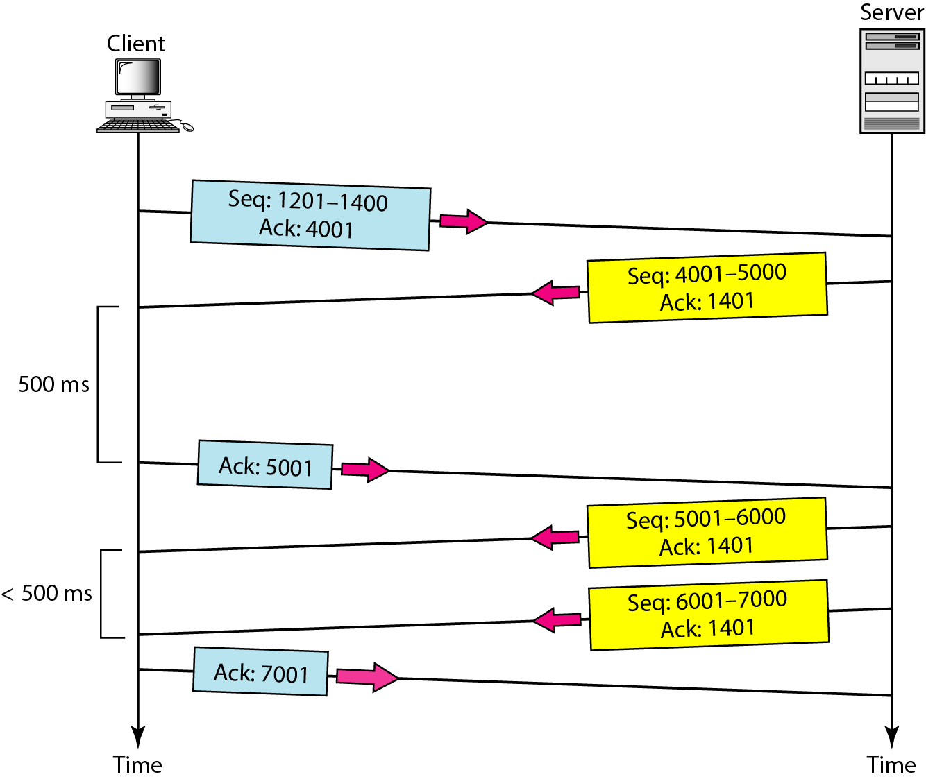
Figure 23.24 Normal operation

Slide 59
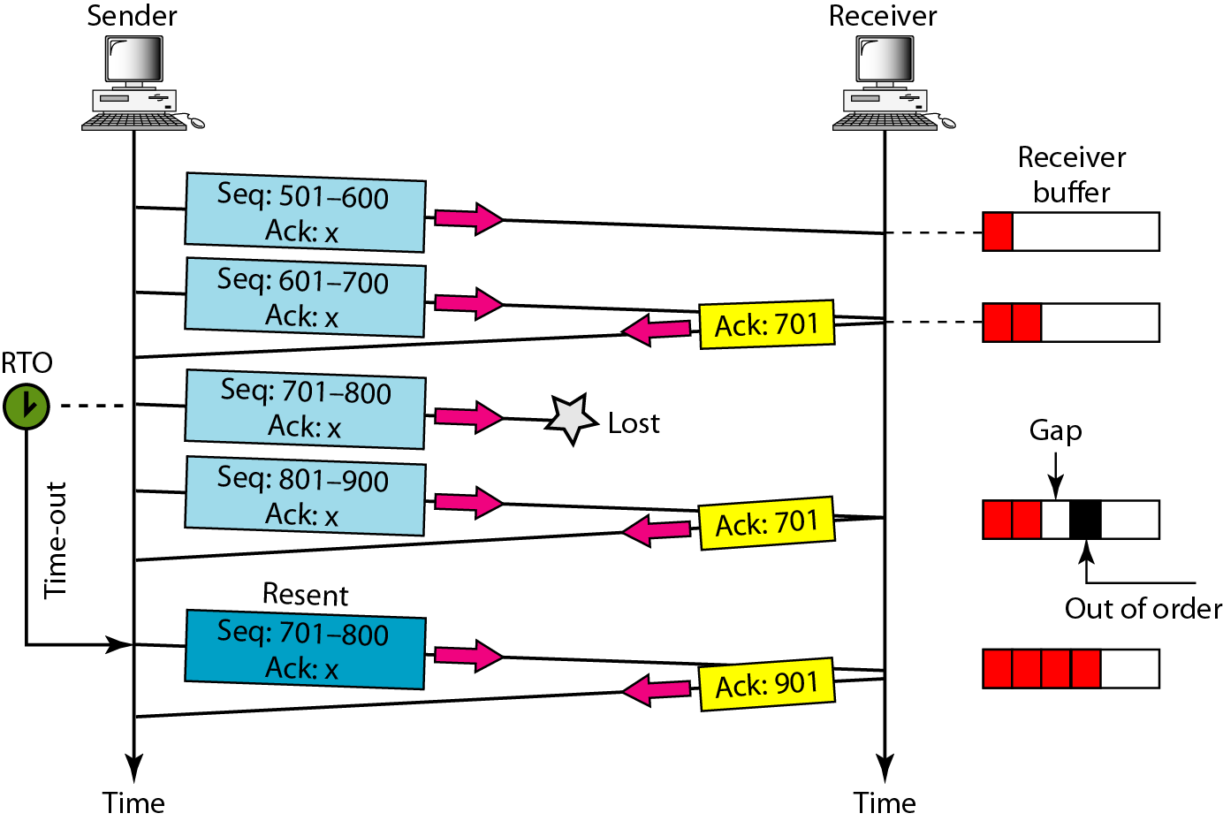
Figure 23.25 Lost segment

Slide 60
Note
The receiver TCP delivers only ordered data to the process.

Slide 61
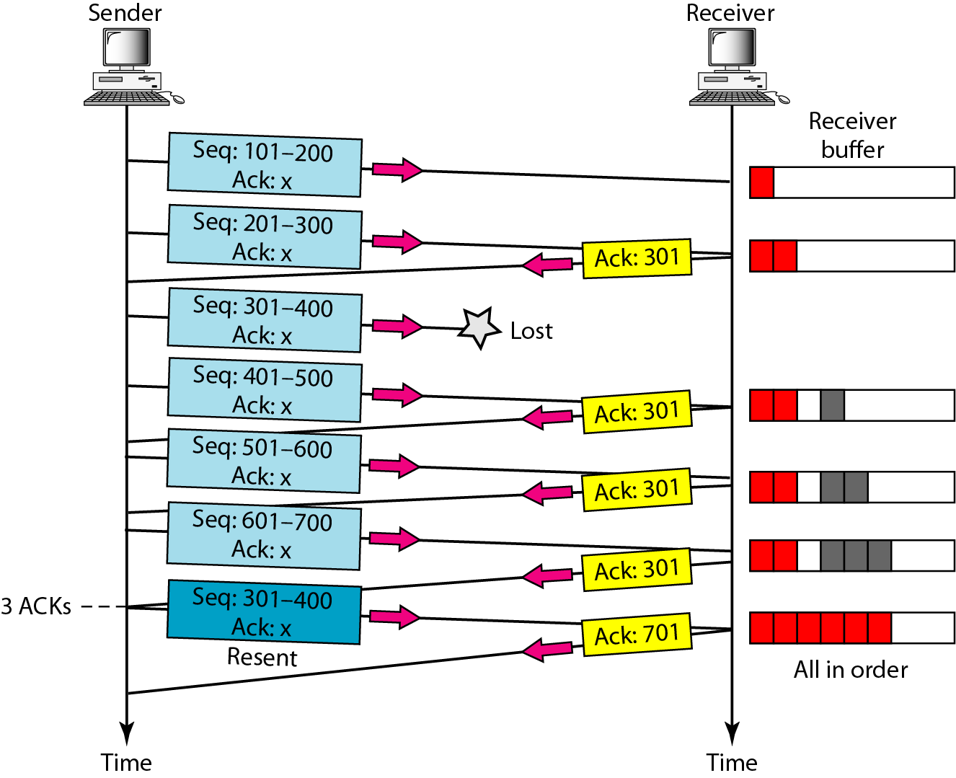
Figure 23.26 Fast retransmission

Slide 62
What have we completed?
Thank You
Well-Known Ports for UDP
User Datagram
Checksum
UDP Operation
Use of UDPTCP Services
TCP Features
Segment
A TCP Connection
Flow Control
Error Control

