Slide 1
TCP/IP Protocol suite
Lecture-03
( Chapter 02 )

Slide 2
Topics to be discussed
TCP/IP Protocol Suite
Difference between TCP/IP & OSI model
Layers of TCP/IP
Types of addresses

Slide 3

TCP/IP PROTOCOL SUITE
The layers in the TCP/IP protocol suite do not exactly match those in the OSI model.
The original TCP/IP protocol suite was defined as having four layers: host-to-network, internet, transport, and application.
However, when TCP/IP is compared to OSI, we can say that the TCP/IP protocol suite is made of five layers: physical, data link, network, transport, and application.
Let’s start with an animation
https://www.youtube.com/watch?v=2QGgEk20RXM

Slide 4
Difference between OSI & TCP-IP
1. The modules are not necessarily interdependent i.e. the layers of the TCP/IP protocol suite contain relatively independent protocols that can be mixed and matched depending on the needs of the system.
Whereas the OSI model specifies which functions belong to each of its layers and the modules are interdependent.
2. In TCP/IP the top 3 layers are merged to form a single Application Layer. So TCP/IP protocol suite has 5 layers.
Whereas the OSI model has 7 layers.

Slide 5
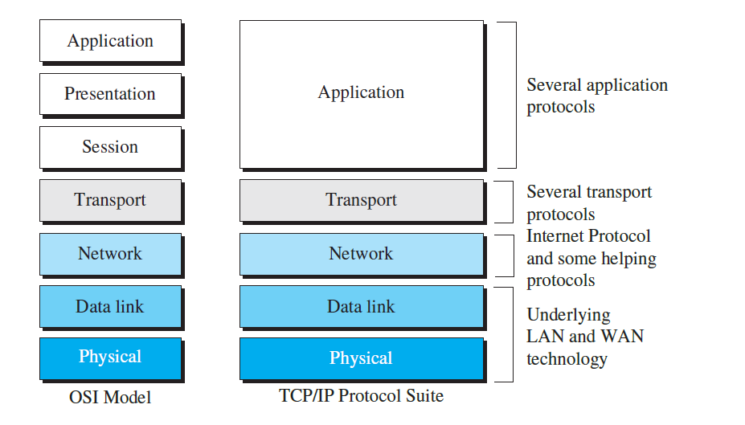
TCP/IP and OSI model

Slide 6
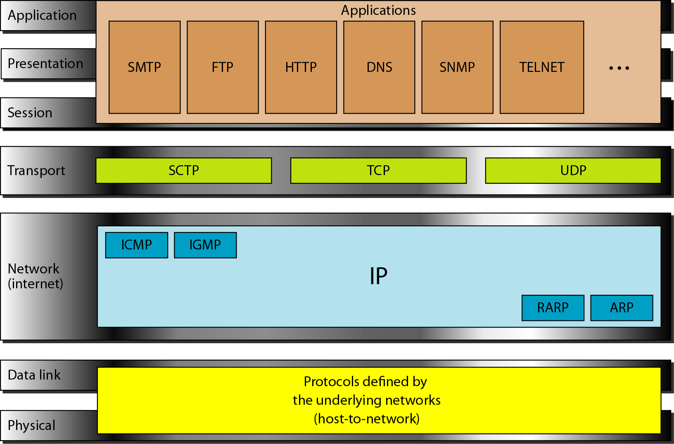
TCP/IP and OSI model

Slide 7
Physical and Data Link Layers
At the physical and data link layers, TCP/IP does not define any specific protocol.
It supports all the standard and proprietary protocols. A network in a TCP/IP internetwork can be a local-area network or a wide-area network.
Example:
Datalink Layer protocols: Ethernet, the IEEE 802.11 WiFi protocols, ATM and Frame Relay
Physical Layer protocols: 1000BASE-SX Ethernet, 100BaseTX Ethernet, 802.11 physical-layer variants, Bluetooth, Controller Area Network, Universal Serial Bus.

Slide 8
Network Layer
Internetworking Protocol (IP):
IP is the transmission mechanism used by the TCP/IP protocols which uses four supporting protocols: ARP, RARP, ICMP, and IGMP.
It is an unreliable and connectionless protocol-a best-effort delivery service(provides no error checking or tracking).
IP transports data in packets called datagrams, each of which is transported separately.
IP does not keep track of the routes and has no facility for reordering datagrams once they arrive at their destination.
The biggest advantage of IP is, it provides bare-bones transmission functions that free the user to add only those facilities necessary for a given application and thereby allows for maximum efficiency.

Slide 9

Network Layer (continues…)
Address Resolution Protocol:
The Address Resolution Protocol (ARP) is used to associate a logical address with a physical address.
On a typical physical network, such as a LAN, each device on a link is identified by a physical or station address, usually imprinted on the network interface card (NIC).
ARP is used to find the physical address of the node when its Internet address is known.

Slide 10
Network Layer (continues…)
Reverse Address Resolution Protocol:
The Reverse Address Resolution Protocol (RARP) allows a host to discover its Inter-net address when it knows only its physical address.
It is used when a computer is connected to a network for the first time or when a computer is booted.

Slide 11
Network Layer (continues…)
Internet Control Message Protocol:
The Internet Control Message Protocol (ICMP) is a mechanism used by hosts and gateways to send notification of datagram problems back to the sender.
ICMP sends query and error reporting messages.
Internet Group Message Protocol:
The Internet Group Message Protocol (IGMP) is used to facilitate the simultaneous transmission of a message to a group of recipients.

Slide 12
Transport Layer
Traditionally the transport layer was represented in TCP/IP by two protocols: TCP and UDP. A new transport layer protocol, SCTP, has been devised to meet the needs of some newer applications.
User Datagram Protocol:
The User Datagram Protocol (UDP) is the simpler of the two standard TCPIIP transport protocols.
It is a process-to-process protocol that adds only port addresses, checksum error control, and length information to the data from the upper layer.

Slide 13
Transport Layer (continues…)
Transmission Control Protocol:
The Transmission Control Protocol (TCP) provides full transport-layer services to applications.
It is connection-oriented: A connection must be established between both ends of a transmission before either can transmit data.
At the sending end of each transmission, TCP divides a stream of data into smaller units called segments.
Each segment includes a sequence number for reordering after receipt, together with an acknowledgment number for the segments received.
Segments are carried across the internet inside of IP datagrams. At the receiving end, TCP collects each datagram as it comes in and reorders the transmission based on sequence numbers.

Slide 14
Transport Layer (continues…)
Stream Control Transmission Protocol:
The Stream Control Transmission Protocol (SCTP) provides support for newer applications such as voice over the Internet.
It is a transport layer protocol that combines the best features of UDP and TCP.

Slide 15
Application Layer
The application layer in TCP/IP is equivalent to the combined session, presentation and application layers in the OSI model Many protocols are defined at this layer.
Example: TELNET, Hypertext transfer protocol (HTTP), File Transfer Protocol (FTP), Simple mail transport protocol (SMTP)

Slide 16
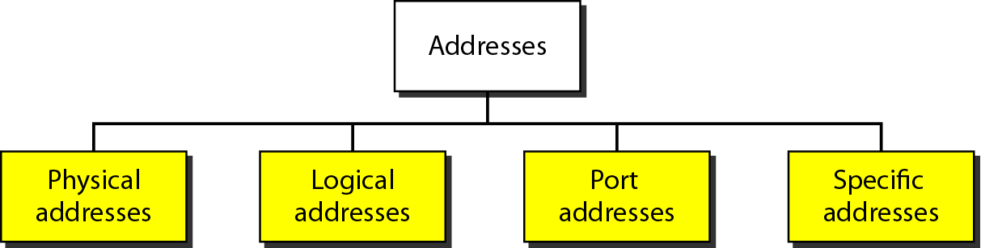
Addresses in TCP/IP

Slide 17
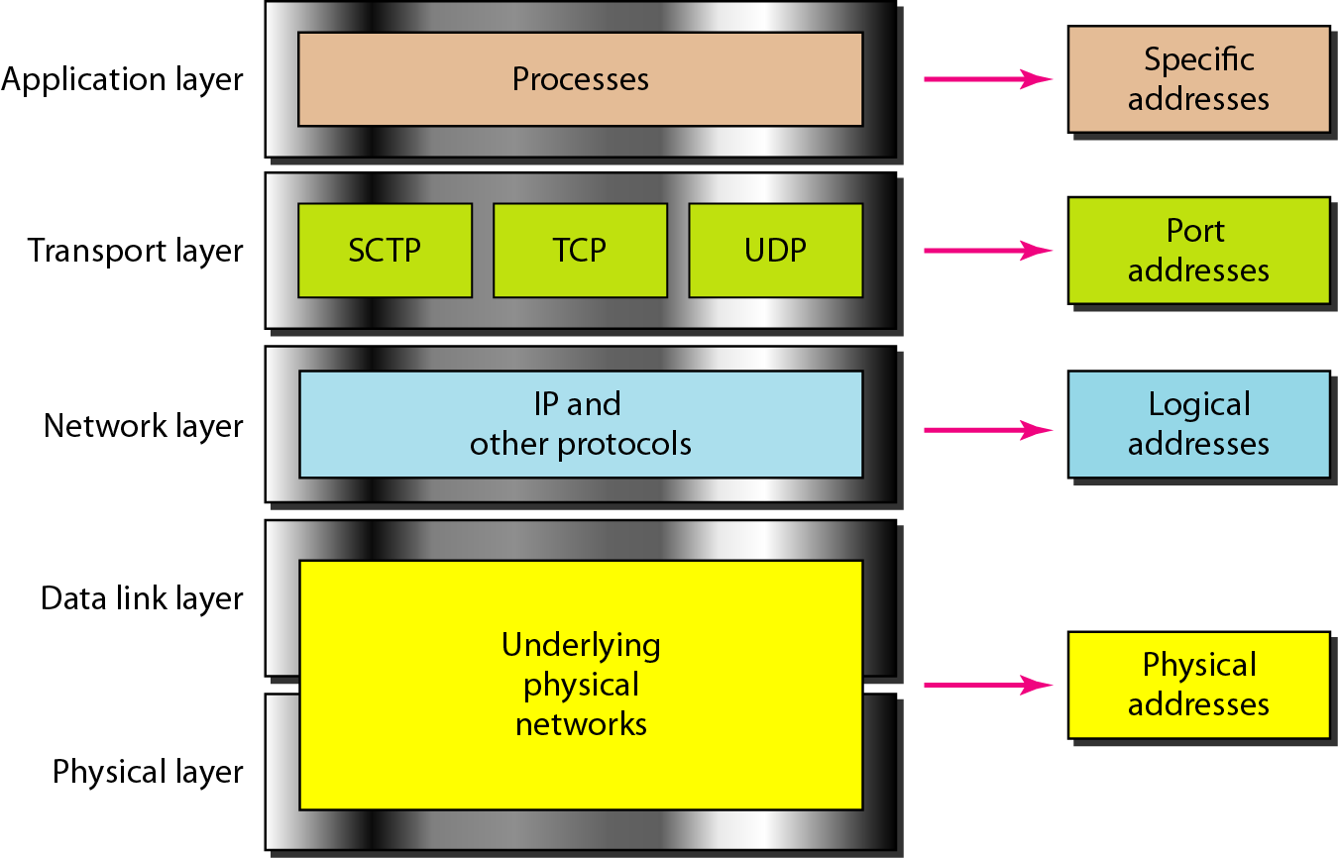
Relationship of layers and addresses in TCP/IP

Slide 18
Physical Addresses
The physical address, also known as the link address, is the address of a node as defined by its LAN or WAN.
It is included in the frame used by the data link layer & it is the lowest-level address.
The size and format of these addresses vary depending on the network.
For example, Ethernet uses a 6-byte (48-bit) physical address that is imprinted on the Network Interface Card (NIC). LocalTalk (Apple), however, has a 1-byte dynamic address that changes each time the station comes up.

Slide 19
Example
Most local-area networks use a 48-bit (6-byte) physical address written as 12 hexadecimal digits; every byte (2 hexadecimal digits) is separated by a colon, as shown below:
07:01:02:01:2C:4B
A 6-byte (12 hexadecimal digits) physical address.

Slide 20
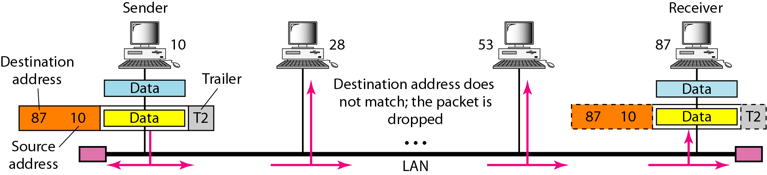
Figure: 2.19 Physical addresses

Slide 21
Example
In Figure 2.19 a node with physical address 10 sends a frame to a node with physical address 87.
The two nodes are connected by a link (bus topology LAN).
As the figure shows, the computer with physical address 10 is the sender, and the computer with physical address 87 is the receiver.

Slide 22
Logical Addresses
Logical addresses are necessary for universal communications that are independent of underlying physical networks.
Physical addresses are not adequate in an internetwork environment where different networks can have different address formats.
A universal addressing system is needed in which each host can be identified uniquely, regardless of the underlying physical network.
A logical address in the Internet is currently a 32-bit address that can uniquely define a host connected to the Internet.
No two publicly addressed and visible hosts on the Internet can have the same IP address.

Slide 23
Example 2.3
Figure 2.20 shows a part of an internet with two routers connecting three LANs.
Each device (computer or router) has a pair of addresses (logical and physical) for each connection.
In this case, each computer is connected to only one link and therefore has only one pair of addresses.
Each router, however, is connected to three networks (only two are shown in the figure).
So each router has three pairs of addresses, one for each connection.

Slide 24
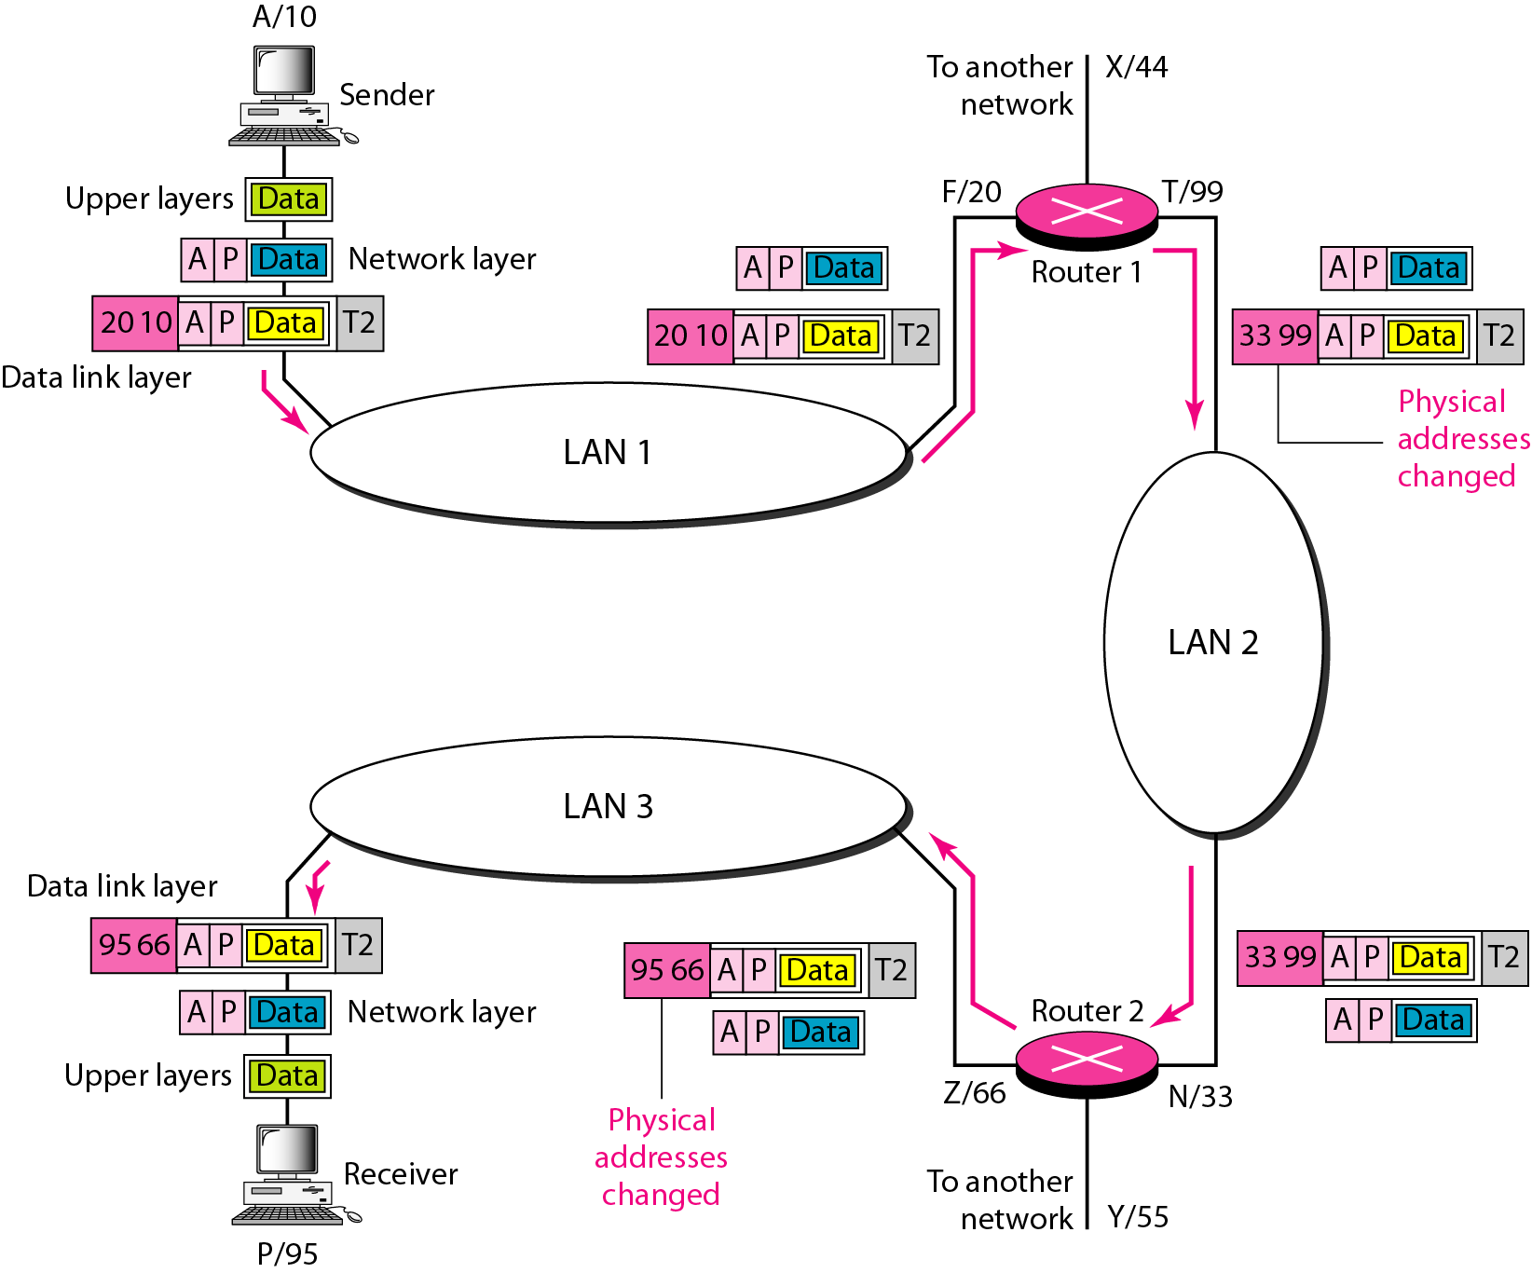
Figure 2.20 IP addresses

Slide 25
Example 2.3 cont…
Scenario: The computer with logical address A and physical address 10 needs to send a packet to the computer with logical address P and physical address 95.
The sender encapsulates its data in a packet at the network layer and adds two logical addresses (A and P).
The network layer consults its routing table and finds the logical address of the next hop (router-1) to be F.
The ARP finds the physical address of router 1 that corresponds to the logical address F(i.e. 20).
The Network layer passes this address to the data link layer, which encapsulates the packet with physical destination address 20 and physical source address 10.
The frame is received by every device on LAN-1, but is discarded by all except router-1.

Slide 26
Example 2.3 cont…
The router-1 decapsulates the packet from the frame to read the logical destination address P. Since the logical destination address does not match the router's logical address, the router knows that the packet needs to be forwarded.
The router consults its routing table and ARP to find the physical destination address of the next hop (router-2), creates a new frame, encapsulates the packet, and sends it to router-2.
The source physical address changes from 10 to 99. The destination physical address changes from 20 (router 1 physical address) to 33 (router-2 physical address).
The logical source and destination addresses must remain the same; otherwise the packet will be lost.

Slide 27
Port Addresses
The end objective of Internet communication is a process communicating with another process.
For example, computer A can communicate with computer C by using TELNET. At the same time, computer A communicates with computer B by using the File Transfer Protocol (FTP).
The processes need addresses. In the TCP/IP architecture a process is labeled using a 16bit length address, called a port address.

Slide 28
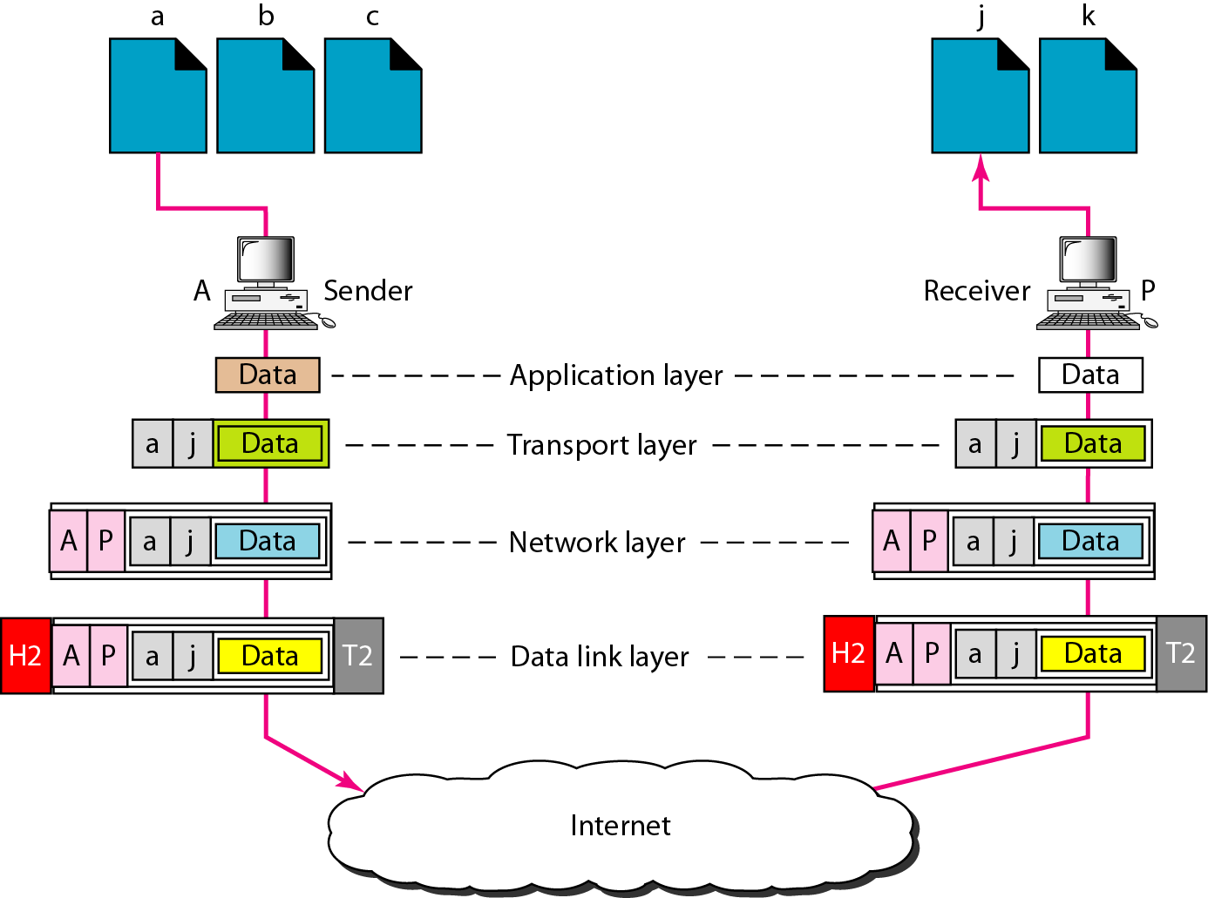
Figure 2.21 Port addresses

Slide 29
Example 2.4
The sending computer is running three processes with port addresses a, b, and c.
The receiving computer is running two processes with port addresses j and k.
Process a in the sending computer needs to communicate with process j in the receiving computer.
Note that although both computers are using the same application, FTP, for example, the port addresses are different because one is a client program and the other is a server program.

Slide 30
Example 2.4 Cont…
To show that data from process a need to be delivered to process j, and not k, the transport layer encapsulates data from the application layer in a packet and adds two port addresses (a and j), source and destination.
The packet from the transport layer is then encapsulated in another packet at the network layer with logical source and destination addresses (A and P).
Finally, this packet is encapsulated in a frame with the physical source and destination addresses of the next hop.
Note that although physical addresses change from hop to hop, logical and port addresses remain the same from the source to destination.

Slide 31
A port address is a 16-bit address represented by one decimal number as shown.
753
A 16-bit port address represented as one single number.

Slide 32
The physical addresses change from hop to hop,
but the logical and port addresses usually remain the same.

Slide 33
What have we completed?
Thank You
TCP/IP Protocol Suite
Difference between TCP/IP & OSI model
Layers of TCP/IP
Types of addresses

