Slide 1
Analog Signals & Digital Signals
By dr. R. K. Ojha
Lecture-4
( Chapter 3 )

Slide 2
Topics to be discussed
Analog & Digital Signals
Periodic Analog Signal
Wavelength & Period
Non-periodic signal
Composite Signal
Bandwidth
Bit Rate
Periodic & non periodic digital signal
Baseband Transmission
Broadband Transmission

Slide 3
ANALOG AND DIGITAL
Data can be analog or digital. The term analog data refers to information that is continuous; digital data refers to information that has discrete states.
Analog data take on continuous values. Digital data take on discrete values.

Slide 4

Signals can be analog or digital. Analog signals can have an infinite number of values in a range; digital signals can have only a limited number of values.

Slide 5
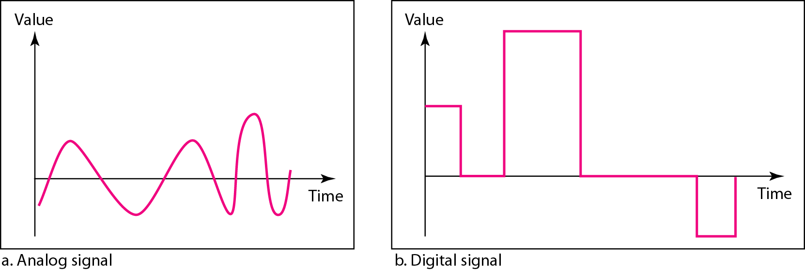
Comparison of analog and digital signals

Slide 6
In data communications, we commonly use periodic analog signals and nonperiodic digital signals.

Slide 7
Analog Signals

Slide 8
PERIODIC ANALOG SIGNALS
Periodic analog signals can be classified as simple or composite.
A simple periodic analog signal, a sine wave, cannot be decomposed into simpler signals.
A composite periodic analog signal is composed of multiple sine waves.

Slide 9
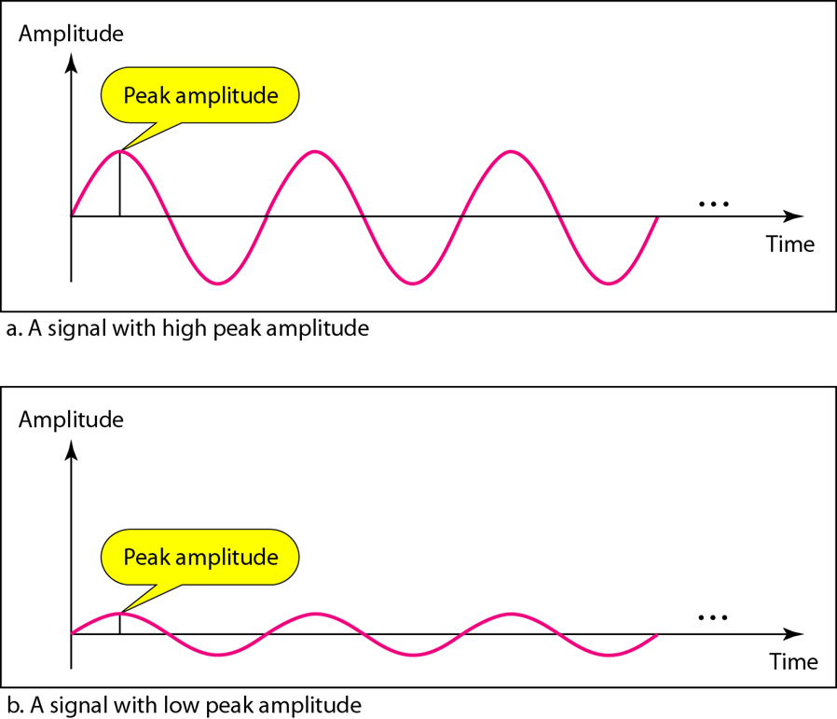
Two signals with the same phase and frequency, but different amplitudes

Slide 10

Frequency and period are the inverse of each other.

Slide 11
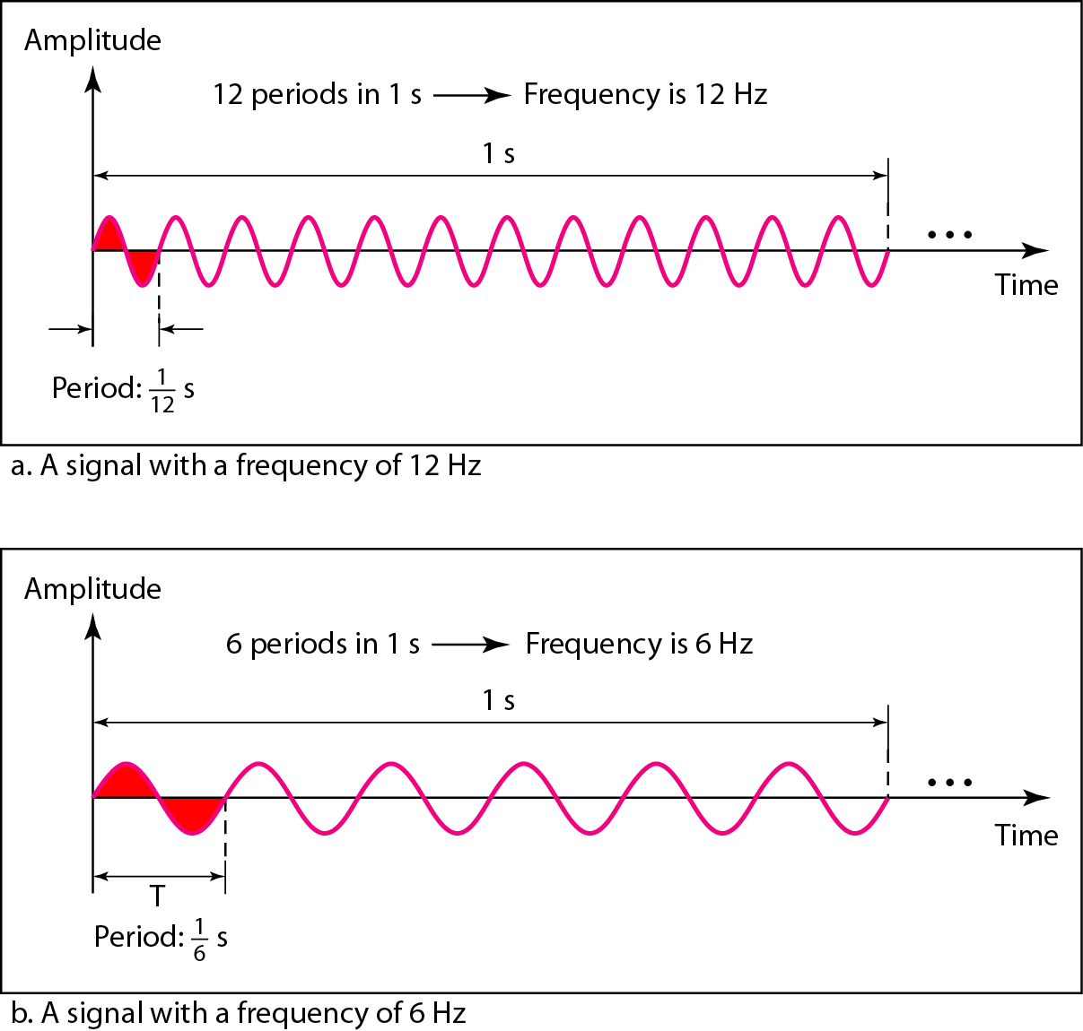
Two signals with the same amplitude and phase, but different frequencies

Slide 12
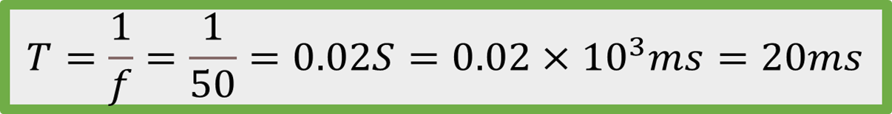
The power we use at home has a frequency of 50 Hz. The period of this sine wave can be determined as follows:

Slide 13
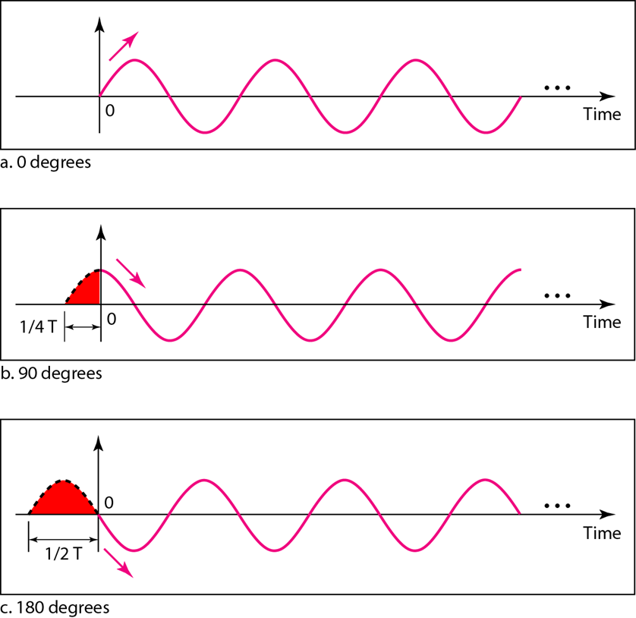
Three sine waves with the same amplitude and frequency, but different phases

Slide 14
A sine wave with a phase of 0° starts at time 0 with a zero amplitude. The amplitude is increasing, i.e. a sine wave with a phase of 0° is not shifted.
A sine wave with a phase of 90° starts at time 0 with a peak amplitude. The
amplitude is decreasing, i.e. a sine wave with a phase of 90° is shifted to the left by 1/4 cycle. However, note that the signal does not really exist before time 0.
3. A sine wave with a phase of 180° starts at time 0 with a zero amplitude. The
amplitude is decreasing, i.e. a sine wave with a phase of 180° is shifted to the left by 1/2 cycle. However, note that the signal does not really exist before time 0.

Slide 15
Frequency is the rate of change with respect to time.
Change in a short span of time means high frequency.
Change over a long span of time means low frequency.
If a signal does not change at all, its frequency is zero.
If a signal changes instantaneously, its frequency is infinite.
Phase describes the position of the waveform relative to time 0.

Slide 16
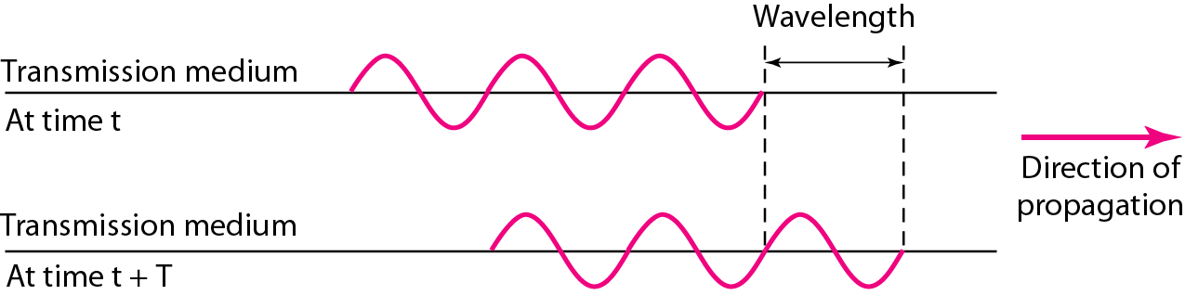

Wavelength and period

Slide 17
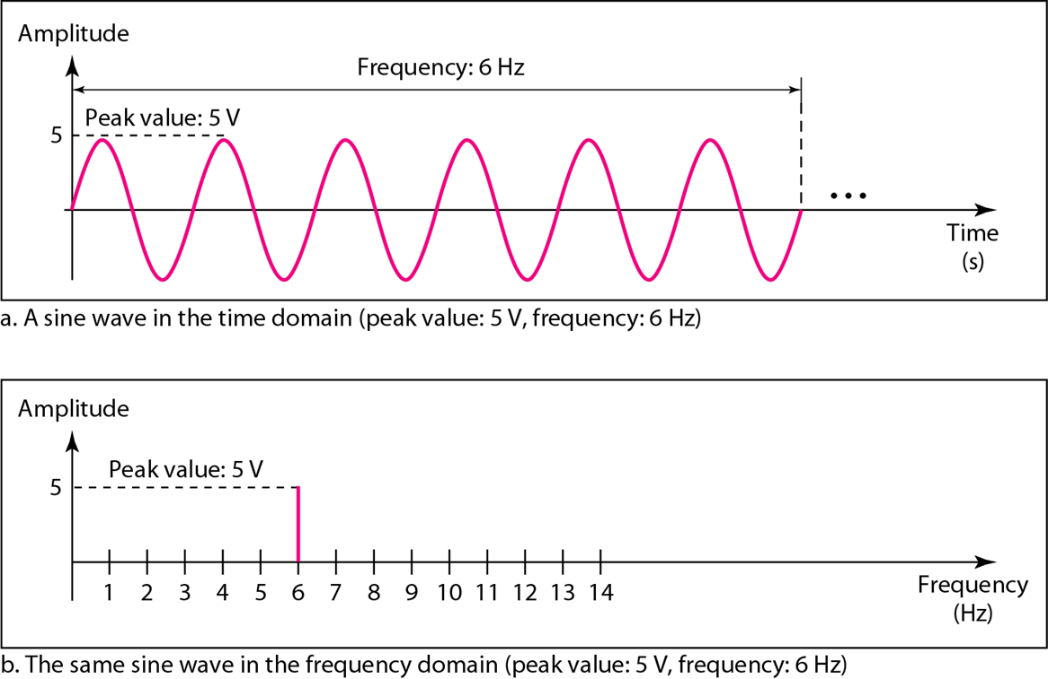
A complete sine wave in the time domain can be represented by one single spike in the frequency domain.
The time-domain and frequency-domain plots of a sine wave

Slide 18
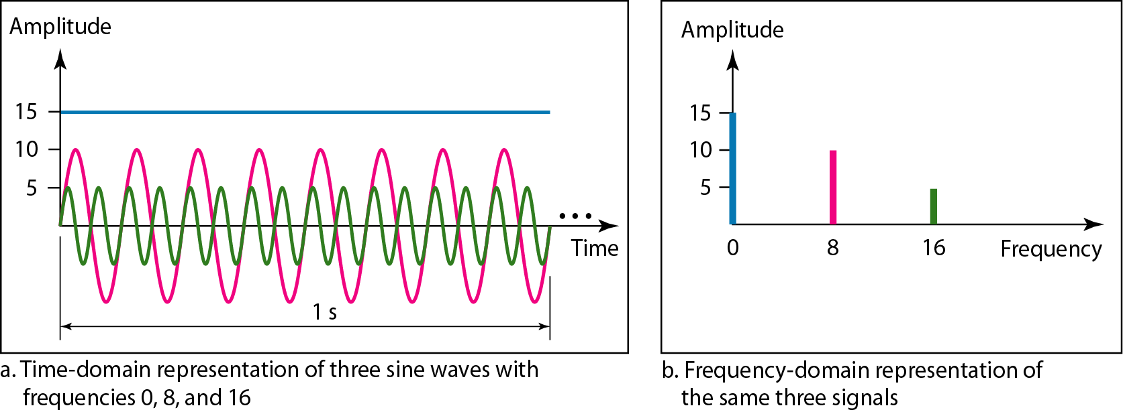
The time domain and frequency domain of three sine waves

Slide 19
Composite Signals and Periodicity
If the composite signal is periodic, the decomposition gives a series of signals with discrete frequencies.
If the composite signal is nonperiodic, the decomposition gives a combination of sine waves with continuous frequencies.

Slide 20
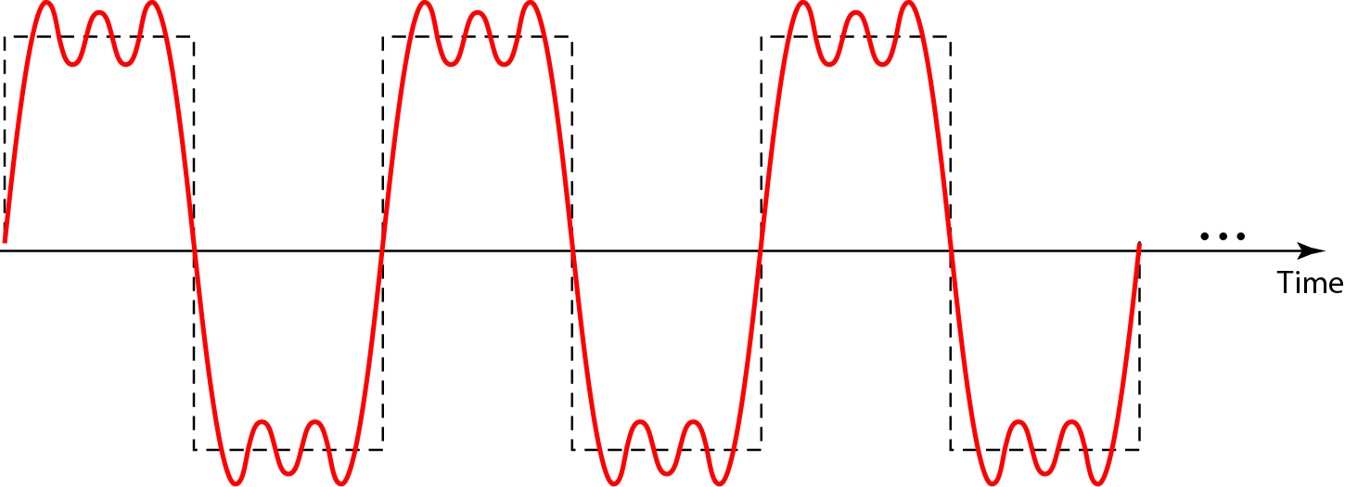
Figure 3.9 A composite periodic signal
Figure 3.9 shows a periodic composite signal with frequency f. This type of signal is not typical of those found in data communications. We can consider it to be three alarm systems, each with a different frequency.

Slide 21
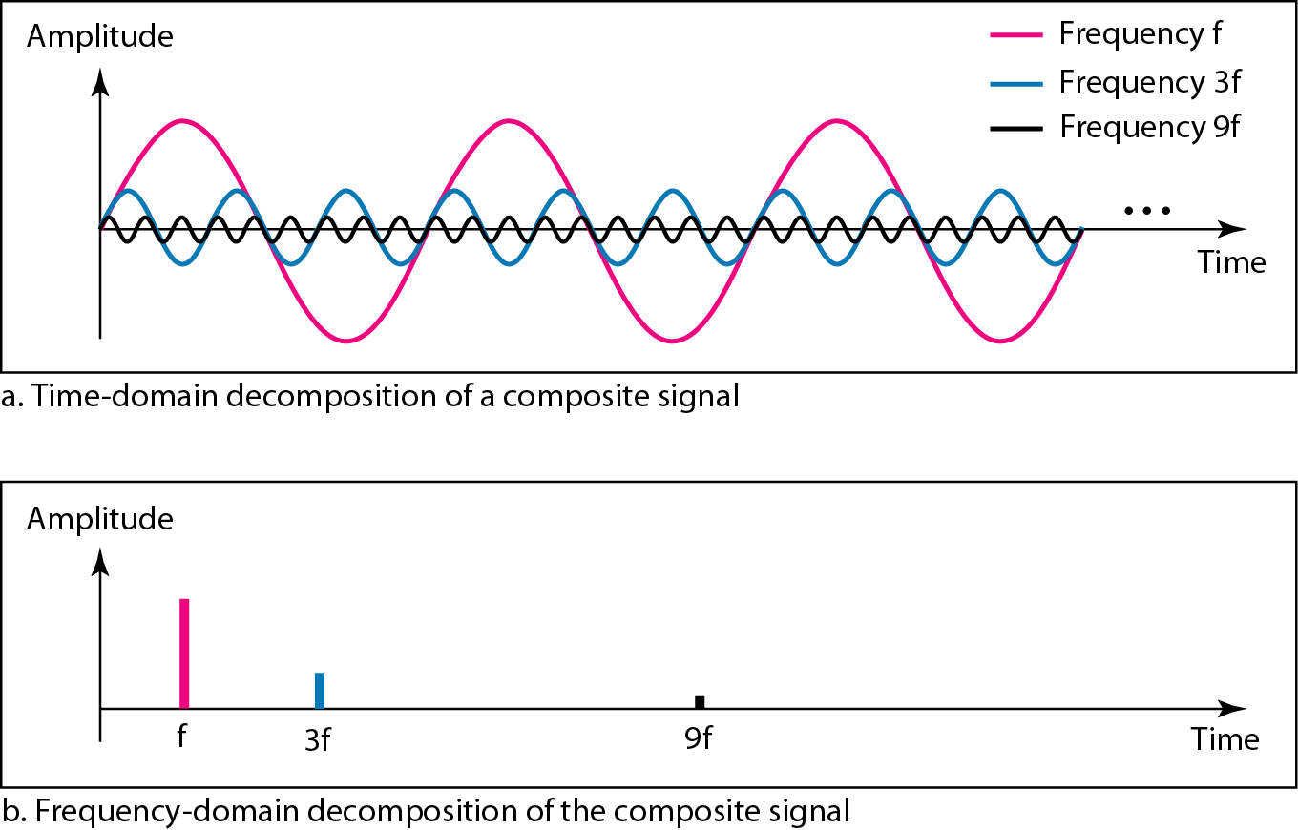
Figure 3.10 Decomposition of a composite periodic signal in the time and frequency domains

Slide 22
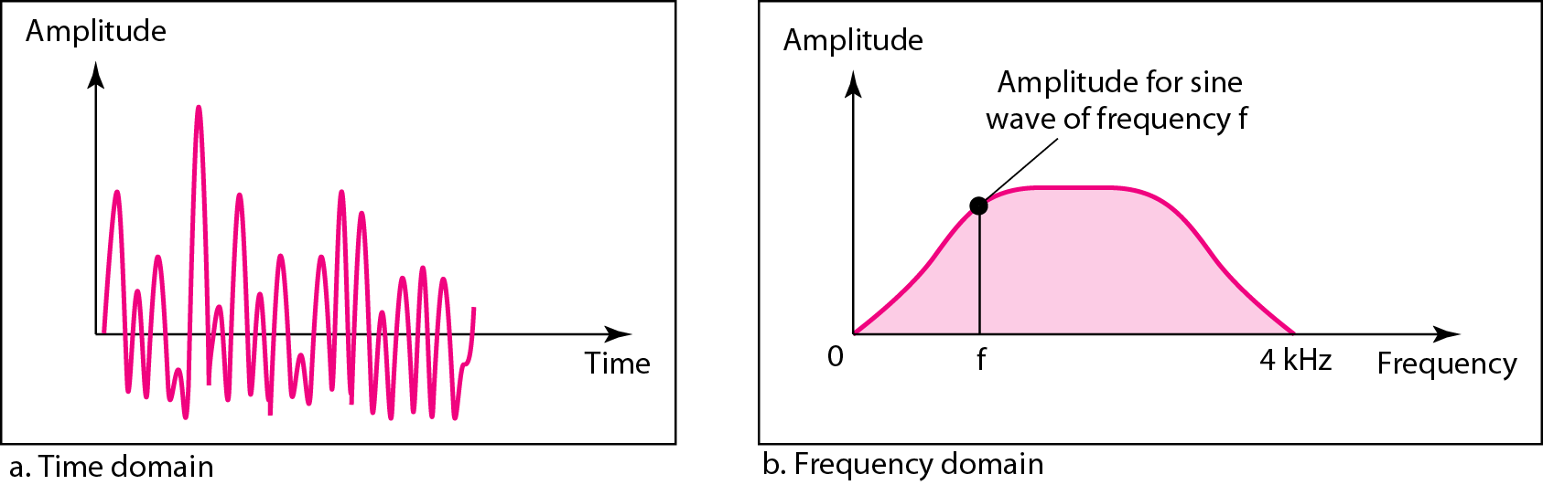
Figure 3.11 The time and frequency domains of a nonperiodic signal
Figure 3.11 shows a nonperiodic composite signal. It can be the signal created by a microphone or a telephone set when a word or two is pronounced. In this case, the composite signal cannot be periodic, because that implies that we are repeating the same word or words with exactly the same tone.

Slide 23
Band width
The range of frequencies contained in a composite signal is its bandwidth.
The bandwidth is normally a difference between two numbers.
For example, if a composite signal contains frequencies between 1000 and 5000, its bandwidth is 5000 - 1000, or 4000.

Slide 24

The bandwidth of a composite signal is the difference between the
highest and the lowest frequencies contained in that signal.

Slide 25
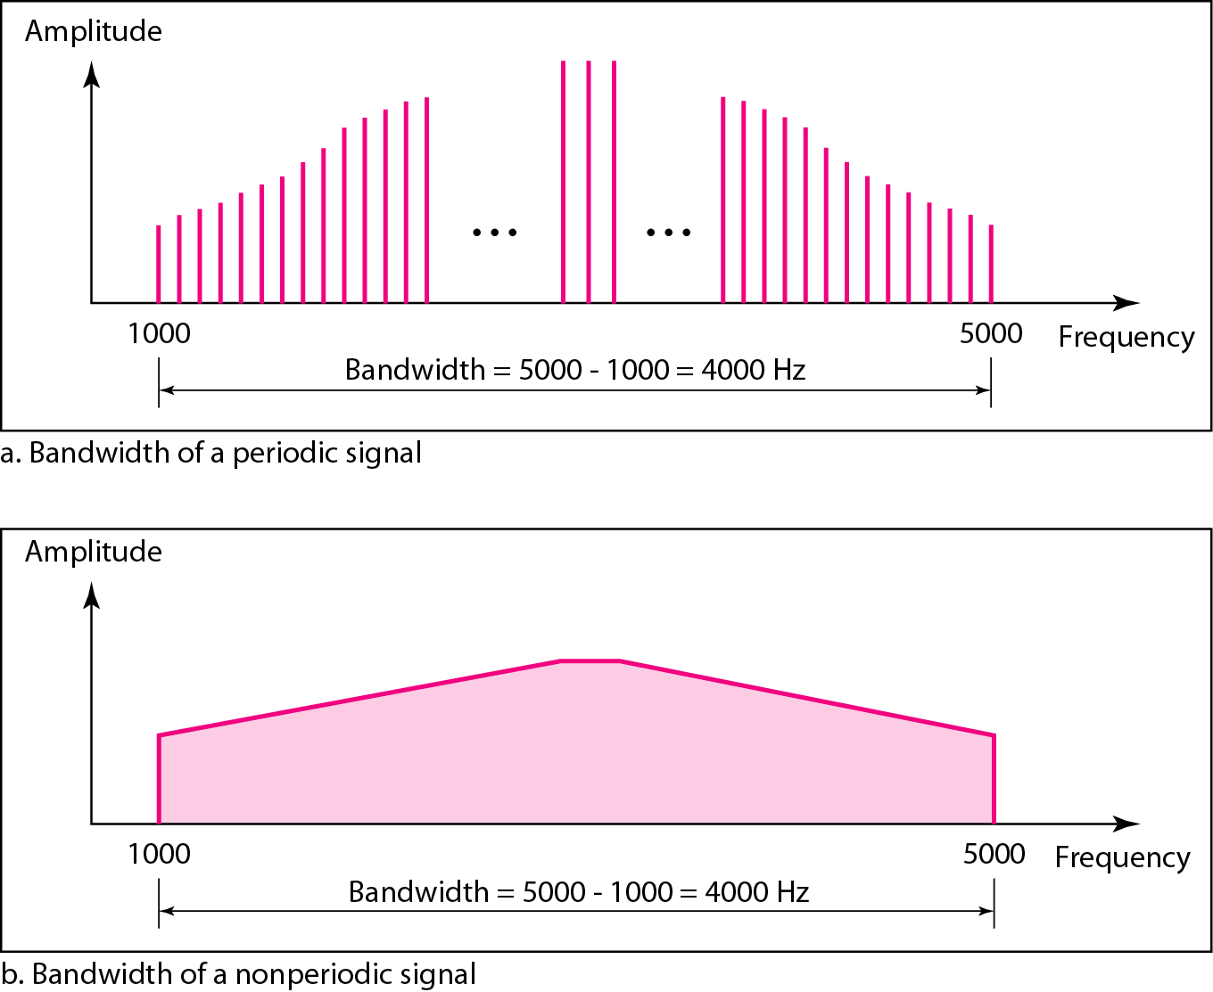
Figure 3.12 The bandwidth of periodic and nonperiodic composite signals

Slide 26
Digital Signals

Slide 27
Bit Rate
Most digital signals are nonperiodic, and thus period and frequency are not appropriate characteristics.
Another term bit rate (instead of frequency) is used to describe digital signals.
“The bit rate is the number of bits sent in 1s, expressed in bits per second (bps).”
The bit length is the distance one bit occupies on the transmission medium. Bit length = propagation speed × bit duration
Bit length= 1/ (bit rate)

Slide 28
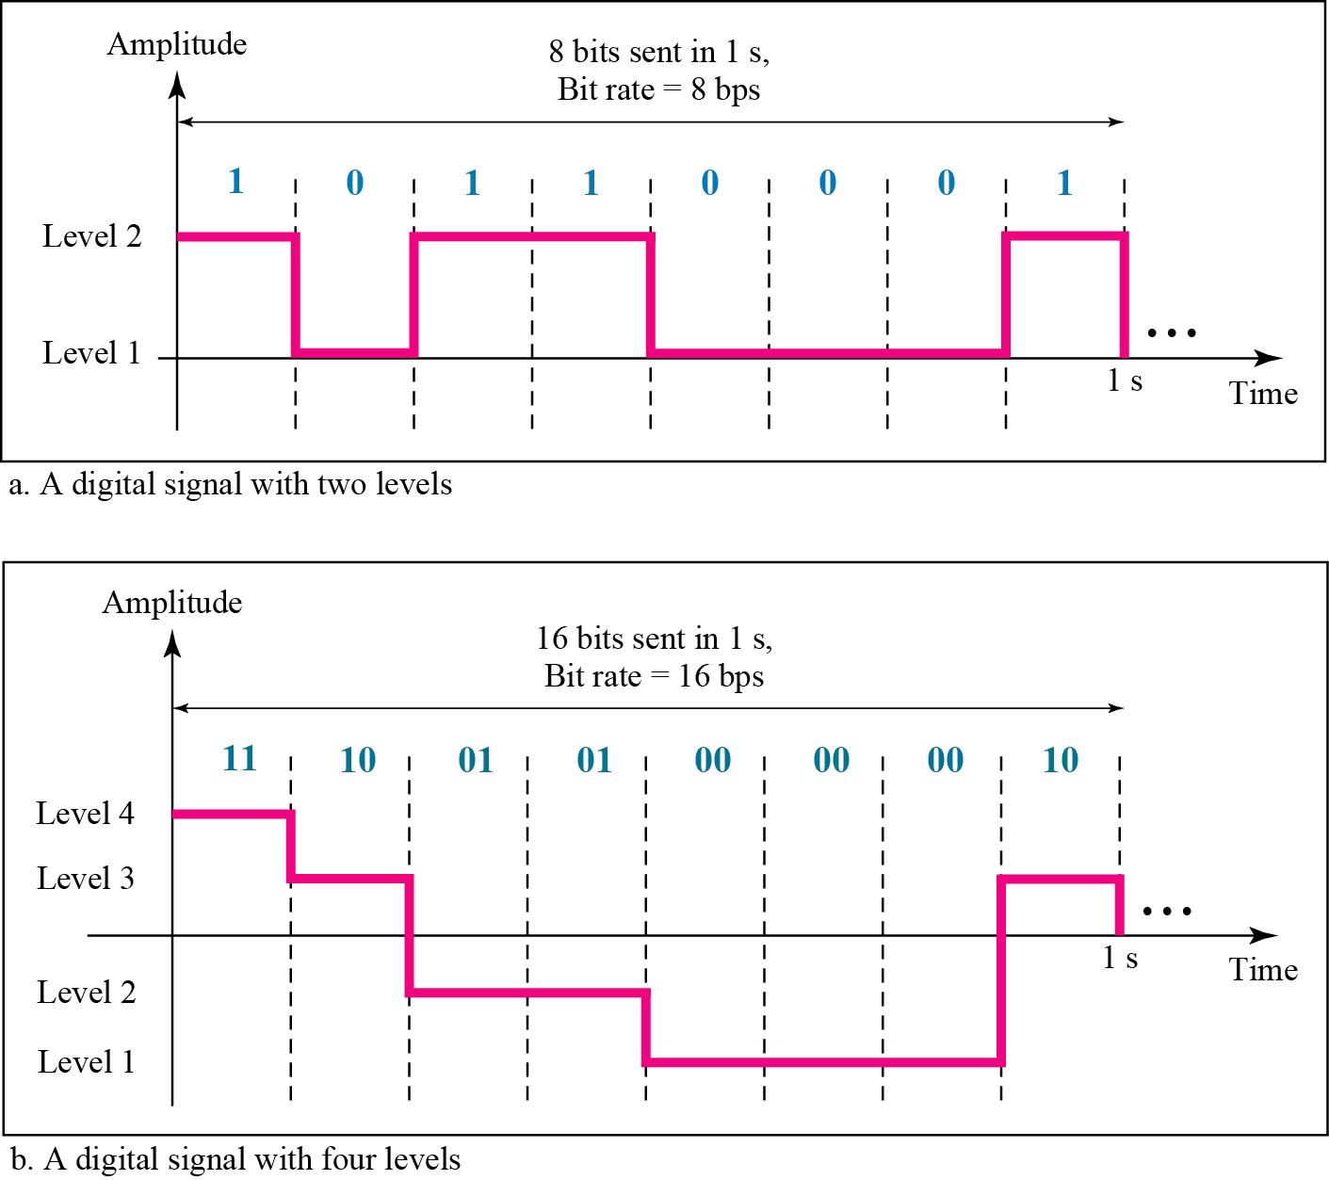
Figure 3.16 Two digital signals: one with two signal levels and the other with four signal levels

Slide 29
Example 3.16
A digital signal has eight levels. How many bits are needed per level?
We calculate the number of bits from the formula:
Each signal level is represented by 3 bits.

Slide 30
Example 3.18
Assume we need to download text documents at the rate of 100 pages per minute. What is the required bit rate of the channel?
Solution
A page is an average of 24 lines with 80 characters in each line. If we assume that one character requires 8 bits, the bit rate is

Slide 31
Example 3.20
What is the bit rate for high-definition TV (HDTV)?
Solution
HDTV uses digital signals to broadcast high quality video signals. The HDTV screen is normally a ratio of 16 : 9. There are 1920 by 1080 pixels per screen, and the screen is renewed 30 times per second. Twenty-four bits represents one color pixel.
* The TV stations reduce this rate to 20 to 40 Mbps through compression.

Slide 32
A digital signal is a composite analog signal with an infinite bandwidth.

Slide 33
Digital Transmission
There are two types of mechanisms used in Digital Transmission:
Baseband Transmission
Broadband Transmission

Slide 34
1. Baseband Transmission
Baseband transmission means sending a digital signal over a channel without changing the digital signal to an analog signal.
Baseband transmission requires a low-pass channel, i.e. a channel with a
bandwidth that starts from zero.
In this case if we have a dedicated medium with a bandwidth constituting only one channel.
For example, the entire bandwidth of a cable connecting two computers is one single channel.

Slide 35
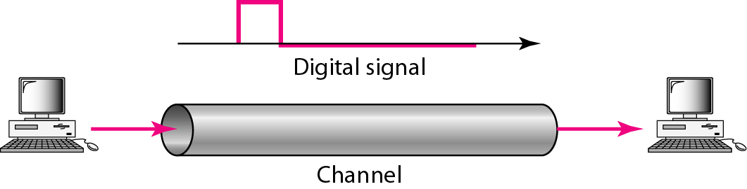
Figure 3.18 Baseband transmission

Slide 36
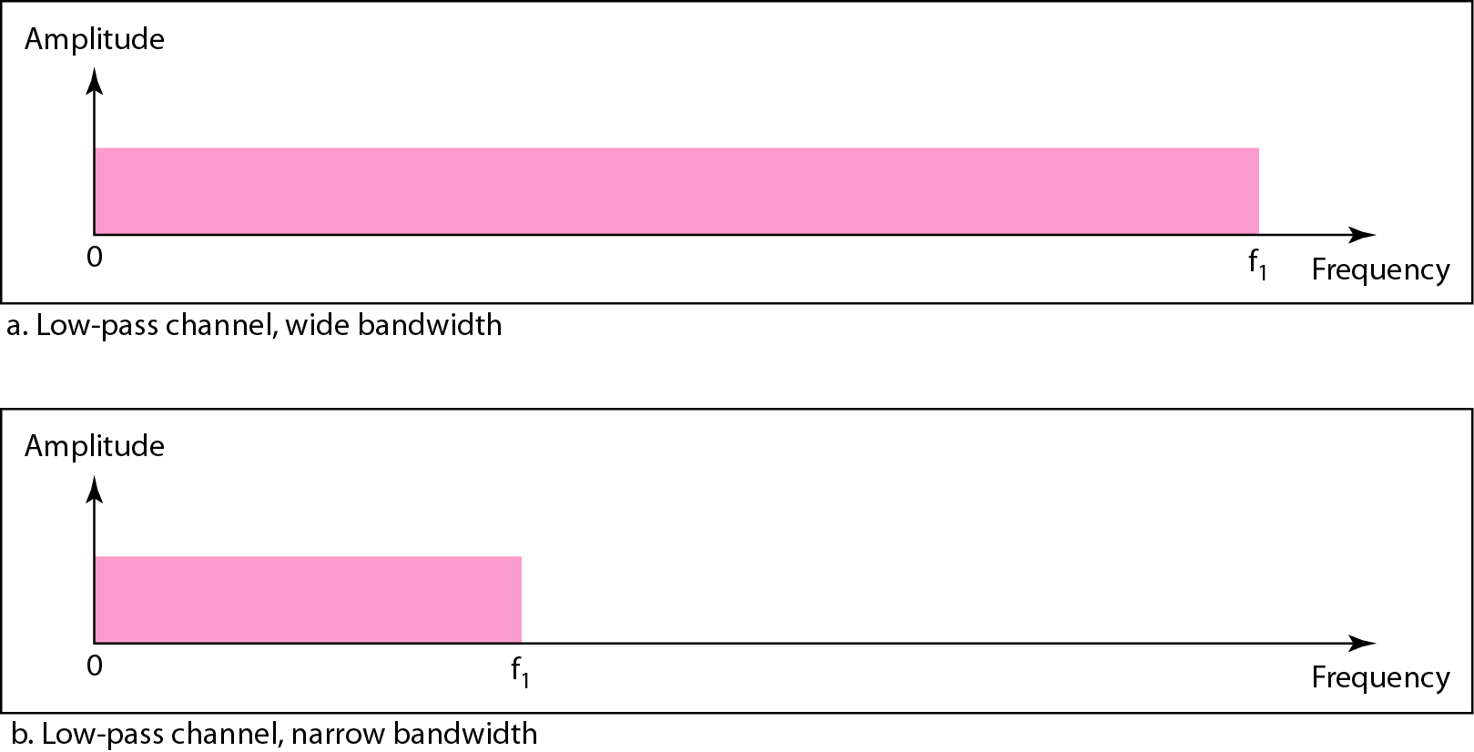
Figure 3.19 Bandwidths of two low-pass channels

Slide 37
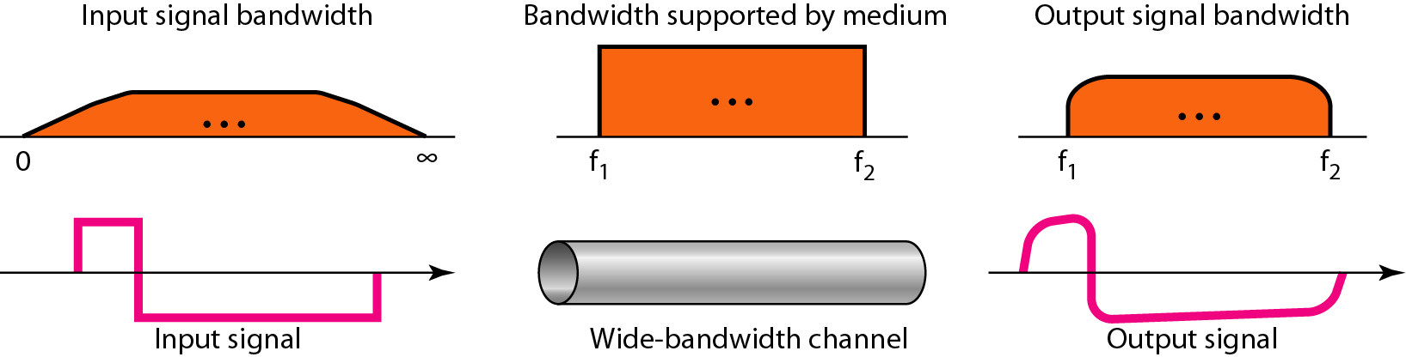
Figure 3.20 Baseband transmission using a dedicated medium
A low-pass channel with infinite bandwidth is ideal, but we cannot have such a channel in real life.

Slide 38
Baseband transmission of a digital signal that preserves the shape of the digital signal is possible only if we have a low-pass channel with an infinite or very wide bandwidth.

Slide 39
Example 3.21
An example of a dedicated channel where the entire bandwidth of the medium is used as one single channel is a LAN.
Almost every wired LAN today uses a dedicated channel for two stations communicating with each other.
In a bus topology LAN with multipoint connections, only two stations can communicate with each other at each moment in time (timesharing); the other stations need to refrain from sending data.
In a star topology LAN, the entire channel between each station and the hub is used for communication between these two entities.

Slide 40

In baseband transmission, the required bandwidth is proportional to the bit rate;
if we need to send bits faster, we need more bandwidth.
In baseband transmission, the required bandwidth is proportional to the bit rate;
if we need to send bits faster, we need more bandwidth.

Slide 41
2. Broadband Transmission
Broadband transmission or modulation means changing the digital signal to an analog signal for transmission.
Modulation allows us to use a bandpass channel-a channel with a bandwidth that does not start from zero.
This type of channel is more available than a low-pass channel.
Figure 3.23 shows a bandpass channel.

Slide 42
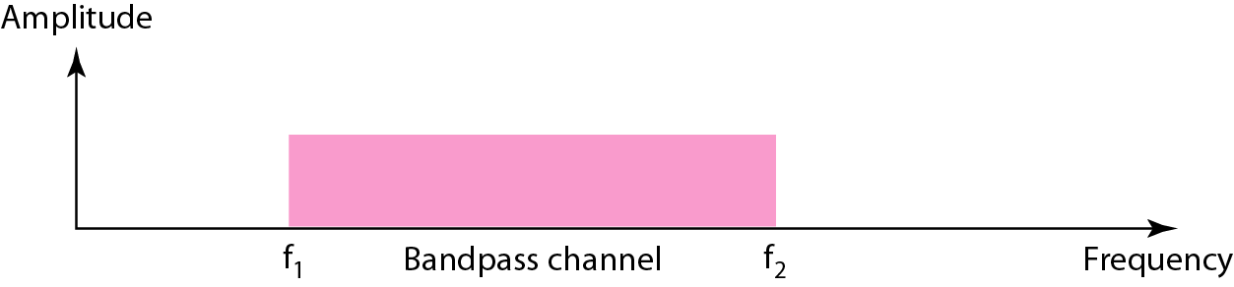
Figure 3.23 Bandwidth of a bandpass channel
Note: A low-pass channel can be considered a bandpass channel with the lower
frequency starting at zero.

Slide 43
If the available channel is a bandpass channel, we cannot send the digital signal directly to the channel; we need to convert the digital signal to an analog signal before transmission.

Slide 44
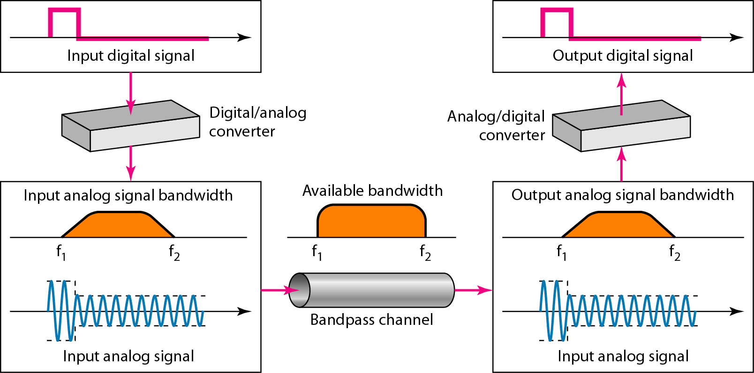
Figure 3.24 Modulation of a digital signal for transmission on a bandpass channel

Slide 45
Example 3.24
An example of broadband transmission using modulation is the sending of computer data through a telephone subscriber line, the line connecting a resident to the central telephone office. These lines are designed to carry voice with a limited bandwidth. The channel is considered a bandpass channel. We convert the digital signal from the computer to an analog signal, and send the analog signal. We can install two converters to change the digital signal to analog and vice versa at the receiving end. The converter, in this case, is called a modem.

Slide 46
Example 3.25
A second example is the digital cellular telephone. For better reception, digital cellular phones convert the analog voice signal to a digital signal. Although the bandwidth allocated to a company providing digital cellular phone service is very wide, we still cannot send the digital signal without conversion. The reason is that we only have a bandpass channel available between caller and callee. We need to convert the digitized voice to a composite analog signal before sending.

Slide 47
What have we completed?
Thank You
Analog & Digital Signals
Periodic Analog Signal
Wavelength & Period
Non-periodic signal
Composite Signal
Bandwidth
Bit Rate
Periodic & non periodic digital signal
Baseband Transmission
Broadband Transmission

