Slide 1
Transmission Impairment
By dr. R. K. Ojha
Lecture-5
( Chapter 3 )

Slide 2
Topics to be discussed
Transmission Impairments
Attenuation
Distortion
Noise
Signal to Noise Ratio
Data Rate Limits
Nyquist Bit Rate
Shannon Capacity
Performance

Slide 3
TRANSMISSION IMPAIRMENT
Signals travel through transmission media, which are not perfect. The imperfection causes signal impairment.
This means that the signal at the beginning of the medium is not the same as the signal at the end of the medium. What is sent is not what is received.
Three causes of impairment are attenuation, distortion, and noise.

Slide 4
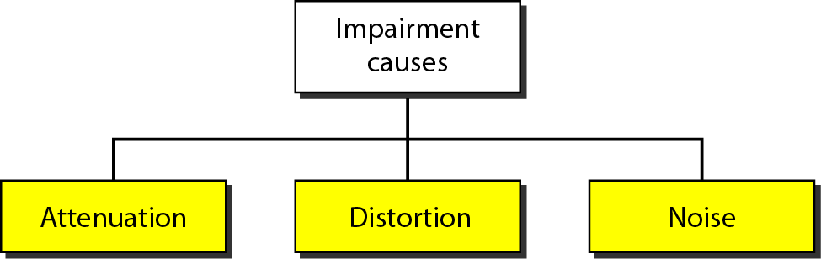
Figure 3.25 Causes of impairment

Slide 5
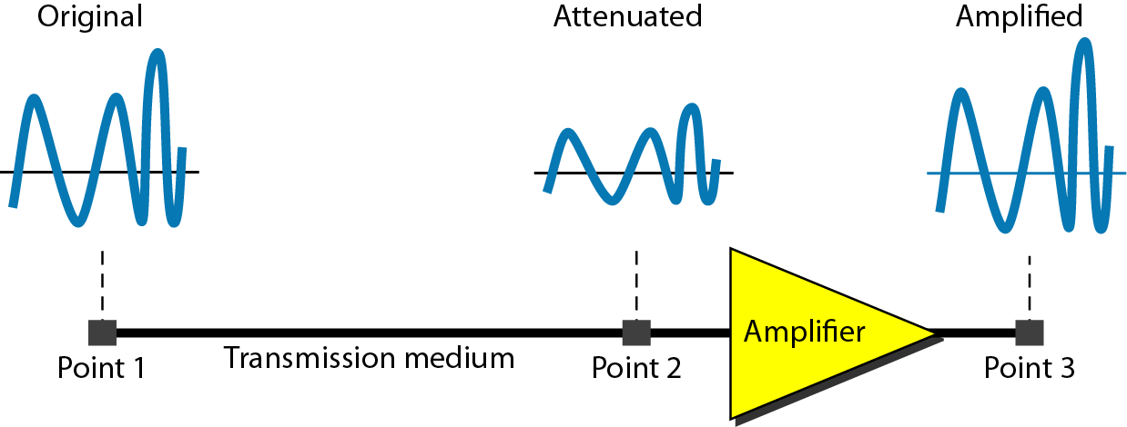
Attenuation
“When a signal, simple or composite, travels through a medium, It loses some of its energy in overcoming the resistance of the medium.”
Example: A wire carrying electric signals gets warm, if not hot, after a while. Some of the electrical energy in the signal is converted to heat.
Figure 3.26 Attenuation

Slide 6
Decibel
To show that a signal has lost or gained strength, engineers use the unit of the decibel.
The decibel (dB) measures the relative strengths of two signals or one signal at two different points.
The decibel is negative if a signal is attenuated and positive if a signal is amplified.
Variables PI and P2 are the powers of a signal at points 1 and 2, respectively.

Slide 7

Example 3.26
Suppose a signal travels through a transmission medium and its power is reduced to one-half. This means that P2 is (1/2)P1. In this case, the attenuation (loss of power) can be calculated as
A loss of 3 dB (–3 dB) is equivalent to losing one-half the power.

Slide 8

Example 3.27
A signal travels through an amplifier, and its power is increased 10 times. This means that P₂ = 10P₁ . In this case, the amplification (gain of power) can be calculated as

Slide 9

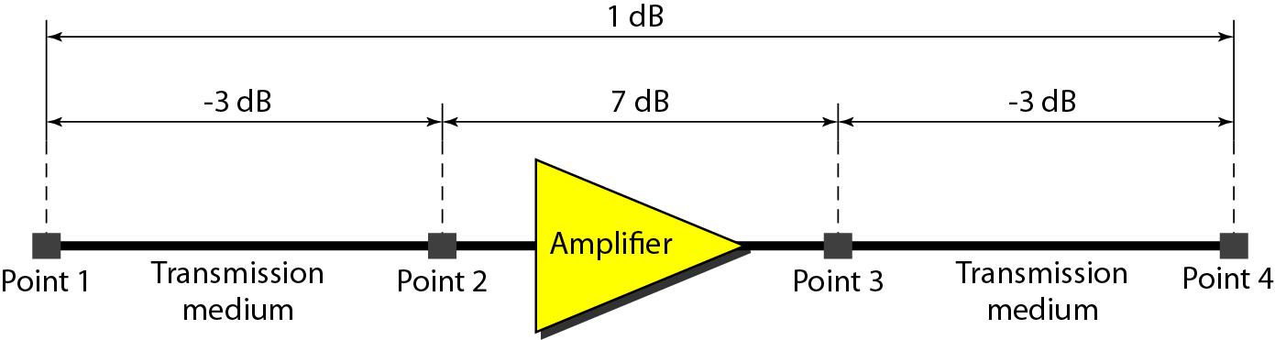
Why decibel?
One reason that engineers use the decibel to measure the changes in the strength of a signal is that decibel numbers can be added (or subtracted) when we are measuring several points (cascading) instead of just two. In Figure 3.27 a signal travels from point 1 to point 4. In this case, the decibel value can be calculated as
Figure 3.27 Decibels for Example

Slide 10
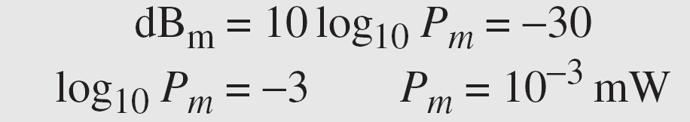
Example 3.29
Sometimes the decibel is used to measure signal power in milliwatts. In this case, it is referred to as dB_{m} and is calculated as dB_{m} = 10 log₁₀ P_{m} , where P_{m} is the power in milliwatts.
Calculate the power of a signal with dB_{m} = −30.
Solution
We can calculate the power in the signal as

Slide 11
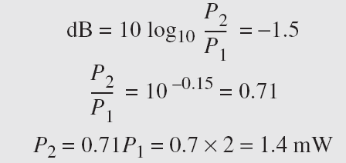
Example 3.30
The loss in a cable is usually defined in decibels per kilometer (dB/km). If the signal at the beginning of a cable with −0.3 dB/km has a power of 2 mW, what is the power of the signal at 5 km?
Solution
The loss in the cable in decibels is 5 × (−0.3) = −1.5 dB. We can calculate the power as

Slide 12
Distortion
Distortion means that the signal changes its form or shape.
Distortion can occur in a composite signal made of different frequencies.
Each signal component has its own propagation speed (see the next section) through a medium and, therefore, its own delay in arriving at the final destination.
Differences in delay may create a difference in phase, if the delay is not exactly the same as the period duration.
In other words, signal components at the receiver have phases different from what they had at the sender.

Slide 13
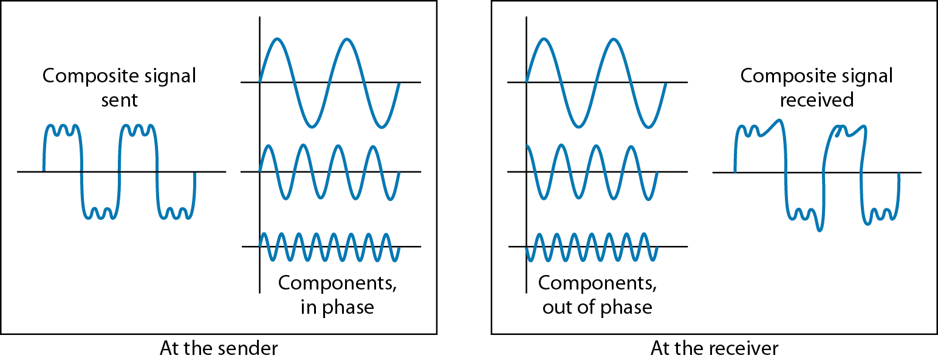
1
1
2
2
3
3
Figure 3.28 Distortion

Slide 14
Noise
Noise is another cause of impairment.
Several types of noise, such as thermal noise, induced noise, crosstalk, and impulse noise, may corrupt the signal.
Thermal noise is the random motion of electrons in a wire which creates an extra signal not originally sent by the transmitter.
Induced noise comes from sources such as motors and appliances. These devices act as a sending antenna, and the transmission medium acts as the receiving antenna.
Crosstalk is the effect of one wire on the other. One wire acts as a sending antenna and the other as the receiving antenna.
Impulse noise is a spike (a signal with high energy in a very short time) that comes from power lines, lightning, and so on.

Slide 15
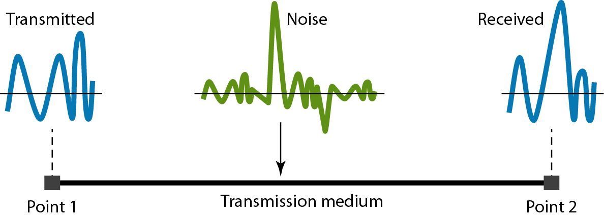
Figure 3.29 Noise

Slide 16
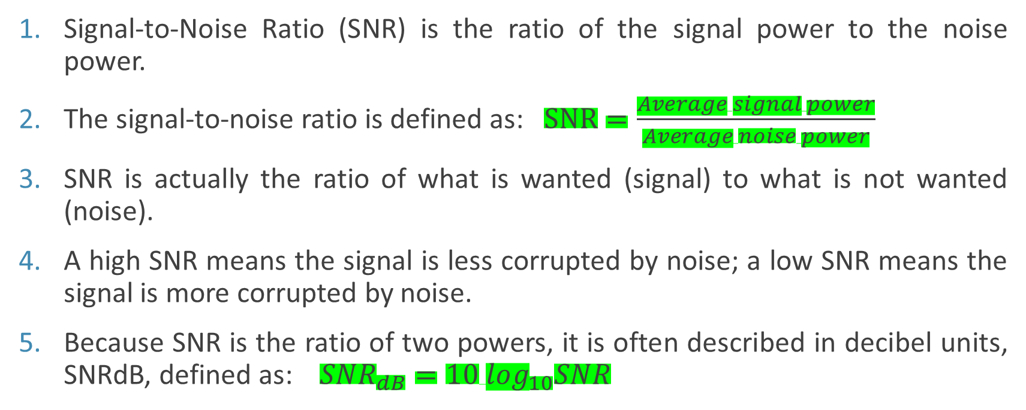
Signal-to-Noise Ratio (SNR)
Signal-to-Noise Ratio (SNR) is the ratio of the signal power to the noise power.
The signal-to-noise ratio is defined as: $SNR=\frac{Average signal power}{Average noise power}$
SNR is actually the ratio of what is wanted (signal) to what is not wanted (noise).
A high SNR means the signal is less corrupted by noise; a low SNR means the signal is more corrupted by noise.
Because SNR is the ratio of two powers, it is often described in decibel units, SNRdB, defined as: ${SNR}_{dB}=10 \log_{10}SNR$

Slide 17
Example 3.31
The power of a signal is 10 mW and the power of the noise is 1 μW; what are the values of SNR and SNR_{dB} ?
Solution
The values of SNR and SNRdB can be calculated as follows:

Slide 18
Example 3.32
The values of SNR and SNR_{dB} for a noiseless channel are
We can never achieve this ratio in real life; it is an ideal.

Slide 19
DATA RATE LIMITS
A very important consideration in data communications is how fast we can send data, in bits per second, over a channel. Data rate depends on three factors:
1. The bandwidth available
2. The level of the signals we use
3. The quality of the channel (the level of noise)
Two theoretical formulas were developed to calculate the data rate:
By Nyquist for a noiseless channel.
By Shannon for a noisy channel.

Slide 20

1. Noiseless Channel: Nyquist Bit Rate
For a noiseless channel, the Nyquist bit rate formula defines the theoretical maximum bit rate.
BitRate = 2 x bandwidth x log₂ L
In this formula, bandwidth is the bandwidth of the channel, L is the number of signal levels used to represent data, and BitRate is the bit rate in bits per second.
Increasing the levels of a signal may reduce the reliability of the system.

Slide 21
Example 3.33
Does the Nyquist theorem bit rate agree with the intuitive bit rate described in baseband transmission?
Solution
They match when we have only two levels. We observed that, in baseband transmission, the bit rate is 2 times the bandwidth, if we use only the first harmonic in the worst case. However, the Nyquist formula is more general than what we derived intuitively; it can be applied to baseband transmission and modulation. Also, it can be applied when we have two or more levels of signals.

Slide 22
Example 3.34
Consider a noiseless channel with a bandwidth of 3000 Hz transmitting a signal with two signal levels. The maximum bit rate can be calculated as

Slide 23
Example 3.35
Consider the same noiseless channel transmitting a signal with four signal levels (for each level, we send 2 bits). The maximum bit rate can be calculated as

Slide 24
Example 3.36
We need to send 265 kbps over a noiseless channel with a bandwidth of 20 kHz. How many signal levels do we need?
Solution
We can use the Nyquist formula as shown:
Since the number of levels is not a power of 2, we need to either increase the number of levels or reduce the bit rate. If we have 128 levels, the bit rate is 280 kbps. If we have 64 levels, the bit rate is 240 kbps.

Slide 25
2. Noisy Channel: Shannon Capacity
In 1944, Claude Shannon introduced a formula, called the Shannon capacity, to determine the theoretical highest data rate for a noisy channel:
Capacity = bandwidth X log2 (1 +SNR)
In this formula, bandwidth is the bandwidth of the channel, SNR is the signal-to-noise ratio, and capacity is the capacity of the channel in bits per second
No matter how many levels we have, we cannot achieve a data rate higher than the capacity of the channel.

Slide 26
Example 3.37
Consider an extremely noisy channel in which the value of the signal-to-noise ratio is almost zero. In other words, the noise is so strong that the signal is faint. For this channel the capacity C is calculated as
This means that the capacity of this channel is zero regardless of the bandwidth. In other words, we cannot receive any data through this channel.

Slide 27
Example 3.38
We can calculate the theoretical highest bit rate of a regular telephone line. A telephone line normally has a bandwidth of 3000. The signal-to-noise ratio is usually 3162. For this channel the capacity is calculated as

Slide 28
Example 3.39
The signal-to-noise ratio is often given in decibels. Assume that SNR_{dB} = 36 and the channel bandwidth is 2 MHz. The theoretical channel capacity can be calculated as:

Slide 29


Example 3.40
For practical purposes, when the SNR is very high, we can assume that SNR + 1 is almost the same as SNR. In these cases, the theoretical channel capacity can be simplified to
For example, we can calculate the theoretical capacity of the previous example as

Slide 30
Example 3.41
We have a channel with a 1-MHz bandwidth. The SNR for this channel is 63. What are the appropriate bit rate and signal level?
Solution
First, we use the Shannon formula to find the upper limit.
The Shannon formula gives us 6 Mbps, the upper limit. For better performance we choose something lower, 4 Mbps, for example. Then we use the Nyquist formula to find the number of signal levels.

Slide 31
The Shannon capacity gives us the upper limit; the Nyquist formula tells us how many signal levels we need.

Slide 32
PERFORMANCE
One important issue in networking is the performance of the network—how good is it?
We discuss quality of service, an overall measurement of network performance, in greater detail in the subsequent Chapter(24).
In this section, we introduce terms that we need for future chapters.

Slide 33
In networking, we use the term bandwidth in two contexts.
The first, bandwidth in hertz, refers to the range of frequencies in a composite signal or the range of frequencies that a channel can pass.
The second, bandwidth in bits per second, refers to the speed of bit transmission in a channel or link.
An increase in bandwidth in hertz means an increase in bandwidth in bits per second.

Slide 34
Example 3.42
The bandwidth of a subscriber line is 4 kHz for voice or data.
The bandwidth of this line for data transmission can be up to 56,000 bps using a sophisticated modem to change the digital signal to analog.
Example 3.43
If the telephone company improves the quality of the line and increases the bandwidth to 8 kHz, we can send 112,000 bps by using the same technology as mentioned above.

Slide 35
Throughput
It is a measure of how fast we can actually send data through a network. Although, at first glance they appears similar due to same units (i.e. bits per second),but, they are different.
A link may have a bandwidth of B bps, but we can only send T bps through this link with T always less than B.
In other words, the bandwidth is a potential measurement of a link; the throughput is an actual measurement of how fast we can send data.
For example, we may have a link with a bandwidth of 1 Mbps, but the devices connected to the end of the link may handle only 200 kbps. This means that we cannot send more than 200 kbps through this link.
Imagine a highway designed to transmit 1000 cars per minute from one point to another. However, if there is congestion on the road, this figure may be reduced to 100 cars per minute. The bandwidth is 1000 cars per minute; the throughput is 100 cars per minute.

Slide 36

Example 3.44
A network with bandwidth of 10 Mbps can pass only an average of 12,000 frames per minute with each frame carrying an average of 10,000 bits. What is the throughput of this network?
Solution
We can calculate the throughput as
The throughput is almost one-fifth of the bandwidth in this case.

Slide 37
Latency (Delay)
The latency or delay defines how long it takes for an entire message to completely arrive at the destination from the time the first bit is sent out from the source.
Latency is made of four components: propagation time, transmission time, queuing time and processing delay.
Latency =propagation time +transmission time +queuing time + processing delay
Propagation Time
Propagation time measures the time required for a bit to travel from the source to the destination.
The propagation time is calculated by dividing the distance by the propagation speed.
Propagation Time = Distance / Propagation Speed

Slide 38
Example 3.45
What is the propagation time if the distance between the two points is 12,000 km? Assume the propagation speed to be 2.4 × 10⁸ m/s in cable.
Solution
We can calculate the propagation time as
The example shows that a bit can go over the Atlantic Ocean in only 50 ms if there is a direct cable between the source and the destination.

Slide 39
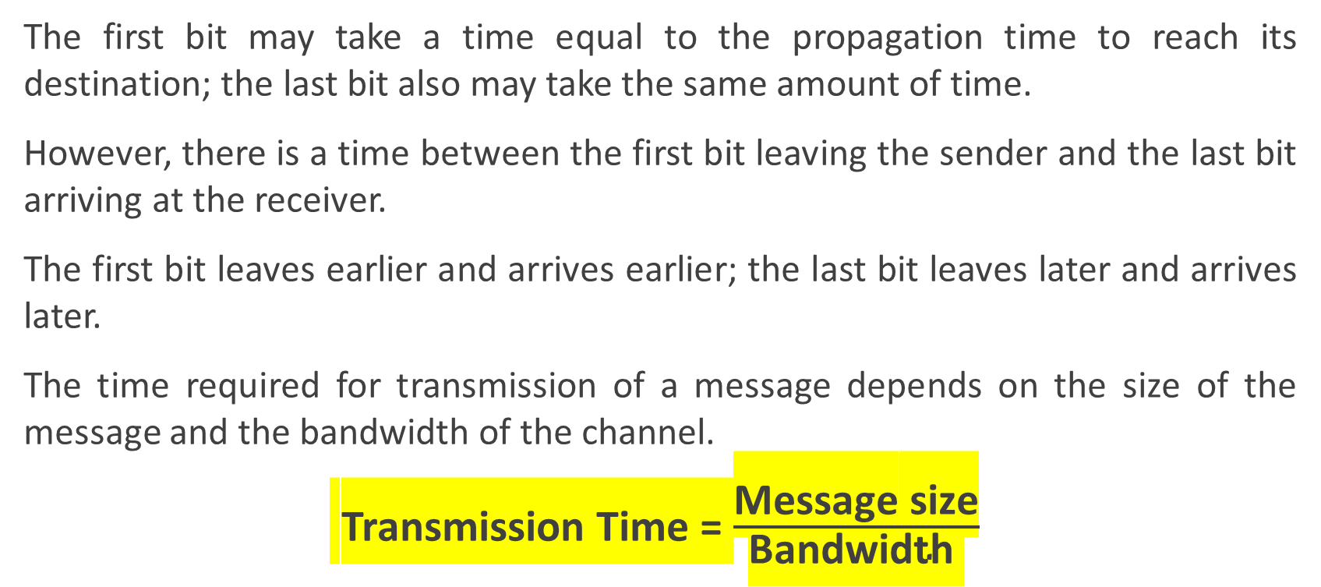
Transmission Time
The first bit may take a time equal to the propagation time to reach its destination; the last bit also may take the same amount of time.
However, there is a time between the first bit leaving the sender and the last bit arriving at the receiver.
The first bit leaves earlier and arrives earlier; the last bit leaves later and arrives later.
The time required for transmission of a message depends on the size of the message and the bandwidth of the channel.
Transmission Time = $\frac{\text{Message} \text{size}}{\text{Bandwidth} }$

Slide 40
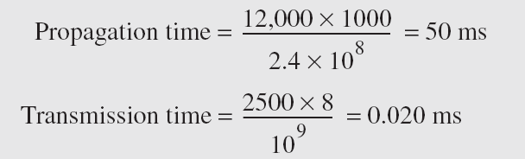
Example 3.46
What are the propagation time and the transmission time for a 2.5-kbyte message (an e-mail) if the bandwidth of the network is 1 Gbps? Assume that the distance between the sender and the receiver is 12,000 km and that light travels at 2.4 × 10⁸ m/s.
Solution
We can calculate the propagation and transmission time as shown:
Note that in this case, because the message is short and the bandwidth is high, the dominant factor is the propagation time, not the transmission time. The transmission time can be ignored.

Slide 41
Example 3.47
What are the propagation time and the transmission time for a 5-Mbyte message (an image) if the bandwidth of the network is 1 Mbps? Assume that the distance between the sender and the receiver is 12,000 km and that light travels at 2.4 × 10⁸ m/s.
Solution
We can calculate the propagation and transmission times as shown below.
Note that in this case, because the message is very long and the bandwidth is not very high, the dominant factor is the transmission time, not the propagation time. The propagation time can be ignored.

Slide 42
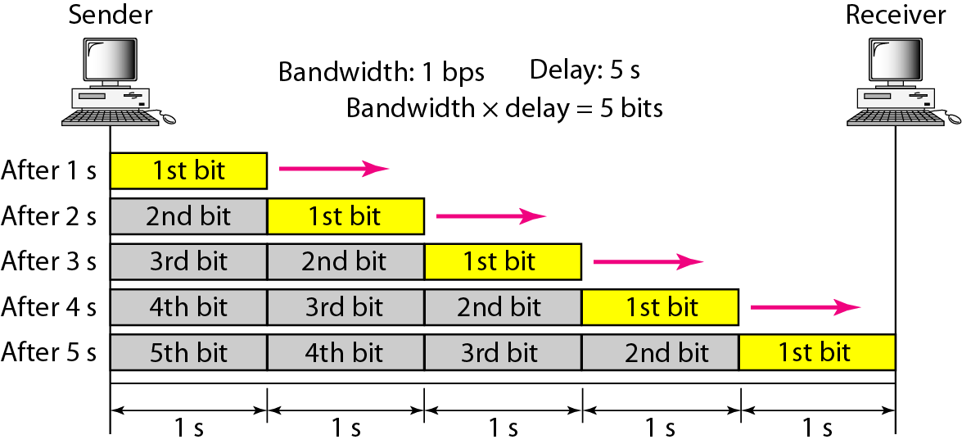
Figure 3.31 Filling the link with bits for case 1

Slide 43
Example 3.48
We can think about the link between two points as a pipe. The cross section of the pipe represents the bandwidth, and the length of the pipe represents the delay. We can say the volume of the pipe defines the bandwidth-delay product, as shown in Figure 3.33.

Slide 44
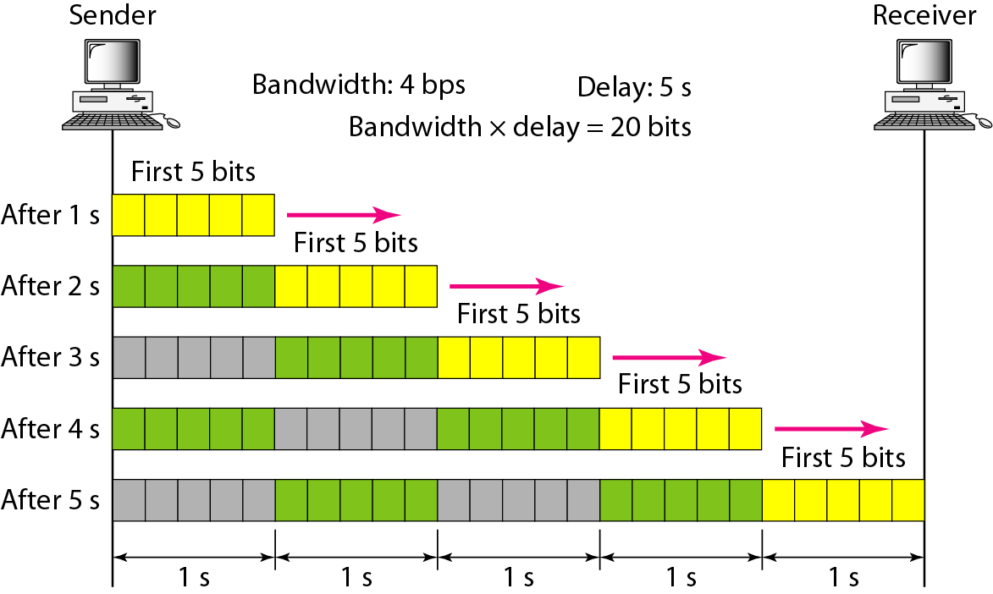
Figure 3.32 Filling the link with bits in case 2
5 bps
25 bits

Slide 45
The bandwidth-delay product defines the number of bits that can fill the link.

Slide 46

Figure 3.33 Concept of bandwidth-delay product

Slide 47
What have we completed?
Thank You
Transmission Impairments
Attenuation
Distortion
Noise
Signal to Noise Ratio
Data Rate Limits
Nyquist Bit Rate
Shannon Capacity
Performance

