Slide 1
Transmission Media
Self Study 1
Chapter 07

Slide 2
Topics covered
Classes of transmission media
Guided media
Unguided media

Slide 3
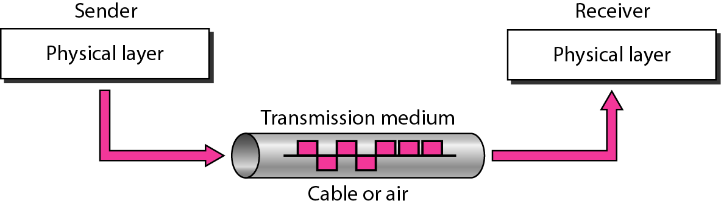
Figure 7.1 Transmission medium and physical layer

Slide 4
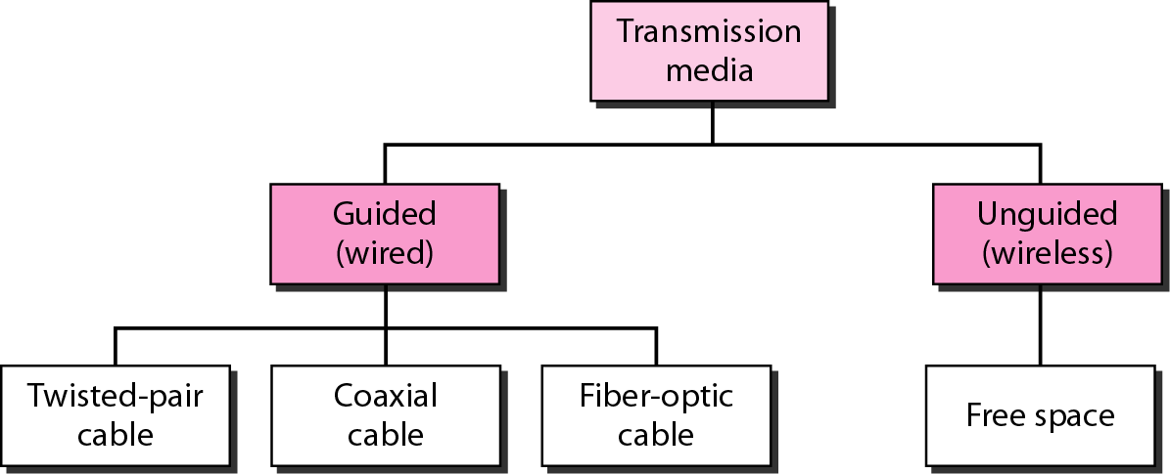
Figure 7.2 Classes of transmission media

Slide 5
7-1 GUIDED MEDIA
Guided media, which are those that provide a conduit from one device to another, include twisted-pair cable, coaxial cable, and fiber-optic cable.
Twisted-Pair Cable Coaxial Cable Fiber-Optic Cable

Slide 6
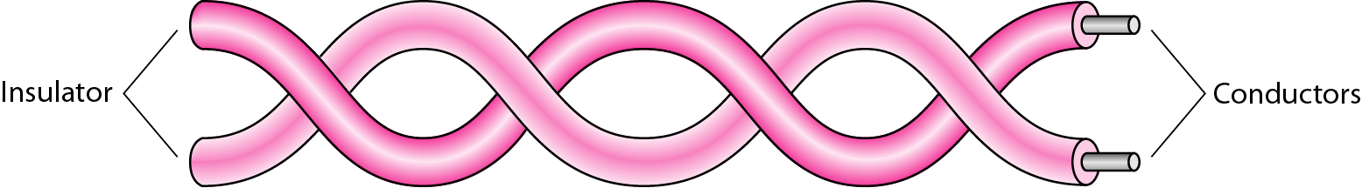
Figure 7.3 Twisted-pair cable

Slide 7
Twisted-pair cable
One of the wires is used to carry signals to the receiver, and the other is used only as a ground reference. The receiver uses the difference between the two.
In addition to the signal sent by the sender on one of the wires, interference (noise) and crosstalk may affect both wires and create unwanted signals.
By twisting the pairs, a balance is maintained. For example, suppose in one twist, one wire is closer to the noise source and the other is farther; in the next twist, the reverse is true.
Twisting makes it probable that both wires are equally affected by external influences (noise or crosstalk). This means that the receiver, which calculates the difference between the two, receives no unwanted signals.

Slide 8
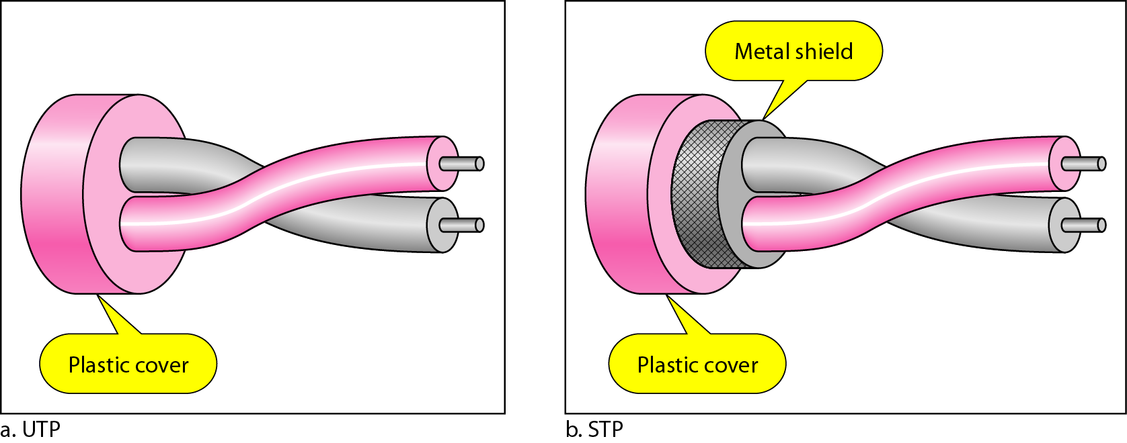
Figure 7.4 UTP and STP cables

Slide 9
The most common twisted-pair cable used in communications is referred to as unshielded twisted-pair (UTP).
IBM has also produced a version of twisted-pair cable for its use, called shielded twisted-pair (STP).
STP cable has a metal foil or braided mesh covering that encases each pair of insulated conductors.
Although metal casing improves the quality of cable by preventing the penetration of noise or crosstalk, it is bulkier and more expensive.

Slide 10
Table 7.1 Categories of unshielded twisted-pair cables

Slide 11
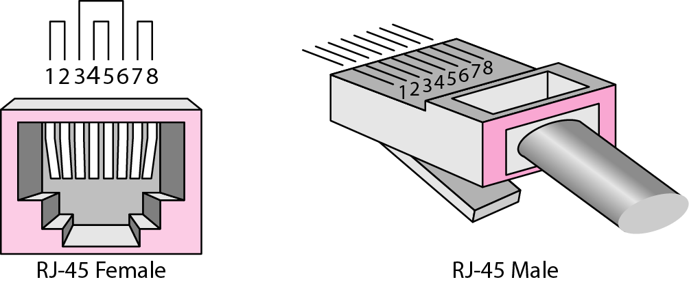
Figure 7.5 UTP connector
The most common UTP connector is RJ45 (RJ stands for registered jack), as shown in Figure 7.5.
The RJ45 is a keyed connector, meaning the connector can be inserted in
only one way.

Slide 12
Applications of twisted pair cable
Twisted-pair cables are used in telephone lines to provide voice and data channels.
The local loop—the line that connects subscribers to the central telephone office—commonly consists of unshielded twisted-pair cables.
The DSL lines that are used by the telephone companies to provide high-data-rate connections also use the high-bandwidth capability of unshielded twisted-pair cables.

Slide 13
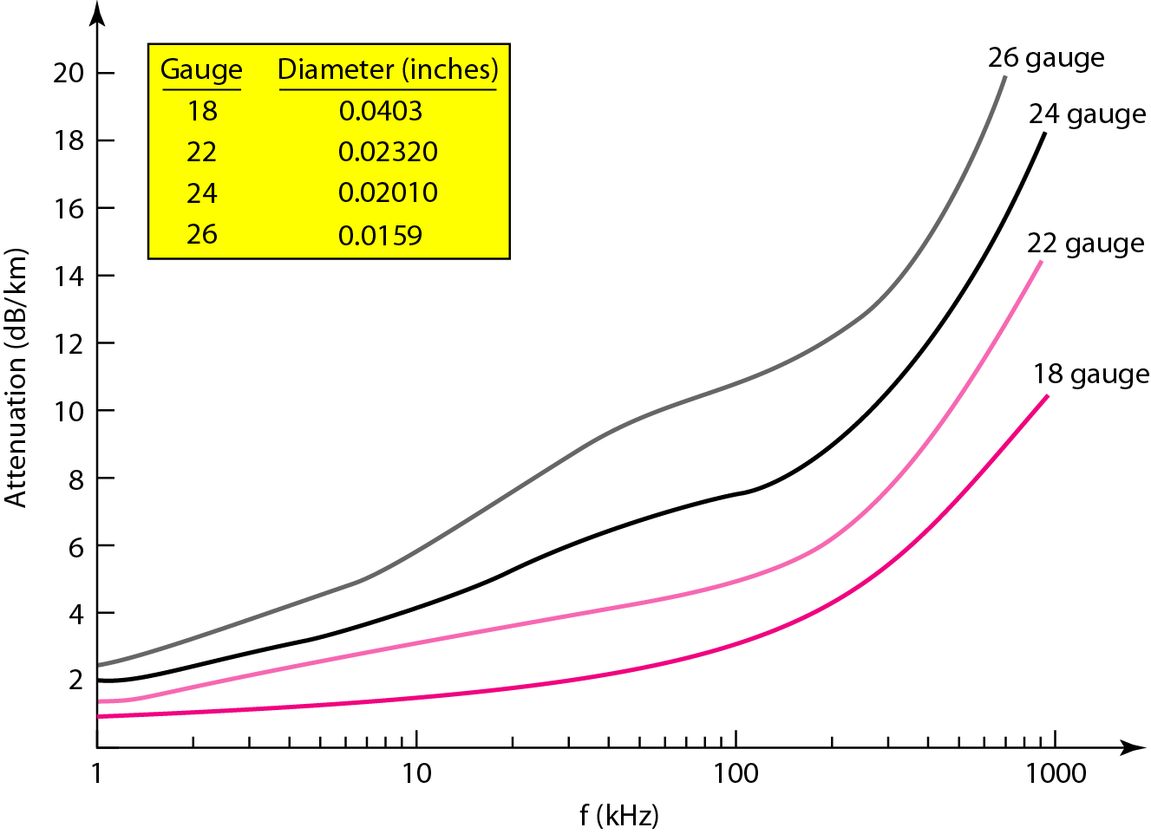
Figure 7.6 UTP performance

Slide 14
Co-axial cable
Coaxial cable (or coax) carries signals of higher frequency ranges than those in twisted-pair cable, in part because the two media are constructed quite differently.
Instead of having two wires, coax has a central core conductor of solid or stranded wire (usually copper) enclosed in an insulating sheath, which is, in turn, encased in an outer conductor of metal foil, braid, or a combination of the two.
The outer metallic wrapping serves both as a shield against noise and as the second conductor, which completes the circuit.
This outer conductor is also enclosed in an insulating sheath, and the whole cable is protected by a plastic cover (see Figure 7.7).

Slide 15
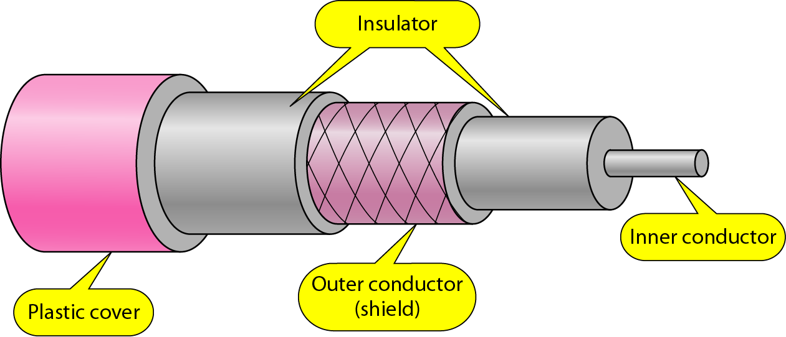
Figure 7.7 Coaxial cable

Slide 16
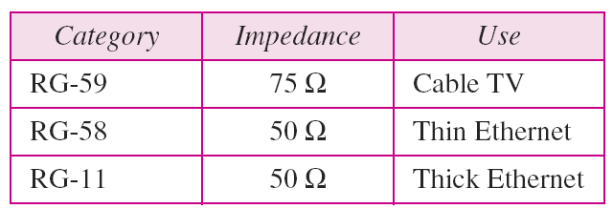
Table 7.2 Categories of coaxial cables

Slide 17
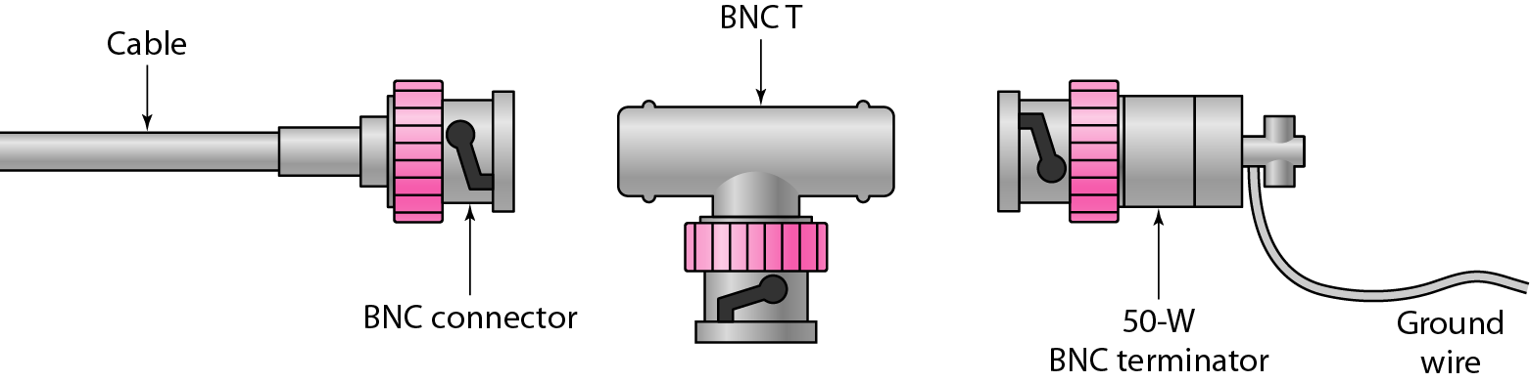
Figure 7.8 BNC connectors
Coaxial Cable Connectors
The most common type of connector used today is the Bayonet Neill-Concelman (BNC) connector.
Figure 7.8 shows three popular types of these connectors: the BNC connector, the BNC T connector, and the BNC terminator. The BNC connector is used to connect the end of the cable to a device, such as a TV set.
The BNC T connector is used in Ethernet networks (see Chapter 13) to branch out to a connection to a computer or other device.
The BNC terminator is used at the end of the cable to prevent the reflection of the signal.

Slide 18
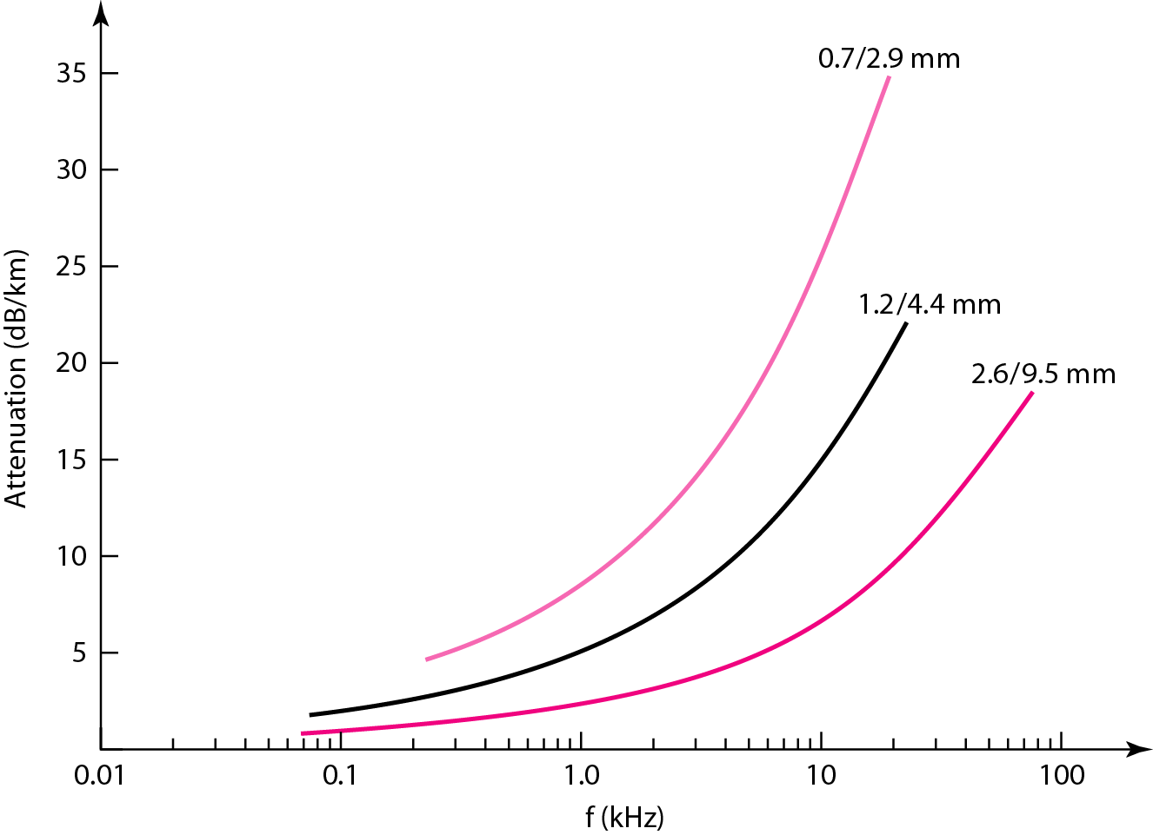
Figure 7.9 Coaxial cable performance

Slide 19
Applications of Co-axial cable
Coaxial cable was widely used in analog telephone networks where a single coaxial network could carry 10,000 voice signals.
Later it was used in digital telephone networks where a single coaxial cable could carry digital data up to 600 Mbps.
However, coaxial cable in telephone networks has largely been replaced today with fiber-optic cable.

Slide 20
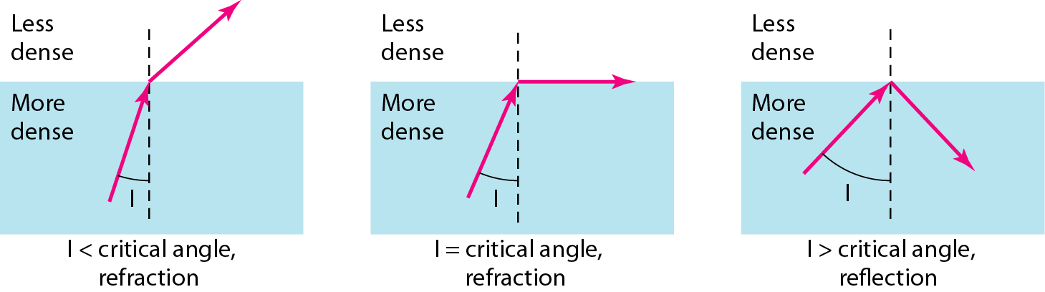
Figure 7.10 Bending of light ray
As the figure shows, if the angle of incidence I (the angle the ray makes with the line perpendicular to the interface between the two substances) is less than the critical angle, the ray refracts and moves closer to the surface.
If the angle of incidence is equal to the critical angle, the light bends along the interface.
If the angle is greater than the critical angle, the ray reflects (makes a turn) and travels again in the denser substance.
Note that the critical angle is a property of the substance, and its value differs from one substance to another.

Slide 21
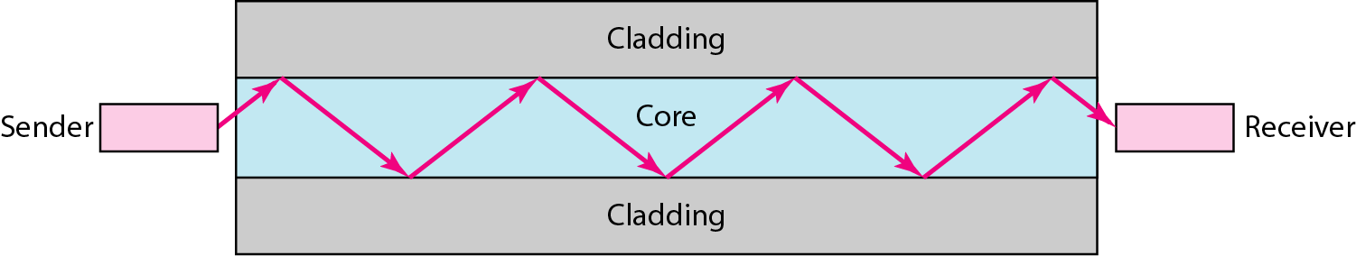
Figure 7.11 Optical fiber
Optical fibers use reflection to guide light through a channel.
A glass or plastic core is surrounded by a cladding of less dense glass or plastic.
The difference in density of the two materials must be such that a beam of light moving through the core is reflected off the cladding instead of being refracted into it. See Figure 7.11.

Slide 22
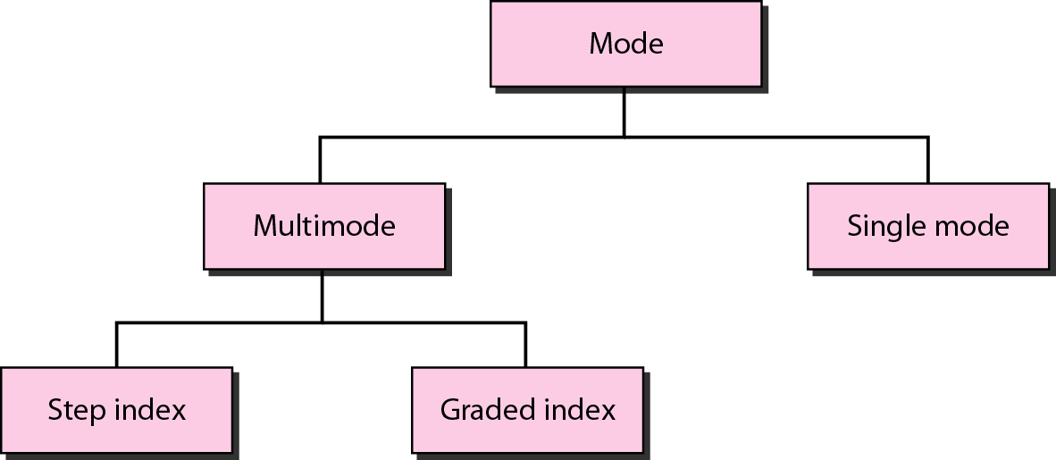
Figure 7.12 Propagation modes

Slide 23
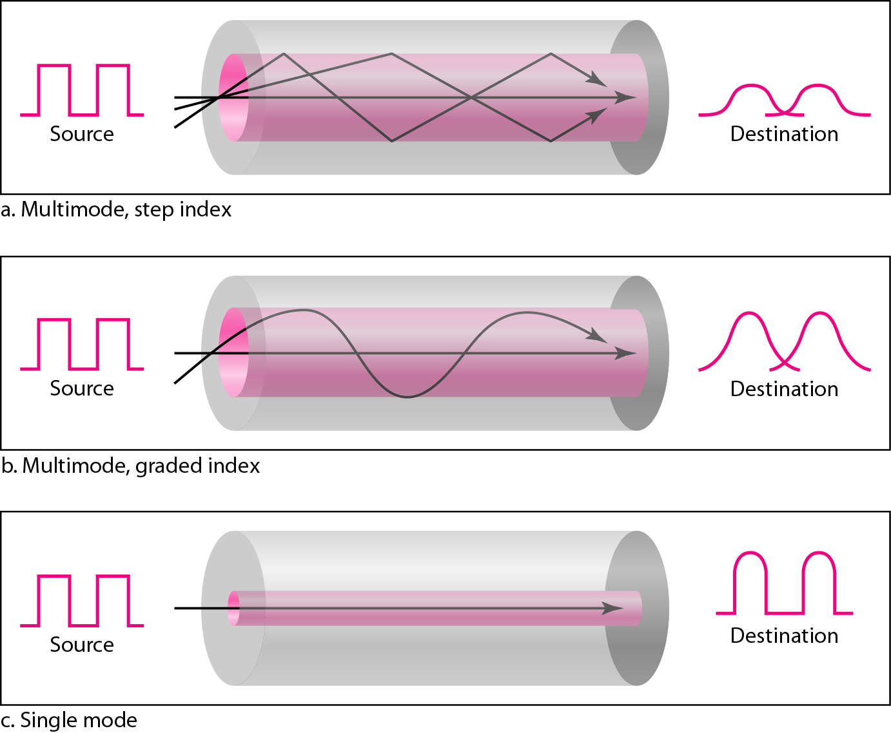
Figure 7.13 Modes

Slide 24
Table 7.3 Fiber types

Slide 25
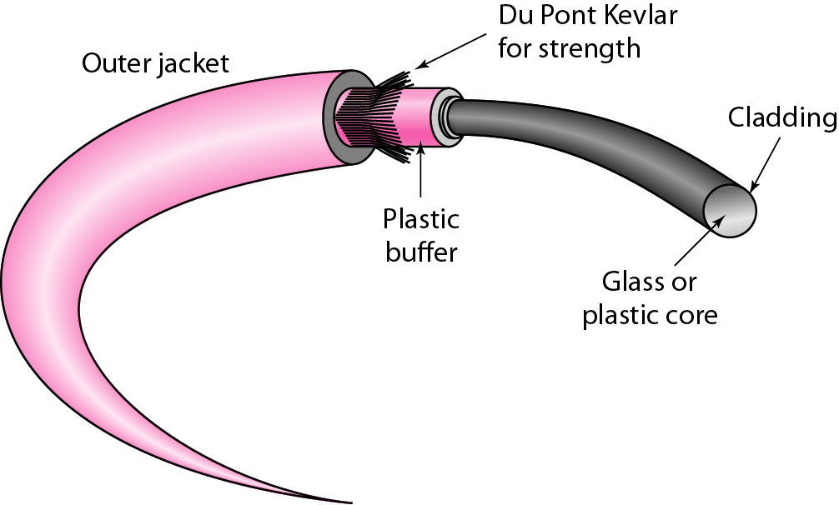
Figure 7.14 Fiber construction

Slide 26
The outer jacket is made of either PVC or Teflon. Inside the jacket are Kevlar strands to strengthen the cable.
Kevlar is a strong material used in the fabrication of bulletproof vests. Below the Kevlar is another plastic coating to cushion the fiber.
The fiber is at the center of the cable, and it consists of cladding and core.

Slide 27
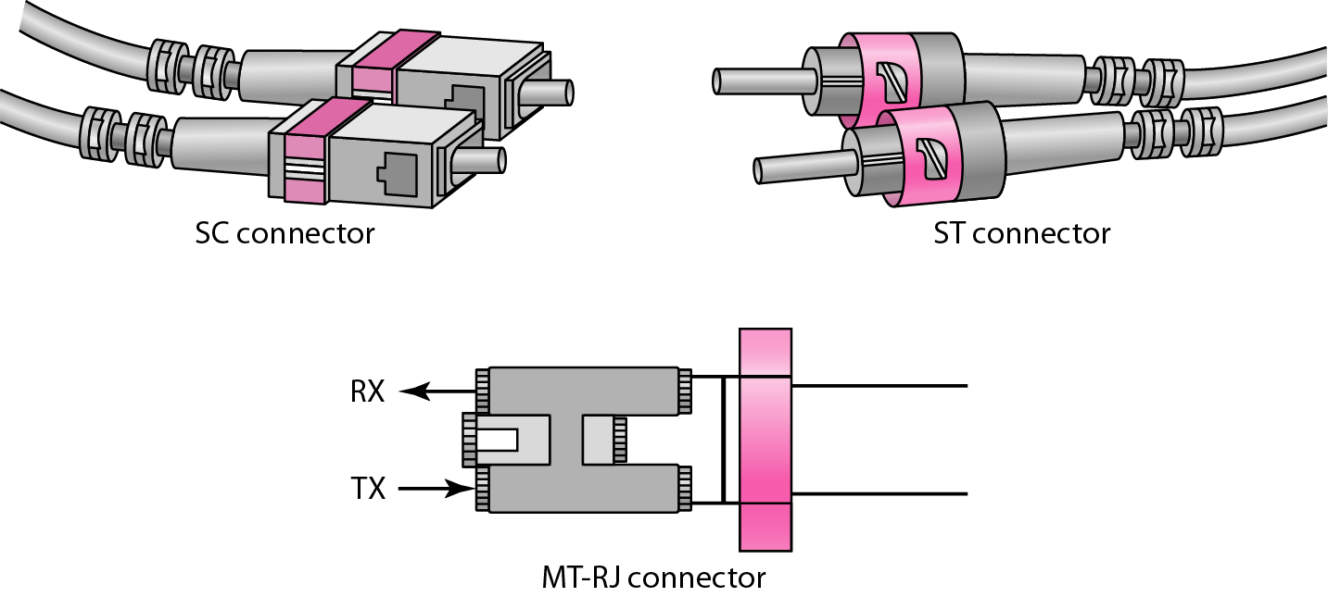
Figure 7.15 Fiber-optic cable connectors

Slide 28
Fiber-Optic Cable Connectors
There are three types of connectors for fiber-optic cables, as shown in Figure 7.15.
The subscriber channel (SC) connector is used for cable TV.
It uses a push/pull locking system.
The straight-tip (ST) connector is used for connecting cable to networking devices.
It uses a bayonet locking system and is more reliable than SC. MT-RJ is a connector that is the same size as RJ45.

Slide 29
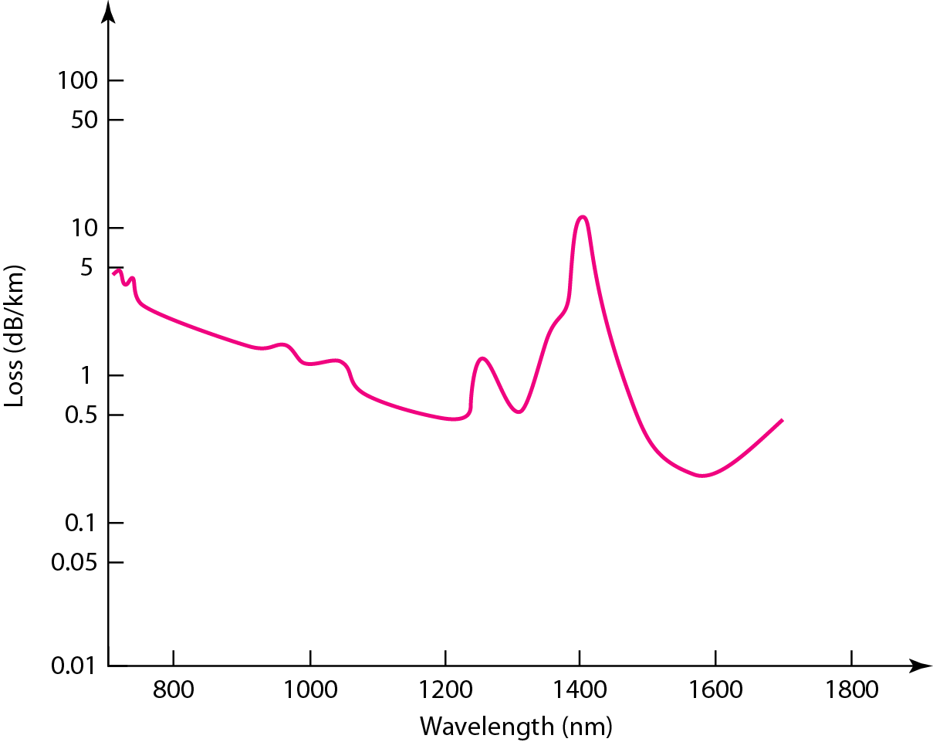
Figure 7.16 Optical fiber performance
The plot of attenuation versus wavelength in Figure 7.16 shows a very interesting phenomenon in fiber-optic cable. Attenuation is flatter than in the case of twisted-pair cable and coaxial cable. The performance is such that we need fewer (actually one tenth as many) repeaters when we use fiber-optic cable.

Slide 30
Applications of OFC
Fiber-optic cable is often found in backbone networks because its wide bandwidth is cost-effective.
With wavelength-division multiplexing (WDM), we can transfer data at a rate of 1600 Gbps.
The SONET network that we will discuss in Chapter 14 provides such a backbone.
Some cable TV companies use a combination of optical fiber and coaxial cable, thus creating a hybrid network.
Optical fiber provides the backbone structure while coaxial cable provides the connection to the user premises.
This is a cost-effective configuration since the narrow bandwidth requirement at the user end does not justify the use of optical fiber.

Slide 31
Advantages of OFC
Fiber-optic cable has several advantages over metallic cable (twisted-pair or coaxial).
Higher bandwidth. Fiber-optic cable can support dramatically higher bandwidths (and hence data rates) than either twisted-pair or coaxial cable. Currently, data rates and bandwidth utilization over fiber-optic cable are limited not by the medium but by the signal generation and reception technology available.
Less signal attenuation. Fiber-optic transmission distance is significantly greater than that of other guided media. A signal can run for 50 km without requiring regeneration. We need repeaters every 5 km for coaxial or twisted-pair cable.
Immunity to electromagnetic interference. Electromagnetic noise cannot affect fiber-optic cables.
Resistance to corrosive materials. Glass is more resistant to corrosive materials than copper.
Light weight. Fiber-optic cables are much lighter than copper cables.
Greater immunity to tapping. Fiber-optic cables are more immune to tapping than copper cables. Copper cables create antenna effects that can easily be tapped.

Slide 32
Disadvantages
Installation and maintenance: Fiber-optic cable is a relatively new technology. Its installation and maintenance require expertise that is not yet available everywhere.
Unidirectional light propagation: Propagation of light is unidirectional. If we
need bidirectional communication, two fibers are needed.
Cost: The cable and the interfaces are relatively more expensive than those of other guided media. If the demand for bandwidth is not high, often the use of optical fiber cannot be justified.

Slide 33
7-2 UNGUIDED MEDIA: WIRELESS
Unguided media transport electromagnetic waves without using a physical conductor. This type of communication is often referred to as wireless communication.

Slide 34
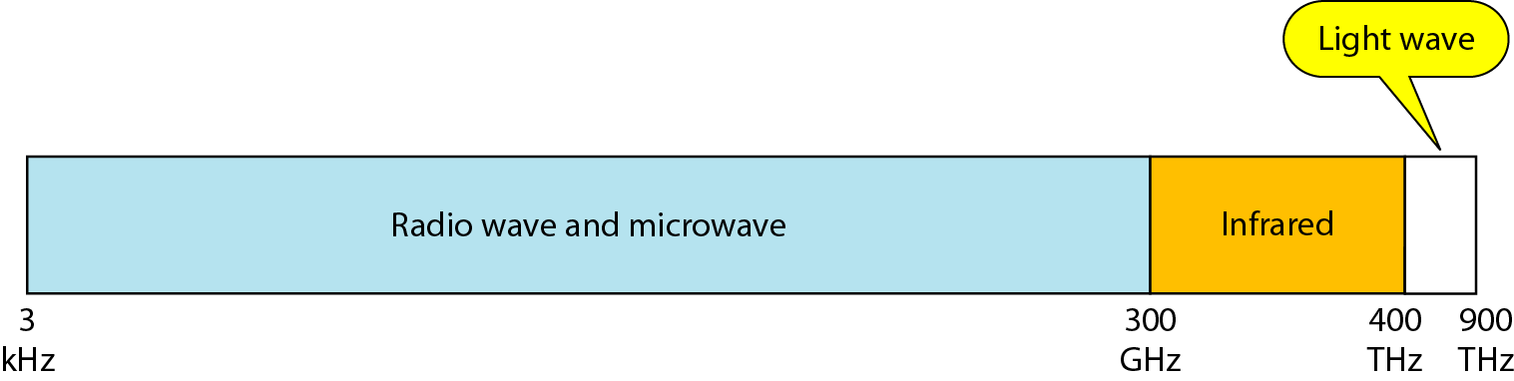
Figure 7.17 Electromagnetic spectrum for wireless communication

Slide 35
In ground propagation, radio waves travel through the lowest portion of the atmosphere, hugging the earth. These low-frequency signals emanate in all directions from the transmitting antenna and follow the curvature of the planet. Distance depends on the amount of power in the signal: The greater the power, the greater the distance.
In sky propagation, higher-frequency radio waves radiate upward into the ionosphere (the layer of atmosphere where particles exist as ions) where they are reflected back to earth. This type of transmission allows for greater distances with lower output power.
In line-of-sight propagation, very high-frequency signals are transmitted in straight lines directly from antenna to antenna. Antennas must be directional, facing each other, and either tall enough or close enough together not to be affected by the curvature of the earth. Line-of sight propagation is tricky because radio transmissions cannot be completely focused.

Slide 36
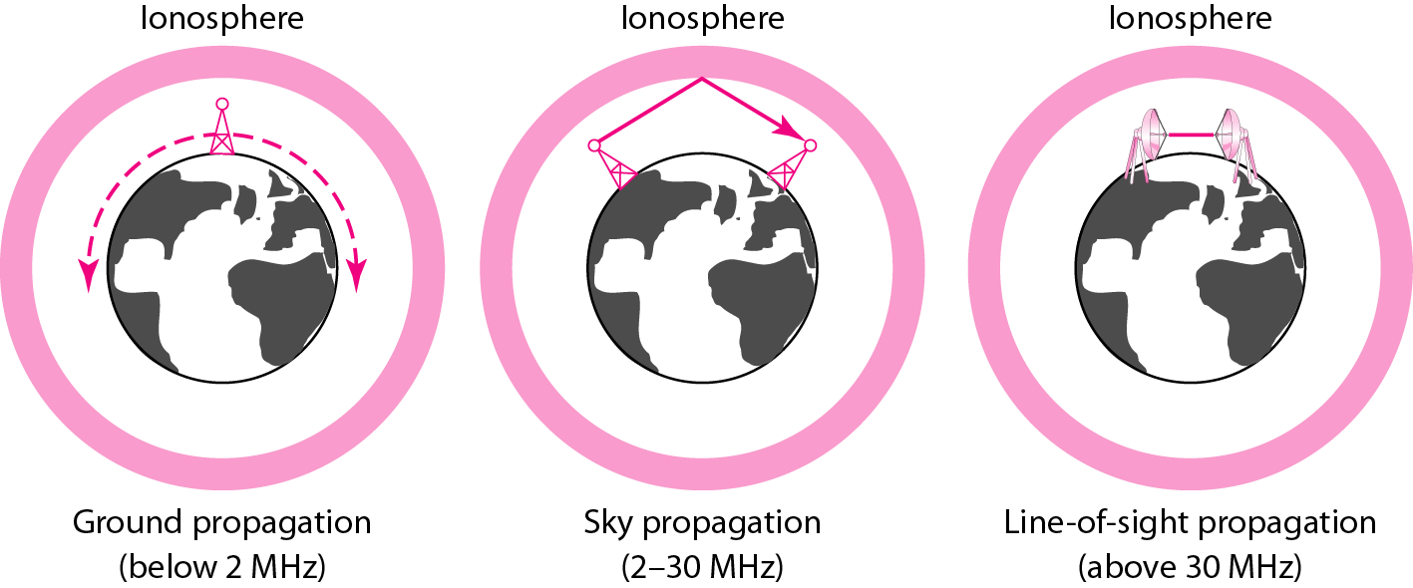
Figure 7.18 Propagation methods

Slide 37
Table 7.4 Bands

Slide 38
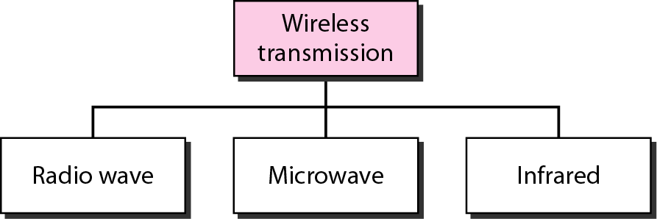
Figure 7.19 Wireless transmission waves

Slide 39
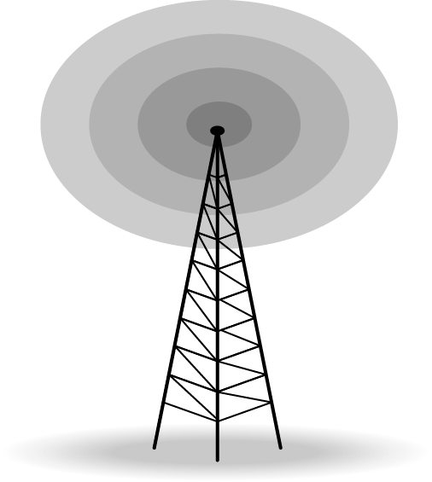
Figure 7.20 Omnidirectional antenna
Radio waves use omnidirectional antennas that send out signals in all directions.
Based on the wavelength, strength, and the purpose of transmission, we can have several
types of antennas. Figure 7.19 shows an omnidirectional antenna.

Slide 40

Applications
Radio waves are used for multicast communications, such as radio and television, and paging systems.

Slide 41
Characteristics of microwave propagation:
Microwave propagation is line-of-sight. Since the towers with the mounted antennas need to be in direct sight of each other, towers that are far apart need to be very tall. The curvature of the earth as well as other blocking obstacles do not allow two short towers to communicate by using microwaves. Repeaters are often needed for longdistance communication.
Very high-frequency microwaves cannot penetrate walls. This characteristic can be a disadvantage if receivers are inside buildings.
The microwave band is relatively wide, almost 299 GHz. Therefore wider subbands can be assigned, and a high data rate is possible.
Use of certain portions of the band requires permission from authorities.

Slide 42
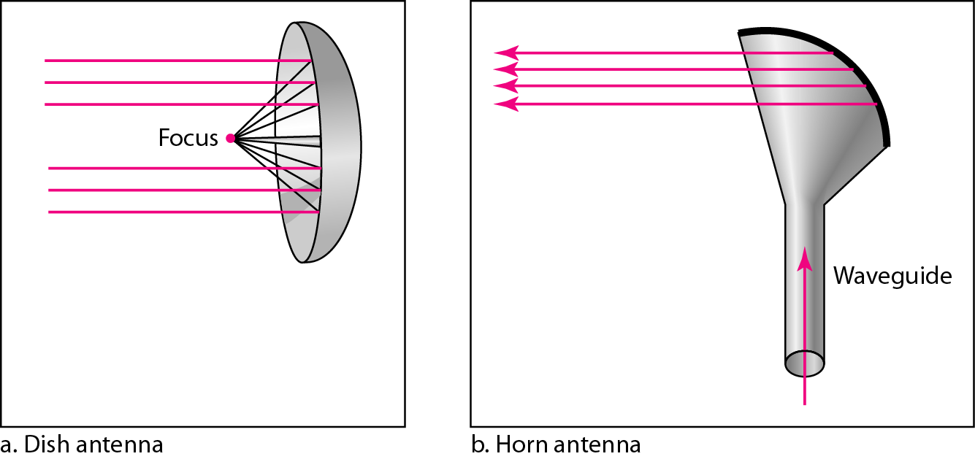
Figure 7.21 Unidirectional antennas
Microwaves need unidirectional antennas that send out signals in one direction. Two types of antennas are used for microwave communications: the parabolic dish and the horn (see Figure 7.21).

Slide 43
Applications of Microwave
Microwaves are used for unicast communication such as cellular telephones, satellite networks, and wireless LANs.

Slide 44
Applications of infrared
Infrared signals can be used for short-range communication in a closed area using line-of-sight propagation.

Slide 45
What have we covered?
Thank You
Classes of transmission media
Guided media
Unguided media

