Slide 1
Graphical search Algorithms [Depth-First Search and Breadth-First Search]
What is an algorithms
An algorithm can be thought of procedure or formula to solve a particular problem
What is graph search
In graph search, we search a path tied with vertices.
We might see an example of a route search for trains before. In route search, it searches the path tied with stations from the train route map
Eg: Google Map’s route search and Facebook’s friend suggestions on the social graph
There are two basic graph search algorithms:
Breadth-first search (BFS) and
Depth-first search (DFS).

Slide 2
BFS and DFS
There are two types of graph search
Breadth-First Search
Depth first Search
Both are graph traversal method
BFS works of queue mechanism, where as DFS works on stack mechanism.
BFS works as FIFO and DFS works as LIFO
BFS works for wide range, where as DFS used for depth.

Slide 3
BFS and DFS
In BFS we will explore a vertex then we go to the next vertex for exploration, but in DFS once we visited new vertex, we suspend the earlier vertex and start exploring new vertex
BFS is just a level order in a binary tree where as DFS is pre order traversal of a graph.
In BFS all connections at one time where as in DFS one connection in one time.
Can start traversal from any vertex in both BFS as well as DFS.

Slide 4
Graph search example
We can apply a graph search algorithm to some problem by changing our viewpoint. For example, tic-tac-toe is that kind of problem. In the figure below, I am a player X and it is my turn to take action. From the figure below, I can draw X on three different positions and only one position can make me win. Of course, I’d like to win this game, so I choose the position makes me win (the position left end).

Slide 5
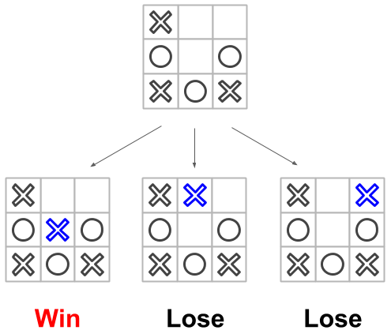
We can see the position as the vertex and the changes in the position as the edge. Now we know finding the path to win .
A tic-tac-toe game is kind of the graph search problem.

Slide 6
Breadth-First Search
Breadth-First Search
Breadth-First Search is one of the essential search algorithms to tackle competitive programming.
BFS can be start from any vertex point and while exploring the vertexes ,can visit any adjacent vertex in any order. But when we are selecting a vertex for exploration .have to visit all the adjacent for particular vertex then only can go with other vertex. All queue and exploration have to be completely done.

Slide 7
Algorithm of the breadth-first search
In breadth-first search, we visit the vertex from around it and finally visit all vertices if possible.
Algorithm as following.
Add the vertex to start the breadth-first search to the empty queue. Mark that vertex visited.
Extract a vertex from the queue and add its neighbors to the queue if that isn't marked visited.
Repeat step 2 until the queue is empty.

Slide 8
Algorithm of the BFS continued
Step 1 is initialization to execute the algorithm. Here when we add the vertex queue, we mark the vertex visited.
Step 2 is the main process for the breadth-first search. Basically, this process repeats to add the neighbors of the vertex extracted from the queue to the queue. However, the vertices added to the queue are only marked not visited. I’ll explain the reason why we should do this later.
Step 3 is the condition to finish the loop of step 2. When the queue is empty, we visited all reachable vertices from the vertex from which we start searching.

Slide 9
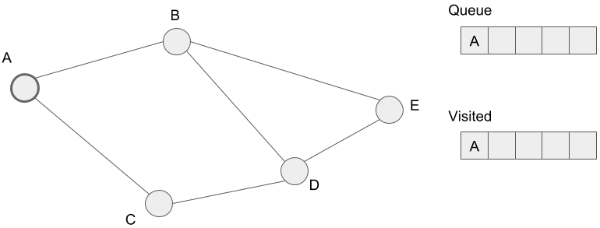
How Algorithm works for BFS
the way how the algorithm works. In the graph below, we start searching from the vertex A. Here is the initial state below.

Slide 10
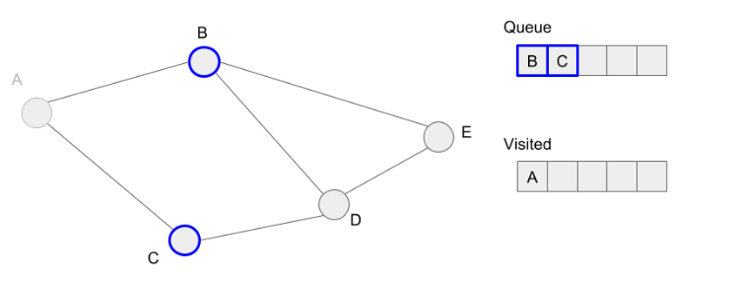
How Algorithm works for BFS contd.
First, we extract vertex A from the queue. The neighbors of the vertex A, B and C, are not visited, so we add these to the queue.

Slide 11
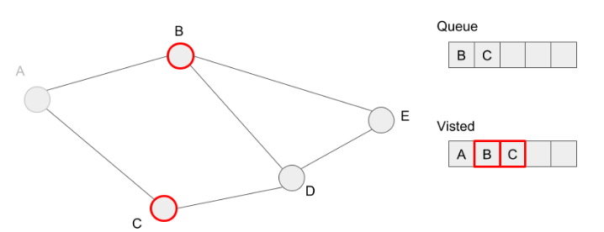
How Algorithm works for BFS contd.
We mark the vertices, B and C as visited because we added these to the queue.

Slide 12
How Algorithm works for BFS contd.
Next, we extract vertex B from the queue and then try to add the neighbors (A, D, E). However, we’ve already marked the vertex A as visited, so we only add the vertices D and E to the queue. Here, let’s think the case what if we also added the vertex A to the queue. If we add vertex A to the queue again, we should visit vertex A again. This means an infinite loop happens, so the program doesn’t finish. In other words, the condition of step 3 in the algorithm is always true because of the queue isn’t empty forever. This is the reason why we shouldn’t add the already visited vertex into the queue

Slide 13
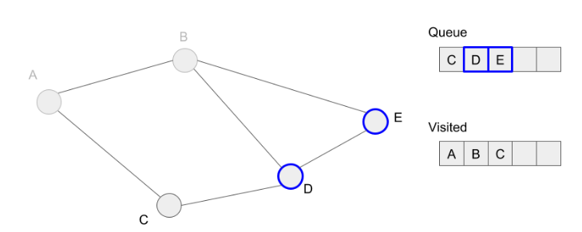
How Algorithm works for BFS contd.
Then we mark vertices D and E visited because we added these to the queue.

Slide 14
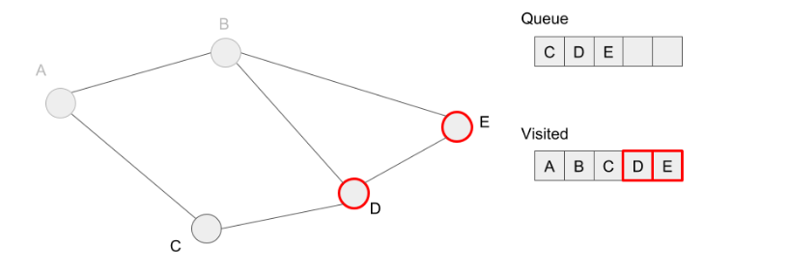
How Algorithm works for BFS contd.
We extract vertex C from the queue. However, we don’t have any vertex added to the queue because we’ve already visited all neighbors of vertex C.

Slide 15
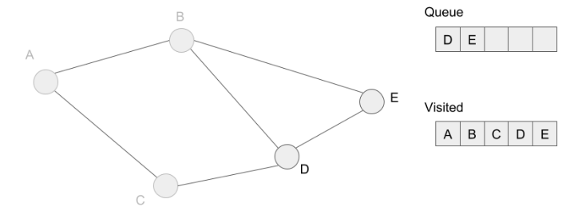
How Algorithm works for BFS contd.
We are going to extract vertices D and E, but we’ve also visited these neighbors before. So the queue is empty and we finish to search. Finally, we’ve visited all reachable vertices from vertex A. In other words, we’ve marked all vertices visited.

Slide 16
Depth first Search
Depth first Search is a recursive algorithm for searching all the vertices of a graph or tree data structure
A standard DFS implementation puts each vertex of the graph into one of two categories:
Visited
Not Visited

Slide 17
DFS algorithm
algorithm is to mark each vertex as visited while avoiding cycles.
The DFS algorithm works as follows:
Start by putting any one of the graph's vertices on top of a stack.
Take the top item of the stack and add it to the visited list.
Create a list of that vertex's adjacent nodes. Add the ones which aren't in the visited list to the top of stack.
Keep repeating steps 2 and 3 until the stack is empty.

Slide 18
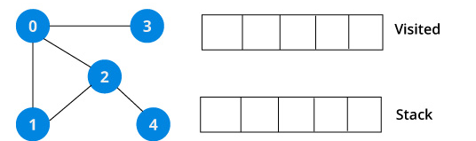
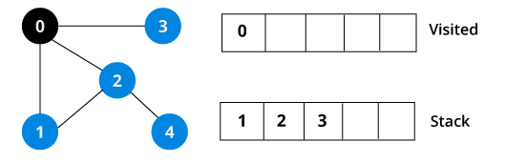
DFS example
Depth First Search algorithm works with an example. We use an undirected graph with 5 vertices.
We start from vertex 0, the DFS algorithm starts by putting it in the Visited list and putting all its adjacent vertices in the stack.

Slide 19
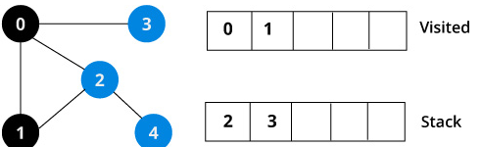
DFS example continued
Next, we visit the element at the top of stack i.e. 1 and go to its adjacent nodes. Since 0 has already been visited, we visit 2 instead.
Vertex 2 has an unvisited adjacent vertex in 4, so we add that to the top of the stack and visit it.

Slide 20
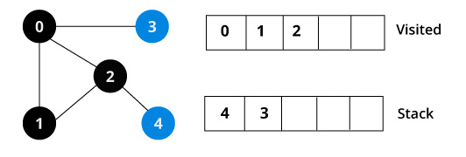
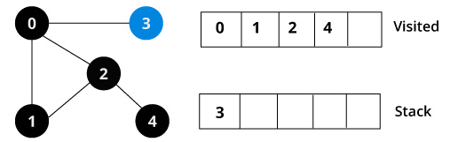
DFS example continued

Slide 21
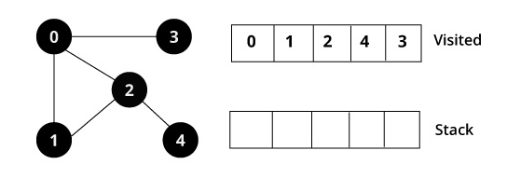
DFS example continued
After we visit the last element 3, it doesn't have any unvisited adjacent nodes, so we have completed the Depth First Traversal of the graph
.

Slide 22
DFS pseudocode (recursive implementation)
The pseudocode for DFS
We need to run the DFS function on every node. This is because the graph might have two different disconnected parts so to make sure that we cover every vertex, we can also run the DFS algorithm on every node.

Slide 23
Defth first Search -program
def dfs(graph, start, visited=None):
if visited is None:
visited = set()
visited.add(start)
print(start)
for next in graph[start] - visited:
dfs(graph, next, visited)
return visited
graph = {'0': set(['1', '2']),
'1': set(['0', '3', '4']),
'2': set(['0']),
'3': set(['1']),
'4': set(['2', '3'])} dfs(graph, '0')

