Slide 1


MUSIC STORE DATA ANALYSIS
USING SQL

Slide 2
Introduction
The digital music industry generates large volumes of customer and sales data. Analyzing this data helps understand user preferences, popular genres, top artists, and revenue patterns.
This project uses SQL to analyze a music store database containing information about customers, tracks, albums, artists, and purchases. By applying queries, meaningful insights are extracted to support data-driven decision making in the music business.

Slide 3
Objective
The objective of this project is to analyze a music store data using SQL to extract meaningful business insights.
The key objectives of this project is:
Understand relational database structure.
Apply SQL concepts to get the meaningful insights from the data.
Practice complex SQL queries.
Analyze the customer behaviour and sales pattern.
Identify top customers, popular genres, popular cities and revenue sources.
Support data-driven business decisions.
This project applies SQL concepts to a real-world dataset to simulate business analytics scenarios

Slide 4
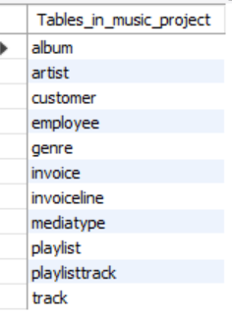
Tables

Slide 5


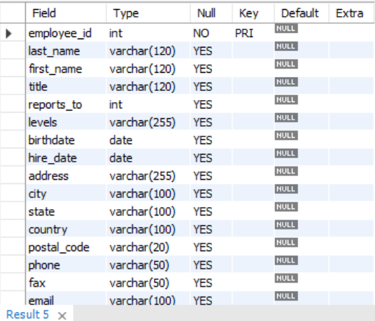
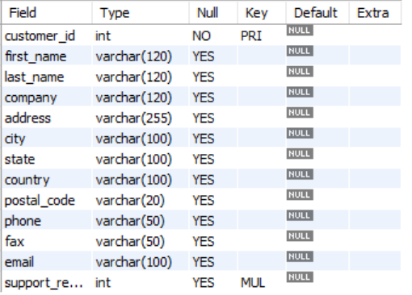
1. Genre Table
Tables Structures
2. MediaType Table
3. Employee Table
4. Customer Table

Slide 6

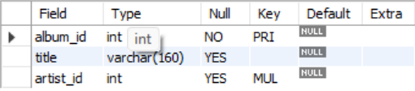
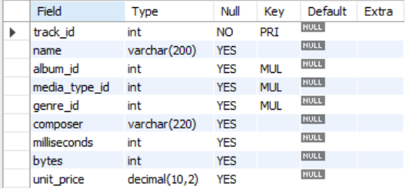
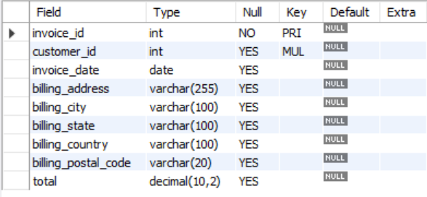
6. Album Table
5. Artist Table
7. Track Table
8. Invoice Table

Slide 7
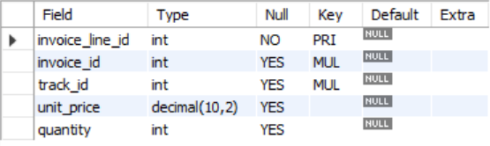


11. Playlisttrack Table
9. Invoiceline Table
10. Playlist Table

Slide 8
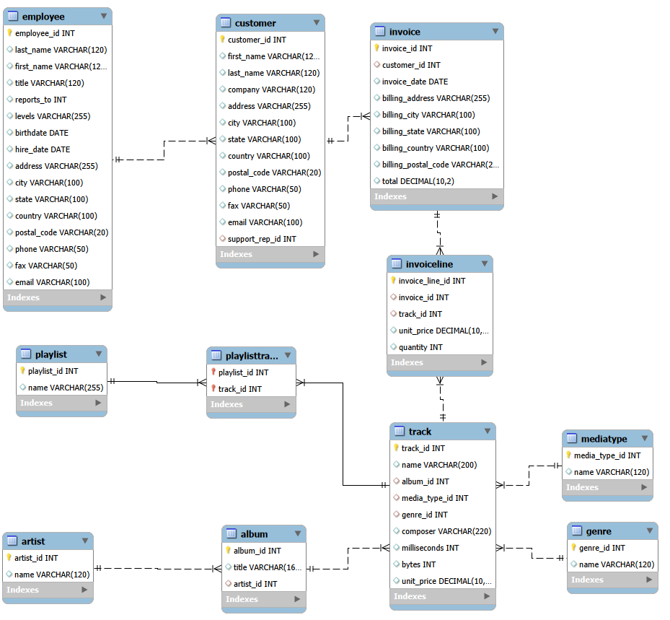
ER Diagram

Slide 9
Analysis
Who is the senior most employee based on job title?
Which countries have the most Invoices?
What are the top 3 values of total invoice?
Which city has the best customers? - We would like to throw a promotional Music Festival in the city we made the most money. Write a query that returns one city that has the highest sum of invoice totals. Return both the city name & sum of all invoice totals
Who is the best customer? - The customer who has spent the most money will be declared the best customer. Write a query that returns the person who has spent the most money
Write a query to return the email, first name, last name, & Genre of all Rock Music listeners. Return your list ordered alphabetically by email starting with A
Let's invite the artists who have written the most rock music in our dataset. Write a query that returns the Artist name and total track count of the top 10 rock bands
Return all the track names that have a song length longer than the average song length.- Return the Name and Milliseconds for each track. Order by the song length, with the longest songs listed first
Find how much amount is spent by each customer on artists? Write a query to return customer name, artist name and total spent
We want to find out the most popular music Genre for each country. We determine the most popular genre as the genre with the highest amount of purchases. Write a query that returns each country along with the top Genre. For countries where the maximum number of purchases is shared, return all Genres
Write a query that determines the customer that has spent the most on music for each country. Write a query that returns the country along with the top customer and how much they spent. For countries where the top amount spent is shared, provide all customers who spent this amount

Slide 10

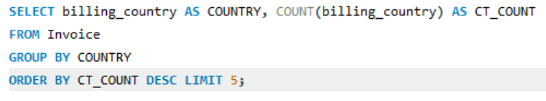
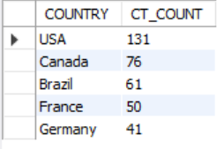
1. Who is the senior most employee based on job title? (Senior Most Employee → Madhan Mohan [S.G.M])
2. Which country have the most invoices? (Country with most invoice → USA 131)

Slide 11
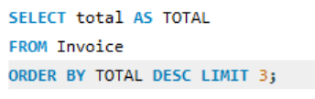
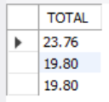
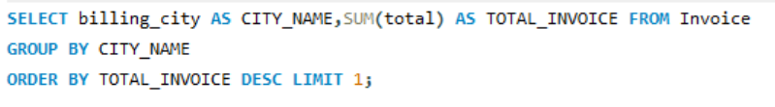

3. What are the top 3 values of total invoices? (Top 3 invoice totals)
4. Which city has the highest sum of invoice totals. Return both the city name & sum of all invoice totals? (City with highest invoice totals → Prague )

Slide 12
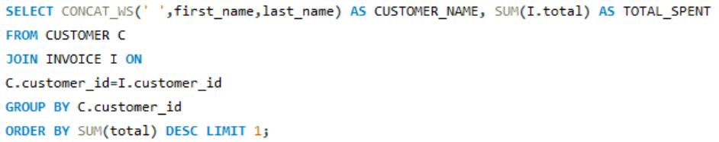

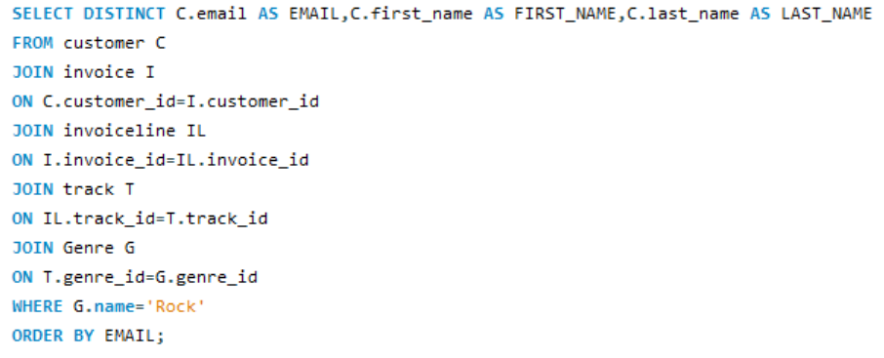
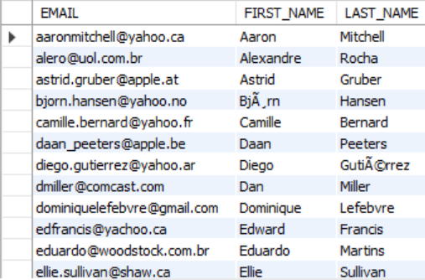
5. Who is the best customer? Write a query that returns the person who has spent the most money? (Best Customer = Highest Spending → FrantiAiek WichterovAi)
6. Write a query to return the email, first name, last name, & Genre of all Rock Music listeners in alphabetical order? (Rock genre music listeners)

Slide 13
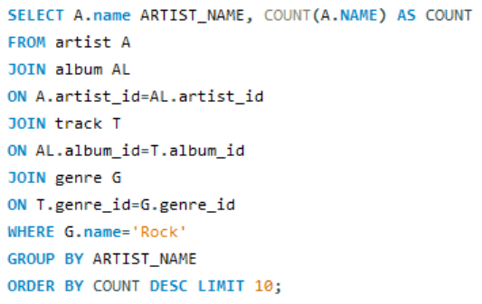
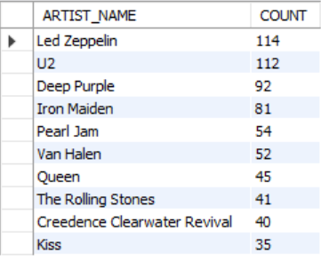
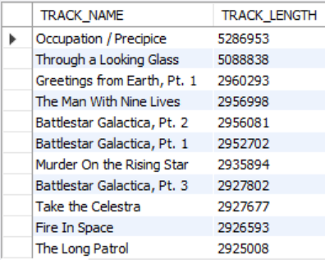
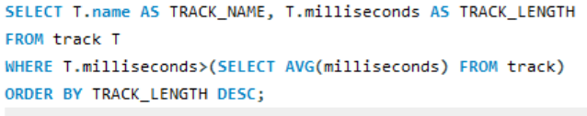
7. Write a query that returns the Artist name and total track count of the top 10 rock bands ? (Top 10 Rock genre artists)
8. Return all the track names that have a song length longer than the average song length.- Return the Name and Milliseconds for each track. Order by the song length, with the longest songs listed first? (Tracks longer than average song length)

Slide 14
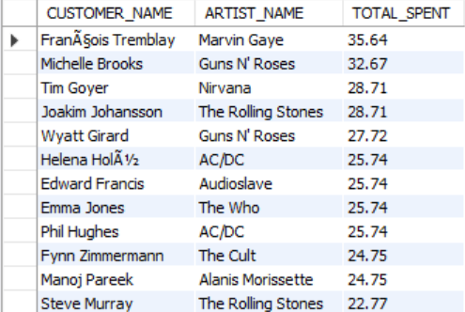
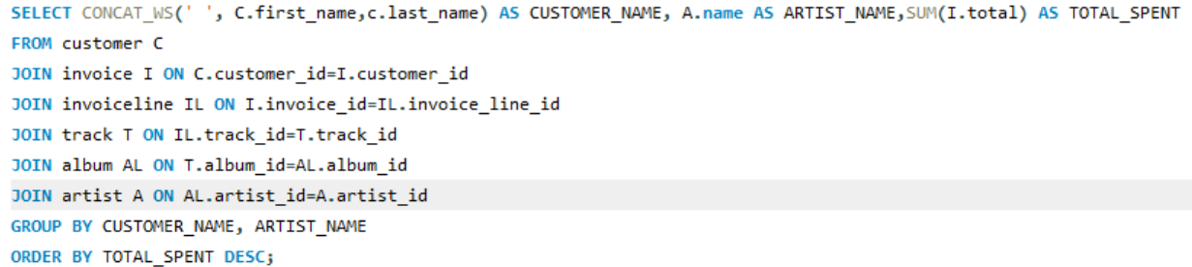
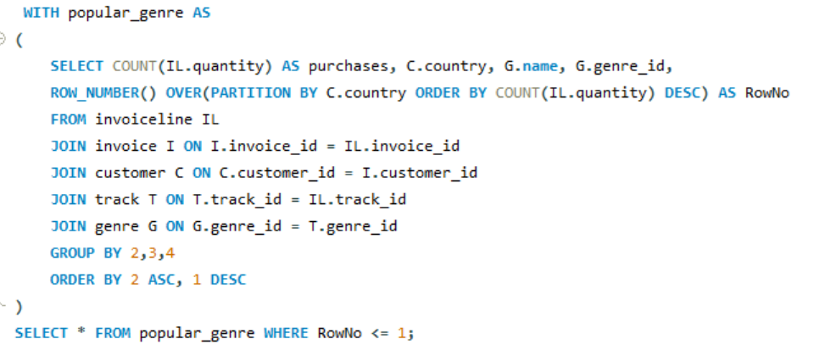
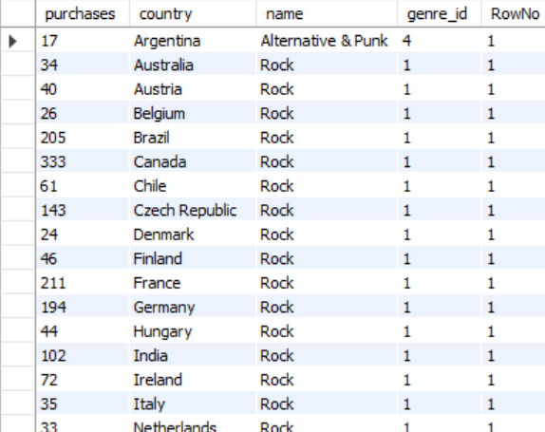
9. Find how much amount is spent by each customer on artists? Write a query to return customer name, artist name and total spent? (Customer spending on artist)
10. Write a query that returns each country along with the top Genre. For countries where the maximum number of purchases is shared, return all Genres? (Most popular genre by country)

Slide 15
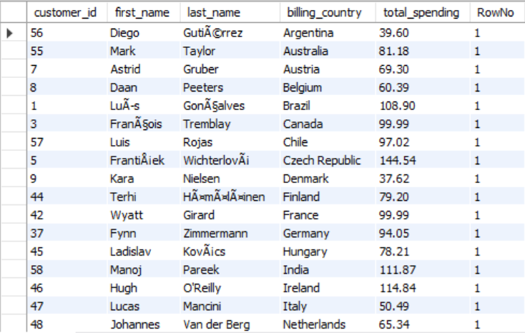
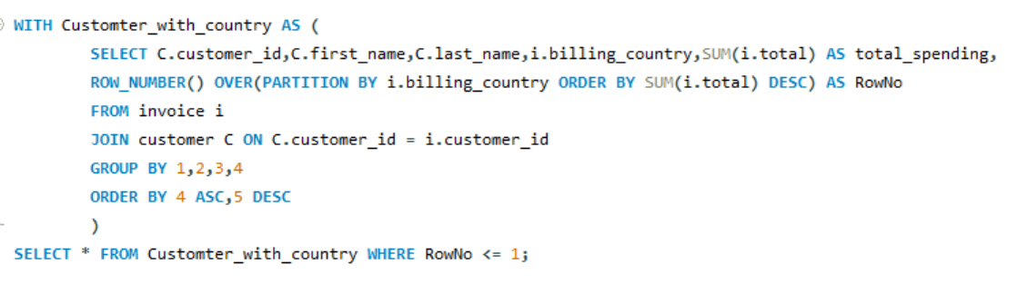
11. Write a query that returns the country along with the top customer and how much they spent. For countries where the top amount spent is shared, provide all customers who spent this amount? (Top customer per country)

Slide 16
Key Insights
Revenue is concentrated in specific cities and countries
A small percentage of customers contribute most sales
Certain genres dominate in particular regions,
Rock genre dominates overall purchases
Rock music has strong listener base
Popular artists significantly influence purchasing pattern

Slide 17
Recommendations
Focus marketing on High –Revenue Regions.
Reward Top Customers
Promote Popular Music Genres.
Collaborate with Top Artists.
Personalize Recommendations.
Target Region –Specific Preferences.
Focus on High – Revenue Cities.

Slide 18
Conclusion
This Project demonstrates how SQL can be used to transform raw transactional data into actionable business insights.
Through the analysis:
Customer behaviour patterns were analyzed.
Revenue trends were analyzed
Market preferences were understood
Strategic decisions can be supported.

Slide 19


