Slide 1





CENTRAL UNIVERSITY OF JHARKHAND
Two-Day Workshop on
Assessment and Accreditation Roadmaps for
Higher Education Institutions (HEIs) of Jharkhand
Title:
Empowering HEI Through Assessment and Accreditation
Venue:
VC Conference Hall,
Central University of Jharkhand
Presented by
Prof. Kunja Bihari Panda

Slide 2
CENTRAL UNIVERSITY OF JHARKHAND A+ ACCREDITATION JOURNEY
The First and only Central University in Jharkhand established in 2009, evolving for the last 15 years striving to establish the Credibility as the Flagship institution of the region
In the year 2019 CUJ Accredited with B grade and secured 2.34 CGPA
In the subsequent accreditation process, the University progressed to A+ after review, with the score rising to 3.27.
Quality Assurance Mechanism: Strengthening of IQAC and systematic documentation of quality initiatives and outcomes.
2025
2025
Final CGPA-3.27
2019
Cycle 2: A+
Cycle 1: B /2.34
2009
CUJ Established

Slide 3
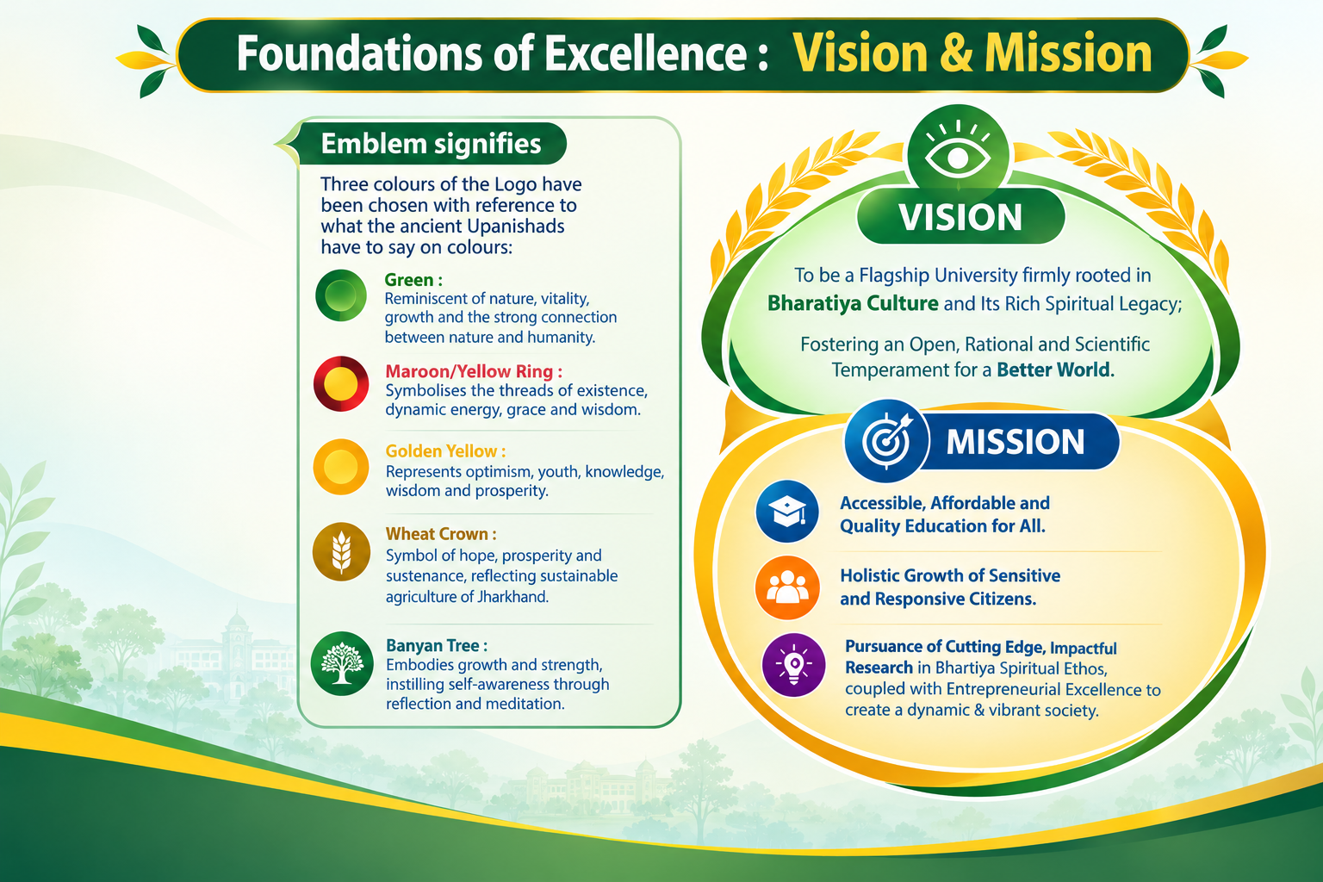

Slide 4
CUJ NAAC A+ – At a Glance
3
1st
A+
3.27
7
University in Jharkhand to receive A+ grade in NAAC
NAAC Grade
Final CGPA
NAAC Criteria
What the A+ signifies:
Academic Excellence – Incorporated employability based curriculum with focus on skill development and entrepreneurship
Student-Centric Education – Focus on student learning outcomes, progression and holistic development
Quality Research & Innovation – Strong performance in research, publications, patents and innovation
Strong Infrastructure – Quality academic, research, digital and student-support facilities
Good Governance & Leadership – Effective institutional governance, leadership and administrative practices
Inclusive & Holistic Growth – Commitment to diversity, equity, student welfare and community engagement

Slide 5
CUJ NAAC Grade Sheet – Key Result
NAAC CRITERION | CGPA / RESULT | GRADE
1. CURRICULAR ASPECTS | 3.47 | A+
2. TEACHING-LEARNING & EVALUATION | 3.47 | A+
3. RESEARCH, INNOVATIONS & EXTENSION | 3.04 | A
4. INFRASTRUCTURE & LEARNING RESOURCES | 3.30 | A+
5. STUDENT SUPPORT & PROGRESSION | 3.55 | A++
6. GOVERNANCE, LEADERSHIP & MANAGEMENT | 3.07 | A
7. INSTITUTIONAL VALUES & BEST PRACTICES | 3.05 | A
Final institutional CGPA: 3.27 | Grade: A+

Slide 6
Criterion 1: Curricular Aspects
No | Key indicators | Wtg. | Score obtained
1.1 | Curriculum Design and Development | 200 | 150
1.2 | Academic Flexibility | 120 | 120
1.3 | Curriculum Enrichment | 200 | 170
1.4 | Feedback System | 80 | 80
TOTAL |  | 600 | 520
 |  |  | 3.47
More than 92% of
the Courses have
been revised
More than 98%
Programmes have Field
Projects/research
project/internship
Courses
Students Registered in
62 Courses of MOOCs ,
4 Diploma Programmes,
6 Certificate Courses
and 12 Value Added
Courses during
More than 95% of Courses Build Employability & Industry-Ready Skills
Over 800 students gained industry & Research Internship experience
40% of Students Pursue Micro-Credential Courses to Enhance Employability
70 Value-Added Courses in Yoga, IKS, Human Values & Life Skills Benefit 60%+ Students
Offer Courses on
Santali, a Tribal
language along with Odia & Sanskrit as
optional
Key Outcomes
NEP 2020-oriented curriculum implemented from 2022–23, aligned with emerging educational and employment needs
Outcome Based Education (OBE) strengthened through clearly defined POs, PSOs and COs
Greater emphasis on critical thinking, creativity, communication, collaboration and problem-solving skills
Integration of multidisciplinary, skill-based, value-based and experiential learning opportunities
Increased exposure to internships, fieldwork, projects, MOOCs/SWAYAM and other external learning resources
Stakeholder feedback contributes to continuous curriculum improvement and academic enhancement.
Overall outcome: more flexible, skill-oriented, multidisciplinary and learner-centric academic programmes

Slide 7
Criterion 2: Teaching-Learning and Evaluation
No | Key indicators | Wtg. | Score obtained
2.1 | Student Enrolment and Profile | 40 | 20
2.2 | Catering to Student Diversity | 80 | 75
2.3 | Teaching-Learning Process | 80 | 70
2.4 | Teacher Profile and Quality | 240 | 200
2.5 | Evaluation Process and Reforms | 120 | 120
2.6 | Student Performance and Learning Outcomes | 120 | 105
2.7 | Student Satisfaction Survey | 120 | 104
 |  | 800 | 694
 |  |  | 3.47
Key Outcomes
Transparent & merit-based admissions through CUET and prescribed mechanisms
Inclusive access with diversity and reservation provisions
ICT-enabled, student-centric teaching-learning practices
Academic support for advanced and slow learners
OBE-based assessment aligned with COs and POs
Digital and automated examination system for greater efficiency
95.3% students pass percentage in the latest completed academic year
Faster, transparent result declaration and examination processes
Student Satisfaction Survey Score: 3.45, reflecting positive stakeholder feedback

Slide 8
Criterion 3: Research, Innovations and Extension
No | Key indicators | Wtg. | Score obtained
3.1 | Promotion of Research and Facilities | 80 | 69
3.2 | Resource Mobilization for Research | 160 | 100
3.3 | Innovation Ecosystem | 80 | 50
3.4 | Research Publications and Awards | 480 | 380
3.5 | Consultancy | 80 | 60
3.6 | Extension Activities | 80 | 60
3.7 | Collaboration | 40 | 40
 |  | 1000 | 759
 |  |  | 3.04
Key Outcomes
Strengthened R&D ecosystem through R&D Cell and research policy
₹2,750.45 lakh external research funding generated.
Fellowships and projects promoted research culture
151 Ph.D. degrees awarded during the assessment period
935 UGC CARE-listed research papers published.
298 books/book chapters contributed to scholarly output
Research impact strengthened – Scopus H-Index 50; WoS H-Index 47
Innovation promoted through CIIE, IIC and patents.
108 outreach programmes strengthened community engagement
70 MoUs/linkages expanded collaborations

Slide 9
Criterion 4: Infrastructure and Learning Resources
No | Key indicators | Wtg | Score obtained
4.1 | Physical Facilities | 120 | 100
4.2 | Library as a Learning Resource | 80 | 65
4.3 | IT Infrastructure | 120 | 105
4.4 | Maintenance of Campus Infrastructure | 80 | 60
 |  | 400 | 330
 |  |  | 3.3
Key Outcomes
500-acre permanent campus with developed academic infrastructure
174 ICT-enabled classrooms supporting digital learning
Modern laboratories, sports and common facilities for multidisciplinary needs
572 computers with a student-computer ratio of 4:1
Automated Vivekananda Central Library with KOHA/RFID and digital resources
Extensive books, e-books, e-journals and research resources
Sports, gymnasium and recreational facilities supporting holistic development
Systematic maintenance mechanisms ensure sustainability and optimal utilization

Slide 10
Criterion 5: Student Support and Progression
No | Key indicators | Wtg. | Score obtained
5.1 | Student Support | 120 | 115
5.2 | Student Progression | 180 | 165
5.3 | Student Participation and Activities | 60 | 45
5.4 | Alumni Engagement | 10 | 30
 |  | 400 | 355
 |  |  | 3.55
Key Outcomes
66.61% of students benefited from scholarships and freeships.
Training and Placement Cell supports career guidance and employability.
Career counselling and skill development enhance student readiness.
Grievance redressal mechanism ensures transparent academic excellence
69.48% of eligible students were placed.
48.35% of students progressed to higher education.
179 students qualified in NET/ SLET & other competitive examinations.
Students secured 69 awards and medals.
Alumni contributed approximately ₹1.01 Crore strengthening institutional development.

Slide 11
STUDENT SUPPORT SYSTEM
STUDENT SUPPORT CELL
DEAN STUDENT WELFARE
STUDENT SUPPORT CELL
Maintain student data, Calendar of Events, Extra Curricular Activities, collect information about course completion, Internship, Exam & Assessment.
Understand the decisions, regulations & solve the difficulties through Academic Advisor / Mentors (Remedial Measures)
Identify Senior Students who can guide or craft their study plan and career goals
Redresses grievances by directing & linking with the appropriate sections to ease the student anxiety.
Co-ordinates with DSW, CDC, NSS & NCC Units
Create a climate & culture of Trust, shared sense of purposes adaptability, democratic values
Help students articulate their expectations & aspirations
Organise Orientation Classes at the Commencement of the session (Sensitization programmes for the Students
ANTI-RAGGING CELL
CAREER DEVELOPMENT CELL
LITERACY
CLUB
STUDENTS
PROCTORIAL BOARD
SPORTS
&
CULTURAL
CLUB
EQUAL OPPORTUNITY CELL
OMBUDSMAN

Slide 12



Student Support Means and Activities
Core Areas of Training
Capacity and Skill Development
Activities for Students
Pursuance of Higher Studies
Competitive Exam Readiness
Cognitive Skill
Employability & Career
Entrepreneurship Orientation
Professional
Skill
STUDENT WELFARE DIRECTORATE
STUDENT SUPPORT
Digital Skill
Core Skill
Domain Specific Skills (Sectoral)
Soft Skill
Interpersonal Skill
Life Skill

Slide 13

Scholarships / Financing Schemes Available for UG and PG Students
TYPES OF SCHOLARSHIP
Jharkhand E-Kalyan
Bihar Post Matric
Odisha Post Matric
UP Post Matric
Kerala Post Matric
MP Post Matric
Chhattisgarh Post Matric
PERCENTAGE OF STUDENT BENEFITED THROUGH SOCHOLARSHIP
= 63.67%
SC/ST Students are given 20% relaxation in tuition Fees

Slide 14

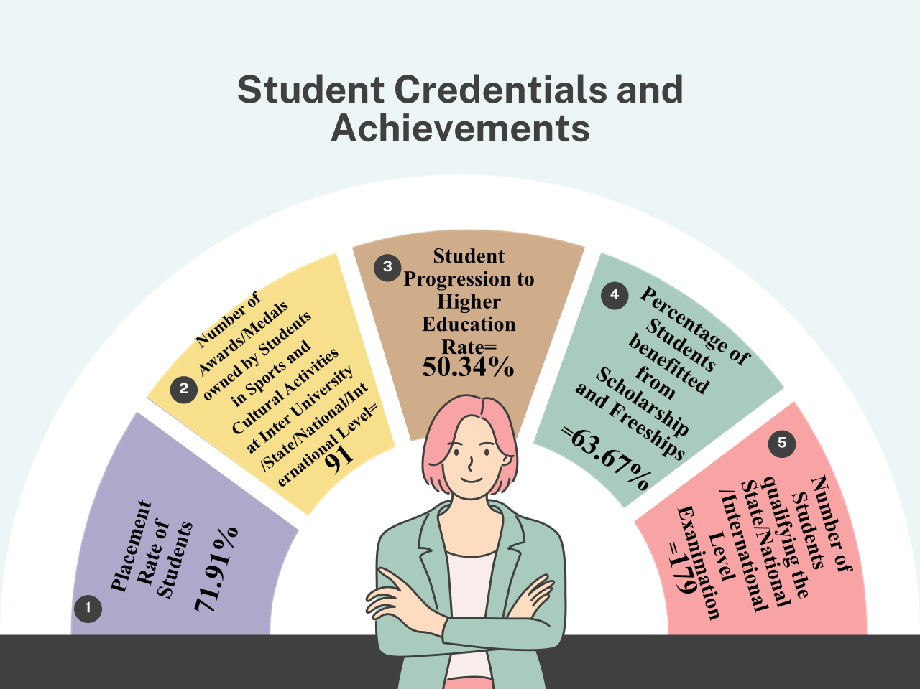

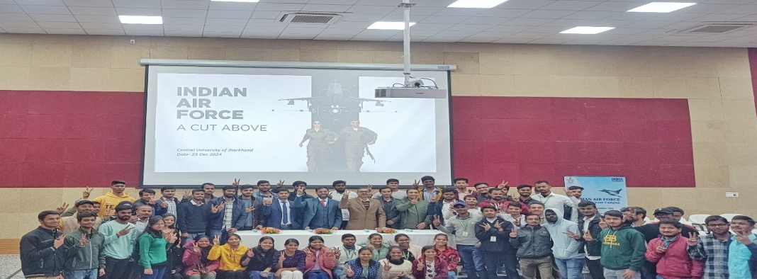


Skill Growth & Student Excellence
Gold Trophy (1st position) won by the NCC cadets in CATC camp which was held 5-14 August 2024 at 19 JH battalion Ranchi
5 students of Department of Far East Languages (DFEL- Chinese) got HUAYU Enrichment Scholarship from the Ministry of Education, Taiwan
Our University proudly hosted students from China, Bhutan, Yemen, Thailand, and Estonia, fostering a Diverse and Inclusive Academic community

Slide 15

CAREER DEVELOPMENT CELL
The ‘Career Development Cell’’
  Imparts training & helps students gets placement both in companies & institutions, &
  Guides the students to opt for Higher Studes or pursue research in reputed institutions with fellowships.
  Imparts training on Entrepreneurship & proide financial linkages
  Self Employment Opportuniies identification & information
CAREER DEVELOPMENT CELL
Placement
Entrepreneurship
Higher Education & Research
Number of Placement of outgoing students during last five years
2019-20 | 2020-21 | 2021-22 | 2022-23 | 2023-24
528 | 561 | 287 | 254 | 252
Number of Entrepreneurship of outgoing students during last five years
2019-20 | 2020-21 | 2021-22 | 2022-23 | 2023-24
45 | 56 | 52 | 45 | 123
Number of progressing to higher education of outgoing students during in last five years
2019-20 | 2020-21 | 2021-22 | 2022-23 | 2023-24
84 | 96 | 141 | 225 | 199

Slide 16

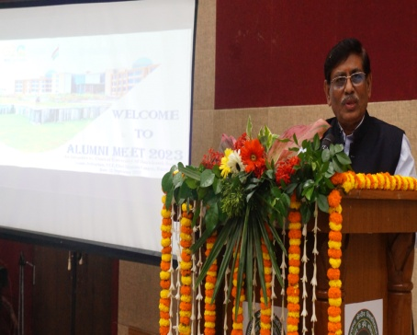
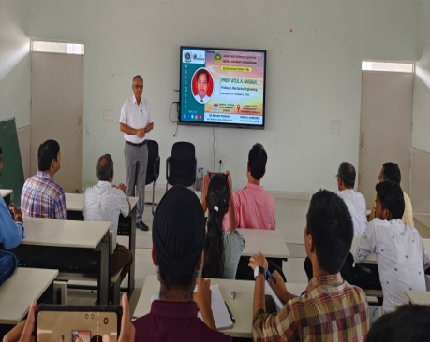


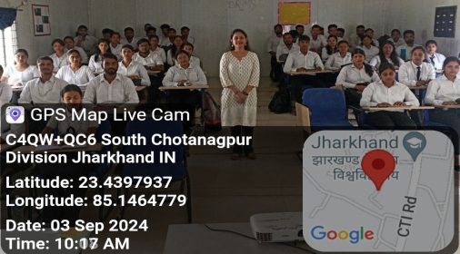
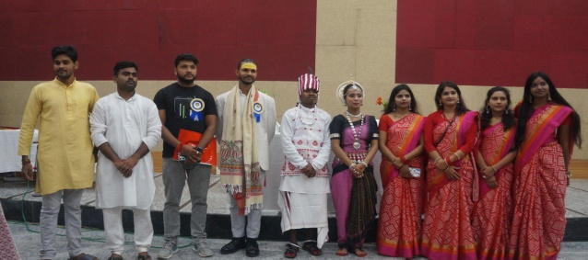

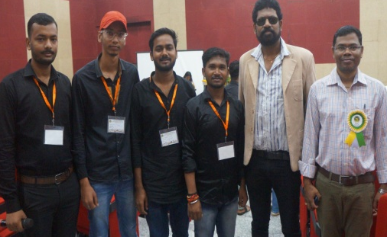

“CUJIANS” Meet by Alumni Cell
Motto of University for All Alumni
To disseminate knowledge & know-how for the mutual benefits
To undertake intellectual, academic, & cultural activities
To provide a forum for interaction & collaboration
3 Alumni Meet Organized (due to COVID-19 Pandemic)
Departmental Alumni Meet Organized in both online and physical mode- 03
Alumni Talk Organised by Every Department
Alumni Cell
Alumni Association
Chief Coordinator
Coordinator
Co-Coordinator
Distinguished Alumni
President
Vice President
Secretary
Members
(Alumni Meet 2023)
(Alumni Talk, 2024)
The Contribution of Alumni Network to the University Development
Recent Alumni Meet in the University
Career Guidance
Financial Support
Programme/Curriculum Enhancement (Through sharing Industry Experiences and Competitive Exam Guidance)
Alumni Contribution to the Institution
= 1.0171 Crores INR

Slide 17
Criterion 6: Governance, Leadership and Management
No | Key indicators | Wtg. | Score obtained
6.1 | Institutional Vision and Leadership | 60 | 45
6.2 | Strategy Development and Deployment | 40 | 35
6.3 | Faculty Empowerment Strategies | 100 | 51
6.4 | Financial Management and Resource Mobilization | 80 | 76
6.5 | Internal Quality Assurance System (IQAS) | 120 | 100
 |  | 400 | 307
 |  |  | 3.07
Key Outcomes
Governance aligned with CUJ’s vision, mission and strategic priorities
Participative management through statutory bodies and decentralized decision-making
Institutional Development Plan guides academic and infrastructural growth
Statutory bodies ensure effective governance and institutional oversight
E-governance and SAMARTH strengthen digital administration and academic processes
IQAC and committees promote continuous quality enhancement
Resource mobilization through government grants, research funding, collaborations and alumni contributions

Slide 18
Criterion 7: Institutional Values and Best Practices
No | Key indicators | Wtg. | Score obtained
7.1 | Institutional Values and Social Responsibilities | 200 | 155
7.2 | Best Practices | 120 | 90
7.3 | Institutional Distinctiveness | 80 | 60
 |  | 400 | 305
 |  |  | 3.05
Key Outcomes
Promotes gender sensitivity, equity, inclusion and social responsibility.
Barrier-free facilities ensure accessibility for Divyangjan.
NSS, NCC and outreach programmes strengthen community engagement.
Promotes cultural diversity, national integration and constitutional values.
Sustainability initiatives include solar energy, plantation and green practices.
Waste management and environmental audits support sustainability.
Preserves tribal languages, culture and indigenous knowledge.
Centre for Endangered Languages and CIKS promote indigenous heritage.
Pre- and post-admission counselling improves student access, retention and GER.

Slide 19
SWOC ANALYSIS
STRENGTH
WEAKNESS
implementation of NEP 2020 aligned with multidisciplinary academic and research ecosystem.
Efficient adoption of SAMARTH e-Governance
Strong collaborations and MoUs with reputed institutions.
Fully automated library with RFID and ONOS
Strong NSS/NCC and community outreach activities
Focus on tribal knowledge, languages and indigenous studies
Land-related issues and fragmented campus development.
Infrastructure gaps in academics and sports
Limited financial resources under recurring and capital heads
Lack of adequate residential facilities/staff quarters
Need for greater decentralization and wider participation.
Waste management and green-campus initiatives need strengthening
Need for improved facilities for women and Divyangjan
S
w
OPPORTUNITY
O
C
CHALLENGES
A multidisciplinary research and skill hub
Industry–academia collaboration
Increase externally funded research and consultancy
Strengthen innovation, incubation and start-up ecosystem
MOOCs and digital learning opportunities
Tribal-centric research and community development
Scope for outreach and extension programmes in Jharkhand
Acquisition and consolidation of land for a single campus.
Mobilization of government and corporate funding
Ensuring adequate financial support for institutional growth
Strengthening industry-oriented research
Balancing tribal-centric education with global academic aspirations
Transforming CUJ into a Multidisciplinary Education and Research University (MERU)

Slide 20










झारखंड केन्द्रीय विश्वविद्यालय का मूल मूल्यबोध
core VALUES OF CENTRAL UNIVERSITY OF JHARKHAND
समृद्धि
और
प्रगति का रास्ता
सत्य
संस्कृति
स्वाभिमान
और
साधना
SAMRIDHI AUR PRAGATI KA RASTA
SATYA
SANSKRITI
SWABHIMAN
SADHANA
AUR
Prof. K.B.Das

Slide 21
10 ATTRIBUTES AS PER NEW NAAC BINARY SYSTEM OF ACCREDITATION
INPUT
PROCESS
OUTCOMES
CURRICULUM DESIGN
5
LEARNING AND TEACHING
8
STUDENT OUTCOMES
1
2
FACULTY RESOURCES
6
EXTENDED CURRICULAR ENGAGEMENTS
9
RESEARCH AND INNOVATION OUTCOMES
3
INFRASTRUCTURE
7
GOVERNANCE AND ADMINISTRATION
10
SUSTAINABILITY OUTCOMES
4
FINANCIAL RESOURCE AND MANAGEMET

Slide 22
MAPPING: NAAC OLD RAF CRITERIA → NEW BINARY ATTRIBUTES
OLD RAF: 7 CRITERIA
MAPPING
NEW BINARY: 10 ATTRIBUTES
C1 | Curricular Aspects
C1 → 1, 5
1. Curriculum Design
FROM C1
2. Faculty Resources
FROM C2
C2 | Teaching–Learning
& Evaluation
C2 → 2, 5, 8
3. Infrastructure
FROM C4
C3 | Research, Innovations
& Extension
C3 → 6, 9
4. Financial Resources & Management
FROM C6
5. Learning & Teaching
FROM C1, C2
C4 | Infrastructure &
Learning Resources
C4 → 3, 10
6. Extended Curricular Engagements
FROM C3, C5, C7
C5 | Student Support
& Progression
C5 → 6, 8
7. Governance & Administration
FROM C6, C7
8. Student Outcomes
FROM C2, C5
C6 | Governance, Leadership
& Management
C6 → 4, 7
9. Research & Innovation Outcomes
FROM C3
C7 | Institutional Values
& Best Practices
C7 → 6, 7, 10
10. Sustainability Outcomes & Green Initiatives
FROM C4, C7
INPUT (1–4)
PROCESS (5–7)
OUTCOME (8–10)

Slide 23

THANK YOU

