Slide 1
Writing Winning Grant Application in the Age of Generative AI
Rajnish Kumar, Ph.D.
Associate Professor
Department of Pharmaceutical Engineering & Technology, IIT(BHU), Varanasi

Slide 2
About me
Associate Professor, IIT(BHU), Nov. 2024
Assistant Professor, IIT(BHU), Oct. 2019
Assistant Professor, Karolinska Institutet, June 2019
JSPS Summer fellow, NIBIOHN, Osaka Japan, Mizuguchi Lab, June 2019-July 2019
Postdoctoral researcher, Karolinska Institutet, Stockholm, Sweden (2016-2019), Winblad group
Postdoctoral researcher, Karolinska Institutet, Stockholm, Sweden (2014-2016), Darreh-Shori group
PhD in Pharmaceutical and Medicinal Chemistry from UIPS, Panjab University, Chandigarh, India (2014)

Slide 3
Research Grants
S.NO. | Funding Agency | PI/Co-PI | Amount | Duration
1. | ICMR | PI | 45,32,684 INR | Jan, 2025-Dec, 2027
2. | SERB-SRG, India | PI | 32,86,840 INR | Jan, 2022-Dec, 2023
3. | SERB-MATRICS, India | PI | 6,60,000 INR | Jan, 2022-Dec, 2024
4. | SERB, India | Co-PI | 40,81,240 INR | Jan, 2021 - Dec, 2023
5. | Seed Grant IIT(BHU), India | PI | 10,00,000 INR | Jan, 2020 - Jan, 2021
6. | The Swedish Research Council, Sweden | Co-PI | 7.2 M SEK ~ 6.16 Crores INR | Jan, 2019 - Dec, 2022
7. | The Swedish Research Council, Sweden | Co-PI | 2.8 M SEK ~ 2.4 Crores INR | Jan, 2017 - Dec, 2020
8. | Alzheimer's Association, United States | C0-PI | 100,000 USD ~ 73.5 Lakhs INR | Jan, 2016 - Jan, 2018
9. | Sigurd and Elsa Goljes Memory Foundation | PI | 40000 SEK ~ 3.5 Lakhs INR | Jan, 2017- Dec 2018
10. | Gun and Bertil Stohnes foundation | PI | 120000 SEK ~ 10.25 Lakhs INR | 2014-2018
11 | Lars Hiertas Memory foundation | PI | 100000 SEK ~ 8.5 Lakhs INR | 2016-2017
12. | Tore Nilsons foundation for medical research; kr; | PI | 130000 SEK ~ 11.15 Lakhs INR | 2015-2016
13. | Foundation for old servants | PI | 280000 SEK ~ 8.5 Lakhs INR | 2015, 2017-2018
14. | Gunvor and Josef Aners foundation | PI | 150000 SEK ~ 12.85 Lakhs INR | 2016-2018
15. | Foundation for Geriatric Diseases at KI | PI | 475 000 SEK ~ 40.5 Lakhs INR | 2016-2019
16. | Loo and Hans Ostermans foundation for medical research in geriatrics | PI | 50000 SEK ~ 4.3 Lakhs INR | 2018

Slide 4

Research Grant- Give me Money
https://www.alamy.com/stock-photo/falling-rupee.html?sortBy=relevant

Slide 5
Grant Writing
Grant writing is as central to a scientific career as are writing papers and doing research.
Careful targeting of a funder and careful preparation of a proposal can determine success or failure.
Make it possible to do research for the benefit of mankind.
Vaccines
Anti-cancer drugs
Gene therapy
Anti-malarial drugs
Mars exploration
Nuclear reactors
Wireless communication

Slide 6
The success of a grant proposal depends on
The sponsoring organization.
The innovative nature or critical importance of the proposed project.
The competition level.
The skills of the grant writer in building a compelling case.
Good luck.
Good timing (in terms of whether the funder and/or society are ready for the idea or approach).

Slide 7
Research Proposal Organisation
1. Abstract
2. Specific Aims
3. Background/Introduction/Statement of Need
4. Preliminary Results
5. Research Design/Research Plan/Methodology/Implementation/Proposed Methods and Procedures/Approach/Strategy
6. Alternate Strategy/Technical Problems and Alternate Routes
7. Summary/Impact Statement
8. References
9. Budget
10. Personnel/Biographical Sketches

Slide 8
Homework before starting writing your grant application
Do not over- or underestimate the required funding for your project, and know the amount to can ask for from the sponsor.
Find out what the proposal deadline is to ensure that you can meet it. Estimate that it will take you about 2 to 3 months to prepare a well-written proposal.
Also take into account the start date of your project. It will take from 3 to 6 months for you to find out whether your proposal will be funded.
Know who will review your proposal. Knowing who your reviewers will be, particularly their training and background, will help you gear your writing level to that specific audience.
Find out the name and contact information for a program officer at the agency. Consider contacting this person if you have questions about the content or format of the proposal you are considering to prepare.

Slide 9
Grant Writing
Make sure that the first page is perfect.
Common mistakes
overambitious research plans
incoherent or unfocused experimental designs
specific aims being too dependent on one another
poor write-up and presentation of the proposed study

Slide 10
Abstract and Specific Aims section
Brief background
Unknown or problem
Objective
Preliminary results
General strategy (may include specific aims if not listed in separate part)
Expected Outcomes—optional
Significance/impact

Slide 11
Abstract and Specific Aims section
Brief background
Unknown or problem
Objective
Preliminary results
General strategy (may include specific aims if not listed in separate part)
Expected Outcomes—optional
Significance/impact
Most common problems
• Omission of parts
• Excessive length
• Unrealistic aims
• Excessive interdependence of aims

Slide 12
Background and Significance
1. Aim to awaken interest.
2. Provide pertinent background information, but do not review the literature.
3. State the unknown, problem, or need.
4. State an implication at the end of the section.
5. Signal all the elements of the section.
6. Use topic sentences and techniques of continuity to tell the story.
7. Organize your background section logically.
8. Present evidence objectively.
9. Provide the necessary amount of detail.

Slide 13
Background and Significance
1. Aim to awaken interest.
2. Provide pertinent background information, but do not review the literature.
3. State the unknown, problem, or need.
4. State an implication at the end of the section.
5. Signal all the elements of the section.
6. Use topic sentences and techniques of continuity to tell the story.
7. Organize your background section logically.
8. Present evidence objectively.
9. Provide the necessary amount of detail.
Most common problems
• Poor organization
• Lack of objectivity
• Amount of detail
• Equating significance with a problem
• Equating significance with innovation

Slide 14
Preliminary Results
1. Report all important previous findings relevant to the topic.
2. Indicate logical next steps or what is unknown or problematic.
3. Use figures and tables if necessary to enhance findings.
4. Interpret your results for the reader. Distinguish between data and results.
5. Summarize and generalize relevant previous results.
6. Organize the Preliminary Results sections chronologically or from most to least important.
7. Organize longer Preliminary Results sections by subtopics and under each subheading chronologically or from most to least important.
8. Pay attention to word choice.
9. Provide only findings directly relevant to your proposed work.
10. Demonstrate your expertise.

Slide 15
Preliminary Results
1. Report all important previous findings relevant to the topic.
2. Indicate logical next steps or what is unknown or problematic.
3. Use figures and tables if necessary to enhance findings.
4. Interpret your results for the reader. Distinguish between data and results.
5. Summarize and generalize relevant previous results.
6. Organize the Preliminary Results sections chronologically or from most to least important.
7. Organize longer Preliminary Results sections by subtopics and under each subheading chronologically or from most to least important.
8. Pay attention to word choice.
9. Provide only findings directly relevant to your proposed work.
10. Demonstrate your expertise.
Most common problems
• Findings not directly related to proposed work
• Experience of investigator not adequate
• Omission of important points or procedures
• Poor organization

Slide 16
Research Design and Methods Section
Address the problems stated in the Background and Preliminary Studies sections
Adjust your level of writing to your audience
Convey confidence—use future tense
Organize the Research Design section into subsections according to your Specific Aims
Provide a concluding summary for the overall section
Indicate the significance of your work
Signal the elements of the Research Design and Methods section; use subheadings
Your experimental plan should be feasible
Do not use too many interrelated aims
Do not too much or too little detail
State expected results clearly and interpret them

Slide 17
Research Design and Methods Section
Address the problems stated in the Background and Preliminary Studies sections
Adjust your level of writing to your audience
Convey confidence—use future tense
Organize the Research Design section into subsections according to your Specific Aims
Provide a concluding summary for the overall section
Indicate the significance of your work
Signal the elements of the Research Design and Methods section; use subheadings
Your experimental plan should be feasible
Do not use too many interrelated aims
Do not too much or too little detail
State expected results clearly and interpret them
Most common problems
• Experimental plan is too ambitious
• Aims depend on previous aims excessively
• Amount of detail
Expected results are not clear

Slide 18
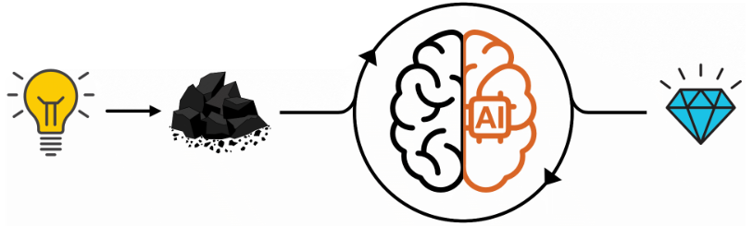
Artificial intelligence (AI) for grant writing
Involves using AI technologies to assist in the creation, editing, and submission of grant proposals.
As AI technologies advance, grant writing professionals face both exciting opportunities and new challenges.
AI can help streamline the grant writing process by automating repetitive tasks, providing data analysis, and generating content that aligns with funding requirements.
One can strategically position themselves to enhance their grant writing efficiency and effectiveness, ultimately improving their chances of securing vital funding.

Slide 19
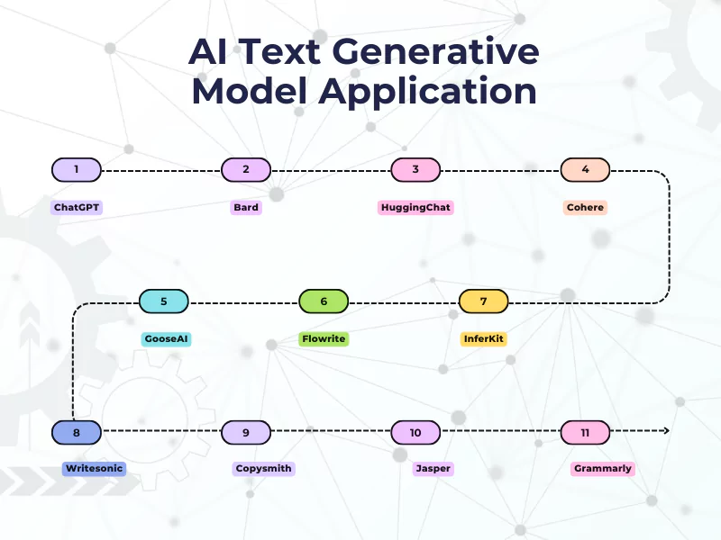
Generative AI
Made to generate text.

Slide 20

Generative AI
Made to generate text.

Slide 21
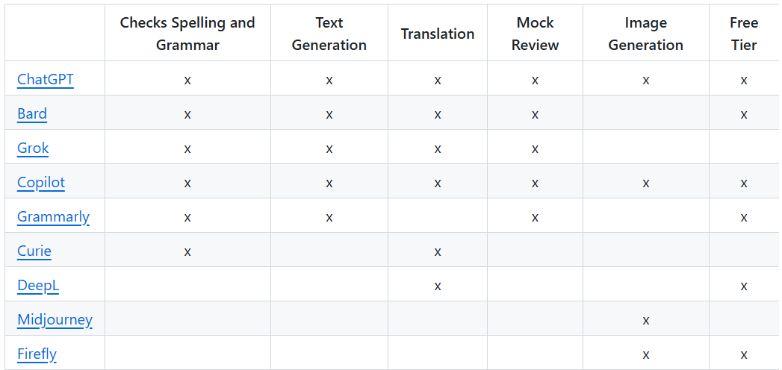
Some tools

Slide 22
Ten simple rules of AI use in Grant writing
https://doi.org/10.1371/journal.pcbi.1011863

Slide 23
Rule 1: Check the guidelines of the funding agency regarding AI
Funding agencies have varied rules regarding AI chatbot usage in publications and grant applications.
Grant Agency Policies:
Might allow AI use with mandatory disclosure.
Might warn against risks like fabrication, falsification, or automated plagiarism and misinformation checks due to AI use.
Dynamic Rules: Regularly review guidelines as policies evolve over time.
Recommendation: Disclose AI usage in grant applications, even if not required.

Slide 24
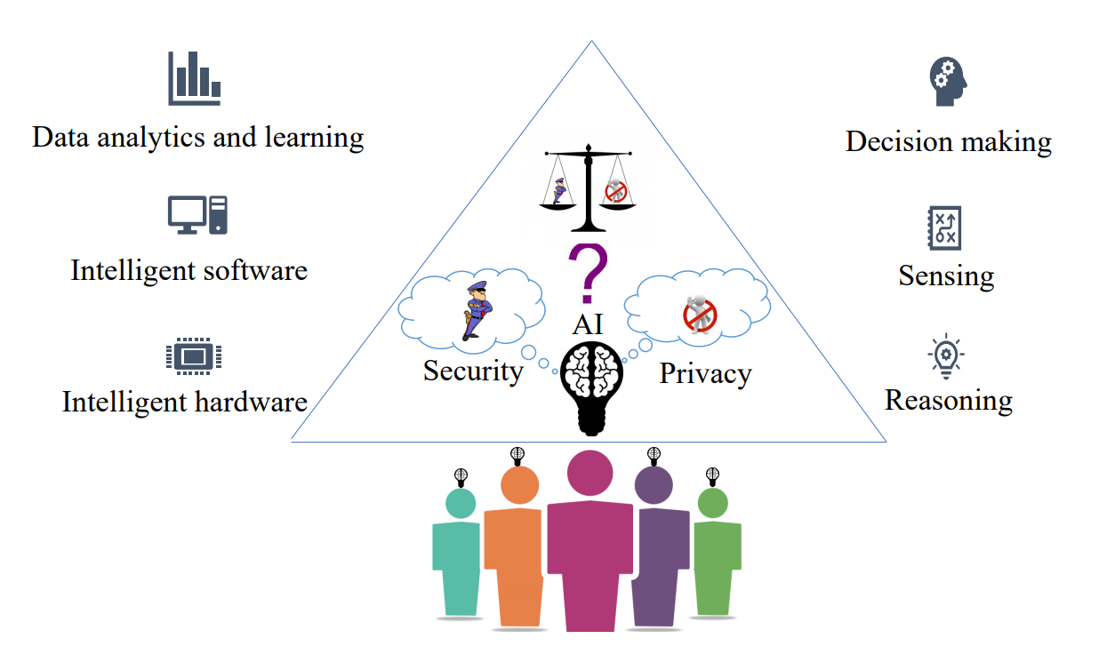
Rule 2: Consider data privacy limitations
Public AI chatbots (e.g., ChatGPT, Google Bard) save user interactions to improve algorithms.
Sharing sensitive information (e.g., grant application drafts) poses risks of data being reused or suggested to competitors.
Review and adjust data storage settings before using AI tools.
An illustration of data and privacy dilemma in AI

Slide 25

Rule 3: Don’t use AI to write your grant
The first draft of any section should be written by you.
AI-generated output may lack originality and scientific validity due to LLM training limitations.
Engage with AI tools only after completing an initial draft for revisions, not for drafting.
Ensure the grant reflects your unique scientific ideas, preliminary data, and novel approach in your own words.

Slide 26
Rule 4: Use custom prompts for specific feedback
Provide precise instructions and context when seeking feedback from AI, similar to human reviewers.
Narrow the AI's focus to specific tasks or sections for better-targeted feedback.
Specify your role, funding agency, and alignment with their mission.
Ask for coherence, cohesion, or grammar/spelling improvements for each section individually.
Focus on incremental evaluations to refine sections and enhance overall proposal quality.
Leverage AI to improve grammar and spelling, reducing the burden of writing in a second language.

Slide 27
Custom prompts examples
As a non-native English speaker, kindly help me revise the following text for improved understanding and clarity. Please check for spelling and sentence structure errors and suggest alternatives.
What suggestions do you have to enhance the clarity of my text?
Please identify any parts of my writing that may be difficult for a lay audience to understand.

Slide 28
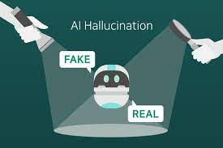
Rule 5: Fact check everything
AI models may fabricate facts, references, or sources due to training limitations.
Improvements in newer versions (e.g., ChatGPT 4.0) reduce but don't eliminate such risk.
Fake or mismatched references and DOIs are common, as evidenced in various studies and experiences.
Verify all claims, references, and figures provided by AI, regardless of their convincing presentation.

Slide 29
Rule 6: Don’t copy-paste; use the AI-generated text as inspiration
AI predicts text without understanding, which can result in convincing but plagiarized, biased, or “fluffy” content.
Do not copy AI-generated text directly into your grant application.
Use AI output as inspiration and carefully revise to align with your draft.
Employ critical thinking to refine and adapt AI-generated suggestions for your specific needs.
Maintain control over the content and watch for unintended changes.

Slide 30
Rule 7: Use this iterative process to become a better grant writer
Review each AI suggestion critically to assess its value: Does it strengthen your application? Is it clearer? Is it consistent?
Use this iterative process to refine your writing and identify patterns in AI feedback.
Supervise your own learning by detecting and adapting to feedback from AI, just as AI systems learn through iteration.
Anticipate and incorporate feedback—key skills for long-term scientific writing.
Create your own “training sets” using successful examples from similar grant mechanisms to identify patterns that lead to funding.

Slide 31

Rule 8: Use the AI for inspiration in developing figures
Tools like DALL-E-3 or Midjourney can generate images from text prompts, which can inspire figures for your grant application.
One can also upload your own images and ask the AI for feedback on clarity or emphasis.
Like text generators, image generators may produce plagiarized or scientifically incorrect content, so always verify the results.
Ensure that AI-generated figures are permitted by the funding agency.

Slide 32
Rule 9: Don’t forget to interact with humans
AI tools are useful, but they cannot replace expert human review, especially for scientific accuracy and technical details.
Always seek feedback from peers and mentors throughout the grant writing process.
For less experienced grant writers, human feedback is crucial to identify errors and improve your proposal.
Engaging with human reviewers helps you grow as a scientist and ensures the quality of your application, making it more competitive.

Slide 33
Rule 10: Play!
The best way to learn how to use AI for grant writing is through experimentation and play.
Use free tools like ChatGPT 3.5 or Google Bard to try different prompts and refine your understanding of AI’s capabilities.
Ask questions you already know the answer to, to test AI’s reliability and learn how to fact-check responses.
As generative models evolve, understanding their strengths and weaknesses will allow you to harness their full potential for grant writing and scientific communication.

Slide 34
Conclusion
Generative AI tools like ChatGPT/ Bard/ Gemini/Copilot etc. can streamline the drafting process, reducing the time and effort required for writing comprehensive grant applications.
These tools can help in refining language, ensuring that the proposal is clear, coherent, and free from errors
Can help with literature review however these tools are prone to make mistakes and proper verification is needed.
Can analyze large datasets to provide valuable insights, supporting the research hypothesis and methodology
Trust but verify- the tools are not fool proof and make mistakes.

Slide 35

C & E News, June 1, 2015 Cover, Volume 93, Issue 22
Questions?

