Slide 1



final_project_CNGSales (2)
View in Power BI
Last data refresh:
9/12/2023 7:16:17 PM UTC
Downloaded at:
9/12/2023 8:14:14 PM UTC

Slide 2
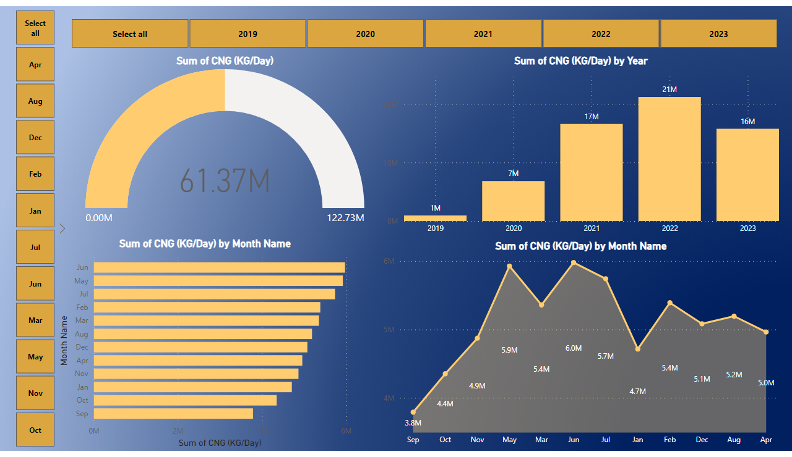
Page 1
Notes:
slicer
No alt text provided
slicer
No alt text provided
stackedAreaChart
No alt text provided
clusteredBarChart
No alt text provided
gauge
No alt text provided
columnChart
No alt text provided

Slide 3
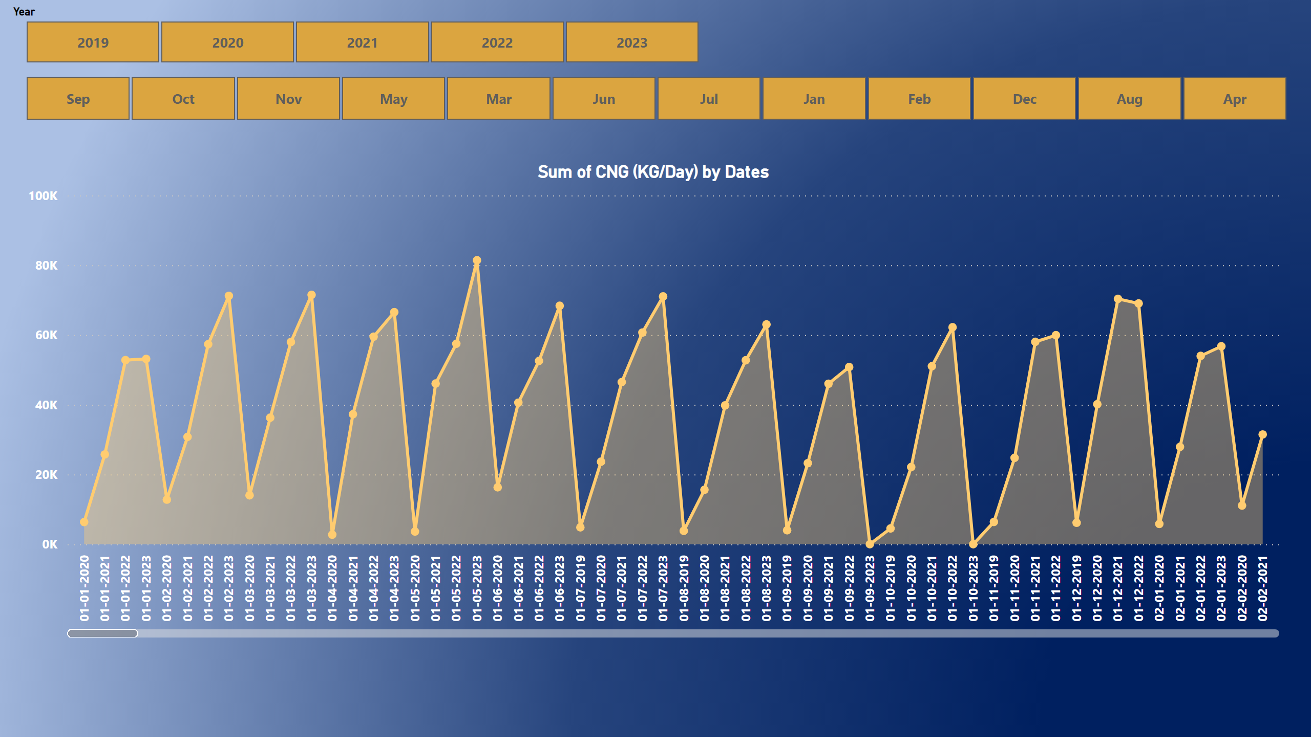
Page 2
Notes:
areaChart
No alt text provided
slicer
No alt text provided
slicer
No alt text provided

