Slide 1

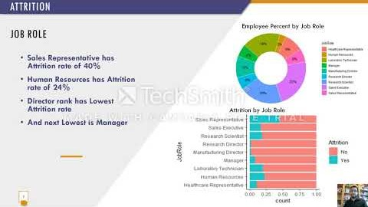
Data Science solution for Talent management from DDSAnalytics
Presentation video
Rajesh Satluri

Slide 2
Scope
Target audience: CEO and CFO executives
Attrition and Monthly Income summary
Facts about Attrition and Influential Factors
Facts about Monthly Income and Influential Factors
Relationship between Attrition and Monthly Income
Classification and Prediction

Slide 3

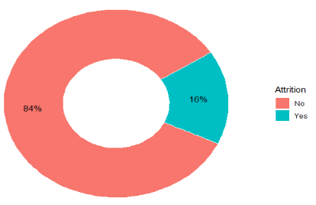

ATTRITION
Employee Attrition is 16%
Average Retail & Consumer Products Attrition is 13%
We shall discuss further factors influencing attrition

Slide 4
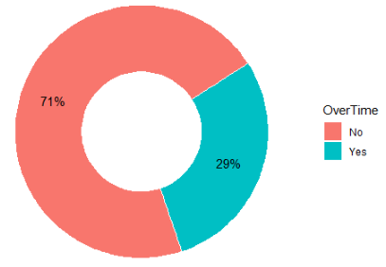
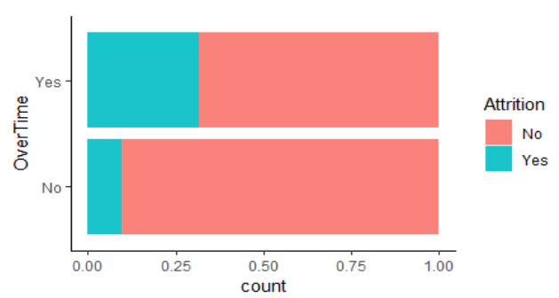
attrition
Employee Percent by Overtime
OverTime
29% of employees does overtime
Attrition rate is more than 30% for the employees who does overtime
Attrition rate is around 10% for the employees who doesn't do overtime
Attrition Percent by Overtime

Slide 5
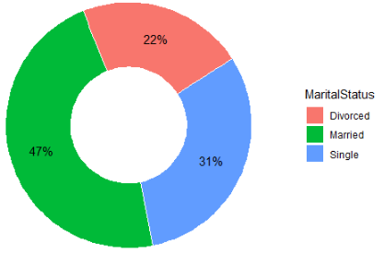
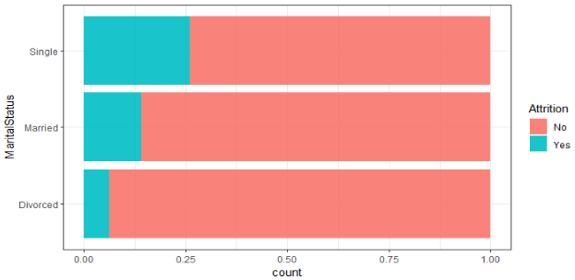
attrition
Employee Percent by Marital Status
Marital Status
31% of employees are Singles
Attrition rate is 25% for Singles
Attrition rate is lowest for Divorced
Attrition Percent by Marital Status

Slide 6
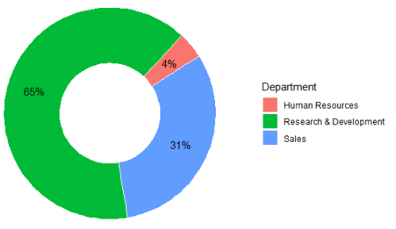
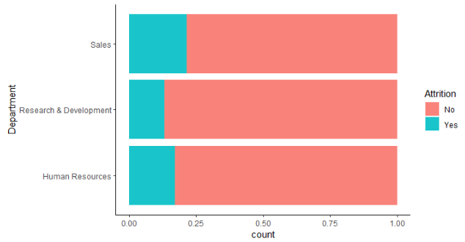
attrition
department
Employee Percent by Department
Sales and Human Resources departments has higher Attrition and makes 35% of the employees
Attrition by Department

Slide 7
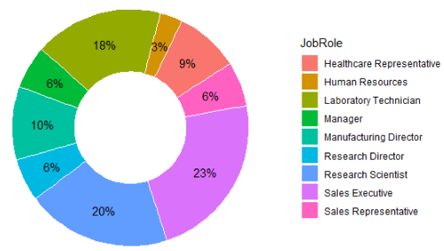
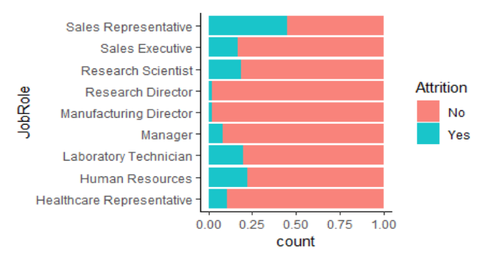
attrition
Employee Percent by Job Role
Job role
Sales Representative has Attrition rate of 40%
Human Resources has Attrition rate of 24%
Director rank has Lowest Attrition rate
And next Lowest is Manager
Attrition by Job Role

Slide 8
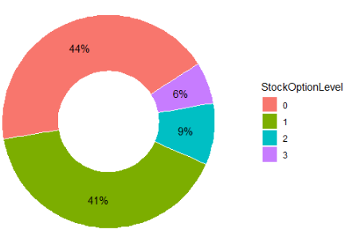
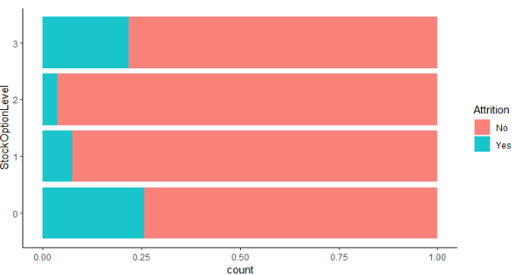
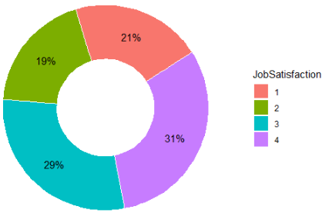
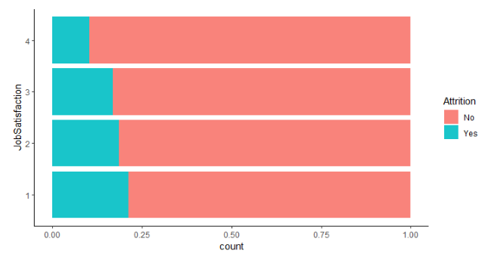
attrition
Employee Percent by Stock options
Job satisfaction and Incentives
Job Satisfaction and Incentives are playing major role
More satisfied less Attrition
Attrition by Stock options
Employee percent by Job Satisfaction
Attrition by Job Satisfaction

Slide 9
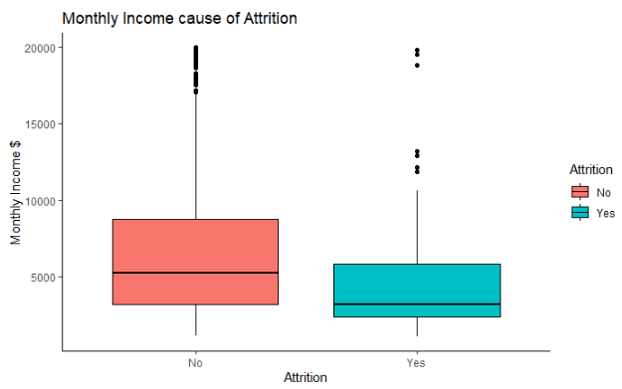
attrition
Attrition and monthly income
Monthly Income is playing a major role in Attrition.
Lower the Income higher the Attrition

Slide 10
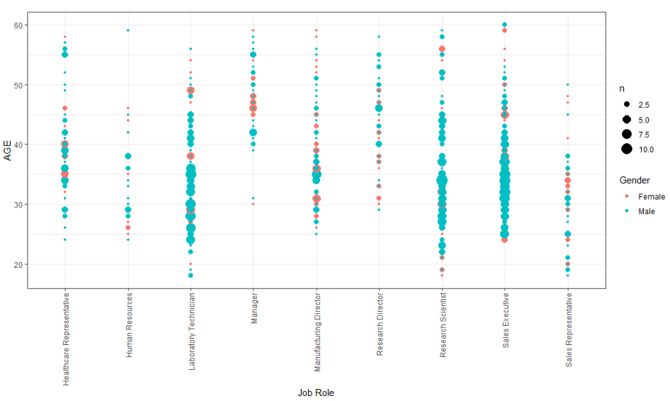
Interesting Observation
Correlation Age, job Role and gender
Majority of the Managers age>=40
Directors ages are almost evenly distributed across 40
HR and Sales Representatives are younger
Technical Job Roles has employees of all ages.
Notes:
If we consider 40 as the median
Majority of the Managers age>=40
Directors ages are almost evenly distributed across 40
HR and Sales Executives are younger
Technical Job Roles has employees of all ages.

Slide 11
Suggestions to Curb Attrition
Limit Business Travel
Understand how employees reacting to Overtime
Consider Remote Work
Consider Hiring people who stick to companies for long time
Job Satisfaction

Slide 12
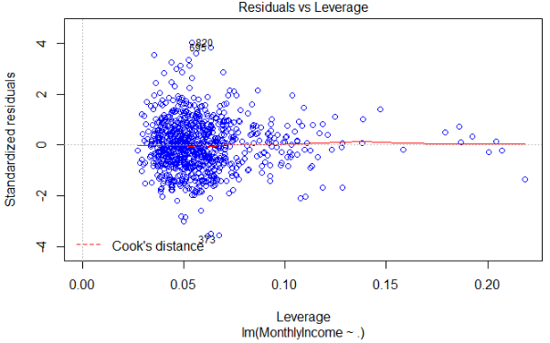
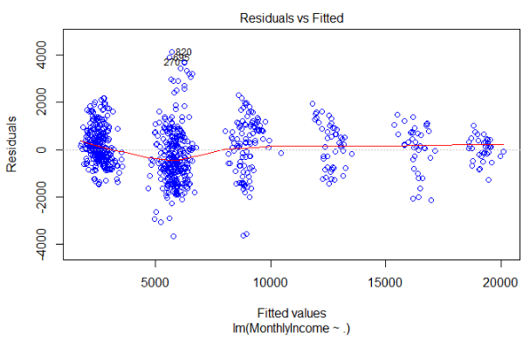
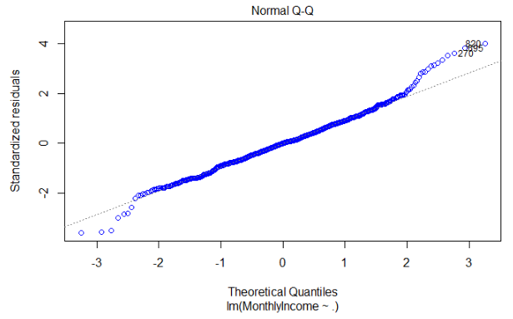
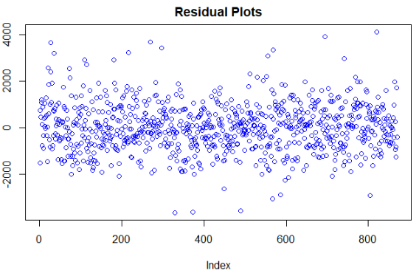
Monthly Income prediction - regression
RMSE = 1381 Adjusted r-square = 0.91

Slide 13
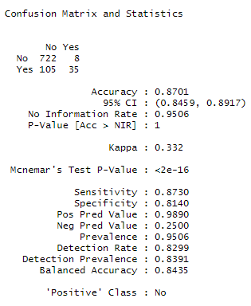
Attrition prediction – knn Classification
Confusion matrix
 | No | Yes
No | 722 | 8 | 730
Yes | 105 | 35 | 140
 | 827 | 43 | 870
KNN model predicts the outcome with an accuracy of 87%
Sensitivity 87%
Specificity 81%

Slide 14

Rajesh Satluri

