Slide 1

Responsive Matrix-Layout Visual Recommender a CSE 591 – Data Visualization
Team Members:
Rajesh Surana (rsurana@asu.edu)
Aritra Kumar Lahiri (aklahiri@asu.edu)

Slide 2
Research Questions
There are very few robust recommender systems for Q&A websites that are responsive for various-sized screen devices. 25% of Internet users only access the internet via a mobile device in the United States
A single adjustable window to display both personalized and generalized recommendations for quick comparison
Using visualization to convey ranking instead of number
Eliminating need of big screen devices to access stackoverflow while on the go

Slide 3
Open it in your mobile as well as laptop
website
http://www.visualrecommender.x10.bz
LINK_to_userid
Password:1234

Slide 4
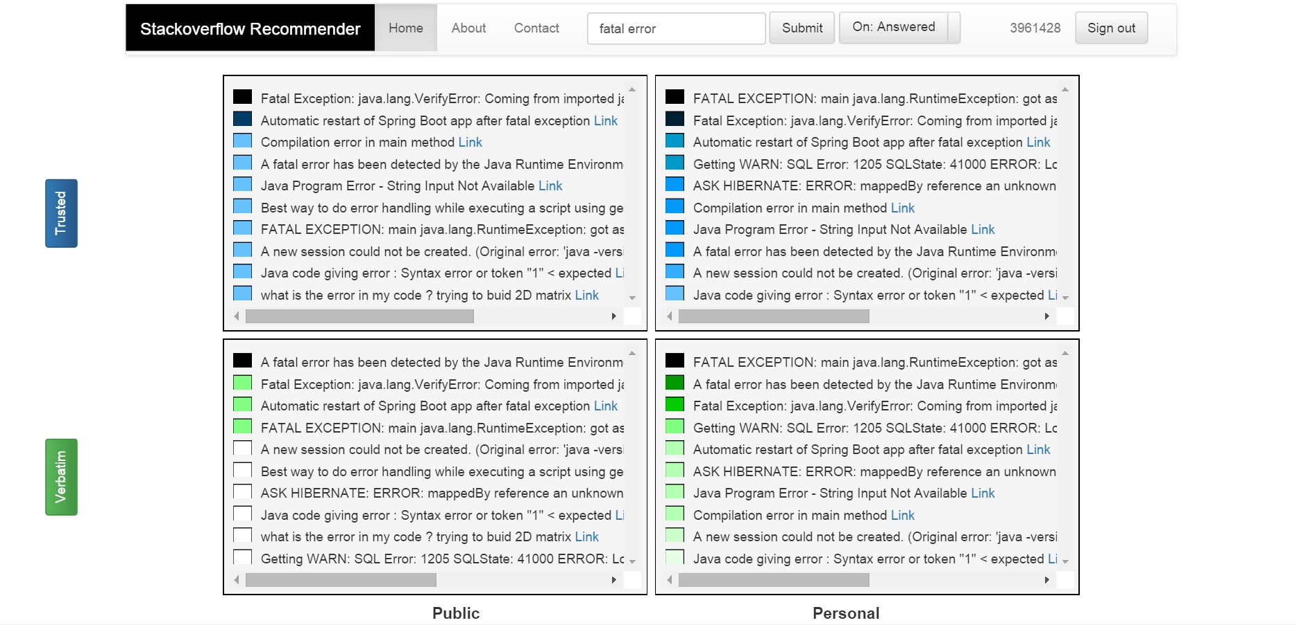

Recommender- Desktop Version
Filtering questions without answers
User
Mouseover Help
One color for a row- Blue
Matrix
Attributes
One color for a row- Green

Slide 5
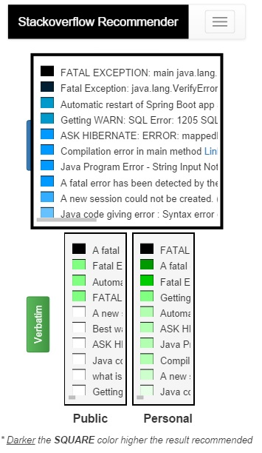
Recommender- Mobile Version
Collapsible Navbar
to save space
Expandable boxes
on mouseover
Explanation
for color scheme

Slide 6
Data Collection & Analysis
Data source:
Extracted from StackOverflow API
Format : CSV
Unique questions : ~ 45,000; answers: ~50,500
Accepted answers: ~17,500
Calculated user interest based on the tags for questions that s/he has asked or answers given
Target Audience
Users of stackoverflow

Slide 7
Technologies Used
PHP – processing engine
MySQL – database
Javascript (bootstrap, Jquery, AJAX) – visualization
SVG – visualization
HTML
CSS

Slide 8
Recommendation Score Calculation
Public scores (data attributes)
Trusted: user reputation
Rated: votes to the question
Popular: number of answers to the question
Verbatim: Maximal string matching with query
Personal scores
Avg of data attributes score and personal domain interests score

Slide 9
Design & Approach
Shneiderman Visual Information Seeking Mantra
Overview first
Filter & Zoom
Details on Demand
Colors
Used only when required
One color for each of two rows of the grid
Heatmap for showing rank for the results (darker is better)
Having system logic that is at least somewhat transparent
Providing ways to refine recommendations by including or excluding particular genres/attribute
Leveraging visualization for ranking rather than mere numbers

Slide 10
References
[1]Sarah Perez. (Aug 2014). Majority Of Digital Media Consumption Now Takes Place In Mobile Apps.
http://techcrunch.com/2014/08/21/majority-of-digital-media-consumption-now-takes-place-in-mobile-apps/
[2] Parra, D., Brusilovsky, P., & Trattner, C. (2014). See what you want to see: visual user-driven approach for hybrid recommendation. Paper presented at the Proceedings of the 19th international conference on Intelligent User Interfaces, Haifa, Israel.
[3]Noah Iliinsky. (Feb 2012). Why Is Data Visualization So Hot?
http://blog.visual.ly/why-is-data-visualization-so-hot/
[4]Stackexchange API
https://api.stackexchange.com/
[5] Owen Phelan, Kevin McCarthy, Mike Bennett, and Barry Smyth. (2011). Terms of a Feather: Content-Based News Recommendation and Discovery Using Twitter , Advances in Information Retrieval Lecture Notes in Computer Science Vol 6611, pp 448-459
[6] Han, S., Hsiao, I. and Parra, D. (2014). A Study of Mobile Information Exploration with Multi-touch Interactions, In SBP. 269-276, Springer.
[7] Stackoverflow Help documentation
http://stackoverflow.com/help

Slide 11
[8]MySQL FULLTEXT index documentation https://dev.mysql.com/doc/refman/5.6/en/innodb-fulltext-index.html
[9] PHP similar_text() function documentation
http://php.net/manual/en/function.similar-text.php
[10] Bootstrap documentation
http://getbootstrap.com/
[11]AJAX documentation
http://www.w3schools.com/ajax/
[12]Swearingen, K., & Sinha, R. (2001, September). Beyond algorithms: An HCI perspective on recommender systems. In ACM SIGIR 2001 Workshop on Recommender Systems, (Vol. 13, No. 5-6, pp. 1-11).
[13]Ben Shneiderman. (1996), The Eyes Have It: A Task by Data Type Taxonomy for Information Visualizations.
[14]Bostandjiev, S., O'Donovan, J., and Höllerer, T. (2012). TasteWeights: a visual interactive hybrid recommender system. In Proceedings of the sixth ACM conference on Recommender systems (RecSys '12). ACM, New York, NY, USA, 35-42.
[15] Herlocker, J. L., Konstan, J. A., Terveen, L. G., & Riedl, J. T. (2004). Evaluating collaborative filtering recommender systems. ACM Transactions on Information Systems (TOIS), 22(1), 5-53

