Slide 1
Classical pattern recognition on Fashion-MNIST
PATTERN RECOGNITION · PROJECT PRESENTATION
Comparing six HOG, PCA and SVM pipelines to find the best way to classify clothing images
Rajesh Turubilli
Nalla Vamsi Krishna Choudhury
S20240020338
S20240020313
IIIT SRICITY· Electronics and Communication Engineering · Academic year M2026
Notes:
Introduce the project: a team study of how far classical, non-deep-learning pipelines can go on Fashion-MNIST. Six approaches were compared under one identical protocol; the proposed one combines HOG features, PCA and an RBF SVM.

Slide 2
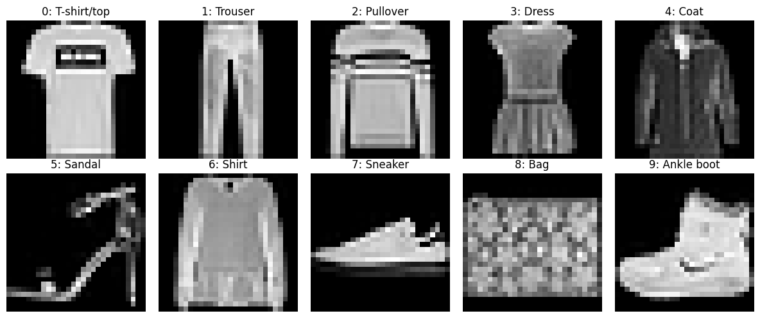
Sorting clothing images into ten categories
THE PROBLEM
Which mix of features, dimensionality reduction and classifier is the most accurate and the most stable, and what does it cost in running time?
70,000
784
10
images
pixels each
balanced classes
One sample per class. Shirt, T-shirt/top, Pullover and Coat look alike.
Source: Fashion-MNIST, Xiao, Rasul and Vollgraf (2017)
02
Notes:
Fashion-MNIST is a harder drop-in replacement for digit MNIST: 28 by 28 grayscale clothing images, 60,000 training and 10,000 test images, exactly 6,000 per class in training. The question is which combination of feature representation, dimensionality reduction and classifier gives the best and most stable results, and how accuracy trades off against running time.

Slide 3
Each pair isolates one design choice
SIX PIPELINES
# | Pipeline | Features | Reduction | Classifier
1 | KNN on raw pixels | 784 pixels | None | KNN, k = 5
2 | Linear SVM on raw pixels | 784 pixels | None | Linear, C = 1
3 | PCA + RBF SVM on raw pixels | 784 pixels | PCA-100 | RBF, C = 5
4 | HOG + Linear SVM | 1,296 HOG | None | Linear, C = 1
5 | HOG + PCA + Linear SVM | 1,296 HOG | PCA-100 | Linear, C = 1
6 | HOG + PCA + RBF SVM (proposed) | 1,296 HOG | PCA-100 | RBF, C = 5
Methods 2 and 4 isolate HOG. Methods 4 and 5 isolate PCA. Methods 3 and 6 differ only in HOG.
03
Notes:
All six use the same folds. Pairs of methods isolate single choices: 2 vs 4 shows what HOG adds for a linear classifier, 4 vs 5 shows what PCA does, and 3 vs 6 shows what HOG adds when PCA and the RBF SVM are held fixed. Hyperparameters were fixed, not tuned.

Slide 4
One leakage-free protocol for every method
METHOD
20,000
3 folds
10,000
Development set
Cross-validation
Test images
Stratified sample of the 60,000 training images, 2,000 per class.
Stratified, with identical folds for all six methods. PCA is fitted on each training fold only.
Official test set, used once, for the selected model only.
Pixels were scaled to [0, 1], seed 42 was fixed everywhere, and the best model was chosen by mean cross-validation Macro-F1.
04
Notes:
Three things keep the comparison fair. First, a stratified 20,000-image development set keeps the experiment feasible on Colab. Second, one StratifiedKFold split is reused for every method, and PCA lives inside a scikit-learn Pipeline so it never sees validation data. HOG has no learned parameters, so computing it once does not leak. Third, the official test set is touched exactly once, after model selection.

Slide 5
HOG turns edges and shape into numbers
FEATURE EXTRACTION
1 · Gradients
2 · Cells
3 · Blocks
4 · Vector
Edge strength and direction at every pixel.
4 × 4 pixel cells, each with a 9-bin orientation histogram.
2 × 2 cell blocks with L2-Hys normalisation against lighting changes.
All block descriptors joined into one vector per image.
7 × 7 cells
→
36 blocks × 36 values
→
1,296 features
Source: Dalal and Triggs (2005)
05
Notes:
Clothing classes differ mostly in outline and internal edges, which is exactly what HOG encodes. A 28 by 28 image has 7 by 7 cells of 4 by 4 pixels. Blocks of 2 by 2 cells slide one cell at a time, giving 6 by 6 = 36 blocks of 36 values each, so 1,296 features. That is more than the 784 raw pixels, but the features are shape statistics, which is why PCA follows.

Slide 6
PCA keeps 100 directions of highest variance
DIMENSIONALITY REDUCTION
87%
92%
3.9×
fewer features on raw pixels (784 → 100)
fewer features on HOG (1,296 → 100)
faster for HOG + Linear SVM (20.5 s → 5.3 s)
PCA sits inside each cross-validation pipeline, so it learns only from training folds. The 100-component count was a fixed choice, and the explained variance was not examined.
06
Notes:
PCA projects centred data onto orthogonal directions ordered by variance. Keeping 100 components cuts the SVM stage cost sharply. The 3.9x speed-up is computed from the report's average times for HOG + Linear SVM without and with PCA, 20.53 s and 5.33 s. Accuracy for that pair slipped slightly, 0.8654 to 0.8613. The report did not test other component counts or report retained variance, so no variance percentage is claimed.

Slide 7

HOG, then PCA, then an RBF SVM
PROPOSED METHOD
Image
HOG
PCA
RBF SVM
Class
28 × 28 grayscale
1,296 shape features
100 components
C = 5, gamma = scale
One of ten
HOG supplies edge and shape cues that tolerate small shifts and lighting changes.
PCA compacts correlated features and makes the kernel cheaper.
RBF SVM draws curved boundaries between overlapping classes.
07
Notes:
This is the combined pipeline the project proposes. Each stage covers a weakness of the others. These are expected mechanisms; the experiments that follow test whether the combination actually helps.

Slide 8
The proposed pipeline leads by 1.2 points
CROSS-VALIDATION RESULTS
HOG + PCA + RBF SVM
0.8936 ± 0.0014
PCA + RBF SVM, raw pixels
0.8816 ± 0.0027
HOG + Linear SVM
0.8654 ± 0.0010
HOG + PCA + Linear SVM
0.8613 ± 0.0041
KNN, raw pixels
0.8311 ± 0.0038
Linear SVM, raw pixels
0.8203 ± 0.0053
Mean accuracy ± standard deviation over 3 folds. Bars start at 0.80. The proposed method led in every fold.
08
Notes:
Ranked by mean cross-validation Macro-F1, which gives the same order as accuracy. The proposed method has the highest accuracy (0.8936) and Macro-F1 (0.8933) with a small standard deviation. The 1.2-point gain over PCA + RBF SVM on raw pixels is the contribution of HOG, since PCA and classifier settings are identical. With only three folds the standard deviation is a rough indicator and no significance test was run.

Slide 9
The most accurate model is also quicker than three rivals
ACCURACY AND SPEED
Pipeline | Accuracy | Macro-F1 | Time (s)
HOG + PCA + RBF SVM | 0.8936 | 0.8933 | 12.04
PCA + RBF SVM, raw pixels | 0.8816 | 0.8812 | 17.61
HOG + Linear SVM | 0.8654 | 0.8649 | 20.53
HOG + PCA + Linear SVM | 0.8613 | 0.8598 | 5.33
KNN, raw pixels | 0.8311 | 0.8311 | 9.64
Linear SVM, raw pixels | 0.8203 | 0.8187 | 27.28
If run time matters most, HOG + PCA + Linear SVM is the fastest at 5.33 s, but 3.2 points less accurate. Times are from a shared Colab runtime and are indicative.
09
Notes:
Average time covers fitting and predicting one validation fold, including PCA, and excludes the one-time HOG extraction. The proposed method took 12.04 s, less than PCA + RBF SVM on raw pixels (17.61 s), HOG + Linear SVM (20.53 s) and Linear SVM on raw pixels (27.28 s). KNN and HOG + PCA + Linear SVM were faster but less accurate.

Slide 10
89.4% accuracy on 10,000 unseen images
FINAL TEST
0.8940
0.8942
0.8940
0.8941
Accuracy
Macro precision
Macro recall
Macro-F1
Cross-validation predicted 0.8936. The test result matches it, so the estimate was realistic and the model did not over-fit.
Only the selected model was tested, so no test-set ranking of the other five methods is claimed.
10
Notes:
The selected model was retrained on the 20,000 development images and evaluated once on the official 10,000-image test set; training and prediction took about 0.4 minutes. Test accuracy 0.8940 versus mean cross-validation accuracy 0.8936.

Slide 11
Shirt is the hardest class
PER-CLASS TEST F1
Bag
0.9765
0.7108
Trouser
0.9758
Ankle boot
0.9627
Shirt F1. It resembles several upper-body garments.
Sandal
0.9618
Sneaker
0.9438
Dress
0.8955
T-shirt/top
0.8514
> 0.96
Pullover
0.8321
Bag, Trouser, Ankle boot and Sandal.
Coat
0.8303
Shirt
0.7108
Bars start at 0.50. Test set, HOG + PCA + RBF SVM.
11
Notes:
Bag, Trouser, Ankle boot and Sandal all exceed 0.96 F1, and Sneaker reaches 0.9438; their outlines are distinctive and HOG captures them. Dress, T-shirt/top, Pullover and Coat sit between 0.83 and 0.90. Shirt is far below at 0.7108 (precision 0.7126, recall 0.7090). Precision and recall are close for every class, so the classifier is not biased toward or against any class.

Slide 12
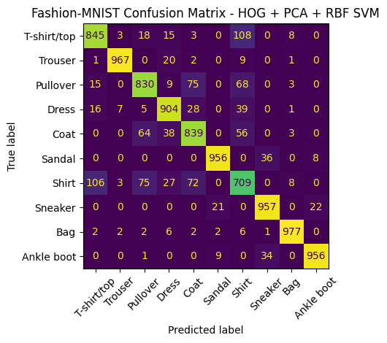
Errors cluster among upper-body garments
CONFUSION MATRIX
True → predicted | Images
T-shirt/top → Shirt | 108
Shirt → T-shirt/top | 106
Pullover → Coat | 75
Shirt → Pullover | 75
Shirt → Coat | 72
Pullover → Shirt | 68
1,060 of 10,000 images were misclassified. Shoe errors are rare and stay between neighbouring types, such as Sandal → Sneaker (36).
Test set, HOG + PCA + RBF SVM
12
Notes:
8,940 images sit on the diagonal. Bag (977), Trouser (967), Sneaker (957), Sandal (956) and Ankle boot (956) are each correct for at least 95% of their images. Almost all errors fall among T-shirt/top, Pullover, Coat and Shirt, whose silhouettes are alike and whose distinguishing details, such as collars and buttons, are lost at 28 by 28 resolution. This is a visual explanation from the matrix, not something tested with extra experiments.

Slide 13
What the experiments showed
CONCLUSION
HOG beats raw pixels
RBF beats linear
A linear SVM gained 4.5 points (0.8203 to 0.8654). With PCA and RBF held fixed, the gain was 1.2 points.
The two best methods both use the RBF kernel, at 0.8936 and 0.8816. Neither kernel was tuned.
PCA mainly saves time
Shirt stays difficult
For HOG + Linear SVM it cut run time from 20.53 s to 5.33 s at a cost of 0.4 points of accuracy.
Its F1 is 0.7108, and it is confused with T-shirt/top, Pullover and Coat.
13
Notes:
Overall, a carefully designed classical pipeline reaches close to 90% accuracy on Fashion-MNIST with modest computation, and gives a transparent, interpretable baseline. Note the PCA effect for the RBF classifier could not be isolated, because no RBF SVM was run on un-reduced features.

Slide 14
What to read with caution, and what to try next
LIMITS AND NEXT STEPS
Limitations
Next steps
Only 20,000 of 60,000 training images were used.
C, gamma, k and the PCA size were fixed, not tuned.
Three folds, one seed, and no significance test.
Only the selected model was run on the test set.
Tune C and gamma, and test 50 to 200 PCA components.
Train on all 60,000 images with 5- or 10-fold validation.
Add other classifiers and compare against CNNs.
Test all six methods, with statistical tests.
Rajesh Turubilli and Nalla Vamsi Krishna Choudhury
14
Notes:
Timings also come from a shared Colab runtime and exclude HOG extraction time, so they are approximate. Closing point: HOG + PCA + RBF SVM was the best of six by cross-validation and its test result of 0.8940 is consistent with that estimate. Invite questions.

Slide 15


