Slide 1


IIIT-B & UpGrad
Airbnb Case Study

Slide 2
Suppose that you are working as a data analyst at Airbnb. For the past few months, Airbnb has seen a major
INTRODUCTION
decline in revenue. Now that the
and
restrictions have started lifting
people have started to travel more, Airbnb wants to make sure that it is fully prepared for this change.

Slide 3
OBJECTIVE
The different leaders at Airbnb want to understand some important insights based on various attributes in the dataset so as to increase the revenue.

Slide 4
PROBLEM STATEMENT
Which type of hosts to acquire more and where?
The categorization of customers based on their preferences.
What are the neighbourhoods they need to target?
What is the pricing ranges preferred by customers?
The various kinds of properties that exist w.r.t. customer
preferences.
Adjustments in the existing properties to make it more
customer-oriented.
What are the most popular localities and properties in New York
currently?
How to get unpopular properties more traction? and so on...

Slide 5
Data Cleaning and Preparation
First, we have understood the data of the dataset in python.
Then we have handled the missing values using median. Identified equal number of null values in both last_review, and reviews_per_month of around 20.55%. Also, identifies in name and host_name.
Then separated the columns of dataset into categorical and
numerical datatypes.
Then we have imputed the categorical column with mode and numerical column with median
Then we have checked if there are any outliers in 6 continuous
columns and treated the using capping method.

Slide 6

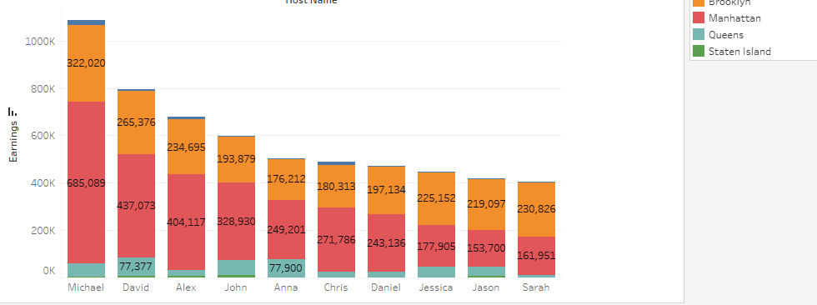
List of Top 10 Host to Acquire
The graphs depicts the top 10 host who are
earning more.
Michael is the top earner who is earning more and
he belongs to Manhattan.

Slide 7

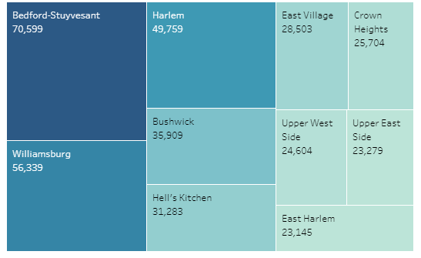
Targeted Neighborhood
We can clearly comprehend that most the people would prefer to go these location / area only.
Reason: The location is nearby beach or services are better than the rest location.

Slide 8

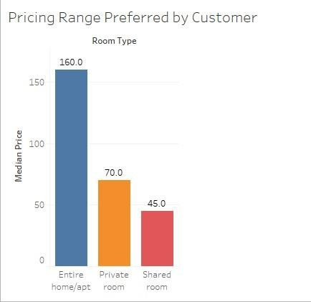
Average Price Prefer by People
On the
the average
basis of room type
price preferred by
customer for Entire Room is 160.
For Private Room is 70
Shared Room is 45

Slide 9
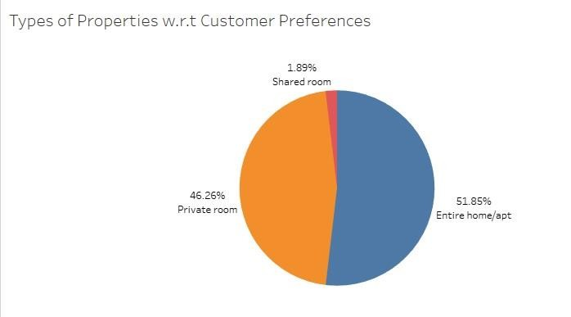
Types of Properties by Customer Preferences
There are three types of rooms – Entire Home/Apartment, Private Room & Shared Room
Overall customers appear to prefer Entire Home (51-85%) & Private Room (46.26%) in comparison to the shared room (1.89%).
Airbnb can focus on promoting shared rooms with discount offers to increase booking of a shared room with discounts.

Slide 10
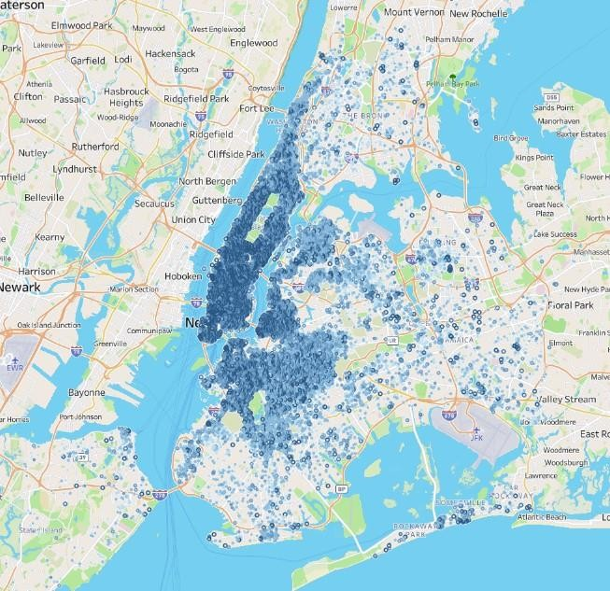
Most Popular Localities and Properties in New York
According to this map more the darker side represents the most popular localities and the lighter side represents the least popular.
We can conclude that Manhattan, Brooklyn & Queens are much popular than Bronx and Staten Island.

Slide 11
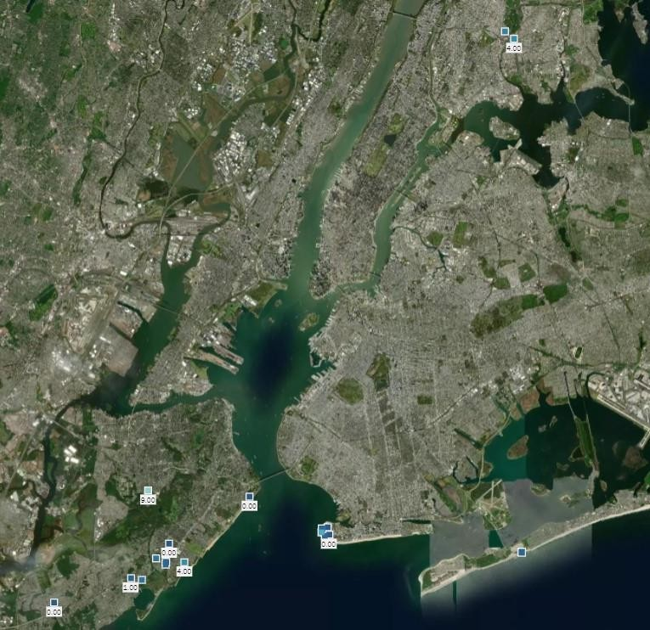
Top 10 Unpopular
Properties
Top 10 unpopular locations where people do not opt for stay.
Because the location of all unpopular localities is at the corner of the city where people do not wish to visit or there may not be any tourist attraction point

Slide 12

Adjustments in the existing properties to make it more customer-oriented
With the exception of Manhattan and Brooklyn, every other city needs to alter
its marketing plan to boost sales.
Most customers prefer to invest their money in the $40 to $160 range. Try a fresh marketing tactic to draw customers, such as offering deals and reductions.
Every unpopular locality needs to alter their current plan in order to increase revenue, such as by creating a tourism draw.
Increase the customer's purchasing ability, etc.
Bookings from clients may rise if there are more coastal purchases and new
construction.

Slide 13
Recommendation
Promotion of shared accommodations with focused savings to boost reservations.
As long as the new acquisition or growth meets the criteria for both customer traffic volume and customer happiness, it can be done for between $40 and $160.
As long as they fall within the desirable price range ($40-$160), new purchases can be looked into to purchase "private rooms" in Manhattan and Brooklyn and "entire homes" in the Bronx and Queens.
Brooklyn costs $113 on average. Given the abundance of listings in Manhattan, Brooklyn may be regarded for growth.
Bookings from clients may rise if there are more coastal purchases and new construction.
Focus on prime locations like Manhattan and Brooklyn where people show interest.

Slide 14

Thank You

