Slide 1


IIIT-B & UpGrad
Airbnb Case Study

Slide 2
Suppose that you are working as a data analyst at Airbnb. For the past few months, Airbnb has seen a major
INTRODUCTION
decline in revenue. Now that the
and
restrictions have started lifting
people have started to travel more, Airbnb wants to make sure that it is fully prepared for this change.

Slide 3
OBJECTIVE
The different leaders at Airbnb want to understand some important insights based on various attributes in the dataset so as to increase the revenue.

Slide 4
PROBLEM STATEMENT
Which type of hosts to acquire more and where?
The categorization of customers based on their preferences.
What are the Neighborhoods they need to target?
What is the pricing ranges preferred by customers?
The various kinds of properties that exist w.r.t. customer
preferences.
Adjustments in the existing properties to make it more
customer-oriented.
What are the most popular localities and properties in New York
currently?
How to get unpopular properties more traction? and so on...

Slide 5
Data Cleaning and Preparation
First, we have understood the data of the dataset in python.
Then we have handled the missing values using median. Identified equal number of null values in both last_review, and reviews_per_month of around 20.55%. Also, identifies in name and host_name.
Then separated the columns of dataset into categorical and numerical datatypes.
Then we have imputed the categorical column with mode and numerical column with median
Then we have checked if there are any outliers in 6 continuous
columns and treated the using capping method.

Slide 6

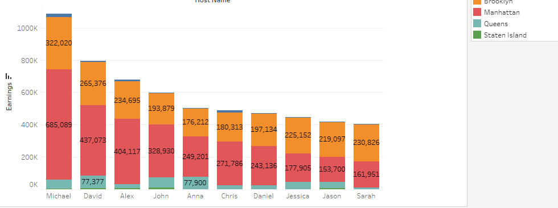
List of Top 10 Host to Acquire
The graphs depicts the top 10 host who are
earning more.
Michael is the top earner who is earning more and
he belongs to Manhattan.

Slide 7
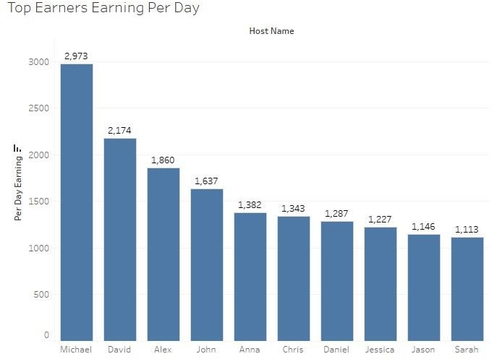
Top Earners Earning Per Day
According to the top 10 per day earning list Michael is earning higher.
The Reason could be their service is better than others or he has a more number of properties in the popular location/area.

Slide 8


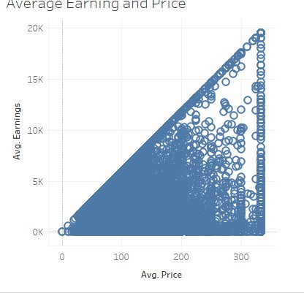
Average Earning and Price
This graph clearly shows that most the people would be more partial to spend their money the people between the range of 40 to 250.
And the average earning by the host is
around 6000- 7000
It also depicts that the host who are charging 170 or more as an average price, only those are earning more than 10,000.

Slide 9

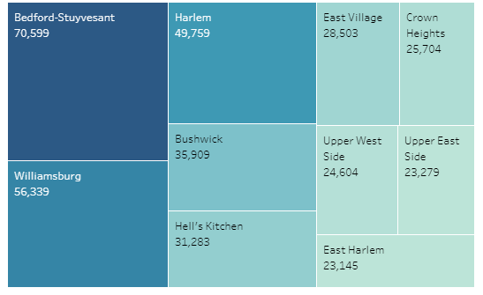
Targeted Neighborhood
We can clearly comprehend that most the people would prefer to go these location / area only.
Reason: The location is nearby beach or services are better than the rest location.
Targeted location
Neighborhoods are
/ Bedford-
Stuyvesant Williamsburg, Harlan,
Bushwick, Hell’s Kitchen and more.

Slide 10

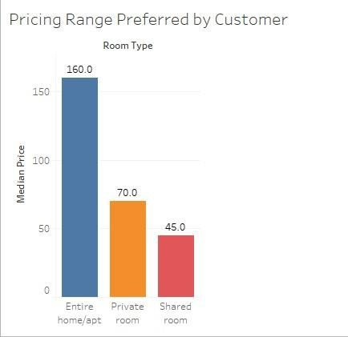
Average Price Prefer by People
On the
the average
basis of room type
price preferred by
customer for Entire Room is 160.
For Private Room is 70
Shared Room is 45

Slide 11
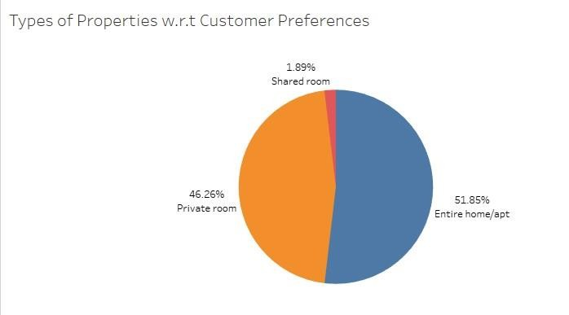
Types of Properties by Customer Preferences
There are three types of rooms – Entire Home/Apartment, Private Room & Shared Room
Overall customers appear to prefer Entire Home (51-85%) & Private Room (46.26%) in comparison to the shared room (1.89%).
Airbnb can focus on promoting shared rooms with discount offers to increase booking of a shared room with discounts.

Slide 12
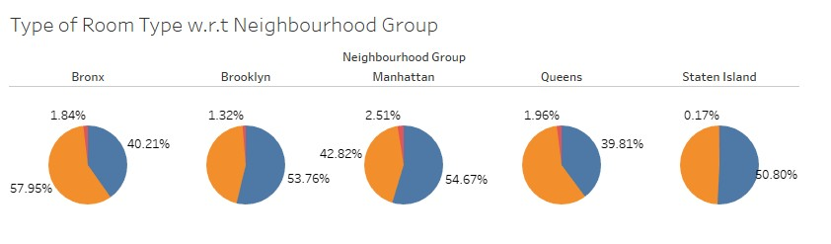
Room Type w.r.t
Neighborhood Group
Based on this map we depict that popular localities & properties concerning Room types in Manhattan (Entire Home / Private) or Brooklyn (entire Home/ Private) in comparison to other Neighborhood.

Slide 13

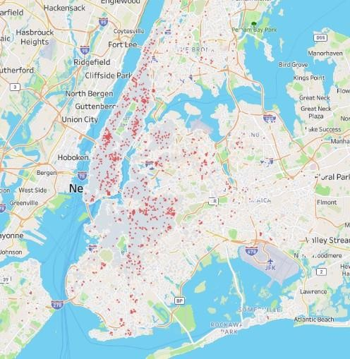
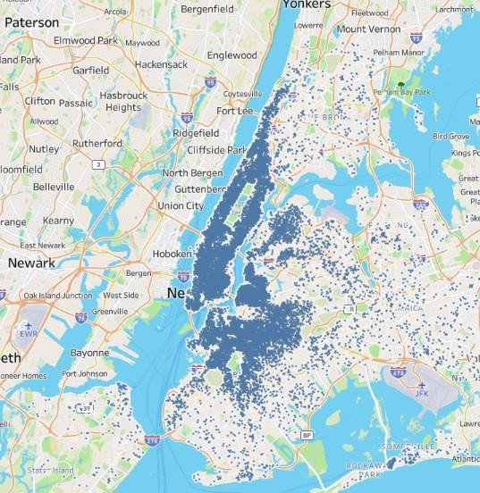
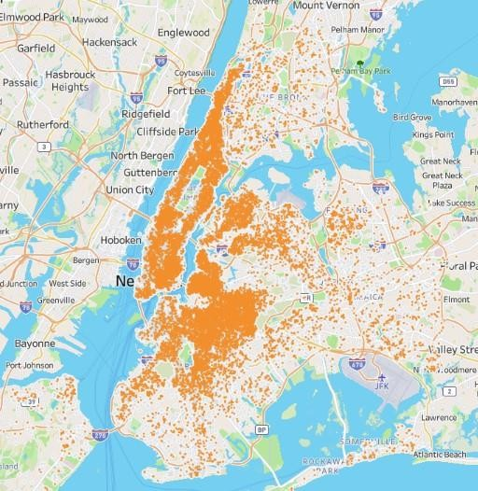
According to this map more the darker side
represents the most popular localities and the
Popular Localities and Properties
lighter side represents the least popular.
We can conclude that ~Manhattan & Brooklyn & the Queens are much popular than. Bronx and Staten Island.

Slide 14
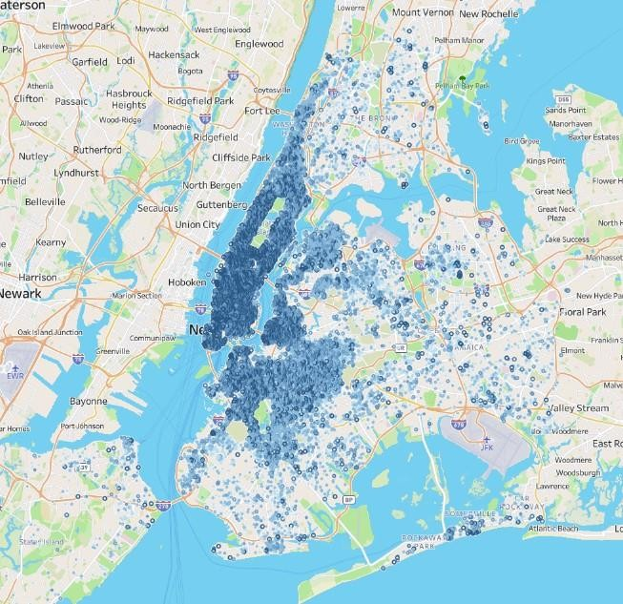
Most Popular Localities and Properties in New York
According to this map more the darker side represents the most popular localities and the lighter side represents the least popular.
We can
conclude that
Manhattan, Brooklyn & Queens are much popular than Bronx and Staten Island.

Slide 15
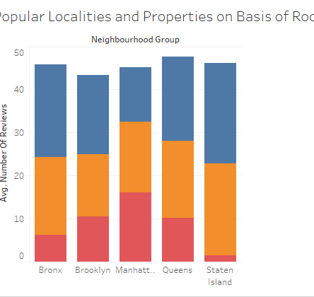
Popular Localities and
Properties on Basis of Room Type
As we can see in this graph
place
Manhattan to the only
where shared rooms are booked more compare to the rest Neighborhood
Reason, because Manhattan is an industry as well as its hub so, the single employee & Solo traveller prefer shared room.

Slide 16
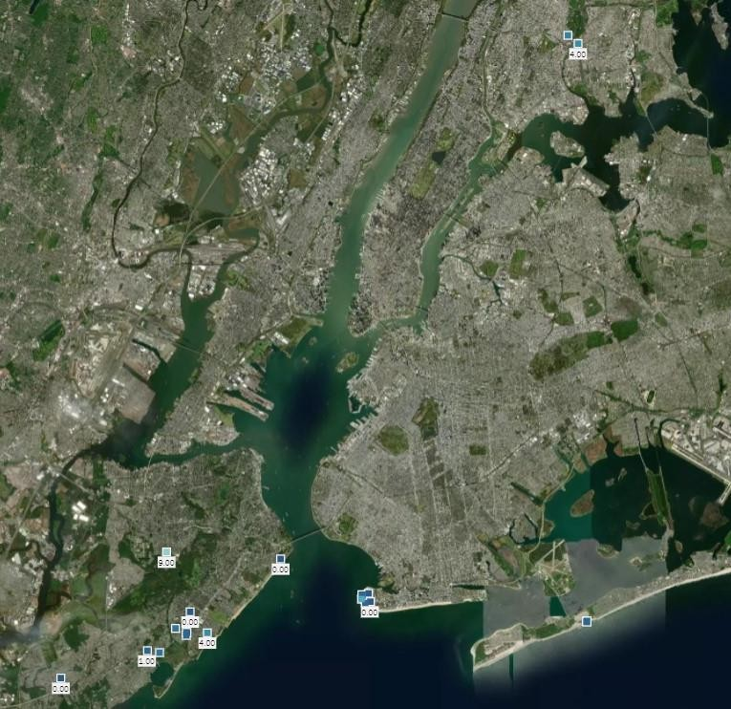
Top 10 Unpopular
Properties
Top 10 unpopular locations where people do not opt for stay.
Because the location of all unpopular localities is at the corner of the city where people do not wish to visit or there may not be any tourist attraction point

Slide 17
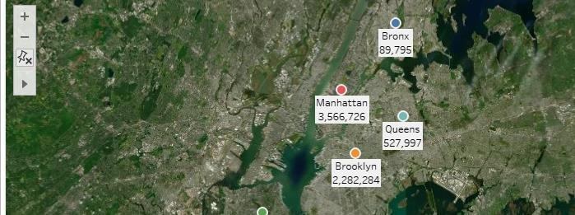
Neighborhood Group Listing on Map
Price of accommodation in Manhattan is pretty higher and affordable for higher class people.
With certainty anyone. Its scenic view is attract
anyone.

Slide 18
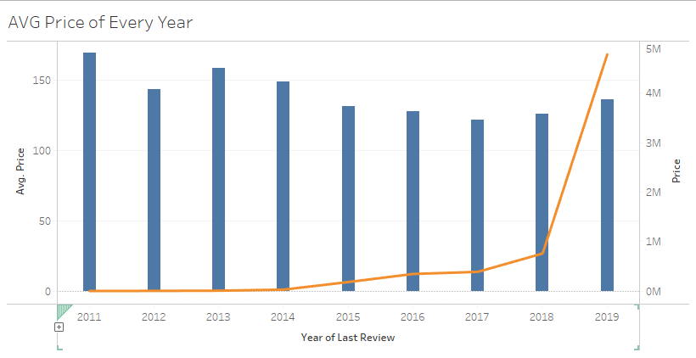
This graph concludes that the average was fallen down compared to 2011 (year) of average business strategy or a different reason
The total price grew up to 2018 at a decent per cent,
AVG Price of Every Year
but in 2019 its increased by more than 400% in
contrast with the 2018

Slide 19
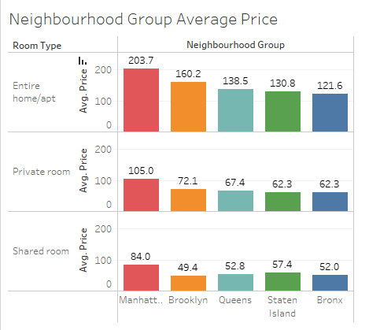
Neighborhood Group Average Price
In all three aspects Manhattan is at the top for changing higher prices (Entire / Private / Shared).
And in two aspects Bronx is the last for charging least price.
Excluding Manhattan, they need to change their marketing strategy to increase sales.

Slide 20
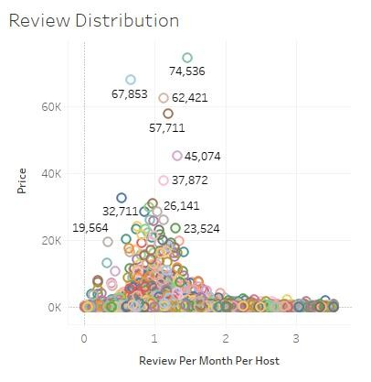
Review Distribution
With this chart, we can summarize that per month the host is 1.2 and the highest rating is 3.5.
3.5 to the highest rating because we have treat
treated Whiskers, as the median.

Slide 21

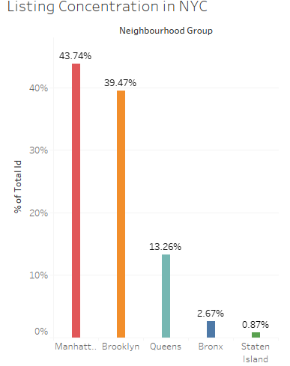
Listing Concentration in NYC
We see that Airbnb has a good presence in Manhattan, Brooklyn & Queens.
Listings are maximum in Manhattan (49.74%). & Brooklyn (39.47%) owing to the high population destiny and it being the financial &tourism hub of NYC.
Staten Island (1%) has the least number of listings, due to low population density are very few tourism destination.

Slide 22

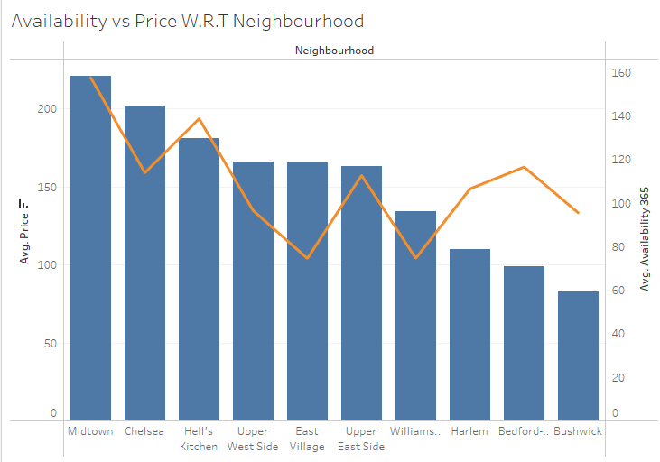
Availability vs Price W.R.T Neighborhood

Slide 23
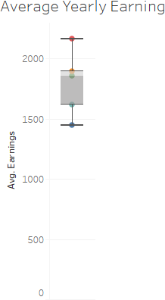
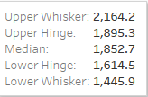
Average Yearly Earning

Slide 24
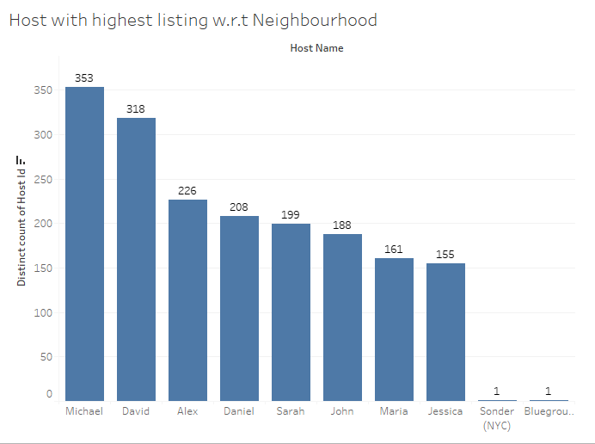
Host with highest listing w.r.t Neighborhood
This Michael,
graph
David
depicts
and
that Alex
captured more than 40% of the
host properties in NYC.
And Move no of properties means higher earnings.

Slide 25
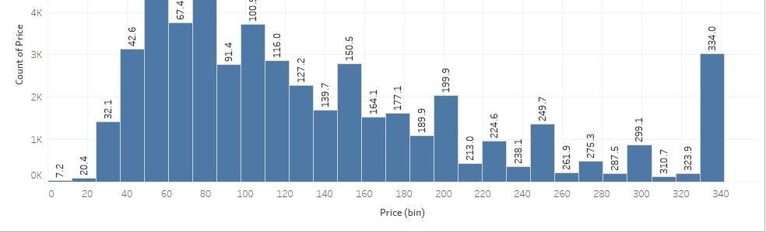
Average Price Distribution By People
Most of the customers prefer to spend their
money between a range of 40 to 160.
And the people who want luxury they are paying more also.

Slide 26
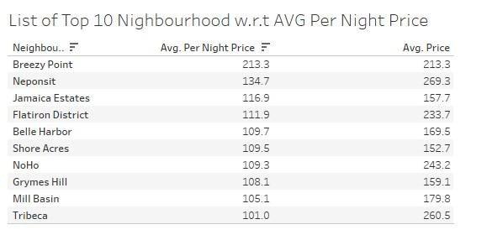

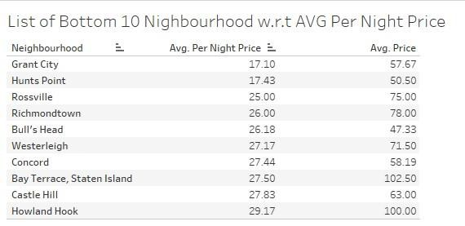
Top 10 / Bottom 10 Neighborhood W.R.T Average Per Night Price
Here are the list of top 10 Neighborhood concerning average price per night.
Midtown is in the top charging a 95$ average for a night, and Grant City is the least changing 17$ neighborhood.

Slide 27

Adjustments in the existing properties to make it more customer-oriented
Excluding Manhattan and Brooklyn, rest all need to change their marketing strategy to increase their sales.
Most of the customers prefer to spend their money between a range of 40 to 160. Try some new marketing strategy to attract people like by giving discounts and offers.
All unpopular localities need to change their existing plan to earn more like develop some tourist attraction point.
Increase the spending power of customer etc.

Slide 28

Recommendation
Promotion of shared accommodations with focused savings to boost reservations.
As long as the new acquisition or growth meets the criteria for both customer traffic volume
and customer happiness, it can be done for between $40 and $160.
As long as they fall within the desirable price range ($40-$160), new purchases can be looked into to purchase "private rooms" in Manhattan and Brooklyn and "entire homes" in the Bronx and Queens.
Brooklyn costs $113 on average. Given the abundance of listings in Manhattan, Brooklyn may be regarded for growth.
Bookings from clients may rise if there are more coastal purchases and new construction.
Focus on prime locations like Manhattan and Brooklyn where people show interest.

Slide 29

Thank You

