Slide 1

Predictive analysis of school shooting incidents
CISC-5800: Machine Learning
Fordham University
By,
1. Ujjwal Samanta
2. Rajeshwar Vempaty

Slide 2
introduction
Background: The increasing frequency and impact of school shooting incidents have become a critical concern in recent years. Our analysis, covering data from 1966 to 2023*, reveals persistent patterns in these tragic events, including temporal trends, geographical hotspots, and specific demographic involvements. These incidents disrupt the educational environment and have lasting effects on communities and individuals involved.
Problem Statement: To uncover patterns and influential factors leading to school shooting incidents and predict victim outcomes. Utilizing Machine Learning techniques to predict the likelihood of school shooting incidents resulting in victims.
Objective: The primary objective of this project is to uncover underlying patterns and influential factors that lead to a shooting incident and determine whether they will result in victims—using Machine Learning techniques to predict the likelihood of school shooting incidents with victim outcomes.
On average, there were about ~5 incidents per month over the years covered by the dataset

Slide 3
Data overview
Data Source: The primary data for this project is sourced from the "Public K-12 School Shooting Database,“ which includes comprehensive details on school shootings, such as incident specifics, shooter profiles, victim information, and weapon types. It contains data on school shooting incidents, including details about the incidents, shooters, victims, and weapons.
- Citation: Riedman, David. ""K-12 School Shooting Database"" (2023)
Dataset consists of four individual sheets,
Incident : Consists of Incident ID number and details of what, where, and when the shooting happened.
Shooter : Incident ID number and details about the shooter. Multiple rows have the same incident ID number if there were multiple shooters
Victim : Incident ID number and details about the victim. Multiple rows have the same incident ID number if there were multiple victims
Weapon : Incident ID number and details about the weapon used (including weapons that were possessed by the shooter during the incident but were not fired). Multiple rows have the same incident ID number if there were multiple weapons used.
Total there were 2,514 school shooting incidents recorded from 1966 to 2023 (till sept) across United States.
Incidents
Shooter
Victims
Weapon

Slide 4
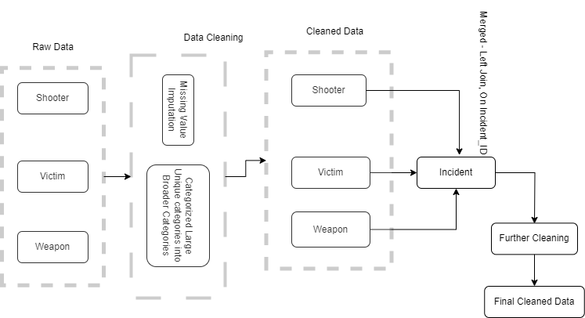
Data cleaning & preprocessing

Slide 5
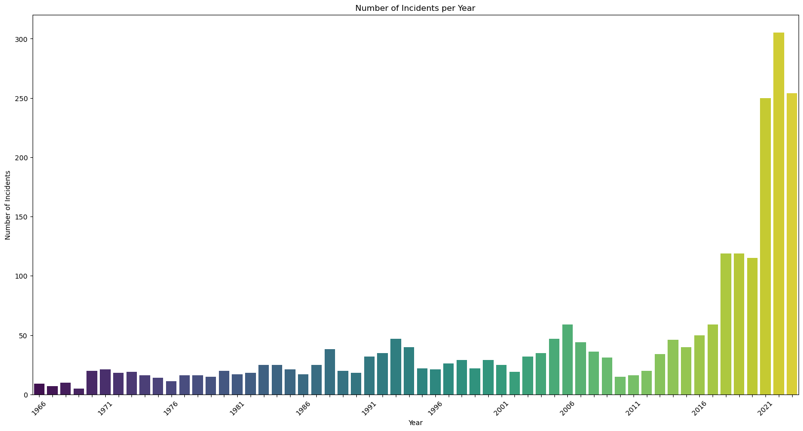
Exploratory data analysis
Incident Details
This bar chart illustrates the number of school shooting incidents per year, based on the dataset extending up to 2023. X-axis represents the years and Y-axis shows the count of the incidents recorded every year
There has been an upsurge in such incidents post-2016, with a particularly sharp rise observed following the COVID-19 pandemic
2021 – 250 Incidents
2022 – 305 Incidents
2023 – 254 Incidents

Slide 6
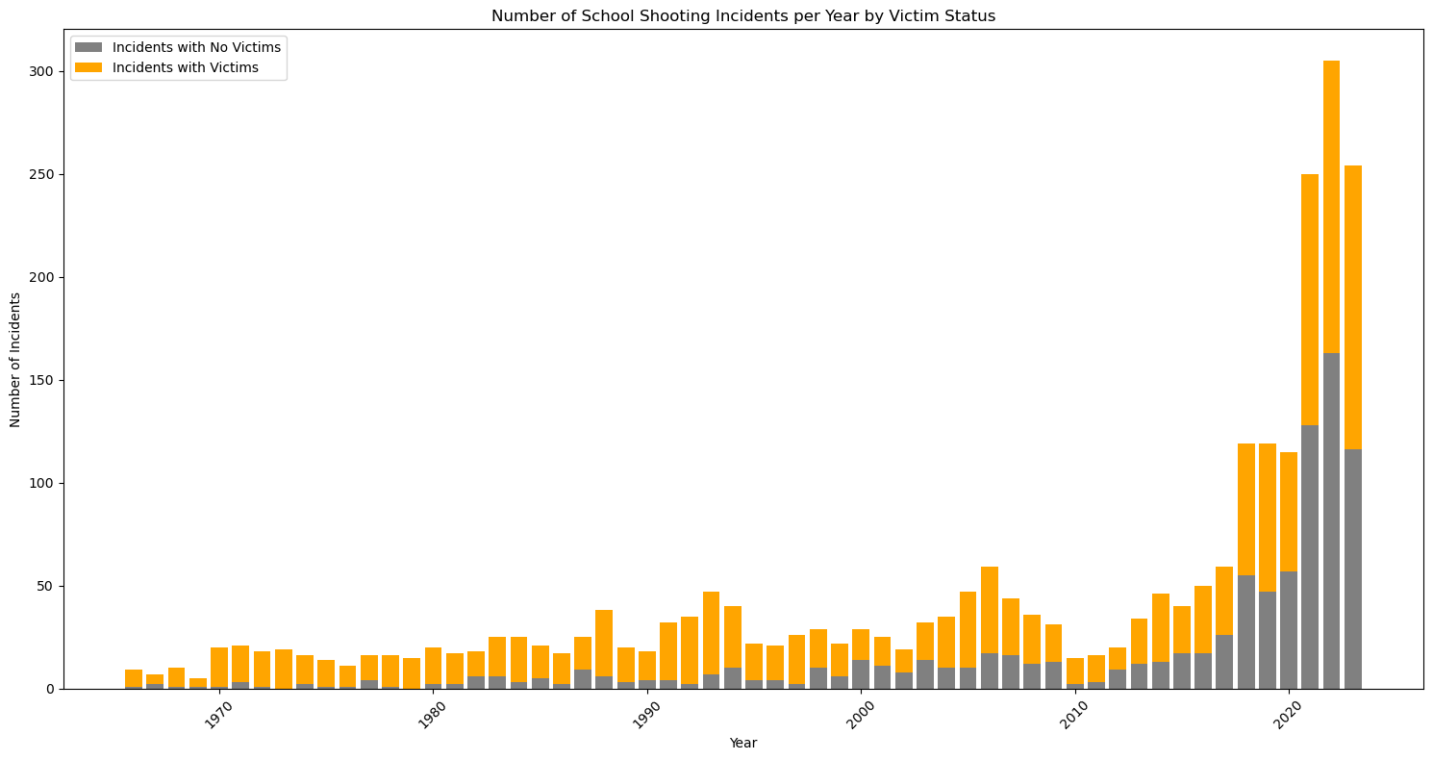
This bar chart illustrates the number of school shooting incidents per year, also shows the distribution of Incidents with victims or without victims
From 1966 to 2000, the proportion of incidents resulting in victims were higher.
Out of 2514 Incidents occurred,
Victims Wounded – 2108
Victims Killed - 765

Slide 7
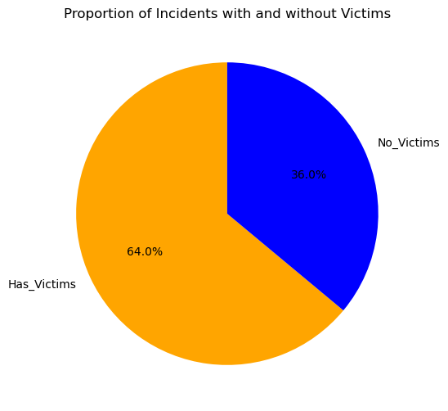
Target variable
Class – 0 : No Victims
Class – 1 : Has Victims

Slide 8
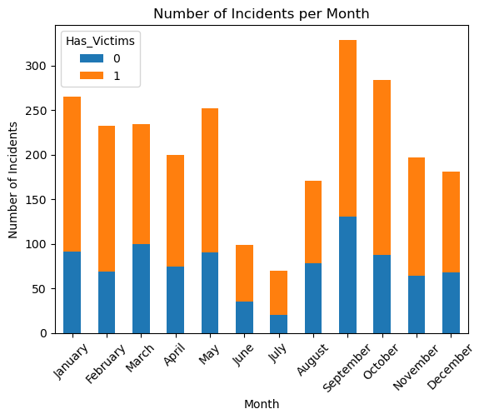
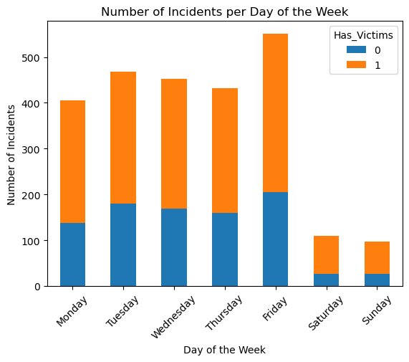
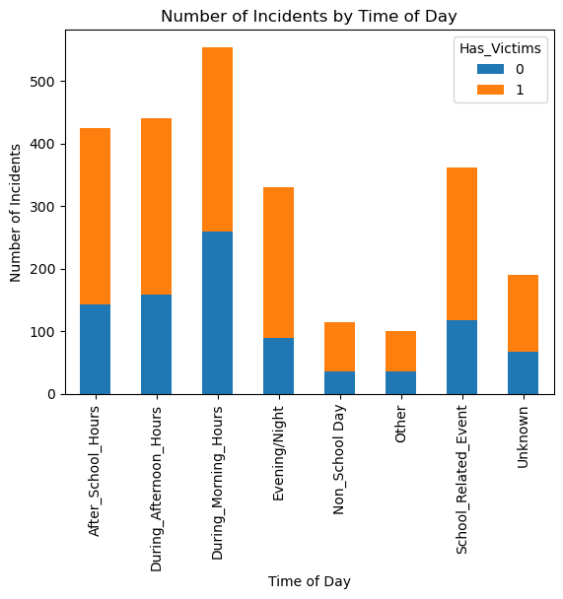
Temporal Analysis
September and October recorded highest number of incidents. In June and July, incidents were less than 100 probably due to summer break.
Most of the incidents occurred during working days, Highest number of incidents observed on Friday.
~900 incidents occurred between morning and afternoon hours.

Slide 9
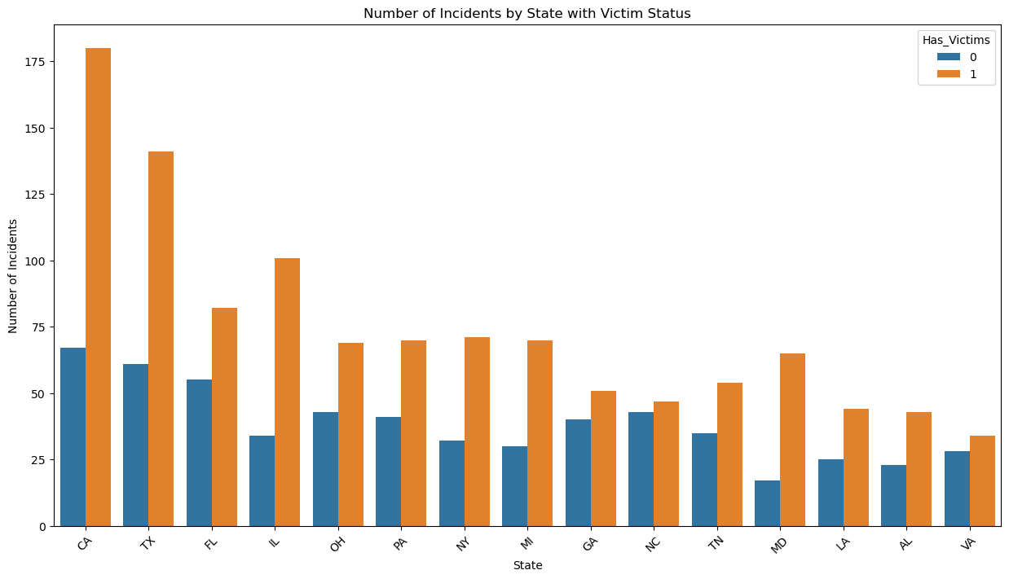
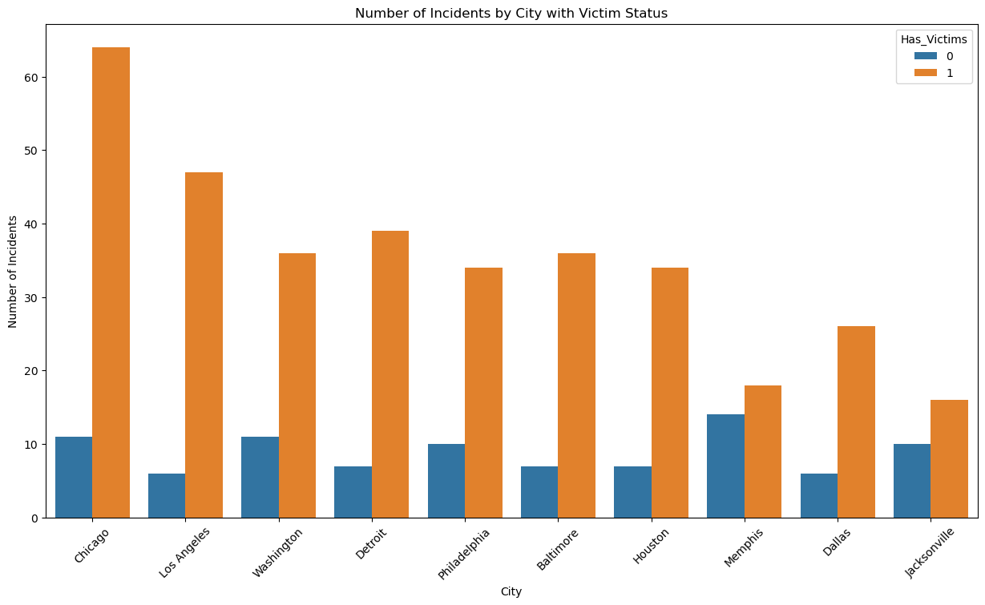
Geographical Analysis
Approximately 25% of the recorded incidents occur in California, Texas, Florida, and Illinois, with a significant portion of these events resulting in casualties.
Urban areas, particularly major metropolitan cities such as Chicago, Los Angeles, Washington, and Detroit, are observed to have a higher occurrence of such incidents.

Slide 10
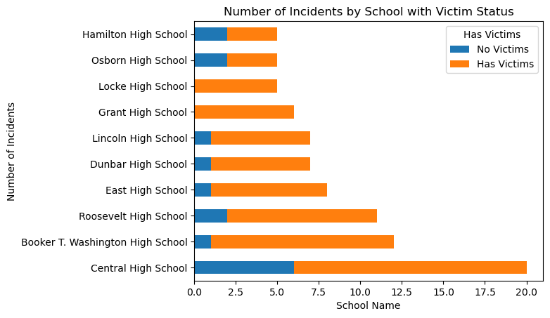
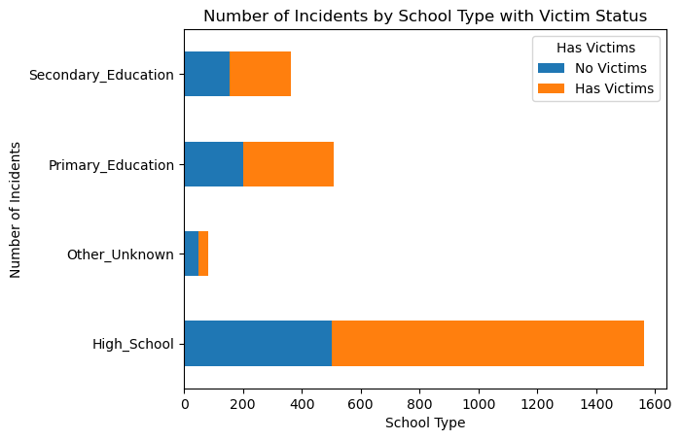
School Analysis
Central High School has the highest occurrence of school shootings, with approximately 20 reported incidents, most of which resulted either wounded or killed.
High Schools are the most frequently impacted, accounting for around 64% of all incidents.

Slide 11
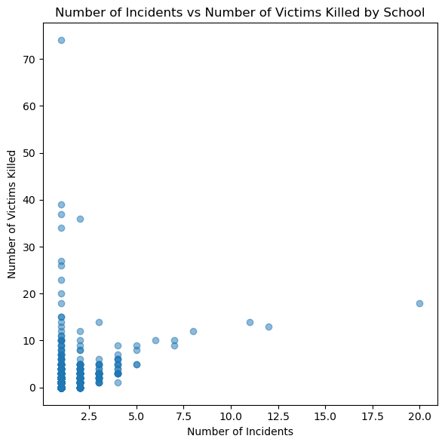
School Analysis
However, the analysis does not indicate a direct correlation between the frequency of incidents at a school and the number of victims affected. Notably, only about 11 schools have experienced more than five incidents. A significant outlier in the dataset is Cokeville Elementary School, which, despite recording a single incident, had approximately 74 victims wounded.

Slide 12
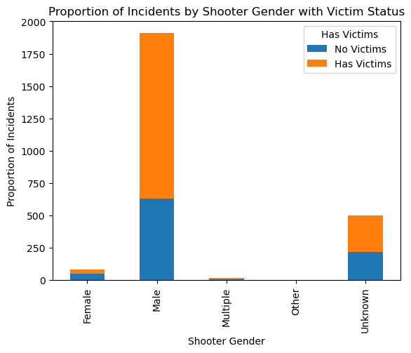
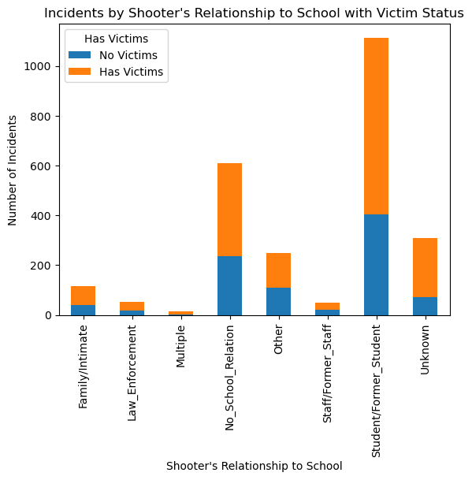
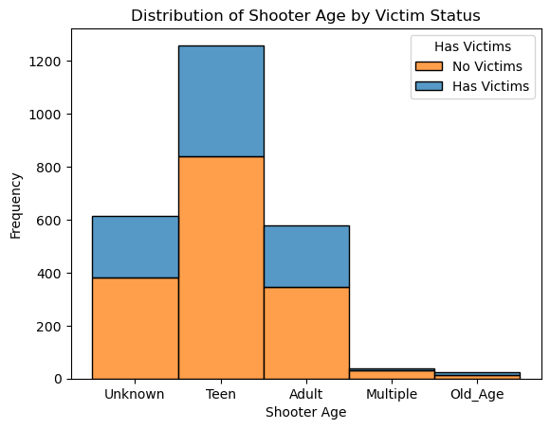
Perpetrator Analysis
Majority of the incidents were perpetrated by males, predominantly within the Teen and Adult age groups.
Notably, over 1000 incidents involved a student or Former Student as the shooter.

Slide 13
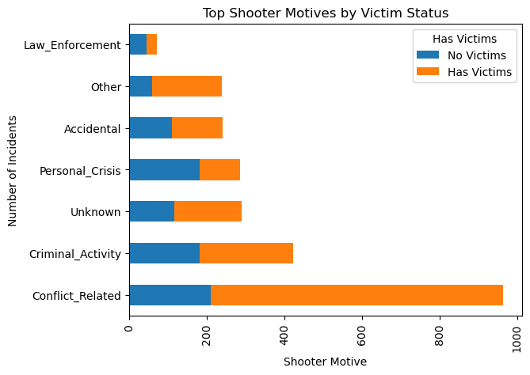
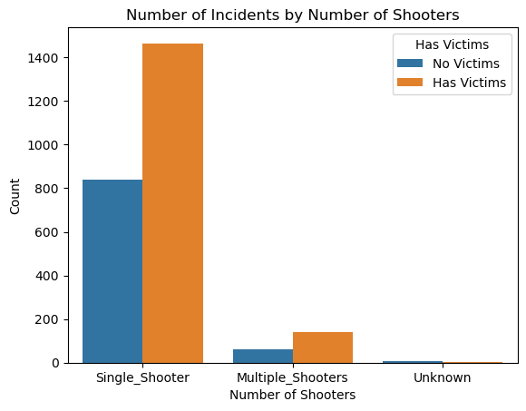
Perpetrator Analysis
Approximately 40% of incidents were attributed to conflict-related causes, while around 15% incidents were linked to criminal activities.
Most incidents were carried out by a single shooter

Slide 14
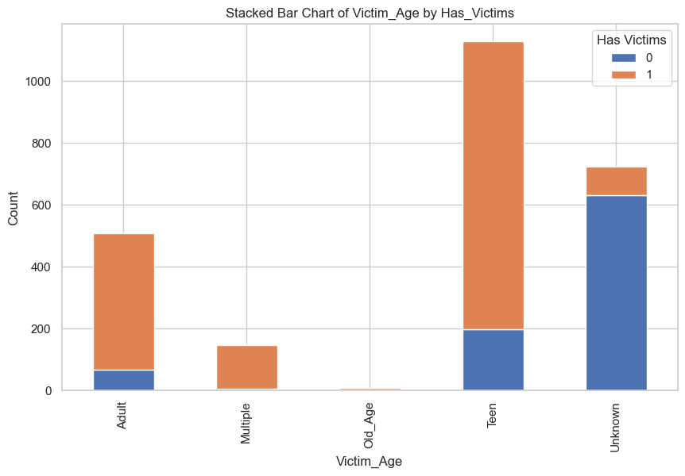
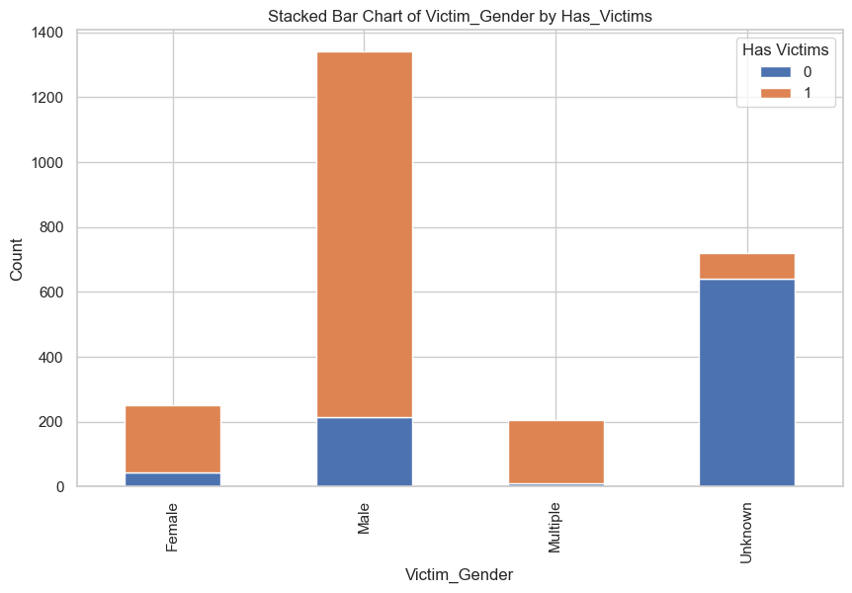
Victim Analysis
The age distribution among victims reveals that teens makeup the largest group followed by adults.
The gender distribution among victims reveals a higher number of males, with a considerable count among them also having victims. This indicates a possible gender-related component in the dynamics of victimization that should be explored.

Slide 15
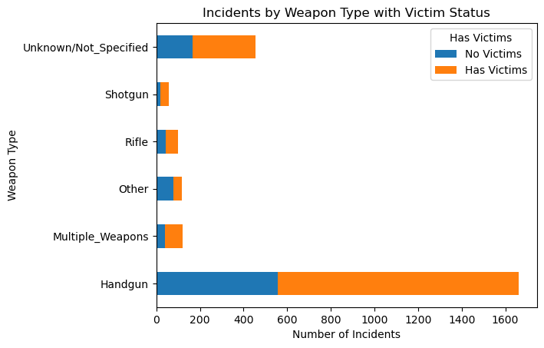
Weapon Analysis
In most of the incident's handguns were used, there are less than 200 instances where multiple weapons were used

Slide 16
Feature selection
Dataset
Categorical - 39
Numerical - 10
Target Variable
0 – No Victims
1 - Victims
Features
Frequency Encoding
Frequency Encoding
Categorical Column 1
Categorical Column 1
Categorical Column 2
Target Variable
Target Variable
Categorical Column 2
Categorical Column 3
Chi Squared Test
Recursive Feature Elimination
Categorical Column 4
Categorical Column 39
Label Encoding
Categorical Column 5
Numerical Column 1
Best Features
Categorical Column 39
Numerical Column 10
Label Encoding

Slide 17
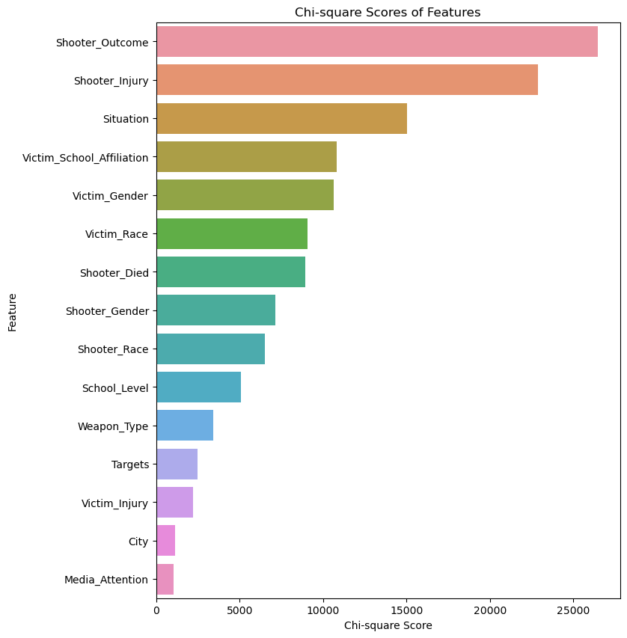
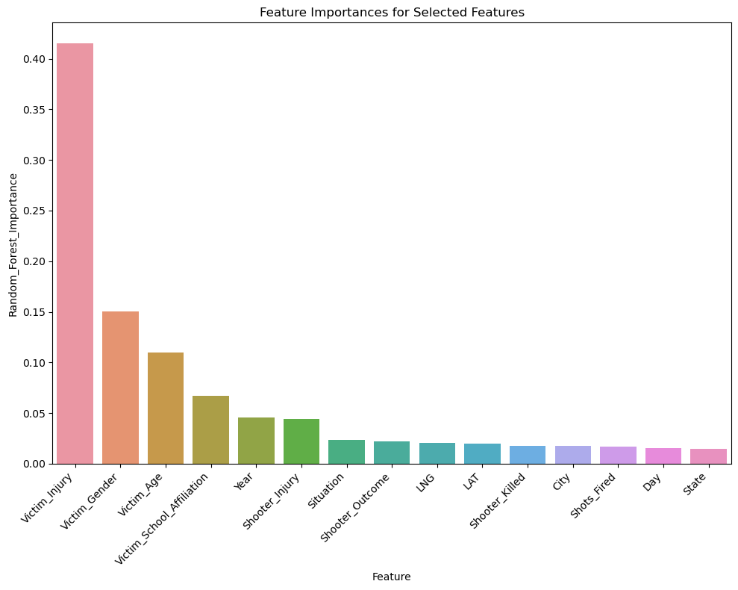
Feature selection – BEST FEATURES

Slide 18
Feature selection – best features
Other
Situation
Targets
Weapon Type
School Level
City
Year
Victim
School Affiliation
Gender
Race
Injury
Shooter
Outcome
Injury
Died
Gender
Race

Slide 19
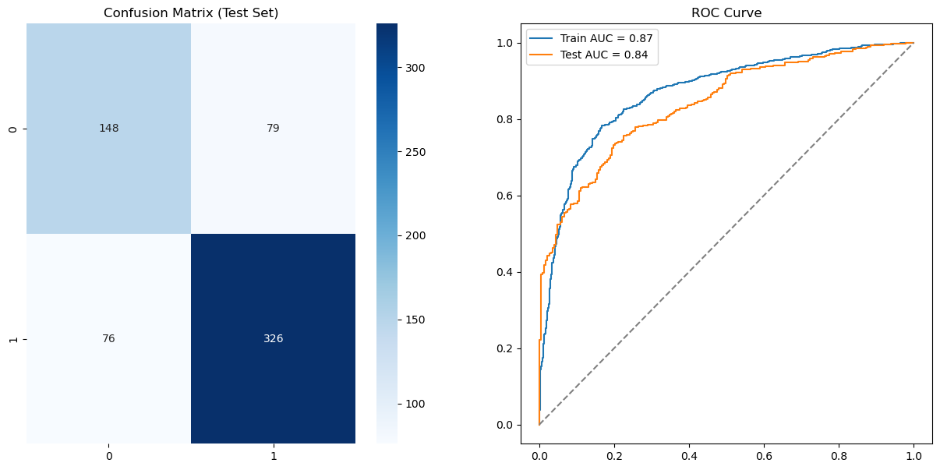
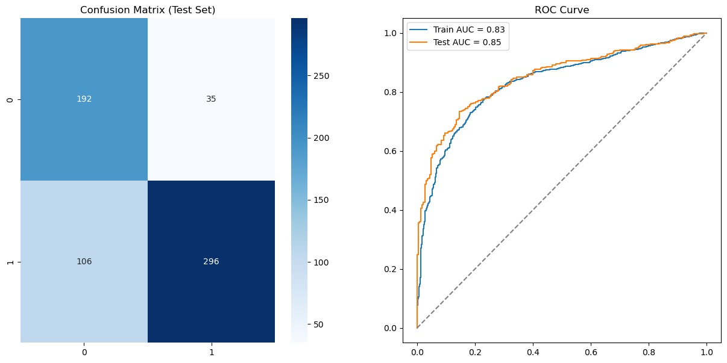
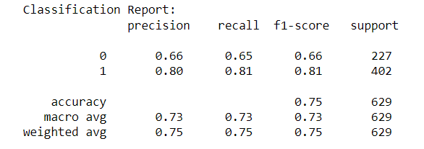
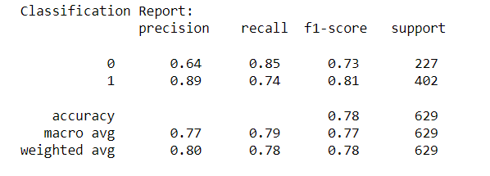
MODEL-1: LOGISTIC REGRESSION
All Features
Best Features

Slide 20
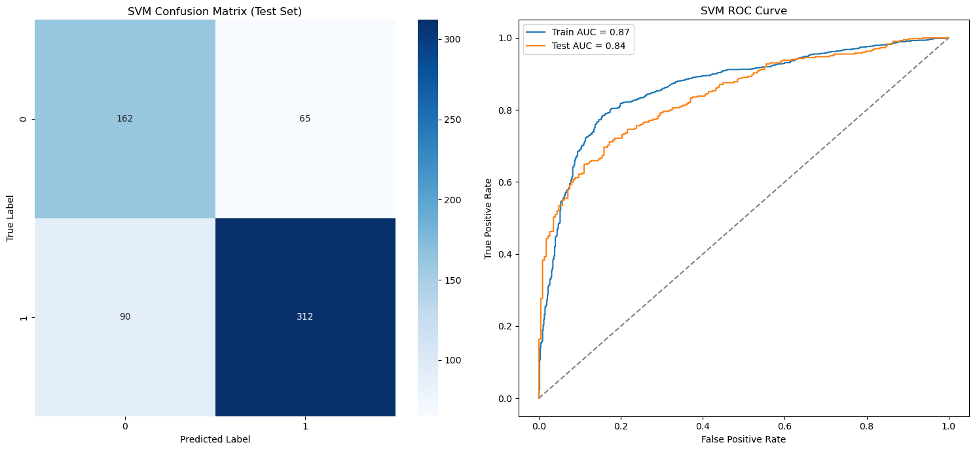
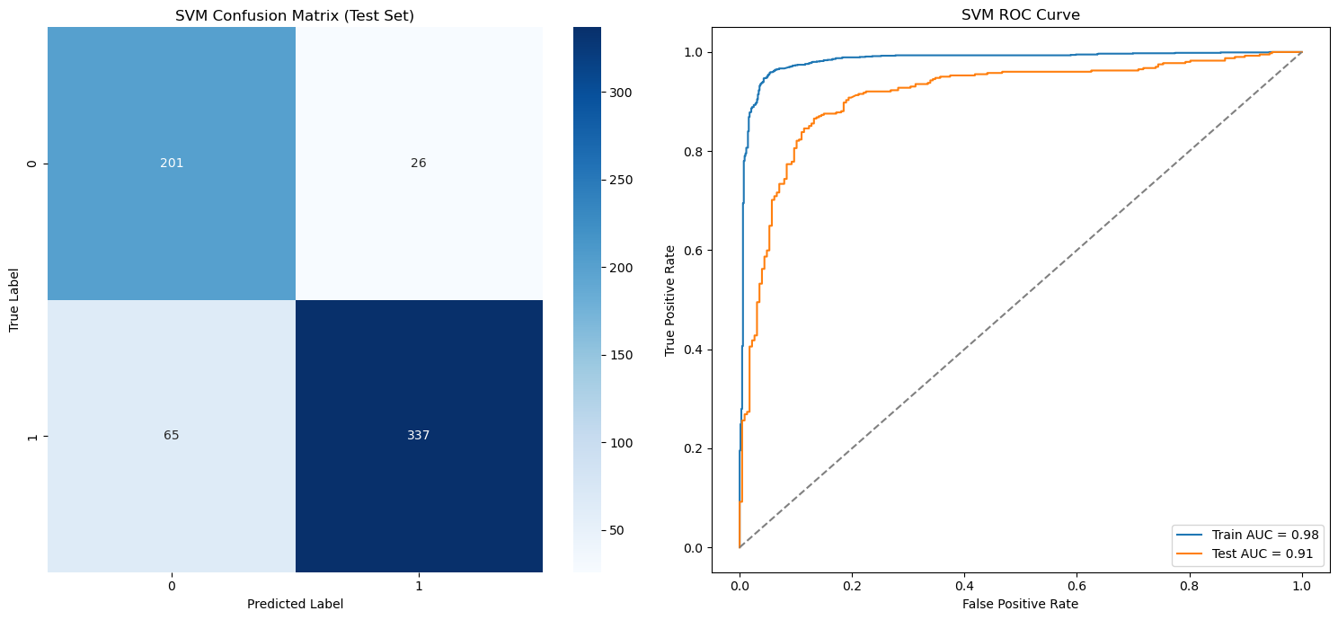
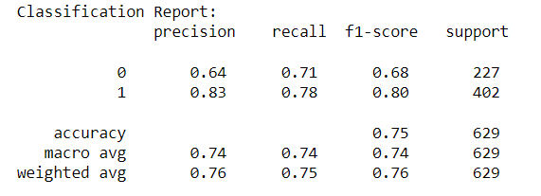
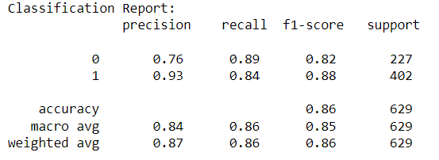
MODEL-2: SUPPORT VECTOR MACHINE
All Features
Best Features

Slide 21
results
Logistic Regression
Metric | Before Feature Selection | After Feature Selection
Accuracy | 75% | 78%
Precision (Class 0) | 66% | 64%
Precision (Class 1) | 80% | 89%
Recall (Class 0) | 65% | 85%
Recall (Class 1) | 81% | 74%
F1-Score (Class 0) | 66% | 73%
F1-Score (Class 1) | 81% | 81%
ROC-AUC (Test) | 84% | 85%
Support Vector Machine
Metric | Before Feature Selection | After Feature Selection
Accuracy | 75% | 86%
Precision (Class 0) | 64% | 76%
Precision (Class 1) | 83% | 93%
Recall (Class 0) | 71% | 89%
Recall (Class 1) | 78% | 84%
F1-Score (Class 0) | 68% | 82%
F1-Score (Class 1) | 80% | 88%
ROC-AUC (Test) | 84% | 91%

Slide 22
CONCLUSION
Accuracy:
The SVM model has a higher overall accuracy (0.86) compared to the Logistic Regression model (0.78), indicating that it correctly classified a higher percentage of the test cases.
Precision and Recall:
The SVM model shows higher precision and recall for both classes, which means it has a higher rate of correct predictions for both 'No_Victims' and 'Has_Victims’.
For Class 1, SVM also has a higher precision, indicating fewer false positives, and a higher recall, suggesting it misses fewer actual 'Has_Victims' cases
ROC-AUC:
The SVM model has a higher ROC-AUC score (0.91) than Logistic Regression (0.85), indicating a better ability to discriminate between the positive and negative classes

