Slide 1

Research AI: Answer Extraction from Research Papers
Rajeshwar Vempaty
Tipu Sultan

Slide 2
Problem Statement
Research papers and other technical PDFs contain valuable knowledge but are often dense and lengthy.
Finding specific answers within these documents can be time-consuming and frustrating.
Traditional keyword search might not capture the nuances of complex questions asked in natural language.
Overview
Research AI is a web application built with Python and Streamlit.
It uses Natural Language Processing, Large Language Models etc
PDF Processing
Knowledge
Representation
Large Language Model
Text Extraction
Text Preprocessing
Question
Answering
Chunking
Embeddings
VectorStore

Slide 3
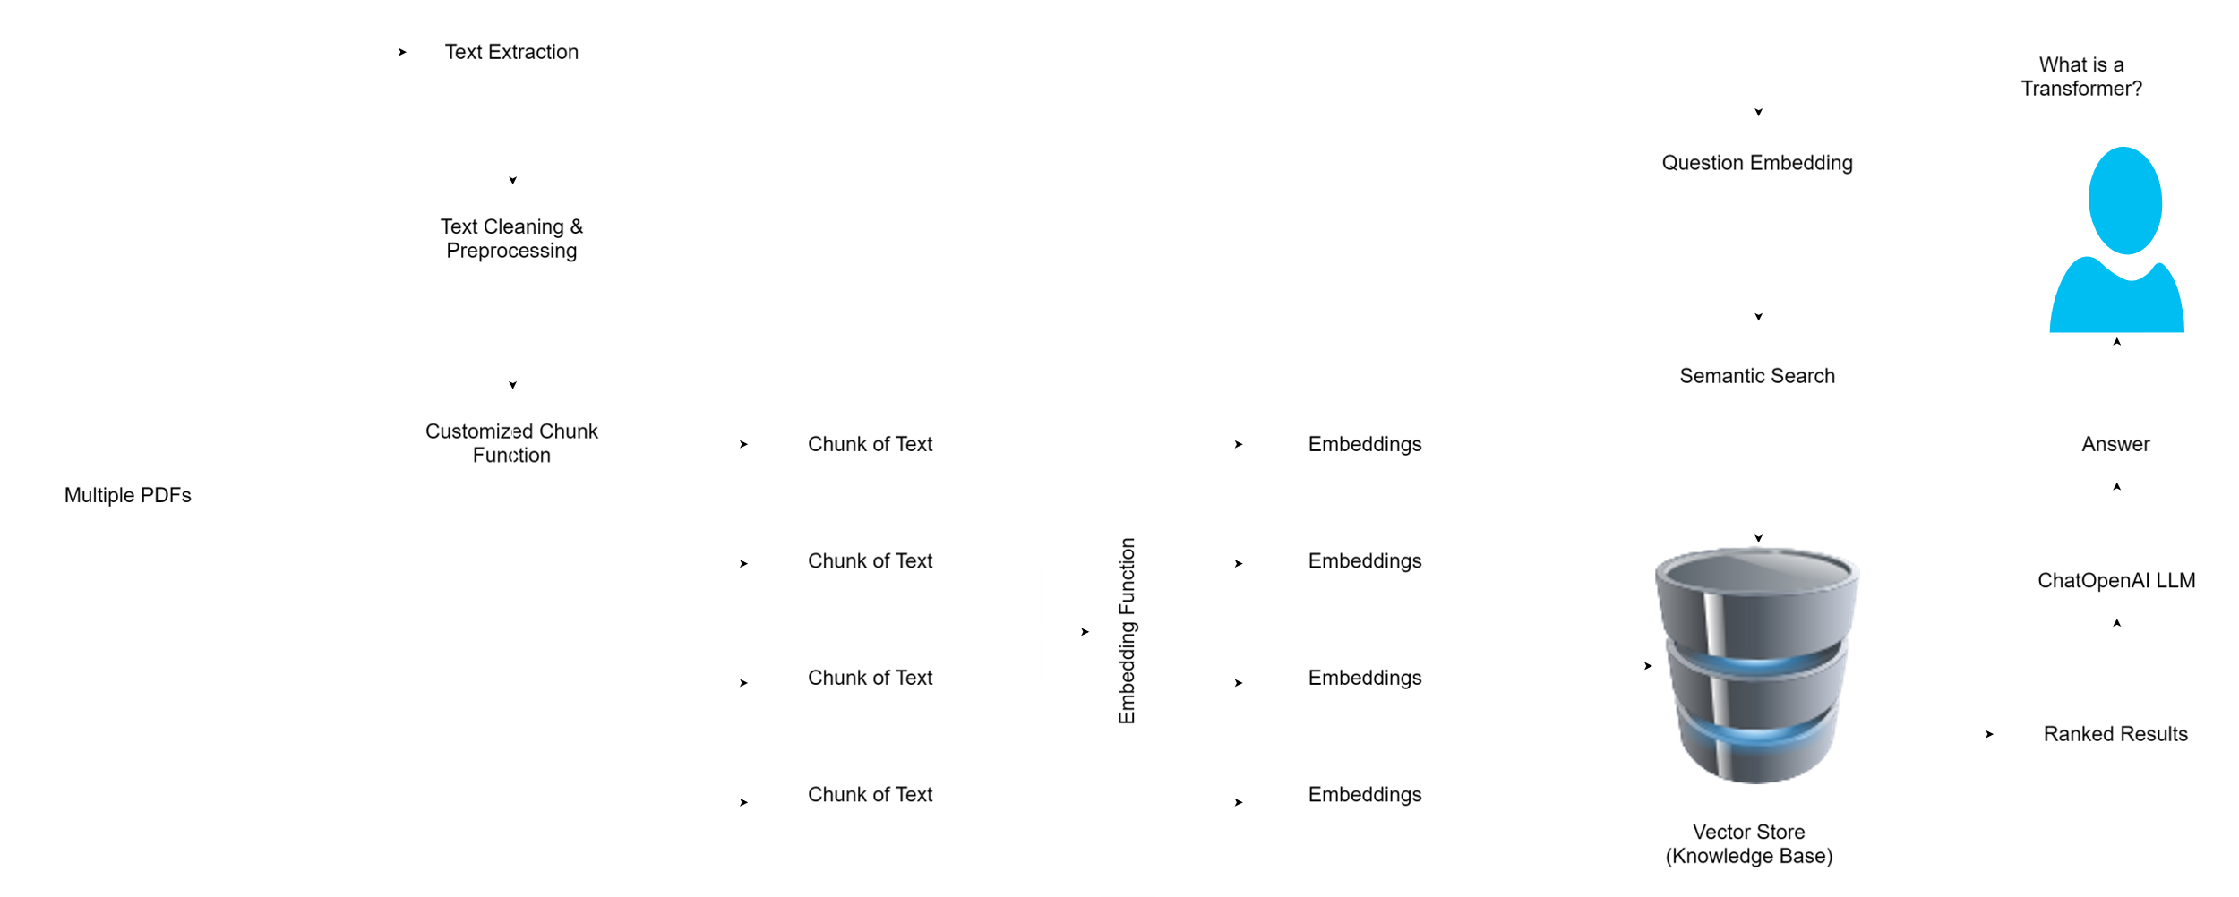
Framework

Slide 4
PDF Processing
Text Extraction:
Uses pdfplumber library to extract raw text from PDFs
Handles various PDF formats and potential errors.
Cleaning:
The clean_text function preprocesses text by converting it to lowercase and removing various patterns including emails, HTML tags, non-ASCII characters, and references to figures, tables, and equations.
It efficiently cleans text by stripping away unnecessary metadata, formatting elements, and other non-essential content that can interfere with data analysis.
The function also normalizes whitespace by condensing multiple spaces into a single space and removing leading/trailing spaces, ensuring a clean and uniform text output.

Slide 5
Knowledge Representation
Chunking:
The get_text_chunks function segments text into sections using headers like Abstract, Introduction, Methods, etc., and further divides these sections into manageable chunks that adhere to a predefined size limit.
Pattern Detection and Sectioning:
Utilizes regular expressions to detect and split text at headers case-insensitively, ensuring each identified section starts on a new line for precise sectioning.
Chunk Processing and Output:
Dynamically accumulates words into chunks, starting a new chunk when the size limit is reached, with each chunk meticulously recorded with its content and exact location offsets for easy retrieval and analysis.
Embeddings & Vector Store:
The function allows for the specification of an embedding model OpenAI embeddings.
It applies the initialized embeddings to the provided text_chunks to convert them into a high-dimensional vector space.
Utilizes FAISS (Facebook AI Similarity Search) to efficiently store and manage these embeddings in a vector store, facilitating quick retrieval and similarity searches.
The function includes error handling to log issues and raise an informative error if the vector store creation fails, aiding in troubleshooting potential issues with the embedding models or input data.

Slide 6
Question Answering
Function Overview: The get_conversation_chain function integrates a ChatOpenAI language model with a vector-based retriever and a conversation memory buffer to enhance conversational AI capabilities.
Component Setup: It initializes a language model and a memory buffer that stores and returns chat history, ensuring context-rich interactions.
Conversational Chain Creation: The function combines these components using ConversationalRetrievalChain, enabling the language model to retrieve relevant information based on query similarity for effective communication.

Slide 7
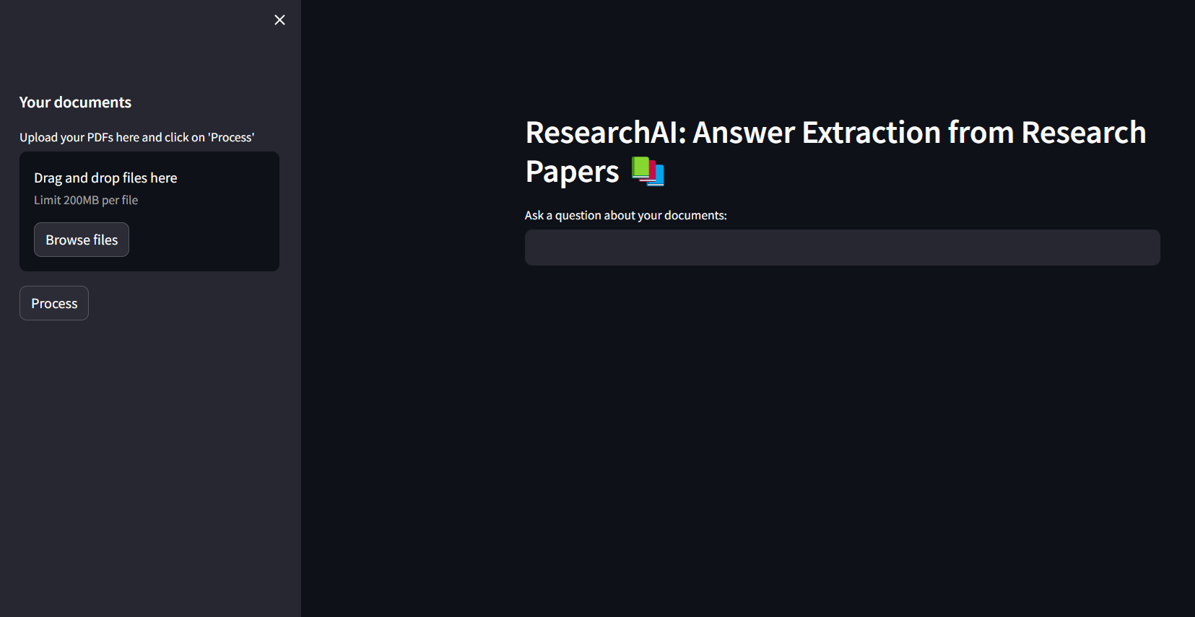
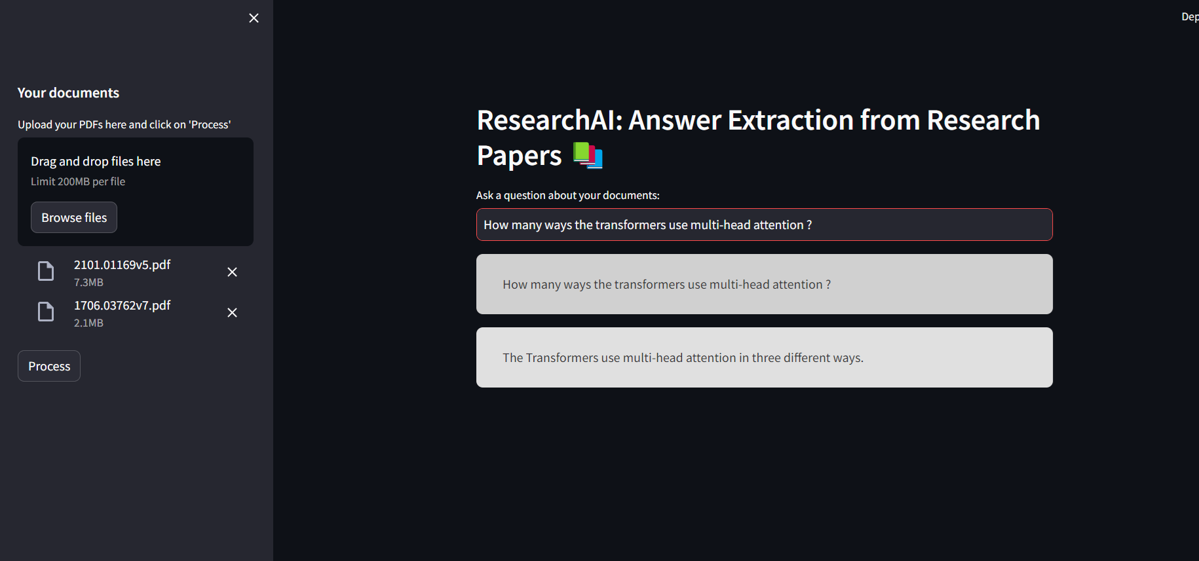
Screenshots

Slide 8
Source Code: https://github.com/rajeshwar-vempaty/NLP_Project
Presentation Recording: https://fordham.zoom.us/rec/share/KcIFT70x4loveHwEEsqZxE5E0za8URcv6DScDRqXF5YYbXNpC85rbd2iXuRQArna.OrgQ_kPrupKUkFM4
Passcode: %67%MZBL

