Slide 1
Global Suicide Analysis
Presented By,
Deepamol Chacko, Rajeshwar Vempaty, Sourav Mallik
MS Data Science, CIS Department,
Fordham University, Lincoln Center
113 W 60th Street, New York, NY 10023, USA

Slide 2






Contents
OBJECTIVE
DATASET
DATA ANALYSIS
HYPOTHESIS TESTING
CONCLUSION
REFERENCES

Slide 3

Objective
The main objective of this work is to explore and analyze the global suicide rates and visualize the parameters based on the dataset.
Detailed analysis was carried out for Russia
Dataset
Combination from, The United Nations Development Program, The World Bank, Kaggle, WHO
Dataset consists of 27,820 Observations, and 12 Features, for 101 Countries
Additional features like Co2 Emissions, Consumer Price Index, & Total Labor Force for Russia added from the World Bank data (https://databank.worldbank.org)
Preprocessing:
HDI column consists of 70% missing values, and feature like Country_year is not required. Hence dropped both features.
Features renaming done and checked for any duplicates.

Slide 4
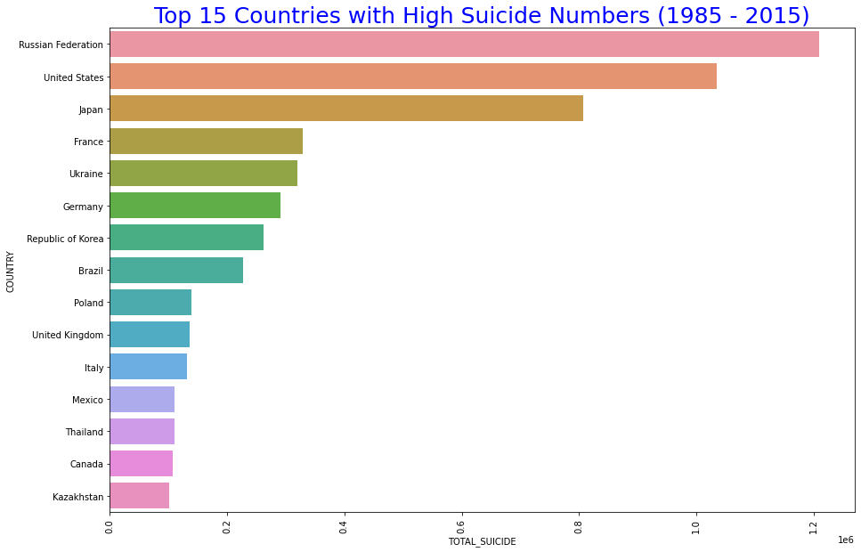
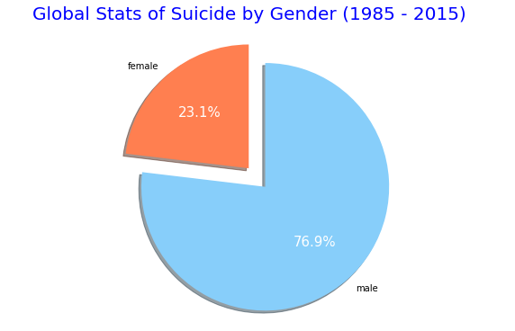
Data Analysis
Russia, The United States, and Japan accounts for 45% of the suicides.
Maldives, Antigua & Barbuda, and San Marino have the least suicides.
Males have higher suicide rates, around 77%.

Slide 5
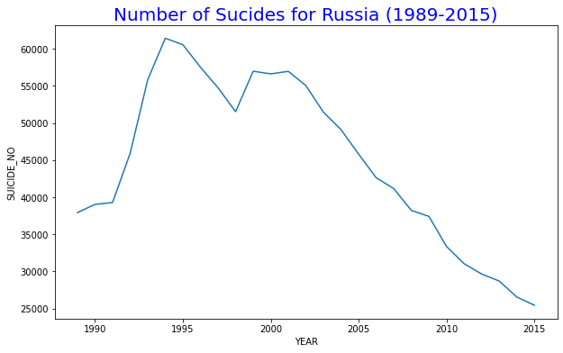
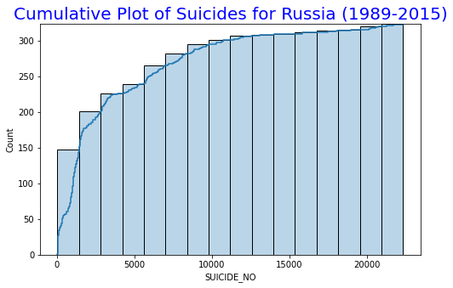
Data Analysis - Russia
Russia accounted for 1.2 Million suicides from 1989 to 2015.
Between 1994 & 1995, Russia witnessed highest number of suicides – 61,420.
Around 70% of the suicides committed in Russia are by Males.
From 2000, The number of suicides started declining.

Slide 6
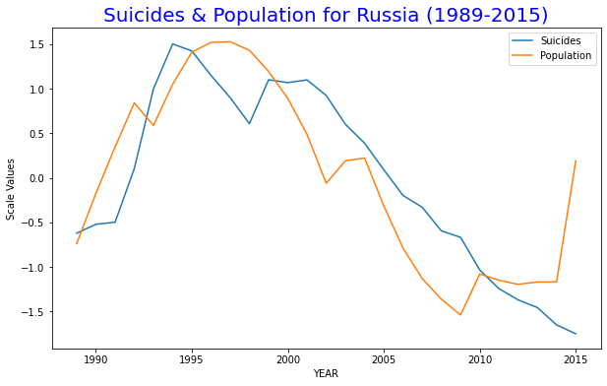
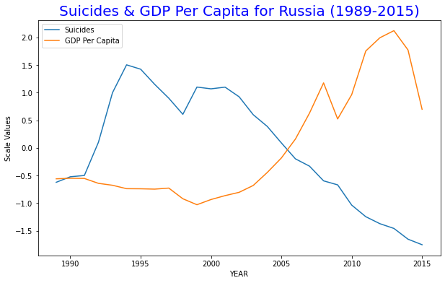
Data Analysis - Russia
Population & Suicide almost followed same trend from 1990 to 2010.
From the year 2000 as the suicides started declining, GDP per capita started rising.

Slide 7
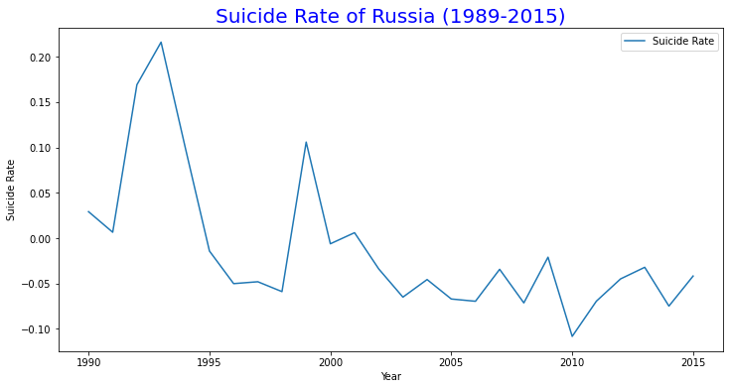
Data Analysis - Russia
Rate of change in suicides was high during 1990 to 2000, and gradually declined.

Slide 8
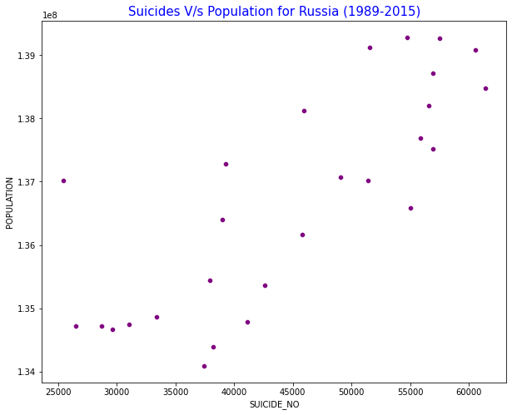
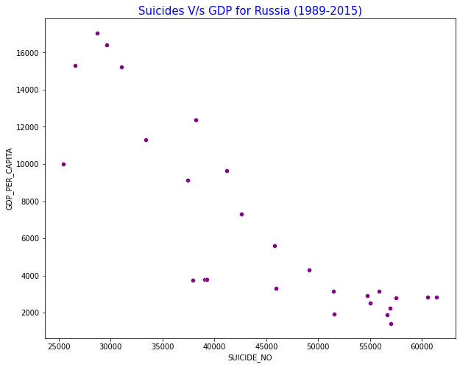
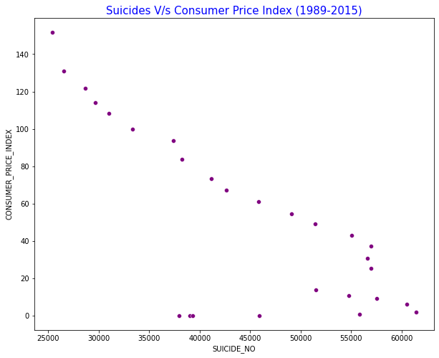
Data Analysis - Russia
Positive correlation between Suicides & Population.
Negative correlation between Suicides & CPI, and Suicides & GDP Per capita.

Slide 9
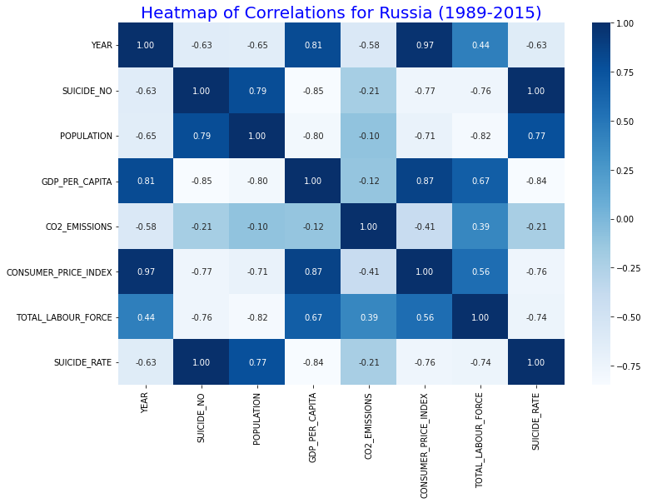
Data Analysis - Russia
Suicides have a significant positive relationship with Population.
Strong negative correlation with GDP per capita, Consumer Price Index, and Total Labor Force.

Slide 10
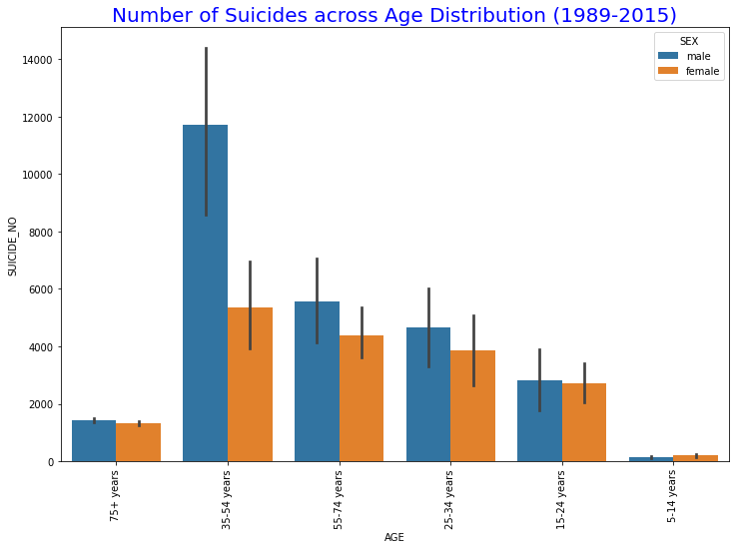
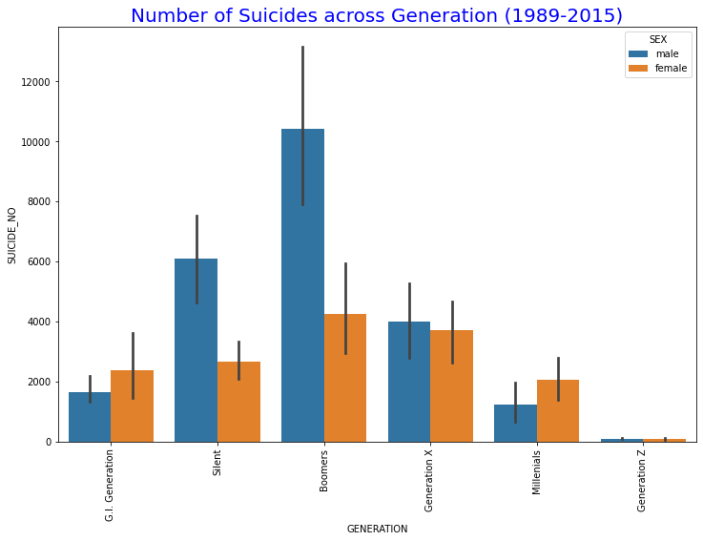
Data Analysis - Russia
Individuals aged between 35-54 are having high suicide rates, assuming most of them working.
Females have almost equal suicides when compared to Males in all age groups except for 35-54.
Males in the Silent and Boomer generations have higher rates of suicide compared to other generations
In the G.I. and the Millennial generations, females committed more suicides than men

Slide 11
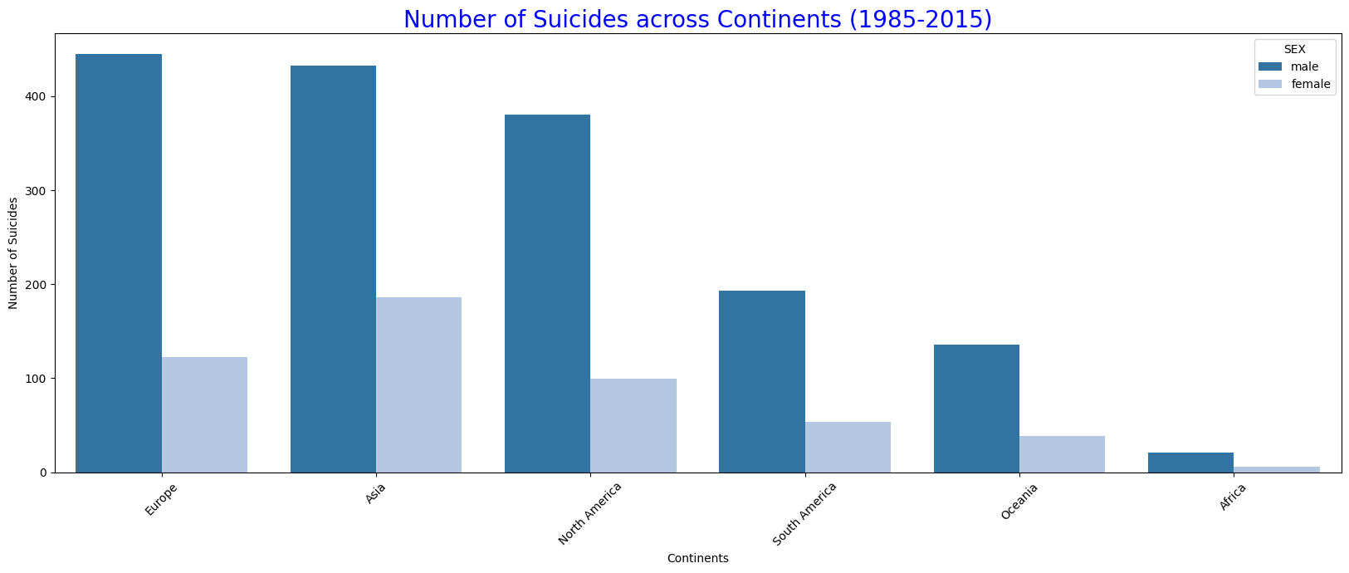
Data Analysis - Russia
Europe, Asia, and North America have the highest number of suicides compared to other regions

Slide 12
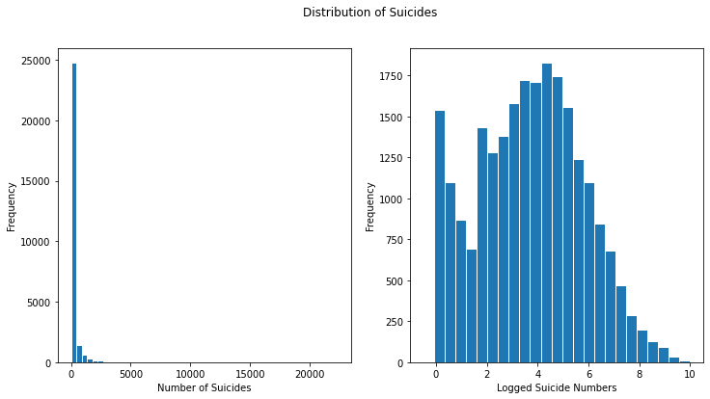
Data Analysis - Russia
Distribution of suicides has a skewed data, there is no presence of outliers.

Slide 13
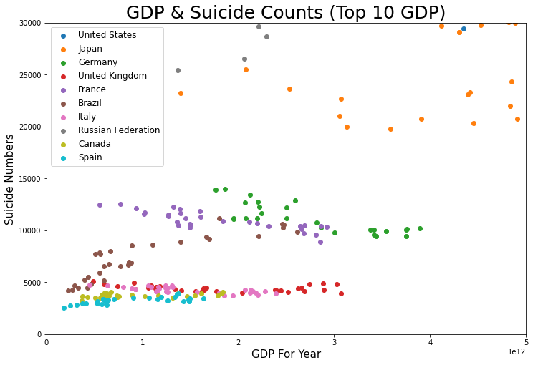
Data Analysis - Russia
Except for United States, Russia, and Japan most of high GDP countries having less suicide rates.

Slide 14
Hypothesis Testing

Slide 15
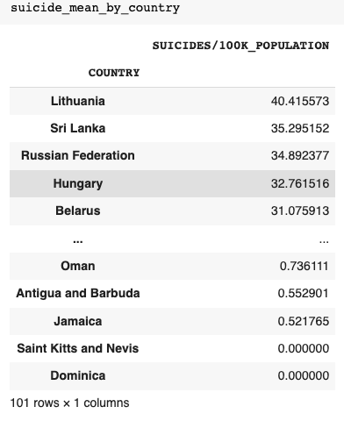
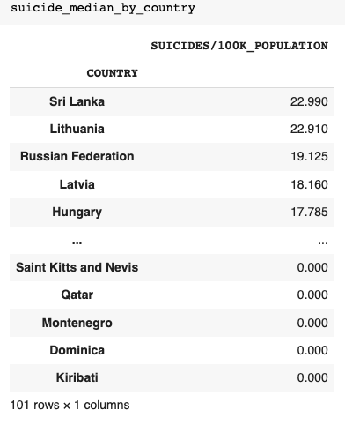
We perform hypothesis testing because :
When ranking by mean, Lithuania comes first with significantly higher value of suicide rate.
When ranked by median Sri Lanka comes on top of Lithuania by a very small margin.

Slide 16
Step 1: Formulate the hypothesis and decide on confidence level.
Null Hypothesis (H0): There is no significant difference between suicide rates of Lithuania and Sri Lanka.
Alternate Hypothesis (H1): There is significant difference between suicide rates of Lithuania and Sri Lanka.
We took sample size of 100 from each country and set the significance level of 5% (0.05).
Significance level, ⍺ = 0.05
Step 2: Decide on the Statistical Test
Difference of Medians of suicide rates of Lithuania and Sri Lanka.
Step 3: Compute the p-value
If p-value is greater than ⍺, then accept the null hypothesis
If p-value is less than ⍺ , then reject the null hypothesis.
We got the p-value = 1.91 which is greater than significance level, ⍺ , P-value > ⍺
A p-Value of 1.91 means that there is no significant difference between suicide rates to Lithuania and Sri Lanka, which is much higher than 5% significance level. Thus we accept our null hypothesis as True.

Slide 17
POSSIBLE CONTRIBUTORS TO RUSSIA'S HIGH SUICIDE RATE INCLUDES :
Country’s GDP
Consumer price index
Age demographics
Carbon emissions

Slide 18
Conclusion
We analyzed the global suicide data and mainly focused on one country. As per our data analysis, the highest number of suicide rates were observed in Russian Federation. The estimated number of suicides in Russia between 1989 and 2015 is approximately 1.2 million.
The rate of change in suicide was higher between 1990 and 2000. One major incident during this period was the disintegration of the Soviet Union, which might be a reason for the high suicide rates.
Increase in population, also increased suicides
GDP per capita has a strong negative correlation with suicides, as we can observe from figure.
Similar to global statistics, males in Russia have the highest suicide rates compared to females.
Europe and Asia have the highest suicides compared to all the countries with respect to their continents
Based on the hypothesis, Lithuania is the most suicidal country when compared to Srilanka.

Slide 19
REFERENCES
Bellman, V., & Namdev, V. (2022). “Suicidality Among Men in Russia: A Review of Recent Epidemiological Data”.Cureus, 14(3). https://doi.org/10.7759/cureus.22990
https://databank.worldbank.org/source/world-development-indicators/Type/TABLE/preview/on#
https://www.careerplanner.com/Career-Articles/Generations.cfm.
Kumar P (April 2019). “Median based Hypothesis Testing”. https://www.advanceinnovationgroup.com/blog/median-based-hypothesis-testing

Slide 20
Thank you

