Slide 1
Logo Lesson 4
TBE 540-40
Fall 2004
Farah Fisher

Slide 2
Prerequisites
Create basic and complex shapes using Logo procedures
Create Logo procedures that use variables.
Create a complex shape using simple shapes with variables.
Access the world wide web using a browser.
Use a search engine to find information.
Download text and graphics from the web.

Slide 3
Objectives
Given a Logo procedure that does not work, correct all errors.
Create a Logo procedure that accepts input from the keyboard while running.
Locate articles and presentations about Logo.
Locate websites about Logo.

Slide 4
“Debugging”
When a program (e.g. a Logo procedure) is written, it does not often work correctly the first time.
Correcting errors in a program is called “debugging”.
The term comes from the 1940s when moths were interfering with the operation of mainframe computers that used telephone relays as switches.

Slide 5
“Debugging”
In order to debug a program, it is necessary to know…
  the programming language being used and
  what the program is supposed to do.
First look for typos (misspelled commands, missing [ ], incorrect spacing, etc.).

Slide 6
“Debugging”
Then look carefully at each line of the program and “run it in your head” or try the results on paper, step by step. Make no assumptions…do exactly what the program commands say to do.
If the program is complex, try making one change at a time, then running the program again.

Slide 7
“Debugging”
Look at the Logo command below. It is supposed to make a square.
REPEAT 4 [ FD50 RT 50 ]
In looking for typos, you will notice that the space in FD50 is missing.
The other error requires knowledge of Logo.
Stepping through the program shows that a turn of 50 degrees is not enough to make a square.

Slide 8
“Debugging”
Try the debugging exercise at http://www.csudh.edu/fisher/tbe540/LW4.htm
Possible answers are available.

Slide 9
Keyboard Input
In Lesson 3, you learned about variables, and how to use MAKE and RANDOM to give variables a value.
It is sometimes useful for the person who is running the procedure to put numbers into variables by typing them while the procedure is running.

Slide 10
Keyboard Input
Two Logo commands can be used for this purpose:
  READLIST
  READCHARACTER (or RC or READCH or READCHAR)
Both of these commands bring in information from the keyboard while a procedure is running.

Slide 11
Keyboard Input
READLIST can bring in any amount of information…everything the user types until Return/Enter is pressed.
READCHARACTER (or RC or READCH or READCHAR) brings in just one character (one keystroke).

Slide 12
Keyboard Input
READLIST and READCHARACTER are used with MAKE to fill up a variable.
Examples:
  MAKE “NAME READLIST
    Everything typed until a Return/Enter is put into :NAME
  MAKE “X FIRST READLIST
    Only information up to the first space is put into :X (prevents extraneous information)
  MAKE “Z READCHARACTER
    The first key pressed (no Return) is put into :Z
    NOTE: This is useful for “Press any key to continue.”

Slide 13
Keyboard Input Example
The procedure below asks for the user to enter the size for a square and then draws it. PR prints a message on the screen (message is between the square brackets [ ]).
  TO INSQUARE
  PR [ENTER SIZE AND PRESS RETURN]
  MAKE “SIZE FIRST READLIST
  SQUARE :SIZE
  END
The procedure assumes that SQUARE with a variable is already in POTS (any variable name is OK for SQUARE).

Slide 14
Keyboard Input Example
The procedure below asks for the user to press any key to continue. NOTE: CS clears the screen.
  TO MESSAGES
  PR [HERE IS THE FIRST MESSAGE]
  PR [PRESS ANY KEY TO CONTINUE.]
  MAKE “C READCHAR
  CS
  PR [HERE IS THE SECOND MESSAGE]
  END

Slide 15
Keyboard Input
See other samples at http://www.csudh.edu/fisher/tbe540/LHO4.htm

Slide 16
Self Check Lesson 4
The line below should make a triangle. It has one or more errors. Where are the errors?
  REPET 4 [ FD100 RT 60]

Slide 17
Self Check Lesson 4
The line below should make a triangle. It has one or more errors. Where are the errors?
  REPET 6 [ FD100 RT 60]
REPEAT
not enough degrees,
should be 120 for
each of 3 turns
should be 3 for a triangle
needs a space
FD 100

Slide 18
Self Check Lesson 4
The following Logo commands were entered. The error message was NOT ENOUGH INPUT. What’s wrong?
  TO RECTANGLE :L :W
  REPEAT 2 [FD :L LT 90 FD :W LT 90]
  END
  RECTANGLE 100

Slide 19
Self Check Lesson 4
The following Logo commands were entered. The error message was NOT ENOUGH INPUT. What’s wrong?
  TO RECTANGLE :L :W
  REPEAT 2 [FD :L LT 90 FD :W LT 90]
  END
  RECTANGLE 100
Since there are two variables after RECTANGLE in the procedure definition, two numbers should have been typed to start the procedure.

Slide 20
Self Check Lesson 4
Which of the Logo command below takes a single letter from the keyboard and puts it into a variable called :KEYS?
MAKE “KEYS READLIST
READLIST “KEYS
READCHAR “KEYS
MAKE “KEYS READCHAR

Slide 21
Self Check Lesson 4
Which of the Logo command below takes a single letter from the keyboard and puts it into a variable called :KEYS?
MAKE “KEYS READLIST
READLIST “KEYS
READCHAR “KEYS
MAKE “KEYS READCHAR

Slide 22
Self Check Lesson 4
You want to display the message ENTER YOUR NAME, get the name and put it into a variable called :WHOM Will the lines below work?
[ENTER YOUR NAME]
MAKE :WHOM READCHAR

Slide 23
Self Check Lesson 4
You want to display the message ENTER YOUR NAME, get the name and put it into a variable called :WHOM Will the lines below work? No, see changes in blue.
PR [ENTER YOUR NAME]
MAKE “WHOM READLIST

Slide 24
Locating Logo Websites
You will need to find 5 websites about Logo for your bibliography.
Remember to record the complete address and write a brief description.
When you use a search engine such as http://www.google.com, use Logo programming as the search term.
This should remove websites about shirt logos, etc. from the list.

Slide 25
Locating Logo Articles/Books
You need to include 5 articles, presentations or books about Logo in your bibliography (references and descriptions).
Articles, presentations, and books about Logo can be found through the CSUDH Library at http://library.csudh.edu/
A good source for articles and presentations about Logo is the online ERIC database.
References to books about Logo can be found in the online catalog.

Slide 26

Locating Logo Articles/Books
NOTE: You may not be able to have full access to online library materials from home unless you register your ID card with the CSUDH Library.
For information, click on Connect from Home Register as Library User on the Library home page or visit the library.

Slide 27

Locating Logo Articles/Books
When you access library.csudh.edu, you will see…

Slide 28
Locating Logo Articles/Books
To see the online catalog, choose this.

Slide 29
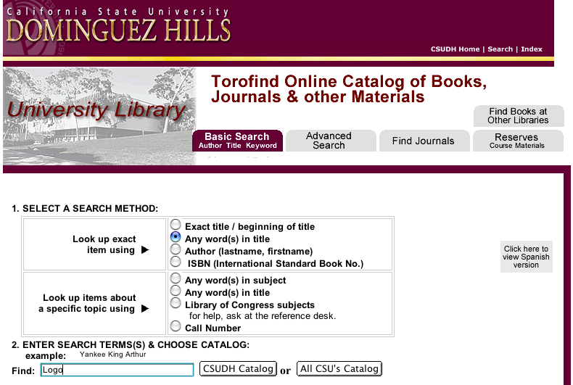
Locating Logo Articles/Books
Look for Logo in book titles.

Slide 30
Locating Logo Articles/Books
To access ERIC, first choose this.

Slide 31

Locating Logo Articles/Books
Choose Subject List.

Slide 32
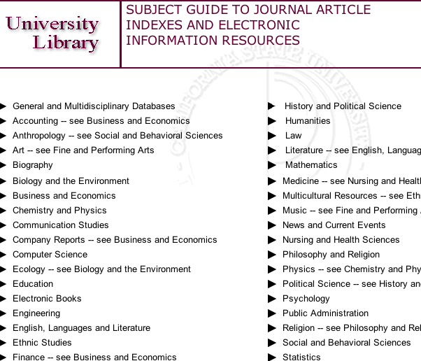
Locating Logo Articles/Books
Choose Education.

Slide 33
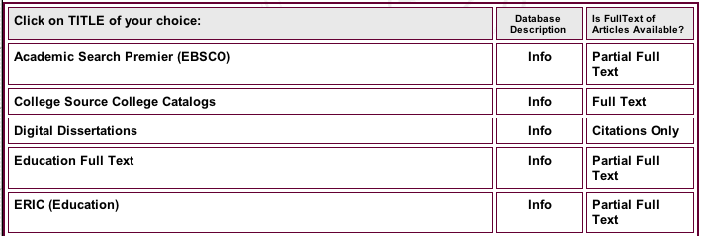
Locating Logo Articles/Books
Choose ERIC (Education).

Slide 34

Locating Logo Articles/Books
Click on ERIC.

Slide 35
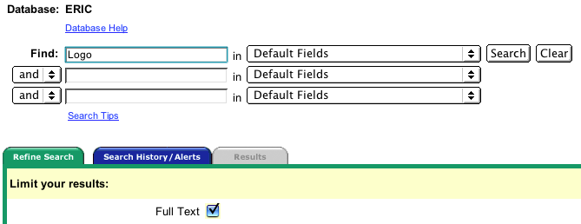
Locating Logo Articles/Books
Enter your search term (Logo). Check Full Text if you want to see only full articles (others are abstracts only). Click Search.

Slide 36
Locating Logo Articles/Books
When you submit your bibliography, be sure to include the appropriate reference format (see class website) and descriptions.

Slide 37
Lesson 4 Quiz
Complete exercises posted on the class website for Lesson 4.

