Slide 1
SDLC
AI – ENHANCED SOFTWARE DEVELOPMENT LIFECYCLE

Slide 2
What is SDLC ?
The Software Development Life Cycle (SDLC) is a structured framework used by software development teams to design, develop, test, and maintain high-quality software. It provides a systematic approach to software creation, ensuring that the final product meets user requirements, is cost-effective, and is delivered within a specified timeline.

Slide 3
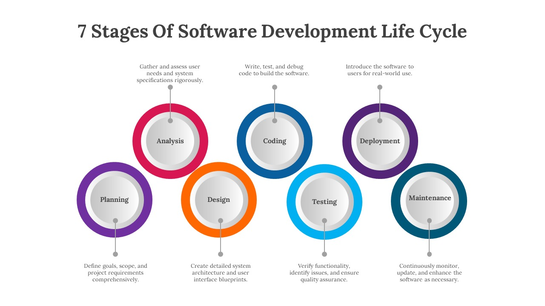

Slide 4
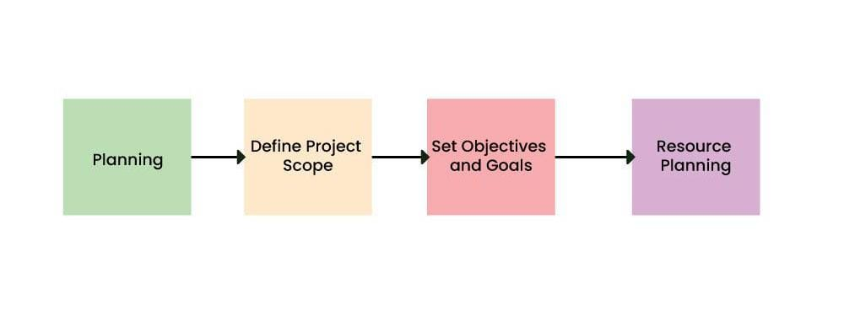
STAGE 1: Analysis Planning & Requirement
Planning is a crucial step in everything, just as in software development. In this same stage, requirement analysis is also performed by the developers of the organization. This is attained from customer inputs, and sales department/market surveys.

Slide 5
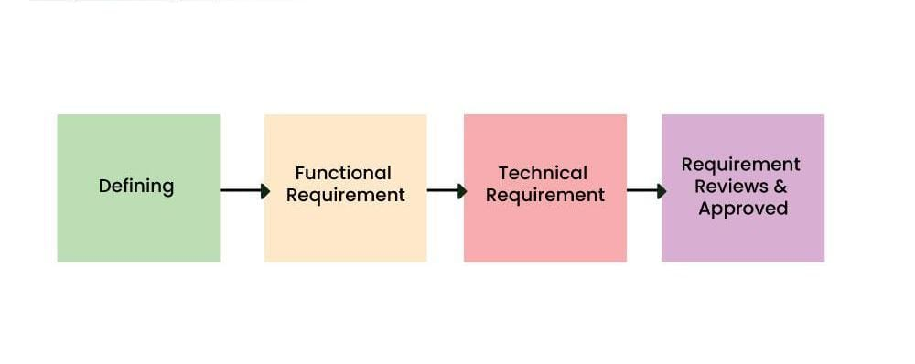
STAGE 2: Defining Requirements
In this stage, all the requirements for the target software are specified. These requirements get approval from customers, market analysts, and stakeholders. This is a sort of document that specifies all those things that need to be defined and created during the entire project cycle.

Slide 6
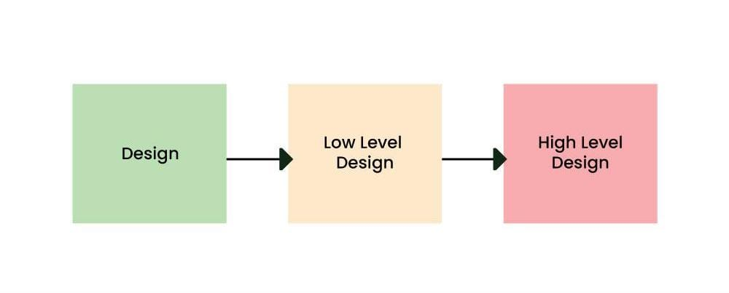
STAGE 3: Designing Architecture
SRS is a reference for software designers to come up with the best architecture for the software. Hence, with the requirements defined in SRS, multiple designs for the product architecture are present in the Design Document Specification (DDS).

Slide 7
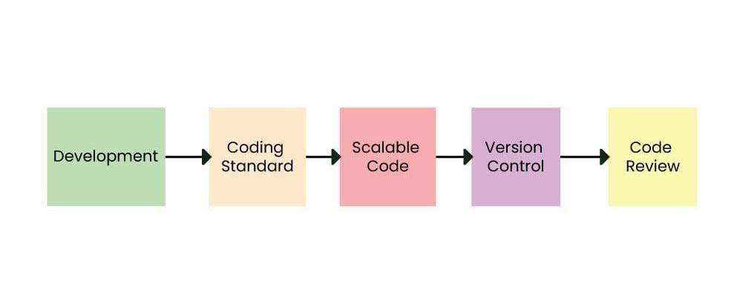
STAGE 4: Developing Product
At this stage, the fundamental development of the product starts. For this, developers use a specific programming code as per the design in the DDS. Hence, it is important for the coders to follow the protocols set by the association. Conventional programming tools like compilers, interpreters, debuggers, etc.

Slide 8
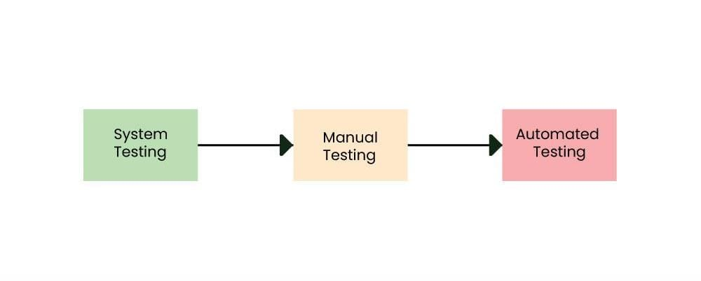
STAGE 5:Product testing and integration
After the development of the product, testing of the software is necessary to ensure its smooth execution. Although, minimal testing is conducted at every stage of SDLC. Therefore, at this stage, all the probable flaws are tracked, fixed, and retested. This ensures that the product confronts the quality requirements of SRS.

Slide 9
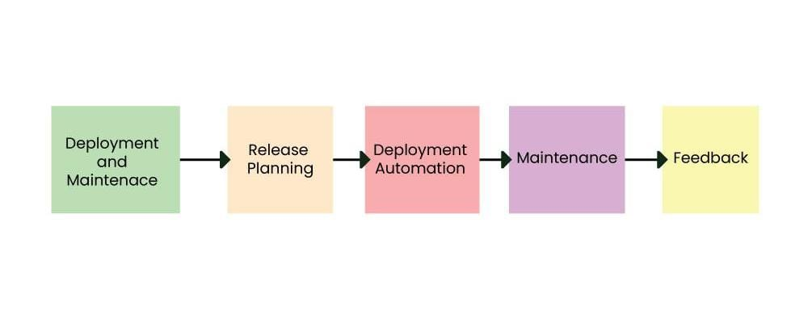
STAGE 6 & 7 :Deployment & Maintenance
It is important to ensure its smooth performance. If it performs well, the organization sends out the product as a whole. After retrieving beneficial feedback, the company releases it as it is or with auxiliary improvements to make it further helpful for the customers

Slide 10
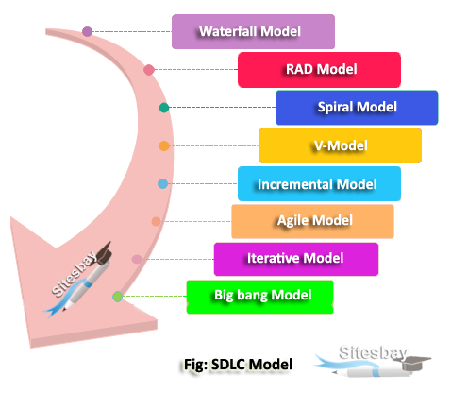
MODELS OF SDLC :
WATERFALL MODEL
RAD MODEL
SPIRAL MODEL
V-MODEL
INCREMENTAL MODEL
AGILE MODEL
ITERATIVE MODEL
BIG BANG MODEL

Slide 11
THANK YOU

