Slide 1

Global EMM Corporation

Slide 2

THE CHALLENGE
Managing 15,000+ Devices Across Global Operations
Global EMM Corporation, a multinational organization with 10,000+ employees across multiple offices and remote locations, faced critical challenges managing their rapidly expanding mobile device ecosystem. With 15,000+ Android and iOS devices—including corporate-owned, BYOD, and field devices—the organization lacked centralized visibility and control, leading to security vulnerabilities and compliance risks.
87%
$2.4M
340hrs
Unauthorized Devices
Annual Security Risk
Manual Management
Unmanaged devices detected on corporate network
Estimated cost of potential breaches and data loss
Monthly hours spent on device enrollment and support

Slide 3

Enterprise Challenges Addressed
01
02
Corporate Office Employees
Remote & Hybrid Workers
Seamless device enrollment and management
Centralized policy enforcement
Secure access to corporate resources
Automated compliance monitoring
Secure VPN and network access
Device location tracking and geofencing
Conditional access policies
Real-time threat detection
03
04
Field Service Teams
BYOD Program
GPS tracking and location-based policies
Offline capability and sync
Rugged device support
Work order integration
Personal device separation and containerization
Selective wipe capabilities
User privacy protection
Flexible policy management
Our EMM platform adapts to every employee segment with role-based policies, device-type flexibility, and industry-standard security controls designed by enterprise security experts.

Slide 4



Our EMM Implementation Approach
Our proven Enterprise Mobility Management methodology follows a structured three-phase approach designed to minimize disruption while maximizing security and compliance. Each phase builds upon the previous one to ensure comprehensive device management transformation.
Discovery & Assessment
Deployment & Enrollment
Optimization & Monitoring
We conduct comprehensive audits of existing device inventory, security posture, and compliance requirements. Stakeholder interviews identify pain points and define success metrics for the implementation.
We deploy the EMM platform with automated enrollment workflows, policy templates, and integration with existing IT systems. Comprehensive training ensures IT teams and end-users understand the new processes.
We establish ongoing monitoring dashboards, security alerts, and compliance reporting. Continuous optimization recommendations ensure the platform evolves with your organization's needs.

Slide 5






CORE CAPABILITIES
Enterprise-Grade EMM Features
Unified Device Management
Intelligent Enrollment
Comprehensive Reporting & Analytics
Single console for managing Android, iOS, and Windows devices across all ownership models and deployment scenarios.
Automated, user-friendly enrollment workflows that reduce IT support burden and accelerate device onboarding.
Real-time dashboards and detailed reports providing visibility into device inventory, compliance status, and security posture.
Advanced Security & Compliance
Policy & Configuration Management
Real-time threat detection, encryption enforcement, and automated compliance reporting for regulatory requirements.
Granular, role-based policies that adapt to different employee segments, departments, and security requirements.

Slide 6


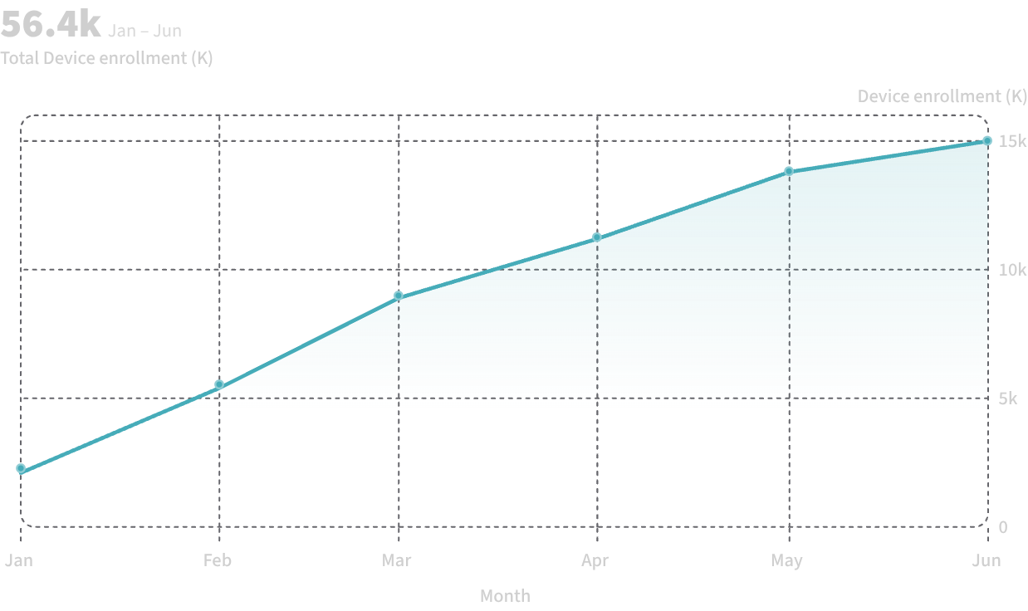


Measurable Outcomes
That Matter
Global EMM Corporation achieved significant, measurable results within the first 90 days of EMM implementation. These improvements directly impacted operational efficiency, security posture, and compliance status.
87%
340hrs
Unauthorized Devices Eliminated
Monthly Hours Saved
Automated enrollment and policy management eliminated manual IT overhead
Reduced unmanaged devices from 87% to 0% through comprehensive enrollment
The enrollment curve demonstrates rapid adoption of the EMM platform across all employee segments. By month six, 100% of corporate devices were under management.
99.2%
$1.8M
Compliance Achievement
Annual Savings
Achieved regulatory compliance across all device categories and locations
Reduced security incidents, support costs, and operational inefficiencies

Slide 7

Global Enterprise Implementation Timeline
Global EMM Corporation completed their EMM implementation in 16 weeks with minimal disruption to operations. The phased approach ensured smooth adoption across all 10,000+ employees and 15,000+ devices.
Phase 1: Discovery & Planning (Weeks 1-3)
1
Comprehensive audit of 15,000 devices across all locations. Identified 87% unmanaged devices and compliance gaps. Defined enrollment strategy for corporate, BYOD, and field devices. Established success metrics and stakeholder alignment.
2
Phase 2: Pilot & Deployment (Weeks 4-8)
Deployed EMM platform and tested with 2,000 corporate office devices. Refined enrollment workflows and policies based on pilot feedback. Integrated with existing Active Directory and MDM systems. Trained IT support teams.
Phase 3: Full Rollout (Weeks 9-14)
3
Enrolled remaining 13,000 devices across all employee segments. Implemented role-based policies for different departments. Activated geofencing and location-based controls for field teams. Enabled BYOD containerization.
4
Phase 4: Optimization & Support (Weeks 15-16+)
Established 24/7 monitoring and security alerts. Deployed compliance dashboards and reporting. Provided ongoing optimization and policy refinement. Transitioned to managed support model.

Slide 8



CLIENT SUCCESS STORY
Case Study: Global EMM Corporation
The Solution
We implemented a comprehensive EMM platform with automated enrollment, role-based policy management, and real-time monitoring. The solution included: unified console for all device types, automated enrollment workflows reducing onboarding to 15 minutes, geofencing and location tracking for field teams, containerization for BYOD devices, and centralized compliance reporting.
The Results
340hrs
Monthly IT Hours Saved
Automated enrollment and policy management
The Challenge
Global EMM Corporation struggled with managing their rapidly growing mobile device ecosystem. With 15,000+ devices across multiple locations, employee types, and ownership models, they faced critical challenges: 87% of devices were unmanaged and unmonitored, security policies were manually enforced with inconsistent compliance, employee onboarding required 8+ hours of IT support per person, lost or stolen devices couldn't be remotely wiped, and field teams had no location visibility or geofencing controls.
99.2%
Compliance Rate Achieved
Automated monitoring and enforcement
87%
Security Improvement
Eliminated unmanaged devices

Slide 9



CLIENT TESTIMONIALS
What Our Clients Say
"The EMM platform transformed how we manage our mobile devices. What used to take our IT team 340 hours per month is now automated. We went from 87% unmanaged devices to 100% visibility and control in just 16 weeks."
Sarah Chen
"Our field teams now have secure access to critical business applications with real-time location tracking and geofencing. The platform's flexibility for BYOD and corporate devices means we can support any employee scenario without compromising security."
Marcus Rodriguez
"The enrollment experience is seamless. Our employees can get their devices set up in 15 minutes instead of waiting for IT support. The automated compliance monitoring gives us confidence that we're meeting all regulatory requirements across our global operations."
Jennifer Park
VP of IT Operations, Global EMM Corporation
Chief Information Security Officer, Global EMM Corporation
Director of Enterprise Mobility, Global EMM Corporation

Slide 10



Let's Connect
Ready to Transform Your Operations?
Join hundreds of organizations who have already discovered the power of our solution. Start your journey today with a free consultation or trial—no obligations, no hidden commitments.
Prefer a personalized discussion?
Schedule a demo with one of our experts. We'll show you exactly how our solution addresses your specific challenges and answer all your questions.

