Slide 1
HRMS
(Human Resource Management System)
Title: HRMS
Name: rajesh Saha
Usn: 1nh16mca51
project guide: c.r.viswanatha

Slide 2
Company Details (Biztechnosys Infotech Pvt ltd)
Biztechnosys Infotech Pvt ltd it’s a start up company. In working in a Biztechnosys for an intern ship and they had appointed me to Node Js Angular Js platform based on this we are developing the above project HRMS.

Slide 3
What Is HRMS
A HRMS (Human Resource Management System) is a combination of systems and processes that connect human resource management and information technology through HR software. A HRMS may help to revolutionize a workplace.

Slide 4
Module HRMS System
They are 5 modules in my project
1)Admin(HR)
2) Employee Management
3) Department Management
4) Attendance Management
5) Salary Slip Management

Slide 5
Admin(HR)
Admin(HR) can access all the details of an employee departments etc. and he can access or modifies the each employee data.

Slide 6
Employee Management
In this module purpose HR has to register the new employee details into the database.

Slide 7
Employee Management
In this module the HR has to register the employee details based on the requirements and it consist of a categories data such as personal details , Address, Qualification, Reference and HR.
HR Data is mandatory for an employee to register a details of an job code, salary code, leave code has been mentioned by HR

Slide 8
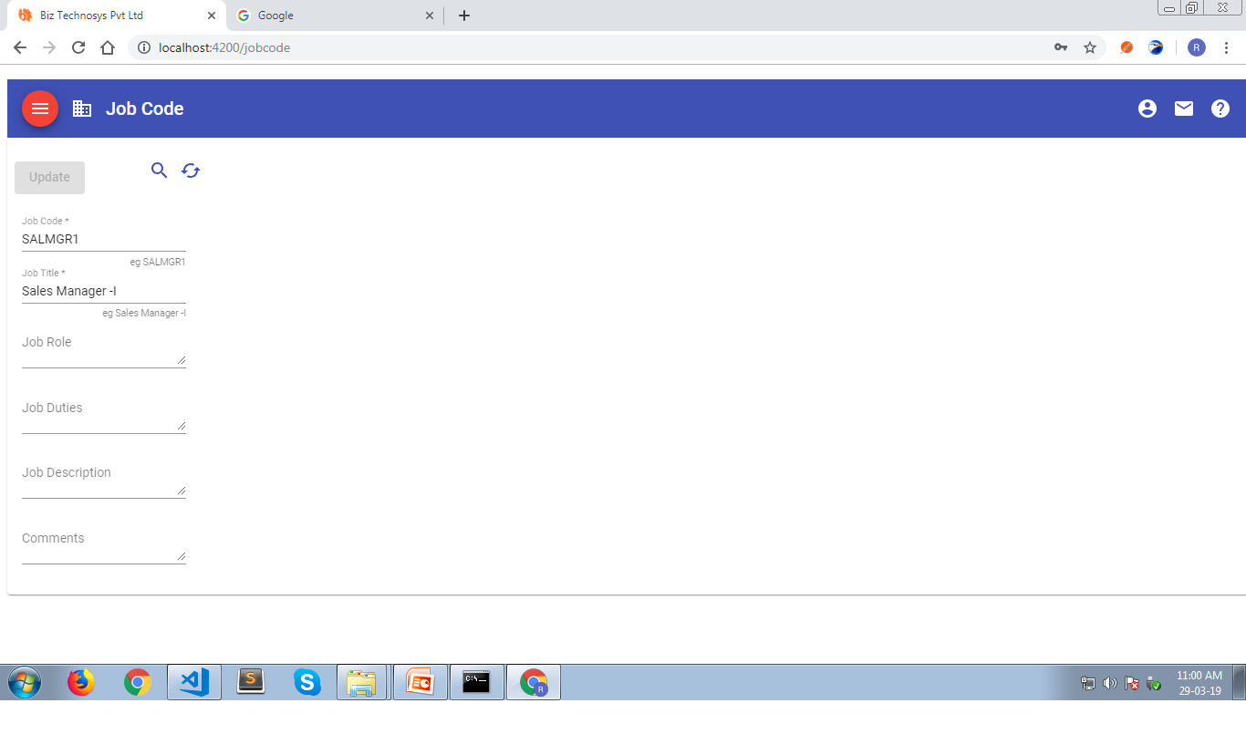
Job Code

Slide 9
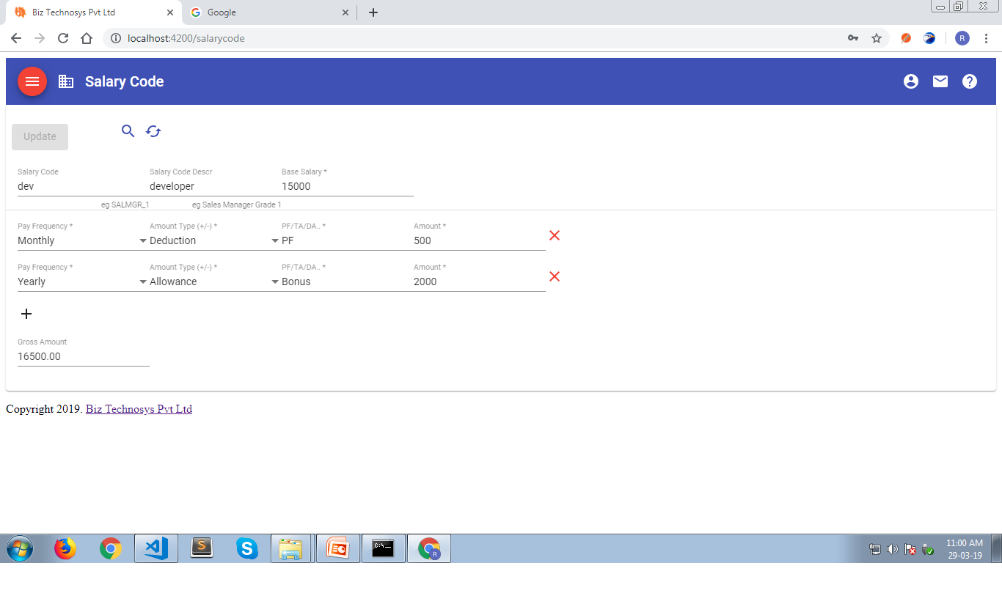
Salary Code

Slide 10
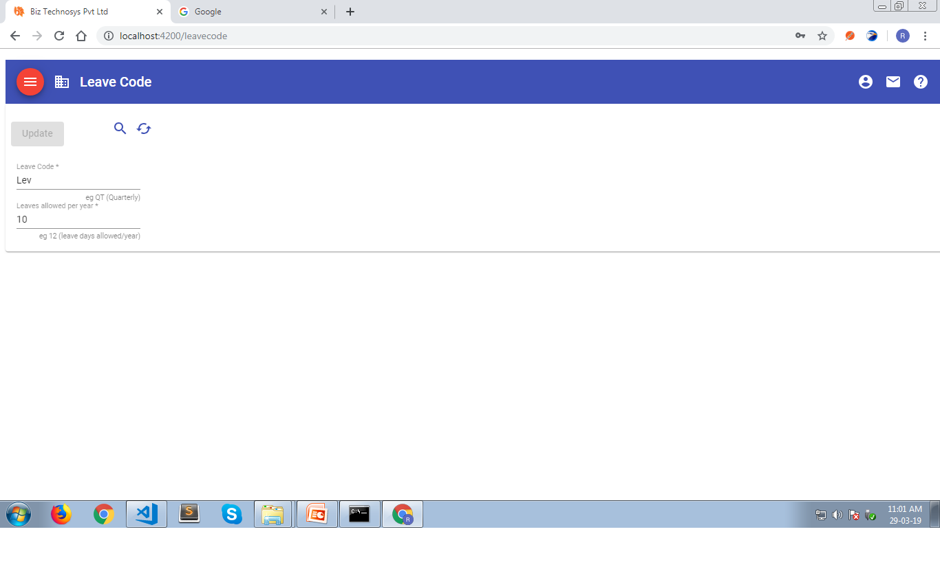
Leave Code

Slide 11
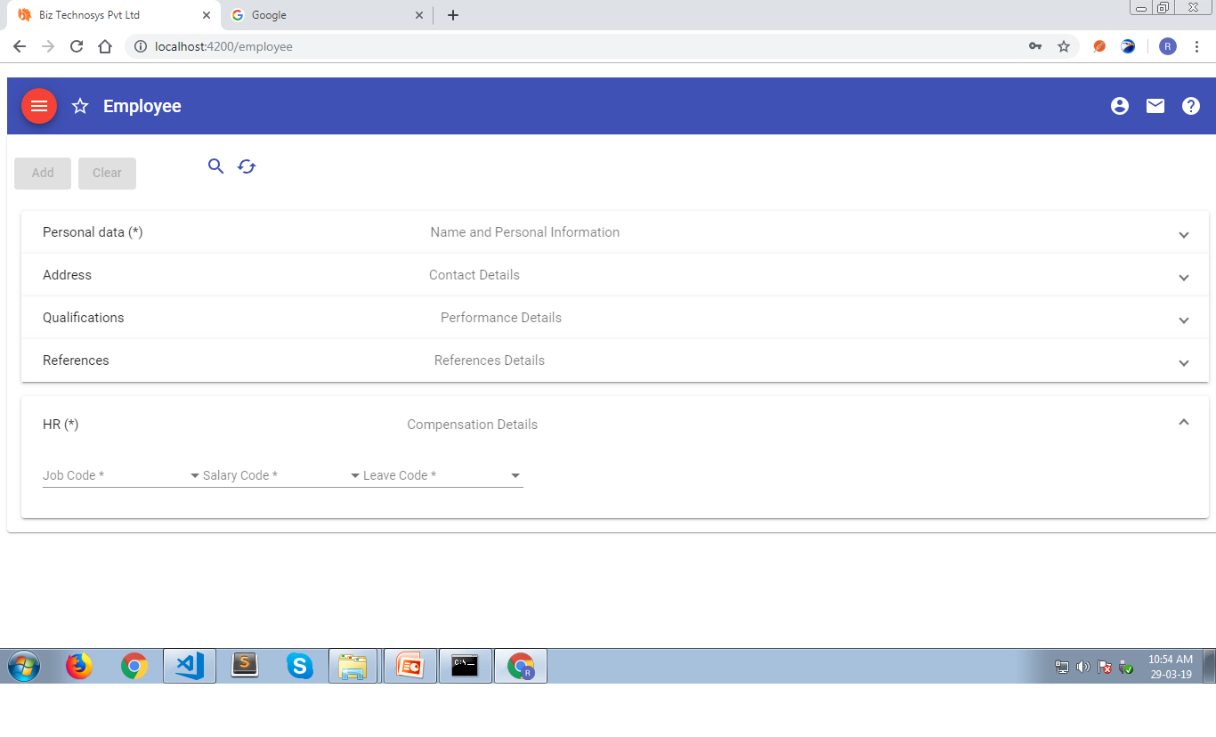
Employee Registration

Slide 12
Department Management
In this module it carries out the list of department where employees are working and that the employees need to report their specified leaders about the job.

Slide 13
Department Management
It consist of different type of job descriptions and salary code this will be handled by HR for providing a job to an employee based on provided department and can specify the annual income salary for the job types etc.

Slide 14
Attendance Management
This module purpose is it maintain the attendance of an employee which gloss’s the salary based on attendance.

Slide 15
Attendance Management
By providing a records into the biometric the employees attendance are to be stored on a backend(mongoDB) database. Based on the attendance it automatically generates employee salary. In this module the hr can see the day by day attendance or monthly attendance of an employee.

Slide 16
Salary Slip Management
Based on the employee attendance our company provides a salary. The employees can access their salary slip by specifying required data into an application & they can download
Their salary slip

Slide 17
Salary Slip Management
It is based on the attendance of an employee he has been already generated different types of department salary code based on the employee id the salary amount will be generated.HR can handle monthly wise if dedication or allowances can be inserted to the employee based on the performance an employee. This salary voucher can be generated has a bill record(PDF file) downloadable.

Slide 18
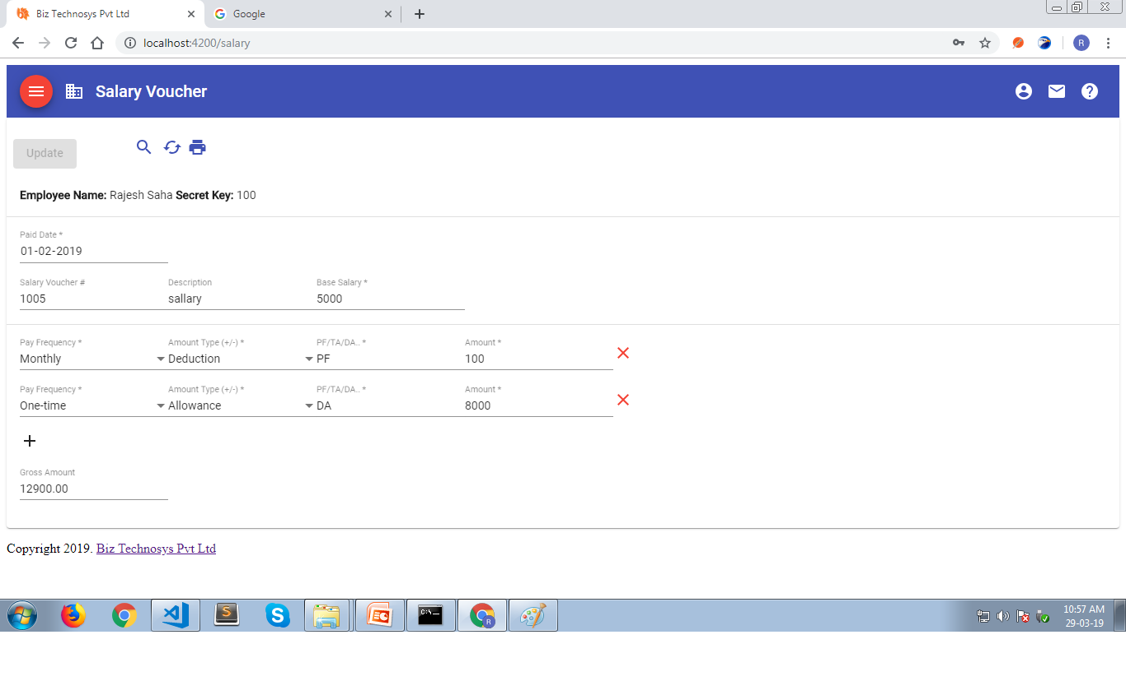
Salary Slip

Slide 19
Thank You

