Slide 1
Building Hybrid Apps with AngularJS and Ionic
Name: Rajesh Saha
Usn: 1nh16mca51
Guide: c.r.viswanatha

Slide 2
Overview
Native vs Hybrid Apps
Intro Ionic
UI Components
Ionic CLI

Slide 3
Native vs Hybrid
Native
● Proficiency in each platform required
● Entirely separate code bases
● Time consuming & expensive
development
● More Platforms. More Problems.
Hybrid Apps
● HTML5 that acts like native
● Direct access to native APIs
● Familiar web dev environment
● Develop a single code base
● reuse code between platforms

Slide 4
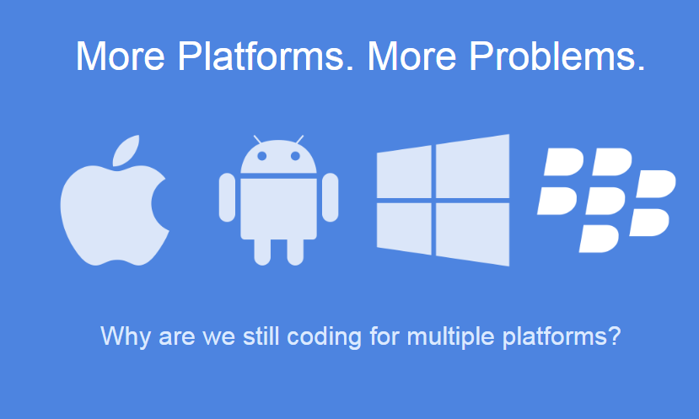
Native vs Hybrid

Slide 5
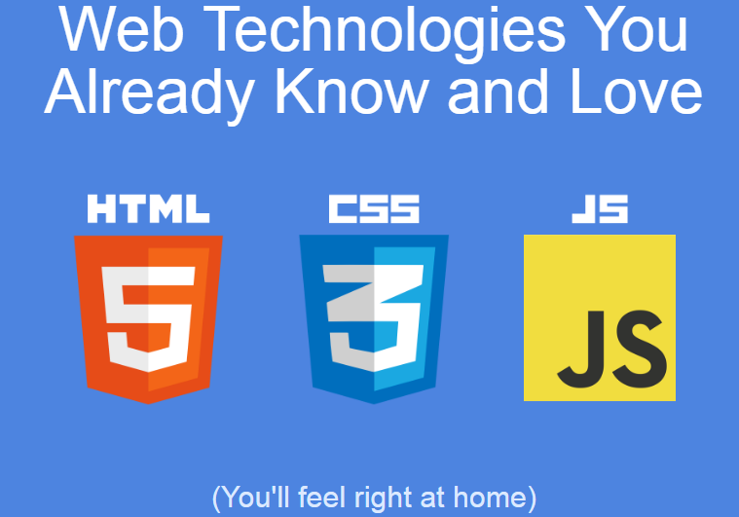

Slide 6

Intro Ionic
HTML5 framework for hybrid mobile apps.
Build on angular, sass.
Uses cordova/phonegap for creating running building deploying mobile apps.
Contains lots of mobile optimised css and javascript components.
Native like performance and beautifully designed

Slide 7

Ionic CLI
Getting started / Install
$ npm install -g cordova ionic
Getting started / Create
$ ionic start myApp [ blank | tabs | sidemenu ]
Getting started / See
$ ionic serve [ --lab ]

Slide 8
Ionic CLI
Common cli commands from cordova
$ ionic platform add [ android | ios ]
$ ionic platform emulate [android | ios ]
$ ionic platform build [android | ios ]

Slide 9
UI Components
ionic CSS components
ionic JS components
Ionicons
Lists
Navigation
Tabs
Side Menu
Slide Box
Action Sheet
Pull to Refresh

Slide 10
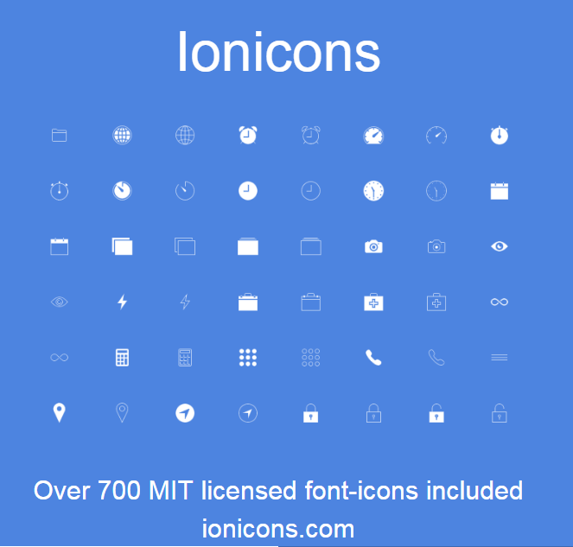
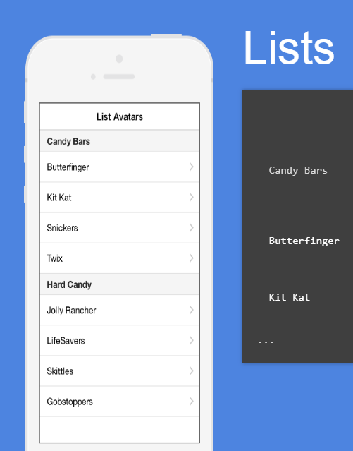
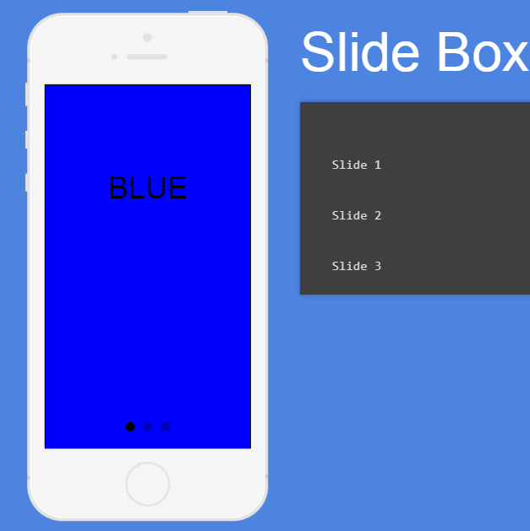
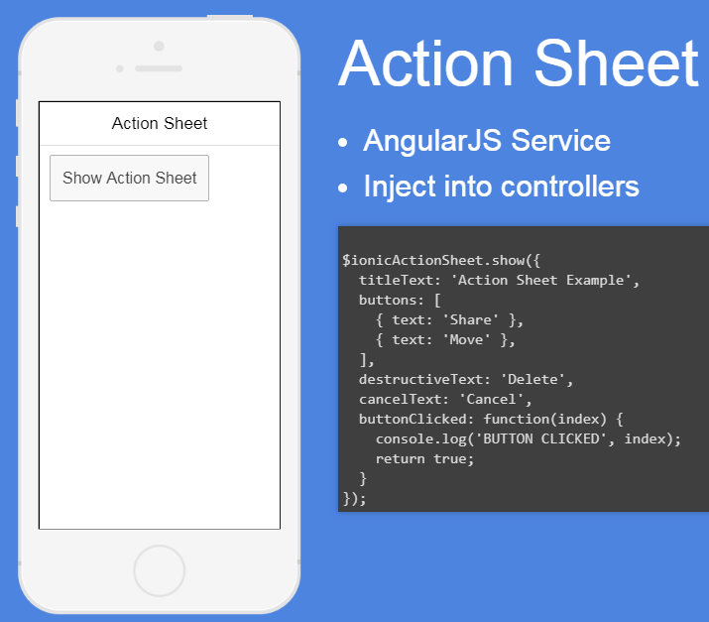
UI Components

Slide 11
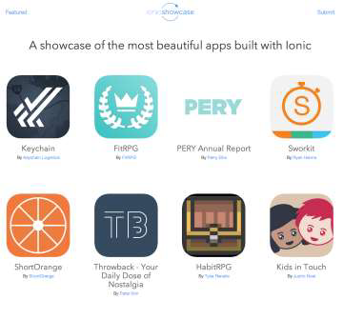
Showcase
Ionic Showcase
showcase.ionicframework.com

Slide 12
Thank you

