Slide 1
Name – Rasbehari Das
Company – Biztechnosys
Project Title - KeepCart

Slide 2
ABSTRACT
In today’s fast-changing business environment, it’s extremely important to be able to respond to client needs in the most effective and timely manner. If your customers wish to see your business online and have instant access to your products or services.
Online Shopping is a lifestyle e-commerce web application, which retails various fashion and lifestyle products. This project allows viewing various products available enables registered users to purchase desired products instantly using PayPal payment processor (Instant Pay) and also can place order by using Cash on Delivery (Pay Later) option. This project provides an easy access to Administrators and Managers to view orders placed using Pay Later and Instant Pay options.

Slide 3
In order to develop an e-commerce website, a number of Technologies must be studied and understood. These include multi-tiered architecture, server and client side scripting techniques, implementation technologies such as ASP.NET, programming language (such as C#) and relational databases.
This is a project with the objective to develop a basic website where a consumer is provided with a shopping cart application and also to know about the technologies used to develop such an application.
This document will discuss each of the underlying technologies to create and implement an ecommerce website.

Slide 4
INTRODUCTION
E-commerce is fast gaining ground as an accepted and used business paradigm. More and more business houses are implementing web sites providing functionality for performing commercial transactions over the web. It is reasonable to say that the process of shopping on the web is becoming commonplace.
The objective of this project is to develop a general purpose e-commerce store where product like clothes can be bought from the comfort of home through the Internet. However, for implementation purposes, this paper will deal with an online shopping for clothes.

Slide 5
OVERALL DESCRIPTION
Any member can register and view available products.
Only registered member can purchase multiple products regardless of quantity.
Contact Us page is available to contact Admin for queries.
There are three roles available: Visitor, User and Admin.
• Visitor can view available products.
• User can view and purchase products.
An Admin has some extra privilege including all privilege of visitor and user.
Admin can add products, edit product information and add/remove product.
Admin can add user, edit user information and can remove user.
Admin can ship order to user based on order placed by sending confirmation mail

Slide 6
Using the code
1. Attach the database in your "SQL Server Management Studio Express".
2. Run the application on Microsoft Visual Studio as web site.
3. Locate the database.
Master Page details
Online Shopping Master Page (Similar Master Page for Visitor, User and Admin).
Web Pages details
Home Page
About Us Page
Clothing Page
Order Us Page
Contact Us Page
Admin Page
Login Page
Register Page
Track

Slide 7
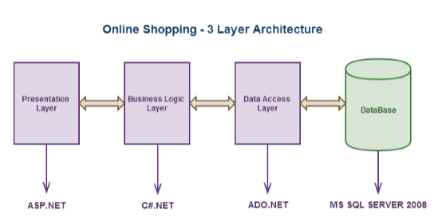
Project Flow

Slide 8
Thank You

