Slide 1
COVID19 vaccine distribution

Slide 2
PREDICTING THE REQUIREMENTS OF VACCINE.
Generally, vaccines are distributed according to the needs on different parts of the world.
The requirement depends upon the density of population(old, young and baby)
Predicting the spread of corona virus depends upon
1. the density of population affected at a particular area.
2. the movement of the people at a particular area.
Depending upon the situation the vaccine is supplied to that area.

Slide 3
Data acquisition and cleaning
Customers sample data is taken from a link below, https://cocl.us/customer_dataset or it can also be taken from Kaggle dataset or from 'https://en.wikipedia.org/wiki/List_of_London_boroughs’
There are total of 850 rows and 9 columns.
The rows are unique.
The data contains customer age and address
The graphs can be plotted between age and count on age.

Slide 4
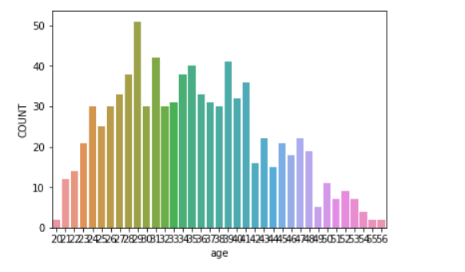
Determining the age and the count using the graph

Slide 5
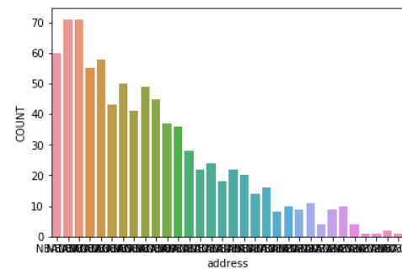
Determining the population at various location

Slide 6
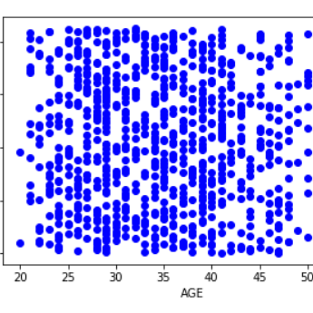
Train data

Slide 7
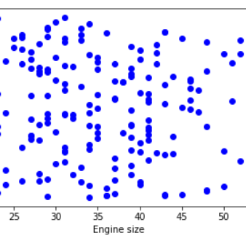
Test data

Slide 8
Conclusion and future directions
To build useful models to predict the spread of virus in newer location.
The model can be improved by writing more robust code.
To know the characteristics and the occupation of people.
Suggestions could be
1. Get the new born babies data and update the current data set.
2. The other financial data related to the people.
3. People past interaction with others could be advantage.

