Slide 1

Artificial Intelligence: A Modern Approach
Fourth Edition, Global Edition
Chapter 5
Constraint Satisfaction Problems
© 2022 Pearson Education Ltd.

Slide 2
Outline
Defining Constraint Satisfaction Problems (CSP)
CSP examples
Backtracking search for CSPs
Local search for CSPs
Problem structure and problem decomposition
© 2022 Pearson Education Ltd.

Slide 3
Defining Constraint Satisfaction Problems
A constraint satisfaction problem (CSP) consists of three components, X, D, and C:
X is a set of variables, {X₁ ….. X_{n}}.
D is a set of domains, {D₁, …. , D_{n}}, one for each variable
C is a set of constraints that specify allowable combination of values
CSPs deal with assignments of values to variables.
A complete assignment is one in which every variable is assigned a value, and a solution to a CSP is a consistent, complete assignment.
A partial assignment is one that leaves some variables unassigned.
Partial solution is a partial assignment that is consistent
© 2022 Pearson Education Ltd.

Slide 4
Constraint satisfaction problems (CSPs)
Standard search problem:
state is a “black box”—any old data structure that supports goal test, eval, successor
CSP:
state is defined by variables X_{i} with values from domain D_{i}
goal test is a set of constraints specifying
allowable combinations of values for subsets of variables
Simple example of a formal representation language
Allows useful general-purpose algorithms with more power than standard search algorithms
© 2022 Pearson Education Ltd.

Slide 5
Example: Map-Coloring
Northern Territory
Western Australia
Queensland
South Australia
New South Wales
Victoria
Variables WA, NT , Q, NSW , V , SA, T
Domains D_{i} = {red, green, blue}
Tasmania
Constraints: adjacent regions must have different colors e.g., WA /= NT (if the language allows this), or
(W A, NT ) ∈ {(red, green), (red, blue), (green, red), (green, blue), . . .}
© 2022 Pearson Education Ltd.

Slide 6
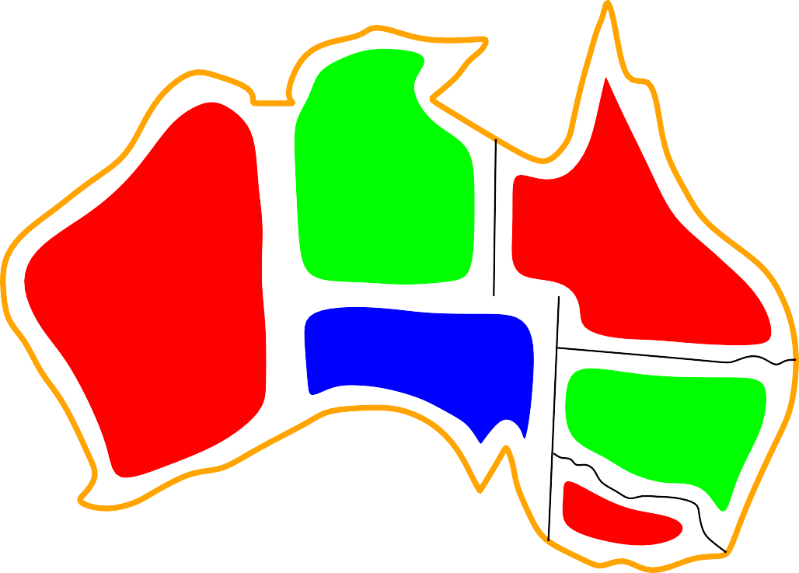

Example: Map-Coloring contd.
Northern Territory
Western Australia
Queensland
South Australia
New South Wales
Victoria Tasmania
Solutions are assignments satisfying all constraints, e.g.,
{WA = red, NT = green, Q = red, NSW = green, V = red, SA = blue, T = green}
© 2022 Pearson Education Ltd.

Slide 7
Constraint graph
Binary CSP: each constraint relates at most two variables
Constraint graph: nodes are variables, arcs show constraints
NT
Q
WA
SA
NSW
VicVtoria
T
General-purpose CSP algorithms use the graph structure
to speed up search. E.g., Tasmania is an independent subproblem!
© 2022 Pearson Education Ltd.

Slide 8
Varieties of CSPs
Discrete variables
finite domains; size d ⇒ O(d^{n}) complete assignments
e.g., Boolean CSPs, incl. Boolean satisfiability (NP-complete) infinite domains (integers, strings, etc.)
e.g., job scheduling, variables are start/end days for each job
need a constraint language, e.g., StartJ ob₁ + 5 ≤ StartJ ob₃
linear constraints solvable, nonlinear undecidable
Continuous variables
e.g., start/end times for Hubble Telescope observations
linear constraints solvable in poly time by LP methods
© 2022 Pearson Education Ltd.

Slide 9
Varieties of constraints
Unary constraints involve a single variable, e.g., SA /= green
Binary constraints involve pairs of variables, e.g., SA /= WA
Higher-order constraints involve 3 or more variables, e.g., cryptarithmetic column constraints
Preferences (soft constraints), e.g., red is better than green
often representable by a cost for each variable assignment
→ constrained optimization problems
© 2022 Pearson Education Ltd.

Slide 10
Example: Cryptarithmetic
T W O
+ T W O F O U R
F
T
U W R
O
X₃
X₂
X₁
Variables: F T U W R O X₁ X₂ X₃
Domains: {0, 1, 2, 3, 4, 5, 6, 7, 8, 9}
Constraints
alldiff(F, T, U, W, R, O)
O + O = R + 10 · X₁, etc.
© 2022 Pearson Education Ltd.

Slide 11
Real-world CSPs
Assignment problems
e.g., who teaches what class
Timetabling problems
e.g., which class is offered when and where?
Hardware configuration
Spreadsheets Transportation scheduling Factory scheduling Floorplanning
Notice that many real-world problems involve real-valued variables
© 2022 Pearson Education Ltd.

Slide 12


Standard search formulation (incremental)
Let’s start with the straightforward, dumb approach, then fix it
States are defined by the values assigned so far
Initial state: the empty assignment, { }
Successor function: assign a value to an unassigned variable that does not conflict with current assignment.
⇒ fail if no legal assignments (not fixable!)
Goal test: the current assignment is complete
This is the same for all CSPs!
Every solution appears at depth n with n variables
⇒ use depth-first search
Path is irrelevant, so can also use complete-state formulation
b = (n − €)d at depth €, hence n!d^{n} leaves!!!!
© 2022 Pearson Education Ltd.

Slide 13
Backtracking search
Variable assignments are commutative, i.e.,
[WA = red then NT = green] same as [NT = green then WA = red]
Only need to consider assignments to a single variable at each node
⇒ b = d and there are d^{n} leaves
Depth-first search for CSPs with single-variable assignments is called backtracking search
Backtracking search is the basic uninformed algorithm for CSPs Can solve n-queens for n ≈ 25
© 2022 Pearson Education Ltd.

Slide 14
Backtracking search
function Backtracking-Search(csp) returns solution/failure
return Recursive-Backtracking({ }, csp)
function Recursive-Backtracking(assignment, csp) returns soln/failure
if assignment is complete then return assignment
var ← Select-Unassigned-Variable(Variables[csp], assignment, csp)
for each value in Order-Domain-Values(var, assignment, csp) do
if value is consistent with assignment given Constraints[csp] then
add {var = value} to assignment
result ← Recursive-Backtracking(assignment, csp)
if result /= failure then return result
remove {var = value} from assignment
return failure
© 2022 Pearson Education Ltd.

Slide 15
Backtracking example
© 2022 Pearson Education Ltd.

Slide 16
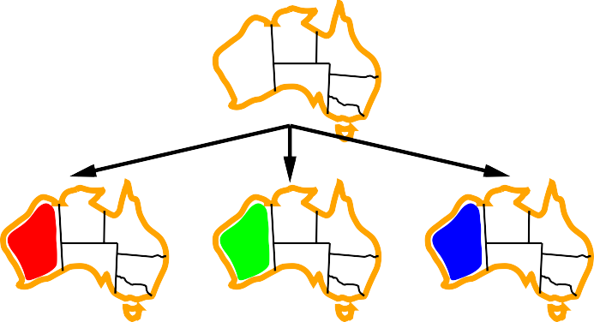
Backtracking example
© 2022 Pearson Education Ltd.

Slide 17


Backtracking example
© 2022 Pearson Education Ltd.

Slide 18

Backtracking example
© 2022 Pearson Education Ltd.

Slide 19
Improving backtracking efficiency
General-purpose methods can give huge gains in speed:
Which variable should be assigned next?
In what order should its values be tried?
Can we detect inevitable failure early?
Can we take advantage of problem structure?
© 2022 Pearson Education Ltd.

Slide 20
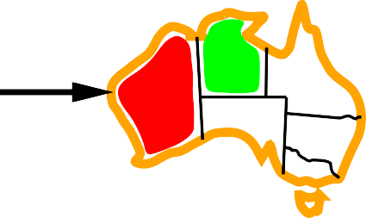
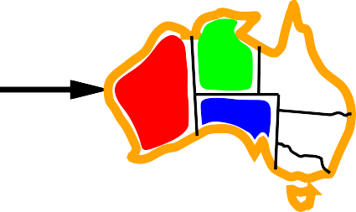


Minimum remaining values
Minimum remaining values (MRV):
choose the variable with the fewest legal values
© 2022 Pearson Education Ltd.

Slide 21
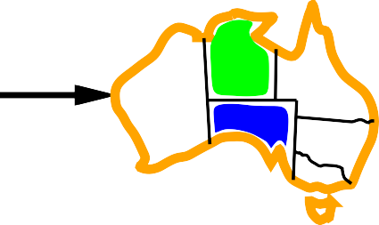
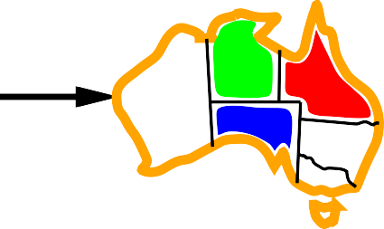

Degree heuristic
Tie-breaker among MRV variables
Degree heuristic:
choose the variable with the most constraints on remaining variables
© 2022 Pearson Education Ltd.

Slide 22
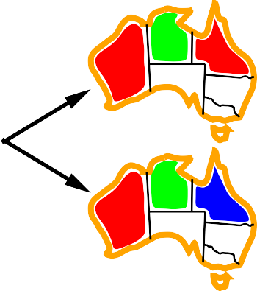
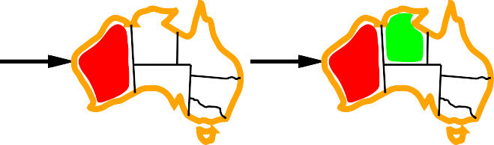
Least constraining value
Given a variable, choose the least constraining value:
the one that rules out the fewest values in the remaining variables
Allows 1 value for SA
Allows 0 values for SA
Combining these heuristics makes 1000 queens feasible
© 2022 Pearson Education Ltd.

Slide 23

Forward checking
Idea: Keep track of remaining legal values for unassigned variables Terminate search when any variable has no legal values
WA
NT
Q
NSW
V
SA
T
© 2022 Pearson Education Ltd.

Slide 24


Forward checking
Idea: Keep track of remaining legal values for unassigned variables Terminate search when any variable has no legal values
WA
NT
Q
NSW
V
SA
T
© 2022 Pearson Education Ltd.

Slide 25
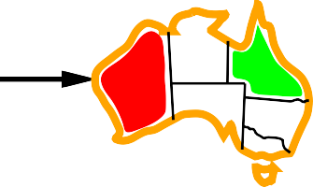


Forward checking
Idea: Keep track of remaining legal values for unassigned variables Terminate search when any variable has no legal values
WA
NT
Q
NSW
V
SA
T
© 2022 Pearson Education Ltd.

Slide 26
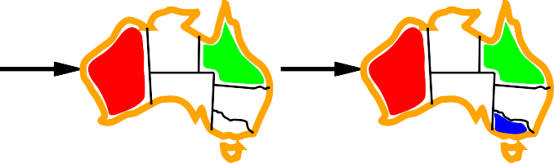


Forward checking
Idea: Keep track of remaining legal values for unassigned variables Terminate search when any variable has no legal values
WA
NT
Q
NSW
V
SA
T
© 2022 Pearson Education Ltd.

Slide 27
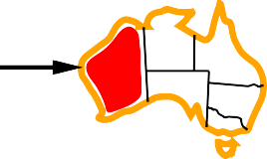

Constraint propagation
Forward checking propagates information from assigned to unassigned vari- ables, but doesn’t provide early detection for all failures:
WA
NT
Q
NSW
V
SA
T
NT and SA cannot both be blue!
Constraint propagation repeatedly enforces constraints locally
© 2022 Pearson Education Ltd.

Slide 28


Arc consistency
Simplest form of propagation makes each arc consistent
X → Y is consistent iff
for every value x of X there is some allowed y
WA
NT
Q
NSW
V
SA
T
© 2022 Pearson Education Ltd.

Slide 29
Arc consistency
Simplest form of propagation makes each arc consistent
X → Y is consistent iff
for every value x of X there is some allowed y
WA
NT
Q
NSW
V
SA
T
© 2022 Pearson Education Ltd.

Slide 30
Arc consistency
Simplest form of propagation makes each arc consistent
X → Y is consistent iff
for every value x of X there is some allowed y
WA
NT
Q
NSW
V
SA
T
If X loses a value, neighbors of X need to be rechecked
© 2022 Pearson Education Ltd.

Slide 31
Arc consistency
Simplest form of propagation makes each arc consistent
X → Y is consistent iff
for every value x of X there is some allowed y
WA
NT
Q
NSW
V
SA
T
If X loses a value, neighbors of X need to be rechecked
Arc consistency detects failure earlier than forward checking Can be run as a preprocessor or after each assignment
© 2022 Pearson Education Ltd.

Slide 32
Arc consistency algorithm
function AC-3( csp) returns the CSP, possibly with reduced domains
inputs: csp, a binary CSP with variables {X₁, X₂, . . . , X_{n}}
local variables: queue, a queue of arcs, initially all the arcs in csp
while queue is not empty do
(X_{i}, X_{j} ) ← Remove-First(queue)
if Remove-Inconsistent-Values(X_{i}, X_{j} ) then for each X_{k} in Neighbors[X_{i}] do
add (X_{k}, X_{i}) to queue
function Remove-Inconsistent-Values( X_{i}, X_{j}) returns true iff succeeds
removed ← false
for each x in Domain[X_{i}] do
if no value y in Domain[X_{j}] allows (x,y) to satisfy the constraint X_{i} ↔ X_{j}
then delete x from Domain[X_{i}]; removed ← true
return removed
O(n²d³), can be reduced to O(n²d²) (but detecting all is NP-hard)
© 2022 Pearson Education Ltd.

Slide 33
Local Search for CSPs
Local search algorithms can be very effective in solving many CSPs.
Local search algorithms use a complete-state formulation where each state assigns a value to every variable, and the search changes the value of one variable at a time.
Min-conflicts heuristic: value that results in the minimum number
of conflicts with other variables that brings us closer to a solution.
Usually has a series of plateaus
Plateau search: allowing sideways moves to another state with the same score.
can help local search find its way off the plateau.
Constraint weighting aims to concentrate the search on the
important constraints
Each constraint is given a numeric weight, initially all 1.
weights adjusted by incrementing when it is violated by the current assignment

Slide 34

Example: 4-Queens
States: 4 queens in 4 columns (4⁴ = 256 states)
Operators: move queen in column Goal test: no attacks
Evaluation: h(n) = number of attacks
h = 5
h = 2
h = 0

Slide 35
Performance of min-conflicts
Given random initial state, can solve n-queens in almost constant time for arbitrary n with high probability (e.g., n = 10,000,000)
The same appears to be true for any randomly-generated CSP
except in a narrow range of the ratio
number of constraints
R =
number of variables
CPU
time
R
critical ratio

Slide 36
Problem structure
NT
Q
WA
SA
NSW
VicVtoria
T
Tasmania and mainland are independent subproblems Identifiable as connected components of constraint graph
© 2022 Pearson Education Ltd.

Slide 37
Problem structure contd.
Suppose each subproblem has c variables out of n total
Worst-case solution cost is n/c · d^{c}, linear in n
E.g., n = 80, d = 2, c = 20
2⁸⁰ = 4 billion years at 10 million nodes/sec
4 · 2²⁰ = 0.4 seconds at 10 million nodes/sec
© 2022 Pearson Education Ltd.

Slide 38
Tree-structured CSPs
A E
B D
C F
Theorem: if the constraint graph has no loops, the CSP can be solved in
O(n d²) time
Compare to general CSPs, where worst-case time is O(d^{n})
This property also applies to logical and probabilistic reasoning:
an important example of the relation between syntactic restrictions and the complexity of reasoning.
© 2022 Pearson Education Ltd.

Slide 39
Algorithm for tree-structured CSPs
1. Choose a variable as root, order variables from root to leaves such that every node’s parent precedes it in the ordering
A E
B D A B C D E F F
C
For j from n down to 2, apply RemoveInconsistent(Parent(X_{j}), X_{j})
For j from 1 to n, assign X_{j} consistently with Parent(X_{j})
© 2022 Pearson Education Ltd.

Slide 40
Nearly tree-structured CSPs
Conditioning: instantiate a variable, prune its neighbors’ domains
NT
NT
Q
Q
WA
WA
SA
NSW
NSW
VicVtoria
VicVtoria
T
T
Cutset conditioning: instantiate (in all ways) a set of variables such that the remaining constraint graph is a tree
Cutset size c ⇒ runtime O(d^{c} · (n − c)d²), very fast for small c
© 2022 Pearson Education Ltd.

Slide 41
Iterative algorithms for CSPs
Hill-climbing, simulated annealing typically work with “complete” states, i.e., all variables assigned
To apply to CSPs:
allow states with unsatisfied constraints operators reassign variable values
Variable selection: randomly select any conflicted variable Value selection by min-conflicts heuristic:
choose value that violates the fewest constraints
i.e., hillclimb with h(n) = total number of violated constraints
© 2022 Pearson Education Ltd.

Slide 42
Summary
CSPs are a special kind of problem:
states defined by values of a fixed set of variables goal test defined by constraints on variable values
Backtracking = depth-first search with one variable assigned per node Variable ordering and value selection heuristics help significantly Forward checking prevents assignments that guarantee later failure Constraint propagation (e.g., arc consistency) does additional work
to constrain values and detect inconsistencies
Local search using the min-conflicts heuristic has also been applied to constraint satisfaction problems with great success
The CSP representation allows analysis of problem structure Tree-structured CSPs can be solved in linear time
© 2022 Pearson Education Ltd.

