Slide 1
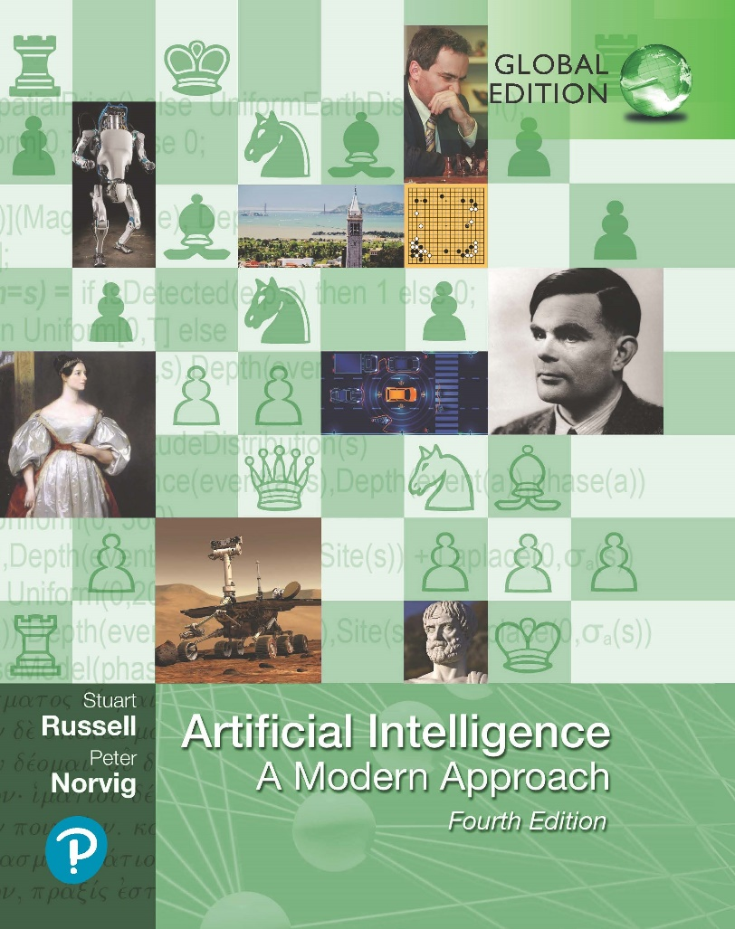
Artificial Intelligence: A Modern Approach
Fourth Edition, Global Edition
Chapter 8
First-order logic
© 2022 Pearson Education Ltd.

Slide 2
Outline
Why FOL?
Syntax and semantics of FOL
Fun with sentences
Wumpus world in FOL
Knowledge Engineering in FOL
© 2022 Pearson Education Ltd.

Slide 3





Pros and cons of propositional logic
Propositional logic is declarative: pieces of syntax correspond to facts
Propositional logic allows partial/disjunctive/negated information (unlike most data structures and databases)
Propositional logic is compositional:
meaning of B_{1,1} ∧ P_{1,2} is derived from meaning of B_{1,1} and of P_{1,2}
Meaning in propositional logic is context-independent
(unlike natural language, where meaning depends on context)
Propositional logic has very limited expressive power (unlike natural language)
E.g., cannot say “pits cause breezes in adjacent squares” except by writing one sentence for each square
© 2022 Pearson Education Ltd.

Slide 4
First-order logic
Whereas propositional logic assumes world contains facts,
first-order logic (like natural language) assumes the world contains
Objects: people, houses, numbers, theories, Ronald McDonald, colors, baseball games, wars, centuries . . .
Relations: red, round, bogus, prime, multistoried . . .,
brother of, bigger than, inside, part of, has color, occurred after, owns, comes between, . . .
Functions: father of, best friend, third inning of, one more than, end of
. . .
© 2022 Pearson Education Ltd.

Slide 5
Logics in general
Language | Ontological Commitment | Epistemological Commitment
Propositional logic | facts | true/false/unknown
First-order logic | facts, objects, relations | true/false/unknown
Temporal logic | facts, objects, relations, times | true/false/unknown
Probability theory | facts | degree of belief
Fuzzy logic | facts + degree of truth | known interval value
© 2022 Pearson Education Ltd.

Slide 6
Syntax of FOL: Basic elements
Constants Predicates Functions Variables Connectives Equality Quantifiers
KingJ ohn, 2, UCB, . . .
Brother, >, . . .
Sqrt, LeftLegOf, . . . x, y, a, b, . . .
∧ ∨ ¬ ⇒ ⇔
=
∀ ∃
© 2022 Pearson Education Ltd.

Slide 7
Atomic sentences
Atomic sentence = predicate(term₁, . . . , term_{n})
or term₁ = term₂
Term = function(term₁, . . . , term_{n})
or constant or variable
E.g., Brother(KingJ ohn, RichardT heLionheart)
> (Length(LeftLegOf (Richard)), Length(LeftLegOf (KingJ ohn)))
© 2022 Pearson Education Ltd.

Slide 8
Complex sentences
Complex sentences are made from atomic sentences using connectives
¬S, S₁ ∧ S₂, S₁ ∨ S₂, S₁ ⇒ S₂, S₁ ⇔ S₂
E.g. Sibling(KingJ ohn, Richard) ⇒ Sibling(Richard, KingJ ohn)
>(1, 2) ∨ ≤(1, 2)
>(1, 2) ∧ ¬>(1, 2)
© 2022 Pearson Education Ltd.

Slide 9
Truth in first-order logic
Sentences are true with respect to a model and an interpretation
Model contains ≥ 1 objects (domain elements) and relations among them Interpretation specifies referents for
constant symbols → objects predicate symbols → relations
function symbols → functional relations
An atomic sentence predicate(term₁, . . . , term_{n}) is true iff the objects referred to by term₁, . . . , term_{n}
are in the relation referred to by predicate
© 2022 Pearson Education Ltd.

Slide 10
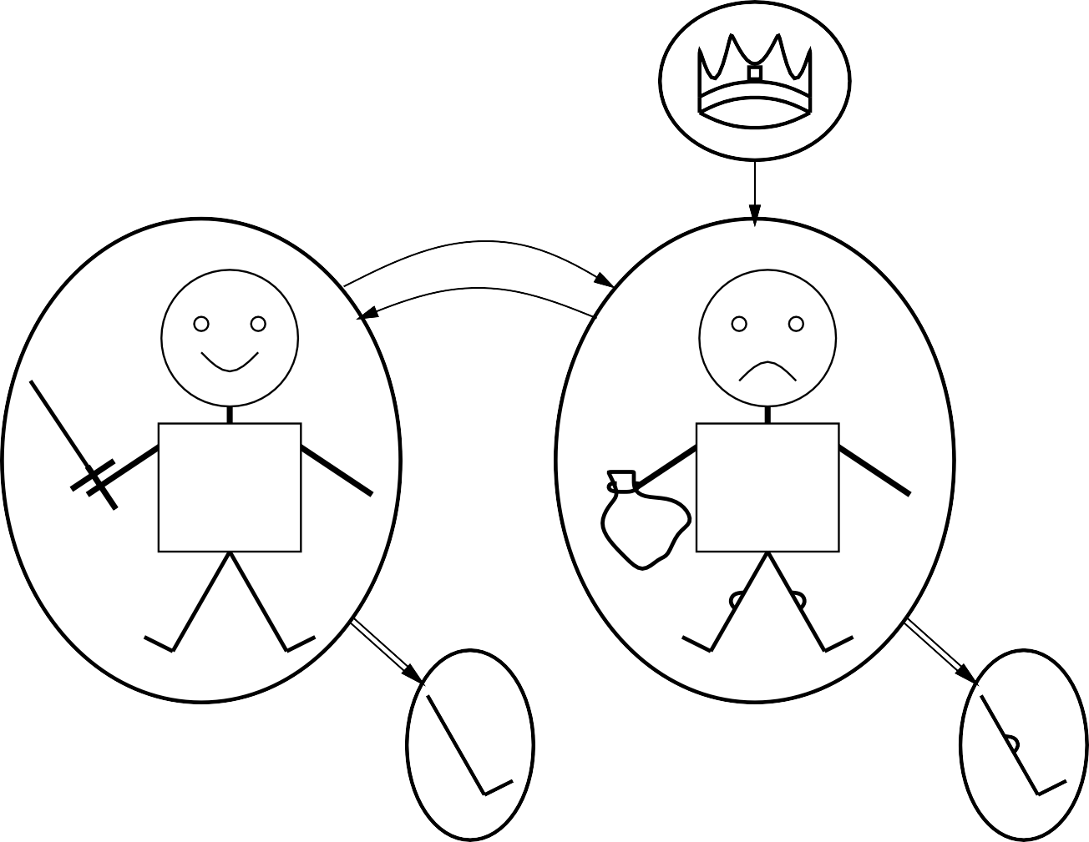
Models for FOL: Example
crown
brother
on head
person king
person
brother
R
J
$
left leg
left leg
© 2022 Pearson Education Ltd.

Slide 11
Truth example
Consider the interpretation in which Richard → Richard the Lionheart J ohn → the evil King John
Brother → the brotherhood relation
Under this interpretation, Brother(Richard, J ohn) is true just in case Richard the Lionheart and the evil King John are in the brotherhood relation in the model
© 2022 Pearson Education Ltd.

Slide 12
Models for FOL: Lots!
Entailment in propositional logic can be computed by enumerating models
We can enumerate the FOL models for a given KB vocabulary: For each number of domain elements n from 1 to ∞
For each k-ary predicate P_{k} in the vocabulary For each possible k-ary relation on n objects
For each constant symbol C in the vocabulary
For each choice of referent for C from n objects . . .
Computing entailment by enumerating FOL models is not easy!
© 2022 Pearson Education Ltd.

Slide 13
Universal quantification
∀ }variabless }sentences
Everyone at Berkeley is smart:
∀ x At(x, Berkeley) ⇒ Smart(x)
∀ x P is true in a model m iff P is true with x being
each possible object in the model
Roughly speaking, equivalent to the conjunction of instantiations of P
(At(KingJ ohn, Berkeley) ⇒ Smart(KingJ ohn))
∧ (At(Richard, Berkeley) ⇒ Smart(Richard))
∧ (At(Berkeley, Berkeley) ⇒ Smart(Berkeley))
∧ . . .
© 2022 Pearson Education Ltd.

Slide 14
A common mistake to avoid
Typically, ⇒ is the main connective with ∀
Common mistake: using ∧ as the main connective with ∀:
∀ x At(x, Berkeley) ∧ Smart(x)
means “Everyone is at Berkeley and everyone is smart”
© 2022 Pearson Education Ltd.

Slide 15
Existential quantification
∃ }variabless }sentences
Someone at Stanford is smart:
∃ x At(x, Stanf ord) ∧ Smart(x)
∃ x P is true in a model m iff P is true with x being
some possible object in the model
Roughly speaking, equivalent to the disjunction of instantiations of P
(At(KingJ ohn, Stanf ord) ∧ Smart(KingJ ohn))
∨ (At(Richard, Stanf ord) ∧ Smart(Richard))
∨ (At(Stanf ord, Stanf ord) ∧ Smart(Stanf ord))
∨ . . .
© 2022 Pearson Education Ltd.

Slide 16
Another common mistake to avoid
Typically, ∧ is the main connective with ∃
Common mistake: using ⇒ as the main connective with ∃:
∃ x At(x, Stanf ord) ⇒ Smart(x)
is true if there is anyone who is not at Stanford!
© 2022 Pearson Education Ltd.

Slide 17
Properties of quantifiers
∀ x | ∀ y | is the same as ∀ y | ∀ x | (why??)
∃ x | ∃ y | is the same as ∃ y | ∃ x | (why??)
∃ x | ∀ y | is not the same as | ∀ y | ∃ x
∃ x ∀ y Loves(x, y)
“There is a person who loves everyone in the world”
∀ y ∃ x Loves(x, y)
“Everyone in the world is loved by at least one person”
Quantifier duality: each can be expressed using the other
∀ x Likes(x, IceCream)
∃ x Likes(x, Broccoli)
¬∃ x ¬Likes(x, IceCream)
¬∀ x ¬Likes(x, Broccoli)
© 2022 Pearson Education Ltd.

Slide 18
Fun with sentences
Brothers are siblings
© 2022 Pearson Education Ltd.

Slide 19
Fun with sentences
Brothers are siblings
∀ x, y Brother(x, y) ⇒ Sibling(x, y). “Sibling” is symmetric
© 2022 Pearson Education Ltd.

Slide 20
Fun with sentences
Brothers are siblings
∀ x, y Brother(x, y) ⇒ Sibling(x, y). “Sibling” is symmetric
∀ x, y Sibling(x, y) ⇔ Sibling(y, x). One’s mother is one’s female parent
© 2022 Pearson Education Ltd.

Slide 21
Fun with sentences
Brothers are siblings
∀ x, y Brother(x, y) ⇒ Sibling(x, y). “Sibling” is symmetric
∀ x, y Sibling(x, y) ⇔ Sibling(y, x). One’s mother is one’s female parent
∀ x, y M other(x, y) ⇔ (F emale(x) ∧ Parent(x, y)). A first cousin is a child of a parent’s sibling
© 2022 Pearson Education Ltd.

Slide 22
Fun with sentences
Brothers are siblings
∀ x, y Brother(x, y) ⇒ Sibling(x, y). “Sibling” is symmetric
∀ x, y Sibling(x, y) ⇔ Sibling(y, x). One’s mother is one’s female parent
∀ x, y M other(x, y) ⇔ (F emale(x) ∧ Parent(x, y)). A first cousin is a child of a parent’s sibling
∀ x, y FirstCousin(x, y) ⇔ ∃ p, ps Parent(p, x) ∧ Sibling(ps, p) ∧
Parent(ps, y)
© 2022 Pearson Education Ltd.

Slide 23
Equality
term₁ = term₂ is true under a given interpretation
if and only if term₁ and term₂ refer to the same object
E.g., 1 = 2 and ∀ x ×(Sqrt(x), Sqrt(x)) = x are satisfiable
2 = 2 is valid
E.g., definition of (full) Sibling in terms of Parent:
∀ x, y Sibling(x, y) ⇔ [¬(x = y) ∧ ∃ m, f ¬(m = f ) ∧
Parent(m, x) ∧ Parent(f, x) ∧ Parent(m, y) ∧ Parent(f, y)]
© 2022 Pearson Education Ltd.

Slide 24
Interacting with FOL KBs
Suppose a wumpus-world agent is using an FOL KB
and perceives a smell and a breeze (but no glitter) at t = 5:
T ell(KB, P ercept([Smell, Breeze, N one], 5))
Ask(KB, ∃ a Action(a, 5))
I.e., does KB entail any particular actions at t = 5? Answer: Y es, {a/Shoot} ← substitution (binding list) Given a sentence S and a substitution σ,
Sσ denotes the result of plugging σ into S; e.g.,
S = Smarter(x, y)
σ = {x/Hillary, y/Bill}
Sσ = Smarter(Hillary, Bill)
Ask(KB, S) returns some/all σ such that KB |= Sσ
© 2022 Pearson Education Ltd.

Slide 25
Knowledge base for the wumpus world
“Perception”
∀ b, g, t P ercept([Smell, b, g], t) ⇒ Smelt(t)
∀ s, b, t P ercept([s, b, Glitter], t) ⇒ AtGold(t)
Reflex: ∀ t AtGold(t) ⇒ Action(Grab, t)
Reflex with internal state: do we have the gold already?
∀ t AtGold(t) ∧ ¬Holding(Gold, t) ⇒ Action(Grab, t)
Holding(Gold, t) cannot be observed
⇒ keeping track of change is essential
© 2022 Pearson Education Ltd.

Slide 26
Deducing hidden properties
Properties of locations:
∀ x, t At(Agent, x, t) ∧ Smelt(t) ⇒ Smelly(x)
∀ x, t At(Agent, x, t) ∧ Breeze(t) ⇒ Breezy(x)
Squares are breezy near a pit:
Diagnostic rule—infer cause from effect
∀ y Breezy(y) ⇒ ∃ x Pit(x) ∧ Adjacent(x, y)
Causal rule—infer effect from cause
∀ x, y Pit(x) ∧ Adjacent(x, y) ⇒ Breezy(y)
Neither of these is complete—e.g., the causal rule doesn’t say whether squares far away from pits can be breezy
Definition for the Breezy predicate:
∀ y Breezy(y) ⇔ [∃ x Pit(x) ∧ Adjacent(x, y)]
© 2022 Pearson Education Ltd.

Slide 27
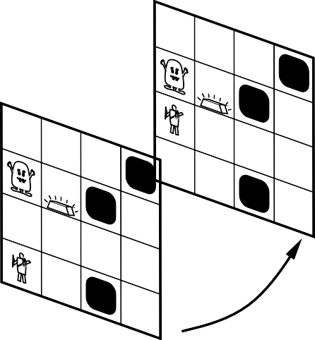
Keeping track of change
Facts hold in situations, rather than eternally
E.g., Holding(Gold, N ow) rather than just Holding(Gold)
Situation calculus is one way to represent change in FOL:
Adds a situation argument to each non-eternal predicate E.g., N ow in Holding(Gold, N ow) denotes a situation
Situations are connected by the Result function
Result(a, s) is the situation that results from doing a in s
PIT
Gold
PIT
PIT
PIT
Gold
PIT
S₁
PIT
Forward
S
0
© 2022 Pearson Education Ltd.

Slide 28
Describing actions I
“Effect” axiom—describe changes due to action
∀ s AtGold(s) ⇒ Holding(Gold, Result(Grab, s))
“Frame” axiom—describe non-changes due to action
∀ s HaveArrow(s) ⇒ HaveArrow(Result(Grab, s))
Frame problem: find an elegant way to handle non-change
representation—avoid frame axioms
inference—avoid repeated “copy-overs” to keep track of state
Qualification problem: true descriptions of real actions require endless caveats— what if gold is slippery or nailed down or . . .
Ramification problem: real actions have many secondary consequences— what about the dust on the gold, wear and tear on gloves, . . .
© 2022 Pearson Education Ltd.

Slide 29
Describing actions II
Successor-state axioms solve the representational frame problem
Each axiom is “about” a predicate (not an action per se):
P true afterwards
⇔ [an action made P true
∨ P true already and no action made P false]
For holding the gold:
∀ a, s Holding(Gold, Result(a, s)) ⇔
[(a = Grab ∧ AtGold(s))
∨ (Holding(Gold, s) ∧ a = Release)]
© 2022 Pearson Education Ltd.

Slide 30
Making plans
Initial condition in KB:
At(Agent, [1, 1], S₀)
At(Gold, [1, 2], S₀)
Query: Ask(KB, ∃ s Holding(Gold, s))
i.e., in what situation will I be holding the gold?
Answer: {s/Result(Grab, Result(F orward, S₀))}
i.e., go forward and then grab the gold
This assumes that the agent is interested in plans starting at S₀ and that S₀
is the only situation described in the KB
© 2022 Pearson Education Ltd.

Slide 31
Making plans: A better way
Represent plans as action sequences [a₁, a₂, . . . , a_{n}]
PlanResult(p, s) is the result of executing p in s
Then the query Ask(KB, ∃ p Holding(Gold, PlanResult(p, S₀)))
has the solution {p/[F orward, Grab]}
Definition of PlanResult in terms of Result:
∀ s PlanResult([ ], s) = s
∀ a, p, s PlanResult([a|p], s) = PlanResult(p, Result(a, s))
Planning systems are special-purpose reasoners designed to do this type of inference more efficiently than a general-purpose reasoner
© 2022 Pearson Education Ltd.

Slide 32
Knowledge Engineering in FOL
Knowledge engineering: the general process of knowledge-base construction.
The steps used in the knowledge engineering process:
Identify the questions.
Assemble the relevant knowledge
Decide on a vocabulary of predicates, functions, and constants
Encode general knowledge about the domain
Encode a description of the problem instance
Pose queries to the inference procedure and get answers
Debug and evaluate the knowledge base
© 2022 Pearson Education Ltd.

Slide 33
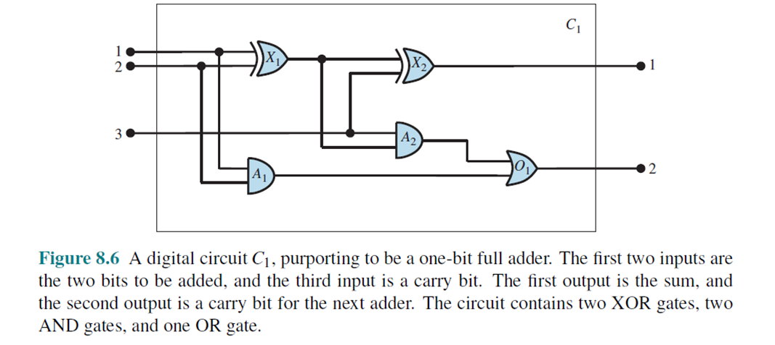
Knowledge Engineering in FOL
Applications in the electronic circuits domain
Identify the questions
Does the circuit in Figure 8.6 actually add properly?
If all the inputs are high, what is the output of gate A2?
Questions about the circuit’s structure are also interesting.
For example, what are all the gates connected to the first input terminal?
Does the circuit contain feedback loops?
© 2022 Pearson Education Ltd.

Slide 34
Knowledge Engineering in FOL
Applications in the electronic circuits domain
2. Assemble the relevant knowledge
Circuits composed of wires and gates.
Signals flow along wires to the input terminals of gates
Each gate produces a signal on the output terminal that flows along another wire.
There are four types of gates: AND, OR, and XOR gates have two input terminals, and NOT gates have one.
© 2022 Pearson Education Ltd.

Slide 35
Knowledge Engineering in FOL
Applications in the electronic circuits domain
3. Decide on a vocabulary
Each gate is represented as an object named by a constant, about which we assert that it is a gate with
Gate(X₁), eg: Type(X₁)=XOR
Circuit(C₁)
Terminal(x)
© 2022 Pearson Education Ltd.

Slide 36
Knowledge Engineering in FOL
Applications in the electronic circuits domain
4. Encode general knowledge of the domain
Example:
If two terminals are connected, then they have the same signal:
∀ t₁, t₂ Terminal(t₁) ∧ Terminal(t₂) ∧ Connected(t₁, t₂) ⇒
Signal(t₁)=Signal(t₂)
© 2022 Pearson Education Ltd.

Slide 37
Knowledge Engineering in FOL
Applications in the electronic circuits domain
5. Encode the specific problem instance
Categorize the circuit and its component gates & show the connections:
Connected(Out(1,X₁), In(1,X₂)) Connected(In(1,C₁); In(1,X₁))
© 2022 Pearson Education Ltd.

Slide 38
Knowledge Engineering in FOL
Applications in the electronic circuits domain
6. Pose queries to the inference procedure
What are the possible sets of values of all the terminals for the adder circuit?
This final query will return a complete input–output table for the device, which can be used
© 2022 Pearson Education Ltd.

Slide 39
Knowledge Engineering in FOL
Applications in the electronic circuits domain
7. Debug the knowledge base
We can perturb the knowledge base in various ways to see what kinds of erroneous behaviors emerge
Example if no assertion 1 ≠ 0
© 2022 Pearson Education Ltd.

Slide 40
Summary
First-order logic:
objects and relations are semantic primitives
syntax: constants, functions, predicates, equality, quantifiers
Increased expressive power: sufficient to define wumpus world
Situation calculus:
conventions for describing actions and change in FOL
can formulate planning as inference on a situation calculus KB
Developing a KB in FOL requires a careful process of analyzing the domain, choosing a vocabulary, and encoding the axioms required to support the desired inferences.
© 2022 Pearson Education Ltd.

