Slide 1

VEHICLE SERVICE MANAGEMENT SYSTEM

Slide 2
INTRODUCTION
Vehicle Service Management System is a web application to manage vehicle servicing.
It is developed using Python (Flask), HTML, CSS, JavaScript, and SQLite database.
It allows customers to book services and track repair status online.
It helps service centers manage customer requests and service records efficiently.

Slide 3
Problem Statement
Traditional vehicle service centers use manual records to manage services.
Customers face difficulty in booking and tracking service status.
Service records are often misplaced or not properly maintained.
Lack of proper communication between customers and mechanics.
Manual systems are time-consuming and inefficient.

Slide 4
Project Vision
To allow customers to book services and track service progress online.
To help mechanics manage repair tasks more efficiently.
To maintain service history records for vehicles.
To improve service quality and customer satisfaction.

Slide 5
workflow
Customer registers, logs in, and adds vehicle details.
Customer books a service by selecting service type and branch.
Admin manages users/services and assigns the request to a mechanic
Mechanic updates service, sends additional repair request, and after customer confirmation, completes the service.
After completion, mechanic earns points, customer makes payment, receives bill, and gives feedback.

Slide 6
SAMPLE SCREENSHOT

Slide 7
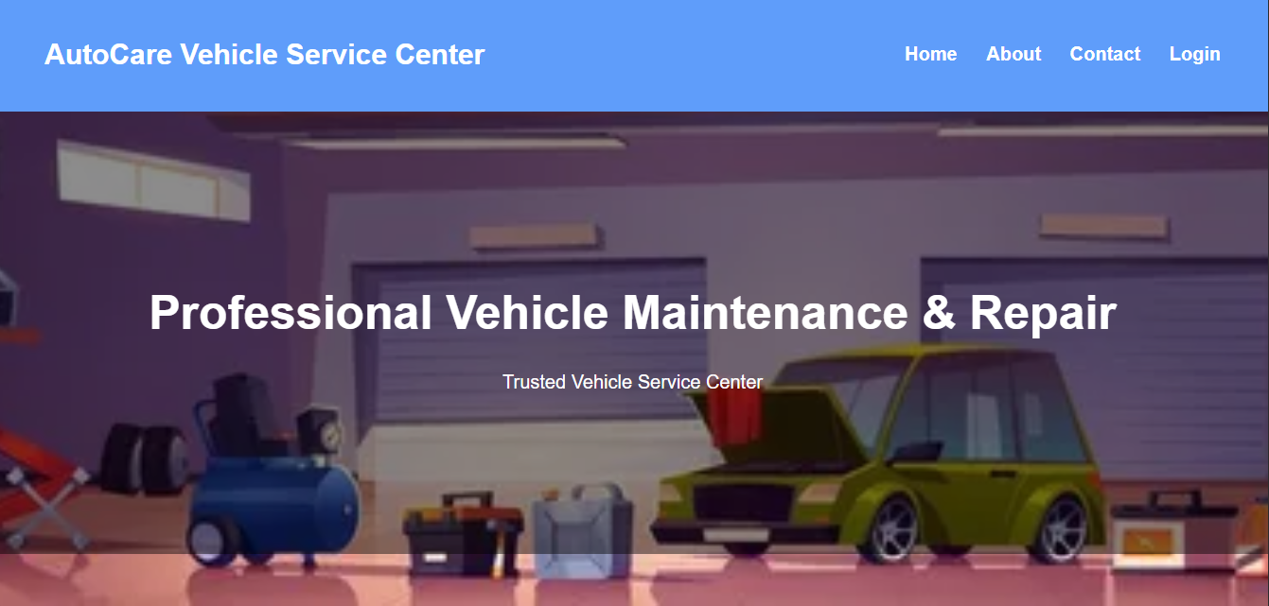

Slide 8
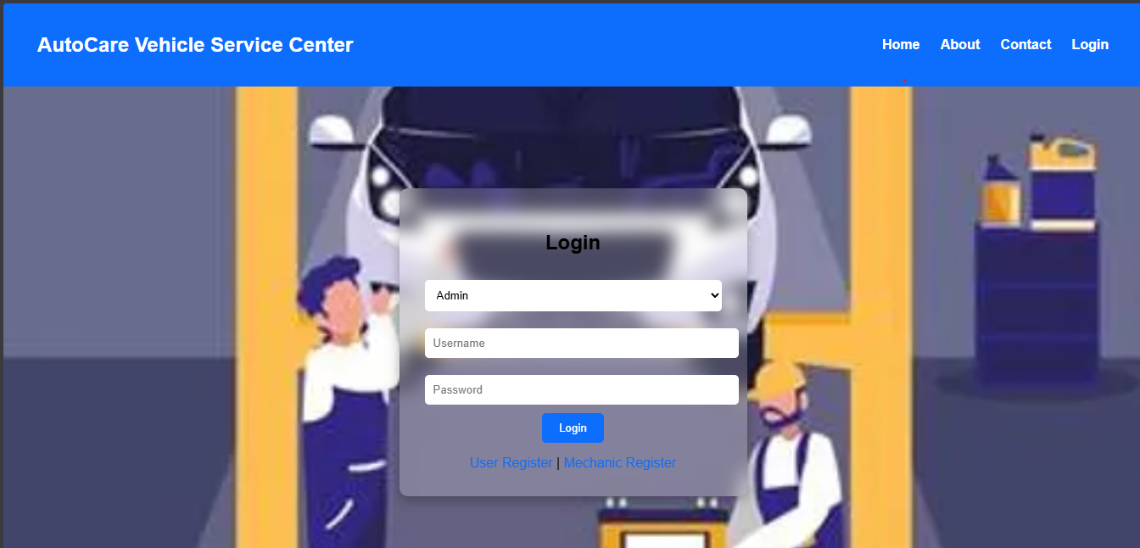

Slide 9
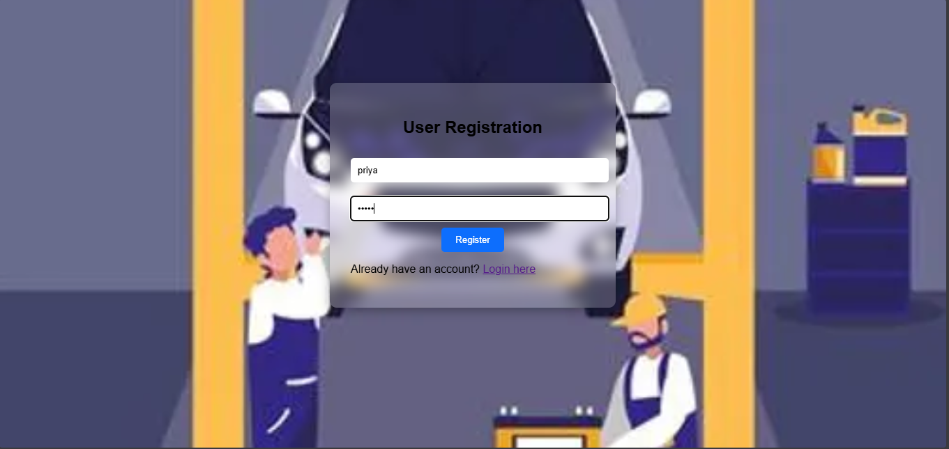

Slide 10
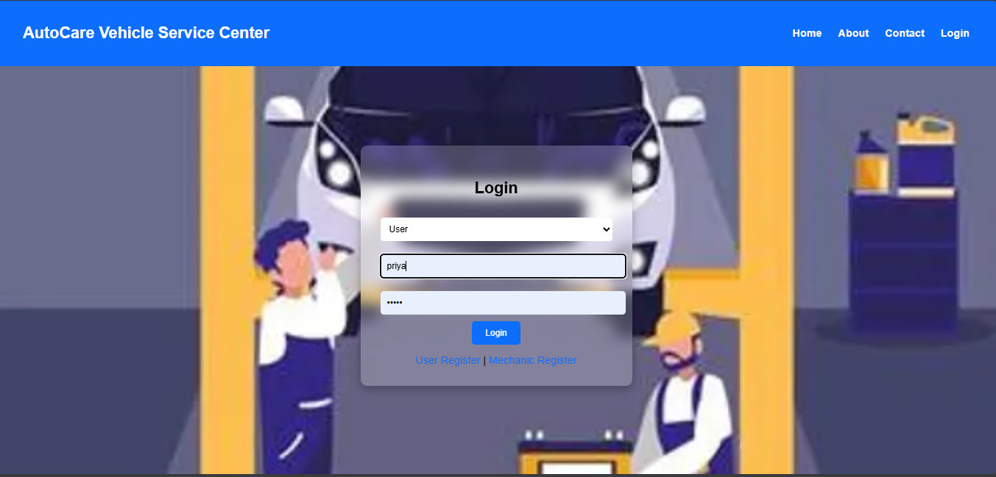

Slide 11
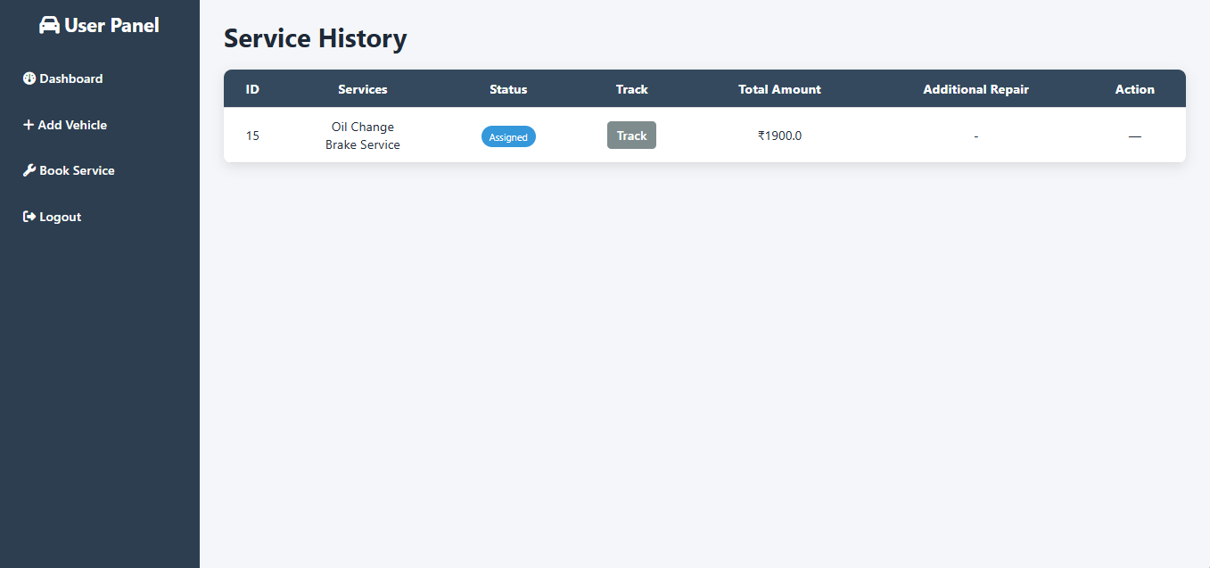

Slide 12
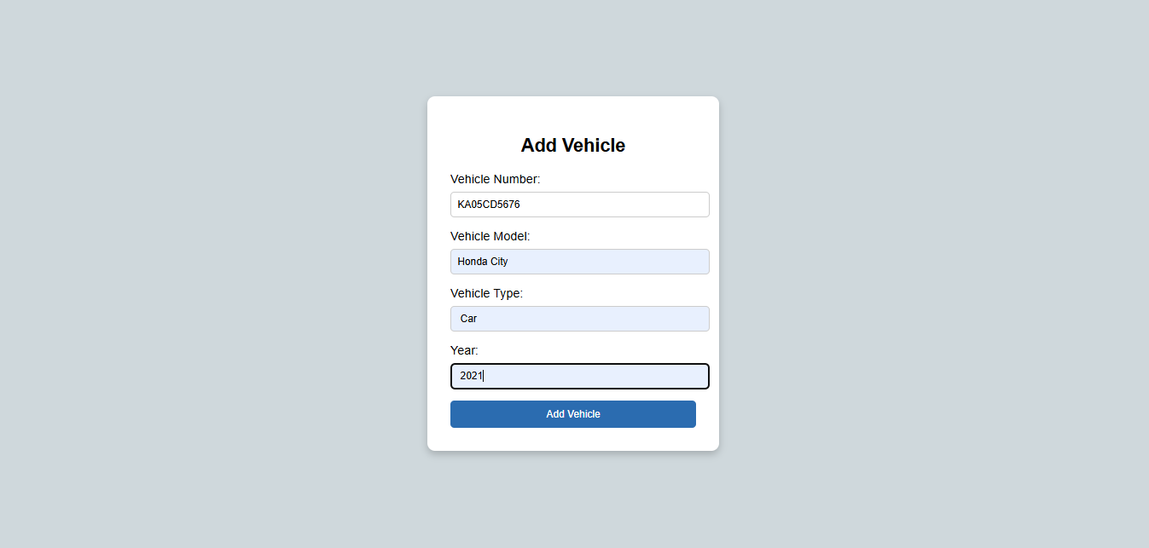

Slide 13
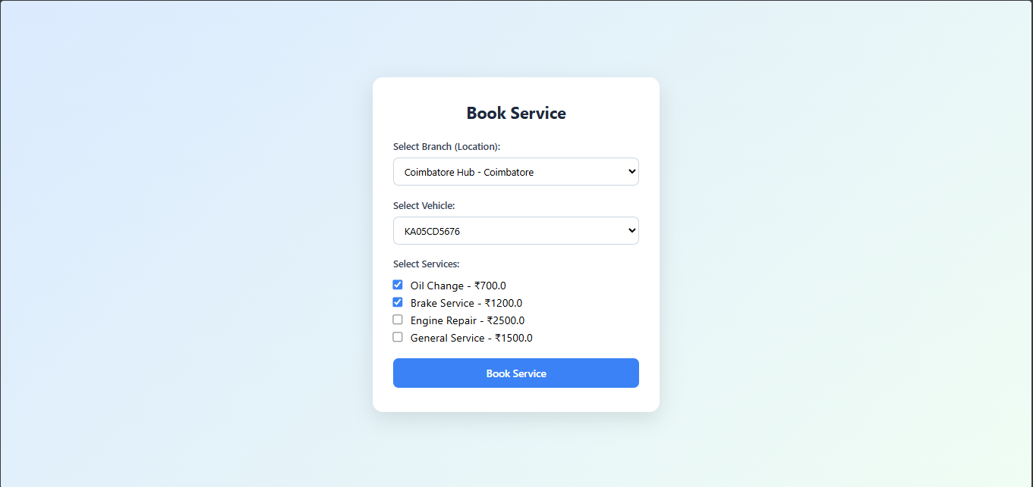

Slide 14
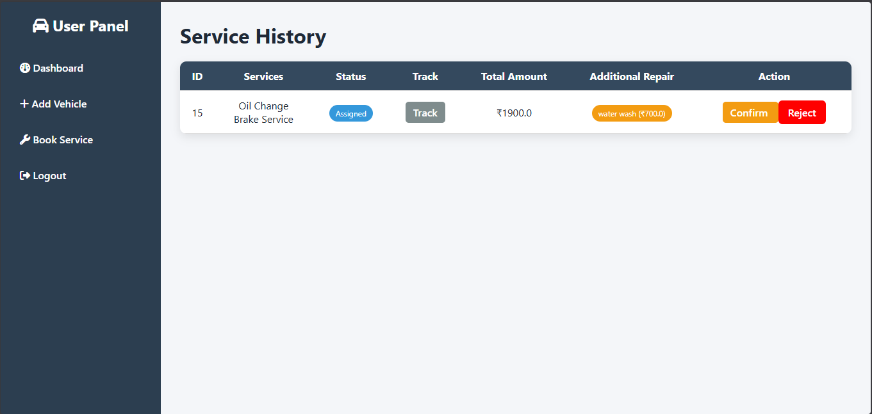

Slide 15
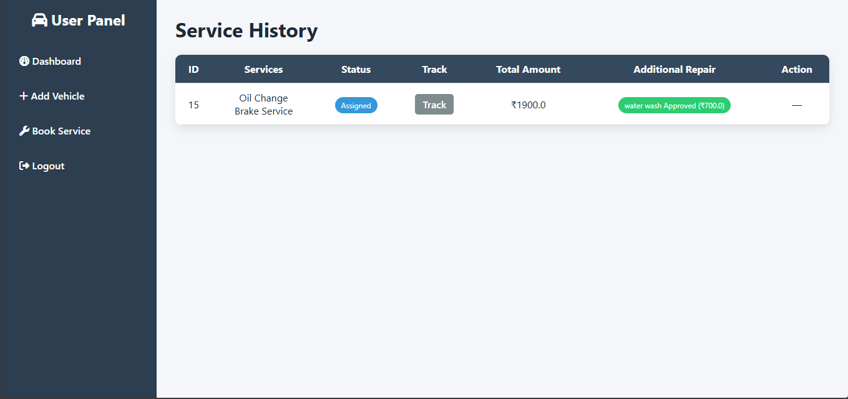

Slide 16
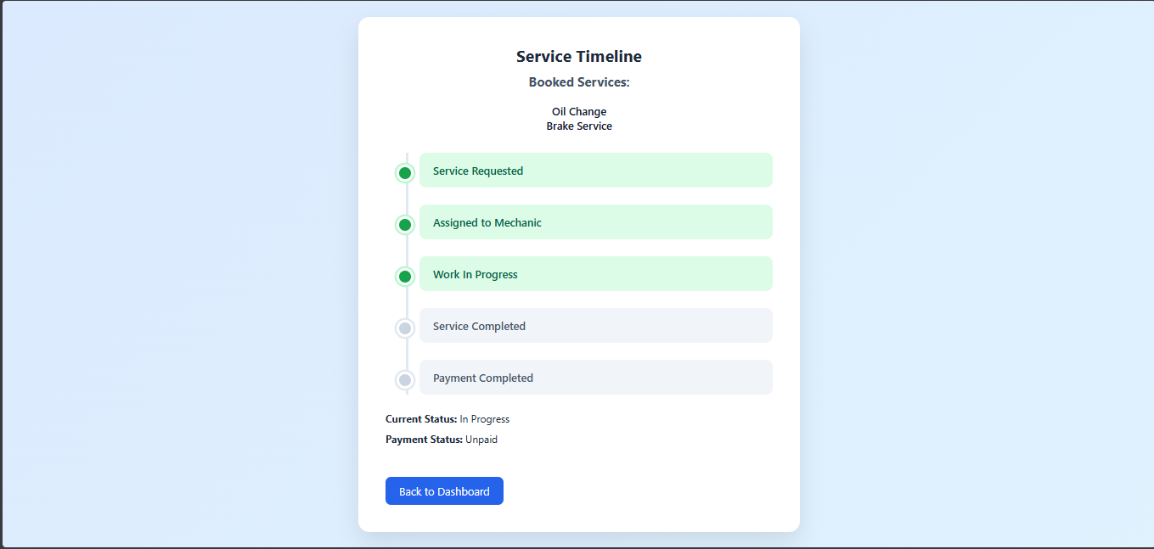

Slide 17
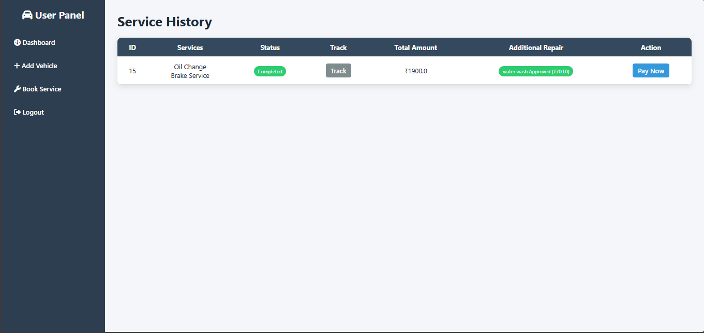

Slide 18
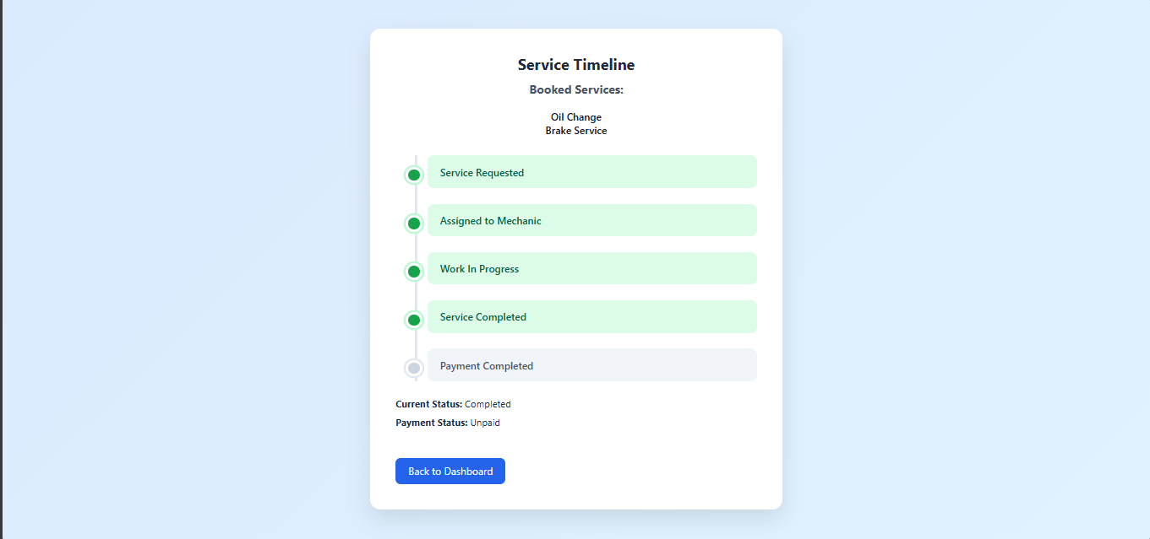

Slide 19
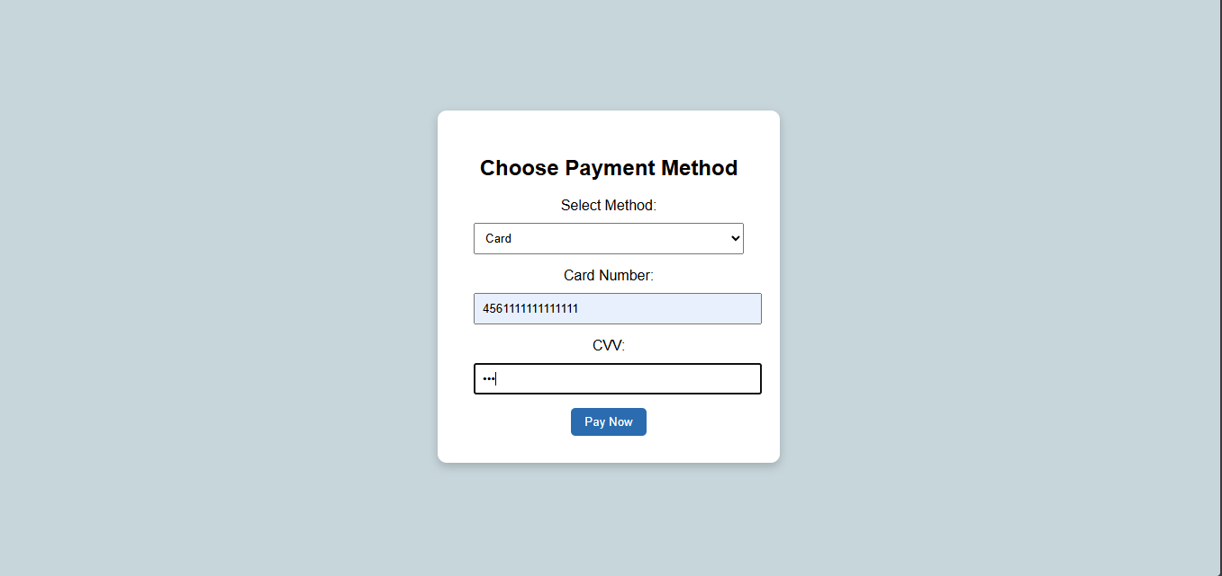

Slide 20
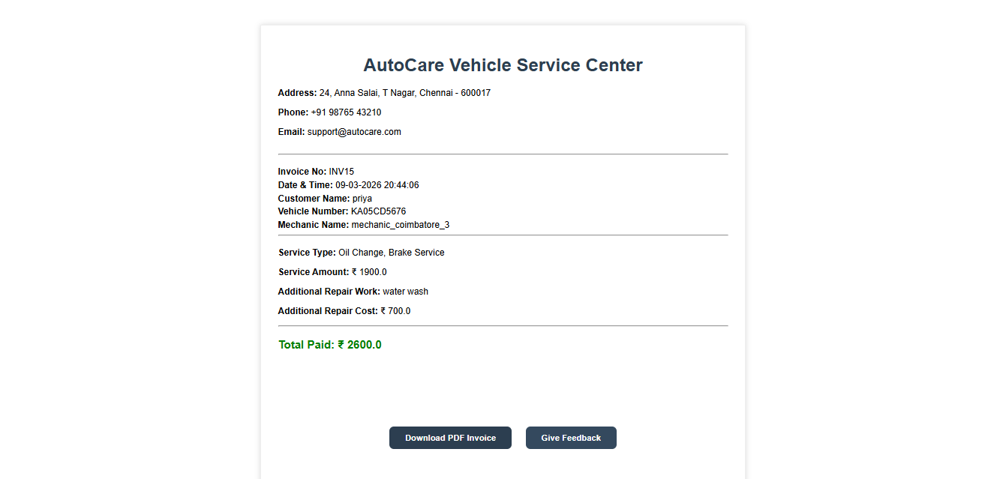

Slide 21
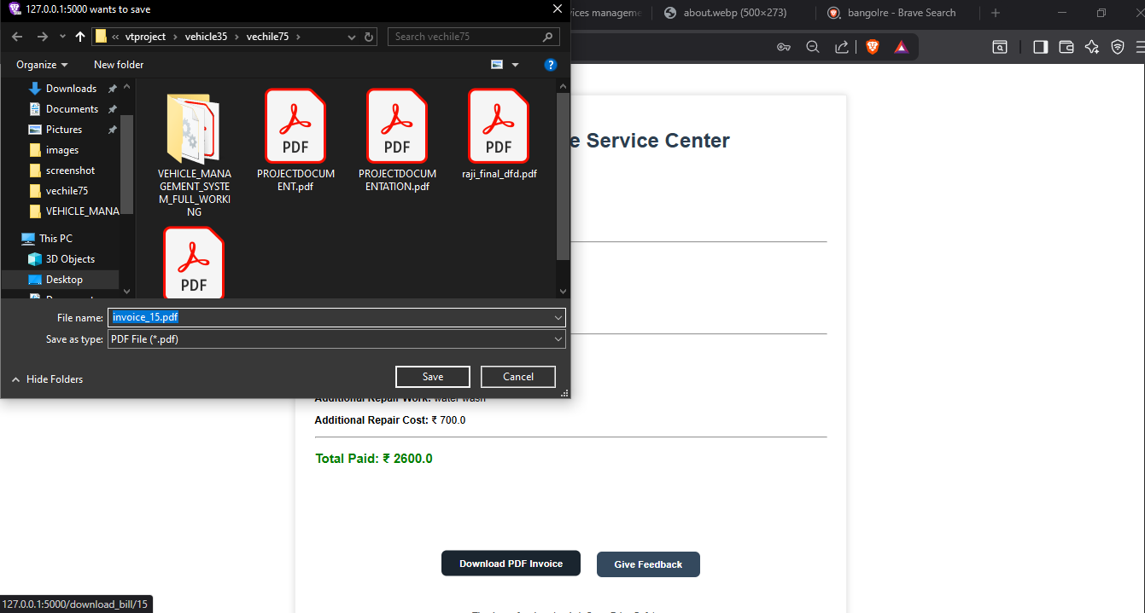

Slide 22
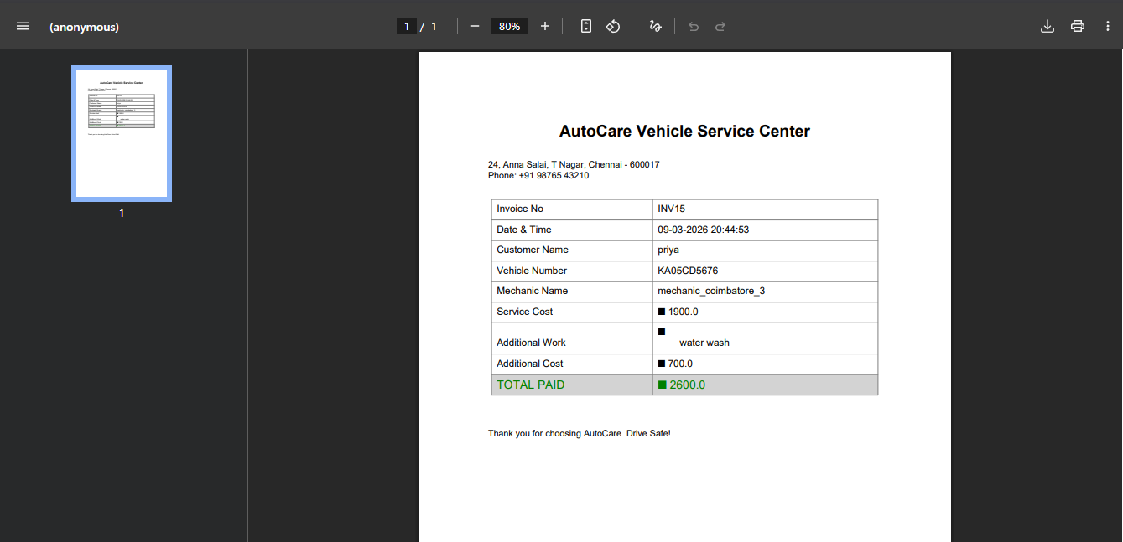

Slide 23
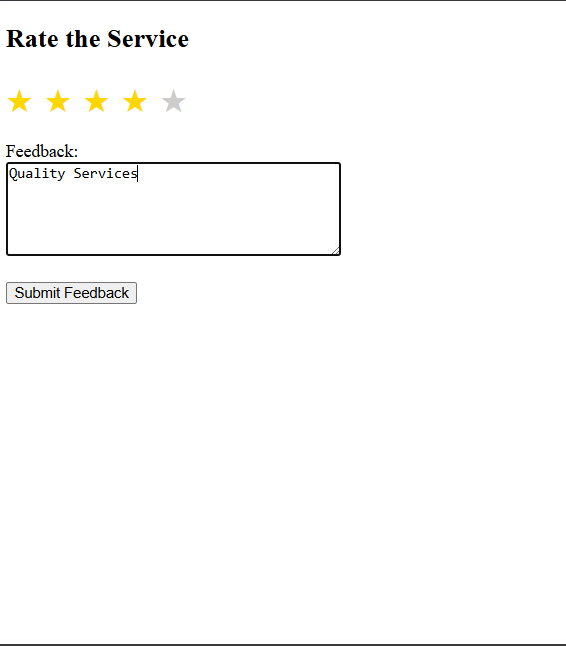

Slide 24
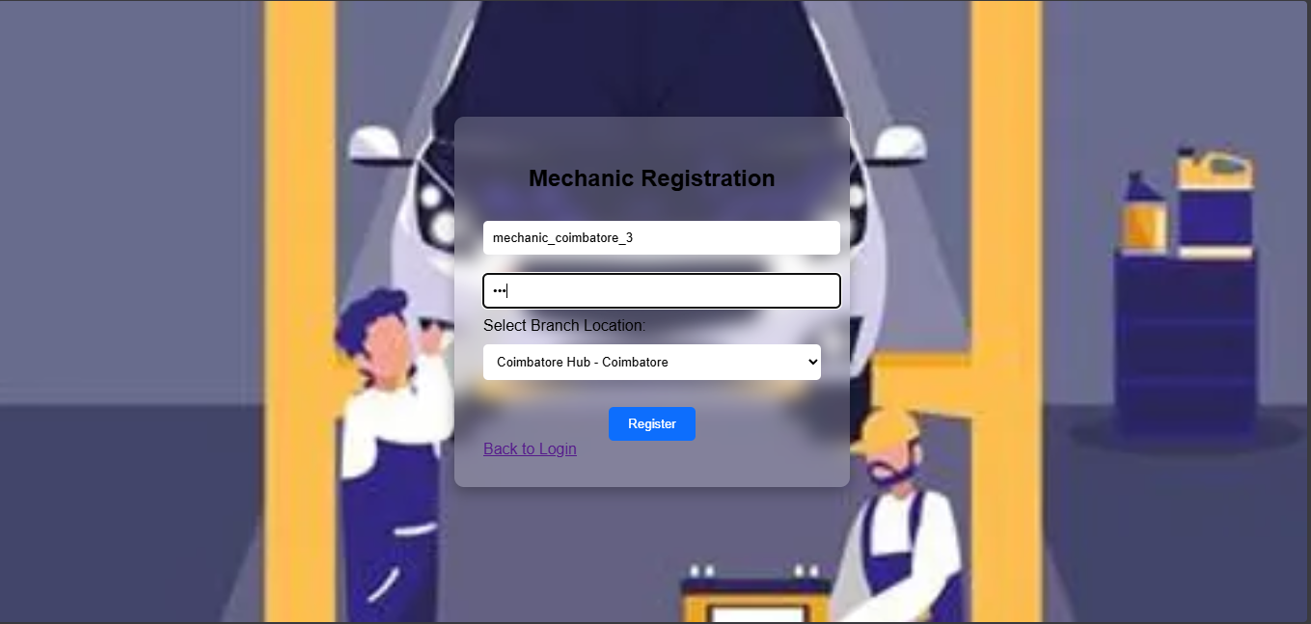

Slide 25
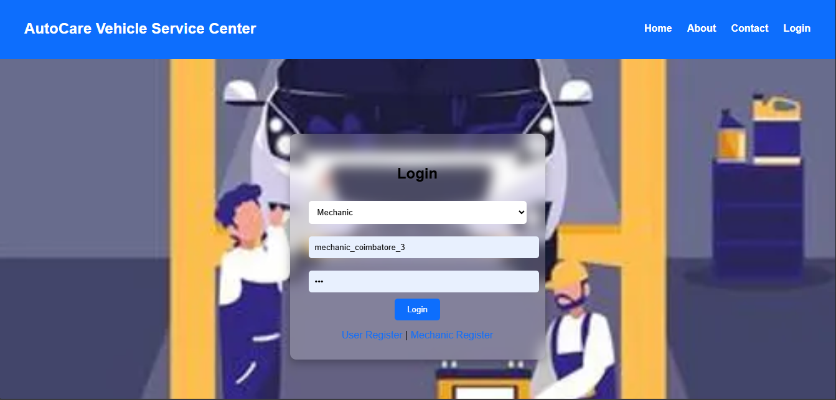

Slide 26
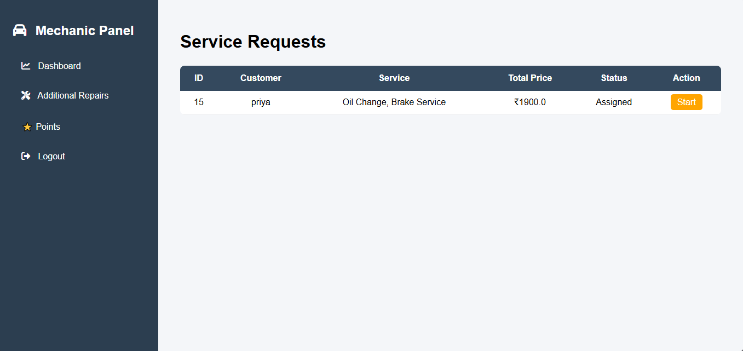

Slide 27
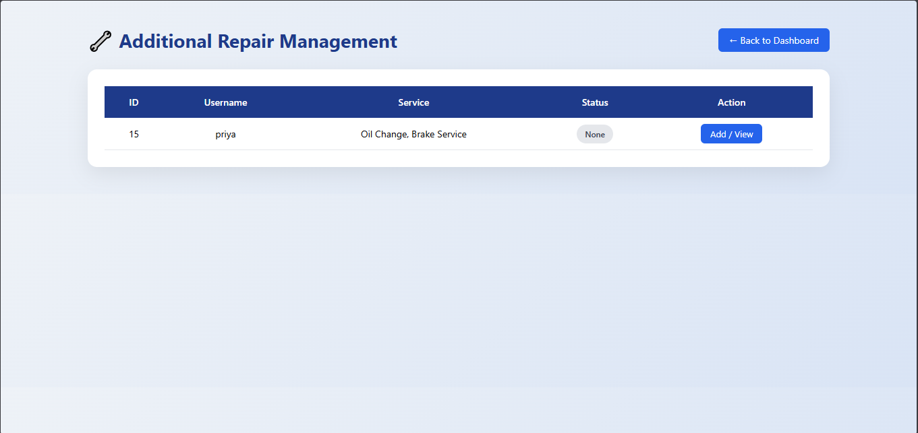

Slide 28
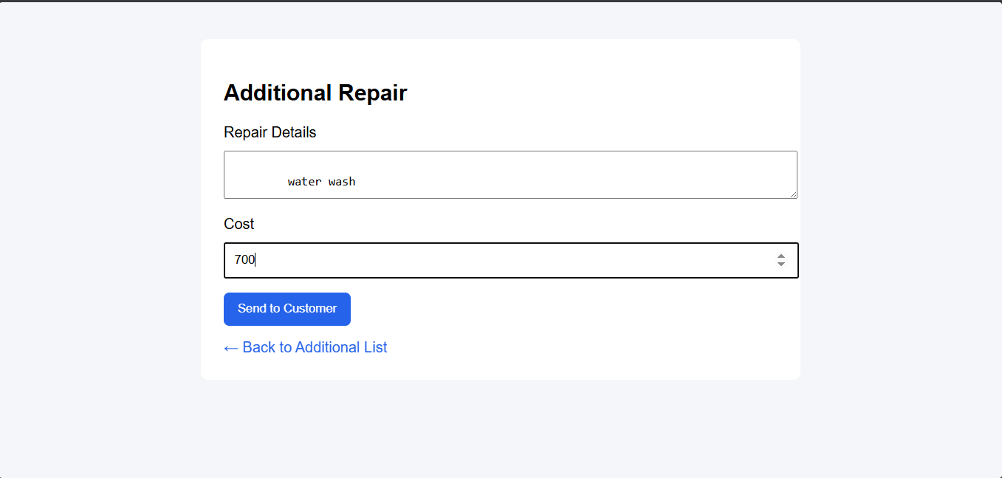

Slide 29
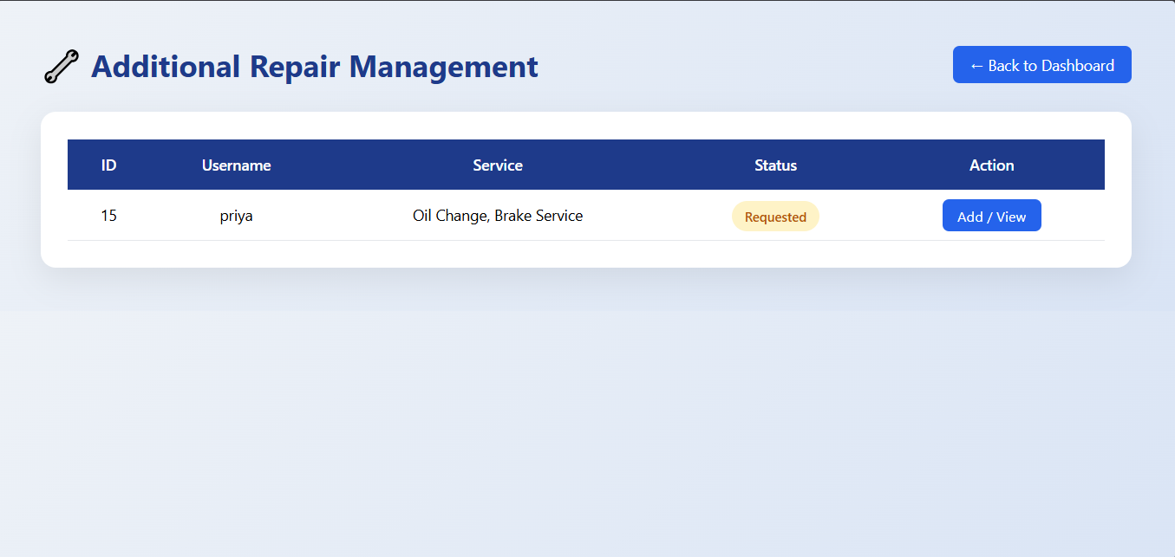

Slide 30
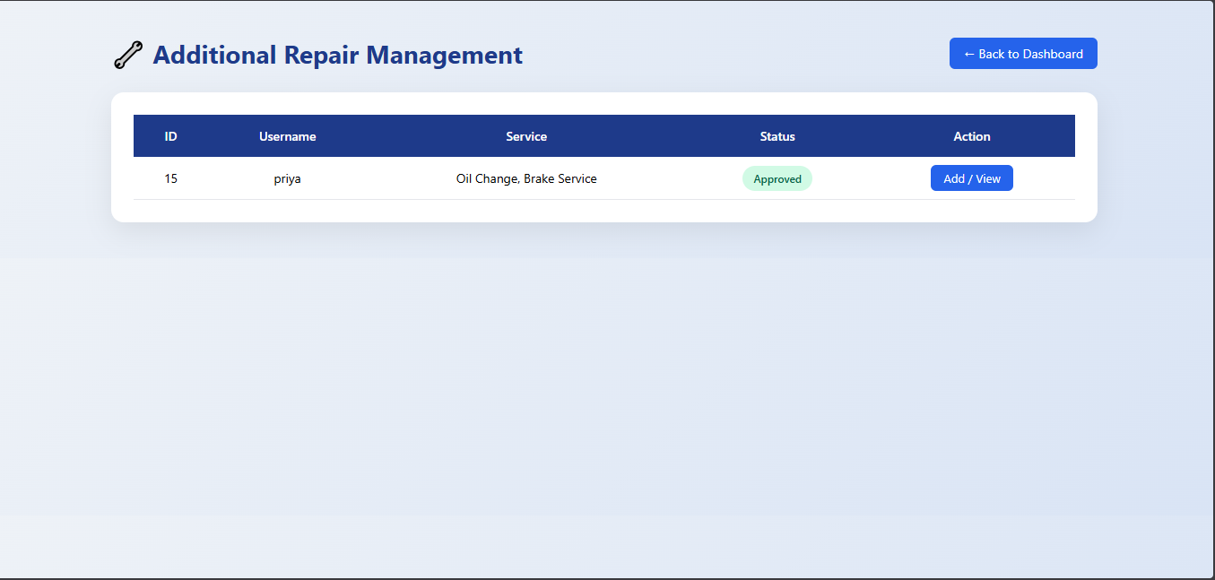

Slide 31
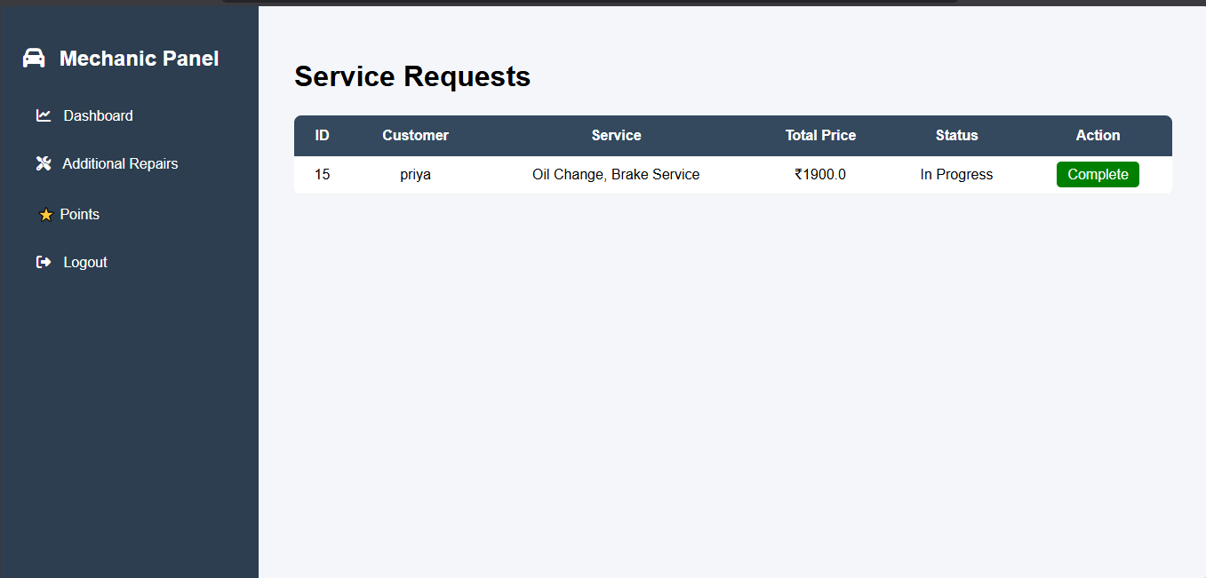

Slide 32
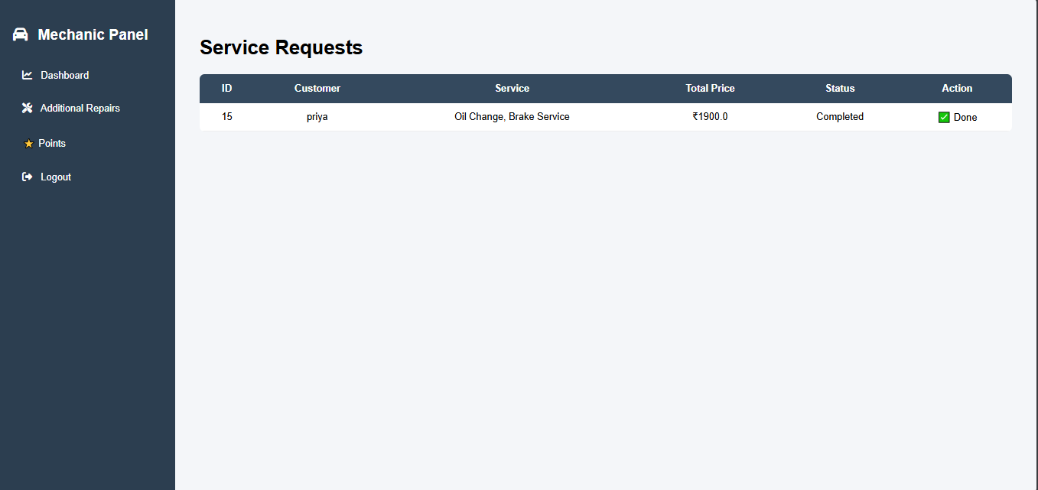

Slide 33
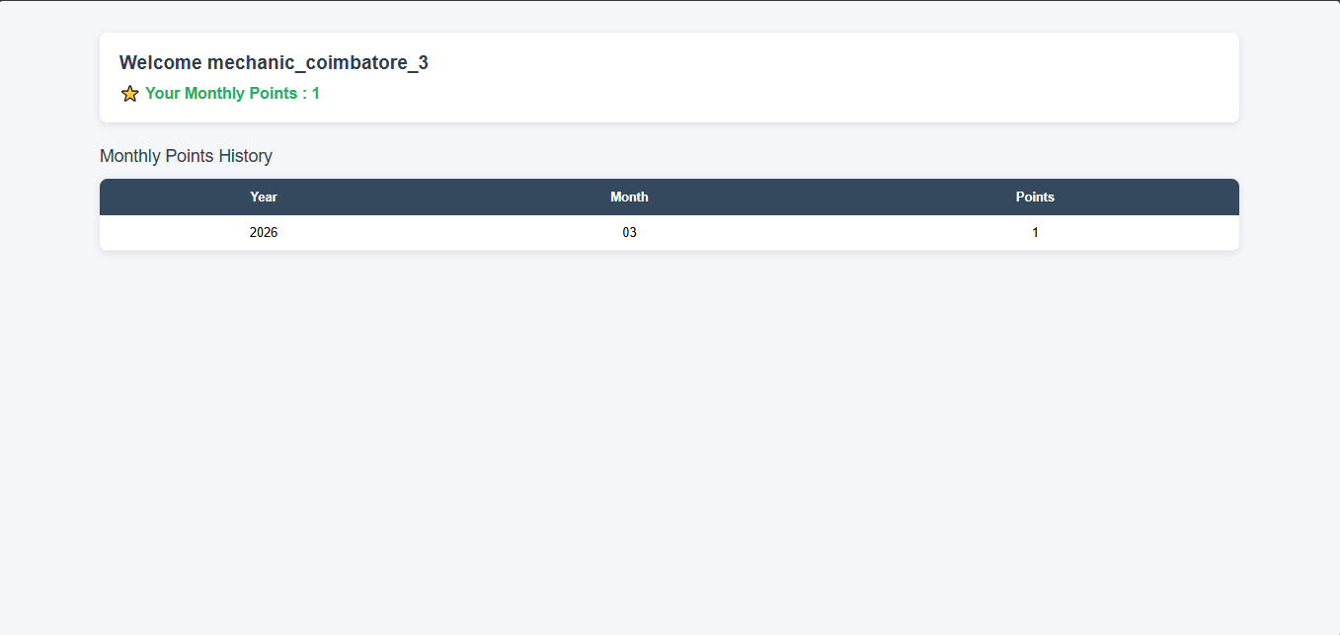

Slide 34


Slide 35
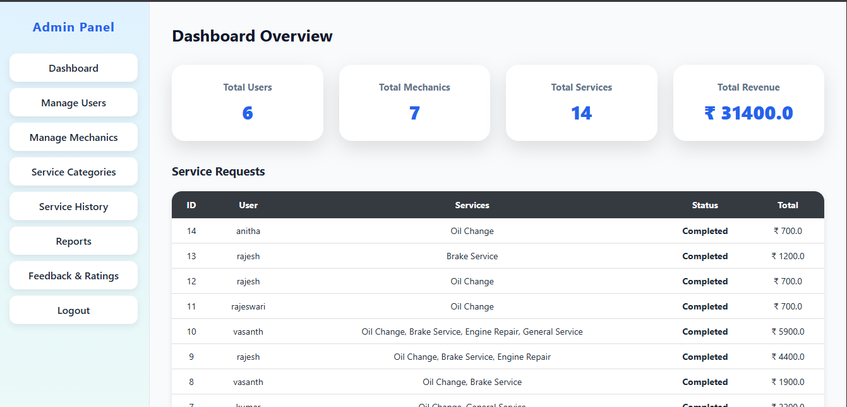

Slide 36
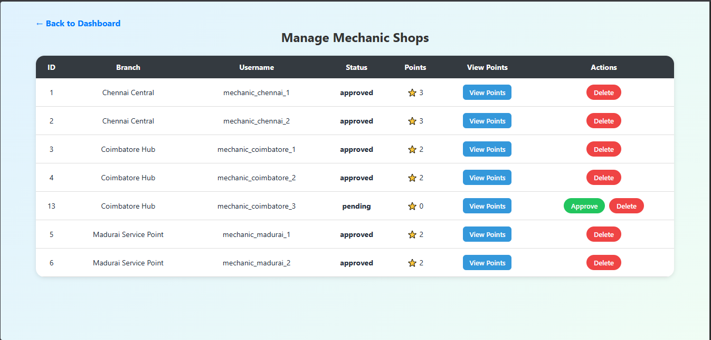

Slide 37
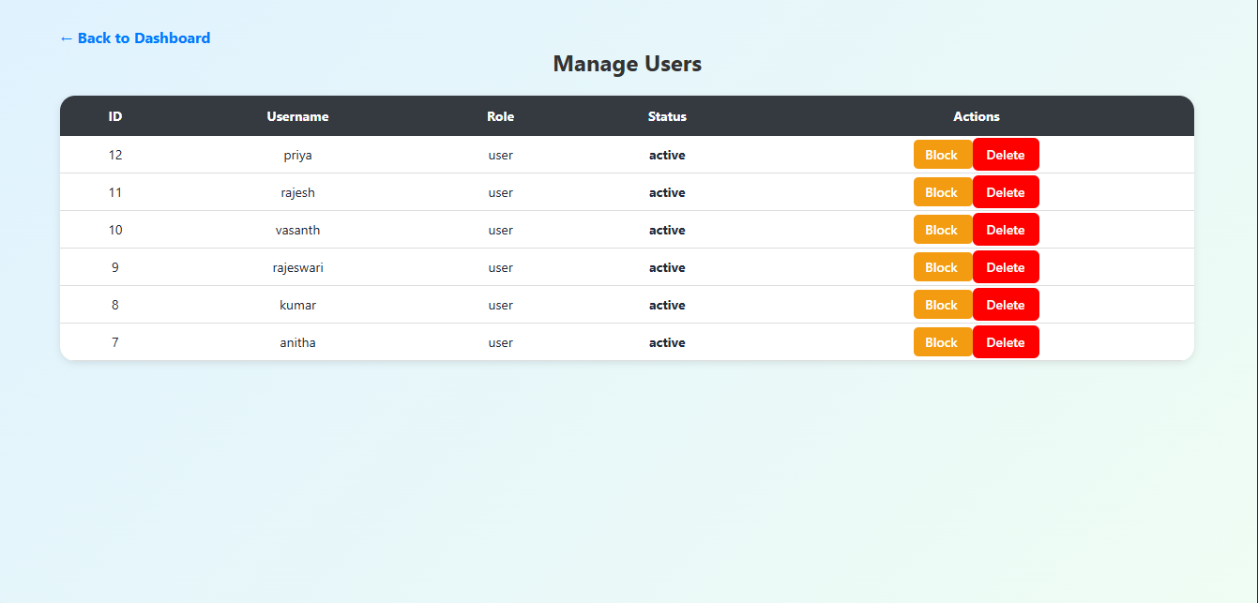

Slide 38
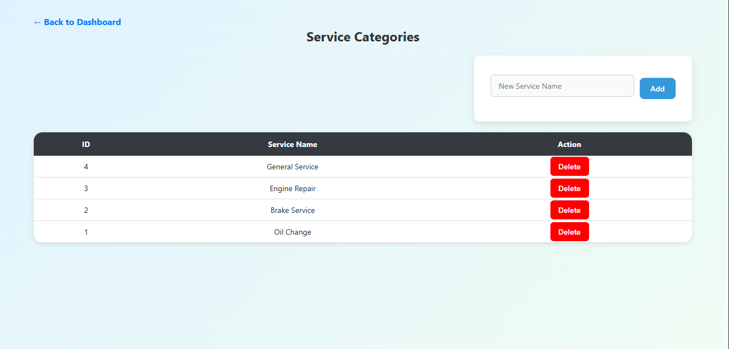

Slide 39
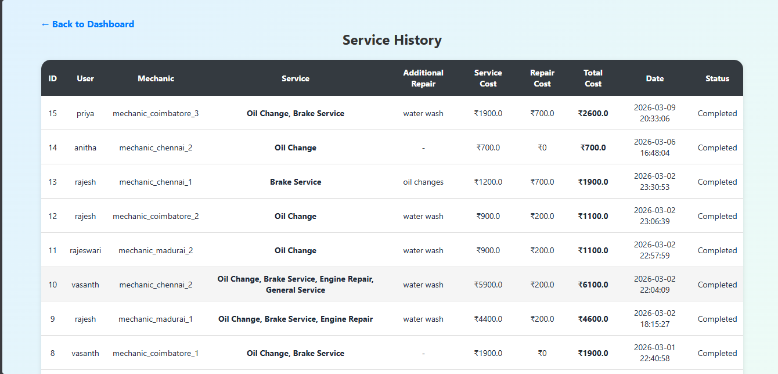

Slide 40
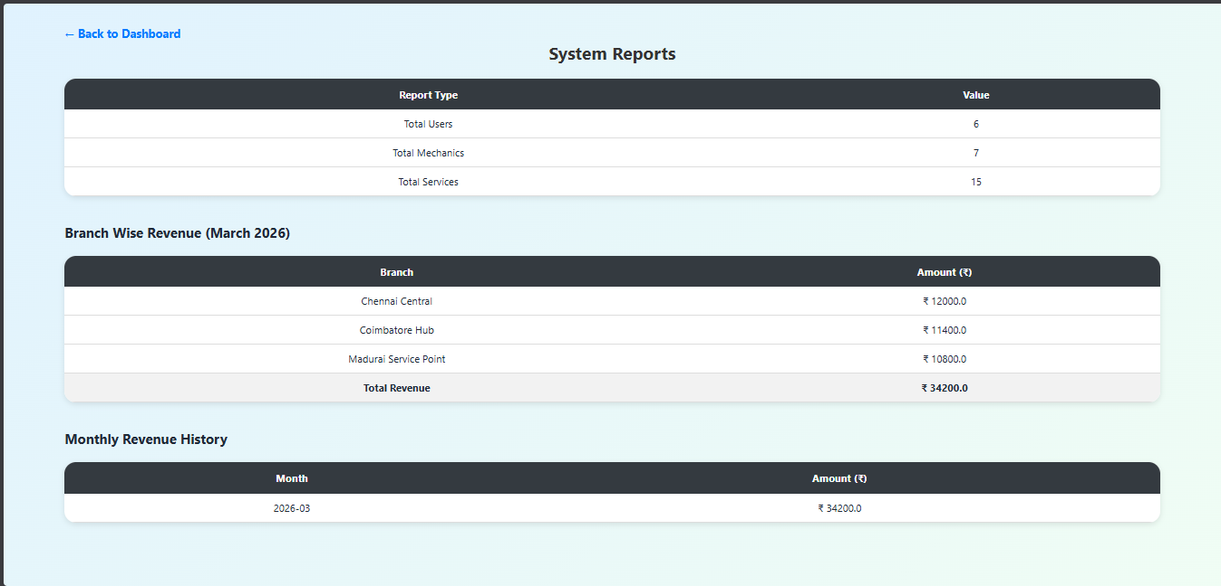

Slide 41
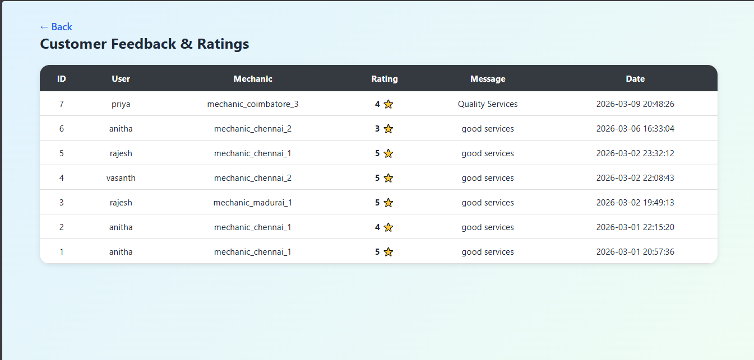

Slide 42
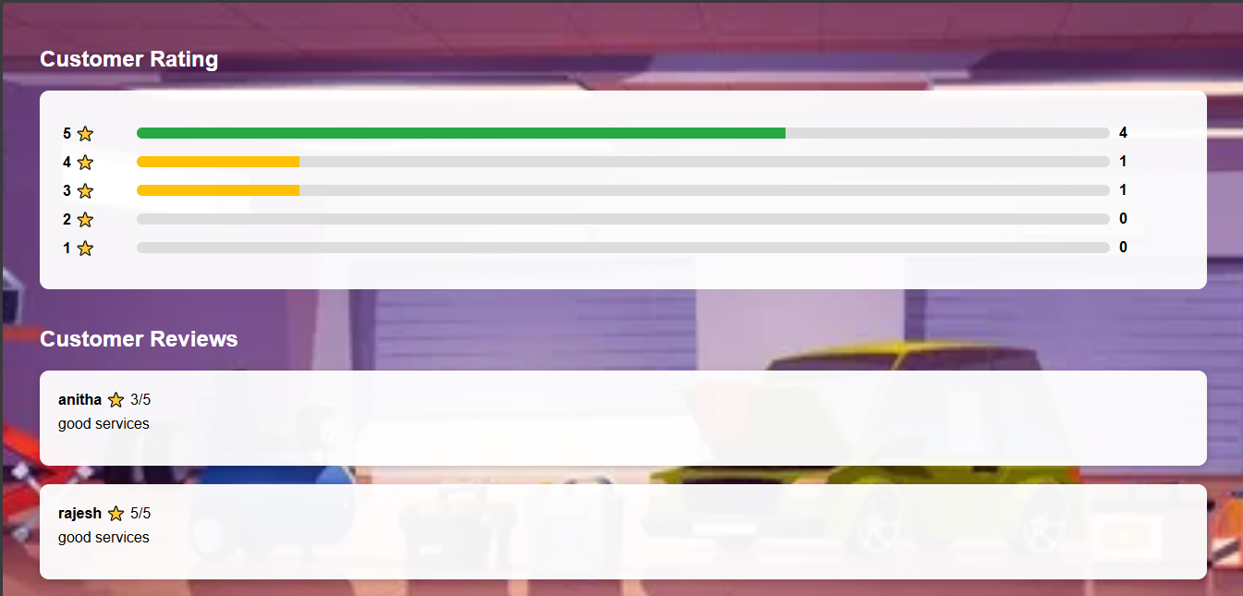

Slide 43
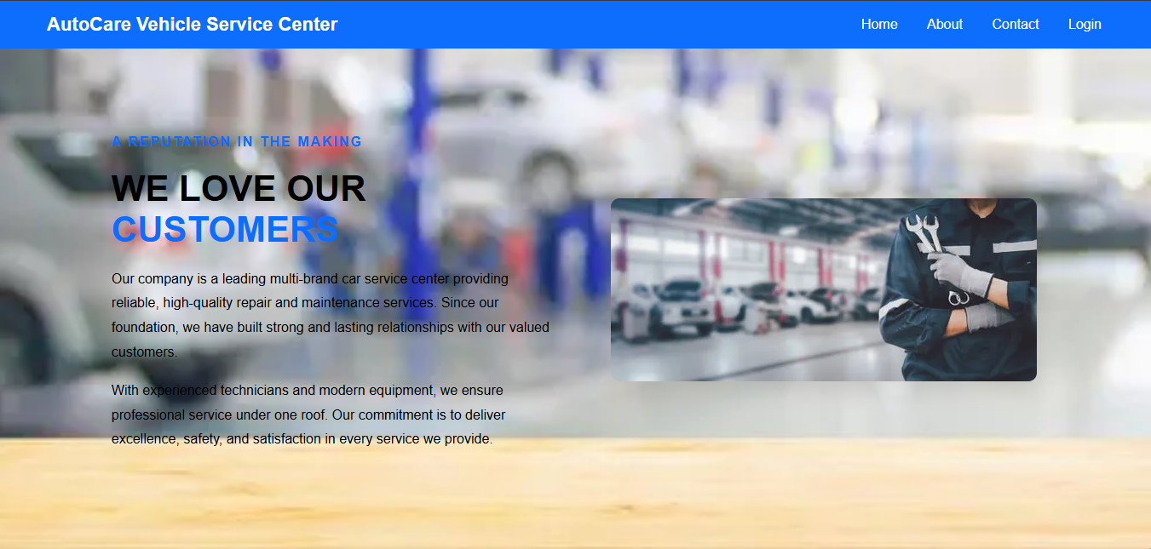

Slide 44
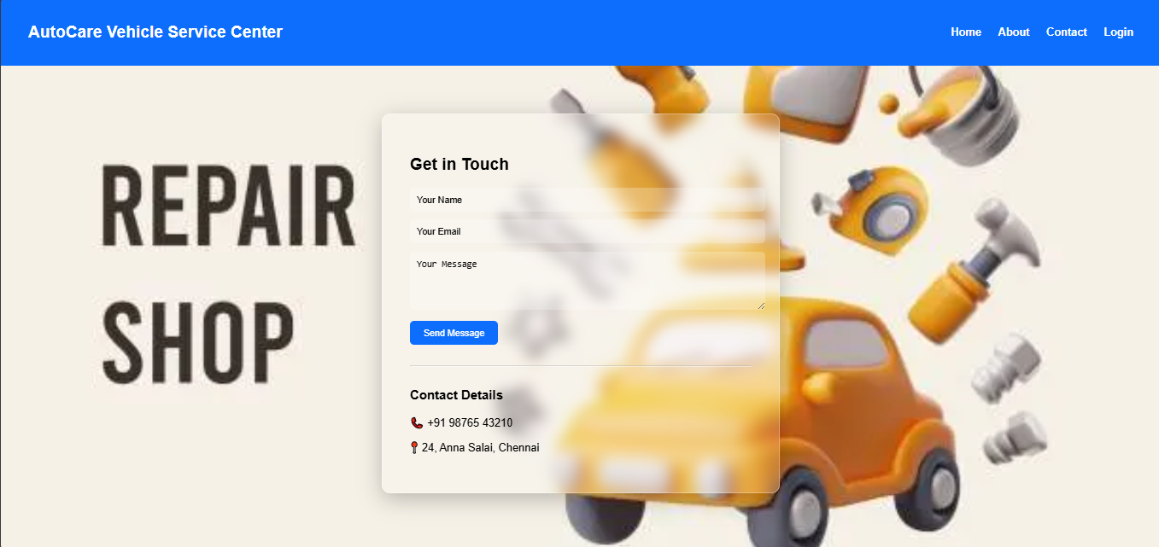

Slide 45
Future Enhancement
Development of mobile application for customers.
Implementation of automatic service reminders for vehicle maintenance.
Integration with GPS tracking for vehicle pickup and delivery.
Advanced analytics and reporting system for service centers.

Slide 46
Conclusion
The system improves vehicle service management.
Customers can easily book and track services.
It reduces manual work and improves efficiency.

Slide 47
References
Python Official Documentation – https://www.python.org
Flask Framework Documentation – https://flask.palletsprojects.com
SQLite Documentation – https://www.sqlite.org
W3Schools – https://www.w3schools.com
Stack Overflow – https://stackoverflow.com

Slide 48
THANK YOU
RAJESWARI B
MASTER OF COMPUTER APPLICATIONS

