Slide 1


DEPARTMENT OF COMPUTER SCIENCE AND ENGINEERING
20CS7503 & DESIGN PROJECT - III
END SEMESTER PRACTICAL EXAMINATION - NOV / DEC 2025
REVIEW PRESENTATION
Batch No.: 5
Date: 28/11/25
Session: FN

Slide 2
SMART PRICE OPTIMIZER USING MACHINE LEARNING
Guide Name:Mrs. SURIYA M,
Assistant Professor/ CSE
Team Members:
NIRANJINI C - 811722104102
NITHYA SREE D - 811722104105
RAJESWARI M - 811722104118

Slide 3
OBJECTIVE OF THE PROJECT
1. To maximize business revenue and profit by setting the most effective price/discount in real time.
2. To enhance customer satisfaction and retention through personalized and fair pricing strategies.
3. To develop an intelligent AI/ML model that adapts dynamically to demand, competition, and customer behavior

Slide 4
INTRODUCTION
1.Dynamic Pricing is a strategy where prices are adjusted in real time based on demand, competition, and customer behavior
2. It is widely used in industries like e-commerce, airlines, ride-hailing, and food delivery to balance profit and customer satisfaction.
3. Traditional pricing models are mostly static or rule-based, which often fail to capture changing market conditions and individual customer needs.
4. With advancements in AI and Machine Learning, businesses can now design intelligent, adaptive pricing systems that learn and optimize continuously
5. It aims to build a personalized, ML-powered pricing and offer optimization system that ensures both revenue growth and improved customer experience

Slide 5
LITERATURE SURVEY
TITLE OF PAPER | AUTHOR(S) | PUBLISHER | TECHNOLOGY USED
Dynamic Pricing and Learning with Strategic Customers | Santiago Balseiro, Omar Besbes | Management Science (INFORMS), 2016 | Reinforcement Learning, Game Theory
Reinforcement Learning in Dynamic Pricing Models for E-Commerce | Dip Bharatbhai Patel | The Es Economics and Entrepreneurship (journal) 2022 | Reinforcement Learning, Review of RL methods
Scalable Reinforcement Learning Approaches for Dynamic Pricing in Ride-Hailing Systems | Zengxiang Lei, Satish V. Ukkusuri | Transportation Research Part B (Elsevier, 2023) | Off-policy RL (TD3), scalable RL for large networks
Dynamic Pricing in High-Speed Railways Using Multi-Agent RL | E. A. Villarrubia-Martín, L. Rodriguez-Benítez, et al. | arXiv (2025) | Multi-Agent RL, Markov Game, Utility modeling for railway pricing

Slide 6
TITLE OF PAPER | AUTHORS | PUBLISHER | TECHNOLOGY USED
Dynamic Pricing & Ordering with Strategic Customers | Parisa Famil Alamdar, Abbas Seifi | ScienceDirect (2024) | Deep Q-learning, DNN demand modeling, dynamic pricing + ordering decisions
Dynamic Pricing & Inventory for Omni-channel Retail | Shiyu Liu, Jun Wang, Rui Wang, et al. | ScienceDirect (2023–24) | Deep RL (PPO), LSTM for high-dimensional POMDP modeling
A Primal–Dual Learning Algorithm for Personalized Dynamic Pricing with an Inventory Constraint | Ningyuan Chen & Guillermo Gallego | Mathematics of Operations Research (2021-2023) | Primal–dual learning, personalized dynamic pricing, inventory constraints

Slide 7







EXISTING SYSTEM ARCHITECTURE
Product
Cart
User
Database
Coupon
Payment

Slide 8
PROBLEM IDENTIFICAITON
1. Most existing e-commerce platforms use general discount schemes for all users, ignoring loyalty level and purchase behavior, which leads to poor customer engagement.
2. Businesses often provide uniform or excessive discounts without analyzing customer loyalty, causing revenue loss and reduced profit margins.
3. Pricing and discount decisions are often made manually, which is slow, inconsistent, and prone to human error, especially when handling large customer datasets.
4.Traditional systems do not adjust offers or discounts in real time based on changing market demand, user behavior, or loyalty score updates.

Slide 9
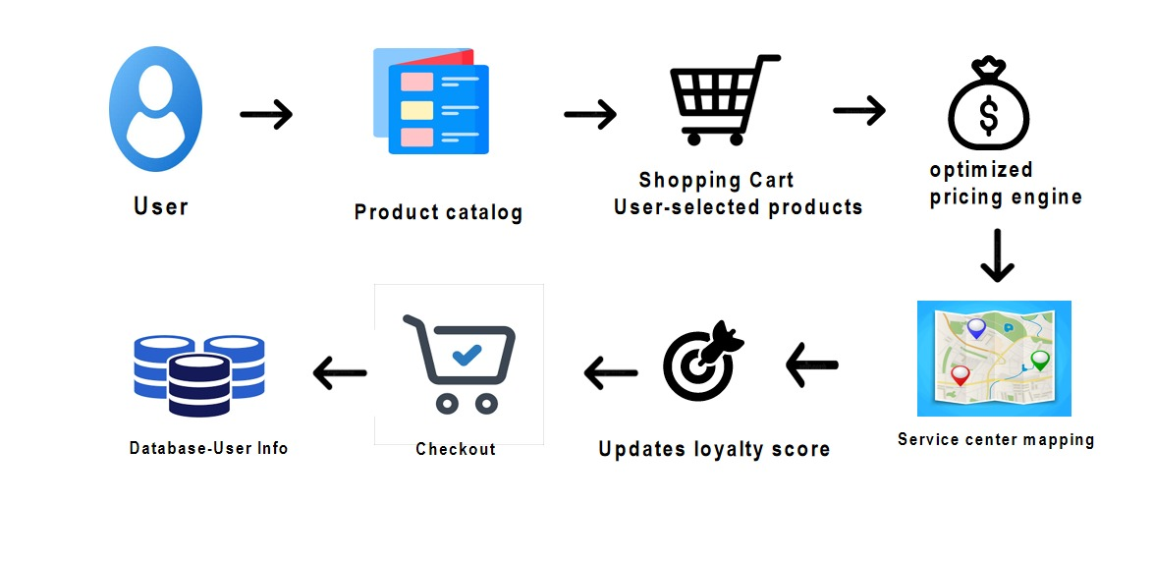
PROPOSED SYSTEM ARCHITECTURE

Slide 10
SOFTWARE AND HARDWARE REQUIREMENTS
HARDWARE
1. Processor: Intel i3 or above
2. RAM: 4 GB (minimum)
3. Storage: 250 GB HDD
SOFTWARE
1.Operating System: Windows10/11, Linux
2.Programming Language: Python (for ml models)
3.Database: MySQL
4.Frontend:HTML,CSS,JavaScript.
5.Backend:Python Flask
6.IDE/Tool: VS Code

Slide 11
MODULES
1. User Management Module
2. Product Management Module
3. Auto Negotiation Module
4. Service center mapping Module
5. Cart & Checkout Module

Slide 12
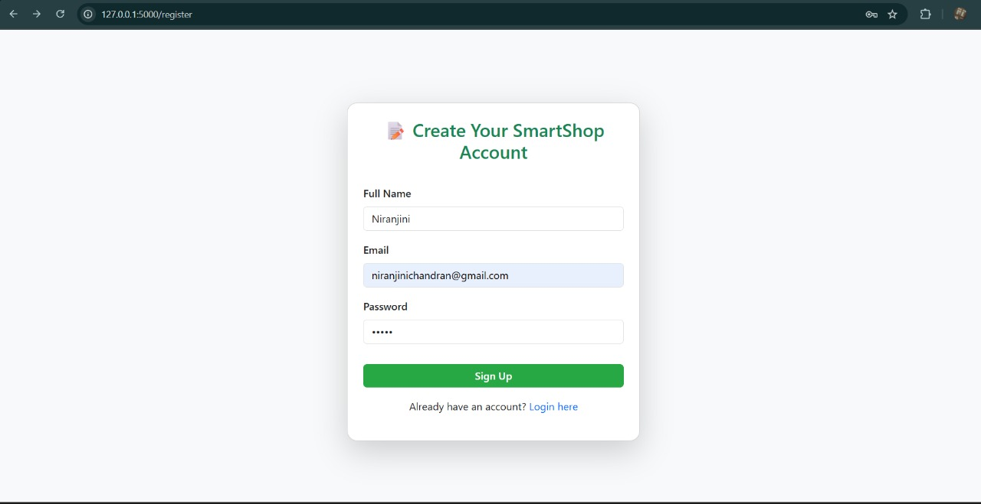
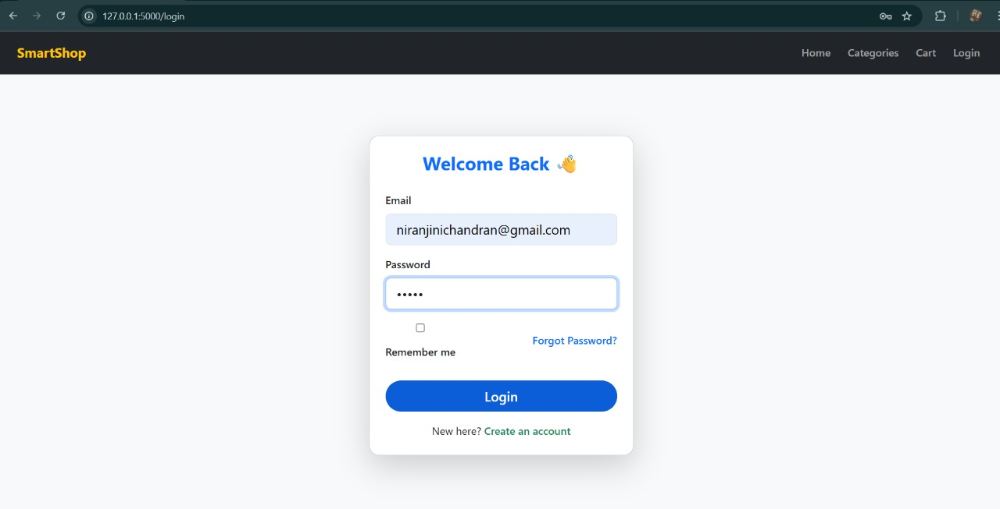
IMPLEMENTATION OF MODULE-1
Registration page
Login page

Slide 13
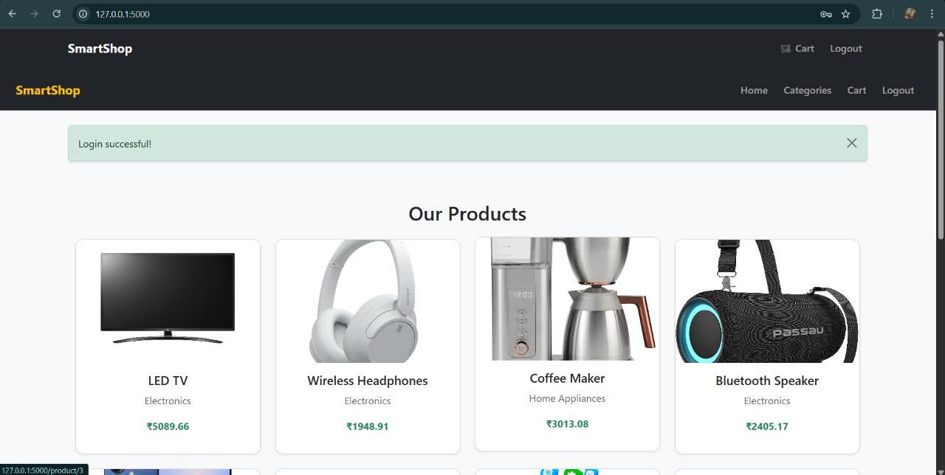
IMPLEMENTATION OF MODULE-2
Product management page

Slide 14
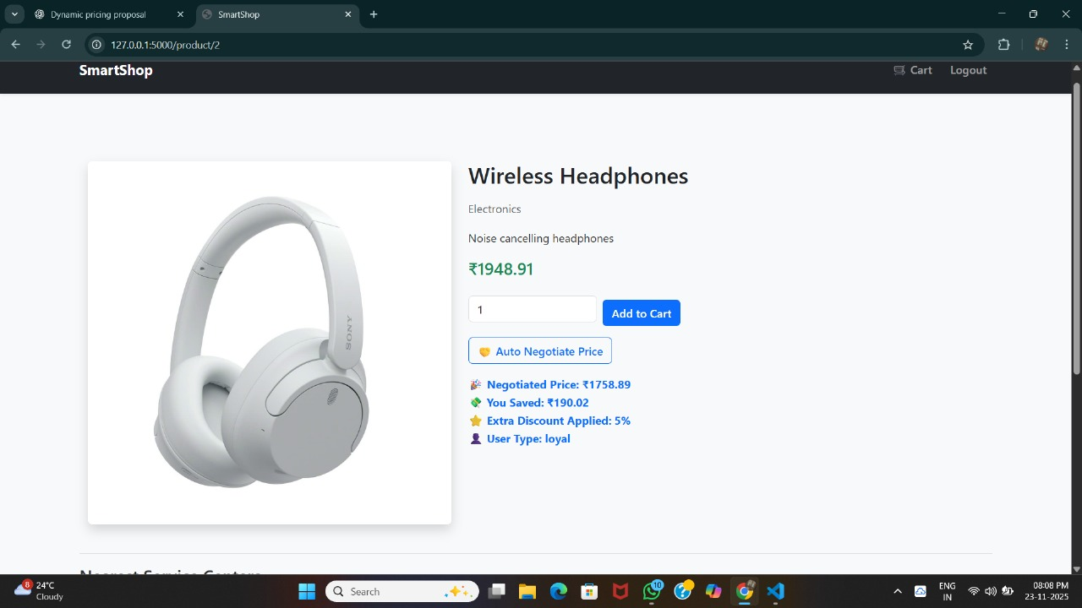
IMPLEMENTATION OF MODULE-3
Auto negotiation

Slide 15
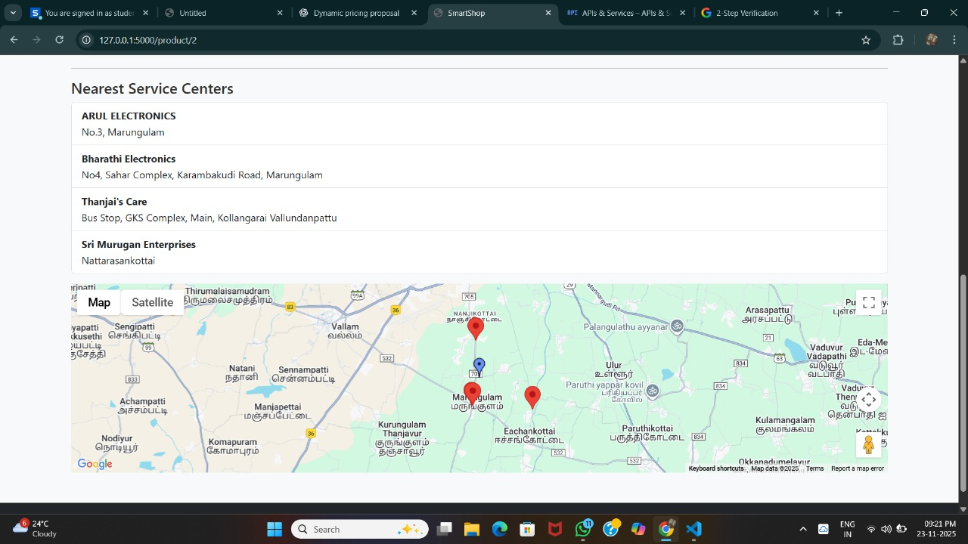
IMPLEMENTATION OF MODULE-4
Service center mapping

Slide 16
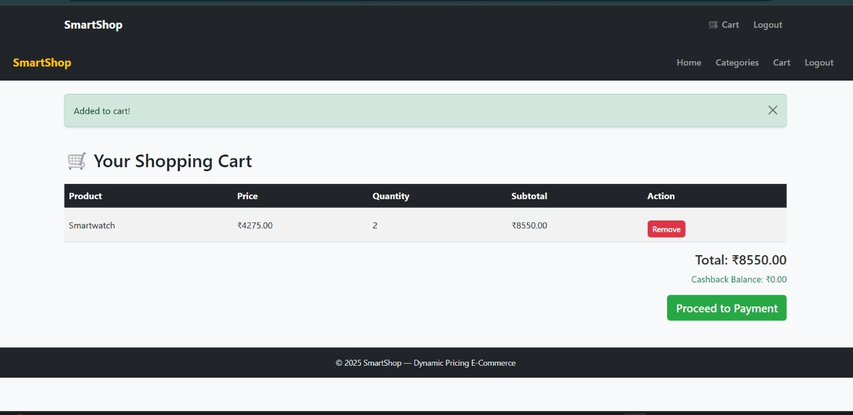
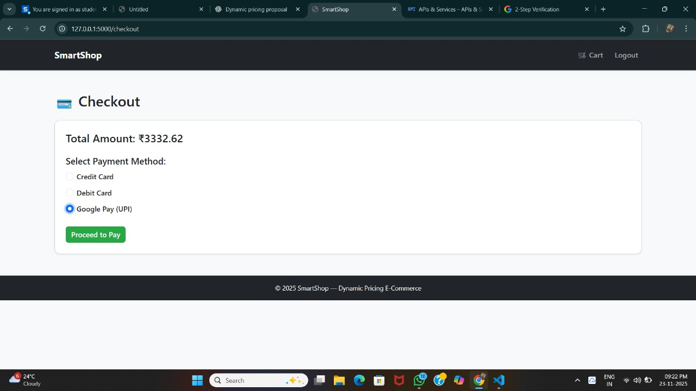
IMPLEMENTATION OF MODULE-5
Cart management page

Slide 17
CONCLUSION
1. The Dynamic Pricing & Offer Optimization system provides a smart, AI-driven approach to overcome the limitations of traditional static or rule-based pricing. By integrating real-time data, customer behavior, and predictive models, the system is able to generate personalized and adaptive pricing strategies.
2. This ensures that businesses can maximize revenue, maintain competitive advantage, and enhance customer satisfaction.

Slide 18
FUTURE ENHANCEMENTS
1. Provide eco-friendly discounts e.g., lower prices for customers choosing sustainable or low-carbon-footprint products ,combining pricing with environmental awareness.
2. ML model predicts which customers are likely to leave or stop purchasing soon and automatically sends targeted offers to retain them.

