Slide 1
Micronaut
07 – Http Client

Slide 2
Agenda
Low Level Http Client
Http Client Configuration
Declarative Http Client
Http Client Filter
Http/2 Support

Slide 3
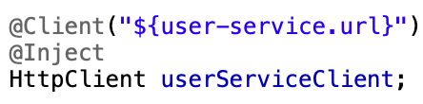
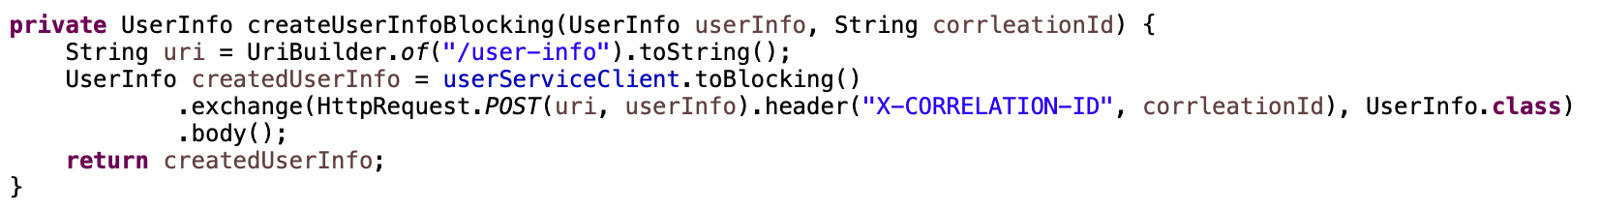
Low Level Http Client
This is ‘Generic’ Http Client which provides more control on Http request invocation
By default the Http Client is non-blocking
Defining Http Client
Making Http Request

Slide 4
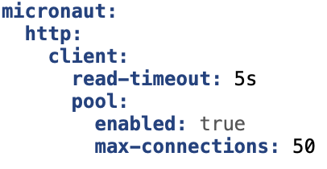
Http Client Configuration
Http client target endpoint can be bound from configuration properties
Global or client specific configurations include
read-timeout
Connection pool configuration etc.

Slide 5
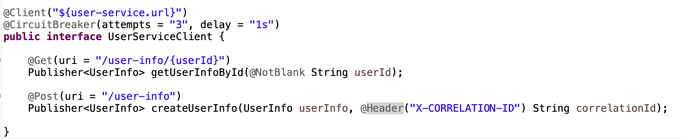
Declarative Http Client
This is strongly typed Http client with annotated methods
Note: every method in the client is non-blocking
Method arguments can be specified to be bound to specific request parameters like path param, header etc.

Slide 6
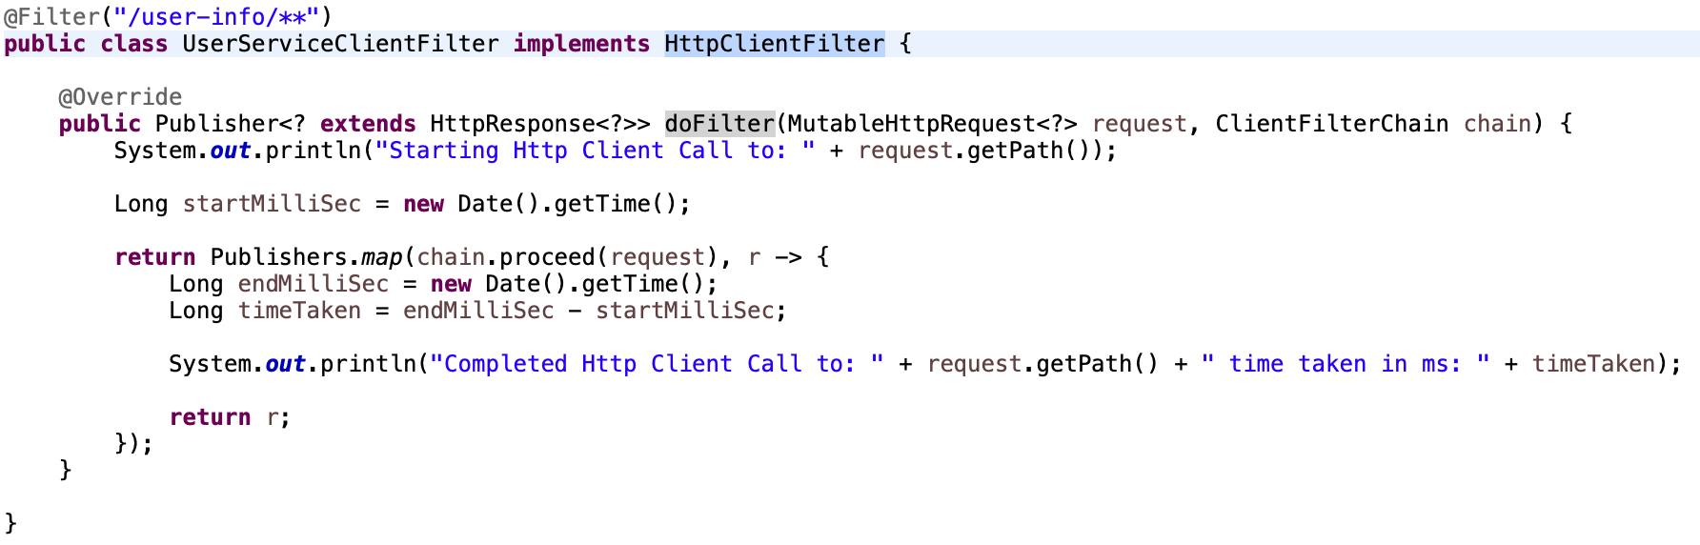
Http Client Filter
Http Client Filter intercepts Http Requests made by clients
Like Http Server Filter, it can decorate request and inspect response
Typically used for implementing cross cutting concerns
Needs to implement HttpClientFilter interface

Slide 7
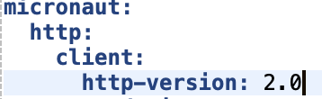
Http/2 Support
By default Http Client is configured for Http 1.1
Http/2 can be enabled
via configuration
via annotation value
Note: Target Http Server must support Http/2 in order for the client to use Http/2

Slide 8
Thank You

