Slide 1
Micronaut
12 – Unit & Integration Test

Slide 2
Agenda
Embedded Server & Application
Junit 5 Support
Mocking with Mockito
RestAssured Support
Testing with Spock
TestContainer Overview
Testing with TestContainer

Slide 3
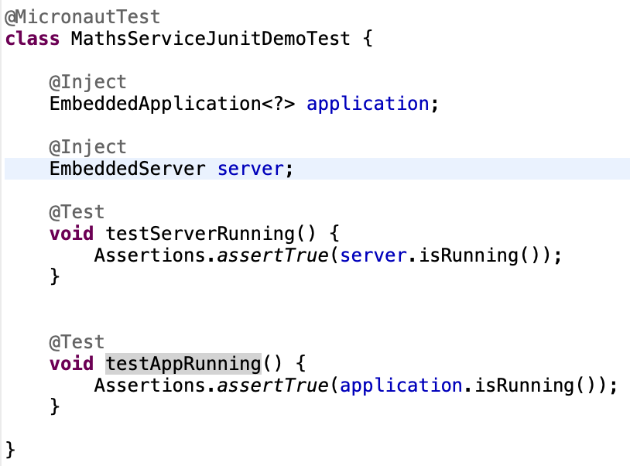
Embedder Server & Application
@MicronautTest annotation can be applied to any Junit Test to run it as Micronaut Test
One can inject Micronaut Embedder Server and Application in Micronaut Tests

Slide 4
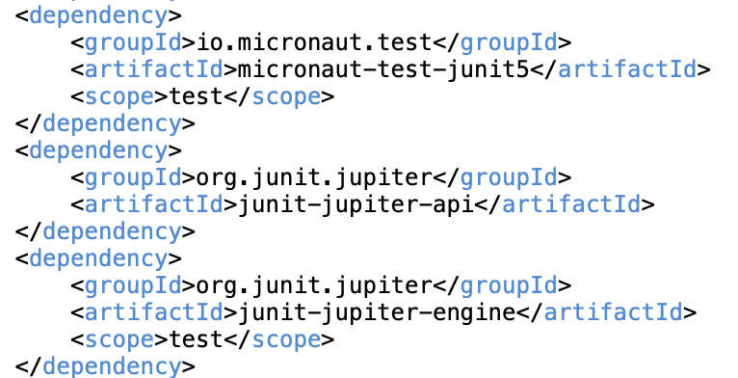

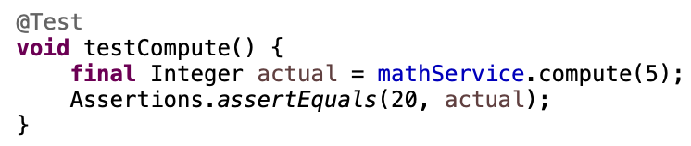
Junit 5 Support
Enabling Junit 5 Support, add following dependency
Using @MicronautTest annotation
Using regular Junit @Test annotation on test methods

Slide 5
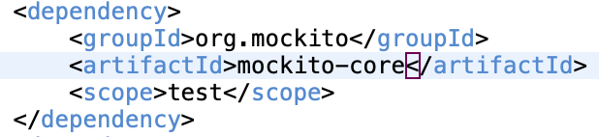
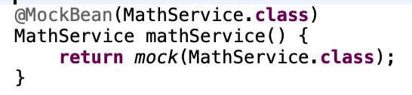
Mocking with Mockito
Adding Mockito dependency
Mocking an inject Bean
Providing a Mock implementation

Slide 6
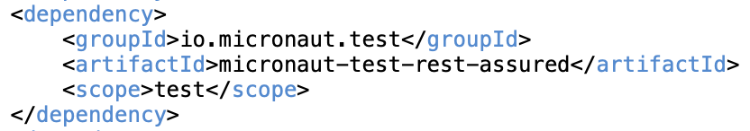
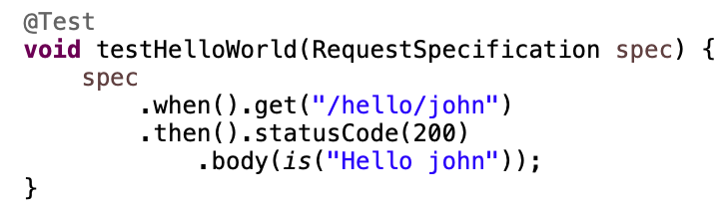
RestAssured Support
RestAssured is a library to test REST services including Response content, Http Status Code etc.
Adding RestAssured dependency
Writing Test with RestAssured

Slide 7
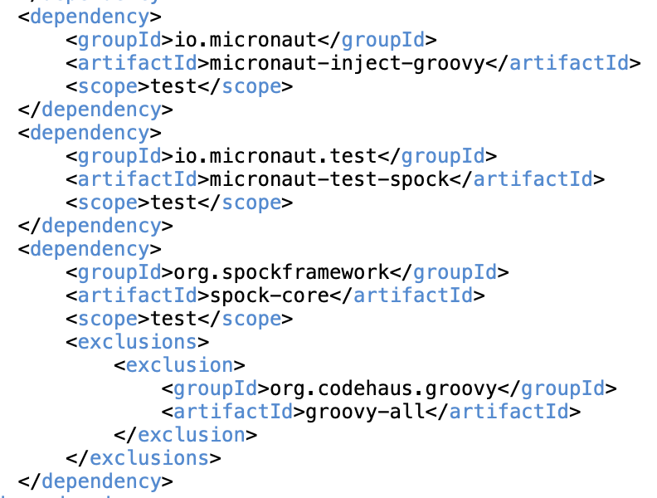
Spock Support
Spock is a testing and specification framework for Java and Groovy applications
Spock test ‘specifications’ are written in highly expressive Groovy Script
Adding Spock dependency

Slide 8
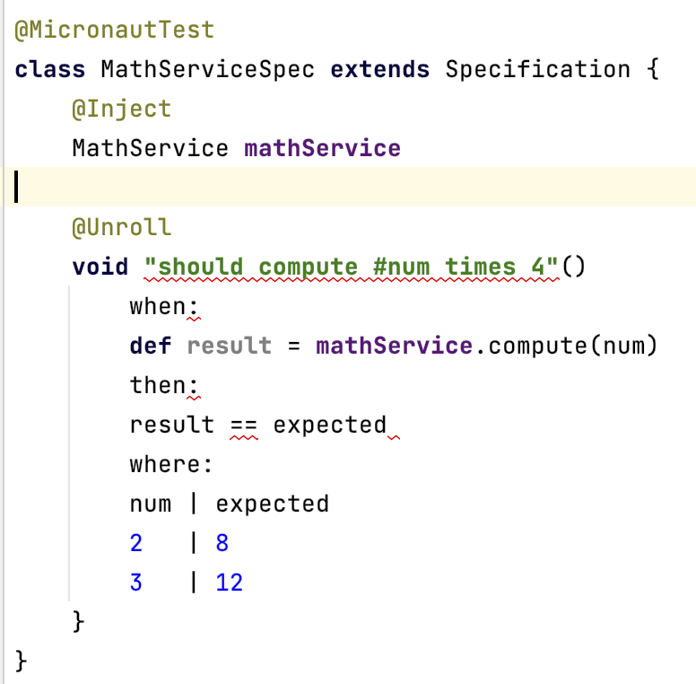
Spock Support…
Adding Spec

Slide 9
Testing with TestContainer
TestContainer is a Java library to test using lightweight, throwaway instances of common databases or anything else that can run in a Docker container
It helps to
Data access layer integration tests without Mocking
Application integration tests
UI/Acceptance tests
Supports testing with
Junit
Spock

Slide 10
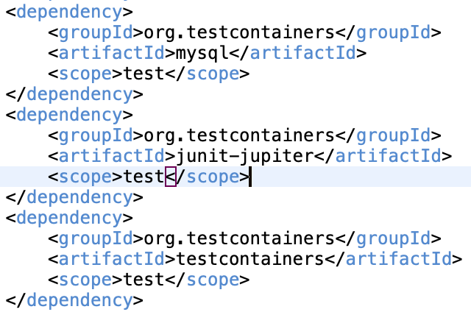
Testing with TestContainer…
Adding Dependencies for MySql TestContainer
Implement a sub-class of MySQLContainer<?> to start & stop MySql TestContainer Instance
Set the DataSource properties with TestContainer MySql instance properties at the start()

Slide 11
Testing with TestContainer…
Db set up in the @BeforeAll hook of Junit Tests
Start the TestContainer
Use Flyway to execute DDL against the TestContainer MySQL instance – this will create the required Db schema & objects
Execute Tests involving Db access methods - no need to Mock as the TestContainer Db would be accessed
Db Tear Down in the @AfterAll hook of Junit Tests
Stop the TestContainer

Slide 12
Thank You

