Slide 1
Micronaut
02 - Development Environment Setup

Slide 2
Agenda
Pre-requisites
Setting up IDE - Eclipse
Creating Http Server Application
Opening in Eclipse IDE
Adding REST Controller
Deploying Application
Creating Http Client
Micronaut Command Line Interface (CLI)

Slide 3
Pre-Requisites
OS – Windows, Mac or any Unix based Operating System
We will be using Mac for the demo
JDK 8+
We will be using JDK 17 for the demo
Java IDE – Eclipse, IntelliJ IDEA or Visual Studio Code
We will be using Eclipse for the demo
API Testing Tool - Postman

Slide 4
Eclipse IDE Setup
Download latest version of Eclipse from https://www.eclipse.org/downloads/
Once downloaded and installed, launch Eclipse
Eclipse would by-default include required maven or gradle plug ins
Under Eclipse -> Preferences,
Under Java-> Installed JRE, set the default JRE as JDK 17 (or any JDK 1.8+)
Under Maven, configure annotation processing to “Automatically configure JDT APT”

Slide 5
Creating HTTP Server Application
Open Micronaut launch: https://micronaut.io/launch/
Select following
Application Type: Micronaut Application
Micronaut Version: 3.8.3
Java Version: 17 (or according to your local JDK version)
Build Tool: Maven
Test Framework: Junit
Enter application Name & Base Package
Generate project and download as Zip

Slide 6
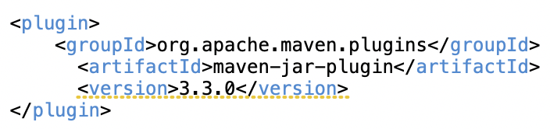
Creating HTTP Server Application …
Unzip Package & Open in Eclipse
Run Maven Install
Note: in POM, you may have to add following to fix Maven jar plug in error during maven install
Run the ‘Application’ class as ‘Java Application.
This will launch the application listening to http://localhost:8080

Slide 7
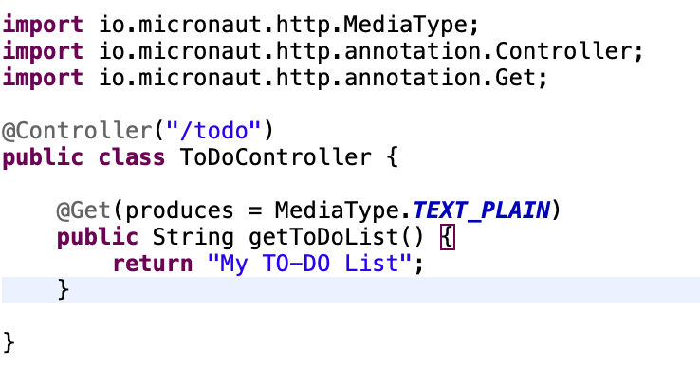
Creating HTTP Server Application …
Add a Controller Class in the Application
Access the API endpoint at http://localhost:8080/todo

Slide 8
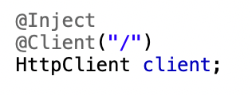
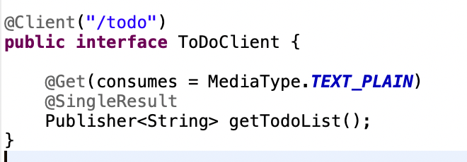
Creating HTTP Client
Create JUnit Tests to test controller response with
Low level http client
Declarative, compile-time http client

Slide 9
Deploying Application
Create executable jar
Run the application

Slide 10
Command Line Interface (CLI)
Micronaut CLI can be used to create Micronaut applications
CLI can be installed using
SDKMan or HomeBrew in MacOS – sdk install micronaut
Chocolatey or from Binary in Windows
Important CLI Commands
create-app --jdk=17 -b=maven <my-test-app>
create (Guided app creation)

Slide 11
Thank You

