Slide 1
Micronaut
09 – Management & Monitoring

Slide 2
Agenda
Enabling Monitoring in Micronaut
Built-in Management Endpoints
Beans
Routes
Info
Health
Logger…
Creating Custom Endpoint

Slide 3
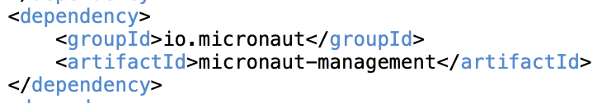
Enabling Application Monitoring
Micronaut supports monitoring applications via ‘Endpoints’
Endpoints are special URLs which return data about application’s health and internal state
To enable management & monitoring following dependency needs to be added
Management Endpoints can be protected using Micronaut security to make those accessible to only authenticated users or users having specific roles
Management Endpoints can be exposed through a different port than application endpoints
Endpoints can be exposed via JMX using micronaut-jmx dependency

Slide 4
Built-in Endpoints

Slide 5
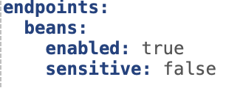
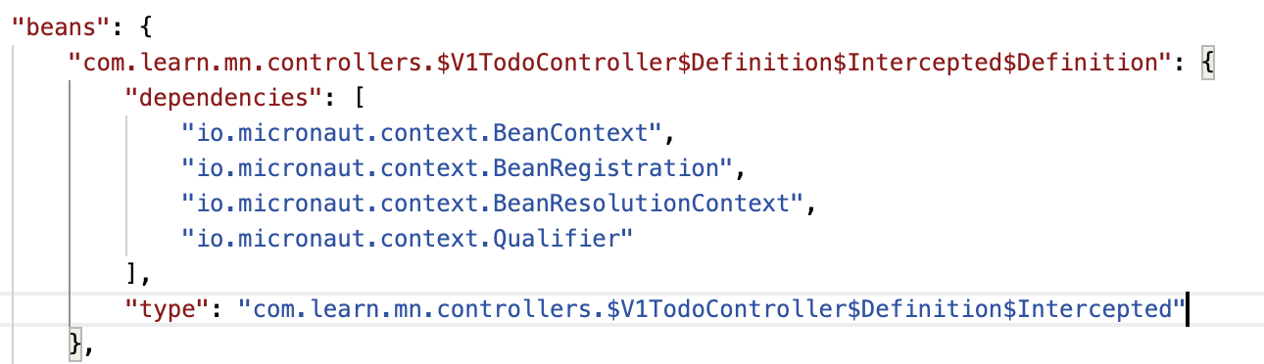
Beans Endpoint
URL: /beans
Provides information about bean definitions
Response is a map structure with key as bean name and value as object with bean properties
Configuration:
Sample Response

Slide 6
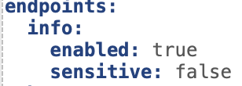
Info Endpoint
URL: /info
Returns static information about the state of the application
Information is provided by one or more ‘info sources’ – config, Git, build
Custom info source can be added
Configuration
Info source Config:
By default enabled
Returns application configuration properties under info key

Slide 7


Info Endpoint …
Info source Git:
Returns Git commit information from git.properties file
This can file can be generated at build phase using following maven plug in:
Info source Build:
Returns Build information from META-INF/build-info.properties file
This can file can be generated at build phase using following maven plug in:

Slide 8
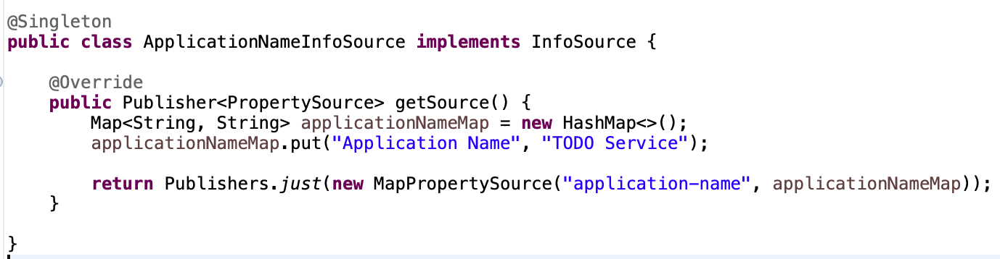
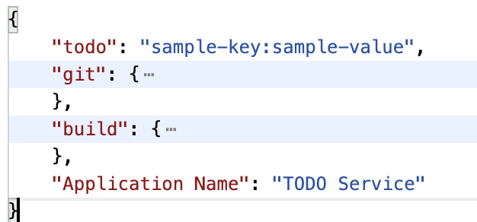
Info Endpoint…
Custom Info Source must implement io.micronaut.management.endpoint.info.InfoSource interface
Sample: Returns Application’s Common Name
Response Fragment:

Slide 9
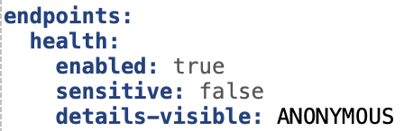
Health Endpoint
URL: /health
Returns the overall ‘health’ status of the application
Health status is provided by one of more health indicators
Configuration
In-built indicators:
Disk space
Discovery client – in case service discovery is used
JDBC – in case JDBC data source is used

Slide 10
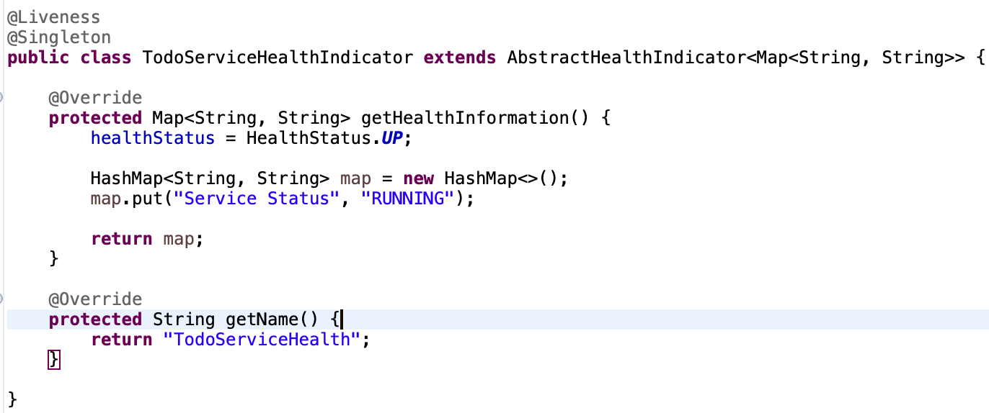
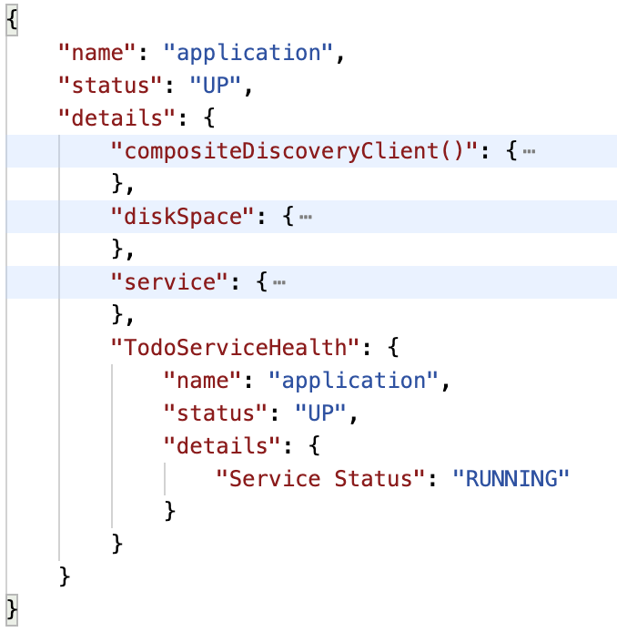
Health Endpoint…
Adding Custom indicator
Extend from io.micronaut.management.health.indicator.AbstractHealthIndicator
Sample Response

Slide 11
Health Endpoint…
/health/readiness – indicates whether application is ready to receive requests
/health/liveness – indicates whether application is up and running

Slide 12
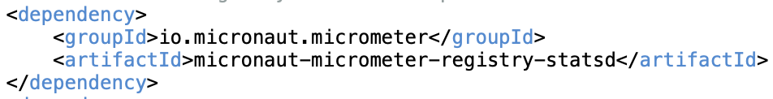
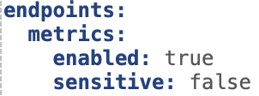
Metrics Endpoint
URL: /metrics/{metric name}
Returns application metrics using Micrometer
A ‘Meter’ is something that generates Metrics
Micrometer allows registering ‘Meters’
Dependency to enable Metrics
Configuration

Slide 13
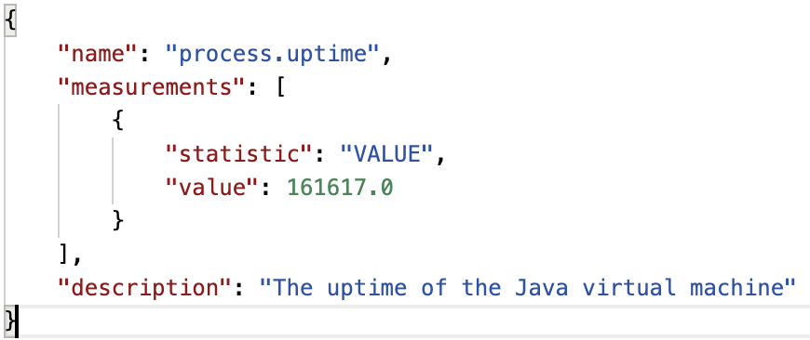
Metrics Endpoint…
/metrics returns a list of available metrics e.g. process.uptime
/metrics/{metrics name} returns the data associated with the metric
metrics/process.uptime sample response

Slide 14
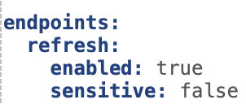
Refresh Endpoint
URL: POST /refresh
Refreshes the application state
All beans with @Refreshable scope get destroyed
These beans get recreated in next request
Done via RefreshEvent publishing
Configuration

Slide 15
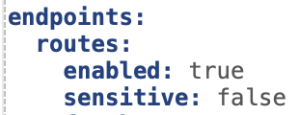
Routes Endpoint
URL: /routes
Returns information about the URLs exposed by the application
Configuration:
Customizable via implementation of RouteDataCollector & RouteData

Slide 16
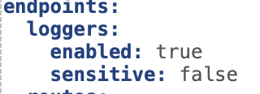
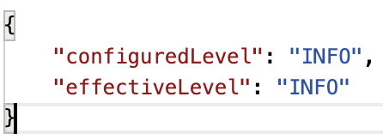
Loggers Endpoint
URL: /loggers/[{logger name}]
Returns the log levels all loggers in the application
Also allows changing the log level of a logger using POST call
Configuration:
Sample Response: GET /loggers/com.learn.mn.controllers.V1TodoController

Slide 17
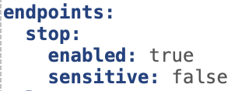
Server Stop Endpoint
URL: POST /stop
Shuts down the application server
Configuration:
Note: Should be enabled with caution

Slide 18
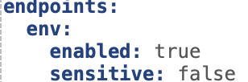
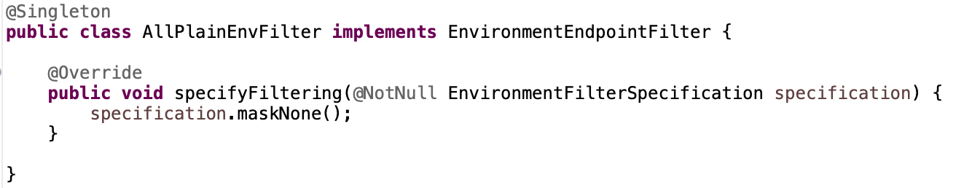
Environment Endpoint
URL: /env/[{property source name}]
Returns information about active environment and its property sources
Configuration:
By default all values are masked
Specific or all values can be unmasked implementing EnvironmentEndpointFilter

Slide 19
Other Built-In Endpoints
ThreadDump Endpoint
URL: /threaddump
Returns information about the threads running in the application
Caches Endpoint
URL: /caches
Returns information about the caches in the application and permits invalidating them
Requires io.micronaut.cache:micronaut-cache-management dependency

Slide 20
Custom Endpoint

Slide 21
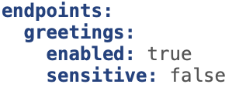
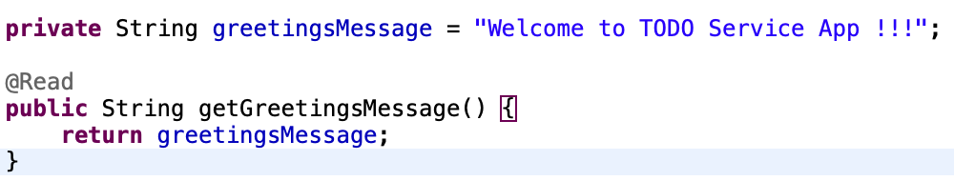
Creating Endpoint
Custom Endpoint can be created using @Endpoint annotation
URL: /greetings
Configuration:
@Read annotated method to return data via GET call

Slide 22
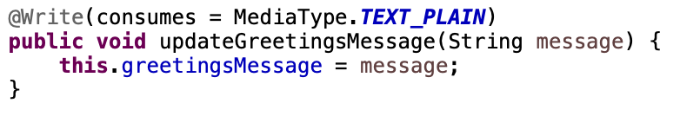
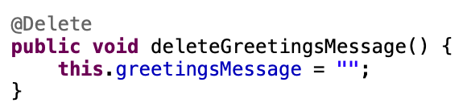
Creating Endpoint…
@Write annotated method to update data
@Delete annotated method to delete data
Sensitivity controls whether endpoint or method can be accessed by anonymous users
Default enable & sensitivity values can be overwritten in config

Slide 23
Thank You

