Slide 1
Micronaut
10.1 – Micronaut Data JDBC

Slide 2
Agenda
Enabling Micronaut Data JDBC
Setting up the MySql Database
Data Source Configuration
Defining an Entity
Defining CRUD Repository
Using Repository Operations
Enabling Db Transactions
JDBC Healthcheck

Slide 3
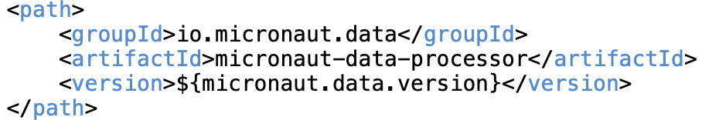
Enabling Micronaut Data JDBC
Micronaut supports both plain JDBC and JPA style data access
Micronaut Data JDBC draws inspiration from Spring JDBC
Following Dependencies need to be added for enabling JDBC
jakarta.annotation:jakarta.annotation-api – to use Jakarta Persistence Annotations
io.micronaut.data:micronaut-data-jdbc
io.micronaut.sql:micronaut-jdbc-hikari – to use hikari jdbc connection pool
mysql:mysql-connector-java – mysql client
Enable annotation processing for Micronaut data

Slide 4
Setting up MySql Database
Install mysql server locally from mysql official website
Use tool like MySql Workbench to access & explore database
By default MySql will run at the port 3306
Create a schema in MySql named ‘todo-services-demo’
Inside this schema create 2 tables : TODO_TBL, USER_TBL
Insert a couple of records in USER_TBL
Create a MySql database user named ‘todo-svc-user’ and give access to perform CRUD in ‘todo-services-demo’ schema

Slide 5
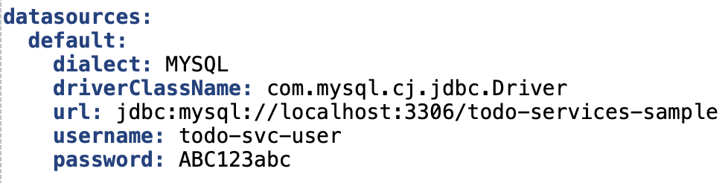
Data Source Configuration
Data source connection string and hikari pool properties are configured in application.yml
One can configure multiple data sources identified by data source name

Slide 6
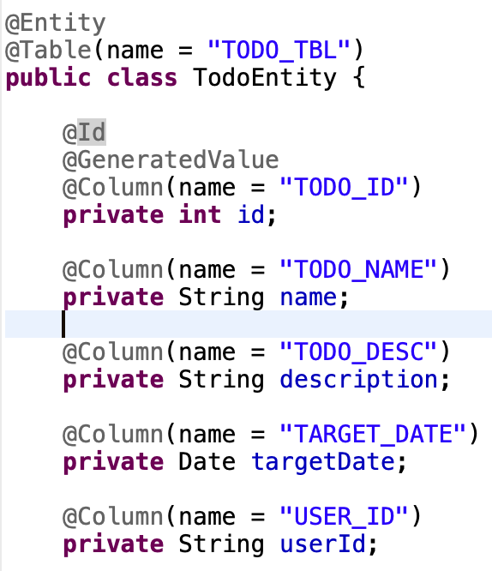
Defining Entity
Micronaut provides Micronaut Data annotations like @MappedEntity etc. to decorate Entity classes
It also supports a subset of Jakarta.persistence JPA annotations like @Entity, @Id etc.

Slide 7
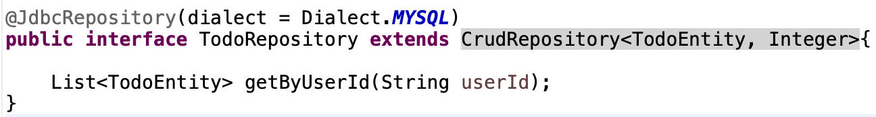
Defining CRUD Repository
A repository interface defines the operations to access the database
Micronaut Data creates implementation of the interface at compilation time
CrudRepository - repository interface for performing CRUD. This is a blocking operation interface.
One can also define additional repository methods using the Entity & its mapped fields

Slide 8

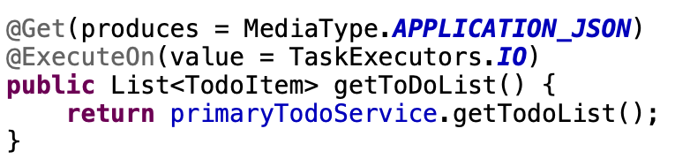
Using Repository Operations
Repository interface can be injected as a bean
Repository methods can be invoked like regular methods
Get All: todoRepository.findAll()
Get by PK: todoRepository.findById(id)
Create: todoRepository.save(todoEntity)
Update: todoRepository.update(todoEntity)
Delete by PK: todoRepository.deleteById(id)
Custom Get by field: todoRepository.getByUserId(userId)
Note: We should execute blocking repository operations in IO Thread

Slide 9
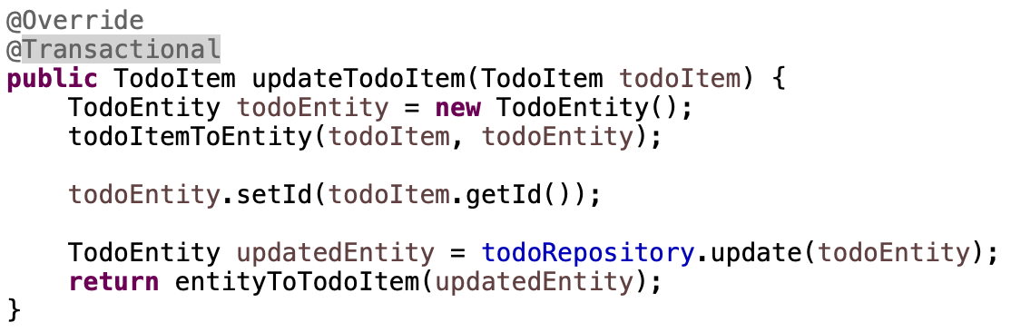
Enabling Db Transactions
By default Micronaut-based transaction management is enabled
Transactions can be enabled by either of the following annotations
io.micronaut.transaction.annotation.TransactionalAdvice
javax.transaction.Transactional annotation

Slide 10
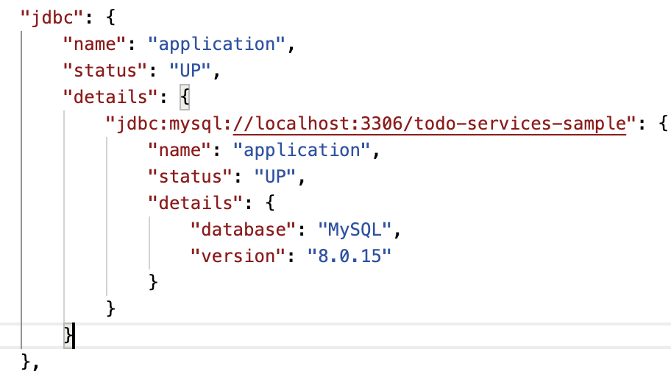
JDBC Health Check
Including the micronaut-data-jdbc dependency adds JDBC health check in the /health Endpoint

Slide 11
Thank You

