Slide 1
Micronaut
11.2: Security – Bearer (jwt) Token

Slide 2
Agenda
Bearer Token Based Authentication Overview
Access Token Overview
Token Claim Validation
Refresh Token
Refresh Token Persistence

Slide 3
Bearer (jwt) Token Based Authentication
Bearer token authentication means that a http request ‘bearing the token’ is considered authenticated and would not require any further authentication
Tokens are usually in the form of Json Web Token (jwt)
Types of Token:
Access Token: Includes ‘claims’ & roles, usually short lived
Refresh Token: Long lived, used to get a new Access Token without needing re-authentication
Id Token: Includes user’s identity information like name, email, phone etc.

Slide 4
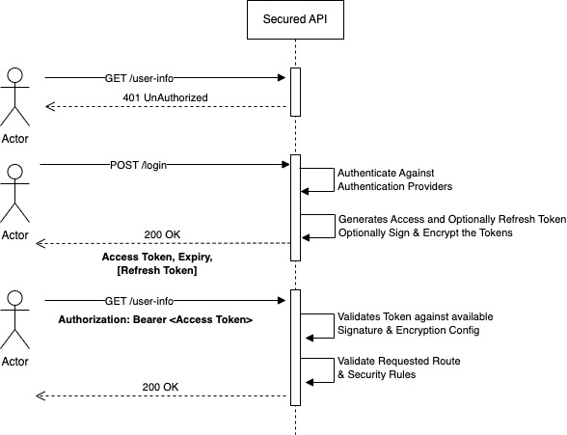
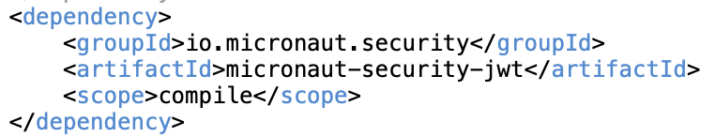
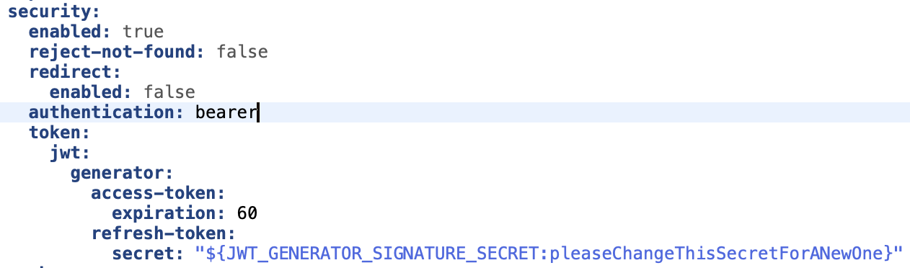
Token Based Authentication/Authorization
Enable token based Auth with following dependency:
Configuration

Slide 5
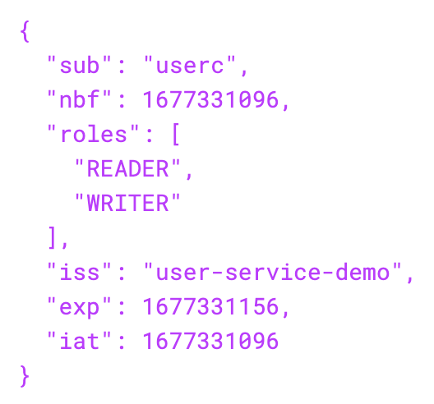
Access Token
Encoded: "eyJhbGciOiJub25lIn0.eyJzdWIiOiJ1c2VyYyIsIm5iZiI6MTY3Nz…..TZ9.”
Decoded:
Used as Authorization Header
Bearer eyJhbGciOiJub25lIn0.eyJzdWIiOiJ1c2VyYyIsIm5iZiI6…..TZ9.

Slide 6
Token Claim Validation
The claims of a jwt are validated using every bean of type GenericJwtClaimsValidator.
Provided Validators:
Bean | Description | Enabled
AudienceJwtClaimsValidator | JWT aud claim includes an expected value. | Enabled when the micronaut.security.token.jwt.claims-validators.audience property is set.
ExpirationJwtClaimsValidator | JWT is not expired. It uses the exp claim. | Enabled by default.
IssuerJwtClaimsValidator | JWT iss claim is set to an expected value. | Enabled when the micronaut.security.token.jwt.claims-validators.issuer property is set.
NotBeforeJwtClaimsValidator | If the JWT nbf claim is set, the token should only be valid if the current date is not before the provided date. | Disabled by default. Enabled when the micronaut.security.token.jwt.claims-validators.not-before property is set to true
SubjectNotNullJwtClaimsValidator | JWT sub claim is not null. | Enabled by default.

Slide 7
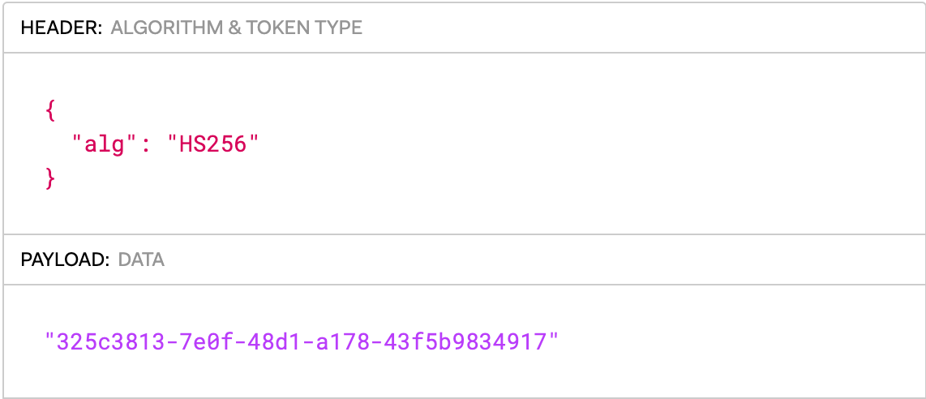
Refresh Token
Signed:
eyJhbGciOiJIUzI1NiJ9.MzI1YzM4MTMtN2UwZi00OGQxLWExNzgtNDNmNWI5ODM0OTE3.wG1WYOBM-S3qYA4XOV1edtIUxBIAO9TYkmuLIxCjBGo
Decoded:
Need to persisted at server for validation
Used to get new Access Token

Slide 8
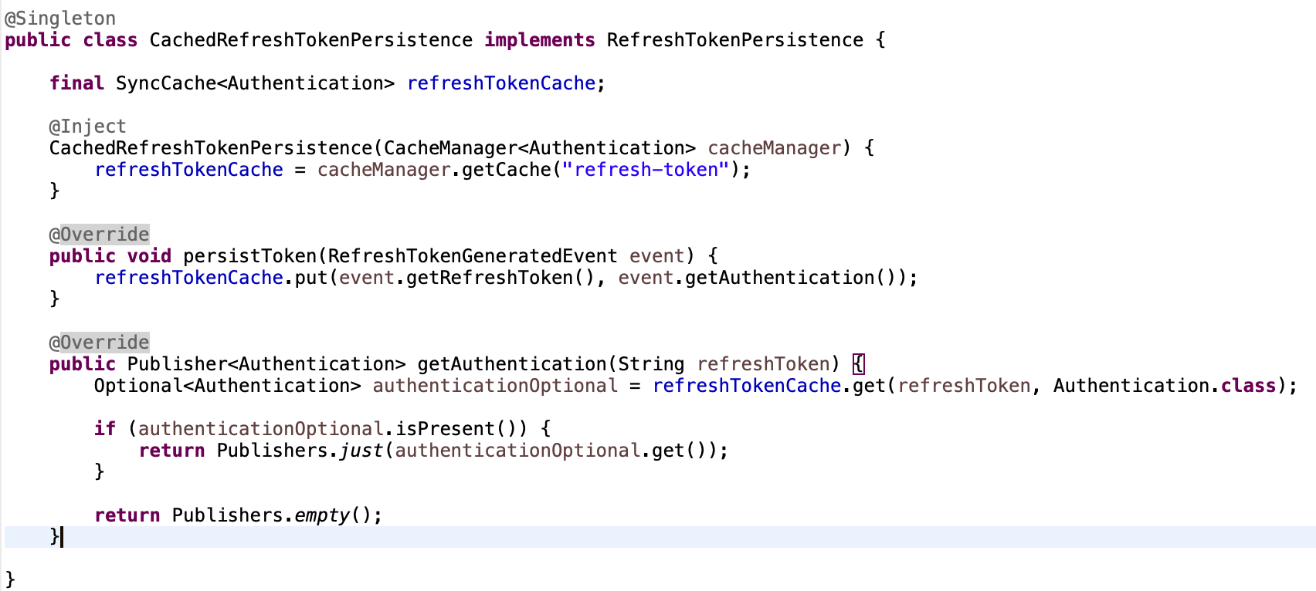
Refresh Token Persistence
Must be provided by Application implementation
Must implement io.micronaut.security.token.refresh.RefreshTokenPersistence
Example

Slide 9
Thank You

