Slide 1
Micronaut
10.2 – Micronaut Data R2DBC

Slide 2
Agenda
Introduction to R2DBC
Enabling R2DBC in Micronaut
Configuring Reactive Data Source
Creating an Entity
Creating a Reactive Stream Crud Repository
Using Reactive CRUD Operations

Slide 3
Introduction to R2DBC
R2DBC (Reactive Relational Database Connectivity) brings Reactive Programming APIs to RDBMS
R2DBC
Based on Reactive Streams specification
Works with relational databases
Supports scalability by moving away from ‘one thread per Db connection’ model
Provides SPI based on open specification for drivers to implement and clients to consume
Drivers are available for Oracle, MySql, Postgres among other Dbs
Connection pooling is provided by r2dbc-pool
Observability is provided by r2dbc-proxy

Slide 4
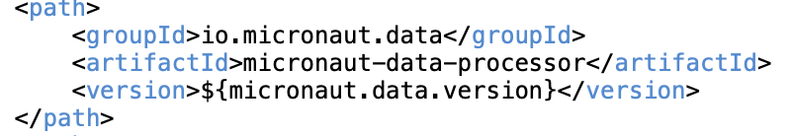
Enabling R2DBC in Micronaut
Add following dependencies
io.micronaut.data: micronaut-data-r2dbc
dev.miku: r2dbc-mysql -> MySql driver compliant with R2DBC SPI
io.r2dbc: r2dbc-pool -> for connection pooling
Add the micronaut-data-processor in annotation processor paths (same as sync JDBC)

Slide 5
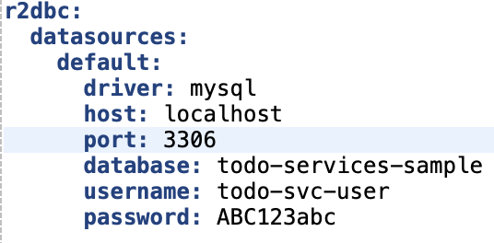
Configuring Reactive Data Source
Data Source configuration in application.yaml
One can also use URL based connection string like r2dbc:mysql://…

Slide 6
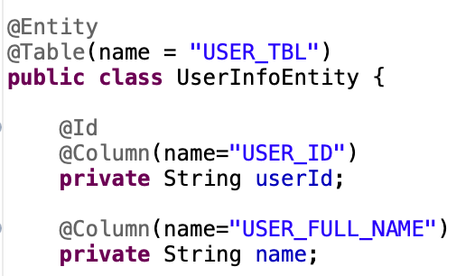
Defining an Entity
@Entity or @MappedEntity annotation can be used to define an Entity – same as sync JDBC

Slide 7
Creating A Reactive Stream Repository
Repository interface should implement ReactiveStreamsCrudRepository
Annoated with @R2dbcRepository
Provides CRUD operations with Reactive return types like Publisher<T>

Slide 8

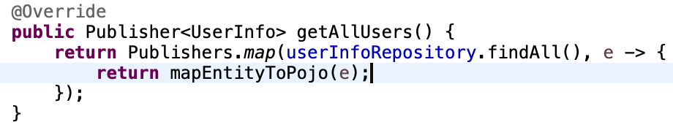
Using Reactive CRUD Operations
Inject Reactive repository interface
Methods using Repository methods should return Reactive types
No need to execute methods in I/O Threadpool as CRUD methods are non-blocking
@Transactional annotation can be used for to initiate a reactive transaction

Slide 9
Thank You

