Slide 1
Micronaut
10.3 – Micronaut Data with NoSQL Database

Slide 2
Agenda
Micronaut Data for NoSQL Databases
Enabling Mongo Db Support in Micronaut
Setting up Mongo Database
Configuring Mongo Db Data Source
Creating an Entity
Creating a Mongo Db CRUD Repository
Using CRUD Operations
Cassandra Support Overview

Slide 3
Micronaut Data for NoSQL Databases
NoSQL stands for Not-Only-SQL
NoSQL databases have gained popularity because of high scalability & availability they offer, they are often ‘eventually consistent’
Micronaut Data supports NoSQL databases using familiar JDBC APIs used for RDBMS
NoSQL Databases support include Mongo Db, Azure Cosmos Db, AWS Dynamo Db, Apache Cassandra among others
It provides both sync and async (reactive) programming model for NoSQL databases

Slide 4
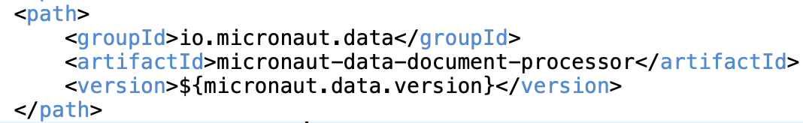
Enabling Mongo Db support in Micronaut
Mongo Db is a ‘document’ storage database which provides high scalability & availability
To enable Mongo Db support, add following dependencies:
io.micronaut.data: micronaut-data-mongodb
org.mongodb: mongodb-driver-reactivestreams -> Reactive driver for Mongo Db
Add the micronaut-data-document-processor in annotation processor paths

Slide 5
Setting up Mongo Db Database
Install Mongo Db from Mongo Db official site
Create Mongo Db data and log folders
Start Mongo Db from terminal/command prompt using
./mongod --dbpath ”<path to data director>" --logpath ”<path to log directory>/mongo.log”
Install Mongo Db explorer like Robo 3T
Start Robo 3T and connect to locally running Mongo Db instance (default port is 27017)
Create a new database named ‘todo-services-demo’
Under this database, create a new collection named ‘﻿USER_ADDR_COLL’

Slide 6
Configuring Mongo Db Data Source
Data Source configuration in application.yaml
Note: If Mongo Db access requires user name & password, then those should be part of the uri in the form of mongodb://[username:password@]localhost:27017/todo-services-demo

Slide 7
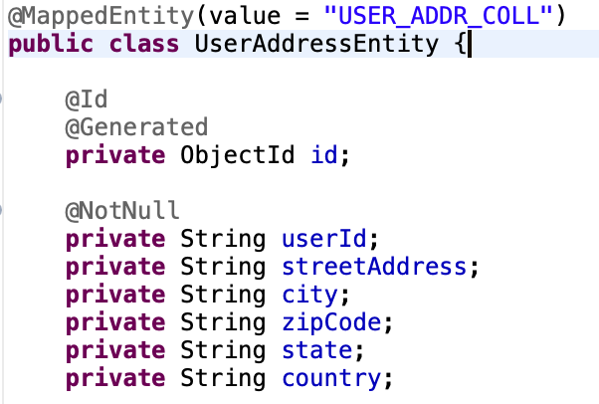
Defining an Entity
@Entity or @MappedEntity annotation can be used to define an Entity – same as JDBC
@Id annotated field should of type Bson ObjectId

Slide 8
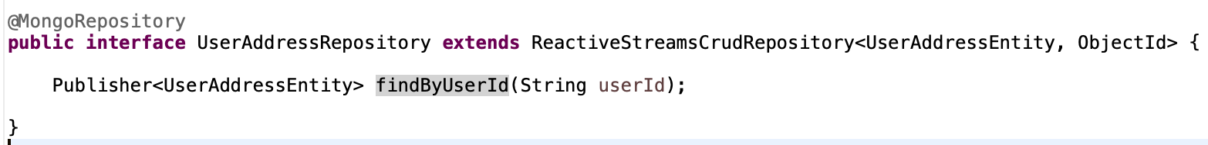
Creating a Mongo Db Repository
Repository interface should implement ReactiveStreamsCrudRepository
Annoated with @MongoRepository
Provides CRUD operations with Reactive return types like Publisher<T>
One can also add custom methods based on Entity fields

Slide 9

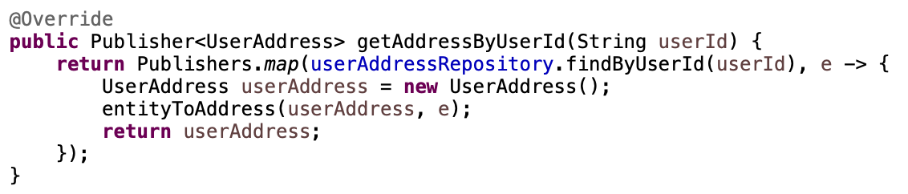
Using Mongo Db CRUD Operations
Inject Mongo repository interface
Methods using Repository methods should return Reactive types
No need to execute methods in I/O Threadpool as CRUD methods are non-blocking

Slide 10
Overview of Cassandra Support
Cassandra is a scalable & distributed NoSQL database
It is a ‘wide column’ database - names and format of the columns can vary across rows, even within the same table
Micronaut provides Cassandra support via io.micronaut.cassandra :micronaut-Cassandra dependency
It uses Datastax Java Driver for Cassandra
Data source configuration can be provided by application properties
Micronaut creates CqlSession bean instance which provides API for interacting with Cassandra

Slide 11
Thank You

