Slide 1
Micronaut
11.1 – Security: Basic Auth, Session Auth

Slide 2
Agenda
Micronaut Security Overview
Authentication Provider
Security Rules
Authentication/Authorization Strategies
Basic Authentication
Session Authentication
Built-in Security Controllers
Accessing Authenticated User
Security Events

Slide 3
Overview
Micronaut Security is a fully featured and customizable security solution for applications.
To enable security, we can add any of the Micronaut security extensions as dependency
Session
Bearer Token (jwt)
LDAP
X509 Certificate
Custom

Slide 4
Authentication Provider
An Authentication Provider authenticates user (typically against some Db or LDAP stored credentials)
It implements io.micronaut.security.authentication.AuthenticationProvider interface
Built-in LoginController & Basic-Auth AuthenticationFether uses every available Authentication Provider implementation Bean for authentication
The first provider that successfully authenticates the user will have its AuthenticationResponse used for session or bearer token
Micronaut provides implementation for LDAP and OAuth2.0 password grant flow Authentication Provider

Slide 5


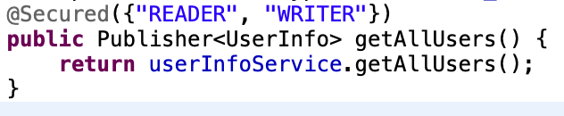
Security Rules
Security Rules decide whether to allow access to a particular endpoint to anonymous or authenticated users
Micronaut supports built-in and custom security rules
It emits ALLOWED, REJECTED or UNKNOWN SecurityRuleResult
@Secured Annotation controls access to controllers or controller methods

Slide 6
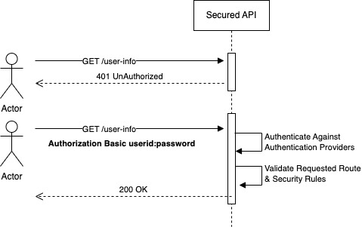
Basic Authentication
Micronaut supports RFC7617 which defines the "Basic" Http authentication scheme, which transmits credentials as user-id/password pairs, encoded using Base64.
Basic Auth is enabled by default
It can be disabled using config key micronaut.security.basic-auth.enabled = false
Demo

Slide 7
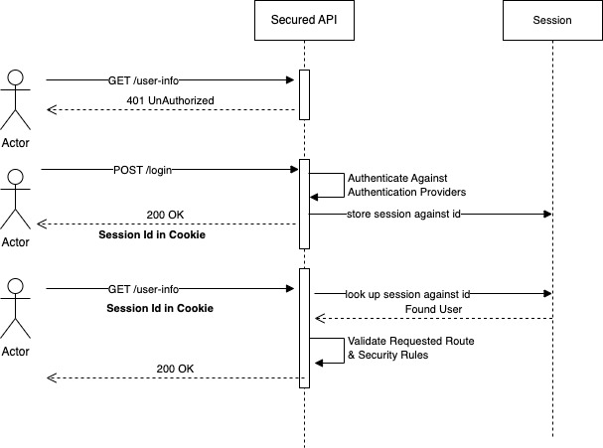
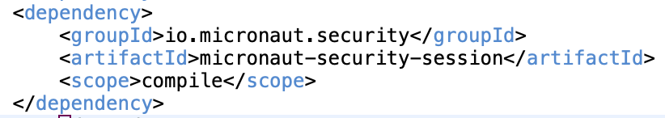
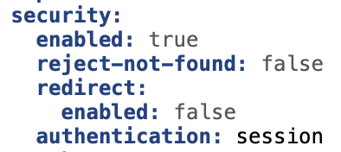
Session Based Authentication
Add following dependency
Set Authentication Mode in config
Demo

Slide 8
Built-in Security Controllers
POST /login: Handles Authentication Request for Session or Bearer Token authentication modes
Accepts {username, password}
Returns session cookie or JWT token based on Authentication Mode
POST /logout: Handles Logout Request
No Argument
Can be configured to respond to GET method

Slide 9
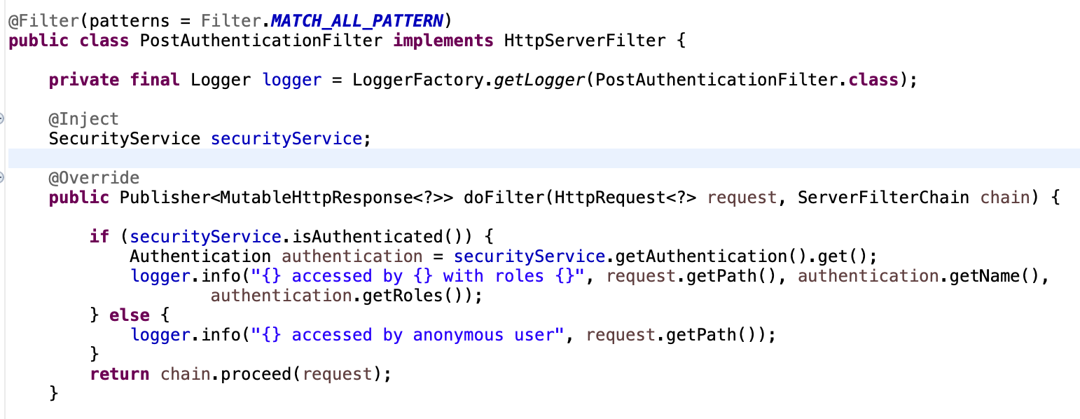
Accessing Authenticated User
java.security.Principal can be injected as parameter in a controller method
SecurityService Bean can be injected in a controller or non-controller Bean

Slide 10
Security Events
Event Name | Description
LoginFailedEvent | Triggered when an unsuccessful login takes place.
LoginSuccessfulEvent | Triggered when a successful login takes place.
LogoutEvent | Triggered when the user logs out.
All Events extend ApplicationEvent

Slide 11
Thank You

