Slide 1
Micronaut
15 – Microservices and Service Discovery

Slide 2
Agenda
Microservices Architecture Overview
Micronaut’s Support for Microservices Architecture
Service Discovery Overview
Service Discovery using Consul
Client Side Load Balancing

Slide 3
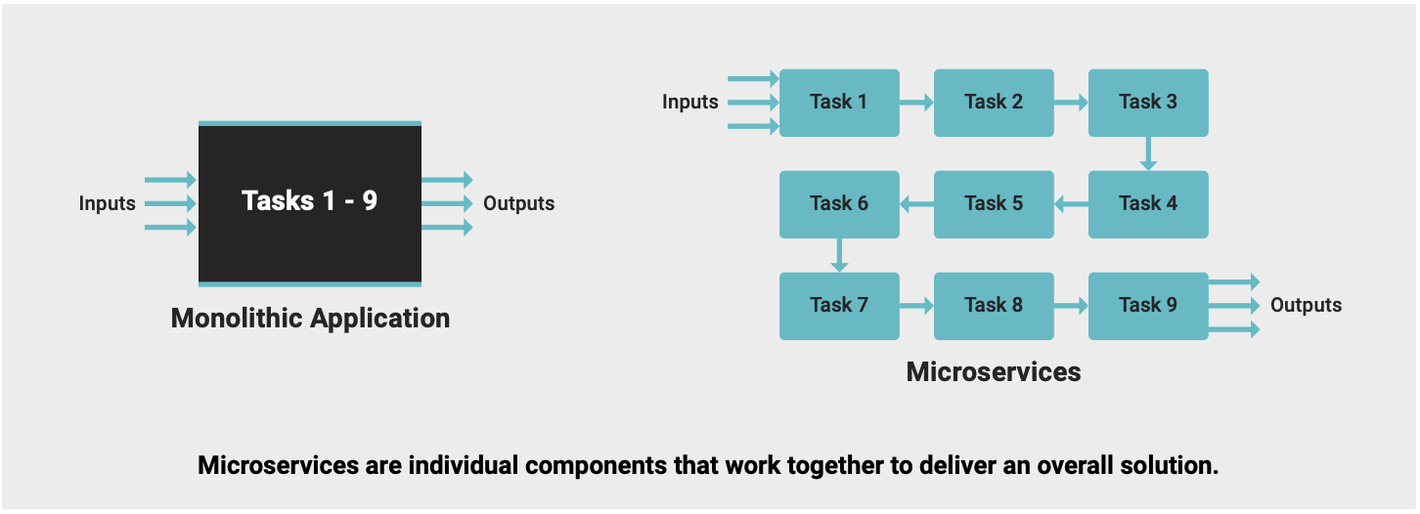
Microservices Architecture
Microservices are a set of applications designed for limited scope that work with each other to form a bigger solution
Each microservice has minimal capabilities that creates highly modularized overall architecture

Slide 4
Advantages of Microservice Architecture
Easier to build and enhance
Easier to deploy
Easier to maintain, troubleshoot & extend
Simplifies cross team collaboration
Deliver performance and scale
Simplifies real time processing
Optimizes cost of operations

Slide 5
Micronaut’s Support for Microservices
Distributed Configuration: Configurations shared by multiple microservices
Service Discovery: Facilitates inter-microservice communication
Client Side Load Balancing: Load distribution across multiple instances of a microservice
Distributed Tracing: Trace a transaction flowing through multiple microservices

Slide 6
Service Discovery
Service Discovery enables microservices to find each other without knowing the physical location or IP address of associated services.
Discovery Service
HashiCorp Consul
Netflix Eureka
Kubernetes
AWS Route 53
Manual Service Discovery Configuration

Slide 7
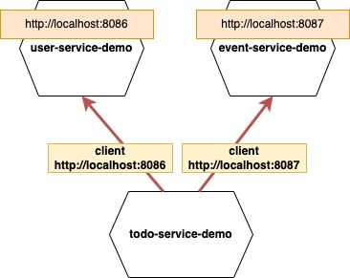
Service Discovery…
Inter microservice communication without service discovery requires each microservice to know others’ location
Difficult to Maintain
Difficult to Scale

Slide 8
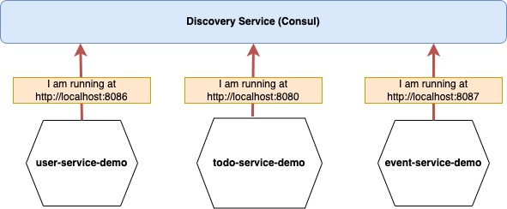
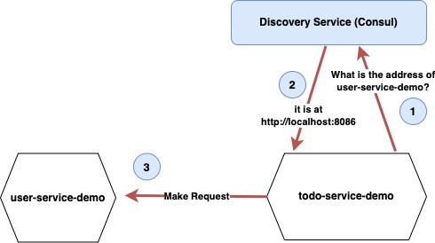
Service Discovery …
With Service Discovery, location of microservices are abstracted away from each other
Easy to scale with load balancing

Slide 9
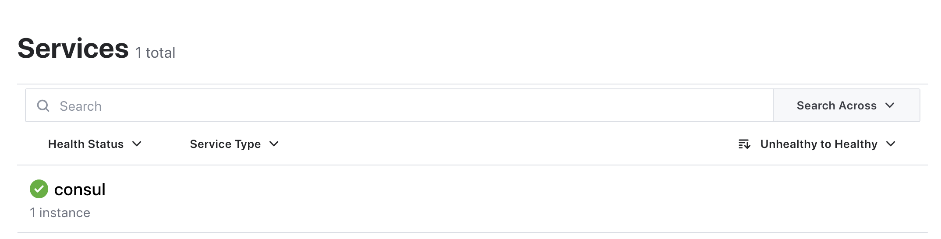
Running Consul Locally
Consul is a centralized registry that discovers, tracks, and monitors services
Pre-requisites: Docker
Run Consul in Docker: docker run -p 8500:8500 consul

Slide 10
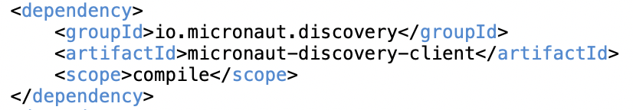
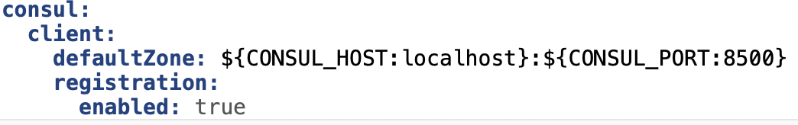
Enabling Micronaut Consul Support
Add following dependency
Add following configuration for auto-registration in consul

Slide 11
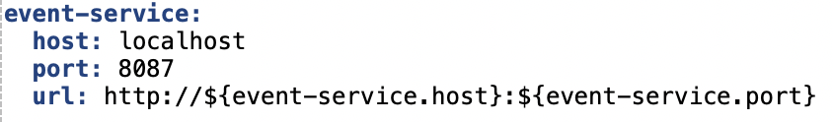
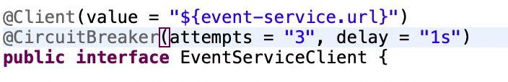
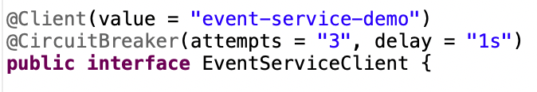
Http Client
Without Service Discovery
Config:
With Service Discovery

Slide 12
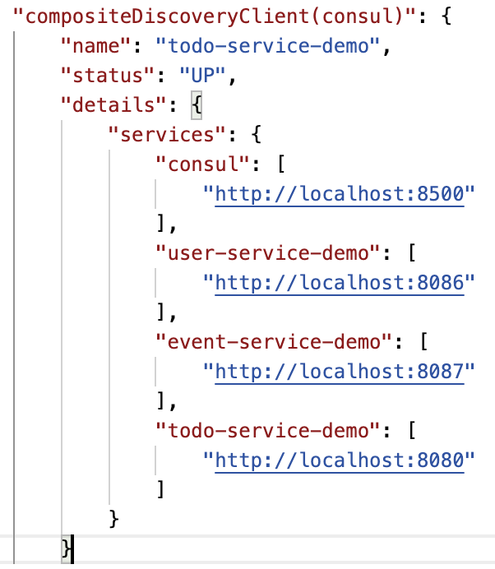
Discovery Client Health
Composite Discovery Client’s health status is accessible via the /health Endpoint

Slide 13
Client Side Load Balancing
DiscoveryClient emits a list of available ServiceInstance for each microservice
Micronaut by default automatically performs Round Robin client-side load balancing using the servers in this list
The load balancing is handled by the LoadBalancer interface, which has a LoadBalancer.select() method that returns a Publisher which emits a ServiceInstance
The default implementation of the LoadBalancer interface is DiscoveryClientRoundRobinLoadBalancer.
Load Balancing strategy can be customized by providing another implementation of LoadBalancer interface
Netflix Ribbon can be used as load balancer using micronaut-netflix-ribbon dependency

Slide 14
Thank You

