Slide 1
Micronaut
04 – Application Configuration

Slide 2
Agenda
Defining and Reading Config Values
Configuration Property Sources
Environment Specific Configuration
Binding & Injecting Configuration
Immutable Configuration

Slide 3

Defining & Reading Configuration
By default config values are loaded from application.properties/.yaml/.json file
Defining config value in application.yaml file
Reading config value
@Inject
Environment environment;
Optional<String> configValueOptional = environment.getProperty("to-do.prop-a", String.class);
Property values can use placeholder & default values e.g. prop-c: ${to-do.prop-a},${to-do.prop-b}
Property references should use kebab case: all lower case, words separated by hyphen (e.g. to-do.prop-a)

Slide 4
Configuration Property Sources
Micronaut combines config values from multiple property sources
Built-in property sources in order of priority:
Command line arguments
Properties from SPRING_APPLICATION_JSON (for Spring compatibility)
Properties from MICRONAUT_APPLICATION_JSON
Java System Properties
OS environment variables
Configuration files from the system property 'micronaut.config.files'.
Environment-specific properties from application-{environment}.{extension}
Application-specific properties from application.{extension}
Custom config property source can also be implemented
Sensitive configuration like secrets, password etc. should be maintained in Vaults/Secret Store and NOT in configs

Slide 5
Environment Specific Configuration
Micronaut support defining Environment(s) while starting the application e.g. dev, test, prod etc.
Through code using ApplicationContextBuilder
Via JVM argument -Dmicronaut.environments
The active environment allows loading that environment specific configuration values from environment specific config file e.g.
application.yaml (default, when no environment is specified)
application-dev.yaml
application-prod.yaml

Slide 6


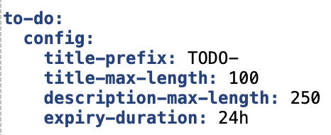
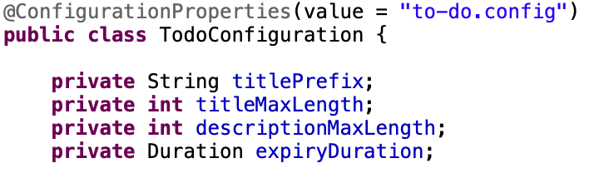
Binding & Injecting Configuration
Configuration properties can be bound to fields using
@Value annotation:
@Property(name=<name>) annotation:
Type-safe bean instances can be initialized from configuration using @ConfigurationProperties annotation

Slide 7
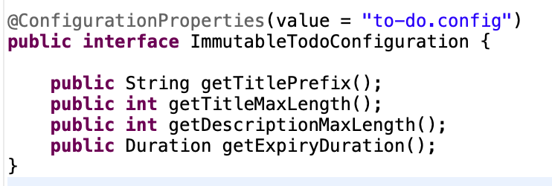
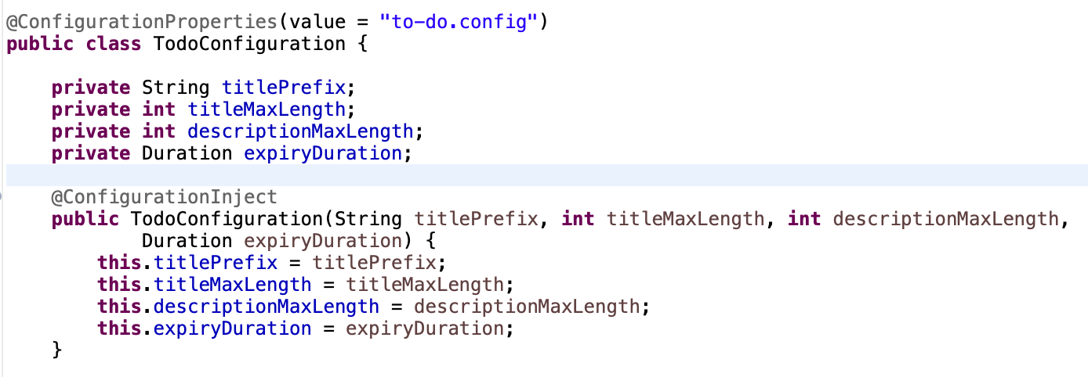
Immutable Configuration
Immutable configurations values can only be set from config property sources (and not from application code)
Immutable configuration can be defined in following ways:
Using @ConfigurationProperties annotation on an Interface
Using @ConfigurationProperties annotation on a class and using @ConfigurationInject annotation on constructor to inject config values

Slide 8
Thank You

