Slide 1
Micronaut
14 - GraalVM

Slide 2
Agenda
Introduction to GraalVM
GraalVM Architecture
Its Advantages
Micronaut Support for GraalVM
Micronaut App in GraalVM - Demo

Slide 3
Introduction to GraalVM
GraalVM is a high-performance JDK designed to accelerate Java application performance while consuming fewer resources
It is developed and supported by Oracle Corporation
It compiles Java application into native machine code
It offers two ways to run Java applications: on the HotSpot JVM with Graal just-in-time (JIT) compiler or as an ahead-of-time (AOT) compiled native executable
Apart from Java, it provides runtime for JavaScript, Ruby, Python, R and few other languages
It makes it possible to mix programming languages in a single application while eliminating any foreign language call costs

Slide 4
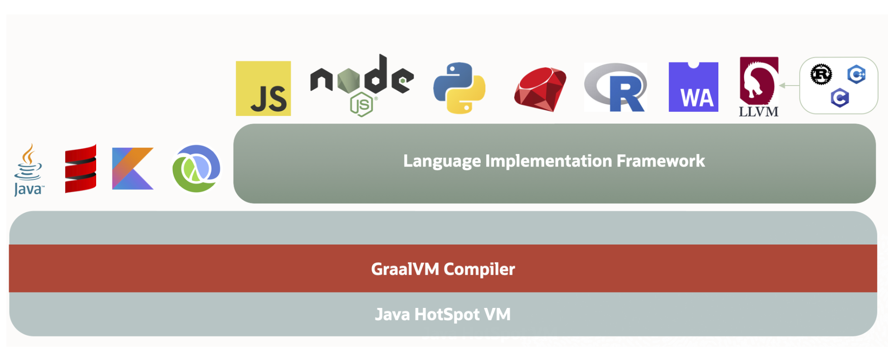
GraalVM Architecture
GraalVM adds an advanced just-in-time (JIT) optimizing compiler, to the HotSpot Java Virtual Machine.
With GraalVM Truffle, Java and other supported languages can directly interoperate with each other and pass data back and forth in the same memory space.

Slide 5
GraalVM Advantages
High Performance: Uses advanced optimized compiler that generates leaner and faster code requiring fewer computing resource
Polyglot Programming: Supports best features and libraries of multiple languages in a single app
Ahead of Time Native Image Compilation: Compiles Java application ahead of time in native machine code that start up instantly without any warm up time
Advanced Tools: Easier debugging, monitoring, profiling and optimizing resource consumption in Java and other languages

Slide 6
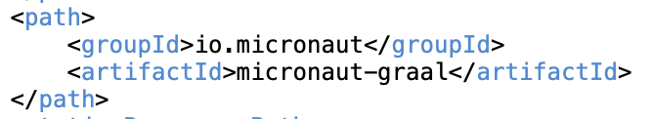
Micronaut Support for GraalVM
Micronaut supports running Micronaut applications using GraalVM’s native-image tool.
Micronaut application can be built into a GraalVM native image using the Micronaut Gradle or Maven plugins.
Micronaut does not use reflection or dynamic classloading, so it works automatically with GraalVM native, certain 3rd party libraries may require additional input about usage of reflection.
Micronaut includes an annotation processor that helps to generate reflection configuration that is automatically picked up by the native-image tool

Slide 7
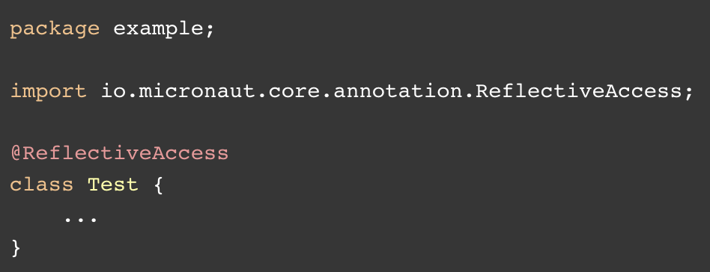
Micronaut Support for GraalVM…
This processor generates additional classes that implement the GraalReflectionConfigurer interface and programmatically register reflection configuration.
It results in the public methods, declared fields and declared constructors of example.Test being registered for reflective access.
Other Annotations for reflective access: @TypeHint, @ReflectionConfiguration

Slide 8
Micronaut App in GraalVM - Demo
GraalVM installation
sdk install java 22.3.r17-grl: Install GraalVM JDK 17
gu install native-image: Install GraalVm Native Image
Create a Micronaut Application using Micronaut Launch – include GraalVM & Jackson serialization as features
Create native executable inside Docker
./mvnw package -Dpackaging=docker-native
Start the application in docker
docker run -p 8080:8080 conference-app-graalvm:latest

Slide 9
Thank You

