Slide 1
Micronaut
03– Inversion of Control

Slide 2
Agenda
Micronaut IoC Internals
Beans
Bean Qualifiers
Primary & Secondary Beans
Scopes
Bean Factory
Bean Lifecycle
Bean Introspection & Validation

Slide 3
Micronaut IoC Internals
Micronaut uses compile time metadata for implementing DI
Does not use reflection & proxies
Does not cache any DI metadata at the run time
Uses java annotation processors to generate classes implementing BeanDefinition at the compile time
Results in faster start-up time & low memory foot print
Memory requirement & performance does not depend on size of the codebase

Slide 4
Beans
Bean is an object whose lifecycle is managed by Micronaut IoC container
Lifecycle includes – creation, execution & destruction
Beans can be injected using javax.inject.Inject annotation
Injection points
Constructor
Field
Property
Method Parameter

Slide 5
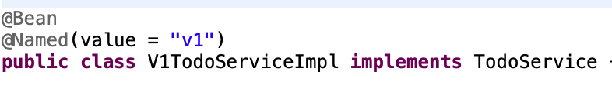
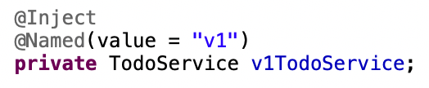
Bean Qualifiers
Qualifiers are used to differentiate multiple beans implementing the same interface
Qualifying by Name - @Named annotation
Custom qualifiers can be implemented with @Qualifier annotation
Other qualifying techniques
By qualifier annotation members
By generic type arguments

Slide 6
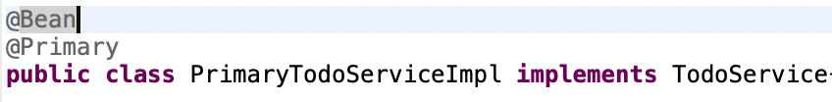

Primary & Secondary Beans
In case of multiple beans implementing same interface, one can be designated as ‘Primary’ - @Primary annotation
A primary bean can be injected without needing any qualifier
@Secondary annotation has the opposite effect of @Primary
Without these annotations, NoUniqueBeanException is thrown in case of multiple implementation of same interface

Slide 7
Scopes
Scopes control the lifetime of a bean
Important Scopes:
Scope | Description
@Prototype | New Bean instance for each injection point
@Singleton | Single Bean instance during application lifetime
@Context | Eagerly initialized Singleton beans
@ThreadLocal | One Bean instance per thread
@RequestScope | One Bean instance per Http Request
Custom scopes can also be implemented i.e. @SessionScope for bean instances per Http Session

Slide 8
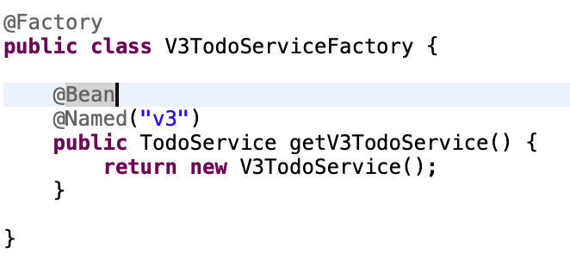
Bean Factories
Useful for injecting classes from external libraries as Beans
Factory class is annotated with @Factory annotation
Provides one or more methods annotated with Bean scopes and returning Bean class instances

Slide 9
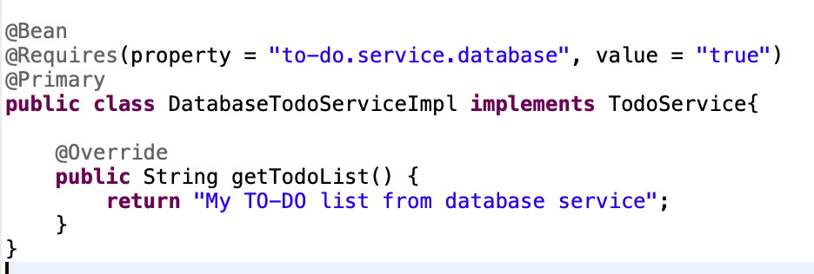
Conditional Beans
Beans made available based on certain conditions
One or more conditions – specified with @Requires annotation
Availability of certain class in classpath
Configuration value
Availability of another Bean

Slide 10
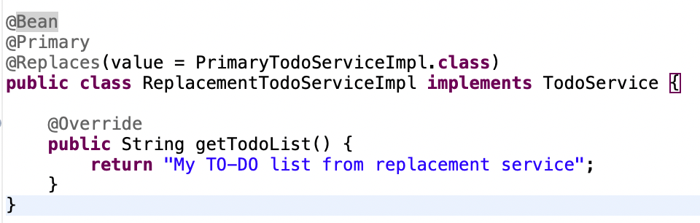
Bean Replacements
A Bean can replace another Bean (of same super type) with @Replaces annotation

Slide 11
Bean Lifecycle
After Bean instance is created - @PostConstruct method is called
Before Bean instance is destroyed - @PreDestroy method is called
Bean Lifecycle events
BeanInitializedEventListener – before PostConstruct is called
BeanCreatedEventListener – after PostConstruct is called

Slide 12
Bean Introspection & Validation
Without using reflection, Bean introspection can
read Bean metadata
create Bean instance
read/write Bean properties
@Introspected annotation makes a Bean available for introspection
Micronaut can validate Introspected Bean properties for constraints
Not null or blank
Min/Max values etc.
javax.validation.Valid annotation triggers cascading validation

Slide 13
Thank You

