Slide 1
Quarkus
02 – Set up

Slide 2
Part 1
Java Platform and Built Tools

Slide 3
Agenda
Java Platform & JDK Version
Maven Plugin Configuration
Maven Plugin Goals
Creating, Building & Running with Maven
Executable Jars
Remote Development Mode
Build Configuration
Gradle Support Overview

Slide 4
Java Platform Requirements
The minimum Java version required is JDK 11
Starting with Quarkus version 2.x the minimum JDK requirement is JDK 11+
Quarkus has been tested with JDK 11 and 17
JDK > 17 has not been actively tested, but should work
Quarkus applications can be compiled as a jar to run within a JVM or can be compiled as native executables

Slide 5
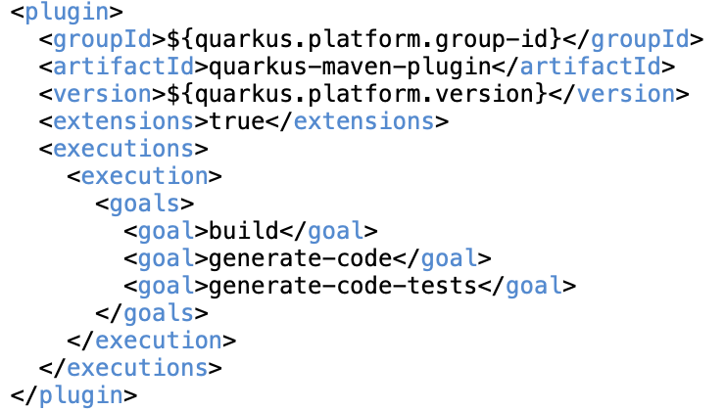
Quarkus Build Tools - Maven
Quarkus supports both Maven and Gradle as build tools
Quarkus Maven plug in
Builds Quarkus application
Launches application in dev mode
Builds native executable

Slide 6
Quarkus Maven Plug in Goals
Goal | Purpose
quarkus:create | Creates a new Quarkus application with sensible defaults
quarkus:build | Builds the application
quarkus:dev | Runs Quarkus application in dev mode i.e. any change in code is automatically reflected in the application without needing explicit compilation or restart
quarkus:info | Log Quarkus-specific project information - Quarkus platform BOMs, Quarkus extensions etc. Also highlight misaligned versions.
quarkus:image-build | Builds a container image
quarkus:generate-code | Generate code from metadata artifacts
quarkus:test | Starts continuous testing outside of dev mode
quarkus:update | Log Quarkus-related recommended updates – platform BOM and extensions
quarkus:add-extension quarkus:add-extensions | Add one or more Quarkus extensions to the Quarkus application
quarkus:list-extensions | List all available Quarkus extensions

Slide 7
Creating, Building and Running with Maven
Create application
mvn io.quarkus.platform:quarkus-maven-plugin:2.16.4.Final:create \ -DprojectGroupId=my-groupId \ -DprojectArtifactId=my-artifactId
List extensions - ./mvnw quarkus:list-extensions
Add extension –
./mvnw quarkus:add-extension -Dextensions="io.quarkus:quarkus-resteasy-reactive”
Run application - ./mvnw quarkus:dev

Slide 8
Executable Jars
fast-jar – default package type
The result of the build is a directory under target directory under the project directory
Executing this jar requires all the class files to be present in target directory
The jar can be executed using standard java –jar <jar full path> command
uber-jar – resulting jar contains all the dependencies
Requires <quarkus.package.type>uber-jar</quarkus.package.type> in pom.xml
Resulting jar name will have –runner prefix by default

Slide 9
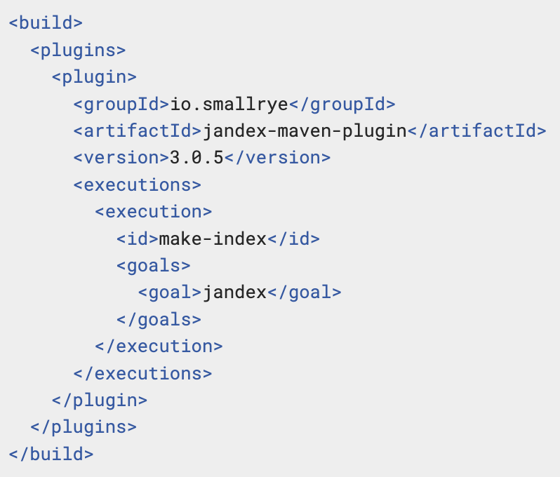
Multi-Module Projects
By default, Quarkus does not discover CDI beans inside another module
This can be enabled using jandex-maven-plugin

Slide 10
Remote Development Mode
Remote development mode allows to run Quarkus application in a container environment and have changes made to local files become immediately visible
Maven command - quarkus:remote-dev
Application properties to enable mutable-jar
quarkus.package.type=mutable-jar
quarkus.live-reload.password=changeit
quarkus.live-reload.url=http://my.cluster.host.com:8080
In remote, set environment variable QUARKUS_LAUNCH_DEVMODE=true and start app
In local ./mvnw quarkus:remote-dev -Dquarkus.live-reload.url=http://my.cluster.host.com :8080
Notes:
Mutable jar contains Quarkus build time information
This is done via an HTTP based long polling transport, that will synchronize your local workspace and the remote application via HTTP calls.

Slide 11
Build Configuration
Building artifact with specific configuration profile according to the target environment
./mvnw install -Dquarkus.profile=<profile-name-here>
Building multiple artifacts from a single module
Example – building application with different configuration profile
Possible through multiple executions in the Quarkus Maven plugin configuration
Configuring project output via application.properties like package type, main class etc.
Notes:
Example: Building for cloud environment

Slide 12
Gradle Support
Extensions
quarkus extension
quarkus extension add 'hibernate-validator’
Build
quarkus build
quarkus build –native
quarkus build -Dquarkus.package.type=uber-jar
Development mode
quarkus dev
./gradlew quarkusRemoteDev -Dquarkus.live-reload.url=http://my-remote-host:8080

Slide 13
End

Slide 14
Part 2
IDE Support

Slide 15
Agenda
Quarkus Supported IDE
Quarkus IDE Plugin Features
Creating and Running Quarkus App – Eclipse
Creating and Running Quarkus App – Intellij IDEA CE
Creating Quarkus App – Visual Studio Code
Other IDE - Intellij IDEA Ultimate, Eclipse Che

Slide 16
Quarkus Supported IDE
Eclipse
Intellij IDEA Community Edition (CE)
Visual Studio Code (VS Code)
Intellij IDEA Ultimate Edition
Eclipse Che

Slide 17
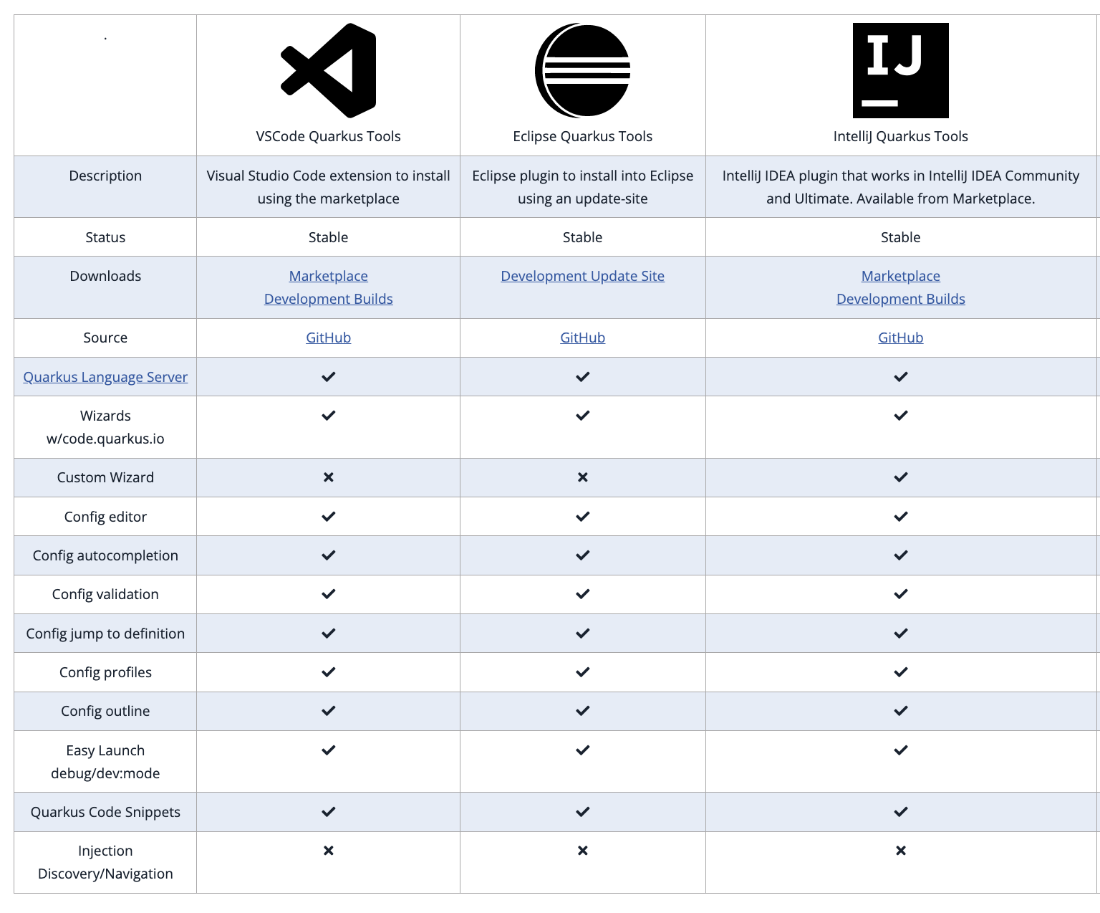
Quarkus IDE Plugin Features

Slide 18
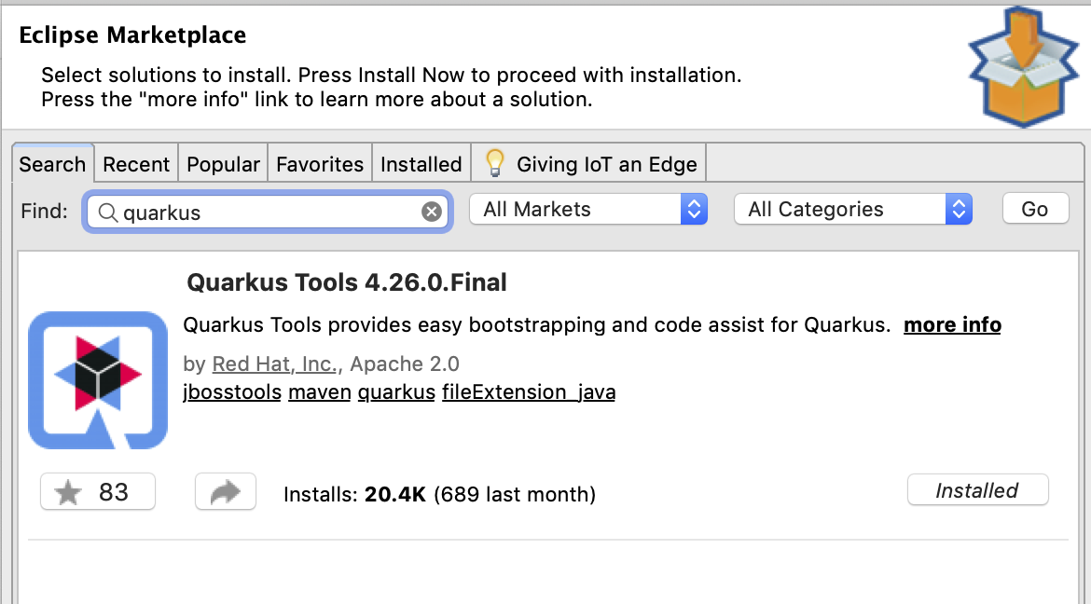
Eclipse Quarkus Tools Plugin
Quarkus app creation
Config intellisense
Run configuration
Website - https://marketplace.eclipse.org/content/quarkus-tools

Slide 19
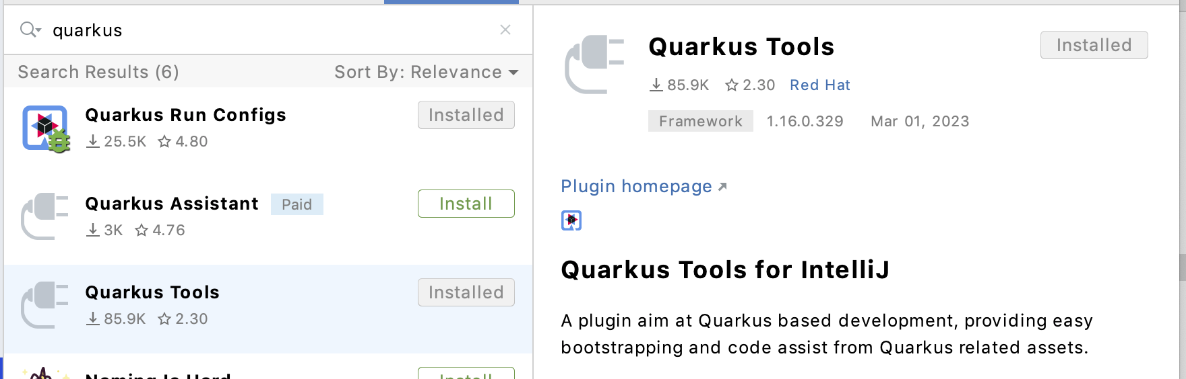
Intellij IDEA CE Quarkus Tools Plugin
Quarkus app creation
Config intellisense
Run configuration
Website - https://plugins.jetbrains.com/plugin/13234-quarkus-tools

Slide 20
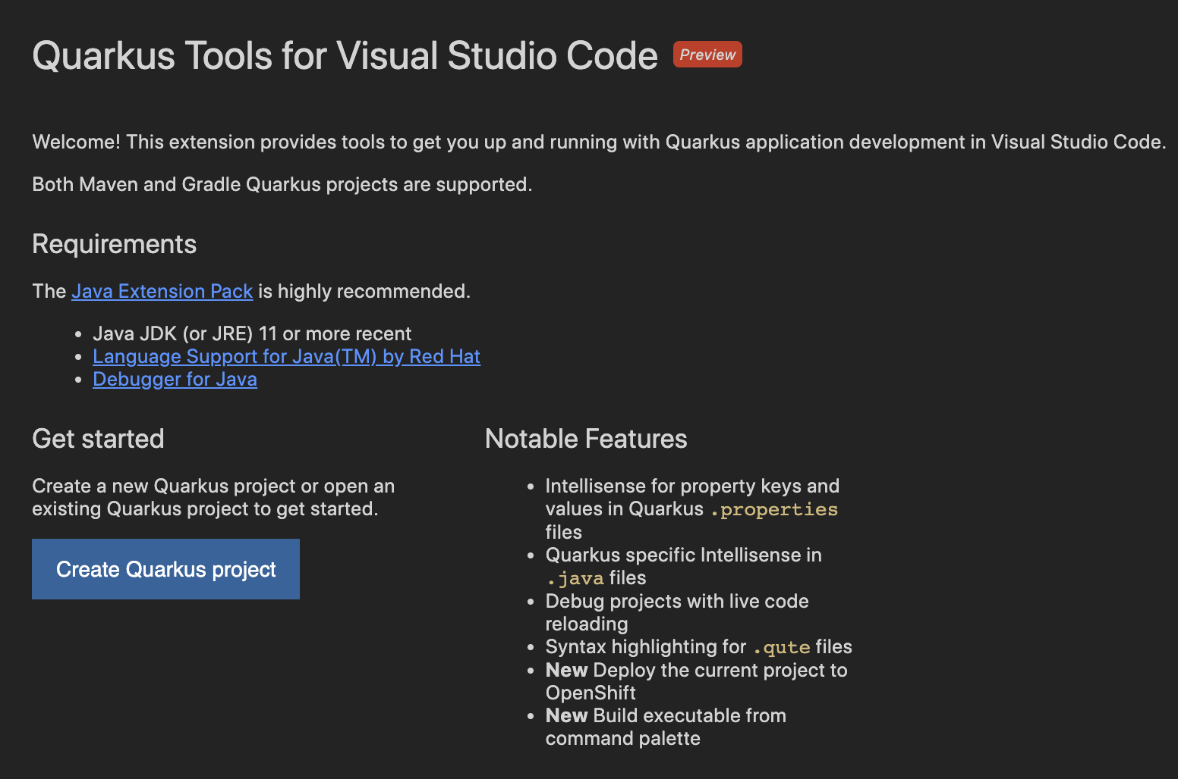
VS Code CE Quarkus Tools Extension
Quarkus app creation
Config intellisense
Run & Debug
Deploy
Website https://marketplace.visualstudio.com/items?itemName=redhat.vscode-quarkus

Slide 21
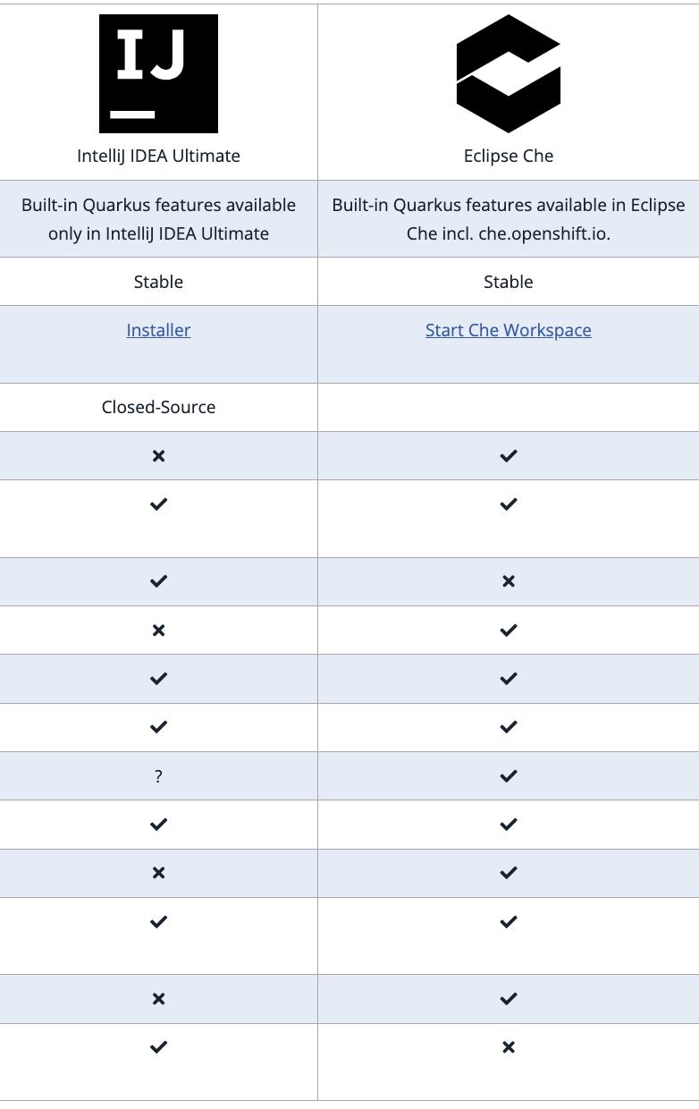
Other IDE Support
Intellij IDEA Ultimate Edition – Licensed version of Intellij IDEA
Eclipse Che - open-source, Java-based developer workspace server and Online IDE
Flexible RESTful webservice
SDK for creating plugins

Slide 22
End

