Slide 1
Quarkus
03 - Context and Dependency Injection (CDI)

Slide 2
Part 1
CDI Basics

Slide 3
Agenda
CDI Introduction
Beans Definition & Example
Bean Injection Rules & Methods
Bean Qualifiers
Bean Scopes
Client Proxy
Bean Types
Interceptors
Decorators
Events

Slide 4
Context & Dependency Injection (CDI)
Dependency Injection is a design pattern in which an object or function receives other objects or functions that it depends on – rather than creating those objects or functions itself
It is a form of Inversion of Control (IoC) design pattern
It separates the following concerns
Object creation & lifecycle management
Object usage
CDI is a standard dependency injection framework included in Java EE 6 and higher
It manages the lifecycle of stateful components via domain-specific lifecycle contexts and inject components into client objects in a type-safe way

Slide 5
Bean
Bean is a container managed object. It supports
Dependency Injection
Lifecycle Events
Interceptors
Container is the environment where the application runs
Container manages bean lifecycle
Creation and destruction of bean instances
Associating instances with designated context
Injecting bean instances in other beans
Application developers don’t have to worry about obtaining a fully initialized object with all dependencies, it is handled by the container

Slide 6
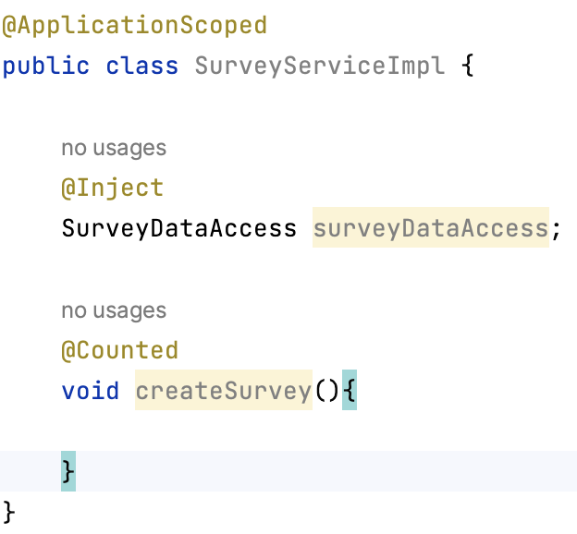
Bean Example
@ApplicationScoped – context association & lifecycle
@Inject – other bean dependency
@Counted – intercepter

Slide 7
Bean Injection Rules
Matching a bean to an injection point is type-safe
A bean is assignable to an injection point if the bean is of matching type and has the required qualifiers
Exactly one bean must be assignable to an injection point, otherwise the build fails
No matching bean – UnsatisfiedResolutionException
Multiple assignable beans - AmbiguousResolutionException

Slide 8
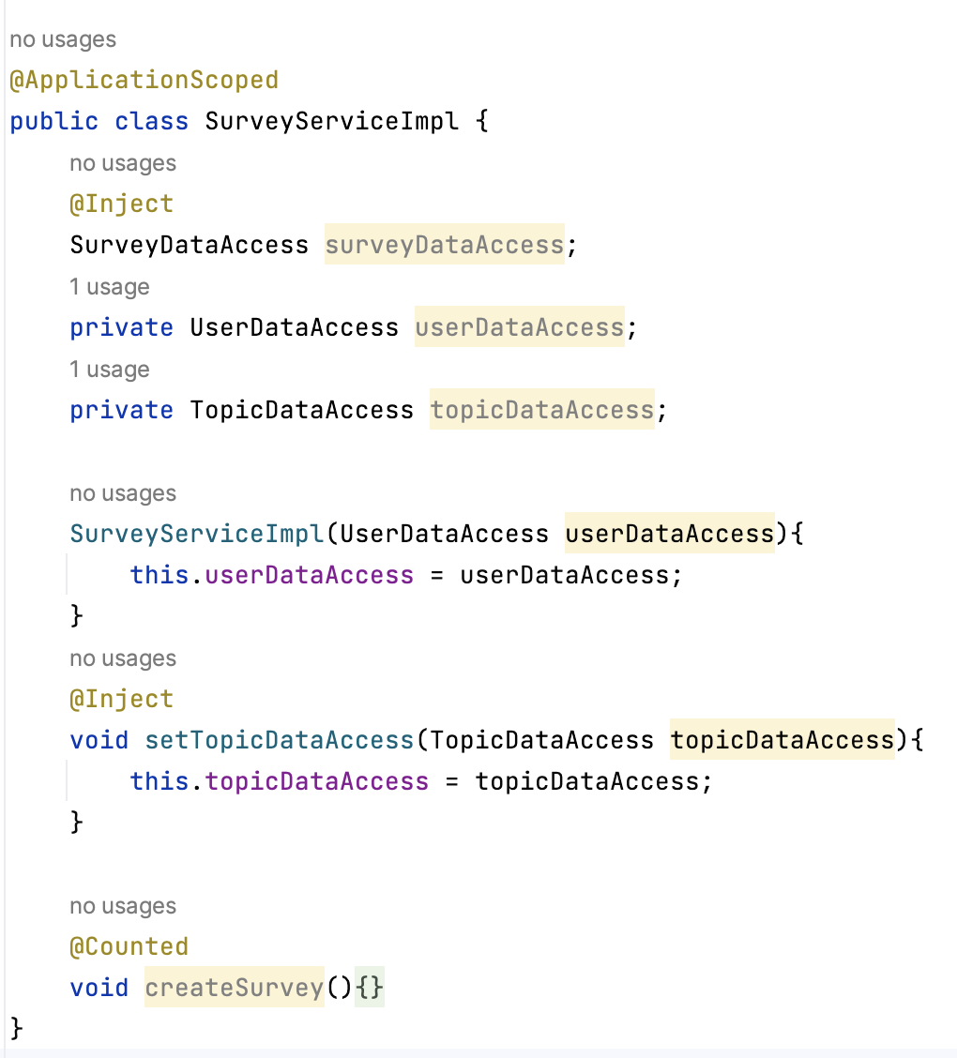
Bean Injection Methods
Field injection
Constructor injection
Initializer Method injection

Slide 9
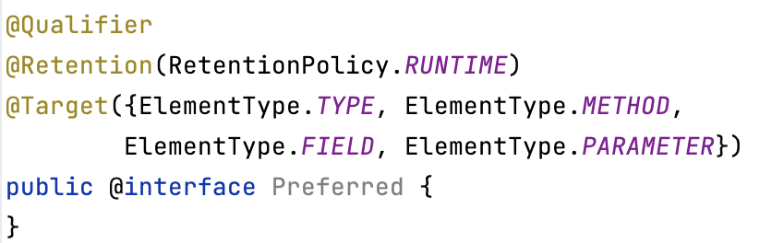
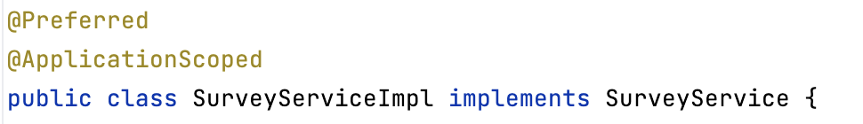
Bean Qualifiers
Qualifiers are annotations that distinguish beans that implement the same type
If no qualifier is mentioned, @Default qualifier is assumed
Assignable:
@Inject @Preferred SurveyService
@Inject @Preferred SurveyServiceImpl
Not Assignable:
@Inject SurveyService
@Inject SurveyServiceImpl

Slide 10
Bean Scope
Scope determines the lifecycle of Bean instances i.e., when and where an instance should be created and destroyed
A Bean can have exactly one scope
Scope | Lifecycle
@ApplicationScoped | Single Bean instance used for whole application & created lazily (via client proxy)
@javax.inject.Singleton | Single Bean instance used for whole application but without client proxy
@RequestScoped | A Bean instance associated with each Http Request
@Dependent | Each injection point creates new instance. Lifecycle is tied with the same of the Bean injecting this Bean.
@SessionScoped | A Bean instance associated with each Http Session

Slide 11
Client Proxy
A client proxy is an object that delegates all method invocations to a target bean instance
In Quarkus, client proxies are created by the Container
Implements io.quarkus.arc.ClientProxy interface
Extends the target Bean class
A client proxy is always injected instead of the actual Bean instance
Client proxy allows:
Lazy instantiation of the target Bean
Inject Bean with "narrower" scope to a bean with "wider" scope
Circular dependencies in the dependency graph
Manual destruction & recreation of target Bean instance

Slide 12
@ApplicationScoped vs. @Singleton
ApplicationScoped | Singleton
Uses client proxy | Does not use client proxy
Lazily instantiated – on first method invocation on instance | Eagerly instantiated – on Bean injection
Should not read/write Bean fields directly – use getter/setter instead | Can read/write Bean fields directly
Slightly less performant because of indirection via client proxy | No impact on performance
Can be mocked using QuarkusMock | Cannot be mocked with QuarkusMock
Original Bean instance can be destroyed and recreated | Original Bean destruction will result in stale Bean reference
Quarkus recommends usage of @ApplicationScoped instead of @Singleton

Slide 13
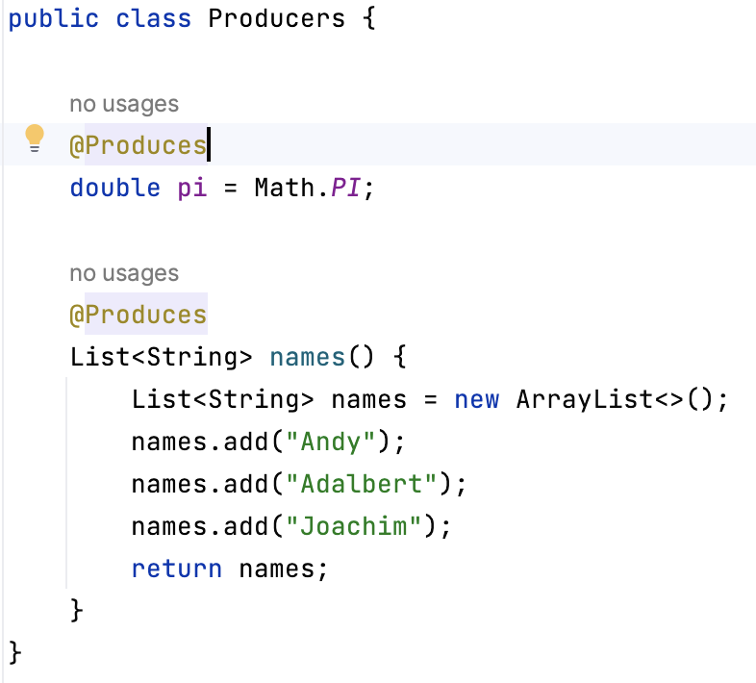
Bean Types
Class Beans – most common
Producer Methods – useful for integrating 3rd party libraries
Producer Fields – similar to producer methods
Synthetic Beans – provided by extensions

Slide 14
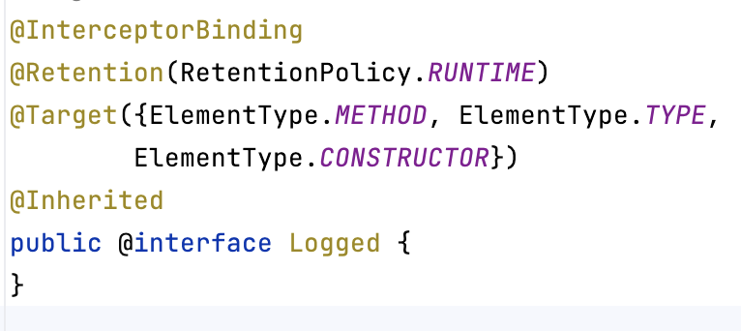
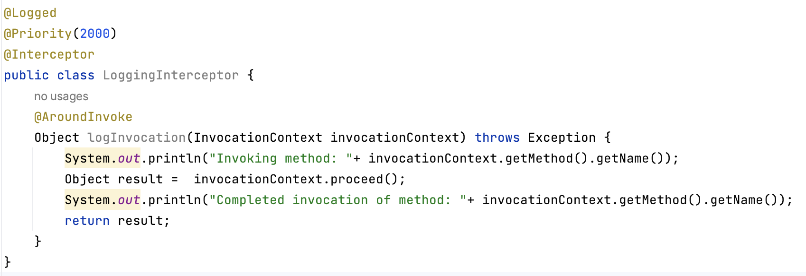
Interceptor
Interceptors are used to separate cross-cutting concerns from business logic
Instances of interceptors are dependent objects of the bean instance they intercept

Slide 15
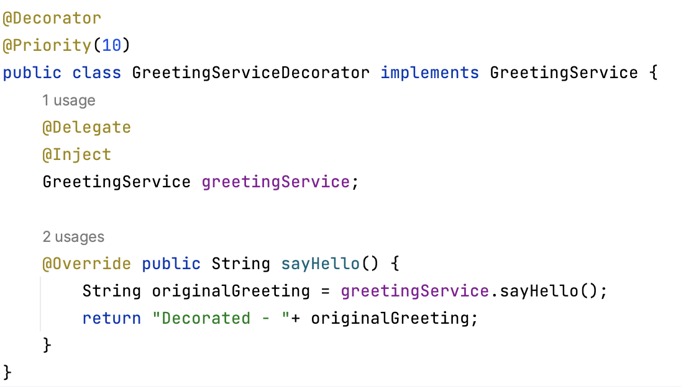
Decorator
Decorators are like interceptors, but they can implement business logic
Instances of decorators are dependent objects of the bean instance they decorate

Slide 16
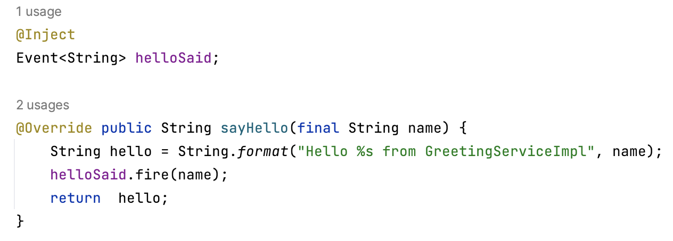
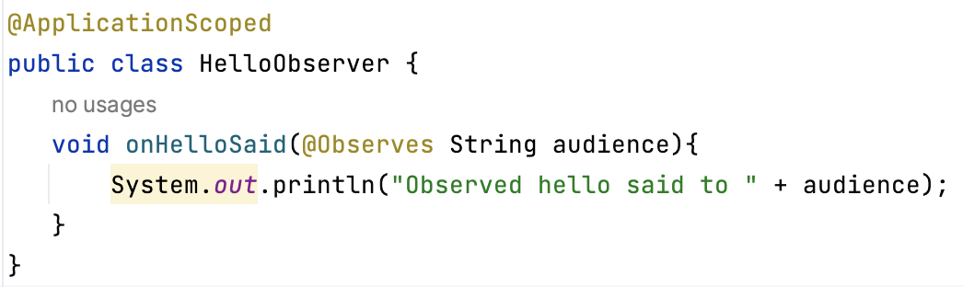
Events
Bean lifecycle events
@PostConstruct - initialization
@PreDestroy – cleanup
Events and Observers
Beans may also produce and consume events to interact in a completely decoupled fashion
Any Java object can be an event payload
The optional qualifiers act as topic selectors

Slide 17
End

Slide 18
Part 2
Quarkus Specific CDI Implementation

Slide 19
Bean Discovery
Quarkus used simplified bean discovery with bean discovery mode as annotated
Beans are discovered from:
Application classes
Dependencies with beans.xml descriptor
Dependencies with Jandex index - META-INF/jandex.idx
Dependencies referenced by quarkus.index-dependency in application.properties
Quarkus integration code
Different from CDI: Producer methods and fields and observer methods are discovered even if the declaring class is not annotated with a bean defining annotation
The declaring classes are considered to have @Dependent annotation
Notes:
Bean discovery annotations include @ApplicationScoped, @Dependent, @RequestScoped etc.

Slide 20
Bean Discovery…
Generating Jandex index file
Using io.smallrye:jandex-maven-plugin maven plug in with execution goal jandex
Adding quarkus.index-dependency entries to application.properties
quarkus.index-dependency.acme.group-id=org.acme
quarkus.index-dependency.acme.artifact-id=acme-api
Excluding types & dependencies from discovery
Adding quarkus.arc.exclude-types entries in application.properties
quarkus.arc.exclude-types=org.acme.Foo,org.acme.*,Bar
Adding quarkus.arc.exclude-dependency entries in application.properties
quarkus.arc.exclude-dependency.acme.group-id=org.acme
quarkus.arc.exclude-dependency.acme.artifact-id=acme-services

Slide 21
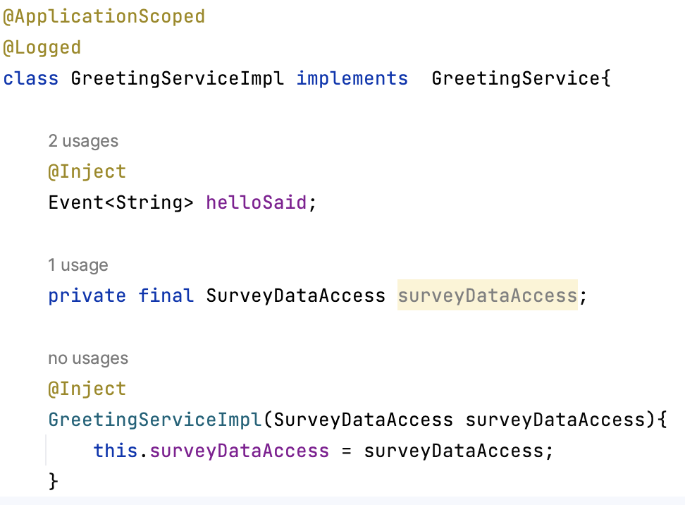
Reflection Usage
GraalVM does not support reflection by default
For reflective operations, all relevant members need to be explicitly registered
This results in a bigger native executable file
Quarkus needs to use reflection to access private members
Quarkus recommends not to use private Bean members
Injected fields, constructors, initializers
Interceptor, observer, producer methods & fields
Alternative is to use
Package private members
Constructor injection (for fields)

Slide 22
Supported CDI Features
Programming model
Managed beans implemented by a Java class
@PostConstruct and @PreDestroy lifecycle callbacks
Producer methods and fields, disposers
Qualifiers
Alternatives
Stereotypes
Dependency injection and lookup
Field, constructor and initializer/setter injection
Type-safe resolution
Programmatic lookup via javax.enterprise.inject.Instance
Client proxies
Injection point metadata
Scopes and contexts
Interceptors & Decorators
Business method interceptors: @AroundInvoke
Interceptors for lifecycle event callbacks: @PostConstruct, @PreDestroy, @AroundConstruct
Events and observer methods

Slide 23
Non-Standard Features
Eager Bean Instantiation
By default, CDI Beans are lazily instantiated when needed
Quarkus allows eager instantiation by using @Startup annotation
This automatically creates a synthetic observer to StartupEvent
Qualified Injected Fields
Unlike CDI, Quarkus does not require @Inject annotation on a field which declares one or more Bean Qualifier Annotation
@ConfigProperty(name = "cool") String coolProperty
Simplified Constructor Injection
Unlike CDI, Quarkus does not need a no-args Bean constructor
@Inject annotation is also not required if there is only one Bean constructor
Notes:
Default CDI Behavior:
A normal scoped bean (@ApplicationScoped, @RequestScoped, etc.) is needed when a method is invoked upon an injected instance (contextual reference per the specification).
In other words, injecting a normal scoped bean will not suffice because a client proxy is injected instead of a contextual instance of the bean.
A bean with a pseudo-scope (@Dependent and @Singleton ) is created when injected.

Slide 24
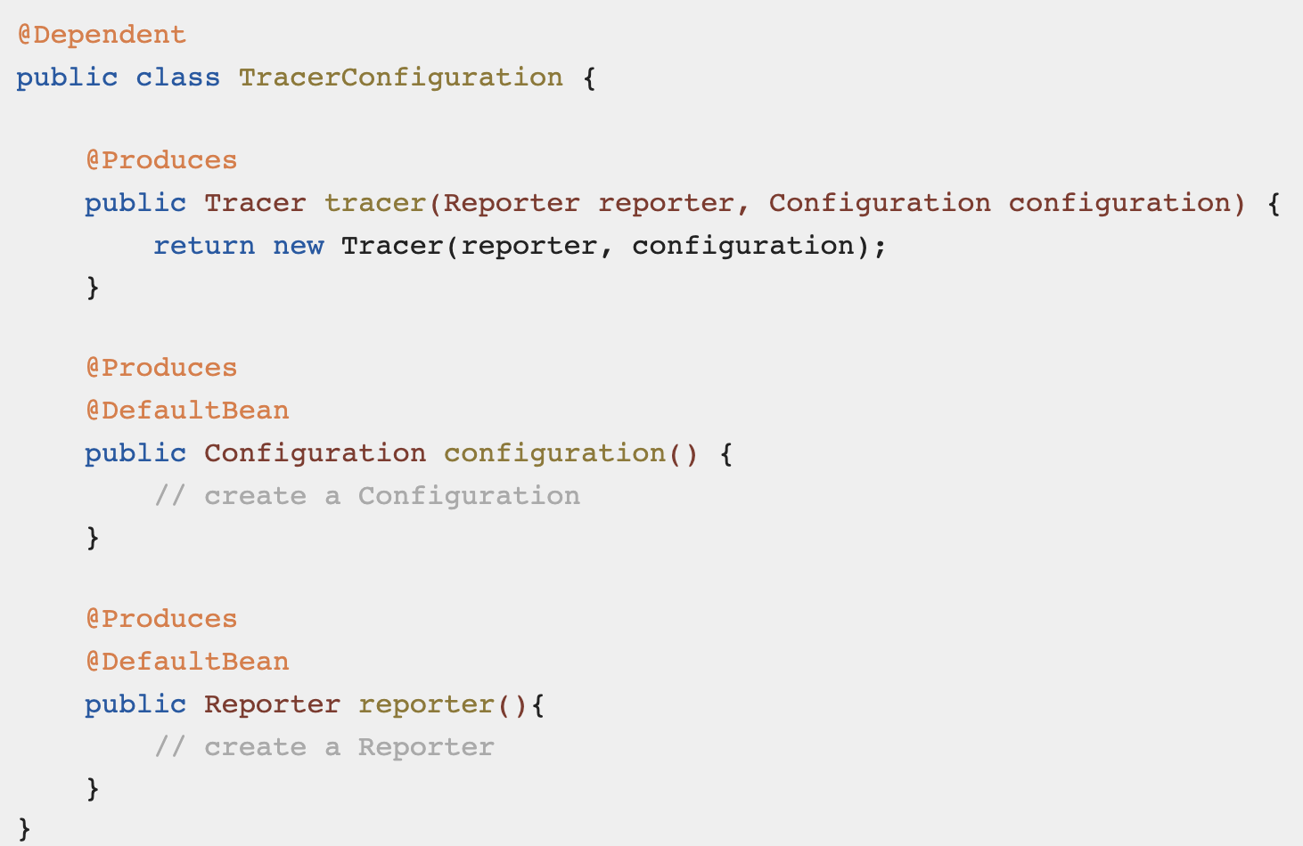
Non-Standard Features…
Default Beans
Quarkus conditionally declare a Bean as default if no other Bean with equal type & qualifiers is available
Uses @io.quarkus.arc.DefaultBean annotation

Slide 25
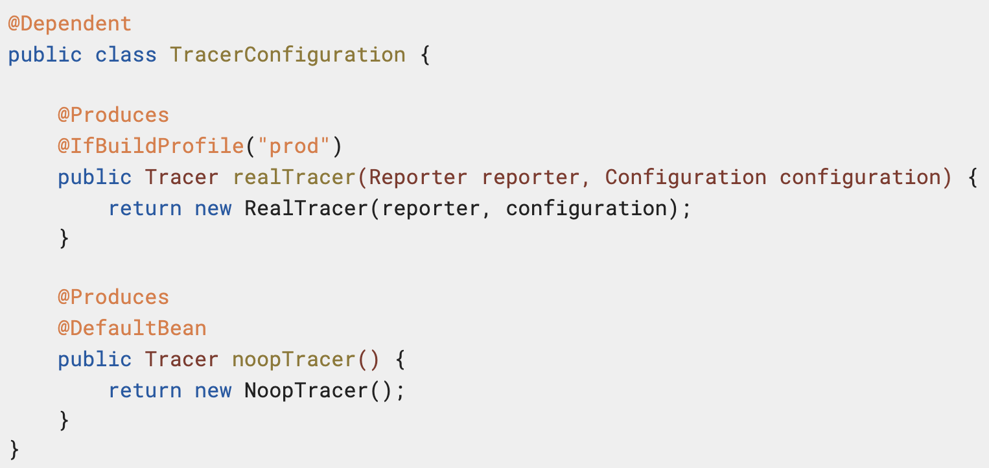
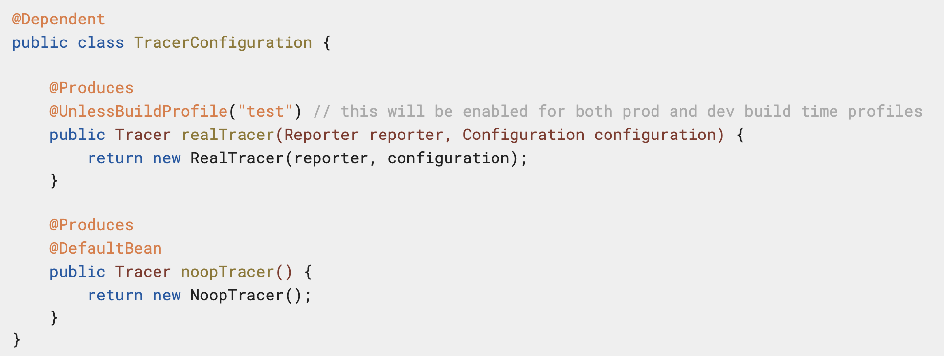
Non-Standard Features…
Conditional Beans based on Quarkus Build profiles
@io.quarkus.arc.profile.IfBuildProfile
@io.quarkus.arc.profile.UnlessBuildProfile

Slide 26
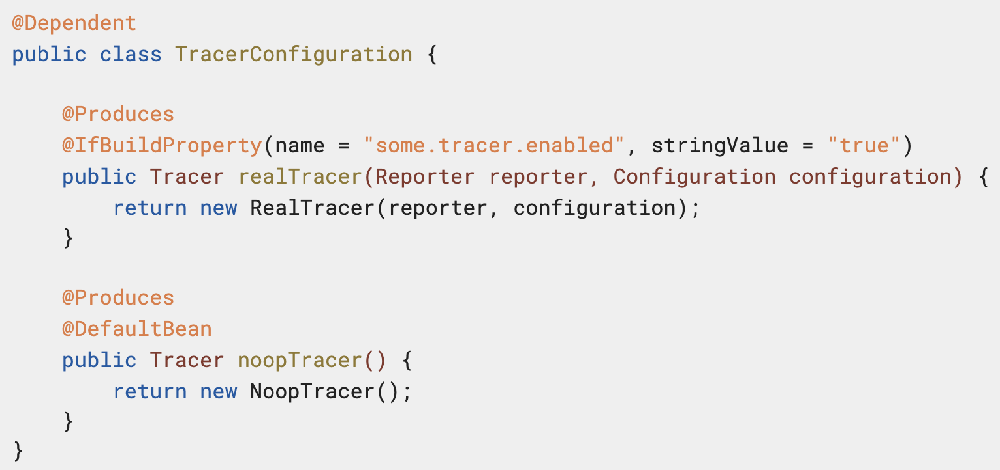
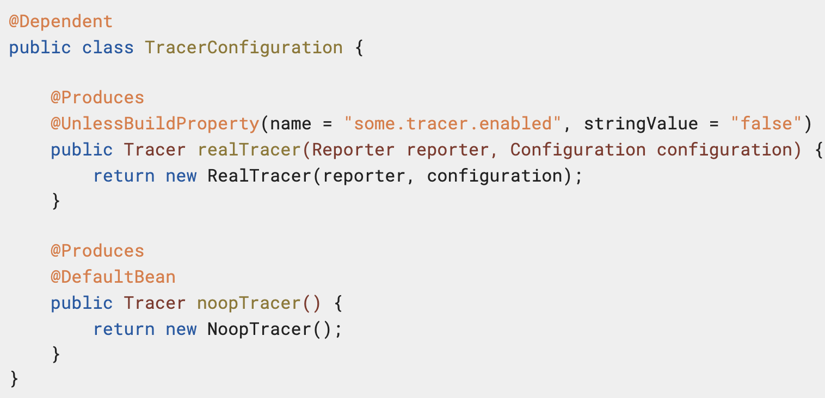
Non-Standard Features…
Conditional Beans based on Quarkus Build properties
@io.quarkus.arc.profile.IfBuildProperty
@io.quarkus.arc.profile.UnlessBuildProperty

Slide 27
Non-Standard Features…
Selected Bean Alternatives
Recommended to use @io.quarkus.arc.Priority for alternative Beans
Alternatives can be declared via quarkus.arc.selected-alternatives property in application.properties
Simplified Producer method declaration
Quarkus does not require @Produces annotation if the method is annotated with either of
Scope annotation
Stereotypes
Bean Qualifiers

Slide 28
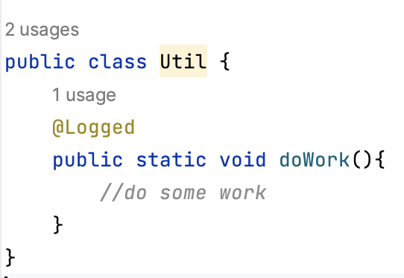
Non-Standard Features…
Static Method Interception
Since Quarkus processes CDI annotations at build time, it can invoke around-invoke interceptors for non-private static methods
Only method level bindings are considered for static method interception
InvocationContext.getTarget() returns null in the interceptor for static methods

Slide 29
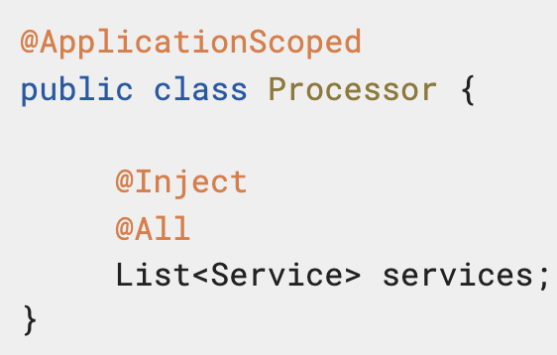
Non-Standard Features…
Final class and method handling
Unlike CDI, Quarkus can create client proxy and intercept final methods if application property quarkus.arc.transform-unproxyable-classes is set to true (default)
Concurrency management
Quarkus provides @io.quarkus.arc.Lock and a built-in interceptor to manage thread safe access to Beans with shared scopes like @ApplicationScoped & @Singleton
Injecting multiple Bean instances
Using java.util.List annotated with the io.quarkus.arc.All qualifier

Slide 30
Unused Bean Removal
Quarkus attempts to remove all unused beans, interceptors and decorators during build by default
This helps to minimize generated classes and reduced memory usage
Quarkus cannot detect dynamically looked up Beans via CDI.current() methods and may remove used Beans – false positives
@io.quarkus.arc.Unremovable annotation marks a Bean not be removed even if found unused
quarkus.arc.unremovable-types application property can be used to indicate unremovable Beans
quarkus.arc.unremovable-types=org.acme.Foo,org.acme.*,Bar

Slide 31
CDI Information in dev Mode
Special endpoints in dev mode
HTTP GET /q/arc - returns the summary; number of beans, config properties, etc.
HTTP GET /q/arc/beans - returns the list of all beans
HTTP GET /q/arc/removed-beans - returns the list of unused beans removed during build
HTTP GET /q/arc/observers - returns the list of all observer methods

Slide 32
End

