Slide 1
Quarkus
04 - Create, Test & Run An Application

Slide 2
Part 1
Create, Build and Run An Application

Slide 3
Agenda
Installing Quarkus CLI
Create Application via Quarkus CLI
Create Application via code.quarkus.io
Adding REST API Endpoint
Build Application
Running Application
dev Mode
non-dev Mode

Slide 4
Quarkus CLI Installation
Command
curl -Ls https://sh.jbang.dev | bash -s - trust add https://repo1.maven.org/maven2/io/quarkus/quarkus-cli/
curl -Ls https://sh.jbang.dev | bash -s - app install --fresh --force quarkus@quarkusio
Windows Powershell
iex "& { $(iwr https://ps.jbang.dev) } trust add https://repo1.maven.org/maven2/io/quarkus/quarkus-cli/”
iex "& { $(iwr https://ps.jbang.dev) } app install --fresh --force quarkus@quarkusio”
Other installation options – SDKMan, HomeBrew (in MacOS), Chocolatey

Slide 5
Creating Application using CLI
Create Application (with default options)
quarkus create app com.learn.qk:code-with-quarkus-from-cli
List available Extensions
quarkus ext ls
Add Extensions
quarkus ext add quarkus-resteasy-reactive
quarkus ext add quarkus-resteasy-reactive-jackson

Slide 6
Create Application from code.quarkus.io
Open https://code.quarkus.io/ in Browser
Enter Group, Artifact and Version
Select Build Tool & Java Version
Select required extensions
Generate App & Download

Slide 7
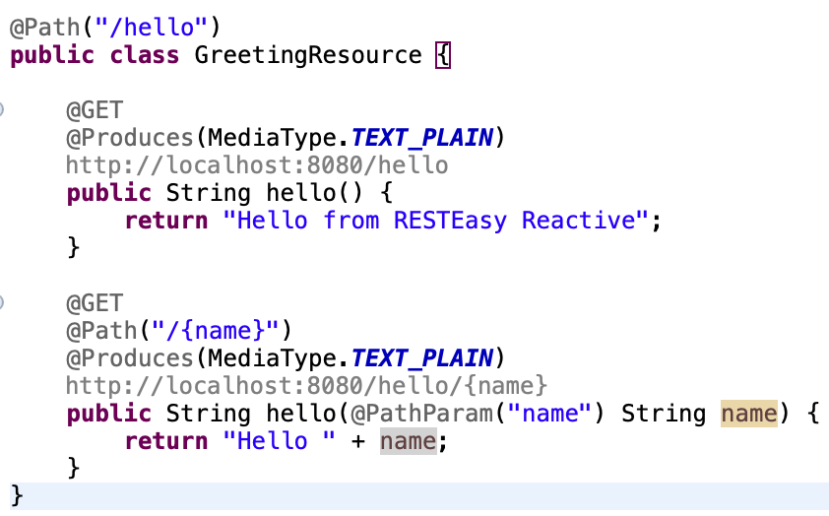
Adding REST API Endpoint
Add the following extensions
quarkus-resteasy-reactive
quarkus-resteasy-reactive-Jackson
Quarkus uses jaxrs annotations for defining REST resource

Slide 8
Building Application
Navigate to Project Directory
Execute quarkus build
This compiles the source code, execute unit tests and create executable jar
Similar to maven install

Slide 9
Running Application
Dev Mode
Navigate to project directory
Execute quarkus dev
Non Dev Mode
Execute quarkus build to build the project and create executable jar
Use java –jar <path to quarkus-run.jar> to run application

Slide 10
End

Slide 11
Part 2
Continuous Testing

Slide 12
Agenda
Introduction to Continuous Testing
Running Tests in Dev Mode
Controlling Continuous Testing Mode
Running Tests without Dev Mode

Slide 13
Introduction to Continuous Testing
Quarkus supports continuous testing, where tests run immediately after code changes have been saved.
This allows to get instant feedback on code changes.
Quarkus detects which tests cover which code, and uses this information to only run the relevant tests when code is changed.

Slide 14
Running Tests in Dev Mode
Run any quarkus application in dev mode
Execute quarkus dev
Press r to resume testing, tests will run
Continuous Tests can be automatically run in dev mode with following entry in application.properties
quarkus.test.continuous-testing=enabled

Slide 15
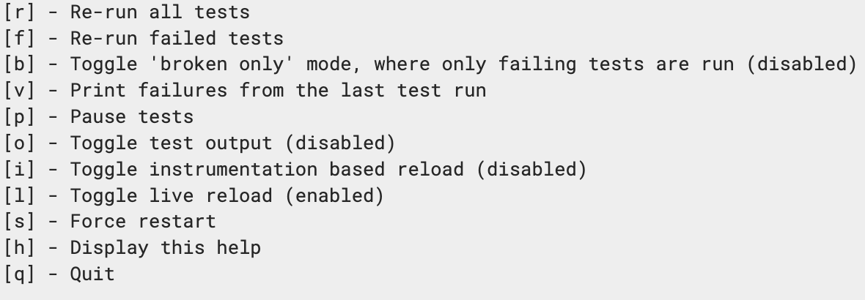
Controlling Continuous Testing
Below Hot Keys can be used to control continuous testing

Slide 16
Continuous Testing without Dev Mode
It is possible to run continuous testing without starting dev mode
This can be useful if dev mode will interfere with tests or if we want to develop only using tests
To start continuous testing mode run mvn quarkus:test
Dev UI is not available in continuous testing mode

Slide 17
End

Slide 18
Part 3
Quarkus Dev Mode

Slide 19
Agenda
Introduction to dev mode
Architectural differences between dev & non-dev mode
Dev mode features
Performance Implications of dev mode
Security Implications of dev mode

Slide 20
What is Quarkus Dev Mode?
Quarkus applications can be run in dev mode using quarkus dev or mvn quarkus:dev commands
In Dev Mode, changes in sources, resources and configurations are automatically reflected in the running application
Dev mode enables hot deployment with background compilation
Any request to the application triggers a scan of the workspace, and if any changes are detected the Java files are compiled, and the application is redeployed

Slide 21
Architectural Difference - dev & non dev
In dev mode, Quarkus uses a ClassLoader hierarchy that enables the live reload of user code without requiring a rebuild and restart of the application.
In a production application, this class loading infrastructure is entirely absent - there is a single, purpose built ClassLoader that loads almost all classes and dependencies.

Slide 22
Dev Mode Features
Live Reload
Dev UI – view and optionally change the state of the application
Changing configuration values
Running Database migration scripts
Clearing of caches
Running scheduled operations
Building a container
Error pages – with more detailed errors
Others –
Database import scripts
Dev Services
Swagger UI
GraphQL UI
Health UI
Mock mailer
gRPC Tools

Slide 23
Performance Implication
In dev mode, the main objective is developer joy and not necessarily reducing run time footprint
Many more classes are loaded and build time operations also take place every time a live-reload is performed
This may increase start up time and memory usage
In Production mode
Build time operations are not performed at run time
Various infrastructure classes needed at build time are not present at all at runtime
Class lookup is done as fast as possible while keeping the minimum amount of jars in memory

Slide 24
Security Implications
Dev mode exposes potentially confidential information via Dev UI
Dev mode enables potentially destructive operations
These may have serious security implications
Application should never be run in dev mode in production

Slide 25
End

