Slide 1
Quarkus
05 – Database Access

Slide 2
Topics
Introduction Database Access Support in Quarkus
Data Access using Reactive SQL Client
Data Access using Hibernate ORM with Panache
Zero Config H2 and MySql Database using Dev Services
Unit Testing Database Access

Slide 3
Part 1
Introduction to Database Support & A Sample Application

Slide 4
Agenda
Quarkus Database Support Overview
Data Access Approaches
Overview of Sample CRUD Application

Slide 5
Quarkus Database Support
Quarkus RDBMS support is provided by extensions
Quarkus supports following RDBMS access
MySql
PostgreSQL
Oracle
Microsoft SQL Server
DB2,
MariaDb
Derby, H2 – in memory
Both regular and Reactive datasource are supported
In dev mode, ‘zero config’ container based databases can be used

Slide 6
Data Access Approaches & Transactions
Supported Methods
Plain JDBC Result Set based data access
Object Relational Mapping (ORM) based access
Hibernate ORM
Simplified Hibernate with Panache
Transactional operations are supported via declarative or programmatic approach

Slide 7
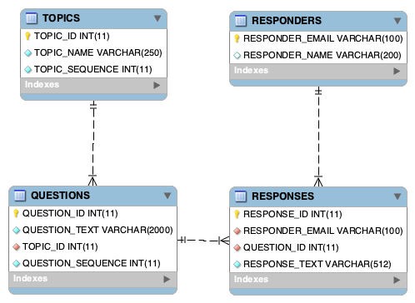
Overview of Sample CRUD Application
Survey service application with REST API to
Create Survey Questions under different Topics
Capture Survey Responses submitted by Responders
Database MySql

Slide 8
End

Slide 9
Part 2
Data Access using Reactive SQL Client

Slide 10
Agenda
Introduction to reactive SQL client
Reactive SQL Client Extensions
Configuring Reactive Datasource
Reading & Writing Data – Reactive way
Handling Transactions

Slide 11
Introduction To Reactive SQL Clients
Quarkus Reactive SQL Clients allow data access in a non-blocking manner thus increasing scalability and reducing overhead
Currently following databases are supported for reactive access:
IBM Db2
PostgreSQL
MariaDB/MySQL
Microsoft SQL Server
Oracle

Slide 12
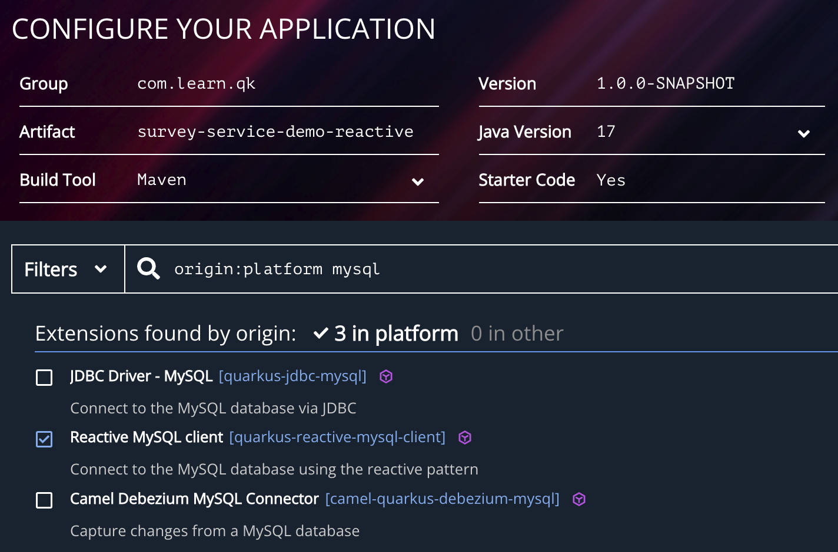
Reactive SQL Client Extensions
Select database specific reactive SQL client extension while creating the application
Add additional extensions for REST API:
restEasy-reactive
restEast-reactive-jackson

Slide 13
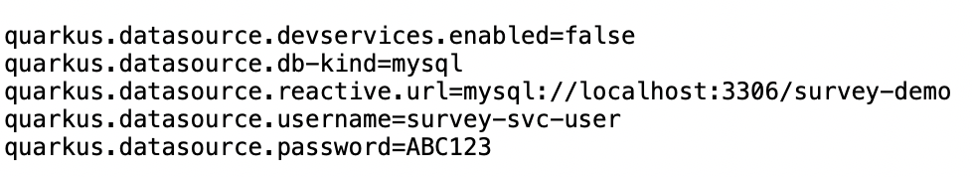
Configure Datasource Properties
dev services are disabled to use external database instead of ‘test containerized’ database
Specific property for reactive JDBC URL
quarkus.datasource.reactive.url

Slide 14
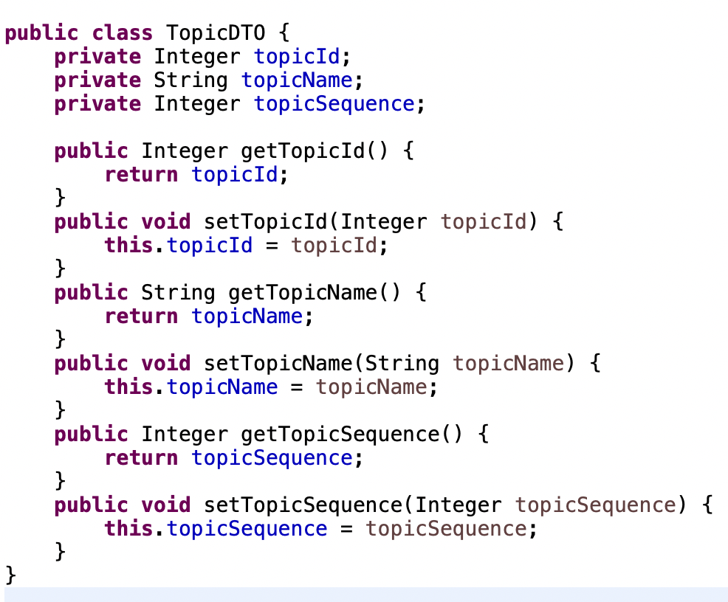
Define DTO/POJO Class

Slide 15
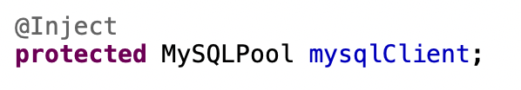
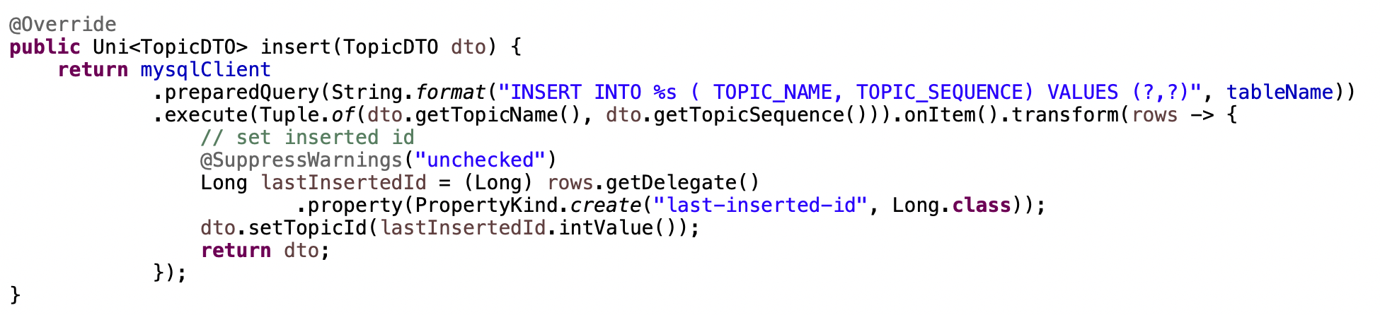
Insert Data
Inject Reactive io.vertx.mutiny.mysqlclient.MySQLPool
Use prepared statement to pass parameters
The returned RowSet contains ‘inserted id’ as metadata property

Slide 16
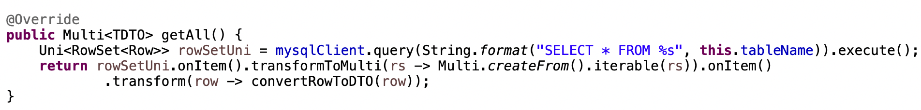
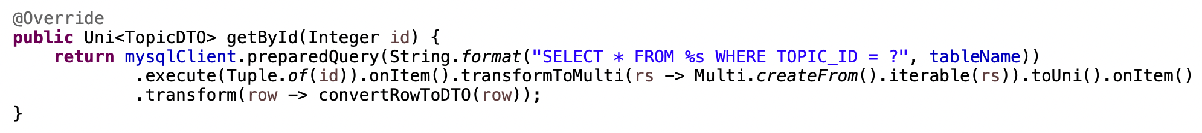
Query Data
Inject Reactive io.vertx.mutiny.mysqlclient.MySQLPool
Execute Query as simple string or prepared statement – this returns reactive streams of RowSet

Slide 17
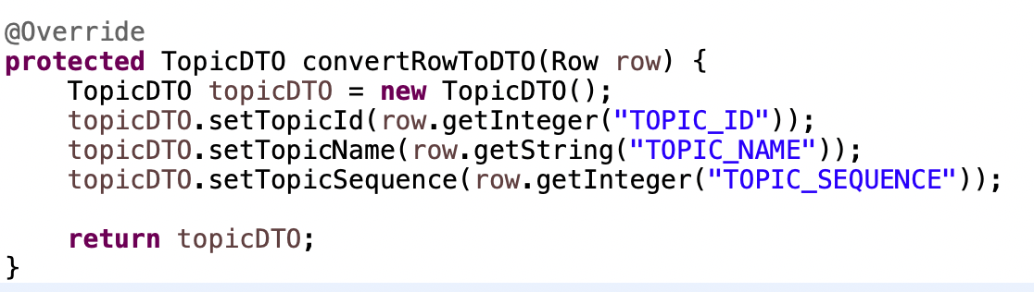
Reading Data & Metadata from Row
Row provides API similar to JDBC ResultSet
Type safe values can be accessed by column name or index
RowSet Metadata
The number of rows affected by the query
Column names

Slide 18
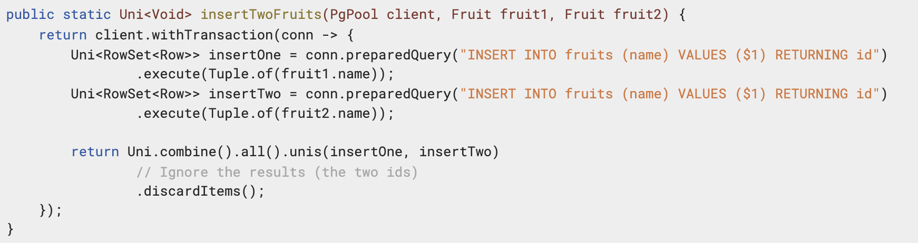
Transactions
The reactive SQL clients support transactions
io.vertx.mutiny.sqlclient.SqlConnection#begin – starts Tx
io.vertx.mutiny.sqlclient.Transaction#commit / rollback – completes Tx
io.vertx.mutiny.sqlclient.Pool#withTransaction methods wraps statements within a Tx

Slide 19
End

Slide 20
Part 3
Data Access using Hibernate ORM with Panache & H2 Database

Slide 21
Agenda
Introduction to Hibernate with Panache
Project Set up
Defining Entity
Defining Repository
Implementing CRUD API
Transaction Handling
Advanced Queries

Slide 22
Introduction to Hibernate with Panache
Hibernate ORM is the de facto JPA implementation in Quarkus
Panache is a Quarkus-specific library that makes Hibernate much easier to use especially for simpler use cases
Panache handles most of the boilerplate code required for Hibernate
Panache supports following patterns for CRUD operations
Active Records – Entity class itself provide CRUD methods
Repository – Entity specific Repository class for CRUD methods

Slide 23
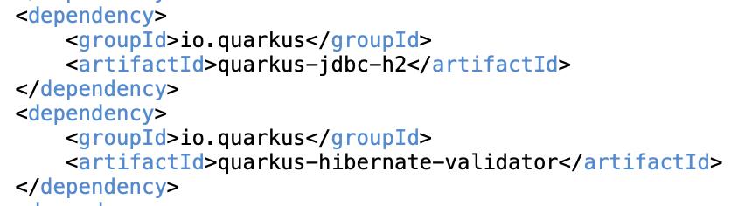
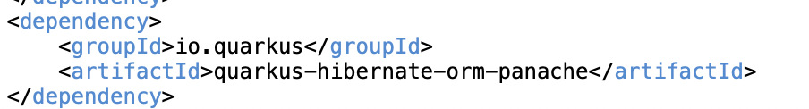
Project Set up with Extensions
H2 JDBC client – for in memory database in development mode
Hibernate validator – entity & field validation
Hibernate ORM Panache

Slide 24
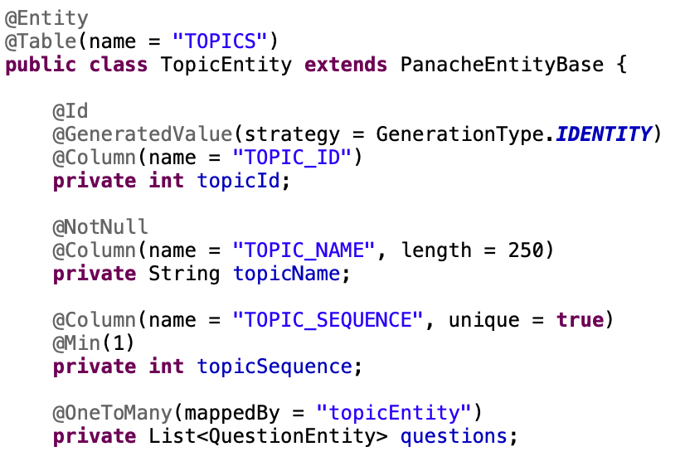
Defining Entity
Uses standard javax.persistence annotations
Extending PanacheEntity provides methods for ‘Active Record’ Pattern
By default a ‘Long’ Id field is assumed in PanacheEntity
To use custom Id field, should extend PanacheEntityBase

Slide 25
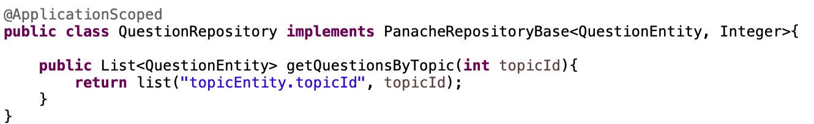
Defining Repository
For Repository pattern, extending PanacheEntity is optional and Entity classes can be regular JPA entities
Repository classes should implement PanacheRepository (or PanacheRepositoryBase for custom entity Ids) interface
Quarkus generates the actual method implementation during build time
Repository can be extended with custom methods

Slide 26
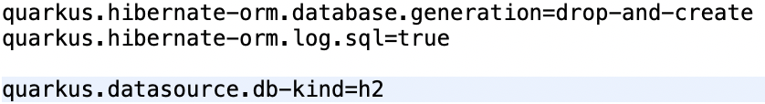
Implementing CRUD API
Define DTO objects for REST Request & Response
Define Service classes for encapsulating business logic
Define Jax-RS resources for exposing REST endpoints
Configure H2 Datasource

Slide 27
Transaction Handling
Methods modifying database (e.g. entity.persist()) should be wrapped within a transaction
Annotate a CDI bean method with @Transactional
Ideally should be done at Service method level handling ‘unit of work’

Slide 28
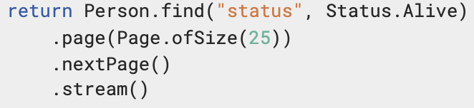
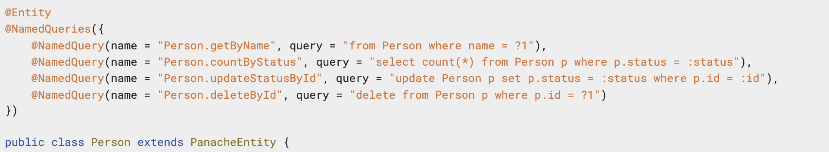
Advanced Queries
Paging
Sorting
NamedQuerie – referenced with # prefix

Slide 29
End

Slide 30
Part 4
Data Access with ‘zero config’ database & ‘production’ database

Slide 31
Agenda
Introduction to Dev Service
Connecting to Dev Service Database
Demonstration – Running against Dev Database
Connecting to ‘PROD’ Database

Slide 32
Introduction to Dev Service
When testing or running in dev mode Quarkus can provide you with a zero-config database out of the box
This is referred as ‘dev service’
Except for in-memory databases like H2, other databases need docker to provide dev service
To enable dev service:
Dev service is enabled by default while running in dev mode
Add corresponding database extension
Don’t configure datasource URL, username & password
To disable dev service:
quarkus.datasource.devservices.enabled=false

Slide 33
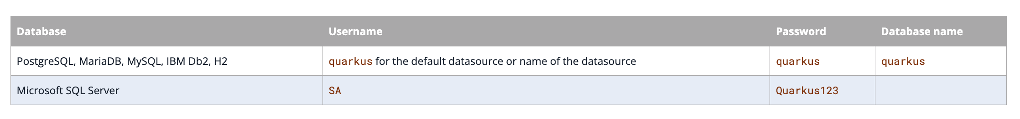
Connecting to dev service Database
Connecting to a database running as a Dev Service is similar to any database running inside a Docker container
Login credentials are the same for most databases, except when the database requirements don’t allow
Database is hosted at a random port which can be found with docker ps
It can be fixed with

Slide 34
Demonstration
Docker images for mysql and test-containers
Running docker containers
Executing CRUD operations

Slide 35
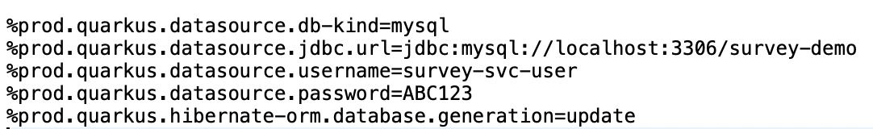
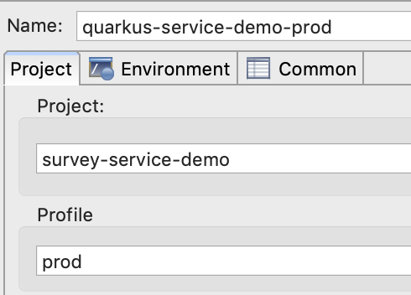
Connecting to ‘PROD’ Database
Prefix config keys with %prod prefix
Start application with prod profile
-Dquarkus.profile=prod
In Eclipse, run configuration

Slide 36
End

Slide 37
Part 5
Unit Testing Database Access

Slide 38
Agenda
Dependencies for Unit Test
Unit Test using Dev Services
Unit Test using Mocks

Slide 39
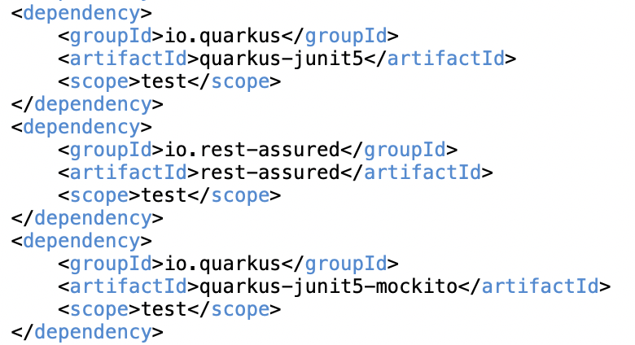
Add Unit Test Dependencies
Quarkus junit5 extension
Rest assured for testing testing REST APIs
Quarkus junit5 Mockito for mocking persistence layer

Slide 40

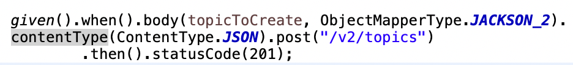
Unit Test using Dev Service Database
Annotate Test Class with @QuarkusTest
Annotate Test Method with @org.junit.jupiter.api.Test
Use rest assured for making REST call and asserting on response
This starts the dev services database and executes the test against the same

Slide 41
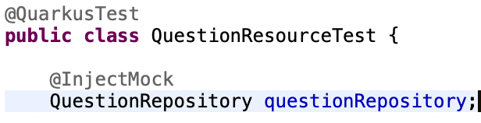
Mocking Repositories
Inject mocked instance of repository in Test class
Inside Test method, mock repository methods using Mockito
Use rest assured to make API call and assert on response, the API implementation will use mocked repository
This does not require dev services database to run tests
Note: Active record pattern requires quarkus-panache-mock dependency along with Mockito to use mocks

Slide 42
End

