Slide 1
Quarkus
06 – Application Configuration

Slide 2
Part 1
Quarkus Configuration Overview

Slide 3
Agenda
Introduction to Quarkus Configuration
Configuration Sources
Accessing Configuration Values
Configuration Value Conversion
Profiles
Property Expressions
Collection Type Properties
YAML File Support

Slide 4
Introduction
Quarkus Applications and Quarkus itself uses SmallRye Config API
SmallRye Config API is an implementation of MicroProfile Config Specification
Quarkus Extensions also use the same mechanism for configuration
Properties prefixed with quarkus. are reserved for configuring Quarkus itself and its extensions

Slide 5
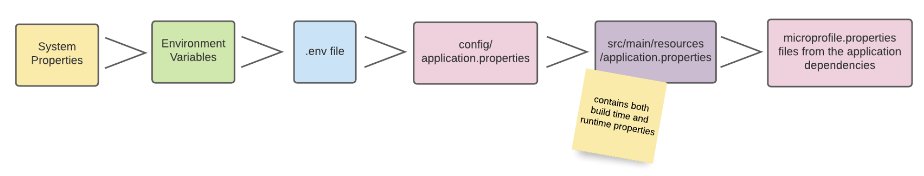
Configuration Sources
Configuration Sources in the descending order of priority
System properties
Environment variables
.env file in the current working directory
Quarkus Application configuration file in $PWD/config/application.properties
Quarkus Application configuration file application.properties in classpath
MicroProfile Config configuration file META-INF/microprofile-config.properties in classpath

Slide 6

Configuration Sources …
System Properties
Can be handed to the application through the -D flag during startup
Environment Variables
.env file in the current working directory
Quarkus Application configuration file
Loaded from classpath resources e.g. src/main/resources/application.properties or $PWD/config/application.properties

Slide 7
Configuration Sources…
MicroProfile configuration file src/main/resources/META-INF/microprofile-config.properties
Follows same syntax as application.properties file
Quarkus recommends to use application.properties instead of microprofile-config.properties
Additional Configuration Sources
Yaml
HashiCorp Vault
Spring Cloud
Consul

Slide 8

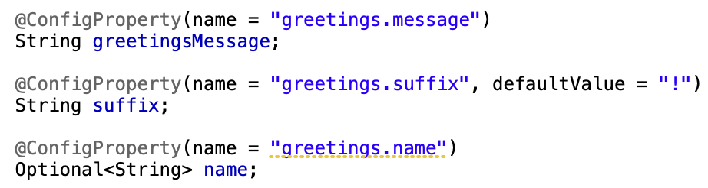
Accessing Configuration Values
Injecting properties
Defining in application.properties file
Accessing in code
Programmatic access
Useful when CDI injection is not available

Slide 9
Value Conversion
Config values expressed as String are automatically converted to the target type by several built-in converters
Primitives: boolean, byte, short, etc.
Boxed primitives: java.lang.Boolean, java.lang.Byte, java.lang.Short, etc.
Optional containers: java.util.Optional, java.util.OptionalInt etc.
Java enum types
JSR 310 java.time.Duration
JDK networking java.net.SocketAddress, java.net.InetAddress, etc.
Custom converters can be implemented by extending org.eclipse.microprofile.config.spi.Converter

Slide 10
Profiles
Allows to have different configuration values based on target environment
At runtime, profile is selected based on –Dquarkus.profile start up argument
Default profiles – dev, test, prod
Custom profiles can also be added via quarkus.profile configuration property
Defining profile specific values
Profile in the config name - %{profile-name}.config.name
Profile specific files - application-{profile}.properties

Slide 11
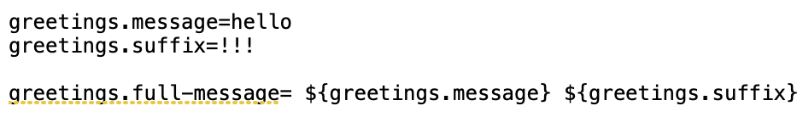
Property Expressions
Expression is a mix of plain texts and expression segments, which are wrapped by the sequence ${ …​ }
Expressions are resolved when the property is read
Expressions can also use Environment variables
Generating random UUID

Slide 12

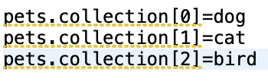
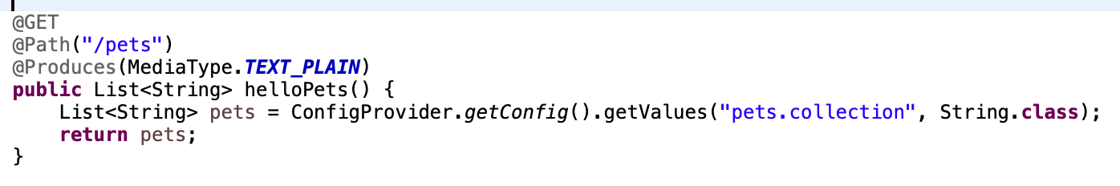
Collection Type Properties
Config value which contains un-escaped commas may be converted to Collection
Indexed Properties provide a way to use indexes in config property names to map specific elements in a Collection type

Slide 13

YAML File Support
Quarkus supports YAML in addition to the standard Java Properties file
This is enabled via quarkus-config-yaml extension
Profile definition requires double quotes like “%prod”
Configuration key conflict is resolved using a ‘null’ key represented by ‘~’

Slide 14
End

Slide 15
Part 2
Mapping Configuration Values to Object

Slide 16
Agenda
Introduction to Configuration Mapping
Config Mapping Registration
Accessing Mapped Config Values
Nested Groups
Overriding Config Names
Config Value Conversion
Defaults
Validation

Slide 17

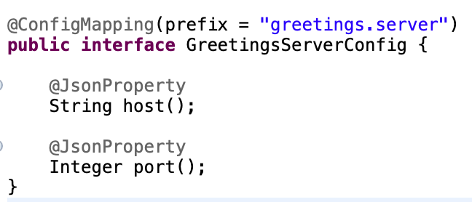
Configuration Mapping
Config mapping enables grouping multiple configuration properties in a single interface that share the same prefix
Configuration values can be automatically mapped to an interface annotated with @io.smallrye.config.ConfigMapping annotation
Defining config values and interface

Slide 18
Configuration Mapping Registration
When a Quarkus application starts, a config mapping can be registered twice
STATIC INIT: Quarkus can start Config service during static initialization
It might not be possible to do static initialization if config source is external e.g. database
@io.quarkus.runtime.configuration.StaticInitSafe can be used to mark config mapping safe for static initialization
RUNTIME INIT: Happens after static initialization
There is no restriction for using runtime initialization

Slide 19
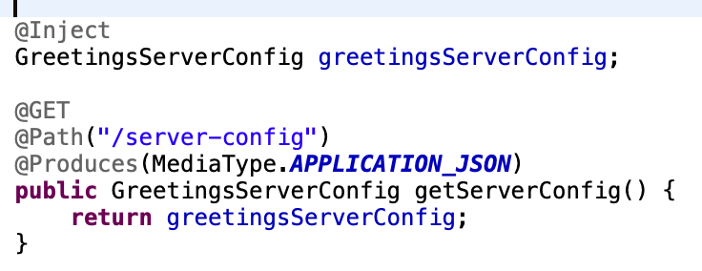
Accessing Mapped Config Values
Config mapped interfaces can be injected in any CDI bean
It can also be accessed via SmallRyeConfig#getConfigMapping method

Slide 20

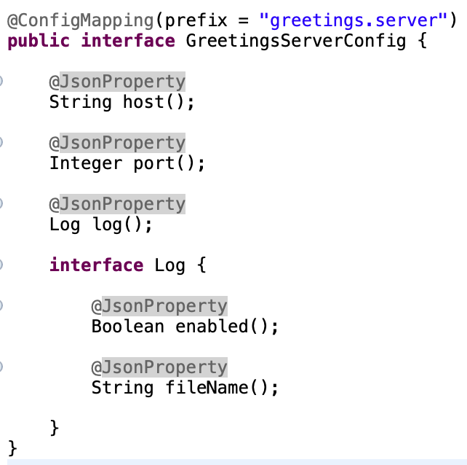
Nested Groups
Nested mapping provides a way to subgroup other config properties
Application properties:
Interface definition:

Slide 21
Overriding Property Name
@WithName: If a method name and a property name do not match with each other, the @WithName annotation can override the method name mapping
@WithParentName: it allows configurations mapping to inherit its container name and simplifies the configuration property name required to match the mapping
Naming Strategy: The mapping strategy can be adjusted by setting namingStrategy value in the @ConfigMapping annotation

Slide 22
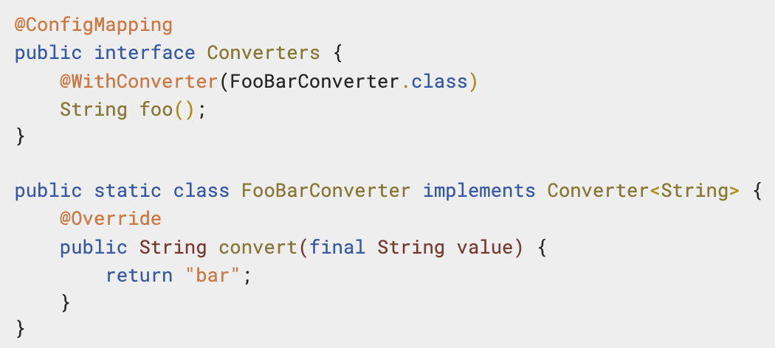
Value Conversion
Config mapping class support automatic conversions of all types available for conversion in Config
@WithConverter annotation provides a way to set a Converter to use in a specific mapping
Config mapping can also map config values to List and Maps

Slide 23
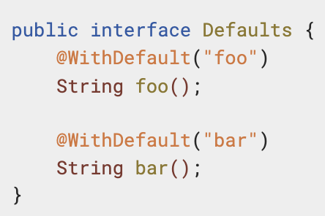
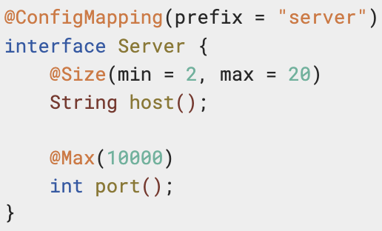
Defaults and Validation
@WithDefault annotation allows to set a default property value if it is not defined in config sources
A config mapping may combine annotations from Bean Validation to validate configuration values

Slide 24
End

Slide 25
Part 3
Extending Configuration Support

Slide 26
Agenda
Introduction to Custom Config Source
Defining Custom Config Source – Example
Config Source Ordinal
Config Source Initialization
Config Source Factory
Custom Converter

Slide 27
Introduction to Custom Config Source
Custom ConfigSource allows reading additional configuration values and add them to the Config instance in a defined ordinal
A custom ConfigSource requires an implementation of org.eclipse.microprofile.config.spi.ConfigSource or org.eclipse.microprofile.config.spi.ConfigSourceProvider
Each implementation requires registration via the ServiceLoader mechanism with any one of the following
META-INF/services/org.eclipse.microprofile.config.spi.ConfigSource
META-INF/services/org.eclipse.microprofile.config.spi.ConfigSourceProvider

Slide 28
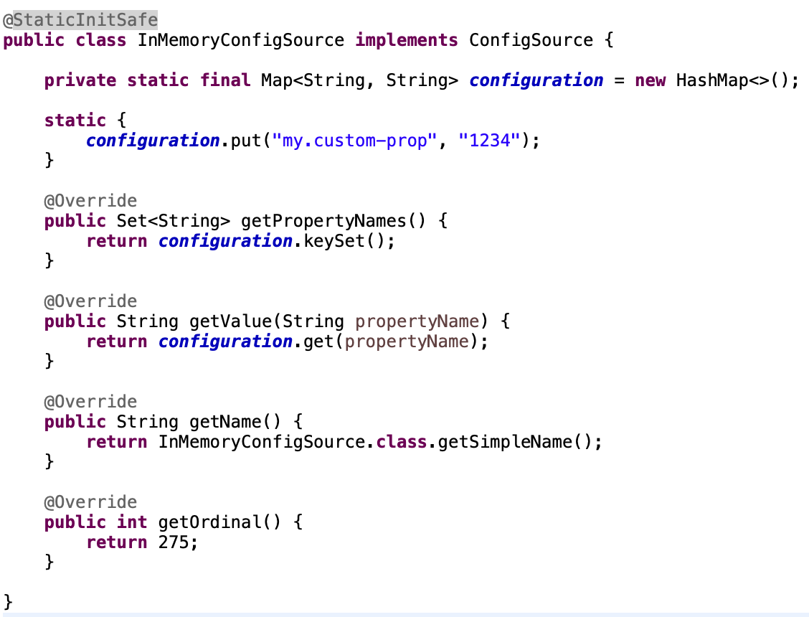
Defining Custom Config Source
Class Definition
Registration as SPI

Slide 29
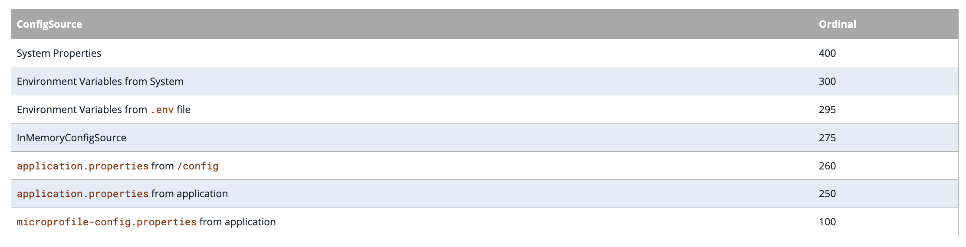
Custom Config Source Ordinal

Slide 30
ConfigSource Init
ConfigSource can be initialized twice
STATIC INIT: A custom ConfigSource requires the annotation @StaticInitSafe to enable STATIC INIT
Should be done only if ConfigSource does not have external dependency like Database
RUNTIME INIT: The RUNTIME INIT stage happens after STATIC INIT
There are no restrictions at this stage

Slide 31
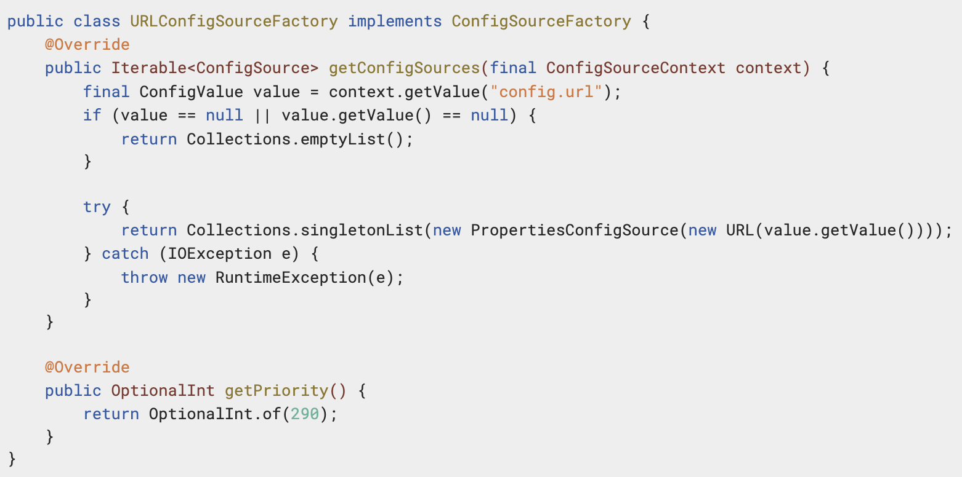
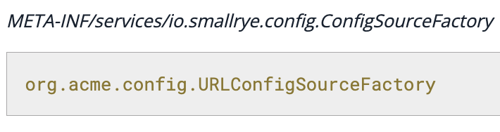
Config Source Factory
Config Source can also be created via io.smallrye.config.ConfigSourceFactory API
Usage of factory provides access to other available configurations

Slide 32
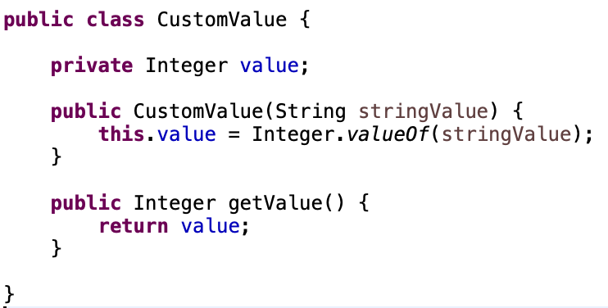
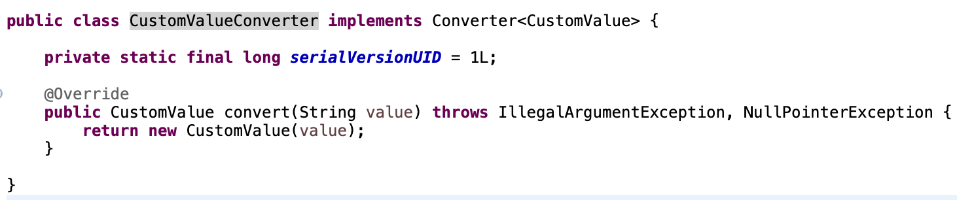
Custom Converter
Custom Converter requires an implementation of org.eclipse.microprofile.config.spi.Converter<T> where T is the config value type
Implementation needs to be registered in META-INF/services/org.eclipse.microprofile.config.spi.Converter file

Slide 33
End

