Slide 1
Quarkus
01- Fundamentals

Slide 2
Part 1
Introduction

Slide 3
Agenda
What is Quarkus?
A little background
GraalVM
OpenJDK HotSpot
History of Quarkus
Design pillars of Quarkus

Slide 4

What is Quarkus?
Quarkus is a Kubernetes-native Java framework tailored for GraalVM and HotSpot, crafted from best-of-breed Java libraries and standards
It is a subatomic supersonic java application framework
Quarkus has been created to enable java developers to create application for modern cloud native microservice & serverless architecture
It tries to address shortcomings of traditional java frameworks built for monolithic application architecture like large memory requirements & long start up times

Slide 5
What is GraalVM?
GraalVM is a Java Virtual Machine for compiling and running applications written in different languages to a native machine binary
Apart from Java, it provides runtime for JavaScript, Ruby, Python, R and few other languages
It makes it possible to mix programming languages in a single application while eliminating any foreign language call costs
It compiles Java byte code into native machine executable
The native executables start much faster and occupies less memory
BUT the native executables does not support some java features like Reflection

Slide 6
What is OpenJDK HotSpot?
The definition of JVM is provided by Java Virtual Machine Specification
Like a ‘real’ machine, a ‘virtual’ machine has instruction set, a virtual computer architecture and an execution model
A virtual machine can execute code written in its instruction set
HotSpot is an implementation of JVM Specification
It was originally developed by Sun Microsystem and currently owned by Oracle Corporation
OpenJDK HotSpot is an open source implementation of HotSpot

Slide 7
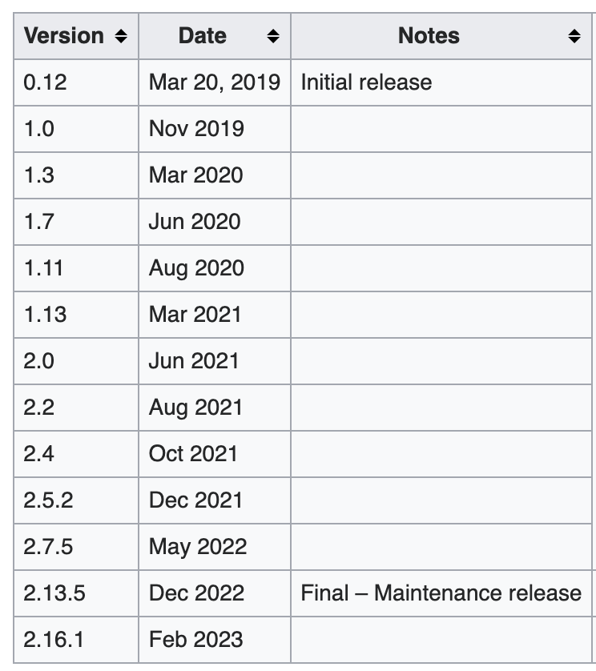
History of Quarkus
Quarkus was initially started by RedHat
It is fully open source and licensed under Apache License 2.0

Slide 8
Design Pillars
Container First
Optimized for containerized applications
As much processing as possible is done at the build time
Avoidance of runtime reflection
Does not load ‘non reachable’ classes in JVM
Optimized for using the native image capability of GraalVM to compile JVM bytecode to a native machine binary
Quarkus app can run as native Linux executable eliminating the JVM

Slide 9
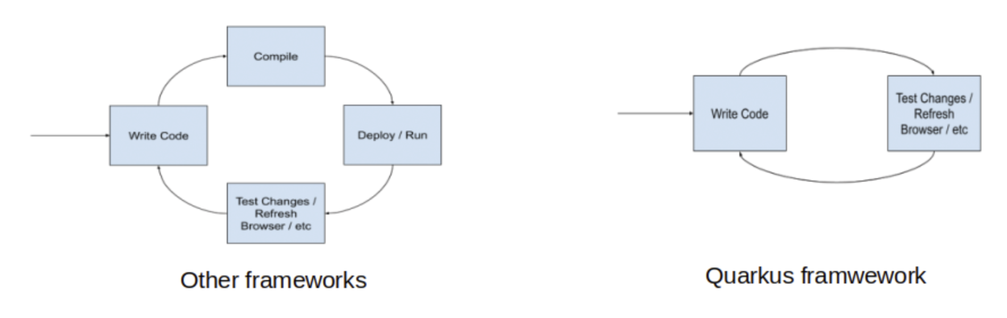
Design Pillars…
Developer ‘Joy’ aka productivity
Live Coding – Enable testing in ‘dev’ mode without need of re-compilation or re-deployment
DEV UI – interactive developer user interface
Support for unit & CI testing using test containers

Slide 10
Design Pillars…
Best of breed libraries & standards - Quarkus programming model builds on top of proven libraries & standards
JAX-RS annotations to define the REST endpoints
JPA annotations to map your persistent entities
JTA annotations to declare the transaction boundaries
Eclipse MicroProfile to configure and monitor application
Eclipse Vert.x
Apache Camel
Many more…

Slide 11
Design Pillars…
Seamless support for Imperative & Reactive programming
Combines familiar imperative style code and the non-blocking, reactive style
Supports Http Microservice, reactive applications, event driven architecture & serverless functions
Quarkus uses RESTEasy Reactive Extension & Mutiny API to combine imperative and reactive programming model in a single application

Slide 12
End

Slide 13
Part 2
Overview of Quarkus Extensions

Slide 14
Agenda
What is Quarkus Extension?
Extension Statuses
Examples
Custom Extension

Slide 15
What is a Quarkus Extension?
Quarkus promotes extensibility & vibrant ecosystem of open source contribution
Quarkus application is composed of a core (CDI) and a set of extensions (integration of 3rd party libraries)
Quarkus extensions are like project dependencies.
Extensions configure, boot and integrate a framework or technology into Quarkus application by exposing components as CDI beans
Extensions provide necessary information for GraalVM native execution during compilation time e.g. reflective usage of classes & methods
Extensions enforce sensible defaults based on ’closed world view’ of the application

Slide 16
Extension Statuses
Stable: Backward compatibility and presence in the ecosystem are taken very seriously. An application can safely rely on these extensions.
Preview:
Backward compatibility and presence in the ecosystem is not guaranteed.
In the middle of their maturation process.
Experimental:
No guarantee of stability nor long term presence in the platform until the solution matures.
At the beginning of their maturation process.
Deprecated:
Backward compatibility and presence in the ecosystem is not guaranteed.
Likely to be replaced or removed in a future version of Quarkus.

Slide 17
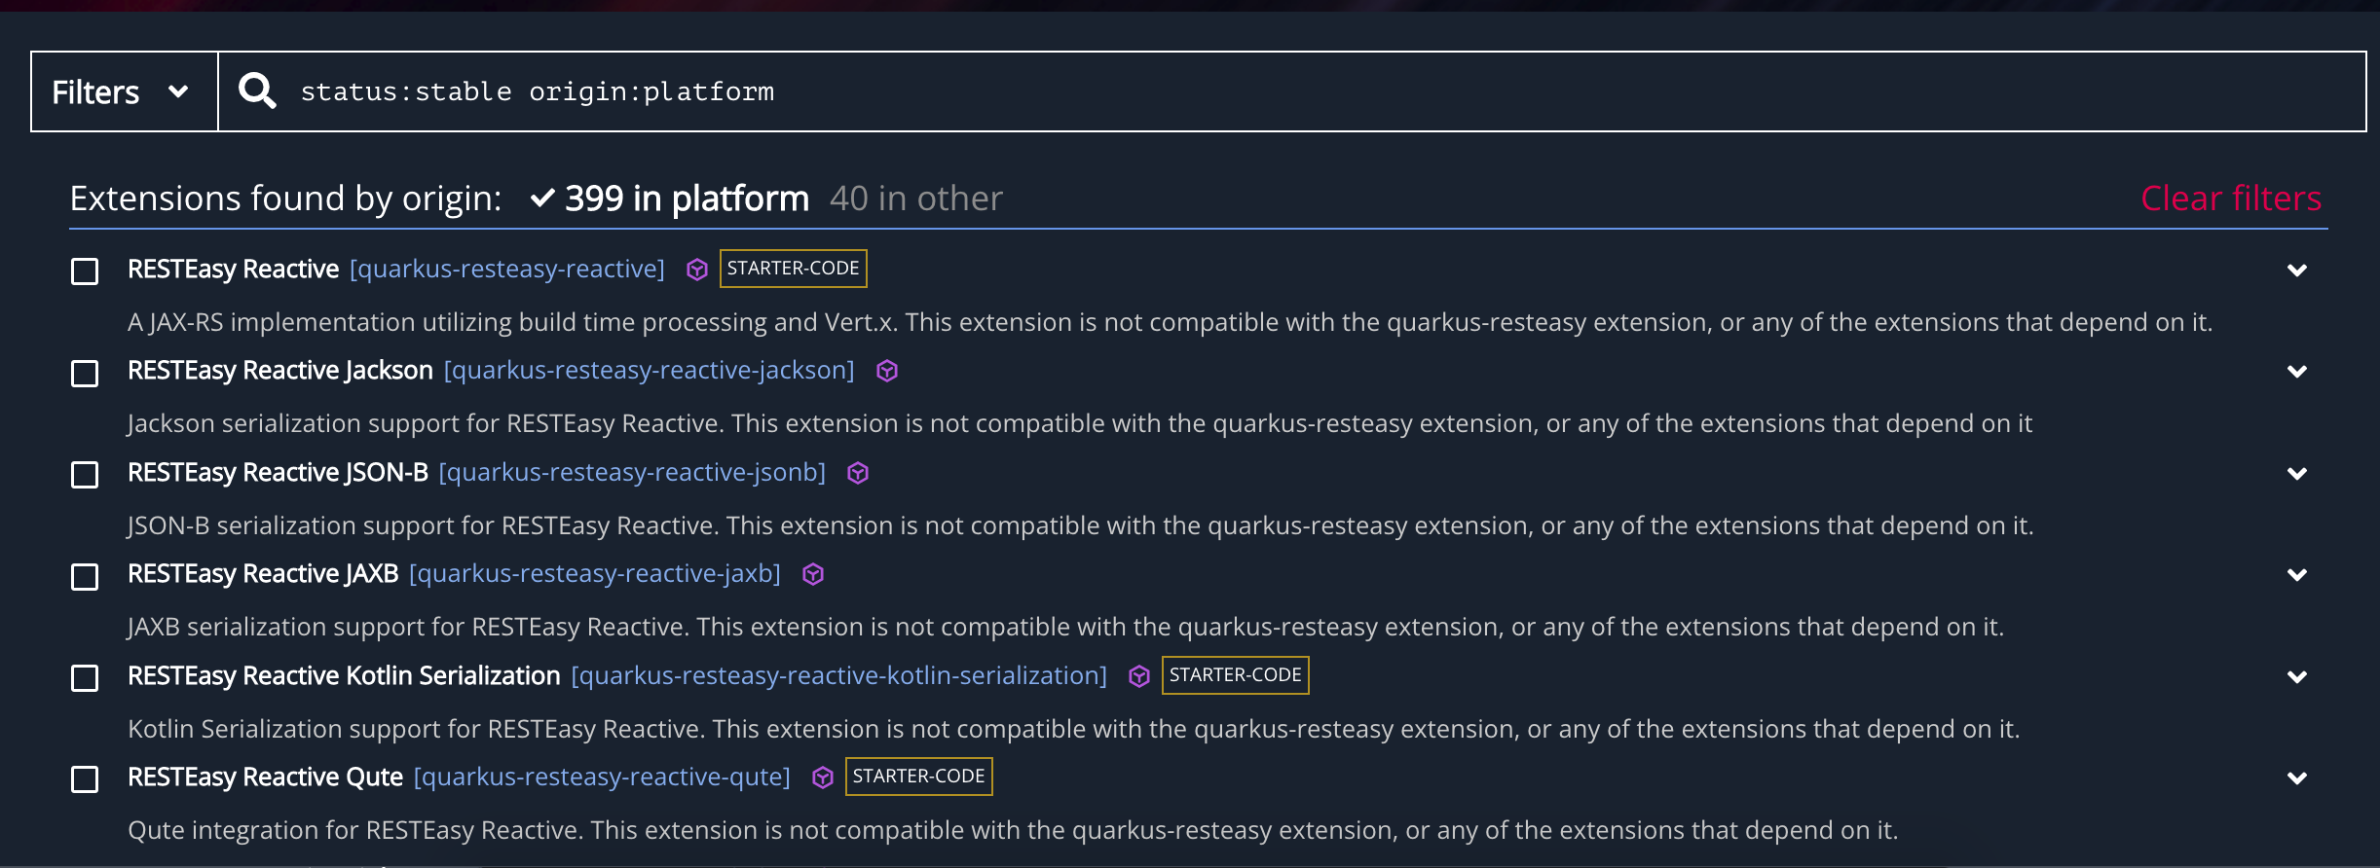
Examples
https://code.quarkus.io/?extension-search=status:stable%20origin:platform

Slide 18
Custom Extensions
It is entirely possible and actually encouraged by Quarkus team to write custom extensions and contribute to Quarkus ecosystem
Any custom extension must work in both OpenJDK and GraalVM native executables
Custom extensions follow an incremental maturity model to be fully ‘Quarked’ i.e. benefitted from Quarkus
Guide for writing custom extensions - link

Slide 19
End

Slide 20
Part 3
Quarkus Reactive Application

Slide 21
Agenda
What is a Reactive Application?
Traditional Http application threading model
Reactive Http application threading model
Quarkus reactive application
Quarkus reactive extensions

Slide 22
What is a Reactive Application?
Reactive is a set of principles and guidelines to build responsive distributed systems and applications.
Characteristics –
Responsive - respond in a timely fashion
Elastic - adapt themselves to the fluctuating load
Resilient - handle failures gracefully
Asynchronous message passing - the components of a reactive system interact using messages
Notes:
Reactive Systems are distributed systems done right.

Slide 23
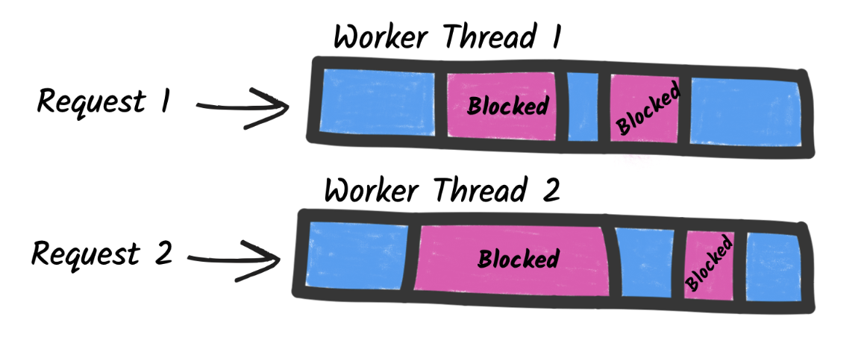
Traditional Http Application Threading
Blocking I/O and an imperative/sequential execution model
Each Http request is handled by a single thread during the whole request duration
The thread is blocked while ‘waiting’ for blocking I/O completion
Requires a ‘worker’ thread pool to handle multiple concurrent requests
Worker thread pool requires more memory & processing capacity
Increased load requires larger thread pool resulting in even more infra requirement

Slide 24
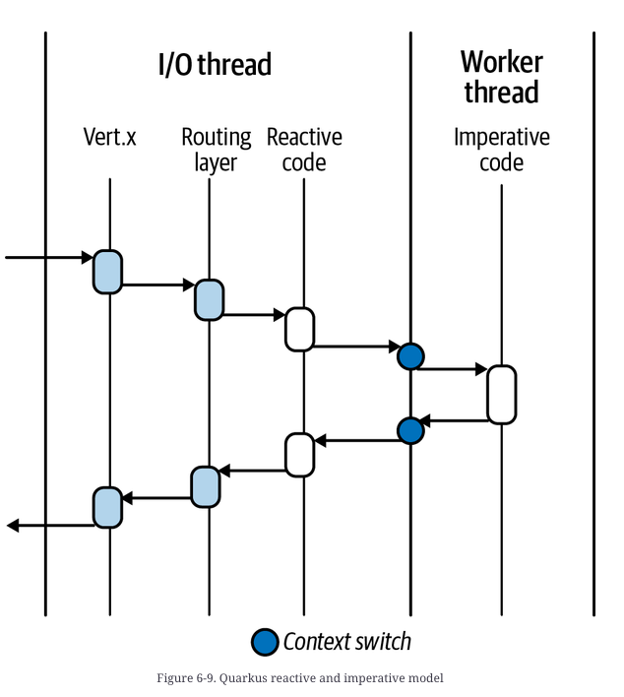
Reactive Http Application Threading
Each Http request can be handled by multiple threads during its execution
A few threads can handle many concurrent I/O
The event loop runs continuously and receive Http requests
Event loop thread does not wait for I/O completion
I/O is scheduled and result is handled as a ‘continuation’
Blocking I/O is off-loaded to ‘worker’ thread pool

Slide 25
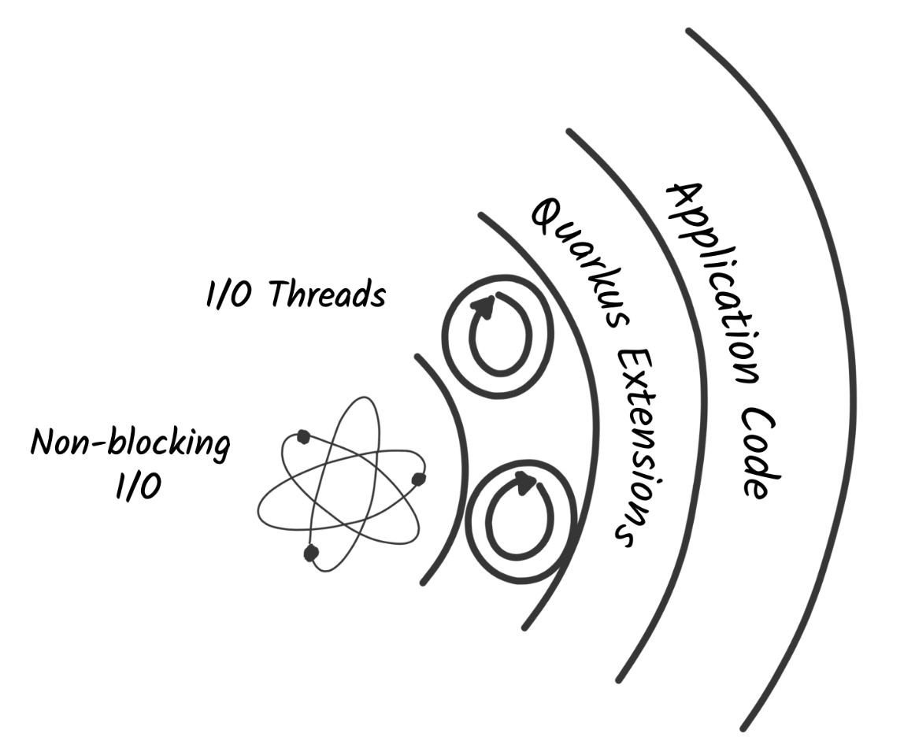
Quarkus Reactive Applications
Quarkus enforces the reactive principles to make applications highly efficient in terms of performance & resource utilization
Quarkus Reactive applications use non-blocking I/O enabling a small number of threads to manage many concurrent I/O
Quarkus applications allow for higher concurrency, use less memory, and improve the deployment density
Notes:
Quarkus has a reactive engine. This engine, powered by Eclipse Vert.x and Netty, handles the non-blocking I/O interactions. Quarkus extensions and the application code can use this engine to orchestrate I/O interactions, interact with databases, send and receive messages, and so on.

Slide 26
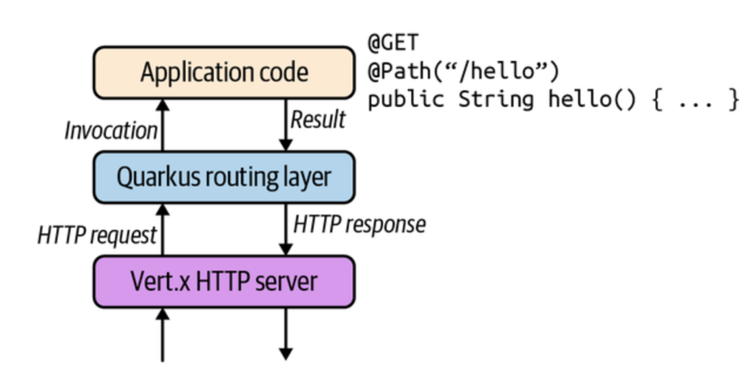
Quarkus Reactive Applications…
Mutiny - an intuitive, event-driven reactive programming library
Code is a pipeline receiving events and processing them
Improve the readability and maintenance of the codebase
Kotlin Coroutines - a way to write asynchronous code sequentially
Suspends the execution of the code during I/O
Registers the rest of the code as the continuation

Slide 27
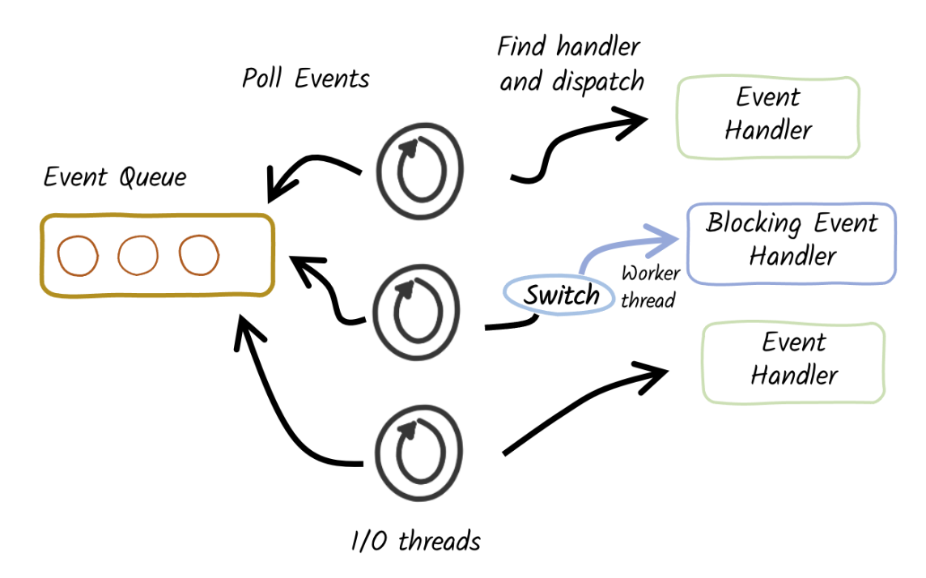
Quarkus Reactive Applications…
Quarkus is inherently Reactive
It uses ‘Proactor’ pattern to switch to worker thread for blocking I/O
REST Resource method return type indicates blocking or non-blocking operations
@Blocking & @NonBlocking annotations can override the default behavior
RESTEasy Reactive extension dispatches the request to worker thread based on @Blocking annotation

Slide 28
Quarkus Reactive Extensions
Http
RESTEasy Reactive
Reactive Rest Client
Data
Hibernate Reactive
Reactive MySQL, Postgres client
Reactive Mongo Db, Casandra & Redis extension
Event Driven Architecture
Kafka, AMQP connectors
Network Protocols & Utilities
gRPC, GraphQL & Fault Tolerance
Engine
Vert.x & Mutiny
Context Propagation

Slide 29
End

Slide 30
Part 4
Advantages & Use cases of Quarkus

Slide 31
Agenda
Advantages
Supersonic - Fast start up time
Subatomic - Low memory footprint
Increased developer productivity
Cloud native
Ecosystem & Support
Use Cases

Slide 32
Supersonic – Fast Start up Time
Traditional Java Framework
Quarkus
Just in Time (JIT) Compilation
Runtime inspection, invocation, and even the creation of new classes, interfaces, constructors, and methods using Reflection
Ahead of Time (AOT) Compilation
Build Phase -
Parse config files
Scan class paths and classes for annotation, getters and metadata
Build framework metamodel objects
Prepare reflection and build proxies
Runtime Phase - Start and openIO, threads etc

Slide 33
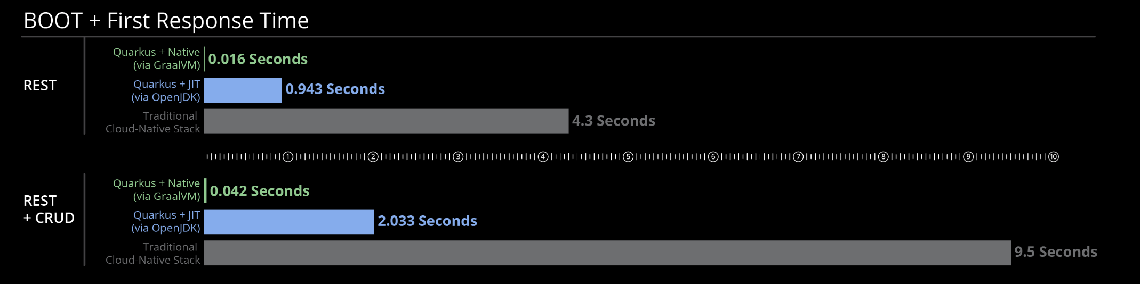
Supersonic – Fast Start up Time…
Application start up & first response time comparison

Slide 34
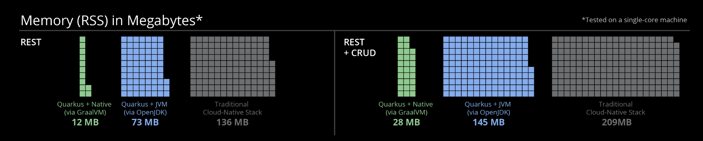
Subatomic – Low Memory Footprint
Quarkus does not use reflection by default
It does not load ‘non reachable’ classes in JVM
Memory usage comparison

Slide 35
Increased Developer Productivity
Live Coding
Interactive DEV UI
Test Container based Unit Test Support
Built in CI support
Unified Configuration
Usage of familiar libraries & API
Seamless combination of Imperative & Reactive programming

Slide 36
Cloud Native
Fast start up enables fast scaling in a cloud environment
Low memory usage improves packing factor reducing infrastructure cost
Cloud provider agnostic support for implementing Serverless applications

Slide 37
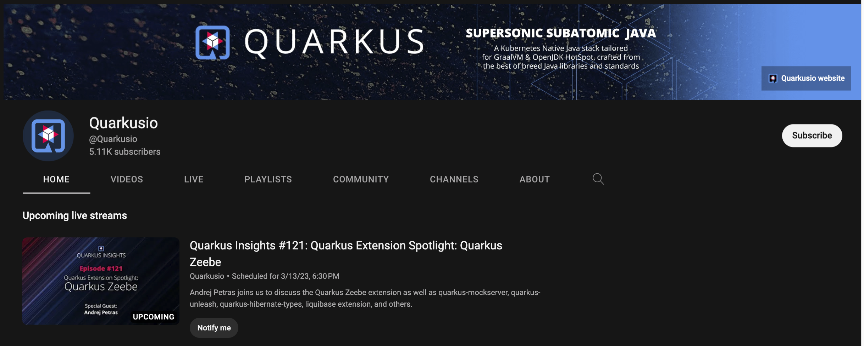
Ecosystem & Support
Backed by Red Hat
Regular release cadence
Extensive documentation and guides
Thriving opens source community
Dedicated YouTube Channel & Twitter Handle

Slide 38
Use Cases
Any distributed application with high scalability requirement will benefit from Quarkus
Applications Types
Http Service – REST, GraphQL, gRPC
Event Driven Systems – AMQP
Real time data streaming - Kafka
Cloud Native Applications
Serverless Containers
Function-as-a-Service e.g. AWS Lambda, GCP Cloud Functions
Highly scalable applications with uneven traffic load

Slide 39
Thank You

